Slide 1
Airline Review Sentiment Analysis
Analysis of Customer Sentiments Across Airlines

Slide 2
Analysis Overview
• Analyzed sentiment for 571 airlines
• Total reviews processed: 260,520
• Average positive sentiment: 35.5%
• Average negative sentiment: 31.0%
• Analysis date: May 08, 2025

Slide 3
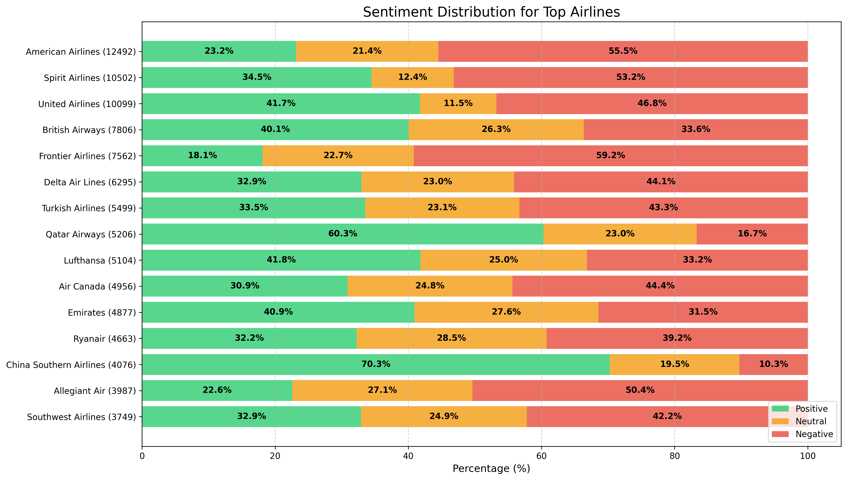
Sentiment Distribution by Airline
This chart shows the percentage breakdown of positive, neutral, and negative reviews for the top airlines by review volume. Numbers in parentheses represent review counts.

Slide 4
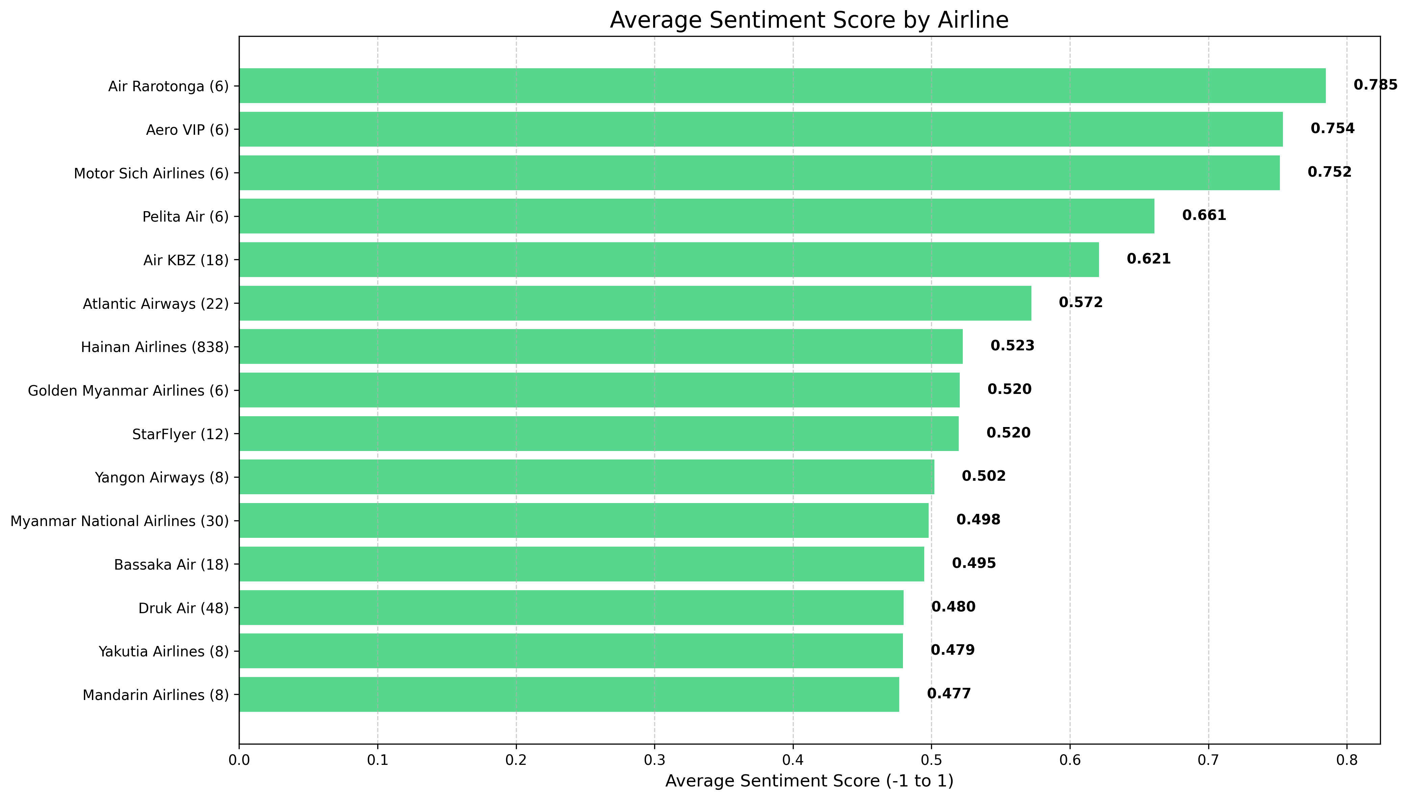
Average Sentiment Score by Airline
Average sentiment scores range from -1 (extremely negative) to +1 (extremely positive). Airlines are sorted by their overall sentiment score.

Slide 5
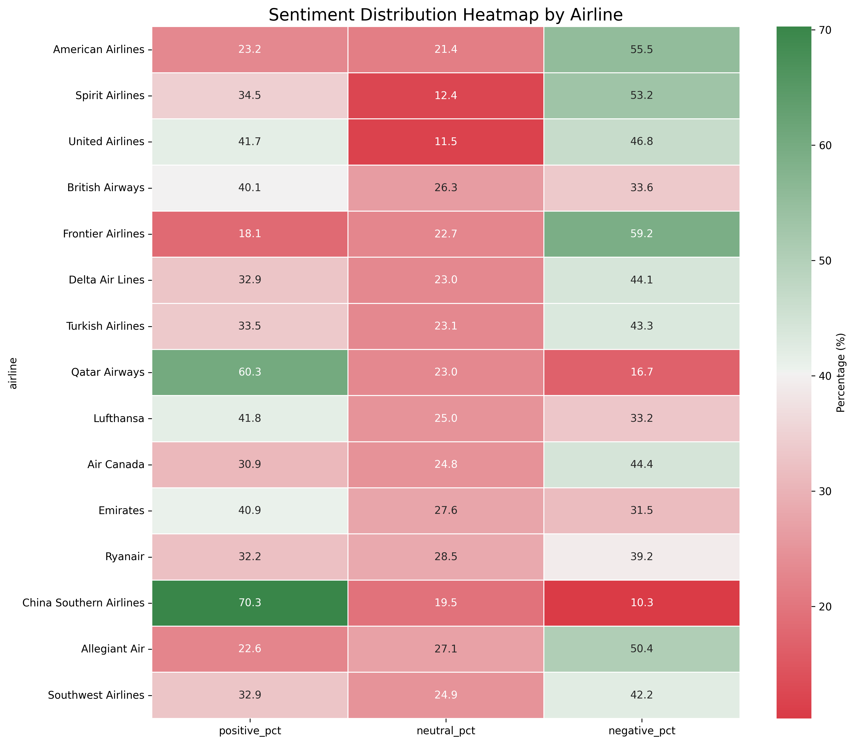
Sentiment Distribution Heatmap
The heatmap illustrates sentiment distribution percentages across airlines. Darker green indicates higher positive sentiment, while darker red shows higher negative sentiment.

Slide 6
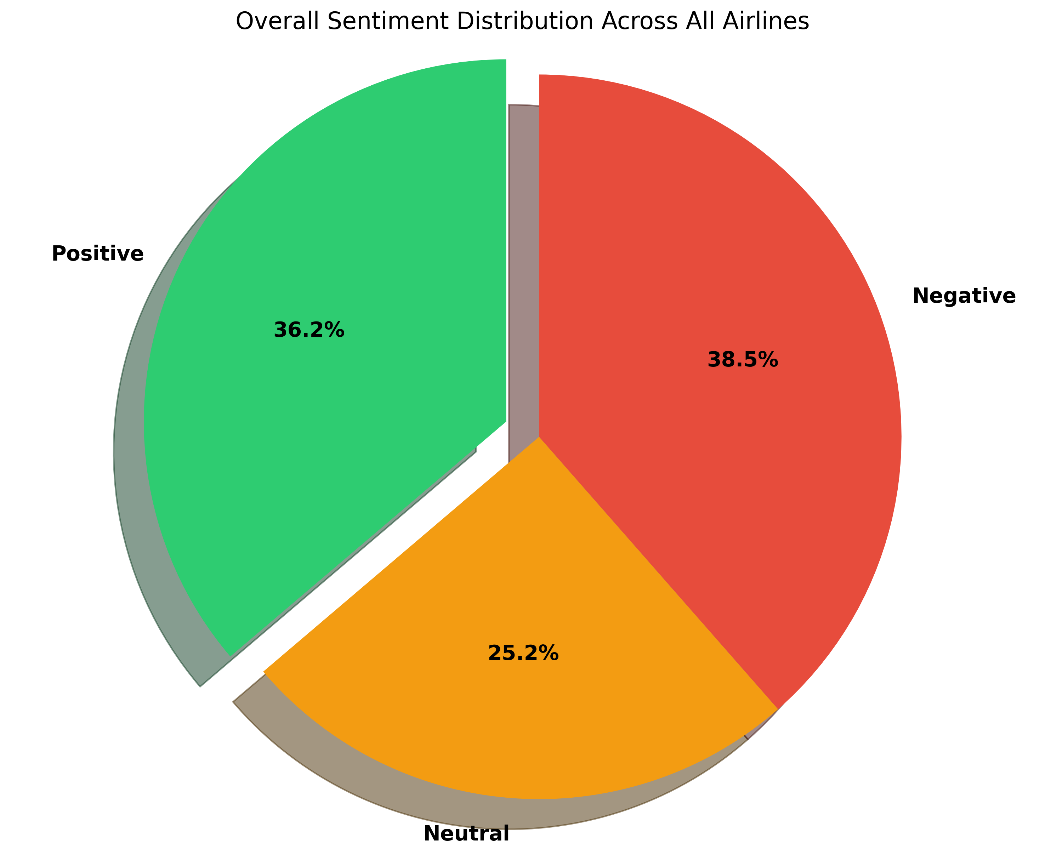
Overall Sentiment Distribution
The pie chart represents the overall sentiment distribution across all airlines, weighted by the number of reviews for each airline.

Slide 7
Key Insights
Top Airlines by Sentiment:
• Manta Air: 0.864 (2 reviews)
• Ariana Afghan Airlines: 0.864 (2 reviews)
• Qazaq Air: 0.830 (4 reviews)
Bottom Airlines by Sentiment:
• Himalaya Airlines: -0.777 (8 reviews)
• MAYAir: -0.770 (2 reviews)
• Voyage Air: -0.758 (2 reviews)
Correlation between review count and sentiment score: -0.065

