Slide 1
Customer Booking Prediction Analysis
Understanding Variables and Predicting Bookings with Machine Learning

Slide 2
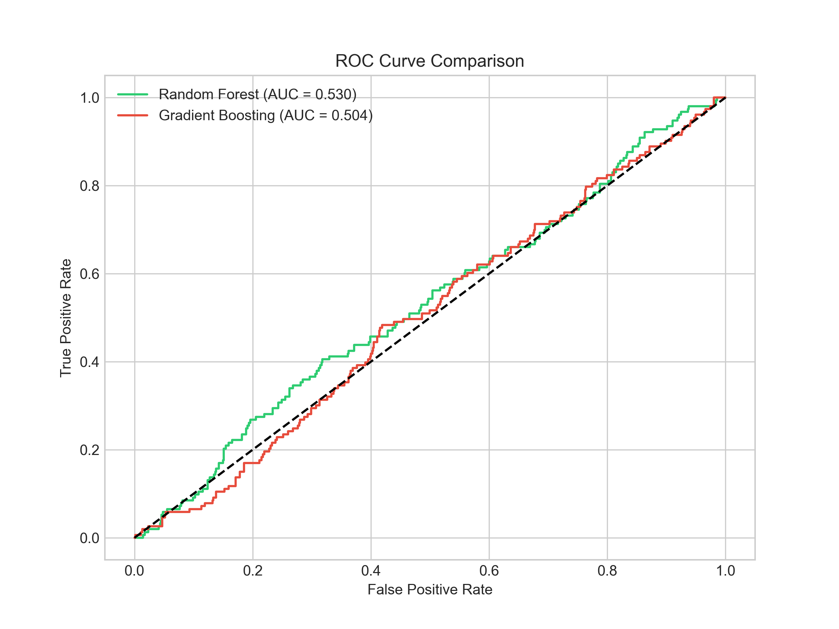
Model Performance Overview
Random Forest: • Accuracy: 85.18% • Precision: 0.5875 • Recall: 0.0314 • F1 Score: 0.0596 • ROC AUC: 0.7981 Gradient Boosting: • Accuracy: 85.34% • Precision: 0.5573 • Recall: 0.0976 • F1 Score: 0.1661 • ROC AUC: 0.7962

Slide 3
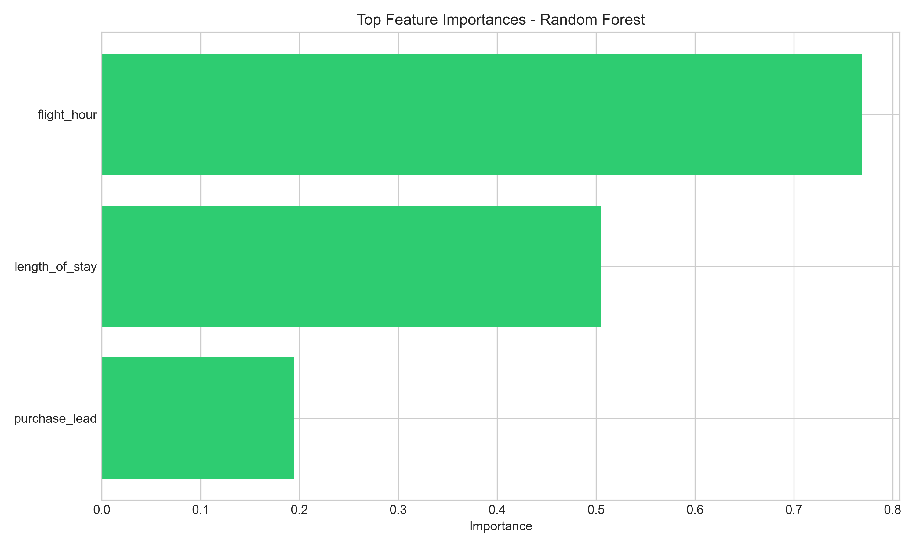
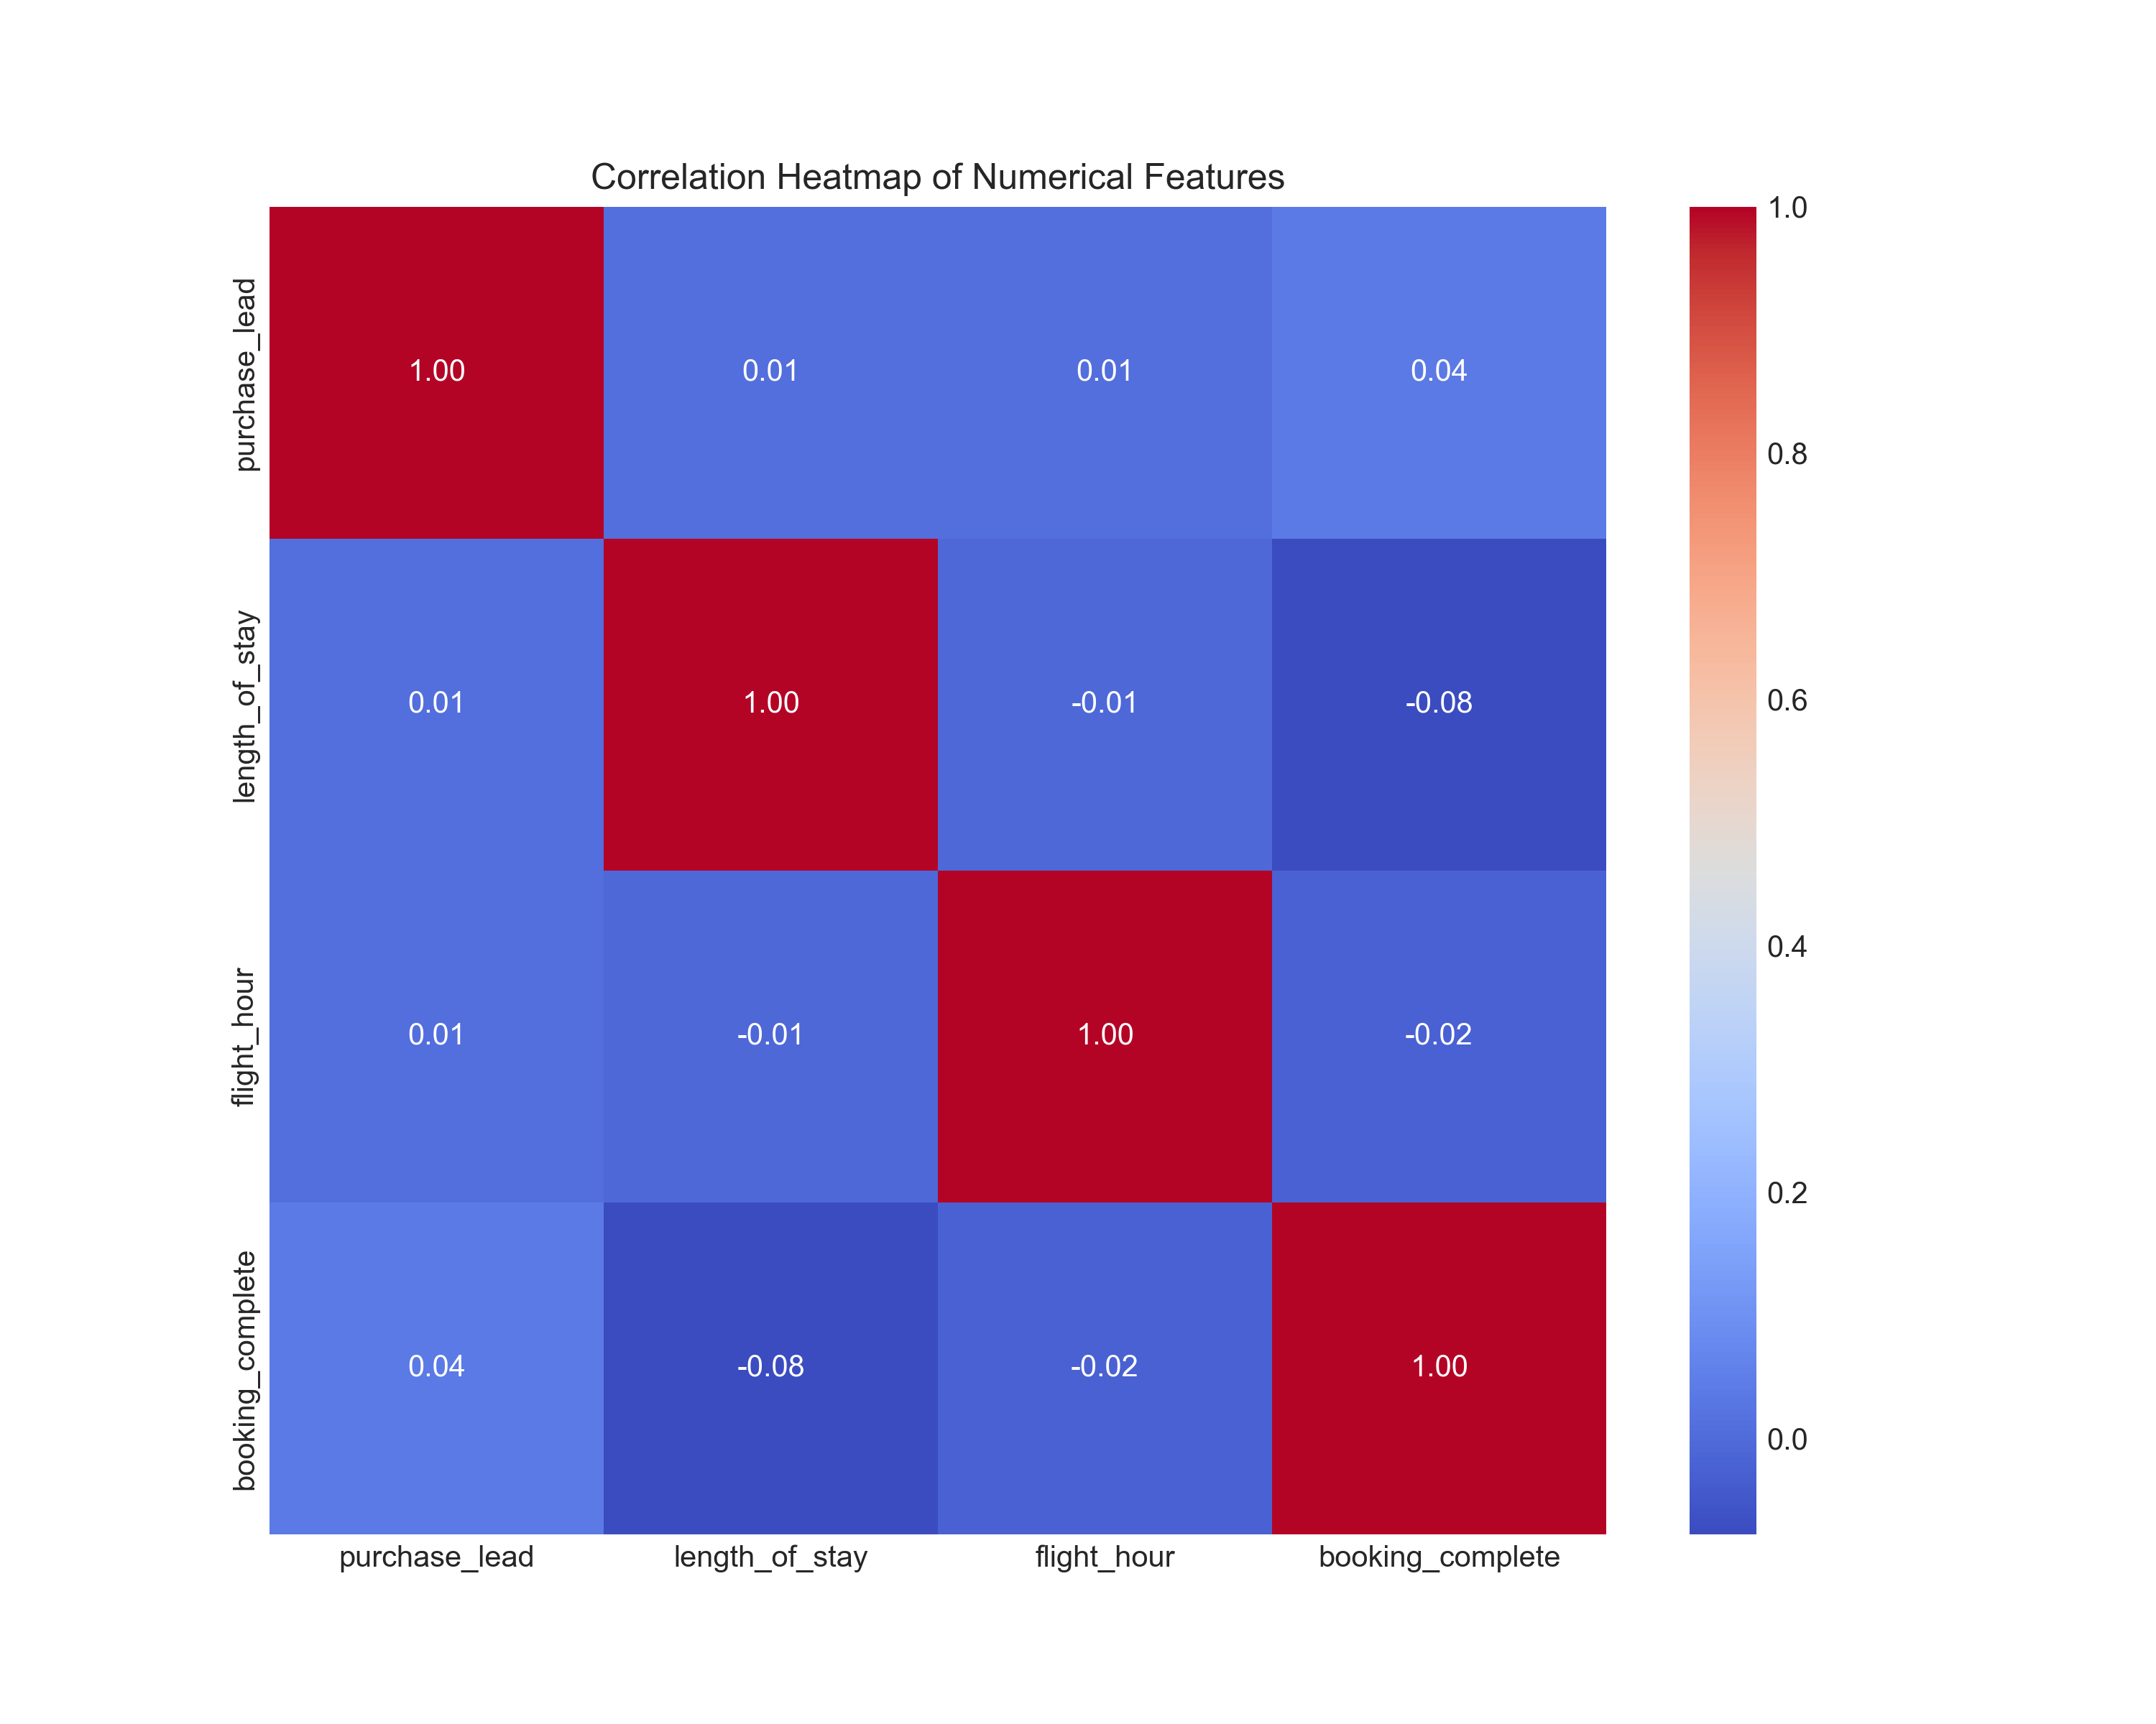
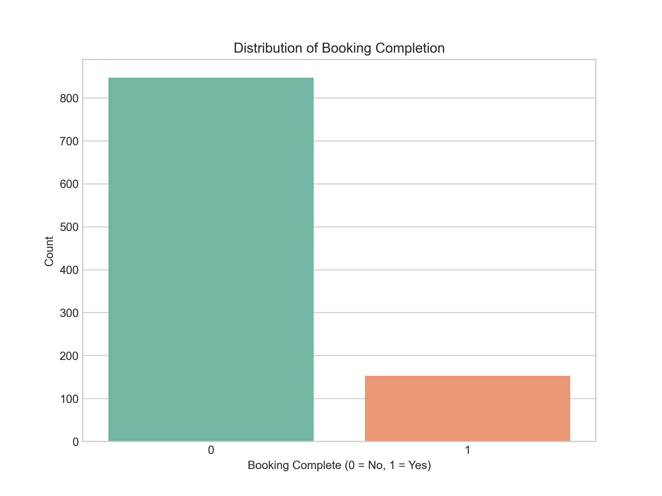
Summary Analysis
Key Findings: - Imbalanced dataset: 85% not completed, 15% completed. - Random Forest slightly better (ROC AUC: 0.798). - Top features: purchase lead, length of stay, flight hour. - Recommendation: Focus on key features for marketing.

