Slide 1
Habits
John Doe

Slide 2
In the morning

Slide 3
Getting up
Turn off alarm
Get out of bed

Slide 4
Breakfast
Eat eggs
Drink coffee
Notes:
Some people like presenter notes for extra detail.
Did you know that you can put nutmeg in your coffee? I highly recommend it.

Slide 5
In the evening

Slide 6
Dinner
Eat spaghetti
Drink wine

Slide 7
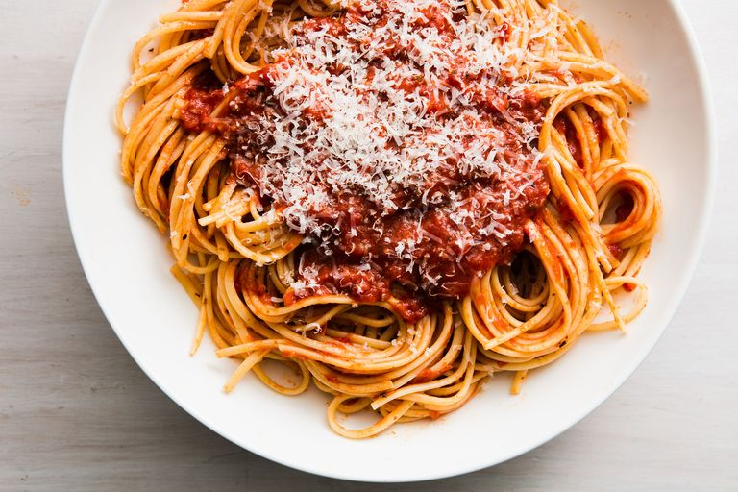
picture of spaghetti

Slide 8
Going to sleep
Get in bed
Count sheep

