Slide 1

QUALCOMM | SNAPDRAGON® AI LAB BUILD & PRESENT CHALLENGE
SmartQC: On-Device Visual Quality Inspection
Optimized for Snapdragon
Samay Thakur
Electronics & Instrumentation Engineering | M.S. Ramaiah Institute of Technology, Bengaluru, India
GitHub | LinkedIn

Slide 2
THE PROBLEM
Quality inspection is slow, inconsistent, or expensive
1
Manual inspection
Depends on human attention span — fatigue and inconsistency creep in over a shift.
2
Cloud-based AI tools
Solve accuracy, but add latency, an internet dependency, and data-privacy exposure.
2
Industrial inspection hardware
3
Accurate and fast, but priced far out of reach for small food producers and workshops.
There is a need for a fast, private, self-contained inspection tool that runs entirely on the device performing the inspection.

Slide 3
THE SOLUTION
SmartQC: factory-grade inspection, without the factory-grade price tag
WHO IT'S FOR
VALUE PROPOSITION
Small bakeries, food producers, and workshops that need reliable visual QC but can't justify a dedicated inspection line.
“Factory-grade visual inspection, without the factory-grade price tag.”
WHAT IT DOES
Classifies product quality from a webcam or uploaded image, entirely on-device — no cloud calls, no internet dependency at inference time.
WHY IT MATTERS
Runs on a Snapdragon laptop the business may already own — zero extra hardware cost.

Slide 4
HOW IT WORKS
Architecture
Webcam / Image
Preprocess
AI Hub Model
ONNX Runtime
Result
→
→
→
→
Live capture or upload
OpenCV / PIL
Quantized ONNX
+ QNN Execution Provider
Label + confidence + latency
The optimized model and ONNX Runtime + QNN Execution Provider path are what make this pipeline Snapdragon-NPU-ready.
App features: live webcam / upload inspection • batch folder inspection + CSV export • confidence threshold flagging • local SQLite history log • rolling defect-rate trend chart • fully offline at inference time

Slide 5
WHY ON-DEVICE, WHY SNAPDRAGON
Built for where inspection actually happens
Cloud-based inspection
SmartQC on Snapdragon
✗ Needs constant internet
✓ Fully offline at inference
✗ Per-image / API cost
✓ Zero marginal cost per scan
✗ Data leaves the device
✓ All data stays on-device
✗ Latency varies with connection
✓ NPU-optimized, low-latency
Snapdragon's on-device NPU + long battery life means SmartQC can run all day on a shop floor — unplugged, private, and instant.

Slide 6
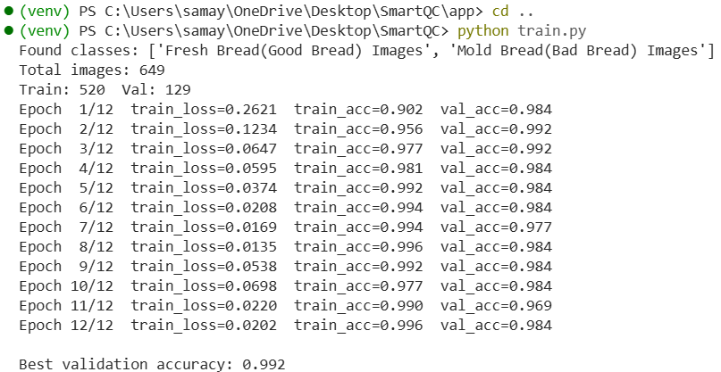
MODEL TRAINING
MobileNetV2, fine-tuned to 99.2% validation accuracy
99.2%
Best validation accuracy
649
Total labeled images (Fresh / Mold bread)
12
Training epochs
Fine-tuned on a Fresh Bread (Good) / Mold Bread (Defective) dataset using transfer learning from ImageNet-pretrained MobileNetV2

Slide 7
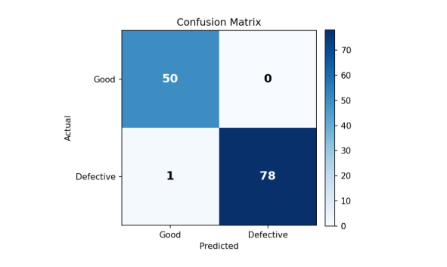
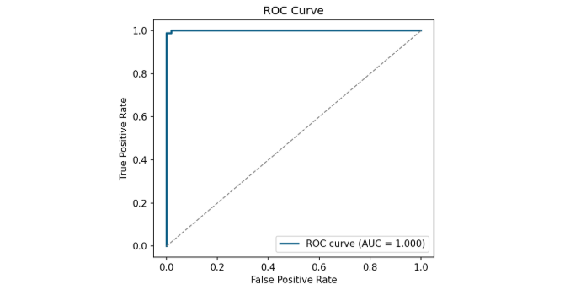
MODEL EVALUATION
Beyond accuracy: confusion matrix, precision/recall, ROC-AUC
129
1
0.9997
Validation images
Total misclassifications
ROC-AUC

Slide 8
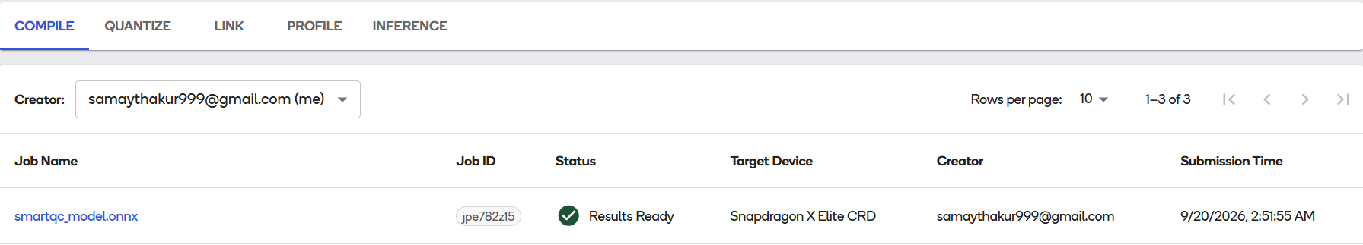
QUALCOMM AI HUB
Compiled and optimized for the Snapdragon X Elite
Compile job jpe782z15 • Target: Snapdragon X Elite CRD • Status: Results Ready

Slide 9
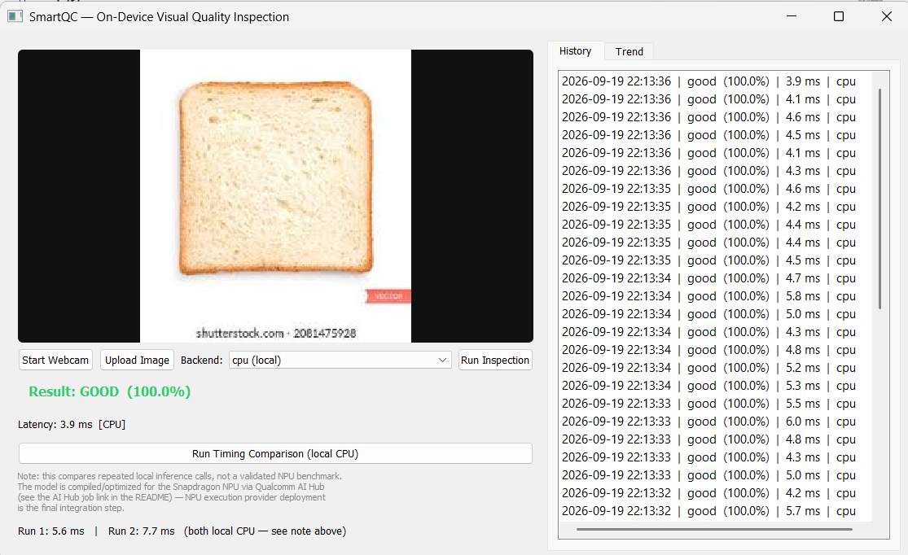
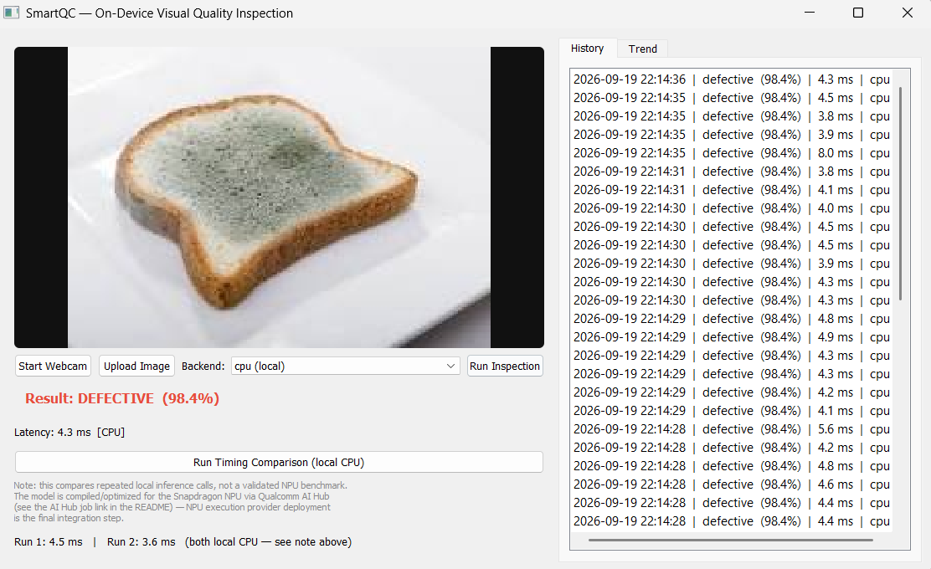
LIVE DEMO
Correctly classifies both good and defective samples
GOOD — 100.0% confidence
DEFECTIVE — 98.4% confidence

Slide 10
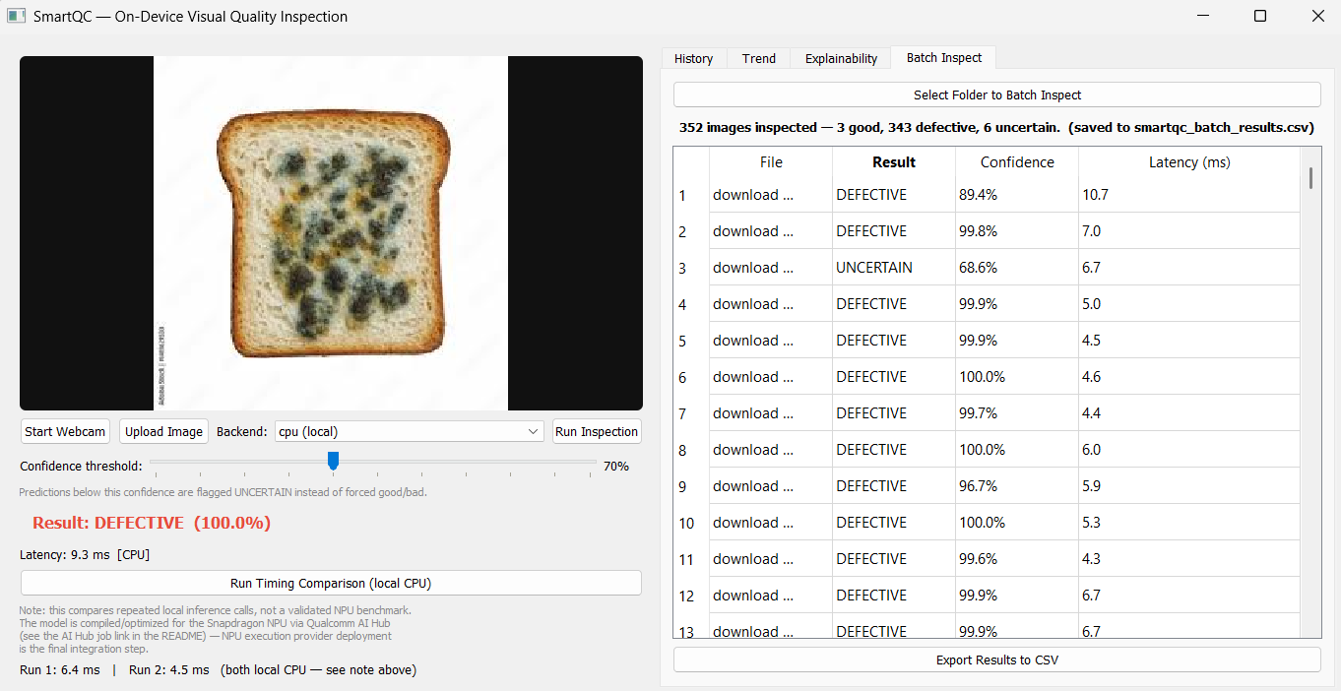
REAL-WORLD VALIDATION
Batch-tested against 352 uncurated images
Beyond the curated 129-image validation set, SmartQC's batch mode was run against a larger, unsorted folder of 352 real-world mold-bread images — a messier, more realistic test than a clean benchmark.
352
343
Images batch-processed
Correctly flagged DEFECTIVE
6
3
Flagged UNCERTAIN (below threshold)
Misclassified (edge cases)
97.4% correct on an uncurated real-world batch — and the confidence-threshold feature caught the ambiguous cases instead of silently guessing wrong.

Slide 11
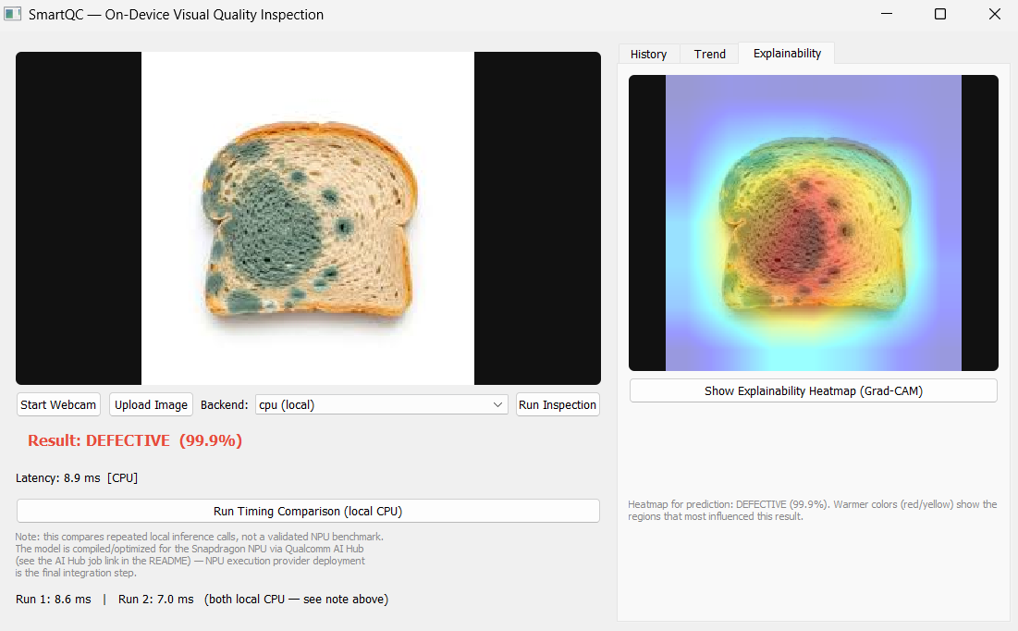
BEYOND CLASSIFICATION
Explainability: showing WHY, not just what
Grad-CAM heatmap
Highlights exactly which pixels drove the model's decision — warmer colors (red/yellow) show the highest-influence regions.
Builds operator trust
A QC operator can visually verify the model is looking at the actual defect, not an unrelated artifact.
Runs on the trained model directly
Computed via PyTorch alongside the ONNX/AI-Hub inference path — an explainability layer, not a replacement for it.

Slide 12
WHAT'S NEXT
Roadmap
1
Multi-product support
2
Multi-class defects
Extend beyond bread to additional inspection domains (produce, packaging, components).
Move beyond good/bad to specific defect types — mold, staleness, physical damage.
3
Fleet / multi-station rollout
Central dashboard aggregating results across multiple inspection stations.

Slide 13
QUALCOMM | SNAPDRAGON® AI LAB BUILD & PRESENT CHALLENGE
SmartQC: On-Device Visual Quality Inspection
Optimized for Snapdragon
Samay Thakur
Electronics & Instrumentation Engineering | M.S. Ramaiah Institute of Technology, Bengaluru, India
Demo | GitHub | LinkedIn
Thank You

