Slide 1
Topic Name: Children Learning System in Assembly Language.
Name :Sadia Islam Sraban Id:222015025
Name : Samayun Mia Chowdhori Id: 222015031
Course Code: CSE-304 Season:222-EA

Slide 2

Child Learning system
Child learning system is a
simple project by which any
children can learn alphabet
and number easily

Slide 3
Objective of the Project
EMU 8086 based System needed
Multiple option is available in the system
User friendly interface
Children Learning System by App, Game,

Slide 4
Implementation & Technology Used in the Project
Assembly language
Emu 8086 compiler used to built the project
Data bus used

Slide 5
Motivation To Chose This Project
In summary, choosing this project that involves teaching children the alphabet and digits using assembly language offers a unique opportunity to blend technology, education,
and creativity.
1.Low-Level Understanding.
2.Innovation in Education.
3.Creative Expression.
4.Alphabet and Digit Mastery

Slide 6
Flow chart
Start
Input any
Input 1/*
Study
decision
Input
Decision
Exit
Output

Slide 7
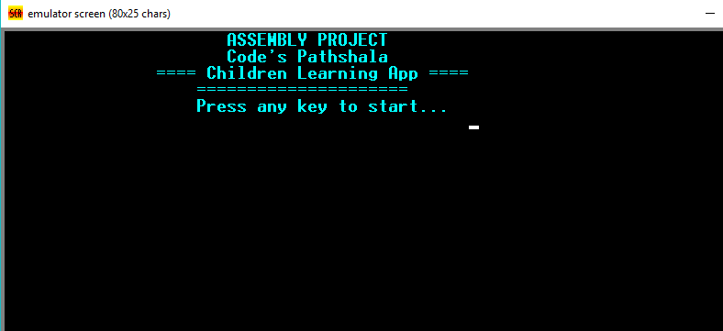
Sample output
After run the application this start page will come

Slide 8
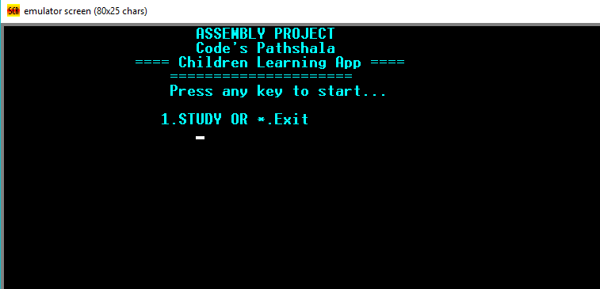
Sample output
If press any key then a menu will show.
There have two option Study and Exit

Slide 9
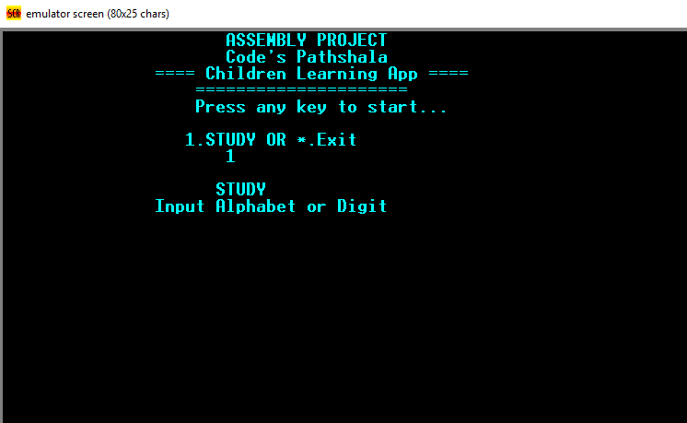
Sample output
If we press 1 the study option will select

Slide 10
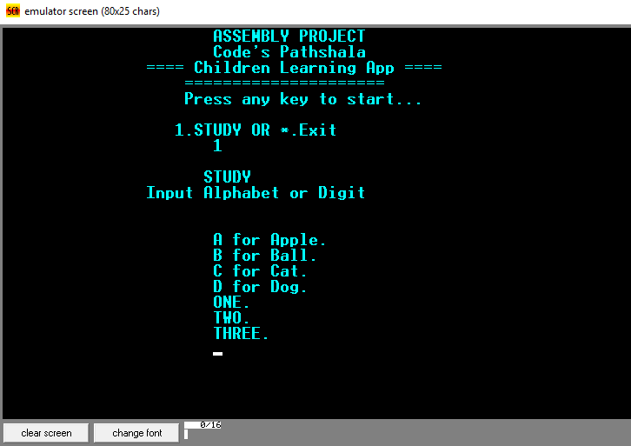
Sample output
If any alphabet or digit is selected then a word will come which is made of the entered letter

Slide 11
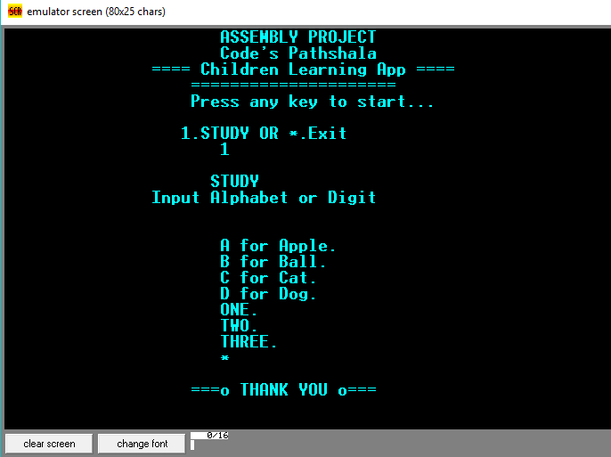
Exit
When * is pressed the program will exit

Slide 12
Find the YouTube video of this project :
https://youtu.be/egjbGw_lJpc

Slide 13
Thanks!!!!!!!!!!

