Slide 1
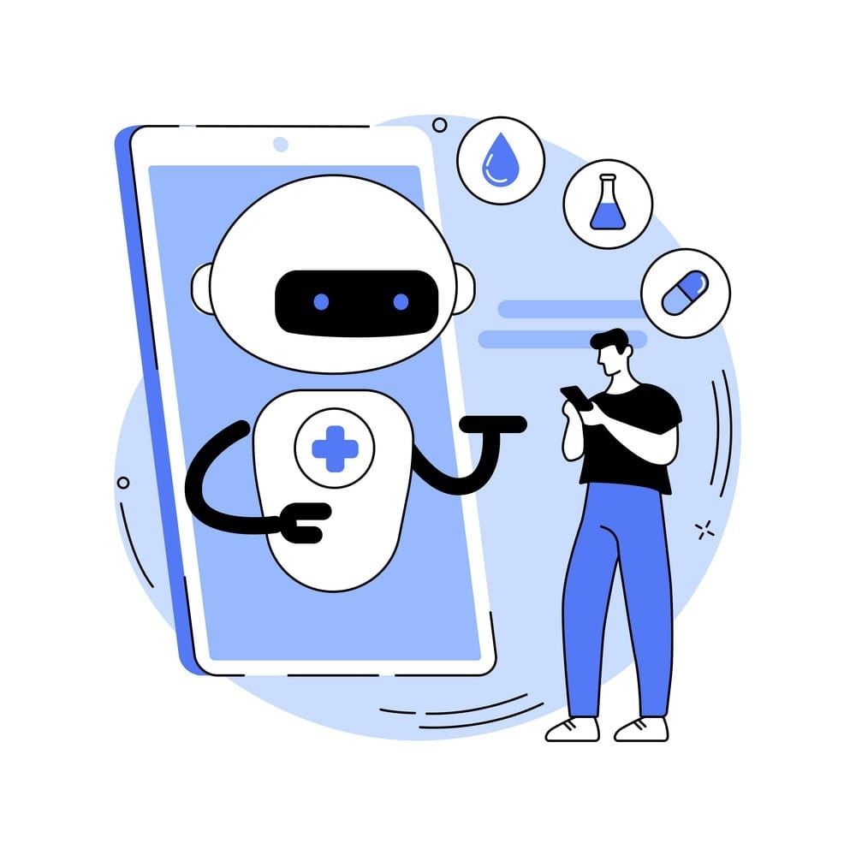
An AI-Based Medical Chatbot Model for Infectious Disease Prediction
Guide : Ms.Ch.V.Madhavi lakshmi
Team number : 10
SK.ALIFA (Y20CS003)
CH.RITHIKA (Y20CS032)
T.SAMBASIVARAO(L21CS211)

Slide 2
Contents
Abstarct
Proposed Techniques
Details of proposed technique
Architecture
Proposed Methodologies and Algorithm
Results Obtained
Analysis of the Results
Conclusion
Future Work

Slide 3
Abstract
The purpose of this work is to show concisely how we can promote chatbots in the medical sector and cure infectious diseases. In this paper, they propose an AI Chatbot interaction and prediction model using a deep feedforward multilayer perceptron. This study describes the functionalities and possible applications of medical chatbots and explores the accompanying challenges posed by the use of these emerging technologies during such health crises mainly posed by pandemics. This work proposes continuous improvement in medical chatbot functionality and will be useful in detecting infectious diseases.

Slide 4
Proposed techniques
Decision-Tree model: A decision tree is a type of supervised learning algorithm that is commonly used in machine learning to model and predict outcomes based on input data. It is a tree-like structure where each internal node tests on attribute, each branch corresponds to attribute value and each leaf node represents the final decision or prediction. The decision tree algorithm falls under the category of supervised learning. They can be used to solve both regression and classification problems.

Slide 5
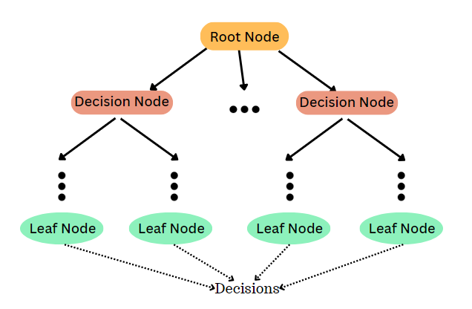
Details of the proposed techniques(Contd.)

Slide 6
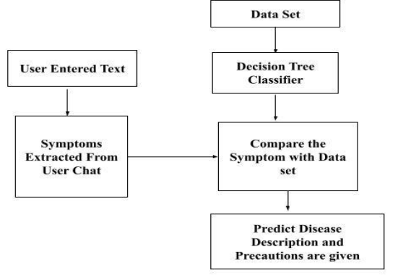
Architecture

Slide 7
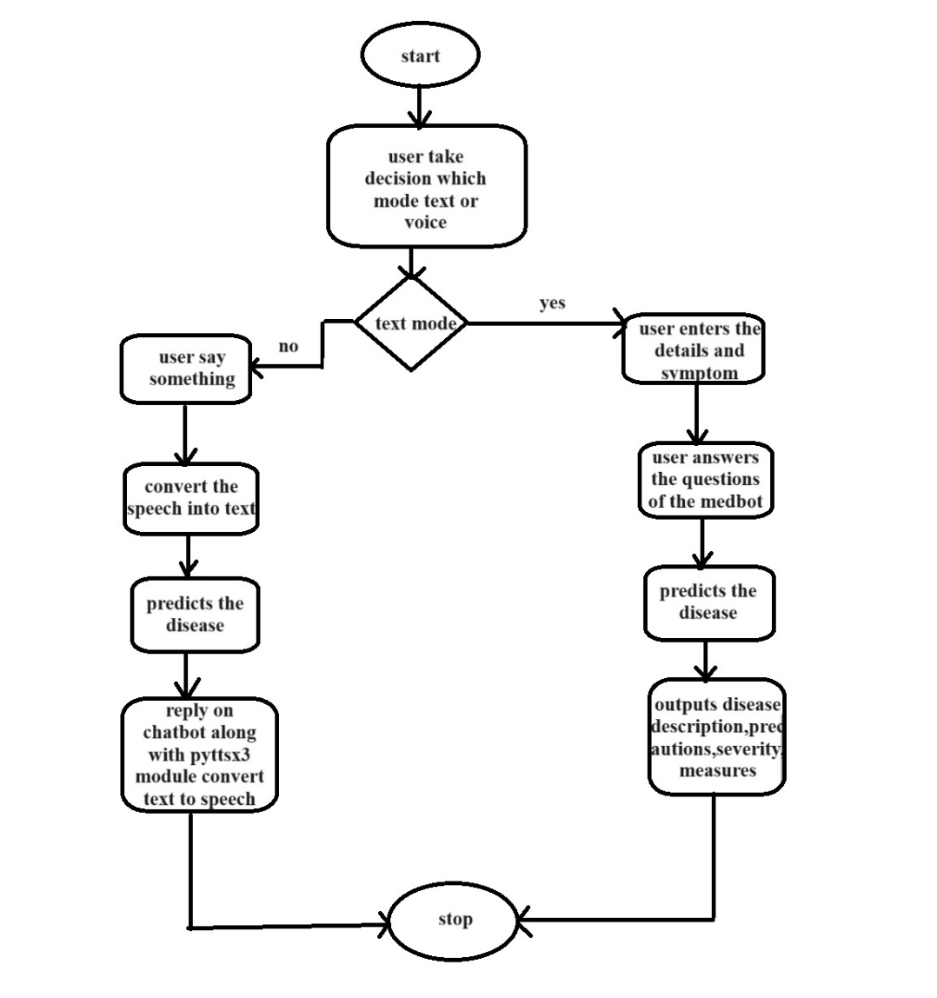
Workflow

Slide 8
Algorithm
Step 1: Import required libraries
Step 2: Read the training and testing datasets into pandas DataFrames: training and testing.
Step 3: Extract the columns from the training dataset and remove the last column, which contains the target variable ('prognosis'). Store the feature columns in the variable cols.
Step 4: Separate the features (x) and target variable (y) from the training dataset.
Step 5: Encode the target variable (y) using LabelEncoder from sklearn.preprocessing.
repeating the same word in model, words=sorted(set(words))

Slide 9
Step 6: Split the training dataset into training and testing sets using train_test_split from sklearn.model_selection.
Step 7: Prepare the testing dataset by separating features (testx) and the target variable (testy), and encode the target variable using the same LabelEncoder as used for the training dataset.
Step 8: Initialize a DecisionTreeClassifier from sklearn.tree.
clf1 = DecisionTreeClassifier()
Step 9: Fit the DecisionTreeClassifier to the training data to train the model.
clf = clf1.fit(x_train,y_train)
Step 10: Perform cross-validation on the trained model using cross_val_score from sklearn.model_selection.

Slide 10
Step 11: Print the mean cross-validated accuracy scores.
Step 12: Extract feature importances from the trained DecisionTreeClassifier to determine the importance of each feature in the decision-making process.
Step 13: Define helper functions: readn, calc_condition, getDescription, getSeverityDict, getprecautionDict, getInfo, check_pattern, sec_predict, print_disease, and tree_to_code.
Step 14: Implement the functionalities of these helper functions:
readn: Utilizes pyttsx3 to read aloud a provided string.
calc_condition: Calculates condition severity based on symptoms experienced and days.
getDescription: Retrieves symptom descriptions from a CSV file.
getSeverityDict: Retrieves severity of symptoms from a CSV file.
getprecautionDict: Retrieves precautionary measures from a CSV file.

Slide 11
getInfo: Gets user information.
check_pattern: Checks input pattern and matches it against diseases.
sec_predict: Predicts disease based on symptoms.
print_disease: Prints disease information.
tree_to_code: Converts decision tree to code and provides an interactive interface for disease prediction and severity assessment based on symptoms.

Slide 12
Step 15: Call the helper functions in the specified order to interactively predict diseases and provide recommendations based on user input.
getSeverityDict()
getDescription()
getprecautionDict()
getInfo()
tree_to_code(clf,cols)
Step 16: Print a separator line at the end of the code execution.

Slide 13
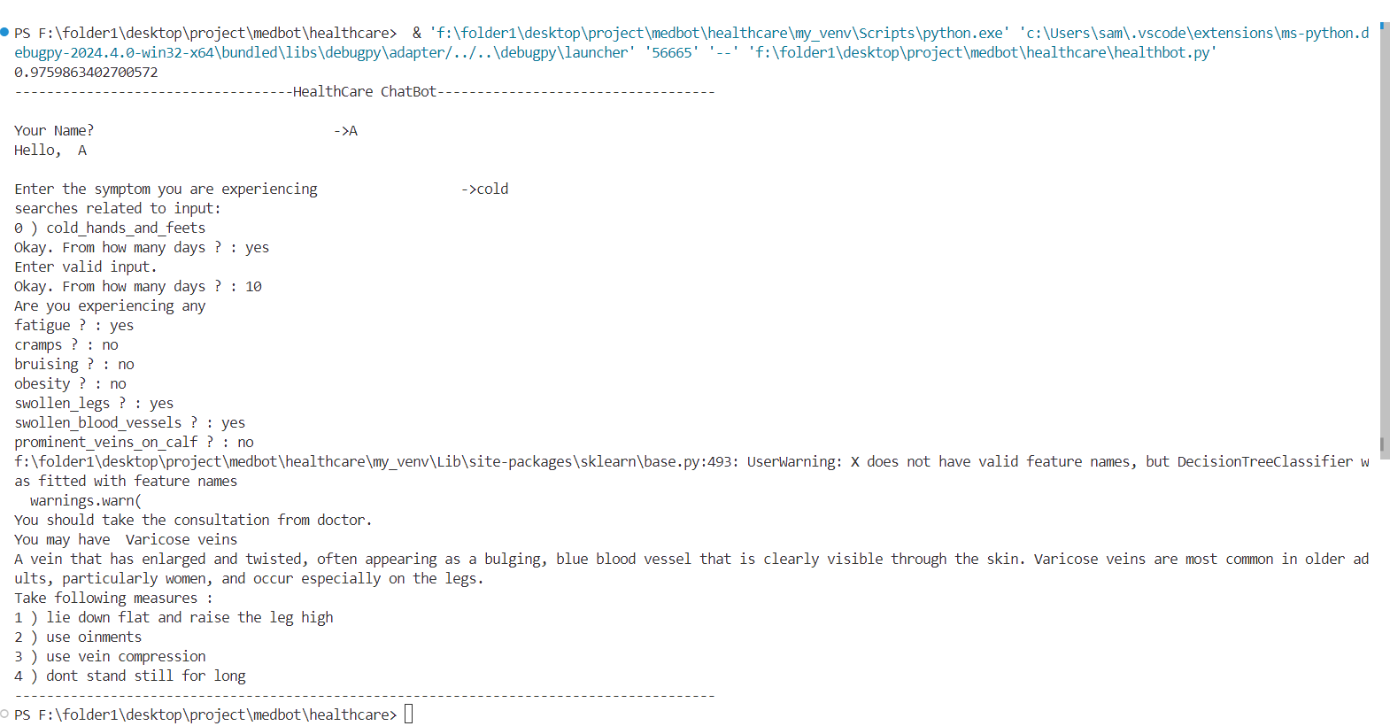
Results

Slide 14
Conclusion
The development and implementation of healthcare chatbots tailored specifically for infectious diseases signify a promising advancement in leveraging technology to address public health challenges. These chatbots, powered by artificial intelligence (AI) and machine learning algorithms, offer a novel approach to support early detection, diagnosis, and management of infectious diseases, thereby contributing to the prevention and control efforts.

Slide 15
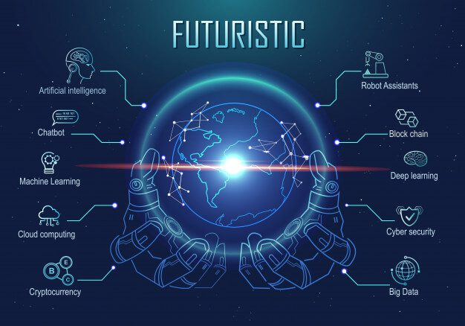
Future Work
Personalized conversations
Omni-channel
Accessibility
Contextual assistance
Bookings
Conversational service
Student assistance

Slide 16


