Slide 1
Not Your Fathers C
C Application Development In 2015

Slide 2
About Me
Living in Leipzig for most of my (adult) life
four years of exploring ways to write high level C
C and me is a „convenience marriage“ (Zweck Ehe)
Other tech stuff: Python, Java
http://blog.toepfer.nu

Slide 3
Leipzig Softwerkskammer
Software Craftmanship Community in Leipzig
Once a month
Mix of coding and beer
https://www.softwerkskammer.org/groups/sachsen

Slide 4
My C Scope
Application development in a legacy system
No embedded software
I am not a kernel hacker

Slide 5
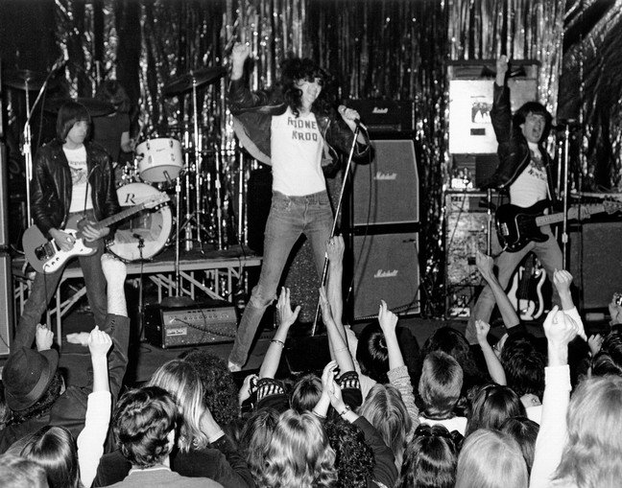
A Punk Rock Language
http://www.bilbaoisrock.com/wp-content/uploads/2013/04/the-ramones.jpg

Slide 6
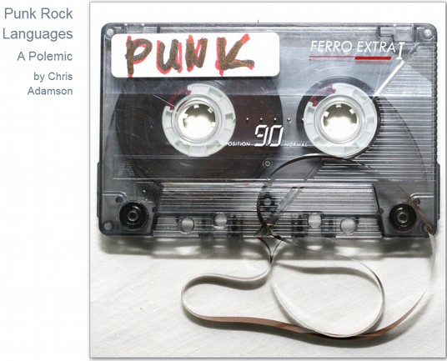
A Punk Rock Language
Essay in PragProg Magazine March 2011
https://pragprog.com/magazines/2011-03/punk-rock-languages

Slide 7
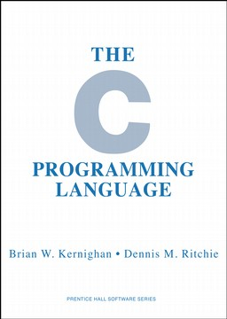

A Punk Rock Language
Book „The C Programming Language“ released in 1978
The same year punk rock had its first peak
[1]
[2]
[1] https://upload.wikimedia.org/wikipedia/commons/thumb/9/95/The_C_Programming_Language,_First_Edition_Cover_(2).svg/2000px- The_C_Programming_Language,_First_Edition_Cover_(2).svg.png
[2] https://ryebreadrodeo.com/prodimages/cz117.jpg

Slide 8
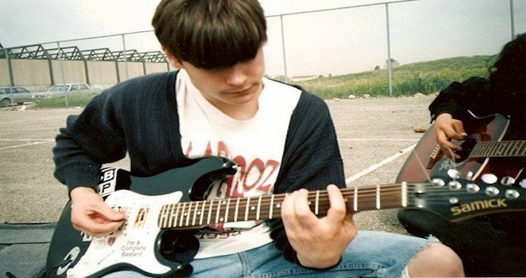
Three Chords
Three Chords Is Enough To Form A Band
http://blog.sharemyguitar.com/wp-content/uploads/2012/03/SMG-Power-Chord.jpg

Slide 9
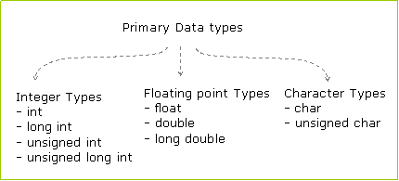
Three Basic Data Types In C
http://codingfox.com/wp-content/uploads/2013/08/data-types.gif

Slide 10
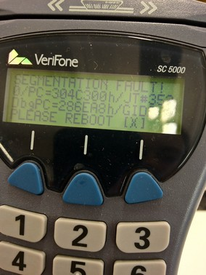
The Craftsmans Question
„C is quirky, flawed, and an enormous success..“ (Dennis Ritchie On C)
How To Deal With A Punk Rock Language?
https://upload.wikimedia.org/wikipedia/commons/2/26/Card_reader_segfault.jpg
Notes:
Quirky – skurril, unkonventionell
Flawed – fehlerhaft

Slide 11
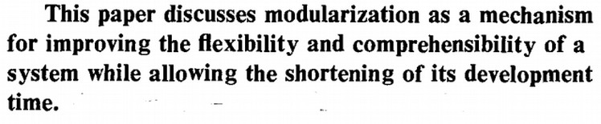
Structure
„On the criteria to be used in decomposing systems into modules”, CACM, Dec., 1972 by David L. Parnas.
Hiding Information To Control Complexity

Slide 12
Structure – What We Are Used To In OO
Classes
Methods
Packages (optional)

Slide 13
Structure – A Python Example
from long.package.path.my_class import MyClass
...
my_instance = MyClass()
print(my_instance.say_hello())

Slide 14
Structure – OO in C
Only global function names are available
We need to use a naming convention for structuring:
  Class name
  Underscore
  Method name
Example: DataLogger_dumpData()

Slide 15
Structure – Example Ported To C
#include "myClass.h"
...
MyClass *my_instance = myClass_create();
printf("%s\n", myClass_sayHello(my_instance));
myClass_destroy(my_instance);

Slide 16
Structure – My Rules
treat a source file (in C called a modul) as a class
all public functions of that file are the methods of the class
the first part of the function name is the name of the class
the second part of the function name is the name of the method

Slide 17
Structure – No Hard Rules
I prefer camel case for class and method names but there are other ways as well (see next example).
As with every convention:
  define your rules and stick to it
  it's not a religion

Slide 18
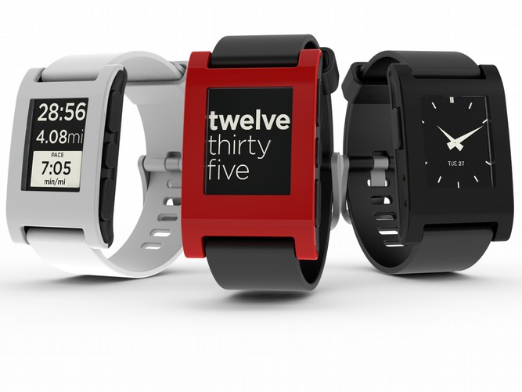
Structure – Pebble Smartwatch
[1]
Smartwatch which started as Crowdfunding campain
[1] https://de.wikipedia.org/wiki/Pebble_(Armbanduhr)#/media/File:Pebble_watch_trio_group_04.png

Slide 19
Structure – „Hello Pebble“
Window *window;
TextLayer *text_layer;
void init() {
window = window_create();
text_layer = text_layer_create(GRect(0, 0, 144, 40));
text_layer_set_text(text_layer, "Hello, Pebble!");
layer_add_child(window_get_root_layer(window),
text_layer_get_layer(text_layer));
window_stack_push(window, true);
}
void deinit() {
text_layer_destroy(text_layer);
window_destroy(window);
}
int main() {
init();
app_event_loop();
deinit();
return 0;
}

Slide 20
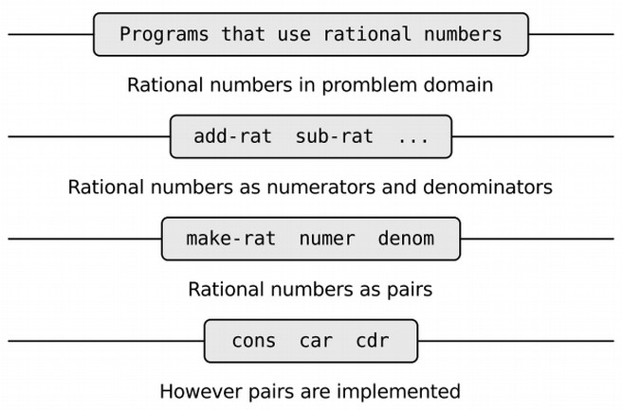
Abstraction – An Old Idea
Taken from „The Structure And Interpretation Of Computer Programs“, 2nd Edition, MIT Press, 1996
Notes:
- Zahlen, die sich durch Brüche ganzer Zahlen ausdrücken lassen.
- cons cell – two elements
- car -extracts first, cdr extracts second
- numerator – Zähler
- denominator - Nenner

Slide 21
Abstraction – The Standards
ANSI standard (Strings, Math, Memory)
Is enhanced by the Posix Standard (Sockets, File descriptors...)
Covers the bare minimum
1000 string functions and non is the right one

Slide 22
Abstraction – What I Expect
Lists
Hashtable/ Assoziative Array/ Dictionary
Painless Strings
…
Basically: Not Re-Inventing The Wheal Every Time

Slide 23
Abstraction - GLib2
https://developer.gnome.org/glib/
Initially developed by GNOME but separated GTK+ to be used in other software
Not to be mistaken with glibc (GNU Implementation of the ANSI and Posix Standards)

Slide 24
Abstraction - GLib2
„the missing standard library“
„Boost for C“
In my opinion the best universal purpose library for C – but there are others as well (Apache)

Slide 25
Abstraction – GLib2 List Example
Todo Example from Wiki

Slide 26
Abstraction – GList Hashtable
void testHashMap(const char* key, const char* value) {
GHashTable* test = g_hash_table_new(g_str_hash, g_str_equal);
g_hash_table_insert(test, g_strdup(key), g_strdup(value));
char * result = g_hash_table_lookup(test, "mykey");
printf("found %s\n", result );
}
int main() {
testHashMap("mykey", "myval");
}

Slide 27
Error Handling
No fancy stuff like exceptions
Has to be done manually
There is a third state: undefined

Slide 28
Error Handling – Classic Via Return Code
int doCalculations()
{
int rc = 0;
rc = calcSomething();
if ( rc != OK )
{
printf("function calcSomething had an error.\n");
return NOT_OK;
}
rc = calcSomethingElse();
if ( rc != OK )
{
printf("function calcSomethingElse had an error.\n");
return NOT_OK;
}
return OK;
}

Slide 29
Error Handling – C Case For Goto
int doCalculations()
{
int rc = 0;
rc = calcSomething();
if ( rc != OK ) goto error_calcSomething;
rc = calcSomethingElse();
if ( rc != OK ) goto error_calcSomethingElse;
return OK;
// error handling
error_calcSomething:
printf("function calcSomething had an error.\n");
return NOT_OK;
error_calcSomethingElse:
printf("function calcSomethingElse had an error.\n");
return NOT_OK;
}

Slide 30
Error Handling – A Case For Goto
Only use it for local error handling & clean up
No replacement for „continue“ and „break“ in loops
Used wildely in the Linux kernel
Forbidden by the Misra Standard

Slide 31
How To Code
I am an IDE person
My setup:
  Eclipse CDT with
  VIM plugin and
  Remote Build Support (PTP)
JetBrains CLion looks promising

Slide 32
How To Code
TODO add picture of Eclipse CDT with demo project

Slide 33
My Conventions
Code for the programmer after me - not the machine
Rarely use Macros - adds one more indirection in my head
Try to keep it plain C pimped with modern libraries - but not a new language (GOBject/ GTK, libcello)

Slide 34
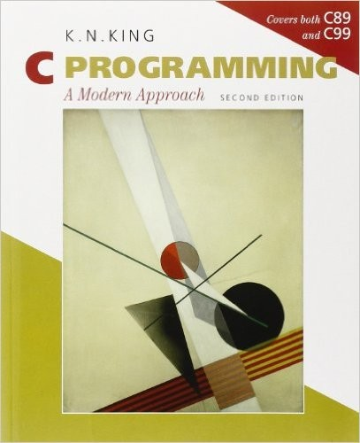
Books – Getting Started
http://ecx.images-amazon.com/images/I/41%2BbFKtFHjL._SX405_BO1,204,203,200_.jpg

Slide 35
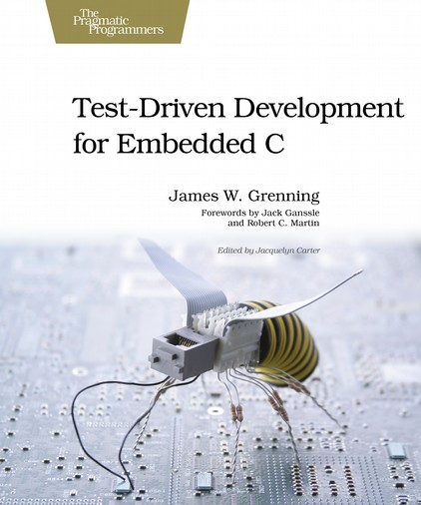
Books - Structure
https://imagery.pragprog.com/products/173/jgade.jpg?1298589886

Slide 36

Books - Syntax
http://ecx.images-amazon.com/images/I/51Rs4gK05iL._SX379_BO1,204,203,200_.jpg

Slide 37
Online
Nice Primer: http://developer.getpebble.com/tutorials/beginner/primer
My collection of C tips: http://we-press-buttons.blogspot.de/search/label/C

