Slide 1
Legal recognition of electronic alternatives to documents of title
the respective roles of legislator and adjudicator
Miriam Goldby
New York 15th February 2011

Slide 2
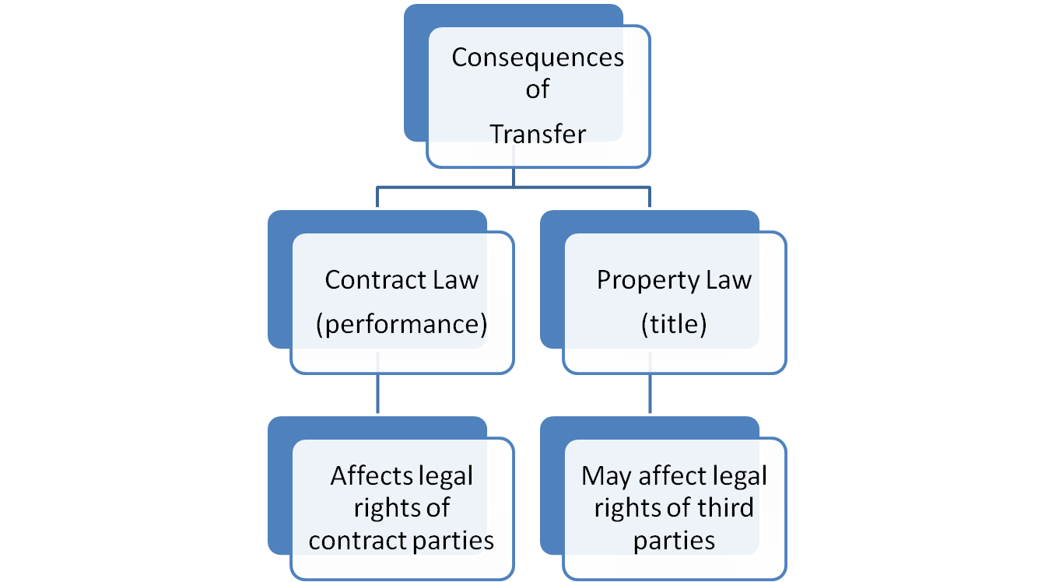
Documents of title (DT)

Slide 3
Contract law aspect
What constitutes performance is determined by the terms of the agreement.
THEREFORE
The question is whether the agreement applies between the parties. “Possession” of the DT usually signifies that “holder” is a party.

Slide 4
Property law aspect
The applicable law will make provision for transfer of title. Notions of “nemo dat quod non habet” or “possession vaut titre”. With DT, some variation of the latter will usually apply.
THEREFORE
The question is whether the DT is recognised by law as capable of transferring title. “Possession” of the DT usually signifies that “holder” has ownership rights.

Slide 5
Contract law aspect (cont.)
Role of legislator:
Implication of contractual terms (usually to protect weaker party to the contract)
Where “writing” or “signature” required, recognising the ability of electronic communications to satisfy these requirements
Role of courts:
Recognition of contract as binding, interpretation of terms, enforcement.
Notes:
Terms implied here will depend on applicable international convention

Slide 6
Property Law Aspect (cont.)
Role of legislator:
Giving “new” DT the power to transfer title, usually under certain conditions.
Role of courts:
Legal Development
  Interpreting and applying legislation.
  Recognising trade usages Edelstein v Schuler & Co [1902] 2 KB 144, at 154.
Doing justice between the parties to the dispute without prejudicing affected third parties.

Slide 7
Problems
If there is no physical DT to “possess”:
  there is no “holder”.
  Contract and title cannot be “transferred” by the transfer of a physical instrument.
THEREFORE
Concepts of “possession” and “holdership” need to be translated to the electronic medium.

Slide 8
Problems (Cont.)
For DT used in international trade, translation needs to be understood uniformly in different jurisdictions.
This requires use of similar terms to refer to concepts equivalent to “holdership” and “control”.
It also requires a high level of uniformity in interpreting requirements by the courts.
Because custom is a source of law, developing standards need to sit well with emerging commercial practice and allow for technological innovation.
Because transfer of title may affect rights of third parties who may or may not be a party to the action, clarity and certainty are key to justice being done.

Slide 9
Current International Standards
Essential to nature of documents of title in general are the concepts of “possession” and “holdership”.
The conditions for an electronic system or process to be functionally equivalent should rest on its ability to achieve the same result.
Standards promulgated so far have tended to refer to the concepts of “singularity” or “uniqueness” and of “control”.

Slide 10
Current International Standards (Cont.)
CMI Rules:
  “Right of Control and Transfer” (Rule 4)
UNCITRAL Model Law on Electronic Commerce:
  “unique” – Art.17(3) and (4)
Rotterdam Rules:
  “exclusive control” – Art.1(21) and (22) (defines “transfer” and “issuance” which in turn define “holder”)
  “right of control” and “controlling party” – Art.50 and Art.51

Slide 11
Current International Standards (Cont.)
eUCP:
  Presentation of electronic records (art e5) (NB notice of completeness art e5(c))
  Authentication (art e5(f), art e3(b)(1), art e12)
  Originality? (art e8)
  BUT
  No provision distinguishes between EDT and other documents presented. Should reference to “exclusive control” be made in article e8?

Slide 12
Commercial Practice
“The Bolero Title Registry provides a repository and workflow for the creation and transfer of negotiable title documents….
The Title Registry is an application for recording and transferring the rights and obligations contained in a Bolero Bill of Lading.
The Bolero Bill of Lading possesses all the attributes of an electronic waybill but with all the benefits of control and pledging capability associated with paper Bills of Lading.”
http://www.bolero.net/core-technology/overview.aspx
“Designation” in the “Title Registry” / “Registration” of rights achieves exclusive control.

Slide 13
Commercial Practice
“The ESS-Databridge™ replaces the physical transfer and couriering of original paper documents by limiting access to ESS’ original eDocs to the appropriate document owner. Essentially, the Exchange replaces ownership of a paper-based title document with access rights to an original eDoc.”
http://www.essdocs.com/ess-databridge-story/edocs-exchange
Having an “original eDoc” to which “access rights” are “limited to the owner” achieves exclusive control.

Slide 14
English Law: No provision for EDT
The principal agreement which underpins ESS’s CargoDocs Services is the ESS-Databridge Services & Users Agreement (DSUA). For Bolero, the multi-party agreement is called the Bolero Rulebook. Both have English law as the Governing Law.
How is legal equivalence achieved?
Contractual rights are transferred through novation (Rulebook para 3.5 and DSUA T&C 8).
Attornment is used to transfer title. (Rulebook para 3.4 and USDA T&C 8.4)
Use of EDT under documentary credits: Bolero “Documentary Credit Suite”; Model clause in DSUA; Notice of completeness.

Slide 15
US Law: Provision for EDT
Article 7-106 and 7-501(b) Uniform Commercial Code (UCC)
Article 9-105 UCC concerning control of electronic chattel paper.
§ 16 Electronic Transactions Act.
Concepts used to define conditions for equivalence:
“single authoritative copy” (holdership)
“control” (possession)
Where US Law is the applicable law of the contract, no attornment or novation is required, subject to the conditions being satisfied. (DSUA T&C 8.1).

Slide 16
Conclusion
Emerging standards providing for electronic alternatives to paper documents of title would at present seem to reflect current commercial practice (and vice versa).
If international standards aimed at harmonisation continue to reflect business practice this will be beneficial to international trade, in that it will create a level of certainty.
This would also assist in adjudicators in their decisions, as the meaning of concepts such as “control” and “uniqueness” will gain a global understanding through transnational business practices.

Slide 17
Thank You!
miriamgoldby@gmail.com

