Slide 1
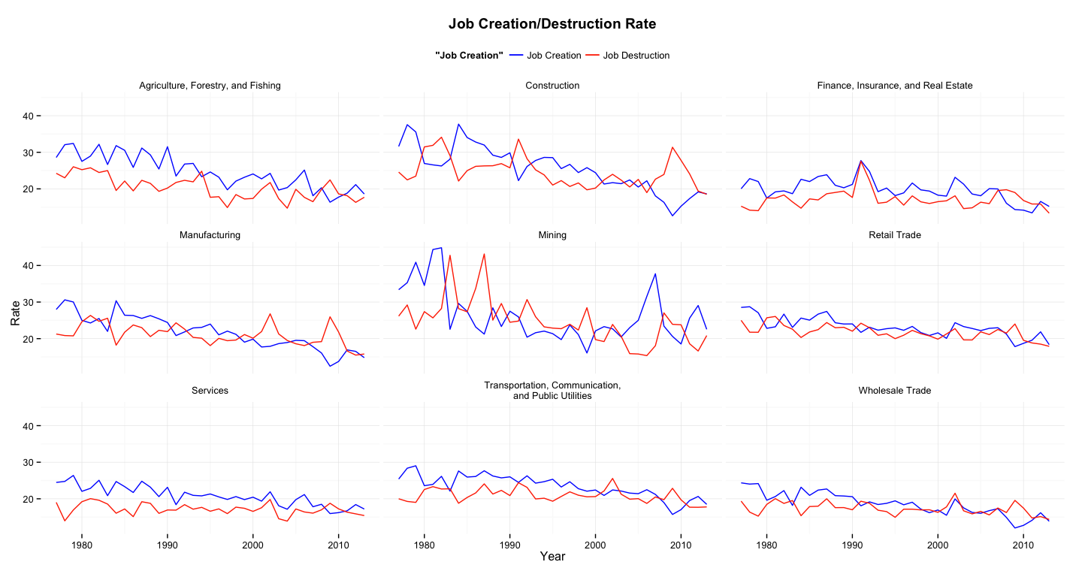
What Sector should we invest? Source of Answer :
JCS and JBS in each sector & Percent Difference between JCS and JBS

Slide 2
