Slide 1
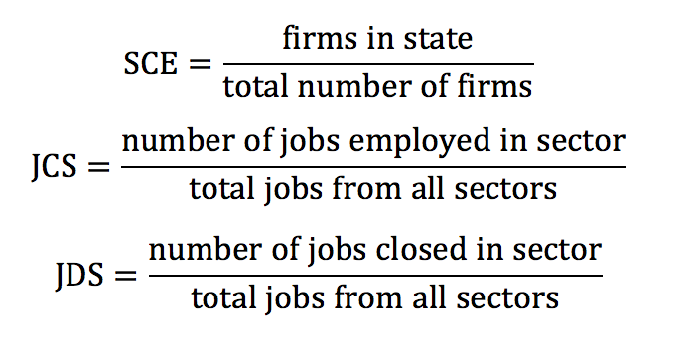
What, Where, and When business should start?
Our assumption: starting business relying on three factors
We created new variables (factors):
- State Contribution to Economy (SCE)
- Job Creation per Sector (JCS)
- Job Destruction per Sector (JDS)

Slide 2
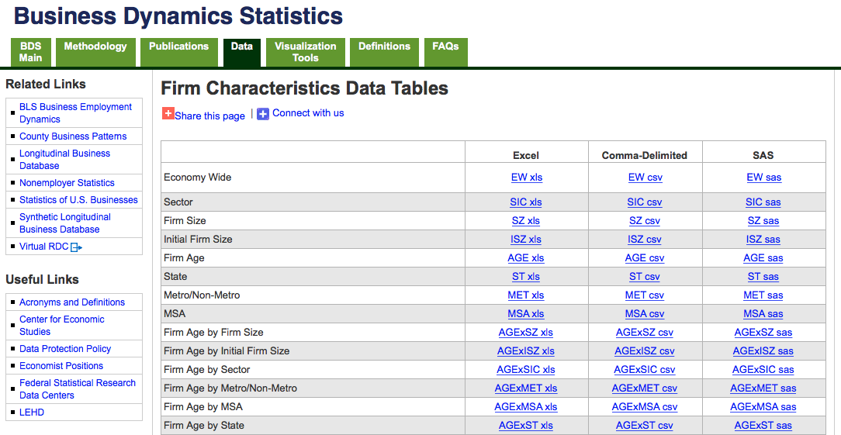
Source of Answer: http://www.census.gov/ces/dataproducts/bds/data_firm.html

Slide 3
What Sector should we invest? Source of Answer :
JCS and JBS in each sector & Percent Difference between JCS and JBS

Slide 4
What Sector should we invest? Source of Answer :
JCS and JBS in each sector & Percent Difference between JCS and JBS

Slide 5
What Sector outperform US market ?
Source of Answer : Percent Difference between JCS and JBS & GDP

Slide 6
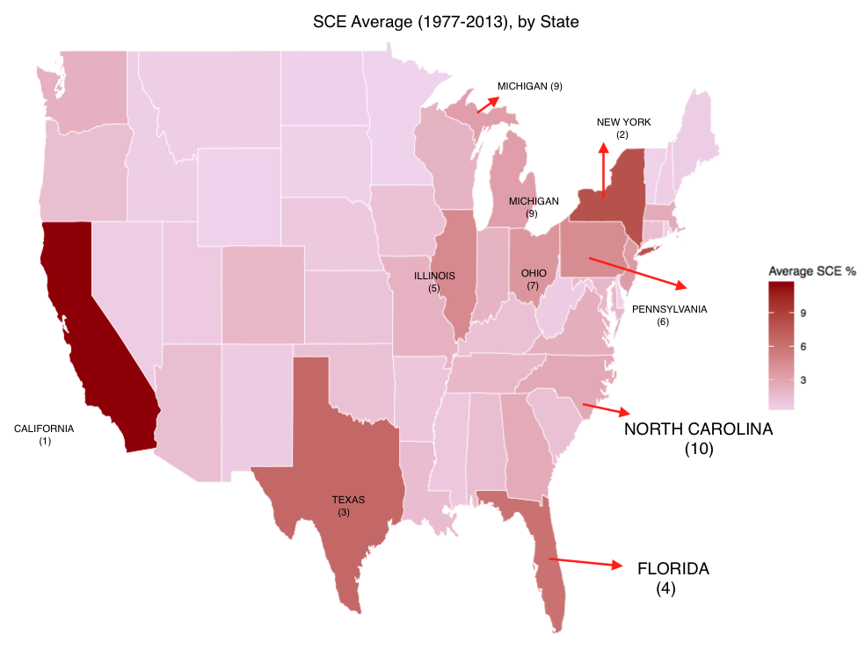
Where and When Business?
Source of Answer : SCE tells us Where in the US
Top 5 SCE's:
1. California 2. New York 3. Texas 4. Florida
5. Illinois 6. Pennsylvania 7. Ohio 8. New jersey
9. Michigan 10. North Carolina

