Slide 1
Face recognition using android emulator
G . Sambasiva
192011089
Software testing for android applications
CSA3731
31-01-2023

Slide 2
Project includes
Introduction
Abstract
Objective
Proposed work
Flow chart
Concept map
Test cases
Apps and tools installation
Appium server
Implementation testing
Testcase outcomes
Conclusion

Slide 3
objective
To identifying or verifying the identity of an individual using their face. Face recognition systems can be used to identify people face.
To test the outcome of the face recognition app.

Slide 4
Abstract
Face recognition system is the verification system to identify the person identity through the biometric method.
Face recognition app will recognise and identifies the faces of people.
The face recognition is used to distinguish each other.
Face recognition application is used to verified whether the face is matched.
The face recognition app accuracy is improved by the testing the application repeatedly.

Slide 5
Proposed work
To develop the face recognition app using android studio.
Run the application using emulator.
Testing the face recognition app for positive and negative outcomes.
Appium interacts with an application automatically and run tests repeatedly against the given application at various sessions.

Slide 6
Test cases
Open app
Image input
Facial recognition
Performance testing
Application UI testing
Text input
N face recognition
Identity verification
Low light face detection
Masked face detection

Slide 7
Data flow diagram
Start process
Install android studio, Appium,jdk ide
Develop face recognition app
Open Appium
Run application
Install android emulator
Testing
Open app
Launch camera
End process
Recognition complete
Recognise face

Slide 8
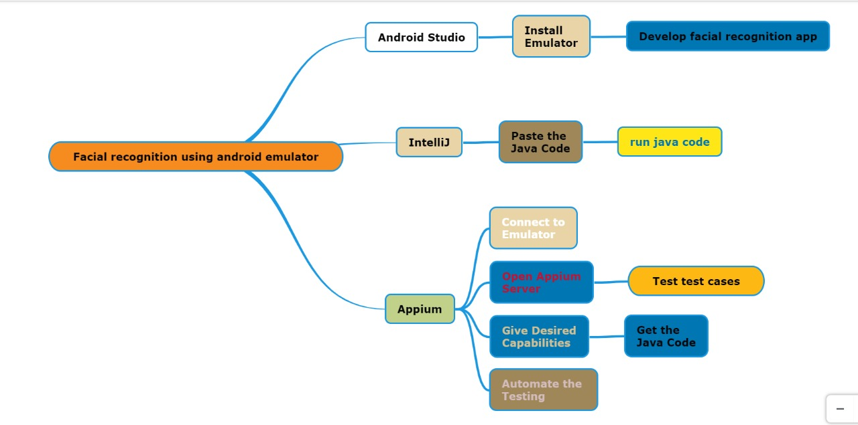
Concept map

Slide 9



Apps and tools installation

Slide 10
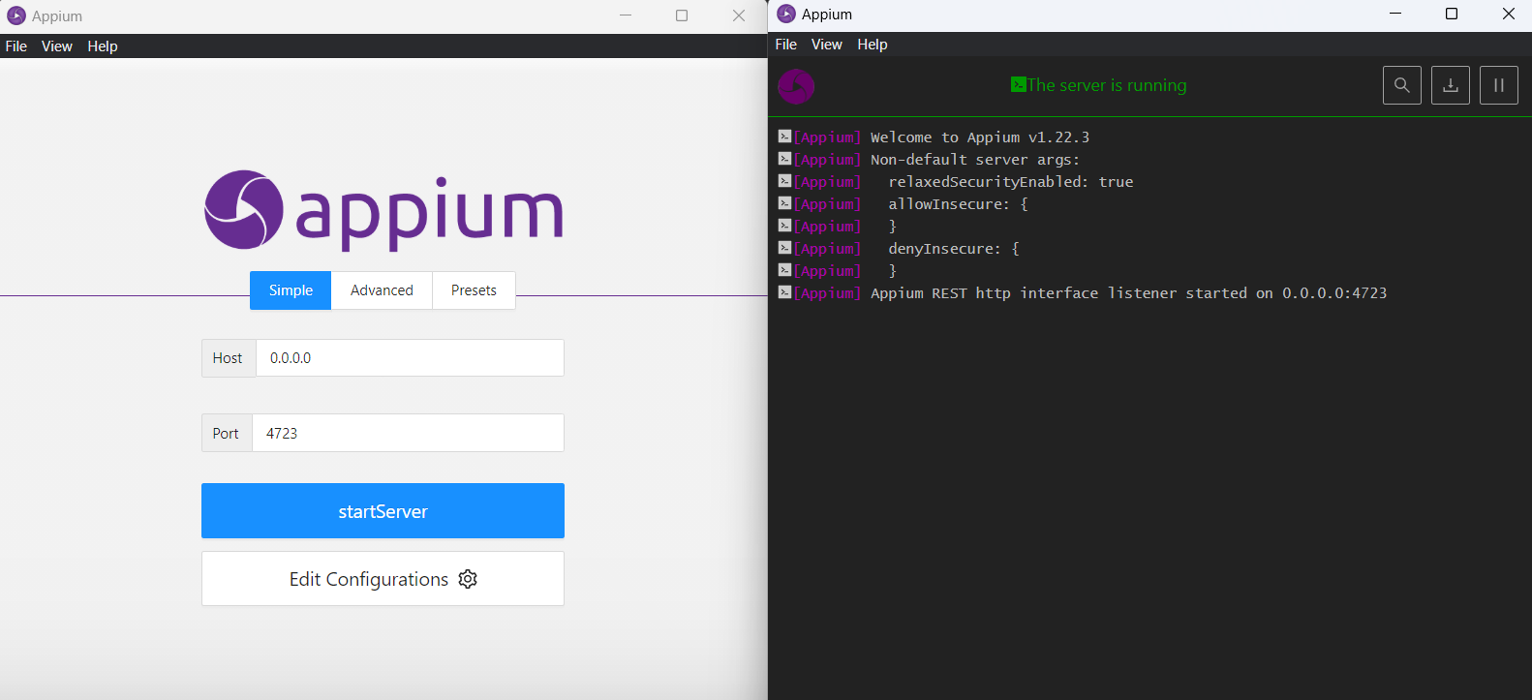
Appium server
Before starting
After starting

Slide 11
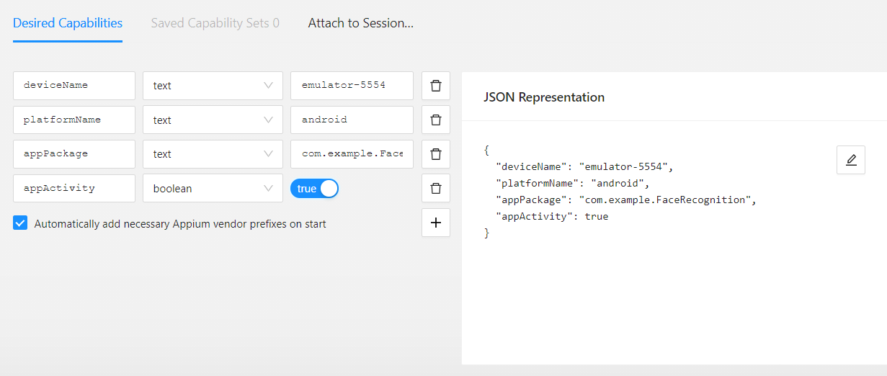
Appium server inspector

Slide 12
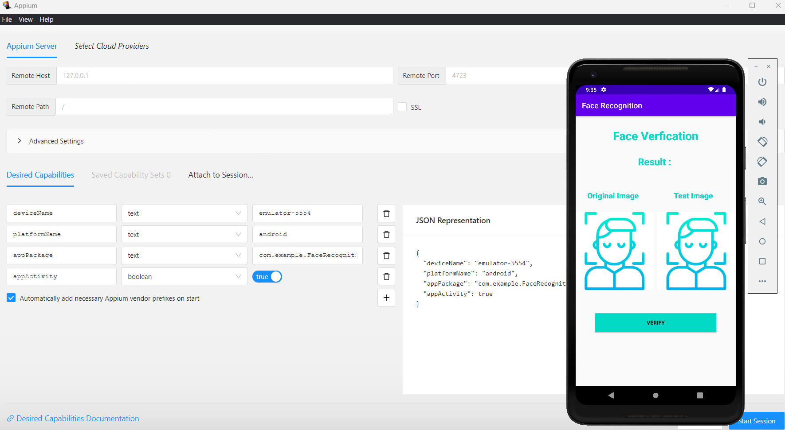
Testing output

Slide 13
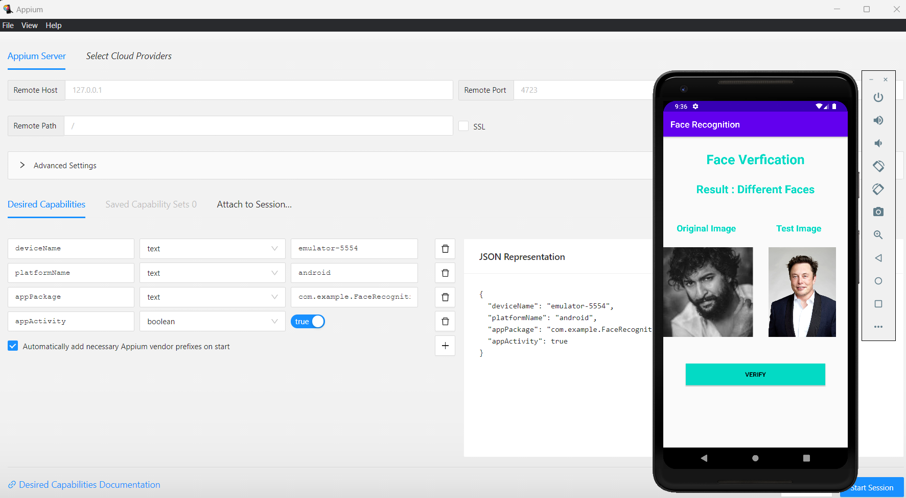
Testing output

Slide 14
Test case outcomes
Test cases | outcomes
Verify if a user is able to Open application. | positive
Verify whether the Image input is taking | positive
Verify whether the face is recognised | positive
Verify if the face is detected in the Low light | negative
Verifying the Performance testing | positive
Verifying the Application UI testing | positive
Verify whether Text input will take or not | negative
Verify if N faces are recognised | positive
Verifying if the Identity verification is performed | positive
Verify if the Masked face is detected | negative

Slide 15
Conclusion
Hence face recognition application is tested using the Appium software.
All the possible outcomes and parameters are tested using Appium server.
70% of test cases are tested positive in the testing process.
30% of test cases are tested negative in the testing process.
By adding the low light detection, face mask detection we can overcome the negative outcomes.

Slide 16
Title
Objective
Abstract
Proposed system
Flow chart
Concept
No . of testcase
Application tools
Test case outcomes
conclusion

Slide 17
Introduction
Appium is an open-source automation tool or we can call it an open-source automation framework which allows us to automate the different type of mobile applications.
It could be a web application, it could be a native or hybrid application.
Single API works for both Android and iOS platform test scripts. It has NO dependency on Mobile device OS.

