Slide 1
Making decisions with code
Shiva K

Slide 2
Every day we are faced with decisions
Should I drive or take the bus?
Which laptop should I buy?
Should I cook or go out for dinner?

Slide 3
The choice we make depends on different conditions
Should I drive or take the bus?
- Depends on price of the gas and bus fair
Which laptop should I buy?
- How much money do I have and what is my RAM requirement
Should I cook or go out for dinner?
- Do I have food at home? Or Do I have enough money to go out?

Slide 4
If you code is going to solve problems,then it has to make decisions as well..
If the user maintained the bank account balance of over $1000,waive the transaction fees.
If the user cancels the appointment before 24 hours of appointment time, charge the cancellation fees.
If the hockey player gets the puck in the net, add one to the score.

Slide 5
If statements allow you to specify code that only executes if specific condition is true
answer = input(“Would you like express shipping?”)
if answer == “Yes” :
print(“That will be an extra 10$”)
What do you think the ‘==‘ sign means?

Slide 6
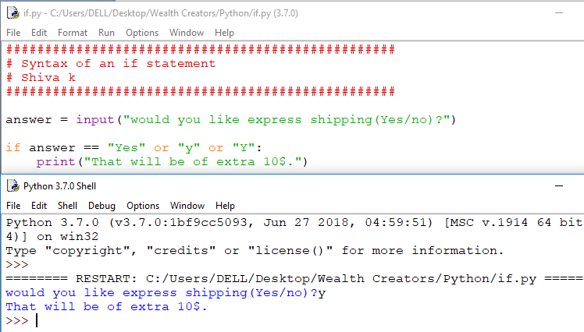

Slide 7
You can user different symbols to check for different conditions!
== is equal to if answer == “Yes”:
!= is not equal to if answer != “Yes”:
> is great than if total > 100 :
< is less than if total <100 :
>= is greater than or equal to
- if total >= 100 :
<= is less than or equal to
-if total <= 100:
-if total <= 100 :

Slide 8
If statement allows you to specify a code that executes only if the condition is true.
answer = input(“Do you need express shipping?(Yes/no)”)
if answer == “Yes” :
print(“That will be an extra $10”)
print(“Have a nice day”)
Does it matter if the print statement is indented?
Yes, only indented statements execute if the condition is true.
:

Slide 9
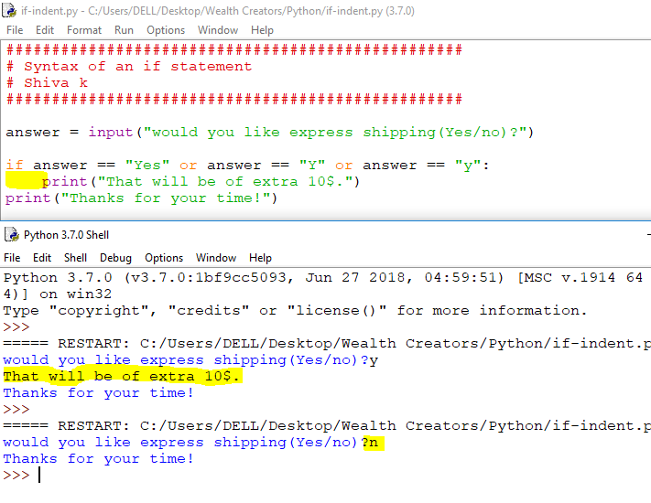

Slide 10
Real world if statements

Slide 11
Almost, every if statement can be written in two ways.
if answer == “yes”:
if not answer == “no”:
if total > 100:
if not total <= 100:
Which one do you prefer ?

Slide 12
Write it the way, you would say it
if course is completed- send certificate
- if courseComplted == ‘Yes’:
if order total is under 50$,add shipping
- if total < 50:
if cat has not been vaccinated-set an appointment with owner
- if not vaccinated == ‘Yes’ :

Slide 13
What do you think will happen, if you type ‘YES’ instead of ‘yes’
answer = input(“Do you need express shipping?(Yes/no)”)
if answer == “Yes” :
print(“That will be an extra $10”)
print(“Have a nice day”)
One of the challenges of working with the strings of characters is , computers considers “Y” and “y” two different letters.
Notes:
Hings.

Slide 14
Is there way we could change the string from upper case to lower case?
answer = input(“Do you need express shipping?(Yes/no)”)
if answer.lower() == “Yes” :
print(“That will be an extra $10”)
print(“Have a nice day”)
Hint: There are functions we could call on these string variables.
Hint: lower()
Notes:
Hings.

Slide 15
What if we apply numbers in the condition instead of strings
deposit = 150
if deposit > 100 :
print(“You will get a free toast”)
print(“Have a nice day”)
What will apear on the screen if deposit is 150?
What will appear on the screen if deposit is 50?
What will appear on the screen if deposit is 100?
Notes:
Hings.

Slide 16
Always,test >,< and boundary conditions!
deposit = 150
if deposit > 100 :
print(“You will get a free toast”)
print(“Have a nice day”)
When check this code,test:
- Value less than 100
- Value great than 100
- Value equal to 100
Notes:
Hings.

Slide 17
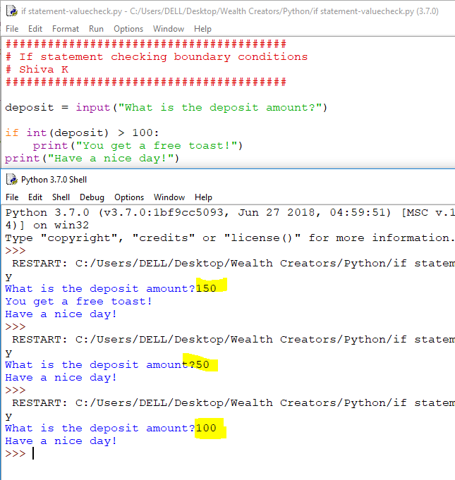

Slide 18
Handling user input

Slide 19
How could we let the user enter the deposit amount?
deposit = input(“Enter the deposit amount:”)
if deposit > 100 :
print(“You will get a free toast”)
print(“Have a nice day!”)
Why will this code crash?
Notes:
Hings.

Slide 20
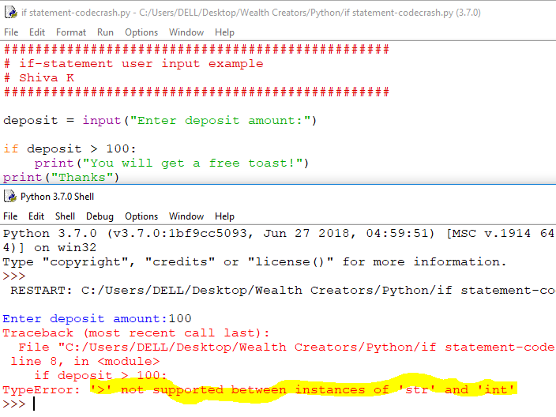

Slide 21
We have to convert the string value returned by the input function to number
deposit = input(“Enter deposit:”)
if int(deposit) > 100 :
print(...........)
Here’s a nother way to do it
deposit = int(input(“Enter deposit:”))
If deposit > 100:
print(.........)
Notes:
Hings.

Slide 22
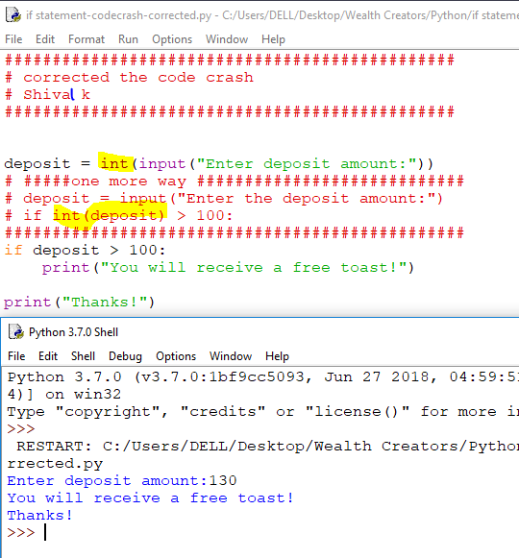

Slide 23
Branching

Slide 24
What if you get a free toaster above 100, and free mug less than 100?
deposit = input(“Enter deposit:”)
if float(deposit) > 100 :
print(“You will get a free toaster”)
else :
print(“Enjoy your free mug”)
print(“Thanks”)
Notes:
Hings.

Slide 25
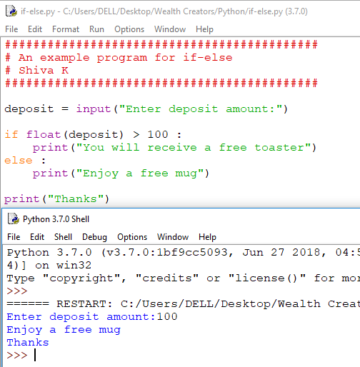

Slide 26
The code in the else statement will execute if the condition is not true
What will appear on the screen if enter
50? 150 ? And 100 ?
Notes:
Hings.

Slide 27
You can use boolean variables to remember if the condition is true or false
deposit = input(“How much would you like to deposit?”)
if float(deposit) > 100:
# set the boolean variable freeToaster to true
freeToaster = True
if freeToaster:
print(“Enjoy your free Toaster”)
Make sure you test your code what happens if condition is true and what happens if the condition is false.
Notes:
Hings.

Slide 28
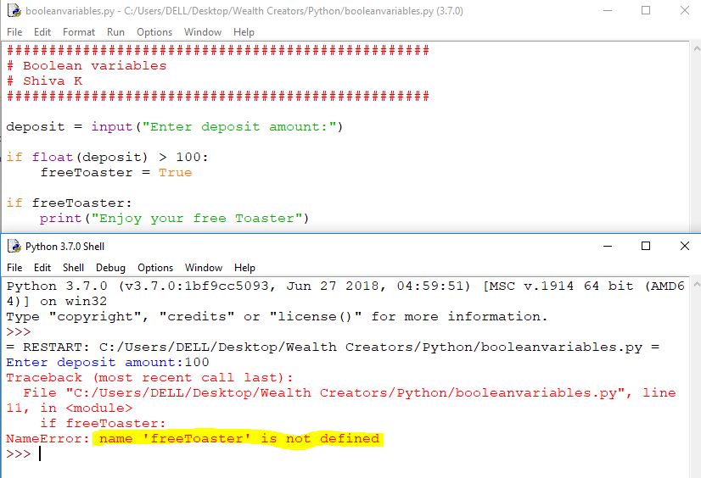

Slide 29
Why did our code crash?
Look at the erroe message!
- Name freeTaoster is not defined.
So, it is necessary to initialize boolean variable before we make use of it in our program.
We correct this error by initializing our boolean variable to False.
Notes:
Hings.

Slide 30
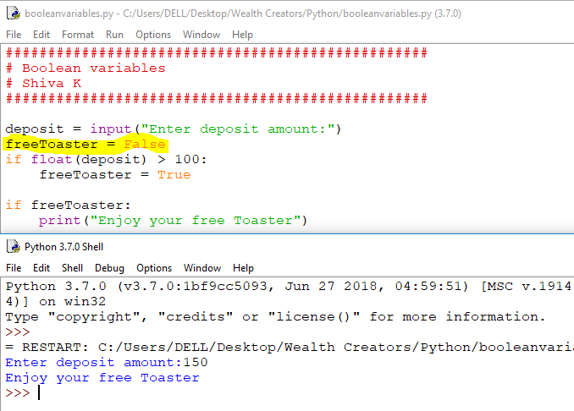

Slide 31
Aren't you just making code complicated by using boolean variables?
That depends ............
What if you are checking the condition in your code more than one place, it is a good practice to check the condition at one place and store the result in a boolean variable.
What if the condition is very complicated,
it is easier to read your code if you use boolean variable(often called flag) in your if statement.
Notes:
Hings.

Slide 32
You Challenge!
Calculate shipping charges for a shopper
Ask the user to enter the amount for their total purchase
If their total is under $50 add $10, otherwise shipping is free
Tell the user their final total including shipping costs and format the number so it looks like a monetary value
Don’t forget to test your solution with
a value > 50
a value < 50
a value of exactly 50
Notes:
Hings.

Slide 33
Congratulations!
Your code can now react to different conditions!
You can solve problems involve decision making.
Notes:
Hings.

