Slide 1
Complex decisions with code
Shiva Kambala

Slide 2
Some times there are multiple conditions that affect the outcome of a decision
If you are in England, say hello. If you are in Germany say Guten tag.If you are in France, say bonajour...
If you win the lottery and prize is over a million dollors then retire to a life of luxury
If it is Monday,Check to see if it is a fresh coffee.If there is no coffee,go to the nearest cafe.

Slide 3
If, then, otherwise.............

Slide 4
If you are in England, say hello. If you are in Germany say Guten tag.If you are in France, say bonajour...
This is an interesting situation, because you only one condition to check but that one condition could have many different values.

Slide 5
The “elif” allows you to check for different values
country = input(“Where are you from?”)
if country == “CANADA”:
print(“Hello”)
elif country == “GERMANY” :
print(“Guten tag”)
elif country == “FRANCE”:
print(“Bonajour”)
Note that elif statement is not indented.
Elif is shot for else if.

Slide 6
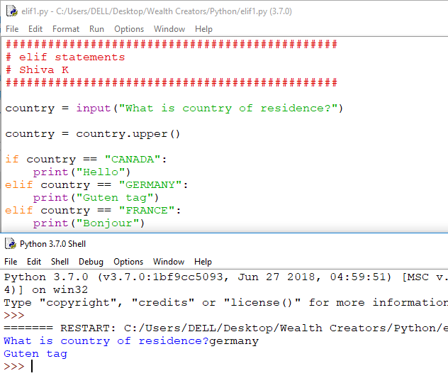

Slide 7
What if someone enters Japan or Italy?
We should add else statement to catch any condition that we did not list.
country = input(“Where are you from?”)
if country == “CANADA”:
print(“Hello”)
elif country == “GERMANY” :
print(“Guten tag”)
elif country == “FRANCE”:
print(“Bonajour”)
else:
print(“Aloha/Ciao/G’Day”)

Slide 8
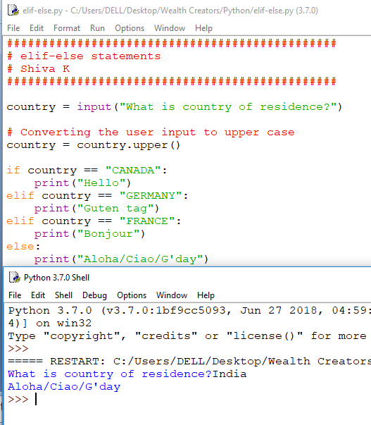

Slide 9
Combining conditions.

Slide 10
If you win the lottery and prize is over one million,then you can retire to a life of luxury.
Sometimes a decision on next step to take depends on combination of factors.
If win the lottery,but only 51$,So I can’t retire
If the lottery gives out million dollors and I didn’t win then I can’t retire
I can only retire If I win the lottery and prize money is over 1 million$.

Slide 11
When you use “AND” all the conditions must be true

Slide 12
The “and” is evaluated as true,if both the conditions are true
# Imagine you have a code that set these two variables true
lotteryWin = True
bigWin = True
# print statement executes only if both the conditions are true.
if lotteryWin and bigWin:
print(“You can retire for life”)

Slide 13
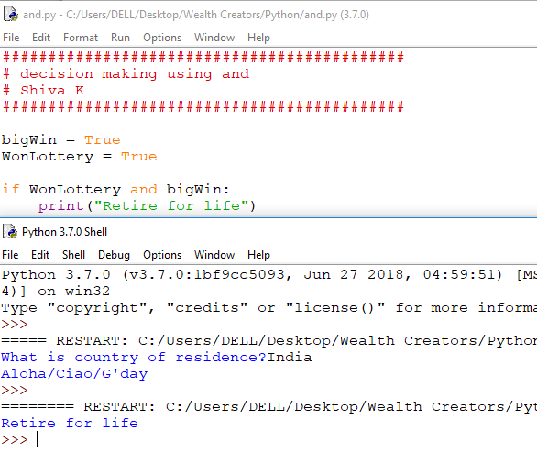

Slide 14
These are all the possible combinations
First conditions is | Second condition is | Statement is
True | True | True
False | False | False
True | False | False
False | True | False

Slide 15
Sometimes,we want to do something,if either condition is true.
If it is Saturday or Sunday then I can sleep.
If it is raining or snowing, don’t bike to work

Slide 16
When you user “or”,you are saying please do the following if either condition is true.
# Imagine you have a code that the following two variables.
Saturday = False
Sunday = True
if Saturday or Sunday:
print(“You can sleep in”)

Slide 17
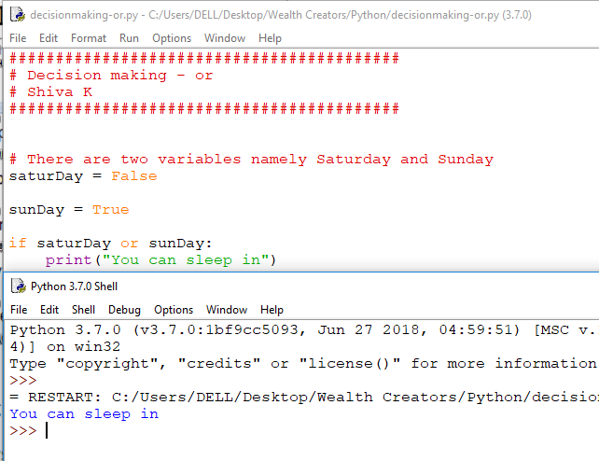

Slide 18
Here’re all the possible combinations.
if condition1 or condition2 :
First condition is | Second condition is | Statement is
True | True | True
True | False | True
False | True | True
False | False | False

Slide 19
You can combine multiple “and/or” in a single if statement.
if month == “Sep” or month == “Apr” or month == “Jun” or month == “Nov”:
print(“There are 30 days in a month”)

Slide 20
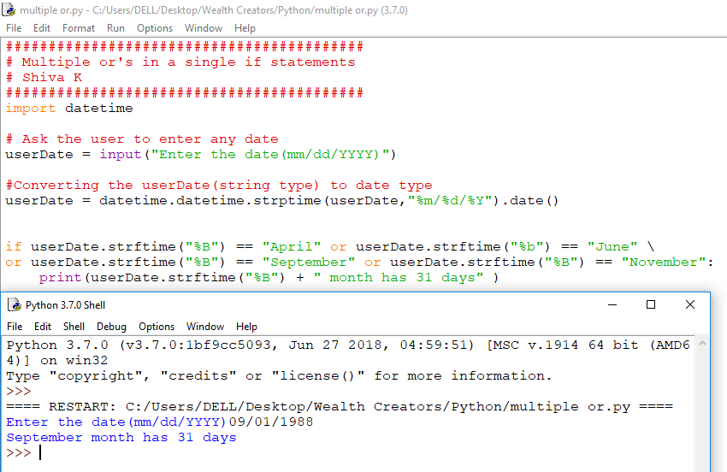

Slide 21
You can combine multiple “and” in a single if statement.
if favMovie == “star wars” and /
favBook == “lord of the rings” and /
favEvent == “comicon” :
print(“You and I should hang out”)

Slide 22
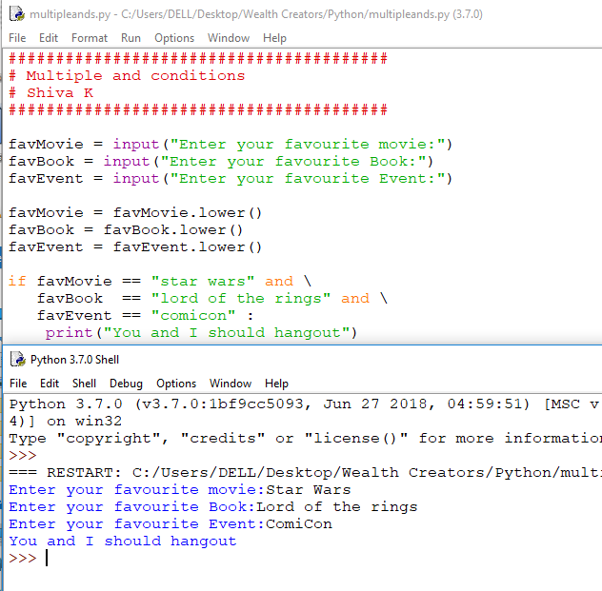

Slide 23
You can combine “and” and “or” in a single if statement.
if country == “CANADA” and \
pet = “MOOSE” or\
pet == “BEAVER” :
print(“Do you play hockey too?”)

Slide 24
Make sure you check all the different coombinations!
Country = CANADA, pet = MOOSE
Country = CANADA, pet = BEAVER
Country = VIETNAM, pet = MOOSE
Country = VIETNAM, pet = BEAVER

Slide 25
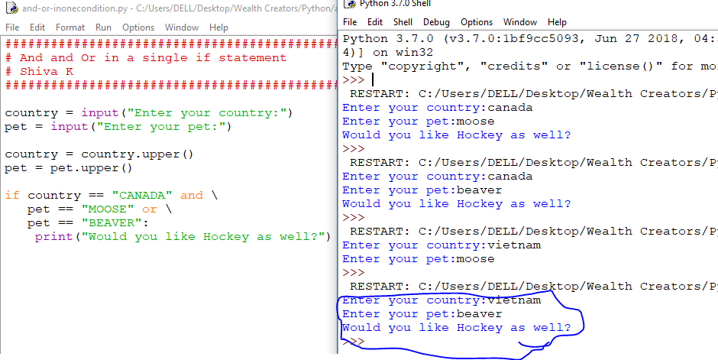

Slide 26
Do you remember the order of operation in math school?
8 + 5 * 2 = ?
Multiplication and division are done before addition and subtraction.
8 + 5 * 2 = 18

Slide 27
There is an order of operations for “and” or “or”. “and” are evaluated first.
if country == “CANADA” and pet = “MOOSE” or\
pet == “BEAVER” :
print(“Do you play hockey too?”)

Slide 28
How do specify, in math, you wanted addition to be done before multiplication?
Use parenthesis!
(8 + 5) * 2 = 26

Slide 29
We can specify parenthesis to execute or before an and
if country == “CANADA” and \
( pet = “MOOSE” or\
pet == “BEAVER” ):
print(“Do you play hockey too?”)
When in doubt add parentheses while combining and ,or in a single if condition.
It might be redundant,but it will be lot easier for others to read your code and you are less likely to make mistakes.

Slide 30
Some times,we have multiple conditions, just using and or or in a single statement will not work.
How could you handle this in code?
If it is Monday, go check to see if there is fresh coffee. If there is no fresh coffee, then go to the nearest cafe.
In this case, you want to check a condition. If it is true, you will check another condition.

Slide 31
Nested if statements..
You can nest if statements inside the each other.
monday = True
freshCoffee = False
if monday :
if not freshCoffee:
print(“Go and Buy coffee”)
print(“I hate Mondays”)
print(“You can go to work”)
Note: Indentation is important here!It determins which statement belong to which if statement.

Slide 32
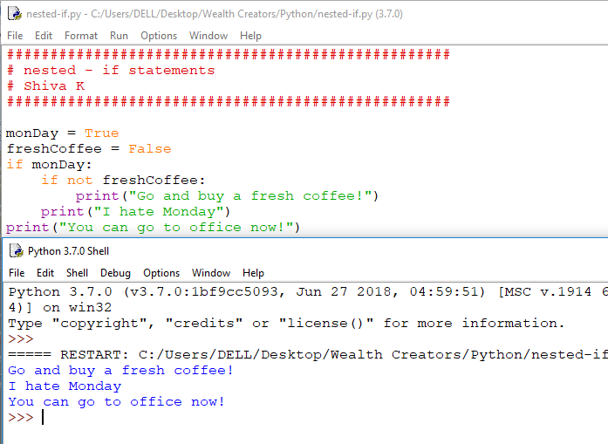

Slide 33
You Challenge
Calculate the order total to charge for an online store in Canada.
Ask the user what country are from and order total
If user is from Canada, ask which province
If the order is from outside canada,do not charge any tax!
If the order is placed in Canada, calculate tax based on province.
- Alberta charge 0.5% GST
- Ontario, New Brunswick, Nova Scotia charge .13% Harmonized sales tax
- All other provinces charge .06% provincial sales tax + .05% GST tax
Tell the user the total for their order with taxes.

Slide 34
Testing your challenge
What do you need to test to ensure your code works correctly?
Someone who is from outside Canada (no tax)
Someone from Alberta, Canada (5% tax)
Someone from Ontario, Canada (13% tax)
Someone from Canada from a different province (e.g. Quebec) (11% tax)

Slide 35
Congratulations!
You can now write code that solves problems requiring more complex decision making

