Slide 1
⚡ FIRELINE BY OPSNERVE
FireLine
AI-Powered Restaurant Operations Platform
The Operational Nervous System
120+ API Endpoints • 18 Database Migrations • 22 Test Packages • 170+ Commits
Multi-Location • Real-Time AI • Predictive Intelligence • Cross-Module Reasoning

Slide 2
THE PROBLEM
Restaurant Chains Are Flying Blind
💰
Food Cost Leakage
Average restaurant wastes 4-10% of food costs through portioning errors, spoilage, and unrecorded waste
👥
Labor Inefficiency
Manual scheduling leads to 12-18% overstaffing during slow periods and understaffing during peaks
🔧
Reactive Maintenance
68% of equipment failures could be prevented with predictive maintenance — instead, restaurants lose $15K+ per incident
📊
Data Silos
POS, inventory, scheduling, and customer data live in separate systems with no cross-module intelligence
⚠️
Decision Latency
CEOs discover problems days/weeks later — by then, damage is done

Slide 3
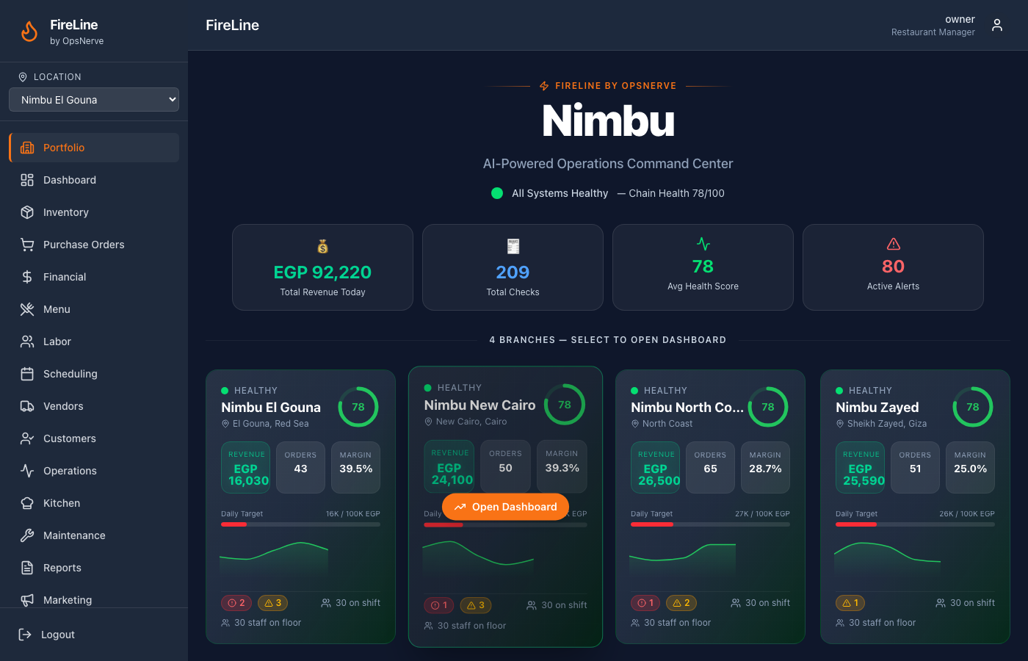
THE SOLUTION
AI Command Center — All Branches at a Glance

Slide 4
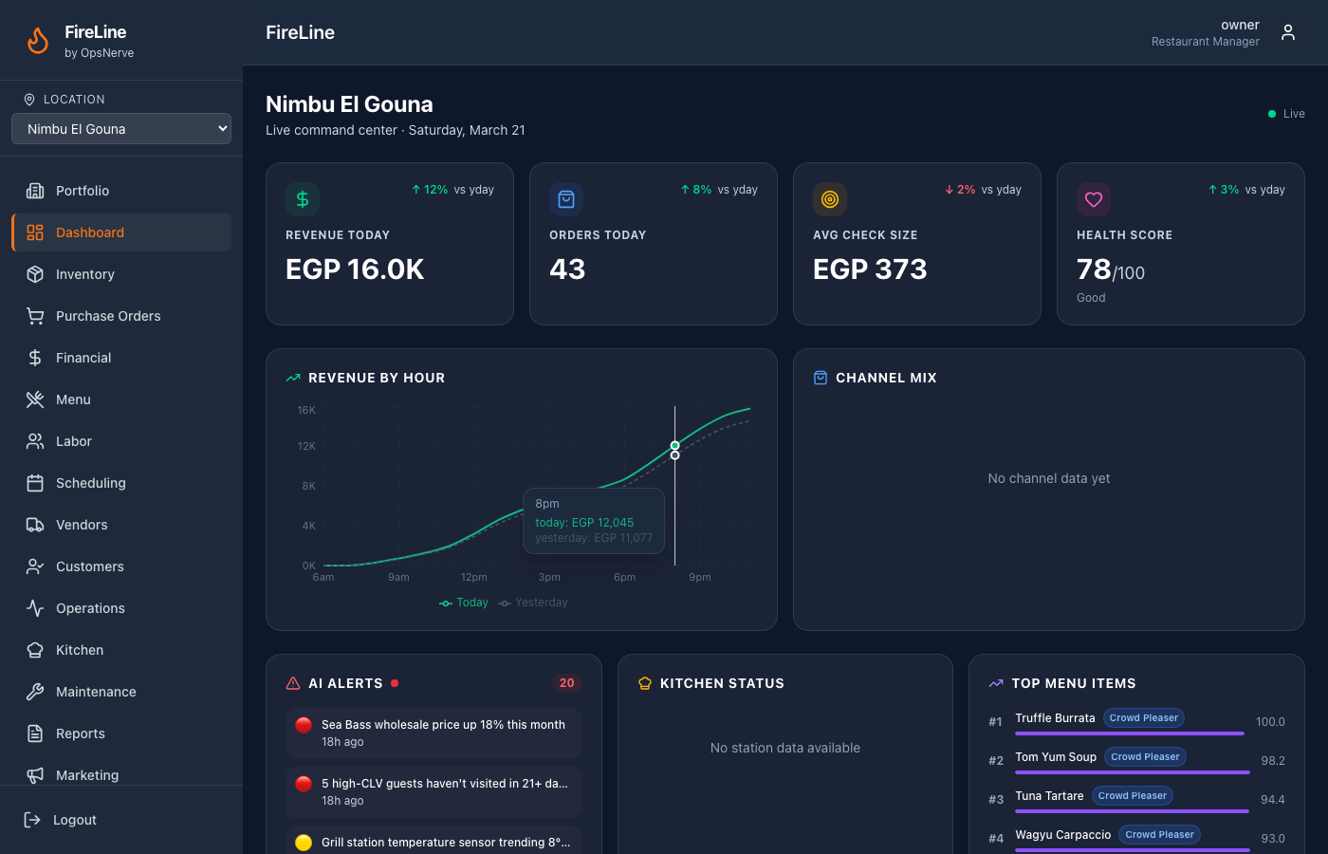
BRANCH DASHBOARD
Real-Time Branch Command Center

Slide 5

CEO INTELLIGENCE
Executive Briefing & AI Recommendations

Slide 6
AI INTELLIGENCE LAYER
10 AI Modules Working in Concert
🔧
💰
📦
🍽️
👥
Predictive Maintenance
Financial Intelligence
Inventory Intelligence
Menu Intelligence
Customer Intelligence
Sensor trend analysis 87% failure prediction
Real-time P&L Anomaly detection
Variance analysis Auto-PO generation
5D scoring 8-class classification
CLV scoring Churn prediction
⏰
🚚
🏪
📢
🏢
Labor Intelligence
Vendor Intelligence
Operations Intelligence
Marketing Intelligence
Multi-Location Intelligence
ELU ratings Demand scheduling
Reliability scoring Price intelligence
Capacity model Overload response
Campaign engine Loyalty program
Benchmarking Best practices

Slide 7
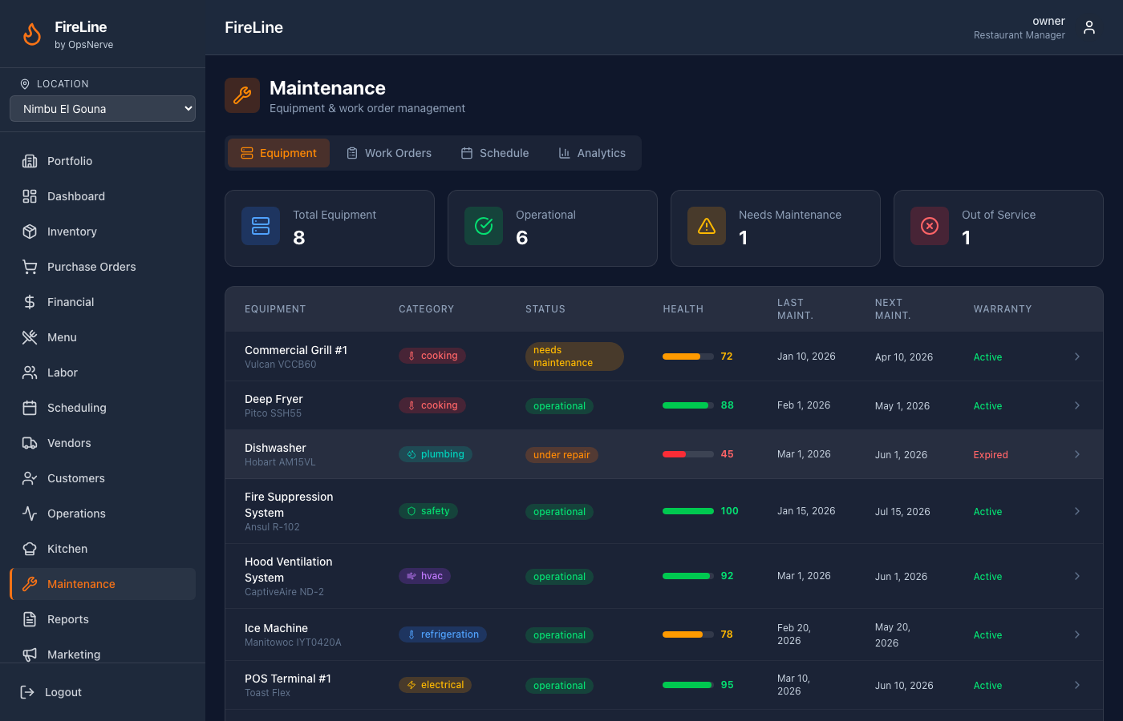
PREDICTIVE MAINTENANCE
AI Detects Equipment Failure Before It Happens
🤖 How It Works
1. Daily kitchen reports log equipment readings
2. AI analyzes 14-day temperature trends
3. Pattern matching against historical failure curves
4. Confidence-scored root cause prediction
5. Auto-generated preventive maintenance ticket
Example: Walk-in Cooler
• Temperature: 2.1°C → 6.5°C over 14 days
• AI Prediction: Compressor degradation (87% confidence)
• Risk: EGP 45,000 in perishable inventory
• Action: Auto-ticket created with repair steps

Slide 8
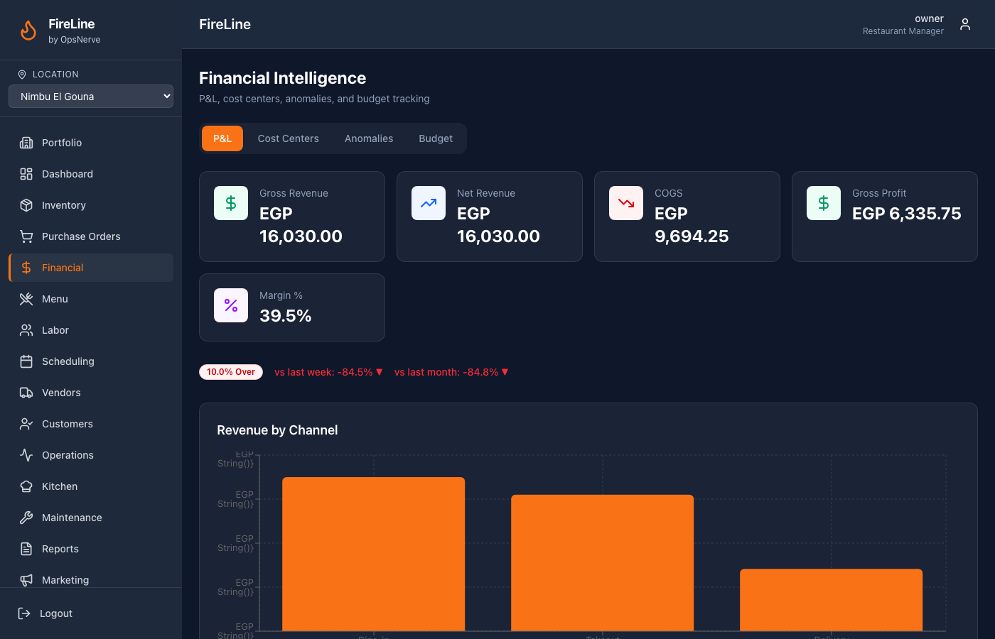
FINANCIAL INTELLIGENCE
Real-Time P&L with AI Anomaly Detection

Slide 9
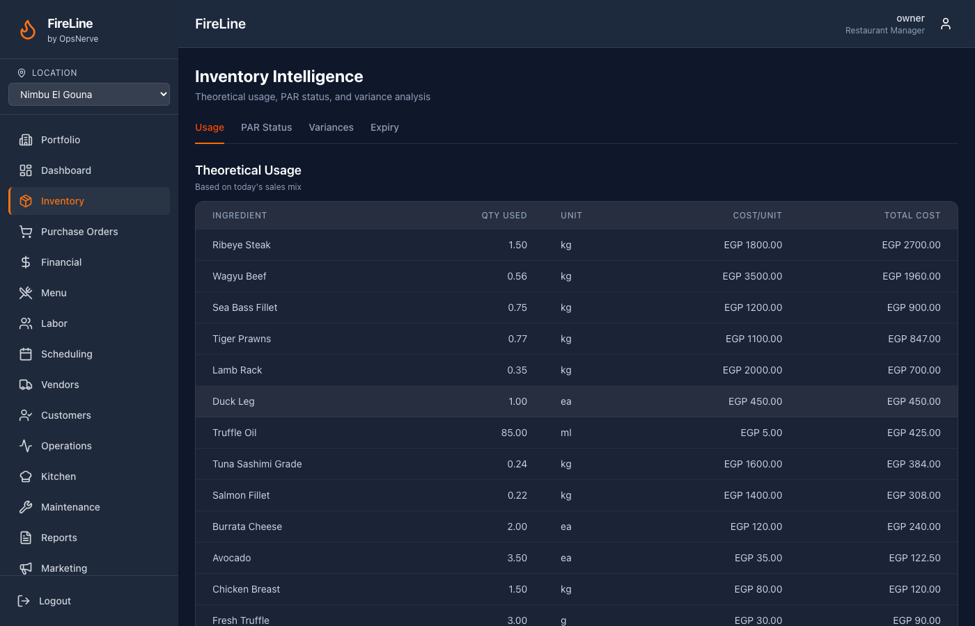
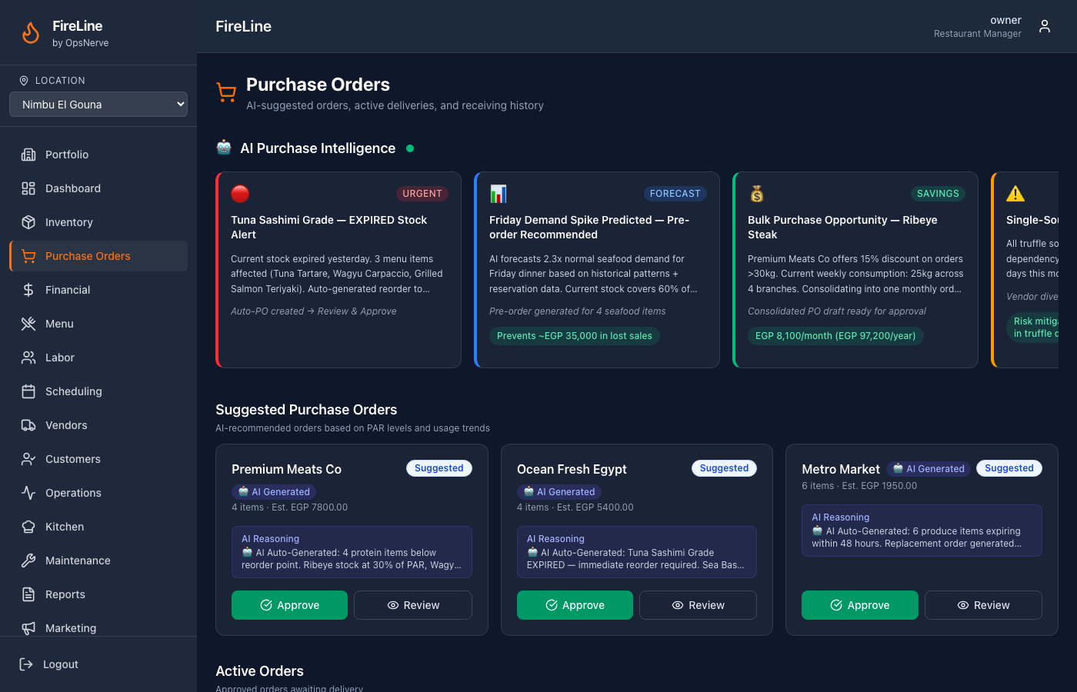
INVENTORY INTELLIGENCE
Variance Detection, Expiry Tracking & Auto-PO

Slide 10
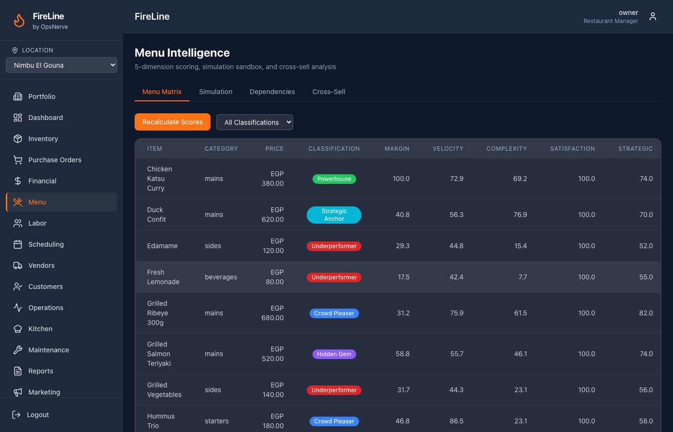
MENU INTELLIGENCE
5-Dimension Scoring & Simulation Sandbox

Slide 11
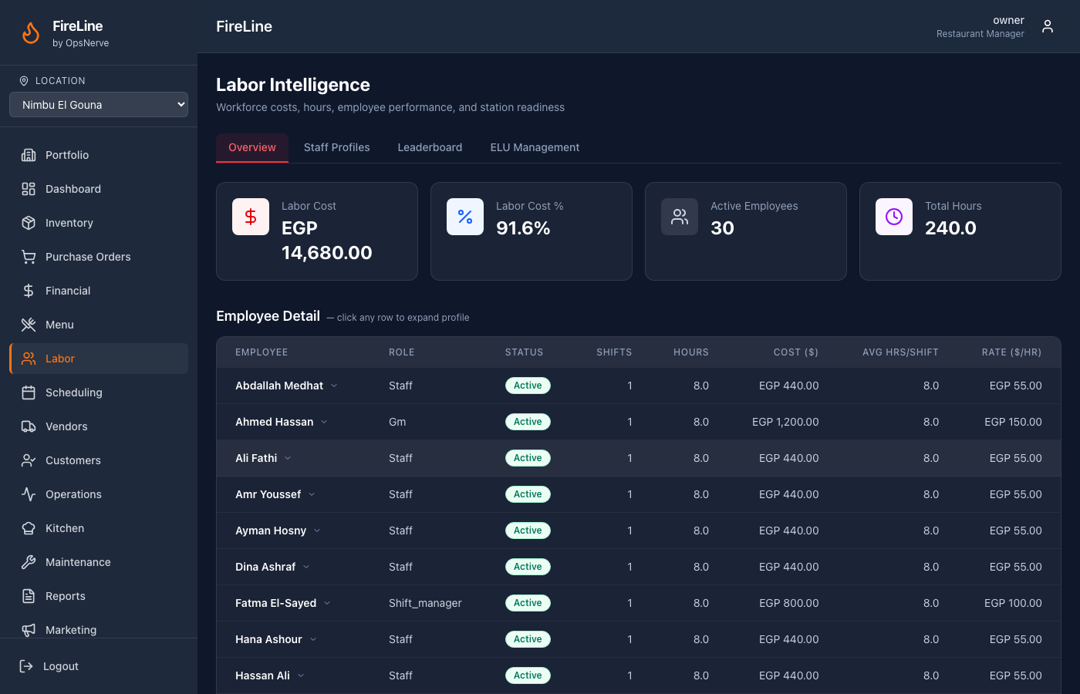
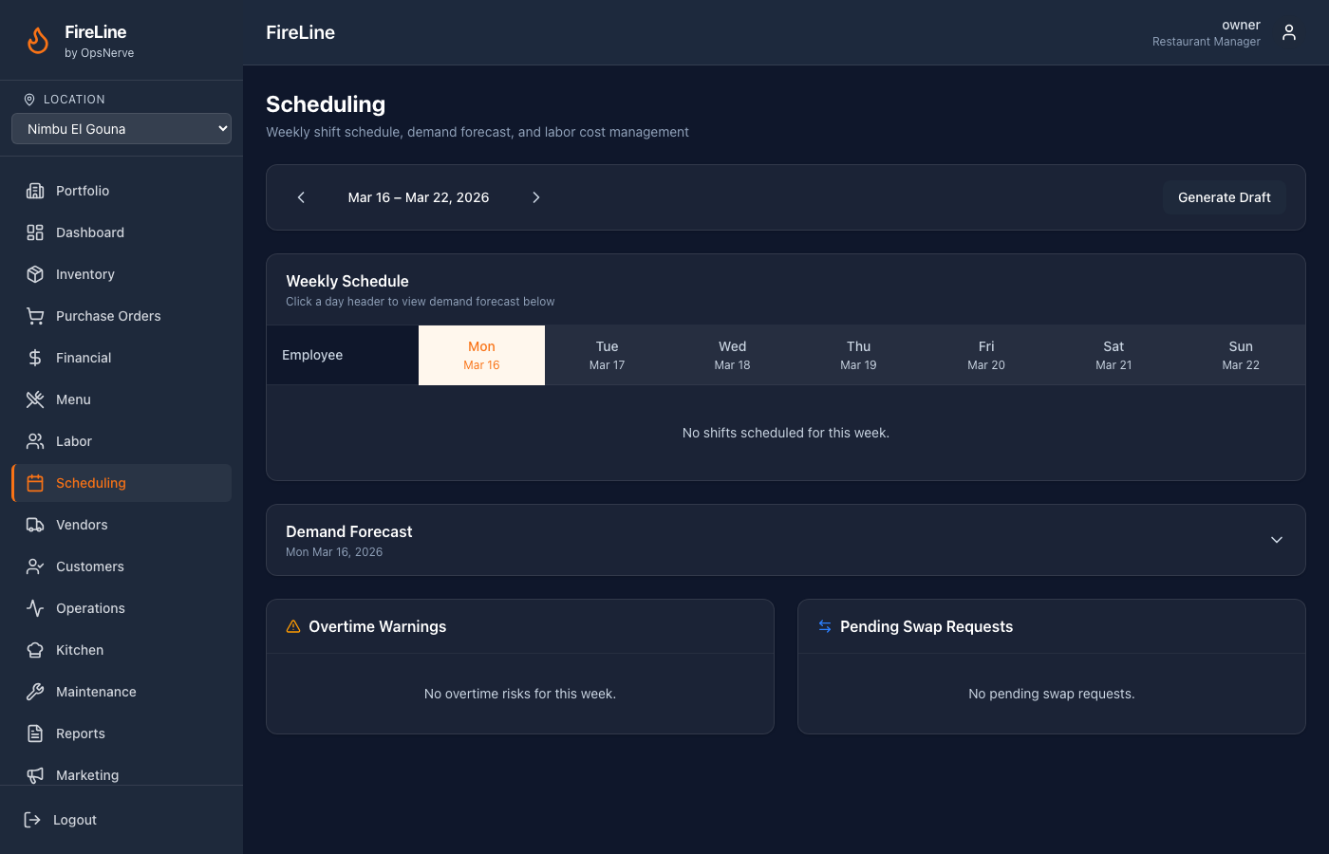
LABOR & SCHEDULING
ELU Ratings, Staff Points & Demand Scheduling

Slide 12
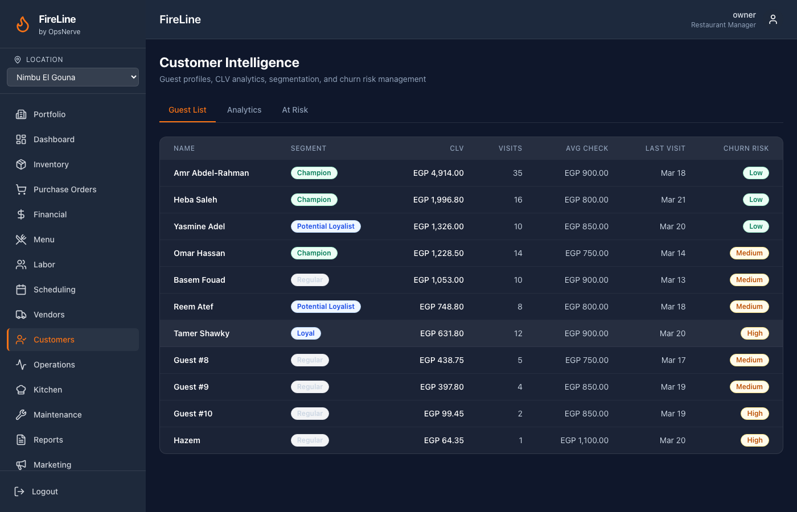
CUSTOMER INTELLIGENCE
CLV Scoring, Segmentation & Churn Prediction

Slide 13
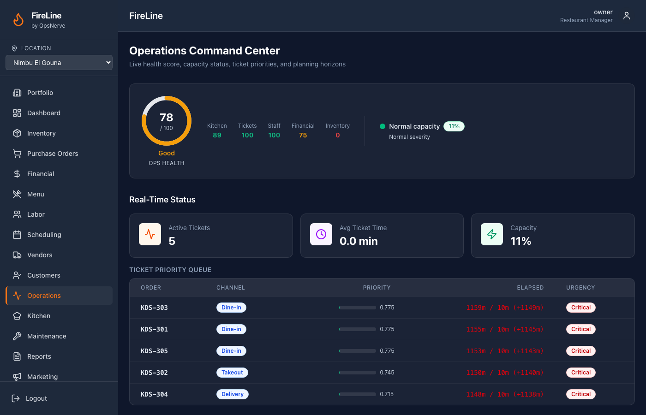
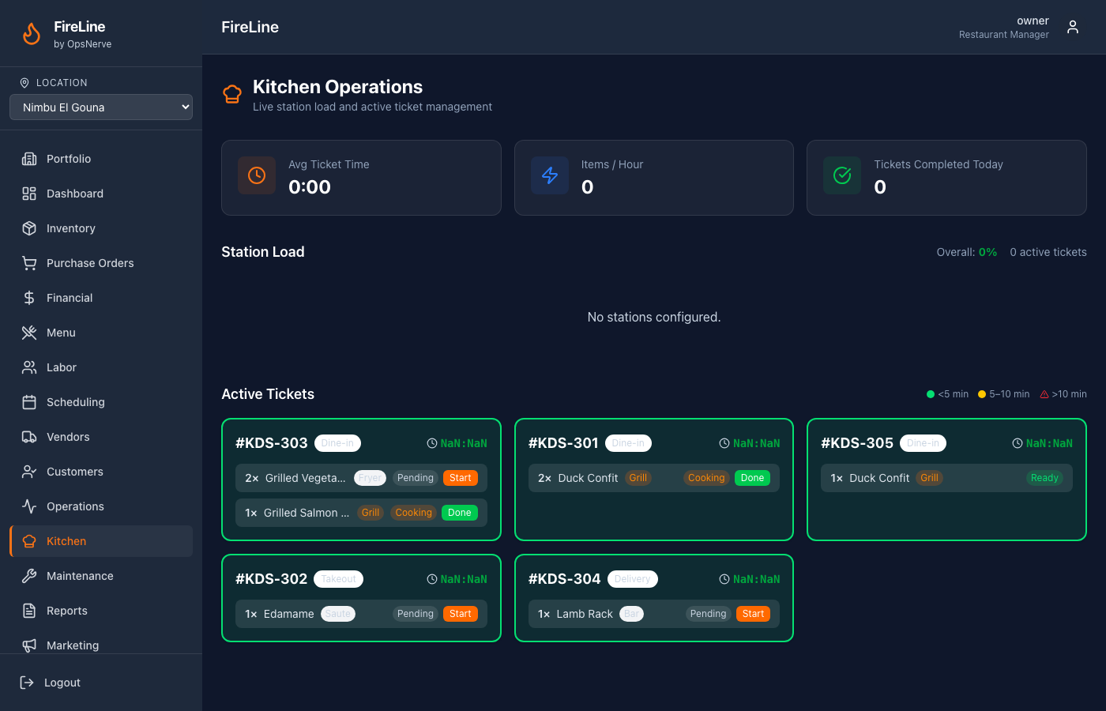
OPERATIONS & KITCHEN
Health Score, Capacity Model & KDS

Slide 14
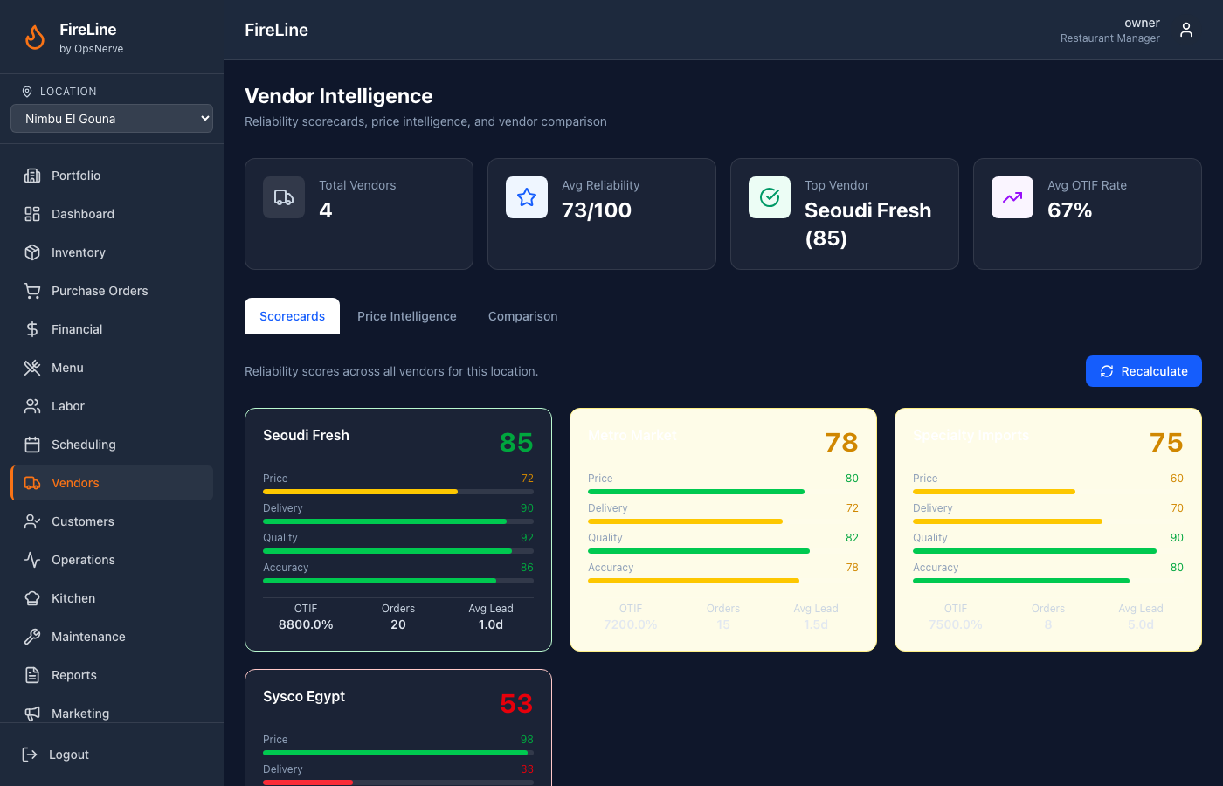
VENDOR INTELLIGENCE
Reliability Scoring, OTIF & Price Intelligence

Slide 15
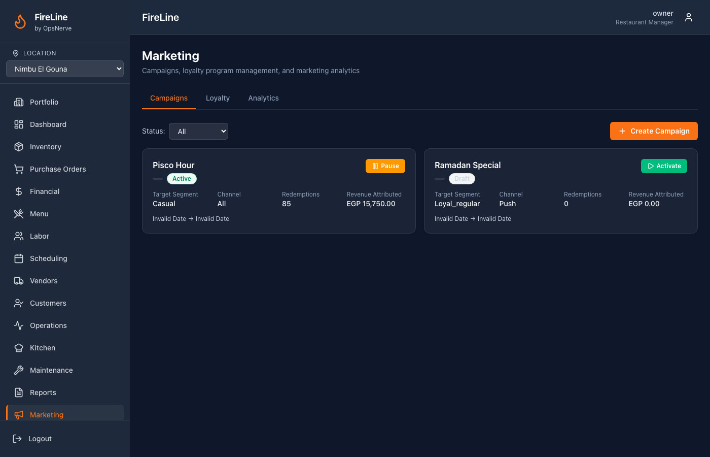
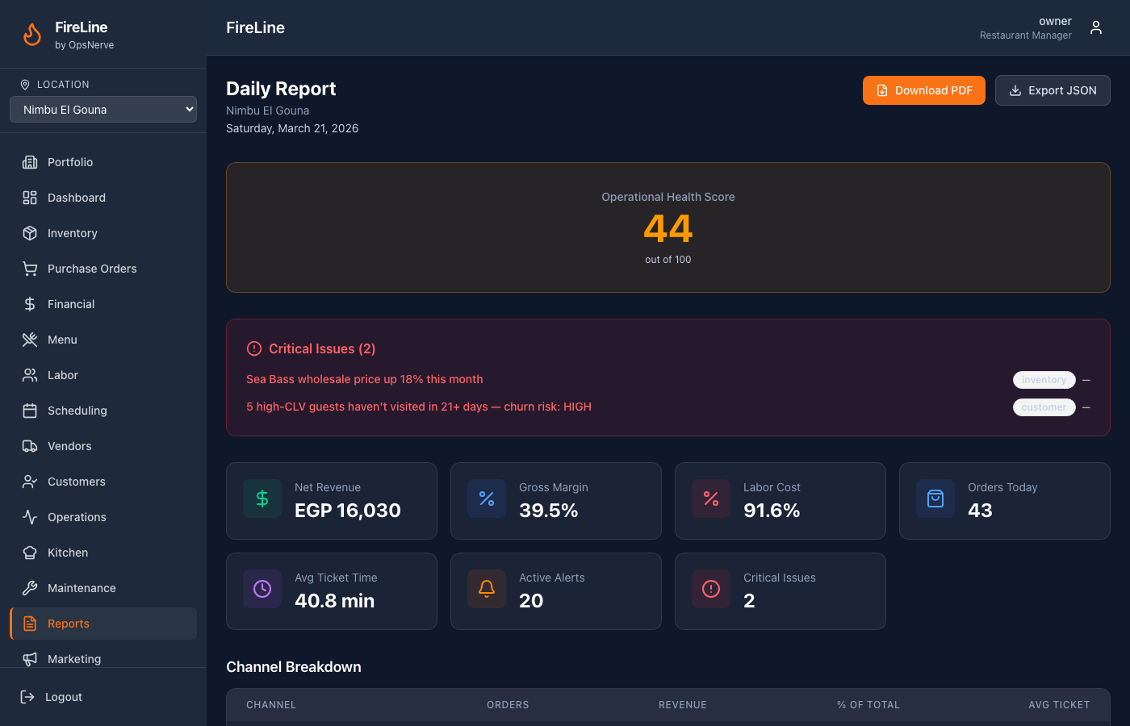
MARKETING & REPORTS
Campaigns, Loyalty Program & Daily Reports

Slide 16
QUANTIFIED BENEFITS
Measurable Impact Across Every Department
2-5%
3-8%
8-12%
15-25%
20-30%
Food Cost Reduction
Labor Cost Optimization
Churn Prevention
Less Downtime
Waste Reduction
Variance detection, portioning alerts, auto-reordering
Demand scheduling, overtime prevention
Predictive win-back for high-CLV guests
Predictive maintenance from sensor trends
Expiry tracking, FIFO, usage variance alerts

Slide 17
ARCHITECTURE
Enterprise-Grade Technical Foundation
Backend
Frontend
Database
Go Modular Monolith 15+ Domain Packages 120+ REST Endpoints
React + TypeScript Tailwind CSS Recharts Visualization
PostgreSQL 16 Row-Level Security 18 Migrations
Mobile
Infra
AI/ML
Expo React Native Tablet: Count, Waste, Receive, KDS
AWS ECS (Terraform) Docker Containers CI/CD Pipeline
Z-Score Anomaly Probabilistic Reasoning Pattern Matching

Slide 18
ROADMAP
What's Next
Q2 2026
Q3 2026
Q4 2026
Near-Term
Medium-Term
Long-Term
• Prophet ML demand forecasting
• Toast & Square POS integration
• Manager mobile app
• SOC 2 readiness
• Computer vision waste detection
• Voice-activated KDS commands
• NLP review sentiment analysis
• Franchise template management
• Blockchain supply chain verification
• Autonomous operations mode
• White-label platform
• International expansion

Slide 19
⚡ FIRELINE BY OPSNERVE
Ready to Transform Your Restaurant Operations?
Live Demo: fireline-nimbu.vercel.app
GitHub: github.com/sambawy01/Fire-Line
Contact: sambawy@gmail.com
The Operational Nervous System for Modern Restaurants

