Slide 1
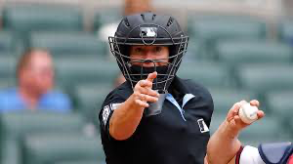
Umpire Scorecard
Featuring the debut of the MLB’s first female umpire
Sam Beilenson — Sports Analytics

Slide 2
What to Expect
Data source: Umpire Scorecard Published on Kaggle, adapted from https://umpscorecards.us/
01 — Data Exploration Findings
02 — Theme 1: The Human Element in the Automated Era
- Expected Versus Actual Accuracy; Home Team Bias; Umpire Clustering; RF Feature Importance (Target: accuracy), Jen Pawol Debut Comparison
03 — Theme 2: Pressure Points and Cross Theme Observations
- Accuracy By Game Type; Postseason vs. Regular Season Accuracy
04 — Highlighting Jen Pawol Debut
05 — Discussion

Slide 3
Data Snapshot (Umpire Scorecard)
Original Features | Engineered Features
id | month
date | is_playoff
umpire | year
home | game_num
away | season_progress
home_team_runs | season_quartile
away_team_runs | margin
pitches_called | game_type
incorrect_calls | dow
expected_incorrect_calls | total_runs
correct_calls | scoring_env
expected_correct_calls | big_impact
correct_calls_above_expected | post_allstar
accuracy | is_weekend
expected_accuracy | home_win
accuracy_above_expected | is_veteran
consistency
favor_home
total_run_impact

Slide 4
Umpire Benchmarks (Top Accuracy)
Accuracy above expected is calculated by subtracting an umpire’s expected accuracy (from pitch-tracking models) from their actual accuracy in called pitches.
Top 10 Umpires (by Accuracy Above Expected)
 | umpire | games | accuracy | expected_accuracy | acc_above_exp | consistency | favor_home | run_impact
0 | Will Little | 209 | 94.13 | 92.18 | +1.94 | 93.70 | +0.075 | +1.209
1 | Brock Ballou | 7 | 94.90 | 93.06 | +1.83 | 95.20 | -0.289 | +1.229
2 | John Libka | 120 | 94.96 | 93.20 | +1.75 | 93.86 | +0.032 | +1.080
3 | Alex Tosi | 43 | 94.50 | 92.83 | +1.67 | 93.63 | +0.150 | +1.128
4 | Jeremie Rehak | 123 | 94.63 | 93.03 | +1.60 | 93.64 | -0.015 | +1.136
5 | Pat Hoberg | 220 | 93.92 | 92.41 | +1.51 | 93.82 | -0.041 | +1.199
6 | Jansen Visconti | 133 | 94.57 | 93.13 | +1.44 | 94.00 | +0.033 | +1.210
7 | Lance Barksdale | 221 | 93.44 | 92.22 | +1.21 | 93.60 | +0.063 | +1.318
8 | Adam Beck | 62 | 94.41 | 93.21 | +1.20 | 94.10 | +0.002 | +1.181
9 | Edwin Moscoso | 83 | 94.64 | 93.47 | +1.17 | 93.82 | -0.019

Slide 5
Umpire Benchmarks (Bottom Accuracy)
 | umpire | games | accuracy | expected_accuracy | acc_above_exp | consistency | favor_home | run_impact
123 | Marcus Pattillo | 5 | 87.80 | 90.20 | -2.40 | 91.36 | -0.322 | +2.382
122 | Tim Welke | 28 | 88.57 | 90.40 | -1.83 | 91.57 | +0.065 | +2.075
121 | Rob Drake | 194 | 90.69 | 92.15 | -1.46 | 92.74 | +0.106 | +1.750
120 | Bob Davidson | 59 | 89.49 | 90.83 | -1.34 | 92.37 | -0.113 | +1.991
119 | Joe West | 206 | 90.88 | 92.20 | -1.32 | 92.84 | +0.037 | +1.875
118 | Kerwin Danley | 150 | 90.79 | 91.97 | -1.19 | 92.20 | +0.058 | +1.834
117 | Ed Hickox | 165 | 91.18 | 92.33 | -1.16 | 92.56 | +0.010 | +1.805
116 | Malachi Moore | 37 | 92.17 | 93.26 | -1.11 | 92.85 | +0.022 | +1.481
115 | Mike Winters | 134 | 90.59 | 91.68 | -1.09 | 92.57 | -0.025 | +1.939
114 | Paul Nauert | 153 | 90.97 | 91.99 | -1.03 | 92.74 | +0.082 | +1.802

Slide 6
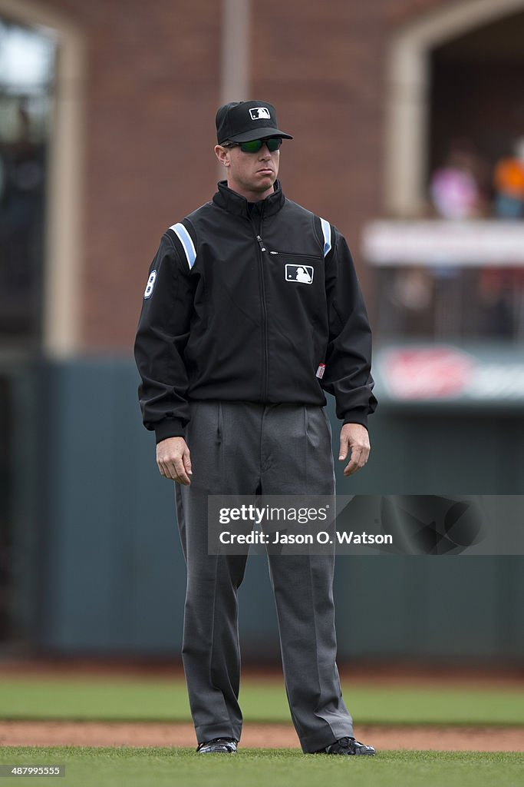
Marcus Patillo (Worst Umpire 2015-2022)

Slide 7
Theme I (Key Questions)
Expected vs. Actual Accuracy
Home-Team Bias
Umpire Clustering
Random Forest Feature Importance (Target Variable: Accuracy)
Jen Pawol Debut Comparison

Slide 8
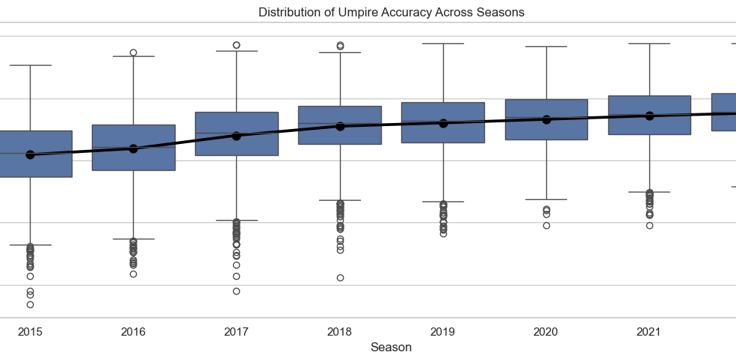

Slide 9
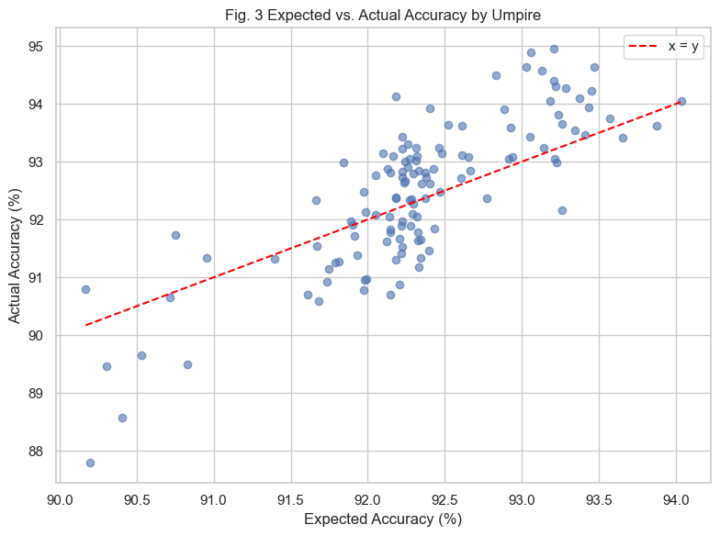
Expected Vs. Actual Accuracy
Above the line → umpire performed better than tracking system’s expectation.
Most umpires are within ±1–2% of expectations
A few consistent over/under-performers
May reflect tendencies tech doesn’t capture

Slide 10
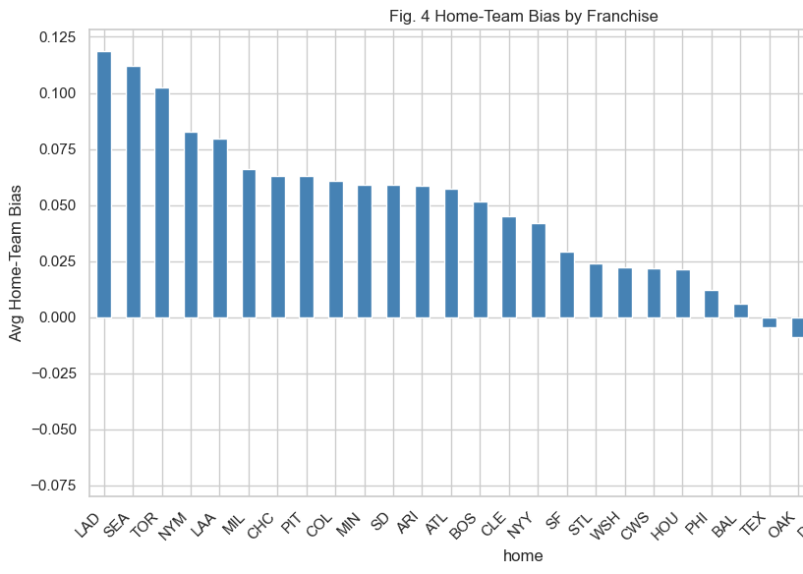
Home Team Bias
Small but consistent lean toward home teams
Typically < 1% difference
Seen across most ballparks

Slide 11
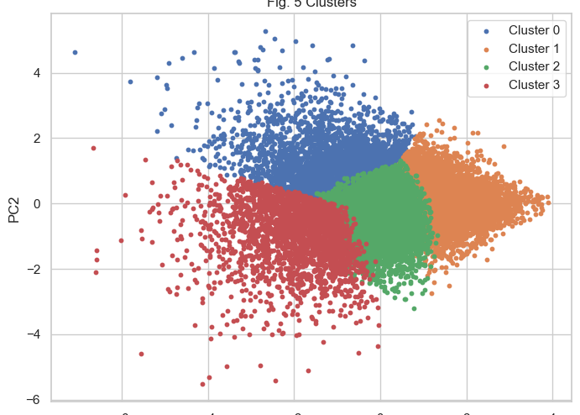
Umpire Clustering
Four clear performance clusters
Top group: high accuracy & consistency
Lower group: more variability in both

Slide 12
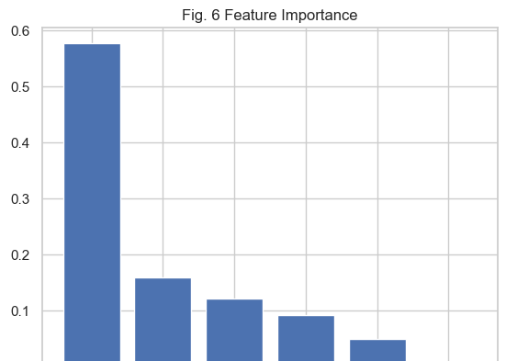
Key Factors Driving Accuracy
Run impact is the strongest predictor (~58%)
Consistency is second (~16%)
Context variables matter less overall

Slide 13
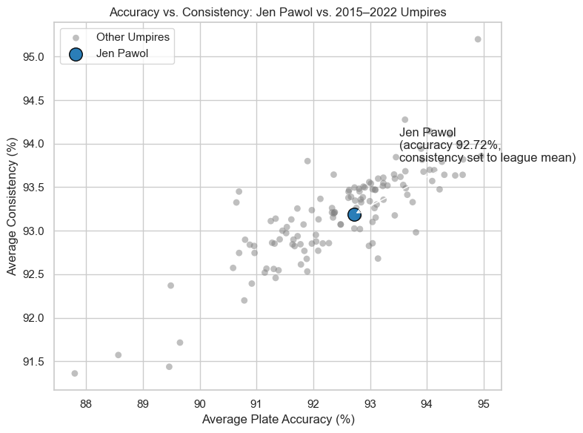
Jen Pawol’s First Plate Game
First female MLB plate umpire
Accuracy in line with veteran umpires
Consistency estimated, not measured

Slide 14
Theme II + Cross Theme Observations (Key Questions)
Accuracy By Game Type
Postseason vs. Regular Season Accuracy
By Experience Level

Slide 15
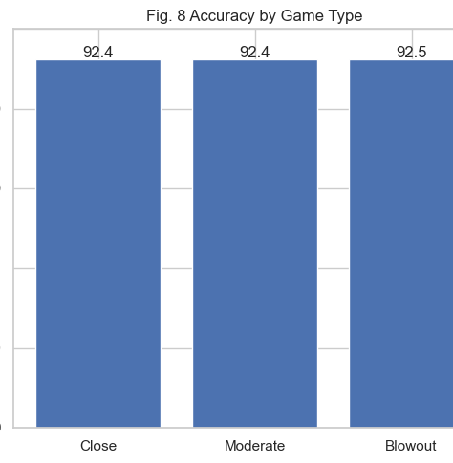
Accuracy By Game Type
Accuracy nearly identical across game types
Final score margin not a factor
Suggests pressure not impacting calls here

Slide 16
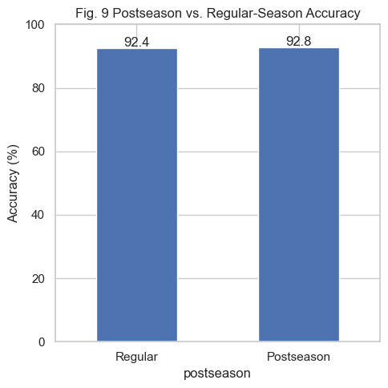
Post-Season vs. Regular Season Accuracy
Accuracy slightly higher in postseason
Difference is minimal (~0.4%)

Slide 17
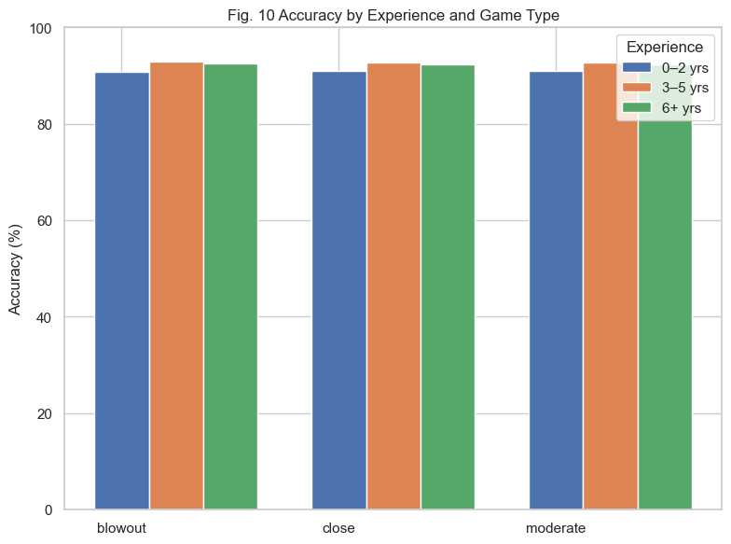
By Experience Level
Accuracy steady across situations
Veteran umpires slightly higher accuracy

Slide 18
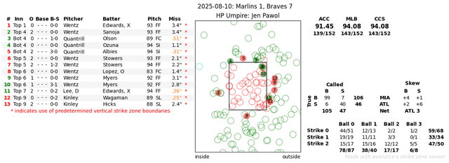
Jen Pawol’s Debut
https://www.mlb.com/video/jen-pawol-debuts-behind-the-plate (1:25-2:00)
140 of 151 pitches called correctly (91.45% accuracy)
Performance within league norms for experienced umpires
First woman to serve as MLB plate umpire in regular season

Slide 19
Other Debut Stats
Umpire | Rookie Year | First Game Accuracy | Rookie Season Avg. Accuracy | 2025 Avg. Accuracy
Alex Tosi | 2019 | 96.69% | 91.8 / 92.5 / 91.01 (next 3 games) | 94.7%
Edwin Moscoso | 2020 | 91.67% | N/A | 95.1%
Malachi Moore | 2020 | 89.38% | 90.8% (over 5 games) | 93.4%
Brennan Miller | 2019 | 94.74% | N/A | 93.8%
Nick Mahrley | 2018 | 91.16% | ~92% or below (over 10 games) | 94.2%
Junior Valentine | 2021 | 95.10% | N/A | 95.7%
Jen Pawol | 2025 | 92.72% | N/A | 92.72%

Slide 20
Discussion + Takeaways
Most MLB umpires call games within 1–2% of expected accuracy.
Context (game type, postseason) impacts accuracy slightly, but individual judgment still matters.
Feature importance points to run impact and consistency as key accuracy drivers.
Rookie debut accuracy varies widely: first game ≠ long-term performance.
Jen Pawol’s debut was right in line with veteran norms.

Slide 21
References
Fox News. (2025). Historic female MLB umpire Jen Pawol’s debut performance finally revealed. https://www.foxnews.com/sports/historic-female-mlb-umpire-jen-pawols-debut-performance-results-behind-home-plate-finally
FanGraphs. (2025). Leverage Index explanation. https://www.fangraphs.com/library/strategy/leverage-index/
CloseCallSports / Reddit. (2025). Final umpire scorecard for Jen Pawol. https://www.reddit.com/r/baseball/comments/1mmte1h/closecallsports_final_umpire_scorecard_for_jen/
MIT Sloan Sports Analytics Conference. (2019). The human element in automated umpiring. https://mitsloan.mit.edu/newsroom/alumni-news/human-element-automated-umpiring
Society for American Baseball Research (SABR). (2020). Statcast’s impact on baseball analytics.

