Slide 1
Reaching Agreement with Market Scoring Rules
Siddharth Namachivayam

Slide 2
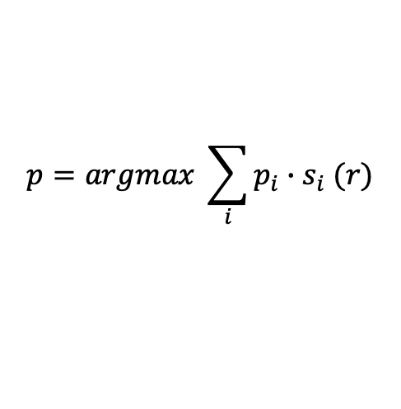
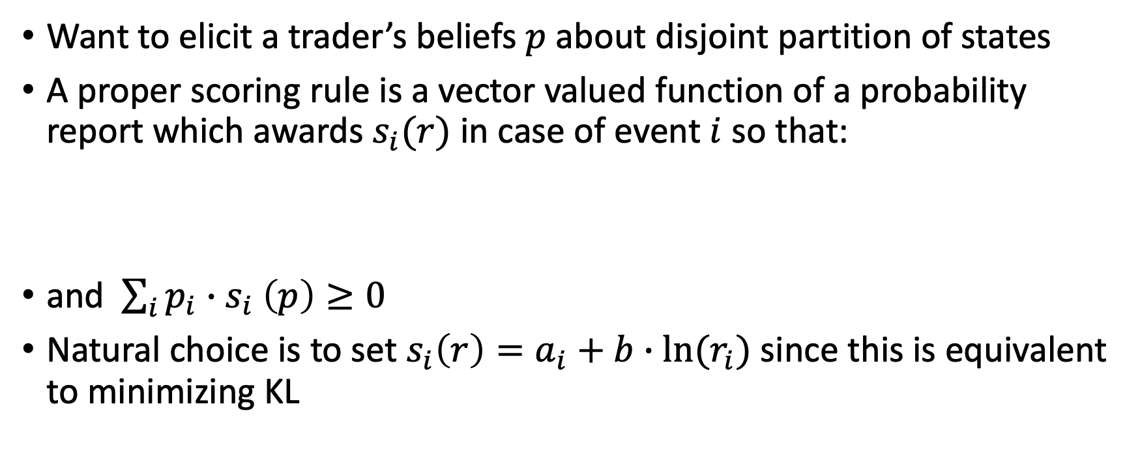
Belief Elicitation
Want to elicit a trader’s beliefs $p$ about disjoint partition of states
A proper scoring rule is a vector valued function of a probability report which awards $s_{i}(r)$ in case of event $i$ so that:
and $\sum_{i}{p_{i}{∙s}_{i}\left(p\right)≥0 }$
Natural choice is to set $s_{i}\left(r\right)=a_{i}+b∙ln⁡(r_{i})$ since this is equivalent to minimizing KL
$$p=argmax \sum_{i}{p_{i}{∙s}_{i}(r)}$$

Slide 3
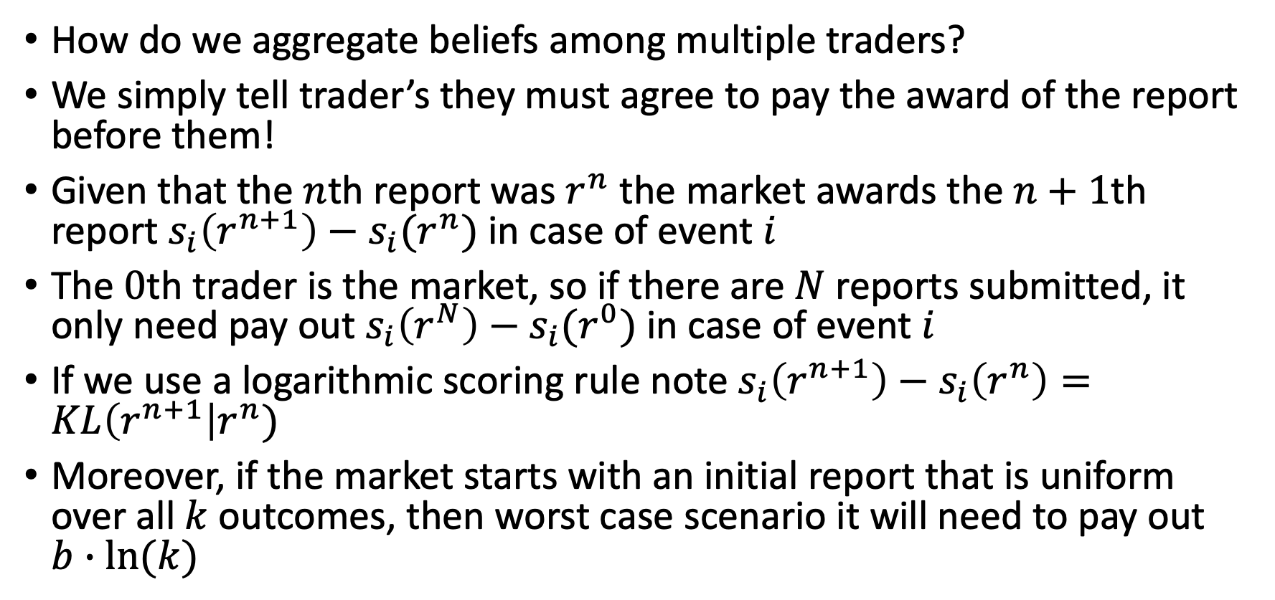
Market Scoring Rules
How do we aggregate beliefs among multiple traders?
We simply tell trader’s they must agree to pay the award of the report before them!
Given that the $n$th report was $r^{n}$ the market awards the $n+1$th report $s_{i}\left(r^{n+1}\right)−s_{i}(r^{n})$ in case of event $i$
The $0$th trader is the market, so if there are $N$ reports submitted, it only need pay out $s_{i}\left(r^{N}\right)−s_{i}(r^{0})$ in case of event $i$
If we use a logarithmic scoring rule note $s_{i}\left(r^{n+1}\right)−s_{i}\left(r^{n}\right)=KL\left(r^{n+1}\right|r^{n})$
Moreover, if the market starts with an initial report that is uniform over all $k$ outcomes, then worst case scenario it will need to pay out $b∙ln⁡(k)$

Slide 4
Aumann’s Theorem
Why should we expect this to lead to consensus?
Suppose there are two agents who have identical priors about an event. If each of them receive different information about the event causing their beliefs to diverge, and they proceed to iteratively report their true beliefs back and forth to one another, then they will eventually come to an agreement (or ‘communication equilibrium’)
Market scoring rules can be viewed as a technology which facilitate this process by making it myopically incentive compatible for traders to report their true beliefs

Slide 5
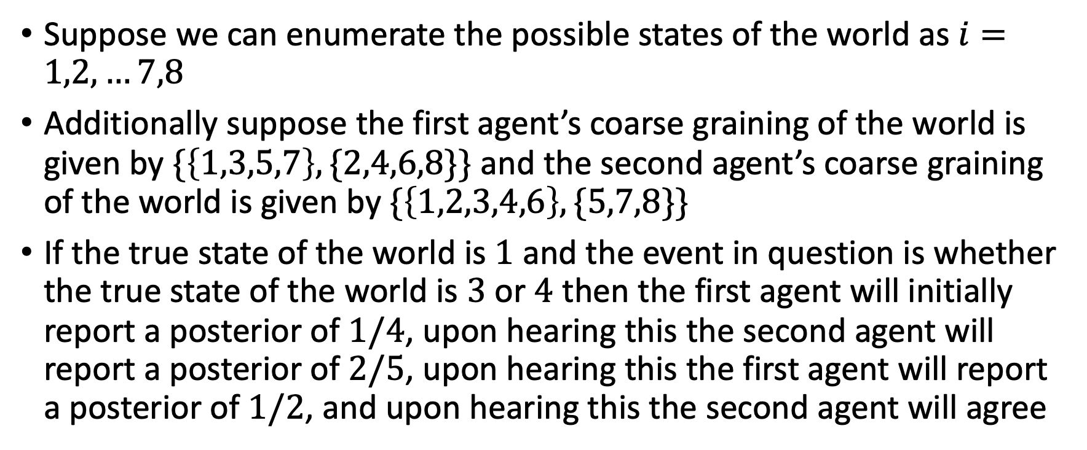
Example
Suppose we can enumerate the possible states of the world as $i=1,2,…7,8$
Additionally suppose the first agent’s coarse graining of the world is given by $\{\left\{1,3,5,7\right\},\{2,4,6,8\}\}$ and the second agent’s coarse graining of the world is given by $\{\left\{1,2,3,4,6\right\},\{5,7,8\}\}$
If the true state of the world is $1$ and the event in question is whether the true state of the world is $3$ or $4$ then the first agent will initially report a posterior of $1/4$, upon hearing this the second agent will report a posterior of $2/5$, upon hearing this the first agent will report a posterior of $1/2$, and upon hearing this the second agent will agree

Slide 6
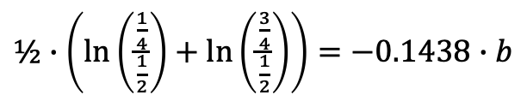
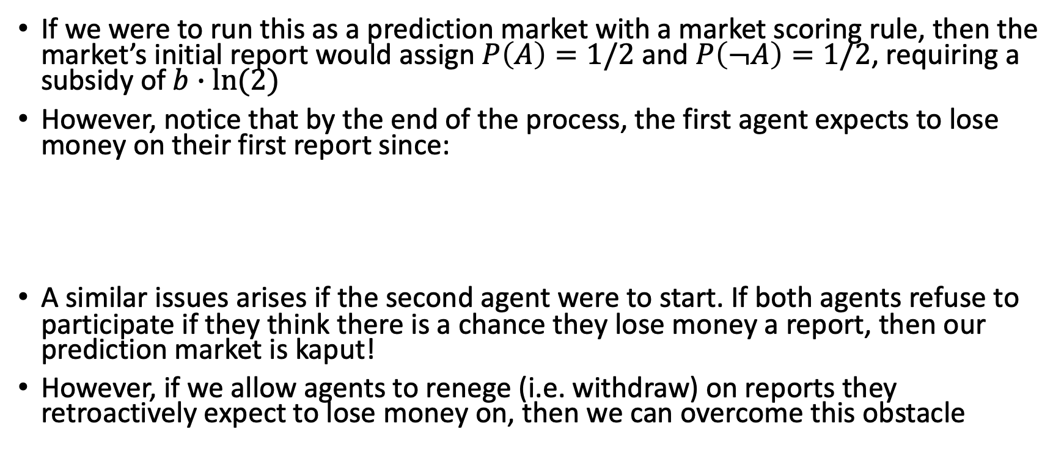
Example Continued
If we were to run this as a prediction market with a market scoring rule, then the market’s initial report would assign $P\left(A\right)=1/2$ and $P\left(¬A\right)=1/2$, requiring a subsidy of $b∙ln⁡(2)$
However, notice that by the end of the process, the first agent expects to lose money on their first report since:
A similar issues arises if the second agent were to start. If both agents refuse to participate if they think there is a chance they lose money a report, then our prediction market is kaput!
However, if we allow agents to renege (i.e. withdraw) on reports they retroactively expect to lose money on, then we can overcome this obstacle
$½∙\left(\ln\left(\frac{\frac{1}{4}}{\frac{1}{2}}\right)+\ln\left(\frac{\frac{3}{4}}{\frac{1}{2}}\right)\right)=−0.1438∙$ $b$

Slide 7
Thermodynamics!

Slide 8
Questions
Are the current analogies I have drawn valid?
What other results can be inferred from the analogy as it stands?
Dissipated work?
Is there a physical process that corresponds to the dynamics of Aumann’s agreement theorem?
When there are 2 agents interacting?
When there are n agents interacting?
What about when we introduce reneging?

