Slide 1
Rational Inattention
Siddharth Namachivayam

Slide 2
Introduction
What is rational inattention?
Formalizes Herbert A. Simon’s notion of ‘bounded rationality’
”A wealth of information creates a poverty of attention and a need to allocate that attention efficiently”- Simon, 1971
Why rational inattention?
”To construct optimizing-agent models that are consistent with people not using freely available information and explain why some freely available information is not used, or imperfectly used”- Sims, 2010

Slide 3




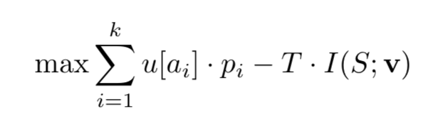
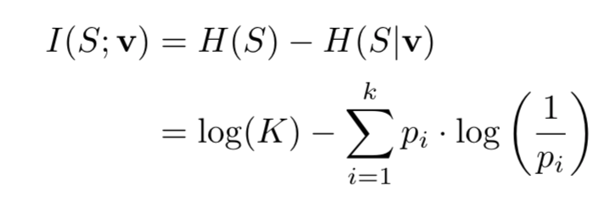
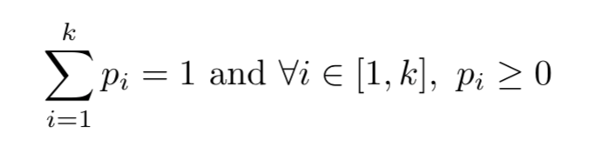
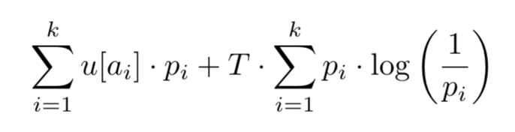
Mutual Information Costs
Pick action from basket of choices
Payoffs:
Prior on agent’s strategy is
Posterior on agent’s strategy
solves the problem:
s.t.

Slide 4
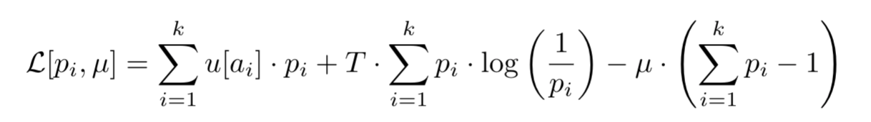
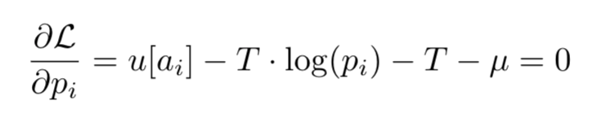
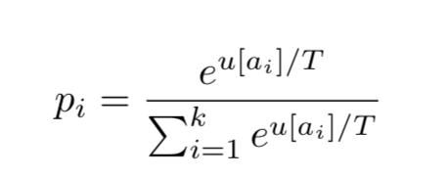
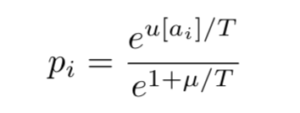
Mutual Information Costs
Boltzmann!

Slide 5
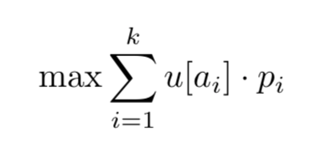
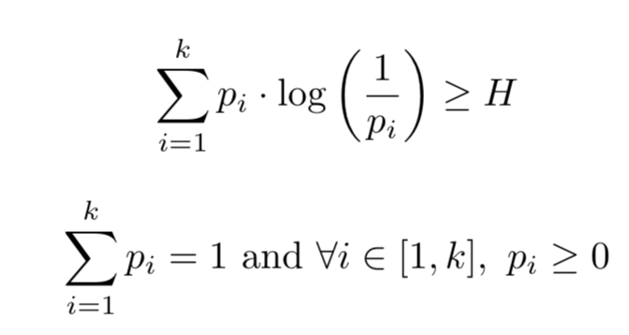
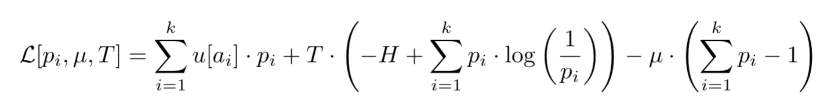
Entropy Constrained Behavior
Why does Boltzmann show up?
Here’s an equivalent model:
Why do we know it’s equivalent?
s.t.
Here’s the Lagrangian:
This is a sort of dual to the derivation of the Boltzmann distribution where entropy is maximized subject to a mean energy constraint.

Slide 6
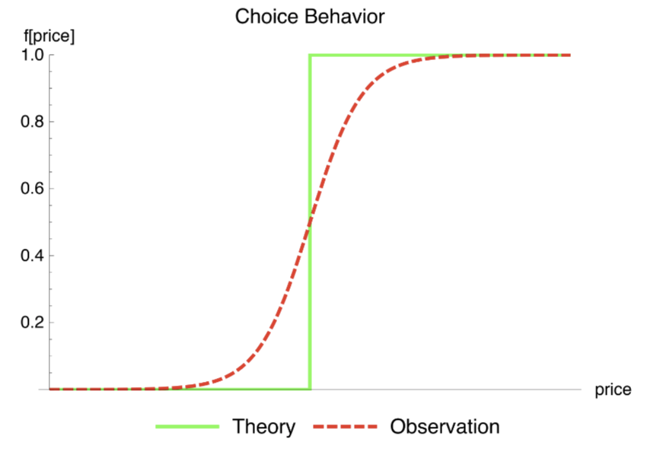
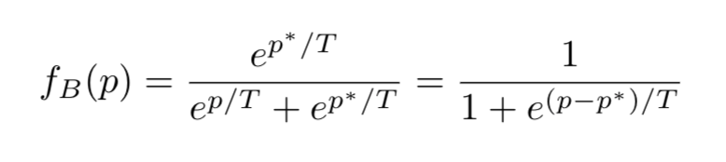
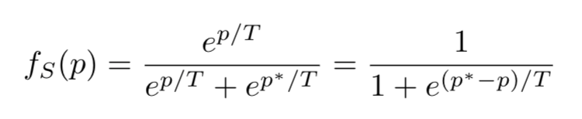
Binary Choice
A buyer decides whether to purchase a good priced at p which they value at p*
If they purchase the good the payoff is p* whereas if they don’t purchase the good, they get to keep their p dollars.
Fermi-Dirac/Logistic Curve!

Slide 7
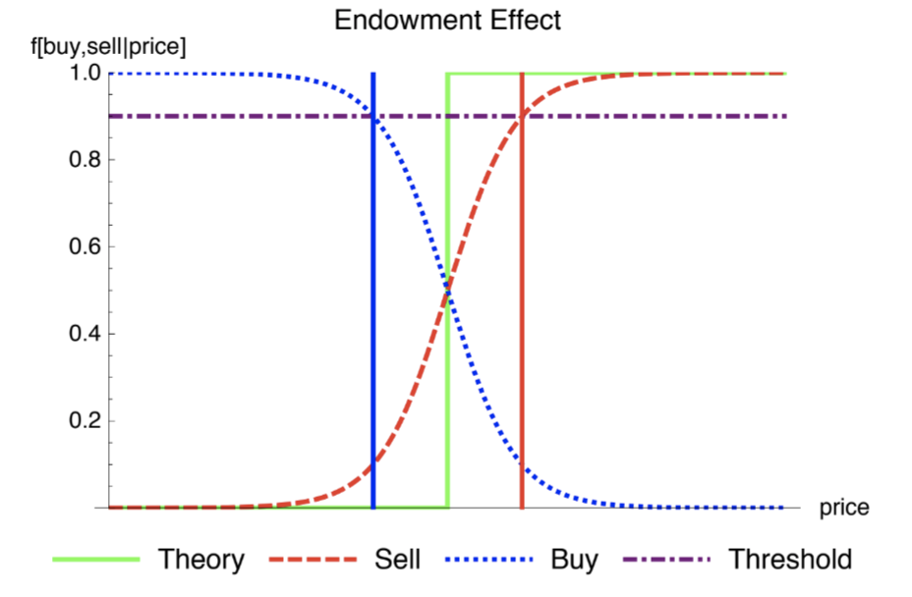
Emergent Properties
Endowment Effect- Value attributed to a good by an agent appears to be higher when they are a seller than when they are a buyer
Can simply vary the assumption that one is either very willing to buy the good or very willing to sell the good and maintain consistent valuation

Slide 8
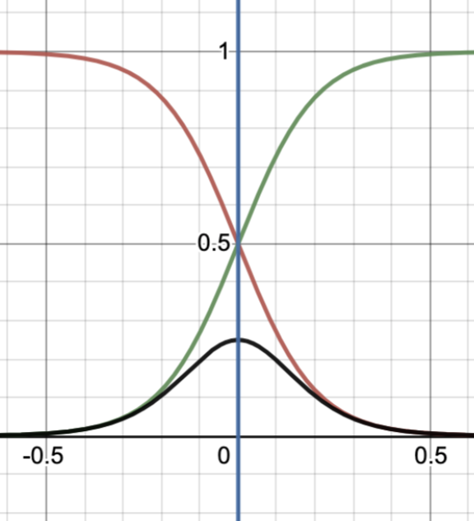
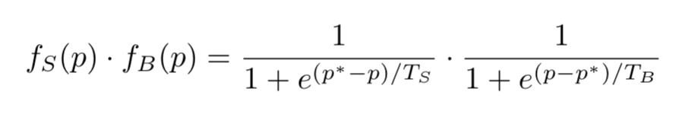
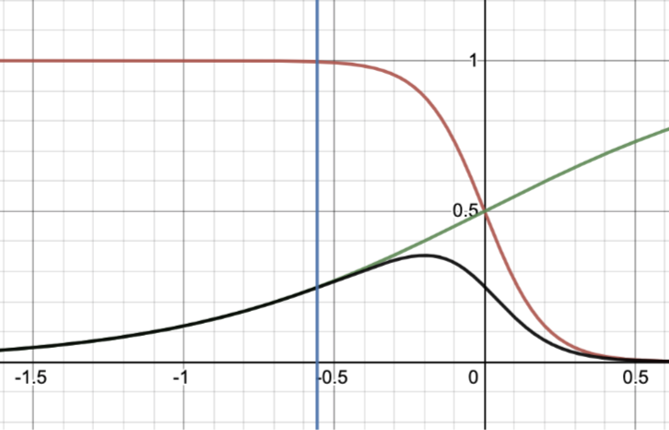
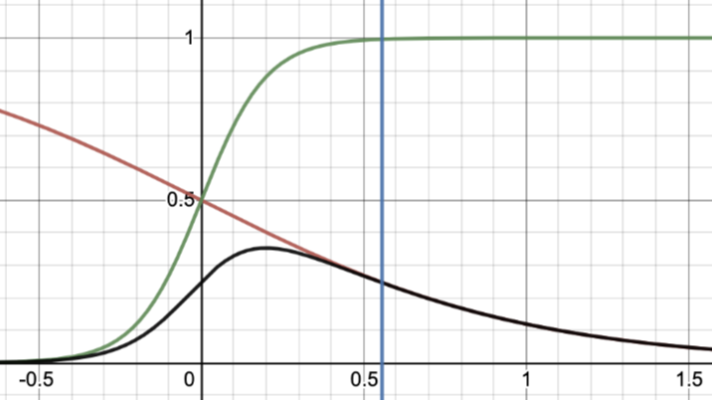
Emergent Properties
T_{B} = T_{S}
Consider the case where a buyer and seller with identical valuations p* of a good and behavior temperatures T_{B} and T_{S} are offered to transact at price p.
T_{B} < T_{S}
T_{B} > T_{S}
Surplus moves from high to low temperature agents!

Slide 9
Conclusion
Rational inattention models provide a simple yet powerful way to examine the mechanisms and consequences of bounded rationality in the market.
Allows us to think about social phenomena using statistical mechanics!

Slide 10
Hope it was worth paying attention!

