Slide 1
World Economic Indicator
How can a country attain sustainable growth ?

Slide 2
Business Problem
Using the given World Economic Indicator dataset, we have to perform data analysis to find meaningful insights on which of the factor country should focus on to sustain GDP/Capita.

Slide 3
Solution
We have performed data analysis on the several factors given in the dataset and their effect on the GDP/Capita of the nation. We have imputed the missing values after concatenating the databases into a single list using a unique identifier with the help of VLOOKUP.
The imputation methodology using aggregated methods/zero value is not used as the information given is particular to country & region for a year & cannot be taken altogether for all the countries.
If the previous year value of the missing entry is also absent, then that entry is kept blank for the analysis.
The outliers are present in the dataset but not taken into consideration for our analysis.

Slide 4
Data Used The columns from the dataset used for analysis are as follows:
GDP/capita | Population Urban | Internet Usage
Health Exp % GPD | Population Total | Mobile Phone Usage
Lending Interest | Inbound Tourism/Capita
Energy Usage/Capita | Outbound Tourism/Capita
CO2 Emission/Capita | Business Tax Rate
Birth Rate | Days to Start Business
Infant Mortality Rate | Ease of Business
Life Expectancy Avg | Hours to do Taxes

Slide 5
Executive Summary
Last 12 years of countries’ data was taken into consideration for analysis and how they affect GDP/Capita of a nation was studied.
We see that there is a positive correlation between GDP/Capita & Health Expenditure. Countries which are having more health expenditure % of GDP have more GDP/capita.
The same can be inferred from the Infant Mortality Rate & Life Expectancy Rate correlation with the GDP/capita. They are having moderate negative and weak positive correlation respectively. A good expenditure on health leads to good life expectancy and low infant mortality rate, thus enhances GDP of the nation.
Along with Health Expenditure, country should focus on Tourism sector of the nation as well as it is found that Tourism is a great source of enhancing GDP of the nation. Tourism Inbound/Capita has a moderate positive correlation with the GDP of the nation.

Slide 6
Energy Usage/Capita and CO2 Emissions/Capita shows moderate positive correlation with the GDP of the nation.
Urbanization can also be considered as a factor for enhancing GDP of the nation. Countries having more population in the urban areas have better GDP/capita compared to others.
The taxation rules on the citizens also affects the GDP/capita of the nation. Lending Interest Rate, Hours to do Tax and Business Tax Rate shows negative correlation with the GDP of the nation. Lesser the value, better the GDP/capita of the nation.
Country should focus on easing rules and regulations for the people newly starting the business, as it was found that countries having more ease of business and less starting days requirement have better GDP/capita compared to others.
Digitization of country economy can be factor to improve the GDP/capita of the nation as it was found that Internet Usage and Mobile Phone Usage have strong positive correlation with the GDP of the nation.
Countries having lower birth rate have low burden on the country’s resources thus leads to better GDP of the nation. Birth Rate shows the strong negative correlation with the GDP/Capita of the nation.

Slide 7
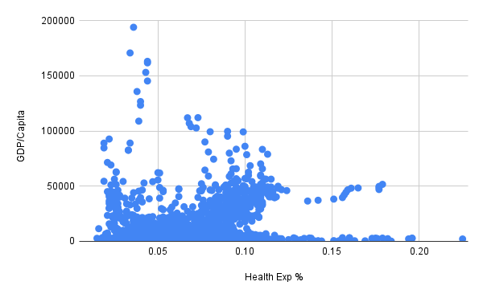
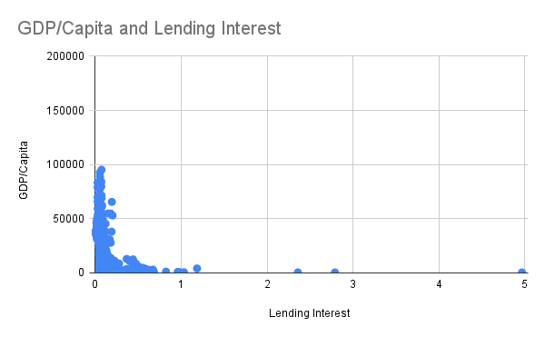
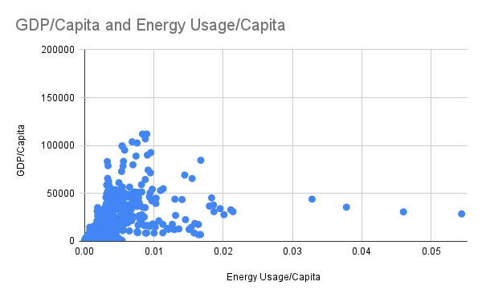
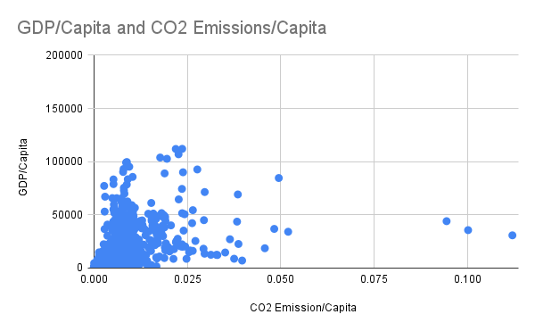
Detailed Analysis Factors on which GDP/Capita Depends:
Higher the Health Expenditure %, higher
the GDP/Capita
Lower the Lending Interest Rate, higher
the GDP/Capita
Higher the Energy Usage/Capita, higher the GDP/Capita
Higher the CO2 Emission/Capita, higher the GDP/Capita

Slide 8
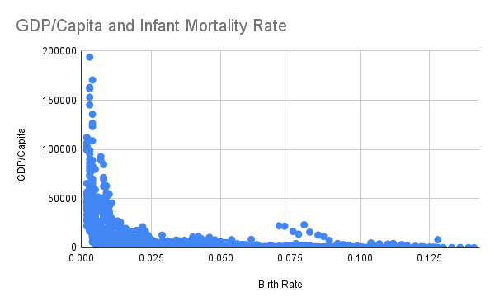

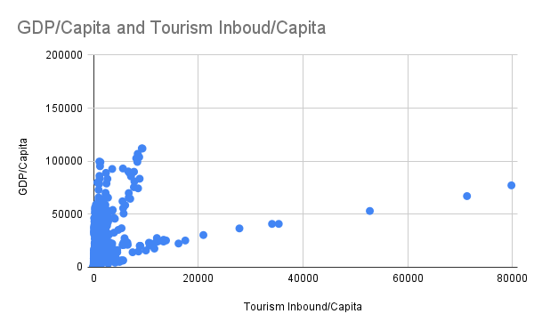
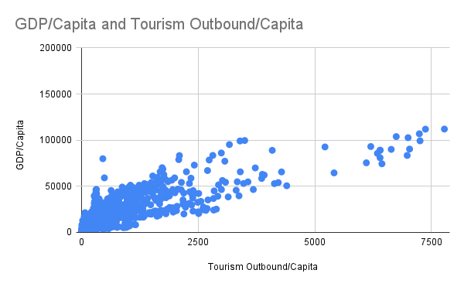
Lower the Birth Rate, higher the GDP/Capita
Lower the Infant Mortality Rate, higher the GDP/Capita
Higher the Tourism Inbound/Capita, higher the GDP/Capita
Higher the Tourism Outbound/Capita, higher the GDP/Capita

Slide 9
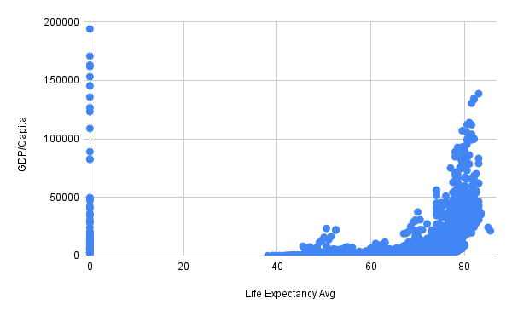
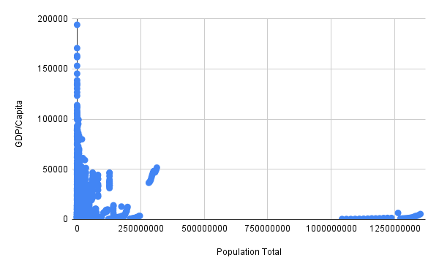
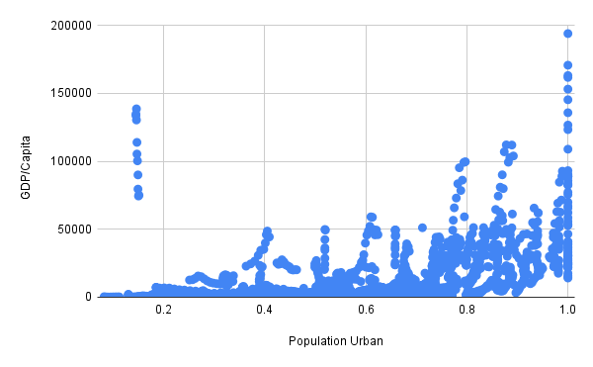
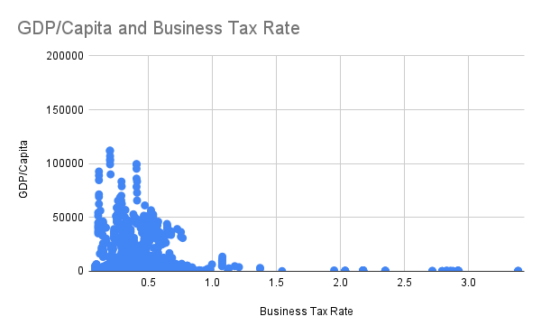
Higher the Life Expectancy, higher the GDP/Capita
Lower the Total Population, higher the GDP/Capita
Higher the Urbanization, higher the GDP/Capita
Lower the Business Tax Rate, higher the GDP/Capita

Slide 10
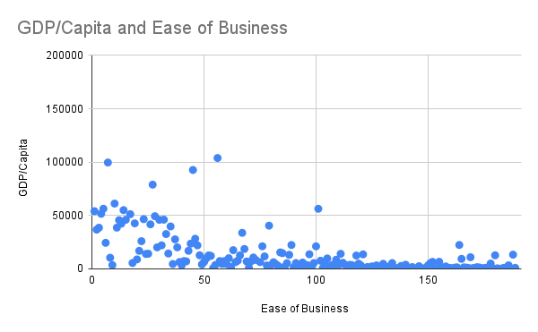
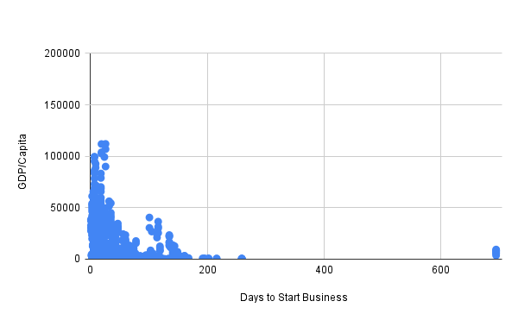
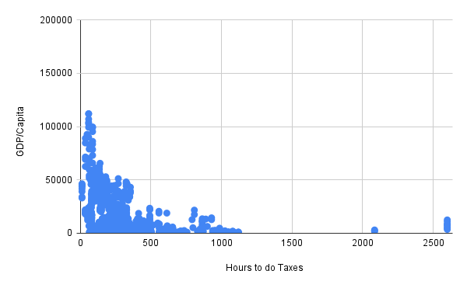
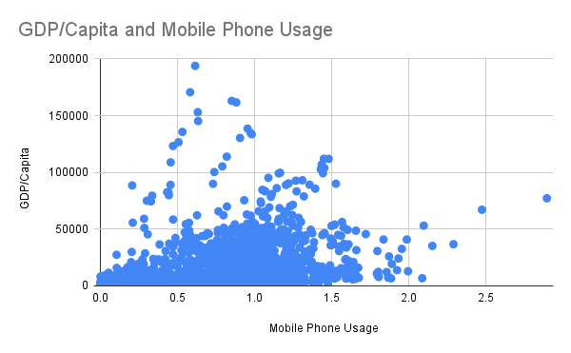
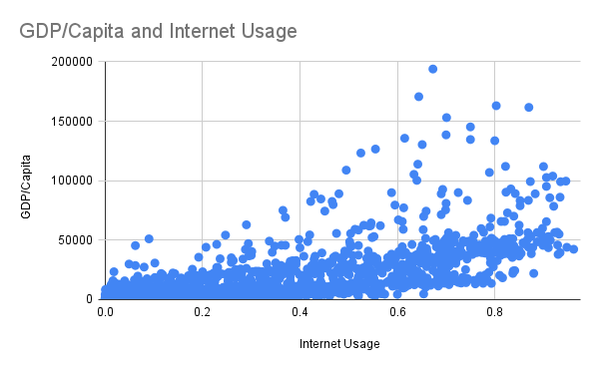
Lesser the Ease of Business, higher
the GDP/Capita
Lower the Days to Start Business,
higher the GDP/Capita
Lower the Hours to do Taxes,
higher the GDP/Capita
Higher the Mobile Phone Usage, higher the GDP/Capita
Higher the Internet Usage, higher the GDP/Capita

Slide 11
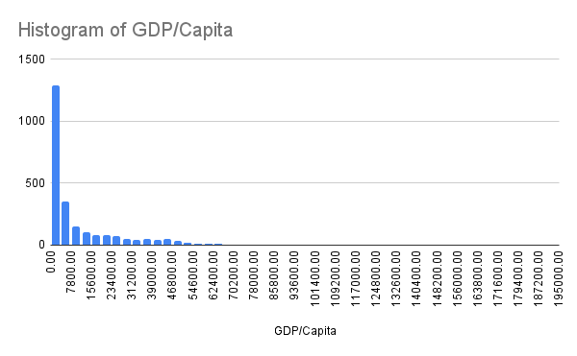
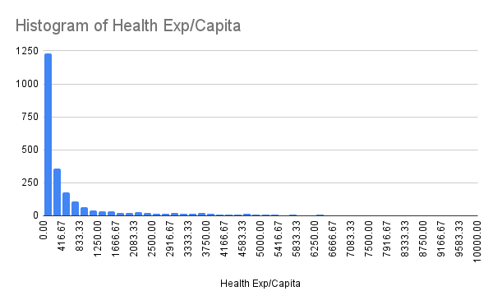
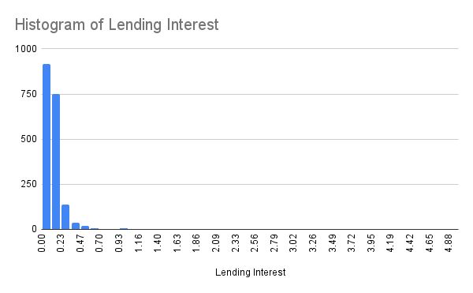
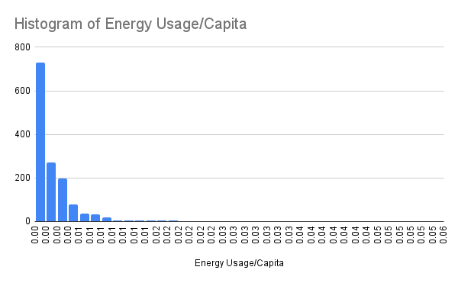
Univariate Analysis performed on the Dataset

Slide 12
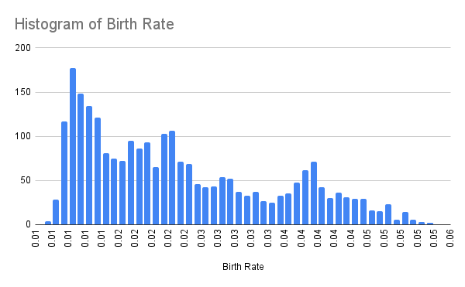
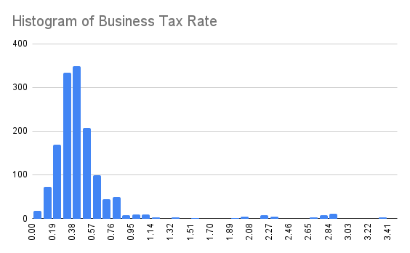
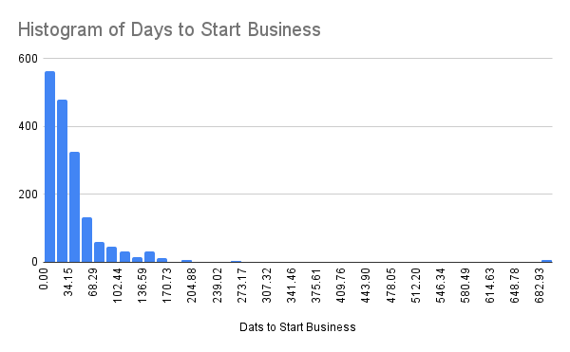
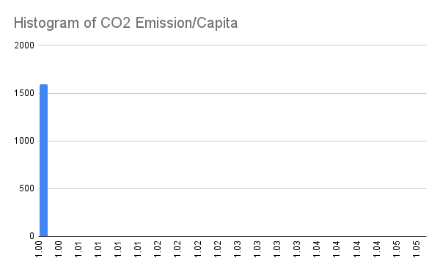
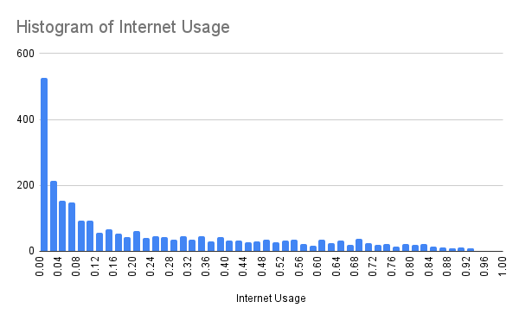
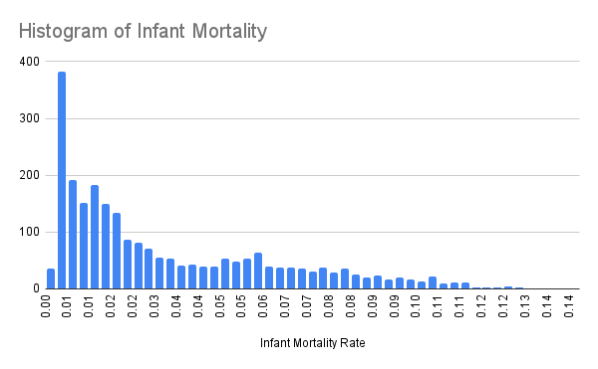

Slide 13
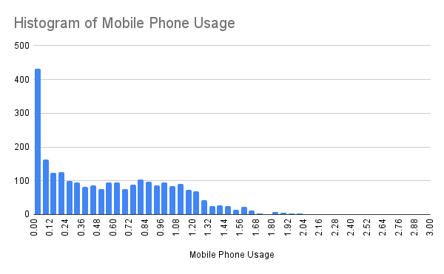
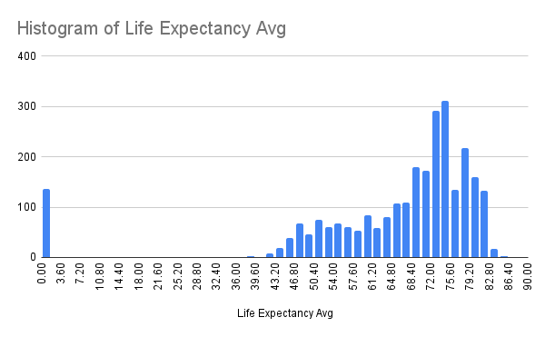
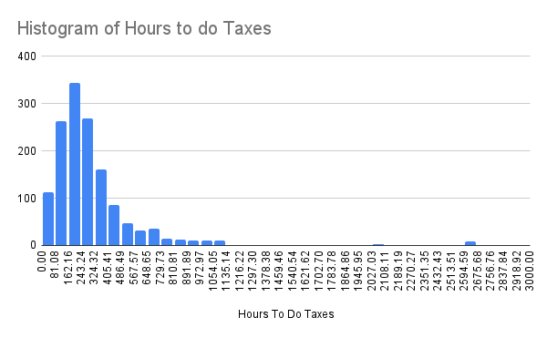
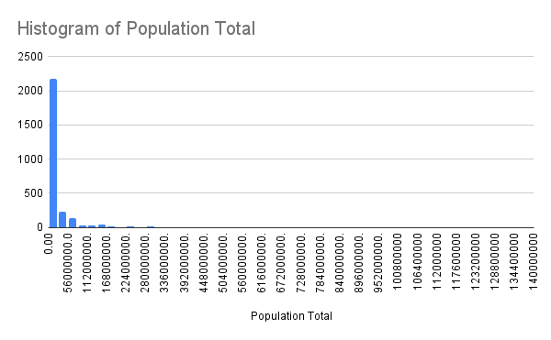
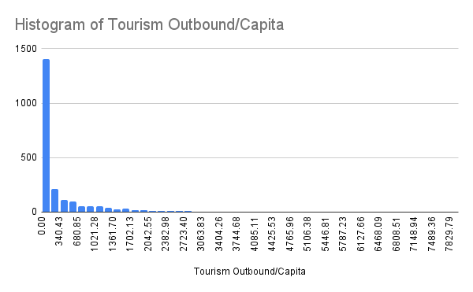
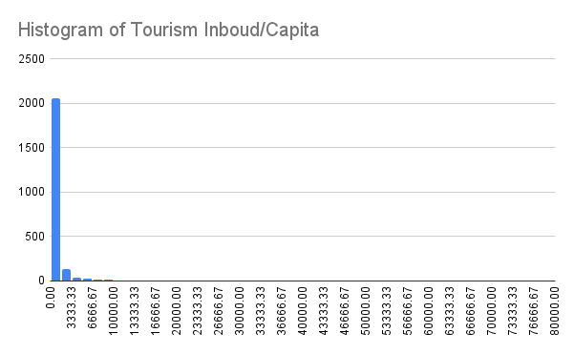

Slide 14
Thank You

