Slide 1
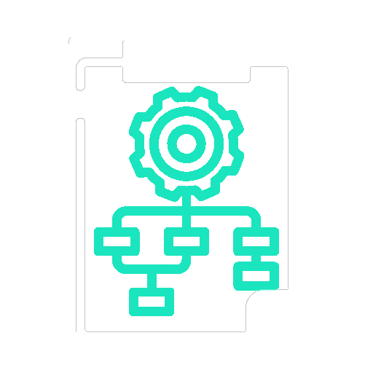
Target Operating Model
Cloud Transformation at Northstar Digital Group
How the enterprise is organized to deliver, govern, and operate cloud-enabled capabilities
Disclaimer: Fictional enterprise case study for portfolio demonstration

Slide 2
Purpose of the Target Operating Model
Purpose
Key Principle
  Define how cloud-related capabilities are owned, delivered, and governed
  Align people, processes, and decision rights to business outcomes
  Enable scalable, repeatable, and secure cloud adoption
  Support long-term operational and financial sustainability
  The operating model enables value streams — it does not constrain them.
Notes:
Sets context. Signals this is not an IT inventory, but a business architecture artefact.

Slide 3
Operating Model Design Principles
Design Principles
  Product and platform-oriented ownership
  Central guardrails with federated execution
  Automation-first delivery and operations
  Security, compliance, and financial accountability embedded by design
These principles guide all structural and role decisions.
Notes:
Pre-empts confusion between activities, tools, and capabilities.

Slide 4
High-Level Operating Model Overview
Target-State Operating Model
  Central Cloud Platform & Governance function
  Federated Product and Workload Teams aligned to business domains
  Embedded Security, Risk, and Finance capabilities
  Shared Enablement and Innovation services
Balance between enterprise control and business agility.
Notes:
This is your one-glance executive view.

Slide 5
Core Operating Model Components
Strategy & Governance
Delivery & Operations
Risk & Finance
  Strategy and Governance
  Platform and Enablement
  Delivery and Product Teams
  Operations and Optimization
  Security, Risk, and Compliance
  Financial Management and Accountability
Each component supports one or more value streams.
Notes:
Positions cloud as a governed business initiative, not ad-hoc IT.

Slide 6
Centralized Capabilities (Enterprise-Level)
Cloud Platform and Governance (Central)
Responsibilities
Accountability
  Define cloud strategy, standards, and guardrails
  Own core cloud platforms and shared services
  Establish security, compliance, and financial controls
  Provide tooling, automation, and reference architectures
  Platform reliability
  Policy enforcement
  Cost transparency
Notes:
Positions cloud as a governed business initiative, not ad-hoc IT.

Slide 7
Federated Capabilities (Business-Aligned)
Product and Workload Teams (Federated)
Responsibilities
Accountability
  Own business workloads end to end
  Deliver and operate applications on cloud platforms
  Optimize performance and cost for owned workloads
  Comply with enterprise guardrails
  Business outcomes
  Service quality
  Cost ownership
Notes:
Bridges business demand to execution without naming tools.

Slide 8
Security, Risk, and Compliance Integration
Embedded Security and Risk Model
  Security and compliance defined centrally
  Controls enforced automatically through platforms
  Risk management embedded into delivery and operations
  Audit and reporting supported continuously
Outcome: Security and compliance become enablers, not blockers.
Notes:
Shows maturity beyond “go-live” — very important in interviews.

Slide 9
Financial Management and Cost Accountability
Financial Operating Model
  Central financial governance and policies
  Distributed cost ownership at product and workload level
  Usage-based cost transparency
  Continuous cost optimization practices
Outcome: Clear accountability for technology spend and value.
Notes:
Demonstrates enterprise-scale thinking, not app-level security.

Slide 10
Decision Rights and Governance
Decision Area | Primary Owner
Cloud standards and guardrails | Central platform governance
Workload design decisions | Product teams
Security and compliance controls | Central security governance
Cost optimization actions | Product teams (within guardrails)
Platform evolution | Central platform team
Notes:
It proves strategic alignment.

Slide 11
Alignment to Value Streams
Operating Model Support for Value Streams
Value Stream | Operating Model Support
Demand-to-Deployment | Product teams + platform enablement
Operate-and-Optimize | Shared operations + product ownership
Govern-and-Secure | Central guardrails + automated controls
Enable-and-Innovate | Enablement teams + experimentation
Value Stream | Operating Model Support
Notes:
It proves strategic alignment.

Slide 12
Skills and Capability Evolution
People and Skills Enablement
  Cloud and platform engineering skills
  Product ownership and lifecycle accountability
  Automation and reliability engineering practices
  Financial and cost management awareness
  Security-by-design mindset
The operating model evolves people, not just structure.
Notes:
Answers the unspoken executive question: “So what?”

Slide 13
Benefits of the Target Operating Model
Business Benefits
  Faster delivery with reduced risk
  Improved operational resilience
  Clear ownership and accountability
  Better cost control and predictability
  Sustainable innovation capability
Notes:
Clean handoff to the next artefact.

Slide 14
Relationship to Other Architecture Views
This Operating Model Enables
  Business Capability Map
  Value Stream execution
  Transformation roadmap
  Governance and funding models
Next Artefact: Transformation Roadmap
Notes:
Clean handoff to the next artefact.

