Slide 1
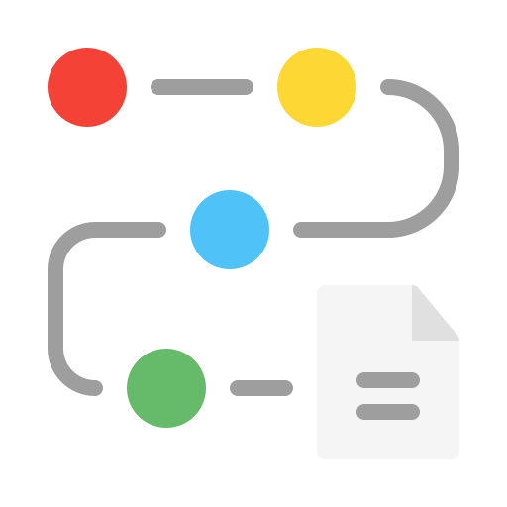
Transformation Roadmap
Cloud Transformation at Northstar Digital Group
Phased execution roadmap aligned to business outcomes
Disclaimer: Fictional enterprise case study for portfolio demonstration

Slide 2
Purpose of the Transformation Roadmap
Translate strategy into a phased execution plan
Prioritize initiatives based on business value and risk
Coordinate capabilities, operating model, and governance changes
Provide visibility into short-, medium-, and long-term outcomes
Key Principle: Value is delivered incrementally, not at the end of transformation.

Slide 3
Roadmap Design Principles
Business outcomes drive sequencing
Stabilize before optimizing
Platform-first, workload-second
Automation and governance embedded early
Incremental delivery with measurable benefits

Slide 4
Roadmap Overview (At a Glance)
Transformation Phases
  Phase 1:
  Phase 2:
  Phase 3
Foundation and Stabilization (0–6 months)
Standardization and Scale (6–18 months)
Optimization and Innovation (18–36 months)
Each phase builds on the previous one.

Slide 5
Phase 1 – Foundation and Stabilization (0–6 Months)
Objective
Key Initiatives
Business Outcomes
Establish secure and governed cloud foundations
Reduce operational risk
Create initial momentum and confidence
Define cloud strategy, standards, and guardrails
Establish central cloud platform and governance
Core environments and shared services setup
Baseline security implementation
Setup cost visibility and basic financial governance
Reduced deployment risk
Improved visibility into cloud usage and cost
Clear ownership and governance established

Slide 6
Phase 2 – Standardization and Scale (6–18 Months)
Objective
Key Initiatives
Business Outcomes
Enable repeatable delivery
Scale cloud adoption across business units
Improve operational efficiency
Standardize delivery pipelines and automation
Onboard priority workloads and business domains
Implement monitoring, incident management, and optimization practices
Embed security, compliance, and cost controls into delivery workflows
Evolve operating model toward product and platform ownership
Faster time-to-market
Improved reliability and resilience
Consistent governance across regions

Slide 7
Phase 3 – Optimization and Innovation (18–36 Months)
Objective
Key Initiatives
Business Outcomes
Optimize cost and performance
Enable advanced digital capabilities
Institutionalize continuous improvement
Advanced cost optimization and chargeback practices
Performance and capacity optimization
Analytics and automation
Run innovation pilots and scale successful initiatives
Continuous improvement
Lower unit technology cost
Improved operational insight and decision-making
Sustainable innovation capability

Slide 8
Target Business Outcomes
Capability Domain | Phase 1 | Phase 2 | Phase 3
Cloud Strategy and Governance | Defined | Embedded | Optimized
Cloud Delivery Enablement | Basic | Standardized | Optimized
Cloud Operations and Optimization | Reactive | Proactive | Predictive
Security, Risk, and Compliance | Baseline | Integrated | Continuous
Innovation and Digital Enablement | Initiated | Enabled | Scaled

Slide 9
Operating Model Evolution Across Phases
Operating Model Evolution
  Phase 1:
  Centralized governance and platform setup
  Phase 2:
  Federated product teams with central guardrails
  Phase 3:
  Mature product and platform operating model
This ensures governance does not become a bottleneck.

Slide 10
Risk and Dependency Considerations
Key Risks and Dependencies
Mitigation Approach
  Legacy system dependencies
  Skills and change management readiness
  Regulatory and compliance constraints
  Budget alignment and investment pacing
  Cross-team coordination
  Phased execution
  Strong governance and prioritization
  Continuous stakeholder engagement

Slide 11
Success Metrics and Measurement
Transformation Success Indicators
  Deployment frequency and lead time
  System availability and recovery time
  Cost transparency and optimization trends
  Compliance and audit outcomes
  Adoption of standardized platforms
  Metrics evolve as maturity increases.

Slide 12
Traceability to Architecture Artefacts
Roadmap Alignment
  Business Strategy View → Defines direction
  Value Stream View → Identifies value delivery paths
  Business Capability Map → Identifies capability gaps
  Target Operating Model → Defines ownership and execution
  The roadmap operationalizes all architecture views.

Slide 13
Key Takeaways
  Cloud transformation is a multi-year business journey
  Value is delivered incrementally across phases
  Governance, delivery, operations, and innovation evolve together
  The roadmap balances speed, control, and sustainability

Slide 14
Closing Slide
Outcome
  A clear, phased transformation roadmap that enables Northstar Digital Group to evolve into a digitally enabled manufacturing enterprise while managing risk, cost, and complexity.

