Slide 1


Presented By: Yashwanth

Slide 2



Notes:
Wash are at the next door. Please help yourself.
Kindly, switch off your mobile phones
Appreciate your questions at the end of the session

Slide 3
Agenda:
Who We Are?
Our Leadership
What We Believe? (Our Mission and Value, Vision)
Why Investors Choose Us?
Communication Workflow

Slide 5
Who we are?
I Focus Data (NASDAQ: IFCD) help small business customers build an affordable solutions in protecting critical data with uptime reliability
Visioned to expand our capabilities and business, meeting the customer expectations
Delivering performance without compromised infrastructure with a blend of virtual and cloud and hosting solutions

Slide 6

Our Leadership

Slide 7
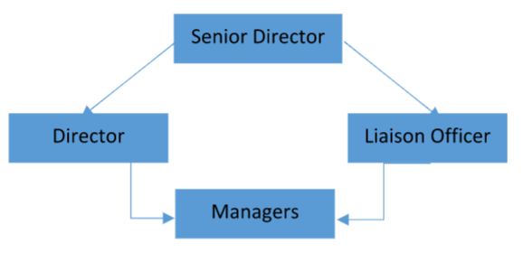
Communication Flow:-
At I Focus Data we follow downward communication flow.

Slide 8
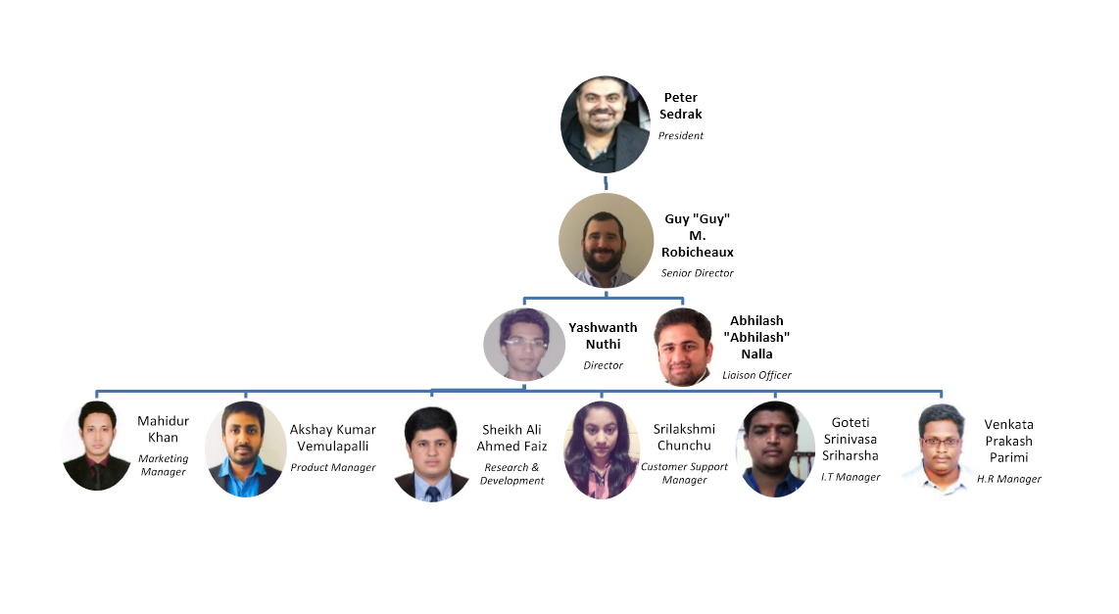
Organizational Chart:-

Slide 9
Mission:-
Values:-
With a zeal and vision of developing an information driven world
Sustainability
Craftsmanship
Passionate
Diversity
Trustworthiness
Notes:
We thrive to ensure the customer satisfaction unlocking the power of knowledge for social change.

Slide 10
Vision:
I Focus Data wishes to become a pioneer in the Data centre industry by meeting the needs of our customer base. Innovation is what we always look for. With a green by design standards we evaluate our efficiency and are quick to adopt to the techniques that are successful on a global scale.

Slide 11
Why Investors Choose Us?
Unbiased perspective and approach
Technology and Customer support
Global product reach
Industry leading standards
Notes:
We implement tailored custom design solutions using the best available technologies based on the customer needs
High class infrastructure combined with best in class customer support has created a unique value proposition for I Focus Data's customers and prospects. Industry leading power densities with a belief on breadth of our services helped in minimizing the downtime
Over a 5 million square feet of premium data center space across two continents helped us enabling our customer to efficiently secure, manage, and deliver business-critical applications and content
Industry leading standards: I Focus Data has incorporated the latest policies and technologies NFPA, Local codes, New York State Energy Conservation Code, Green certifications (LEED, Energy Star), Uptime Institute

