Slide 1
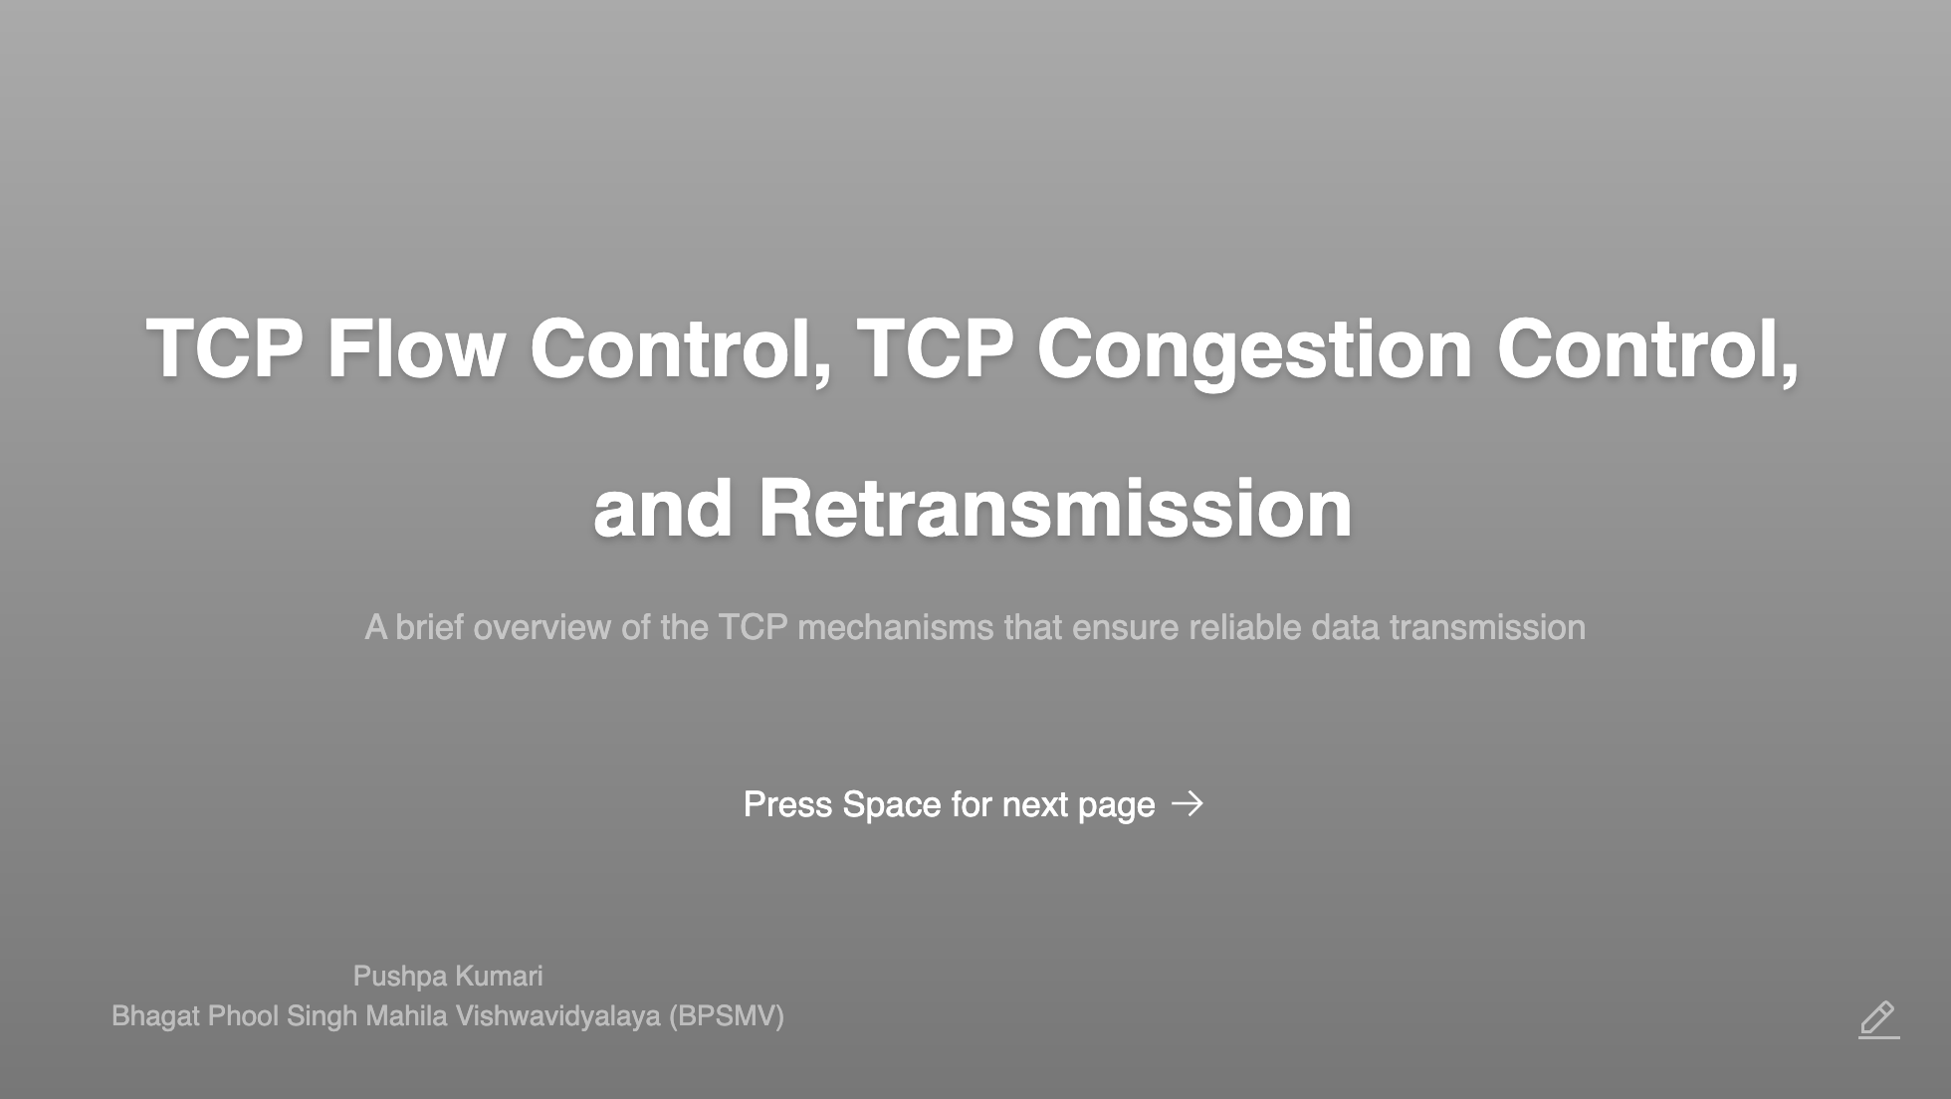
Notes:
Good morning/afternoon, everyone. My name is Pushpa Kumari, and today, I'll be talking about TCP flow control, TCP congestion control, and retransmission — key mechanisms in ensuring the reliability and efficiency of data transfer in TCP networks.

Slide 2
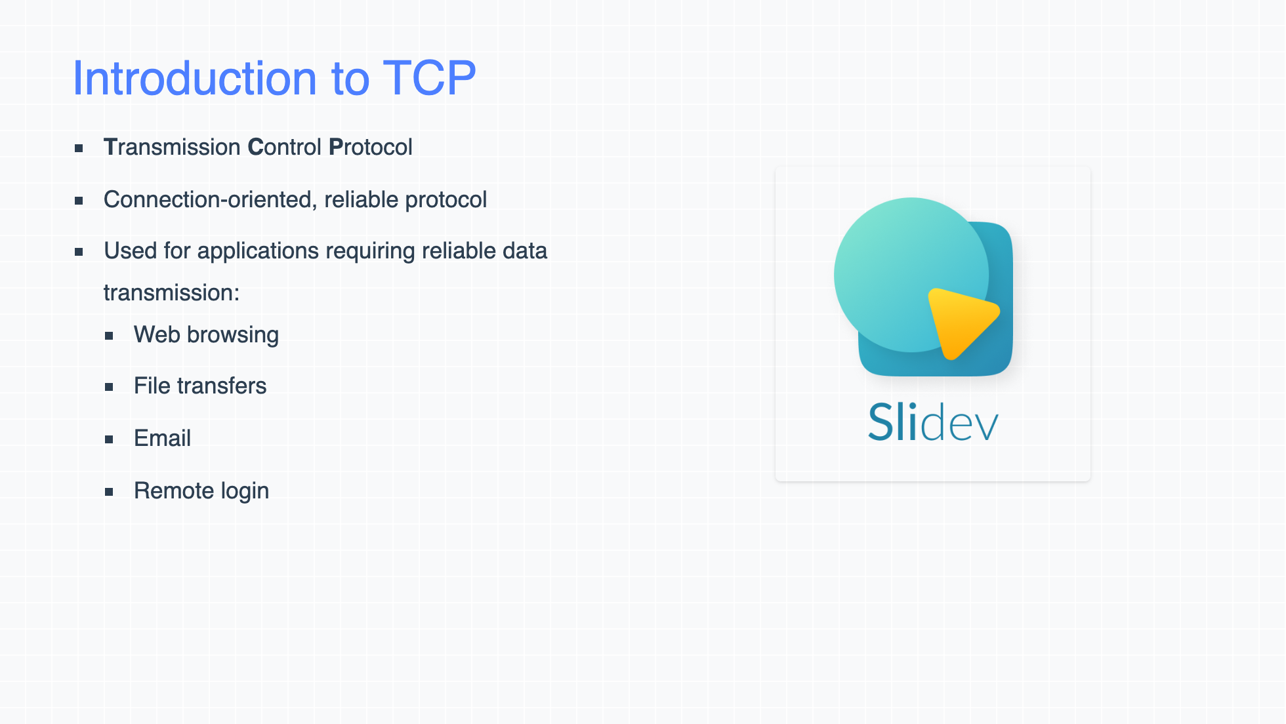
Notes:
Let's begin with a brief introduction to TCP. TCP, or Transmission Control Protocol, is a connection-oriented protocol that ensures reliable communication between devices over a network. Unlike UDP, which is connectionless, TCP guarantees data delivery, error checking, and data integrity, making it ideal for applications like web browsing and file transfers.

Slide 3
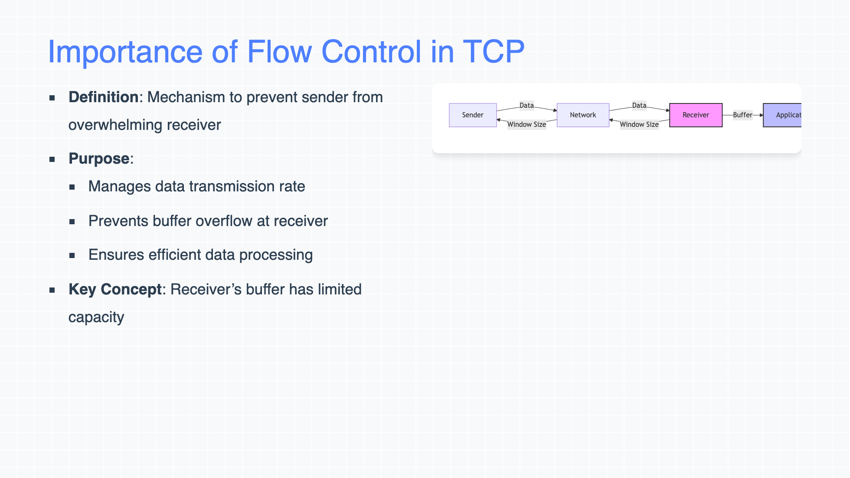
Notes:
Flow control in TCP ensures that the sender doesn't transmit more data than the receiver can handle. This is achieved by managing the data rate and controlling the amount of data in transit. It's crucial for preventing buffer overflow at the receiver's end, thus avoiding data loss.

Slide 4
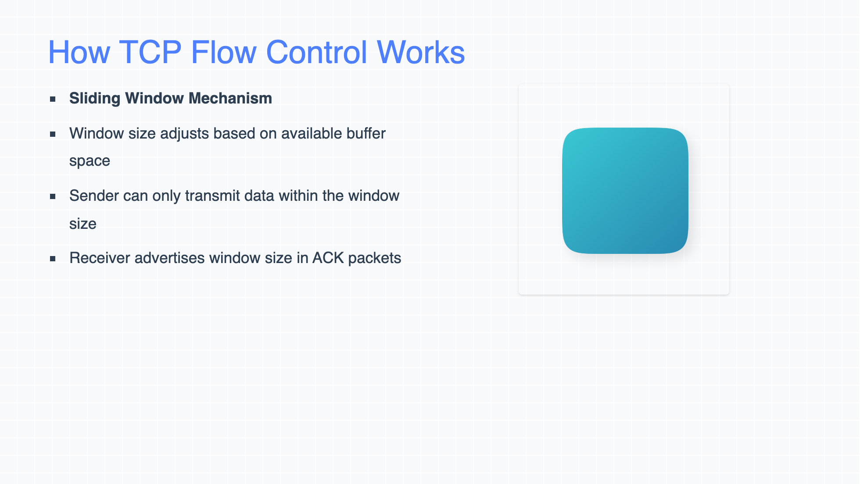
Notes:
TCP uses a sliding window mechanism to manage flow control. The receiver advertises a window size, which indicates the amount of data it can accept. The sender can only send data within this window size. As the receiver processes data, the window size can change, allowing the sender to send more data.

Slide 5
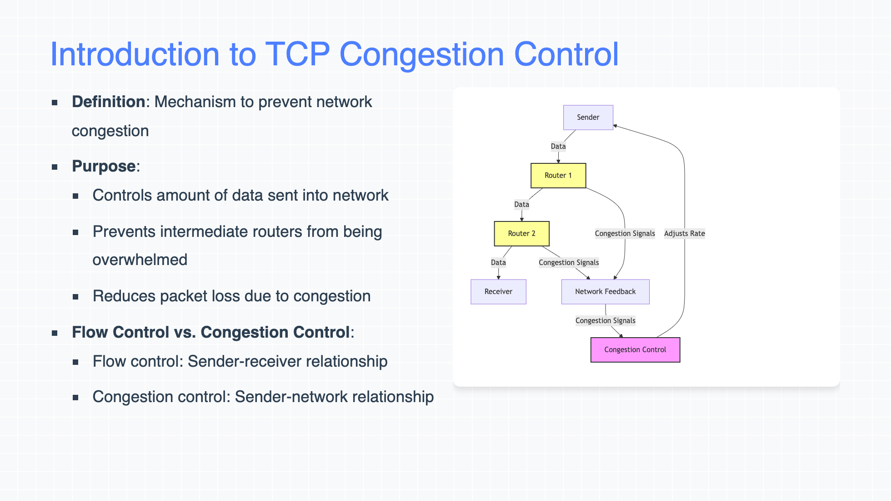
Notes:
Congestion control, on the other hand, aims to prevent congestion in the network. It ensures that the sender doesn't inject too much data into the network, which could overwhelm intermediate routers and cause packet loss. While flow control deals with the sender and receiver, congestion control manages the data rate in the network itself.

Slide 6
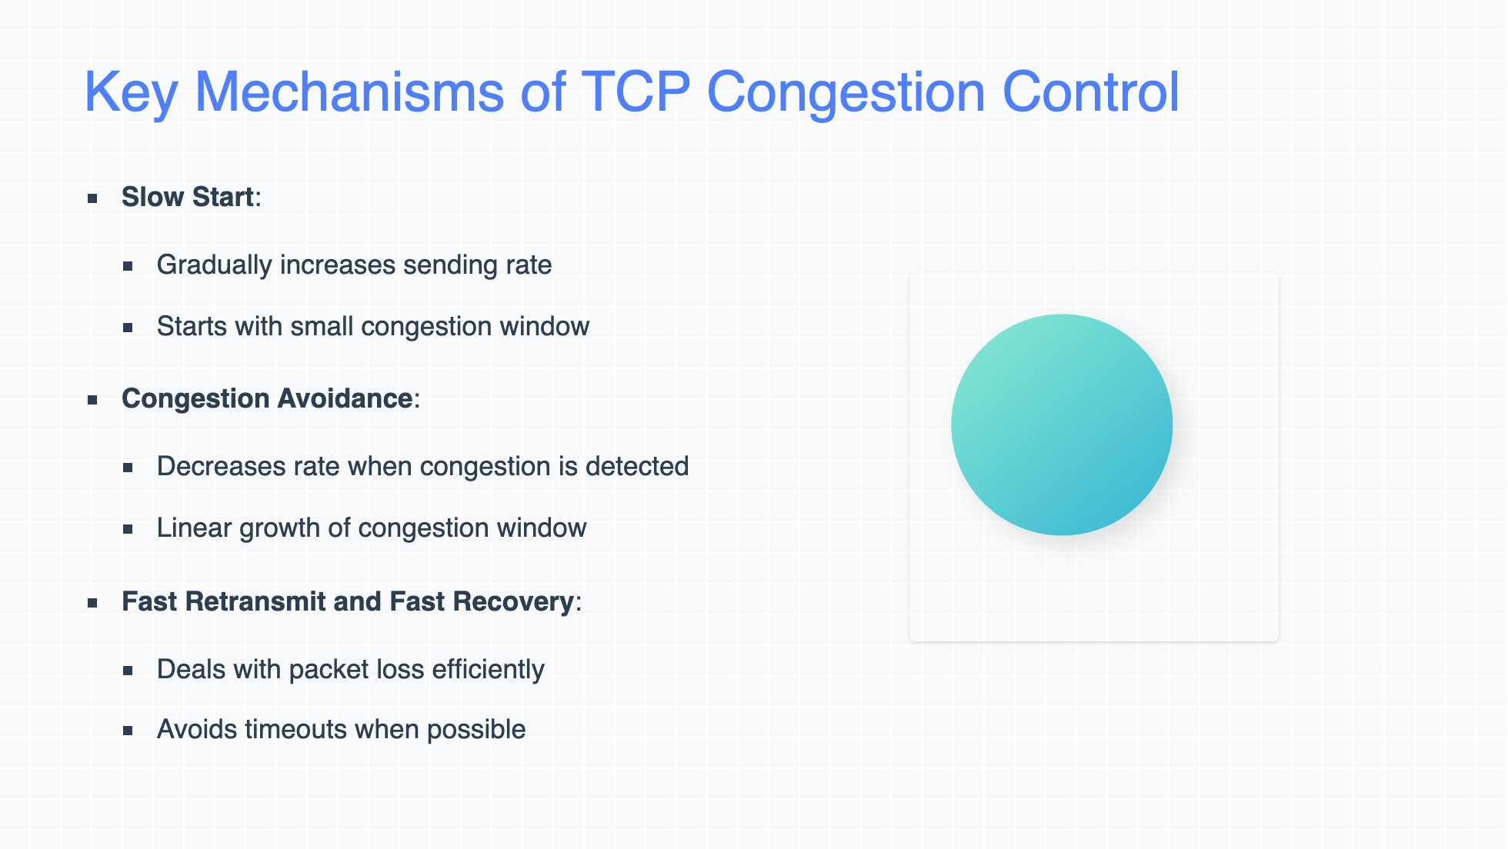
Notes:
TCP uses several algorithms for congestion control, starting with Slow Start, where the sender begins with a small amount of data and gradually increases the sending rate. When congestion is detected, the algorithm switches to Congestion Avoidance, which prevents further congestion by slowing down the sending rate. Additionally, Fast Retransmit and Fast Recovery allow for quick recovery when packet loss is detected.

Slide 7
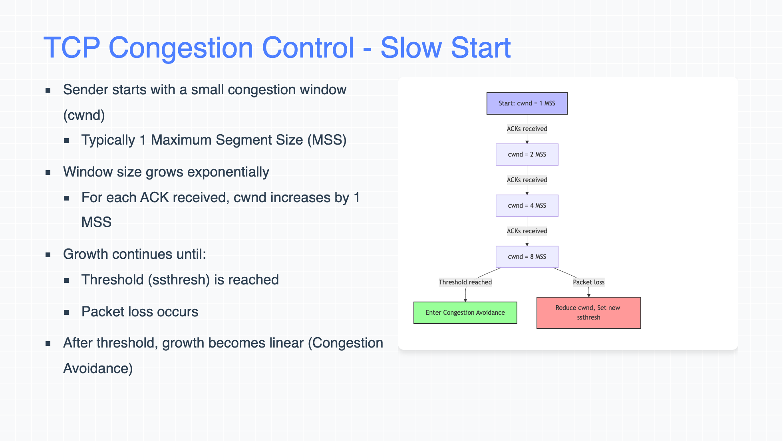
Notes:
In the Slow Start phase, the sender starts with a very small congestion window, typically one Maximum Segment Size (MSS). The window size increases exponentially as the sender successfully receives acknowledgements. However, when the threshold is reached, the window size grows linearly instead.

Slide 8
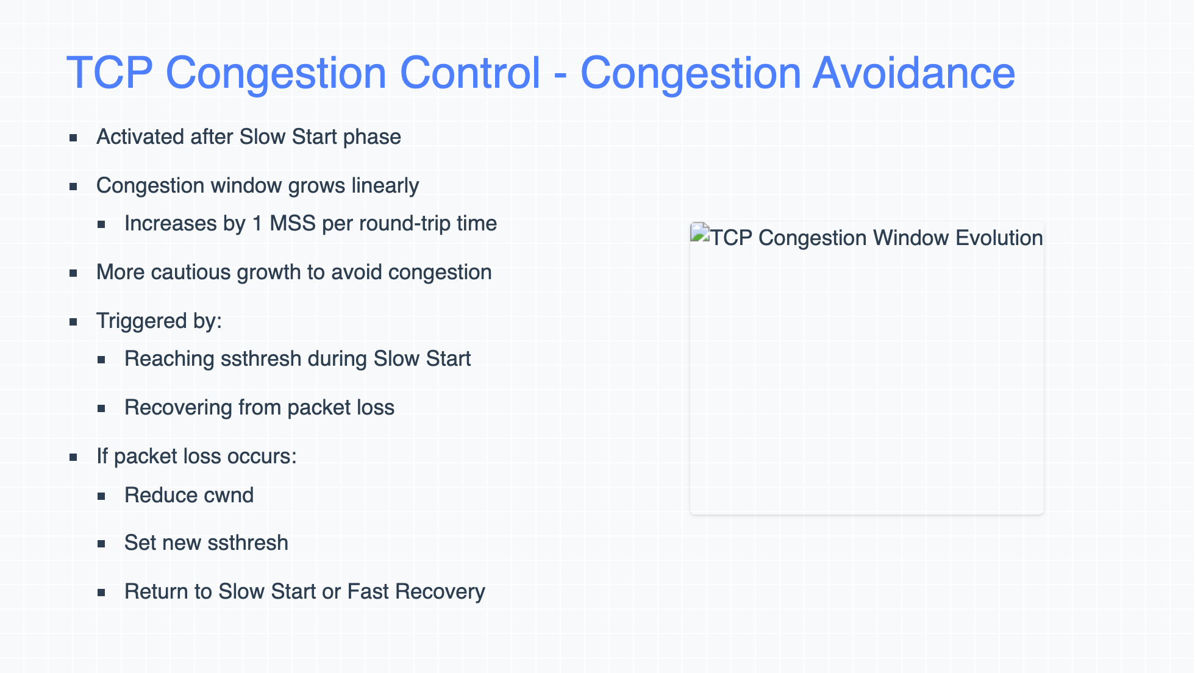
Notes:
Once the threshold is reached, TCP enters the Congestion Avoidance phase, where the congestion window increases linearly. This helps avoid sudden congestion. If packet loss or timeout occurs, TCP reduces the congestion window size and adjusts its behavior to prevent further congestion.

Slide 9
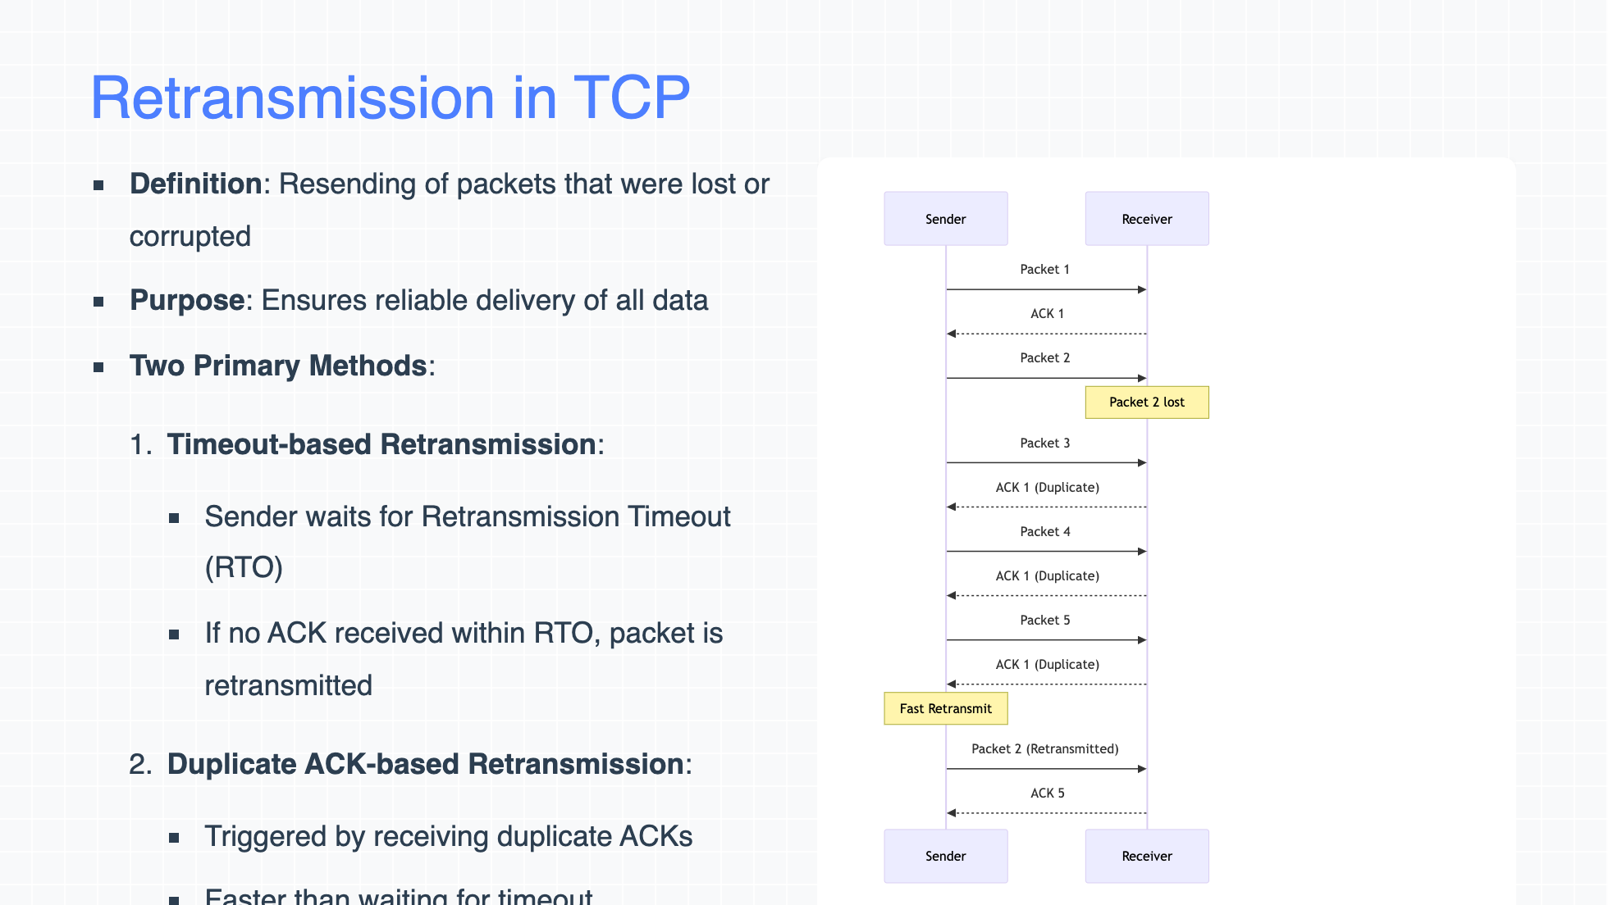
Notes:
Retransmission is a key feature of TCP that guarantees reliable delivery. When a packet is lost, TCP ensures it is resent. There are two primary methods for retransmission: Timeout-based, where the sender waits for a timeout before retransmitting, and Duplicate Acknowledgement-based, where duplicate ACKs from the receiver indicate packet loss and trigger retransmission.

Slide 10
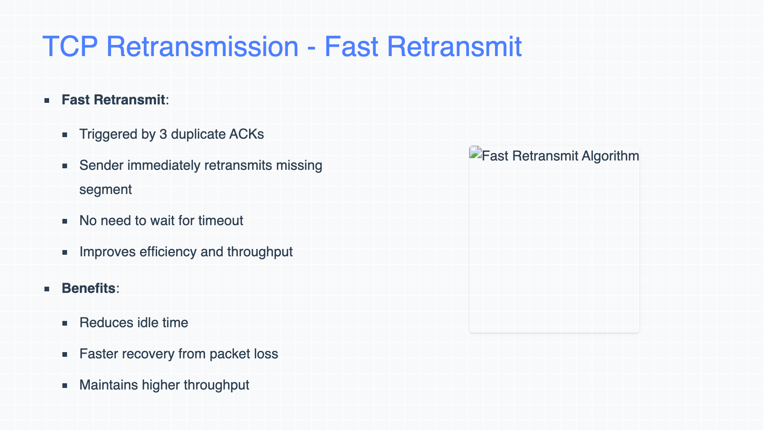
Notes:
Fast Retransmit is a mechanism that helps speed up retransmission. If the sender receives three duplicate acknowledgements for the same packet, it assumes the packet was lost and immediately retransmits it without waiting for a timeout.

Slide 11
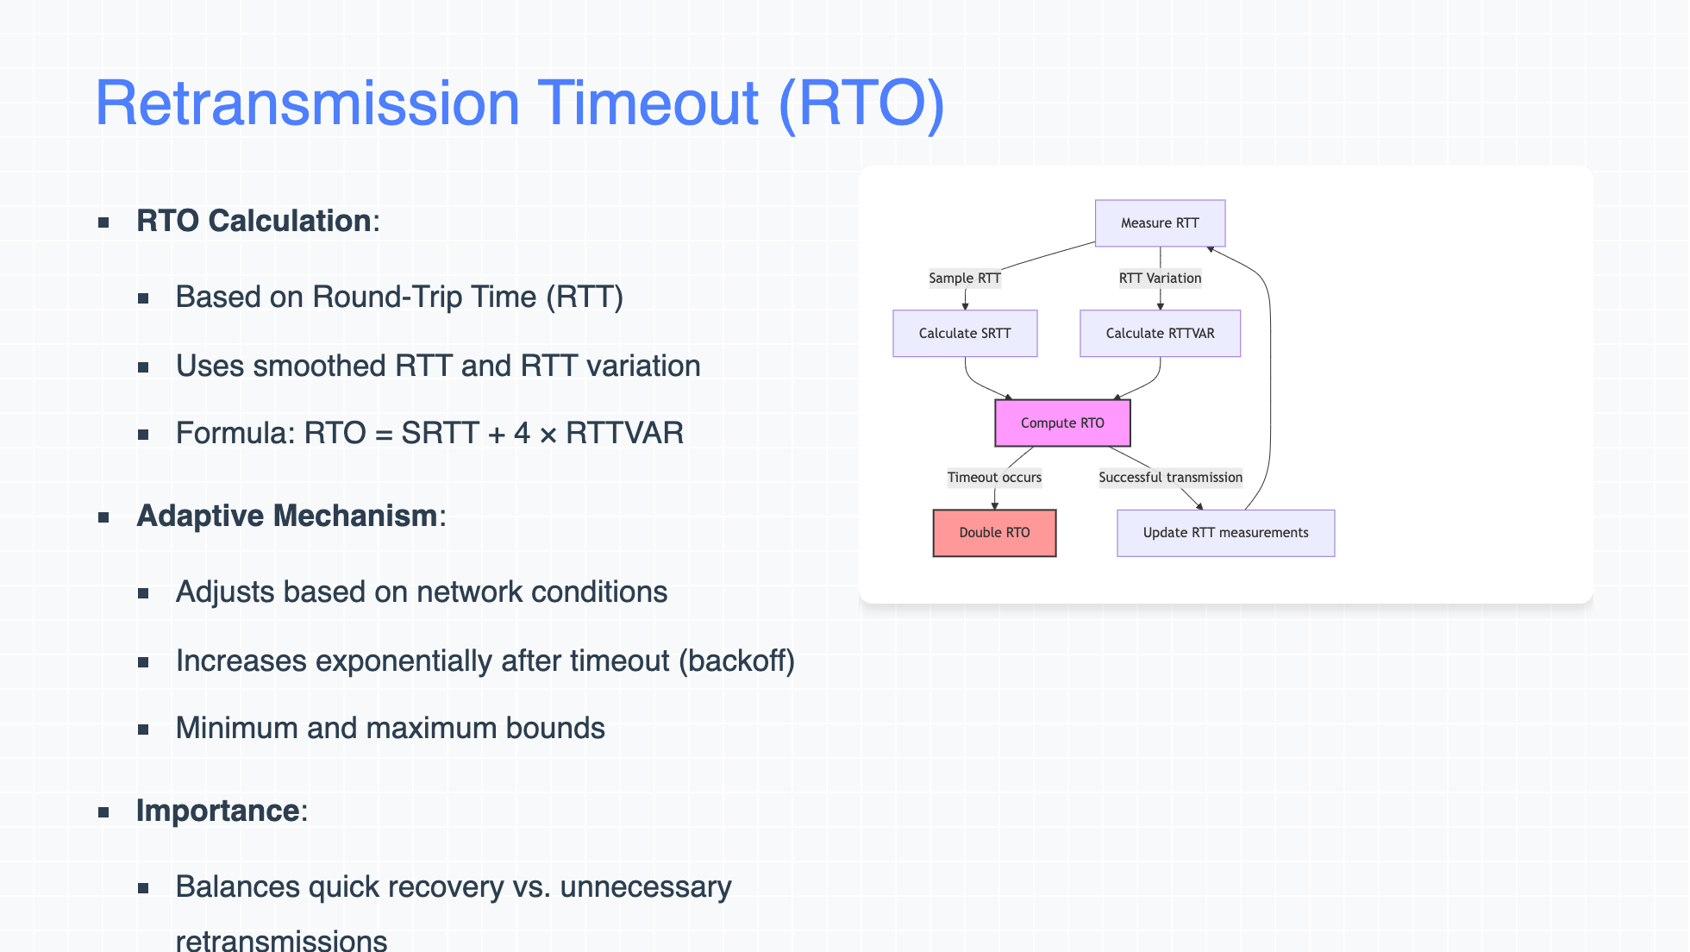
Notes:
Retransmission Timeout (RTO) is calculated based on the round-trip time (RTT) between the sender and receiver. If an ACK is not received within the RTO period, the sender assumes packet loss and retransmits the data. This timeout period is adaptive and adjusts according to network conditions, improving reliability.

Slide 12
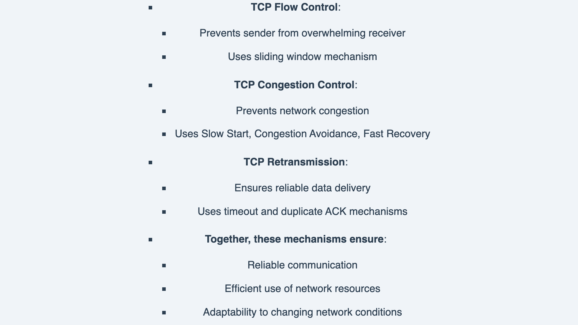
Notes:
To conclude, TCP flow control, congestion control, and retransmission are fundamental mechanisms that ensure reliable communication over a network. Flow control ensures the sender doesn't overwhelm the receiver, while congestion control prevents network congestion. Retransmission guarantees that lost data is recovered. Thank you for your attention, and I am now happy to take any questions.

