Slide 1
Hybrid Travel Recommendation System: Integrating Collaborative and Content-Based Filtering Techniques
Presented By
Sambit Mohanty(M22AI622)
Supervised by
Dr. Sandeep Kumar Yadav
Department of Electrical Engineering
Indian Institute of Technology Jodhpur

Slide 2
Defining the problem
In the rapidly expanding domain of online travel platforms, users often face challenges in discovering personalized travel recommendations that cater to their unique preferences and interests.
Existing recommendation systems primarily rely on either collaborative filtering, which is limited by sparse user-item interactions and content based filtering which may overlook the user behavior.
This project aims to address this gap by developing a hybrid travel recommendation system capable of providing more accurate, diverse, and user-centric travel recommendations in the digital age.

Slide 3
Defining the problem
In the rapidly expanding domain of online travel platforms, users often face challenges in discovering personalized travel recommendations that cater to their unique preferences and interests.
Existing recommendation systems primarily rely on either collaborative filtering, which is limited by sparse user-item interactions and content based filtering which may overlook the user behavior.
This project aims to address this gap by developing a hybrid travel recommendation system capable of providing more accurate, diverse, and user-centric travel recommendations in the digital age.

Slide 4
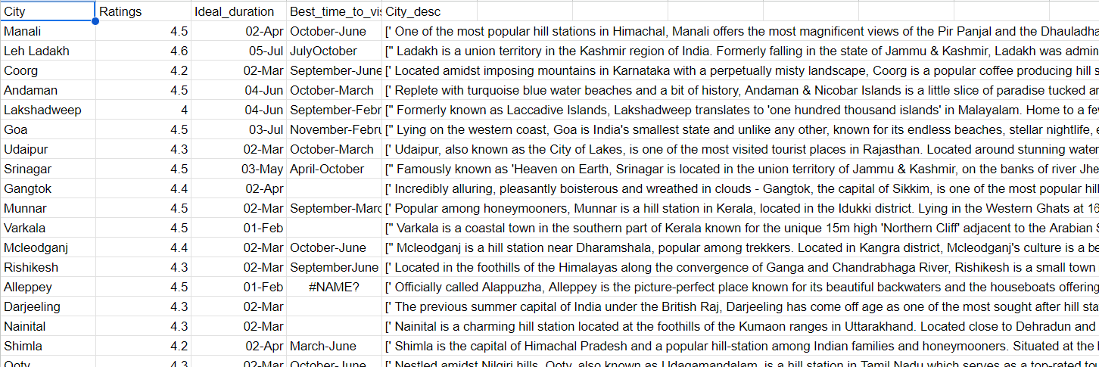
Dataset (Kaggle)
City.csv file used in content-based filtering

Slide 5
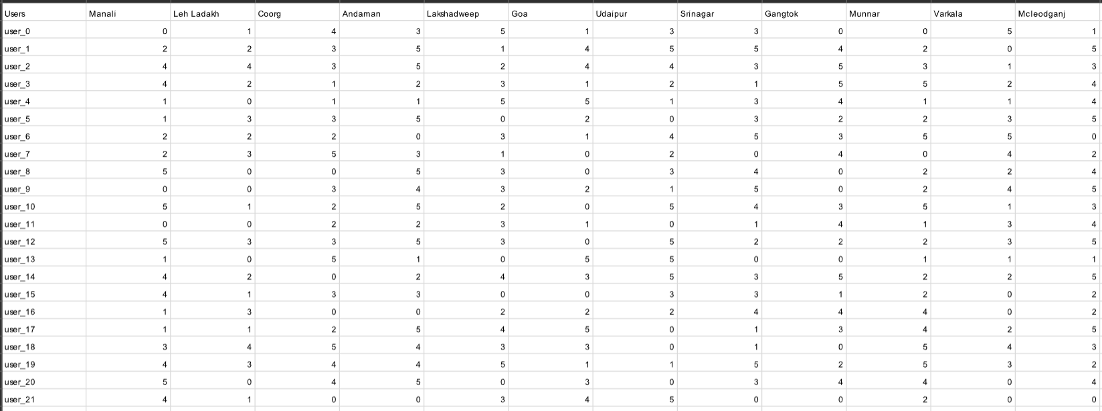
Dataset (Custom)
City.csv file used in content-based filtering
Utility Matrix created based on number of users and the sparse density

Slide 6
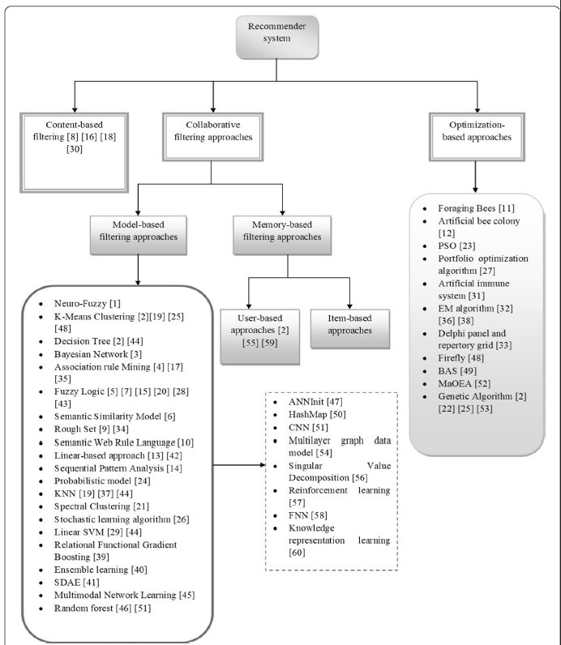
Categorization of Recommendation Systems
City.csv file used in content-based filtering

Slide 7
Content-Based Approach
It is driven by the cosine similarity of the TF-IDF score vectors of a particular location or city
TF-IDF stands for Term Frequency - Inverse Document Frequency.
TF(t,d)=Total number of terms in document d/Number of times term t appears in document d​
IDF(t,D)=log(Number of documents containing term t/Total number of documents in D​)
The TF-IDF score is the product of the TF and IDF values. Cosine similarity is the angle between the two location vectors, where each vector has a TF-IDF component.

Slide 8
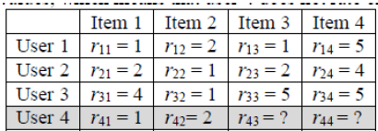
Collaborative Approach
Collaborative filtering (CF) is a recommendation technique that predicts users' preferences based on the preferences or behaviors of similar users.
Input parameter for collaborative approach based model is the utility matrix in which rows represents the users, column represents the cities and the intersection is the rating given by the user to that city/destination.

Slide 9
SVD
After reading utility matrix, the dataframe is converted into Surprise Dataset (defined in the Surprise Library of python).
The dataset is divided into a trainset and a testset (80:20).
After training the data, predictions were made on the test set, and these predictions were used to calculate performance metrics like RMSE and MAE.
Finally, 5-fold cross-validation is performed to generate avg rsme and avg mae
The above process is repeated for all the files that were generated in the dataset creation step.
The performance of SVD model with different sparse densities is compared by plotting avg rsme and avg mae against the sparse densities.
.

Slide 10
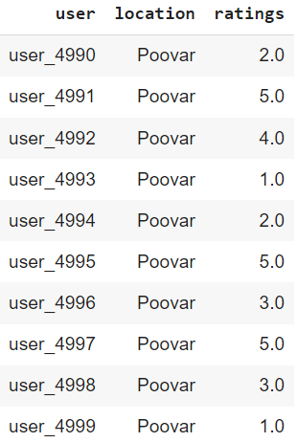
Surprise Dataset

Slide 11
Proposed Algorithm
Initially, we’ll be implementing a content-based algorithm on the ‘City.csv’ dataset. This would give us a set of cities based on the similarity of TF-IDF scores.
20 cities are retrieved, including the city that is given as input to the algorithm.
Before implementing collaborative filtering, only the columns with the same column heading as those of 20 cities retrieved in previous step were fetched from ‘Utility_Matrix_5000_0.3.csv’ dataset.
Some rows were also eliminated based on the logic that the users who have liked the input city should be in the final data frame, i.e., rating > 3 given by the users for the input city.
So collaborative filtering would be applied on a matrix (dataframe) whose dimensions are m x n, where m (no of users) < 5000 and n (no of cities) = 20

Slide 12
Proposed Algorithm (Contd.)
SVD model is preferred for training the data. The process of splitting the data, converting to surprise dataset, cross-validation, and performance metrics calculation remains the same as that explained under “SVD” section.
To get the recommendations, user_id is taken as input.
Cities that are not visited by the user are recommended and are sorted based on the ratings predicted by the model.

Slide 13
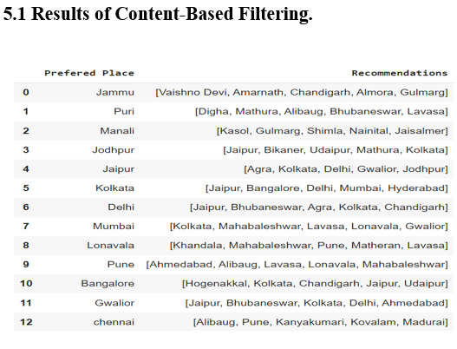
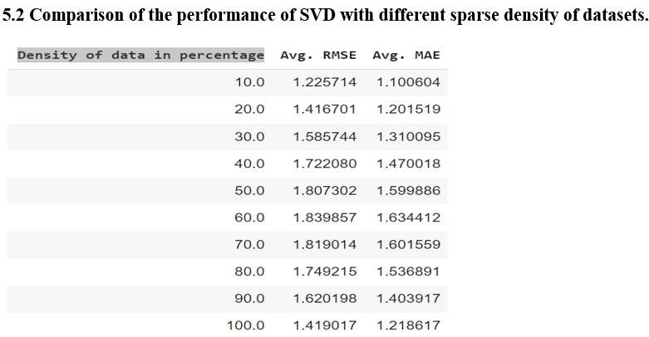
Results

Slide 14
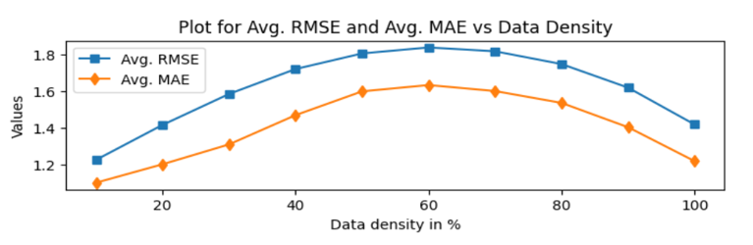
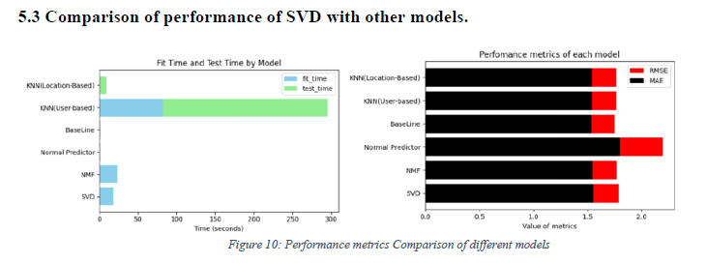
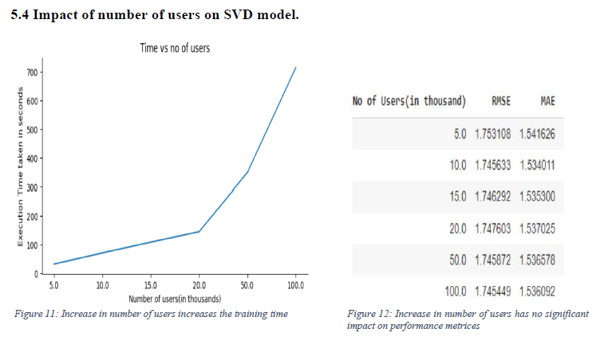
Results (Contd.)

Slide 15
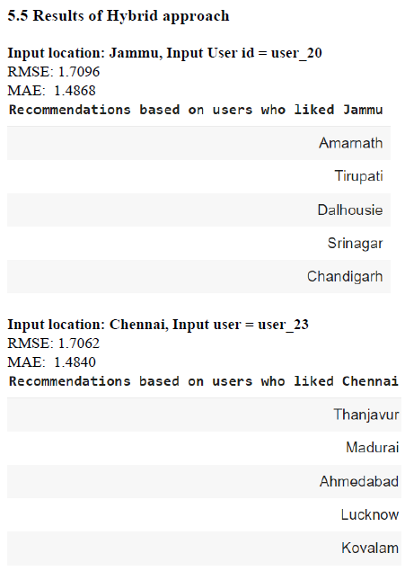
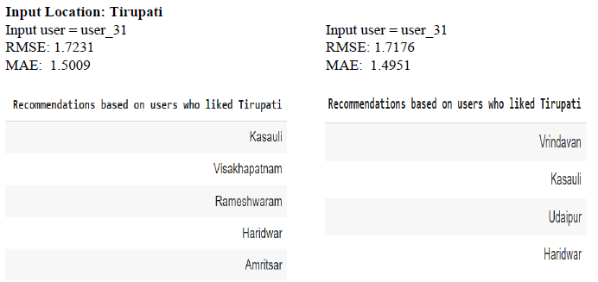
Results (Contd.)

Slide 16
FUTURE WORK
Implementing Re-inforcement learning in Content-Based Algorithm as there are many cities (especially from North East India) which are not present in the City.csv dataset
Exploring Deep Learning Techniques to implement collaborative techniques.
Literature Survey on Hybrid Algorithms and implement the findings in our proposed algorithm.
Implementing Situation Based Travel Recommendation.

Slide 17
Thank you

