Slide 1
Industrial Equipment Overview
Generated using AI/ML pipeline

Slide 2
Generated Script
We produce videos for machines and industrial plants, showing that production systems and industrial machinery must apply to different purposes, sometimes in apparent contradiction. The video of an industrial machine should serve to be bought. Anyone who deals with the sale of new or used systems knows this well. It is often thought that to achieve this goal, the operation of industrial machinery is shown from an attractive point of view, with spectacular images to provoke a strong reaction in the viewer. It is a way that is certainly fine, but perhaps more suitable for consumer goods intended to satisfy the user. The industrial machine instead must produce and return the investment as soon as possible. For this, it is necessary to show how it works, what it does and with what advantages. The first question to ask when shooting a video of a production system is to show why a customer should choose that machine and not a similar model proposed by a competitor. It should be shown from the early stages why that system works better than others, why it requires less maintenance, why it is better suited to getting the job done faster. To obtain these results, it is advisable to film the machine and the operator with sequence shots that leave customers with no doubts. Who can think that what is shown is not real. Shots taken from inside the machines help a lot, or subjective images taken from the operator's point of view, which are very interesting for maintenance operations, or images from above, especially when the machine is running. We provide preview support to understand what to say and in what sequence. And above all, we support the company in preparing a text that the speaker can use to comment on each step. In each language, readjust the sequences to be in sync with the different lengths of the different translations. Well-produced images will be used not only for sale, but also for the production of video instructions and video tutorials. We offer live streaming for remote demos and virtual open houses, or for acceptance, commissioning or startup and functional tests. They are real live demonstrations where you can show how the machine works, not only to sell it, but also for activities and procedures related to the tests that precede the delivery.

Slide 3
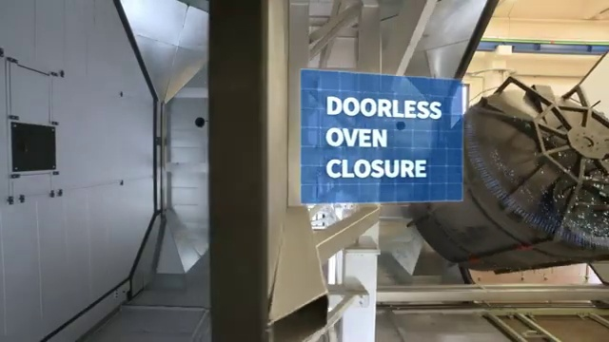
Equipment Image

