Slide 1
Battleship
For CS372, Spring 2017
Aisha Peters and Sam Erie

Slide 2
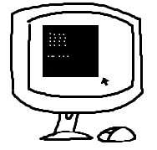
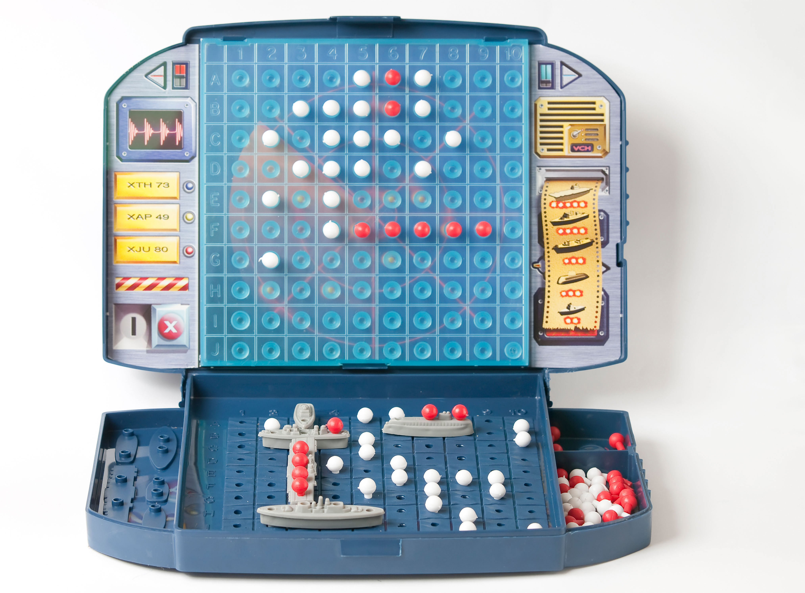
The Project Goal
Notes:
Discuss what the goal of this project was: making the Battleship game in code.

Slide 3
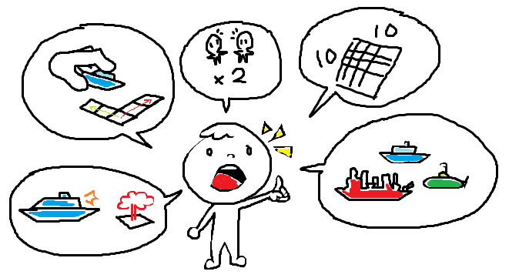
User Stories
Notes:
Discuss user stories. Examples on page: There will be a 10x10 board, there will be ships of certain sizes, there will be a 2-player game, player can place ships horizontal/vertical on board, player can place hit on enemy’s board once per tur

Slide 4
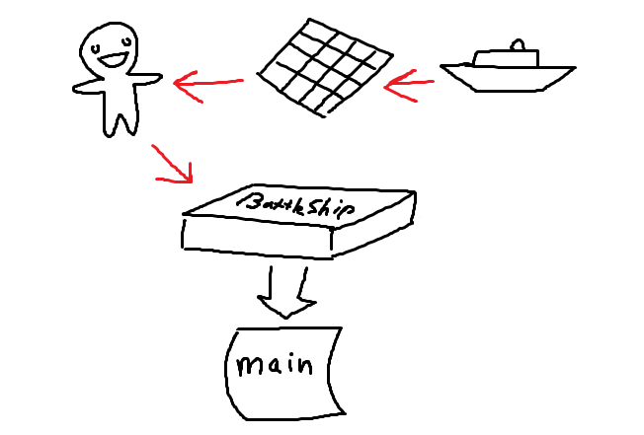
Design Layout
Notes:
Discuss code layout: Started with board class, created ship class that are used by board class, created player class that uses board, created game class that uses player class. Game class is called in main to initiate game.

Slide 5
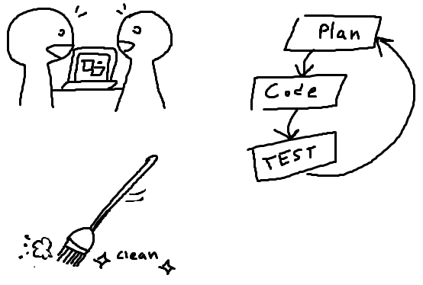
Design Process
Notes:
Discuss thoughts on design methods used: Pair coding, clean coding, projectmanagement

Slide 6
Code Demonstration…
Notes:
Demonstrate code

Slide 7
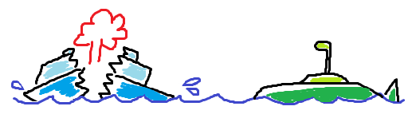
The End

