Slide 1
Employee Attrition Problem
Proof of Concept to Find Solution to Employee Attrition

Slide 2
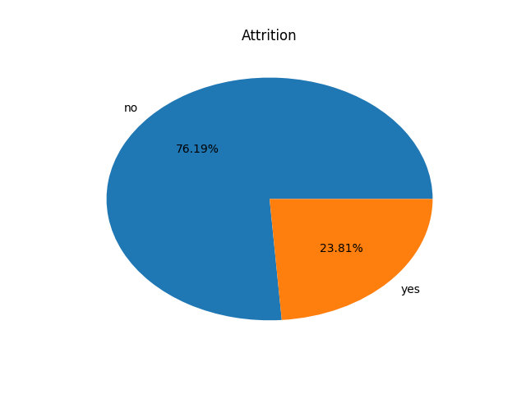
Distribution of employees
76% of records in the dataset are still employees while the remaining 24% have left.

Slide 3
Solving the problem
Import dataset and add attrition column to both current and previous employees sheets
Combine the two sheets to form a single dataframe
Plot a heatmap to determine correlation between columns
Perform exploratory data analysis on the dataset and visualize the data
Build and train the RF model and use it to predict attrition
Test the accuracy of the model
Plot chart of factors leading to attrition

Slide 4
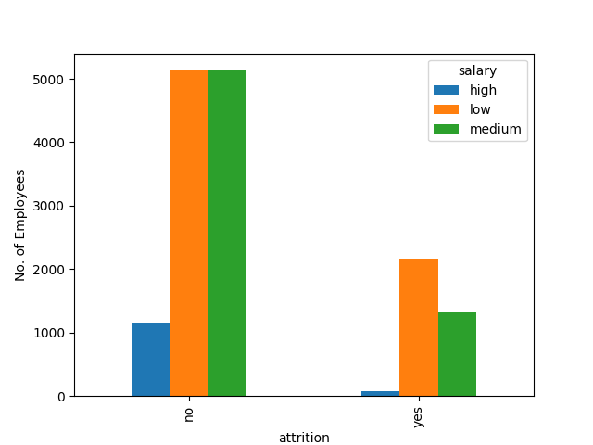
Few people with high salary tend to leave when compared with their colleagues earning less

Slide 5
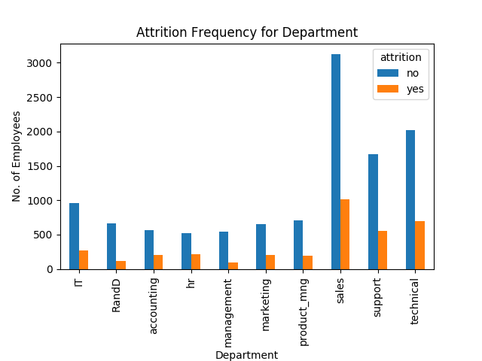

Slide 6
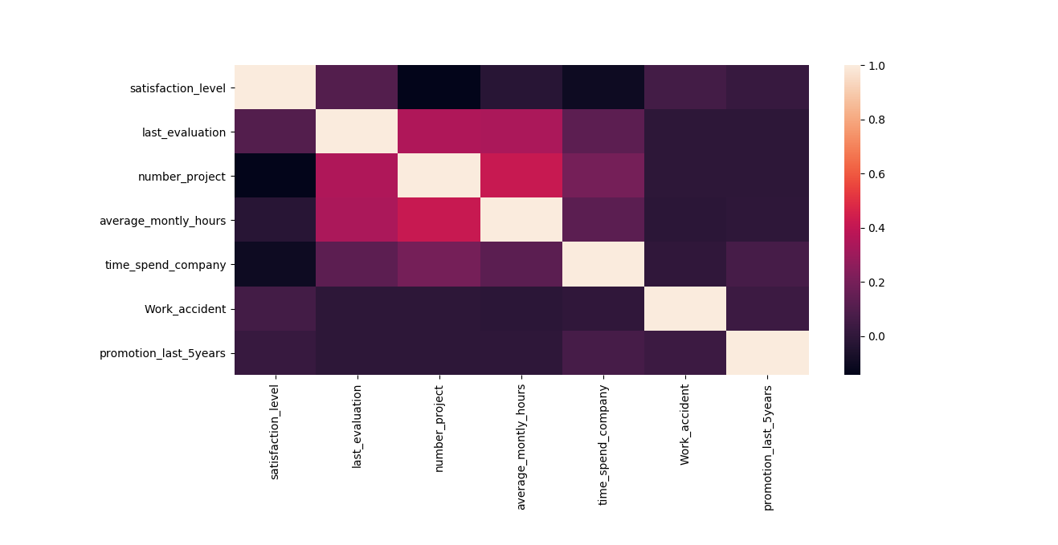

Slide 7
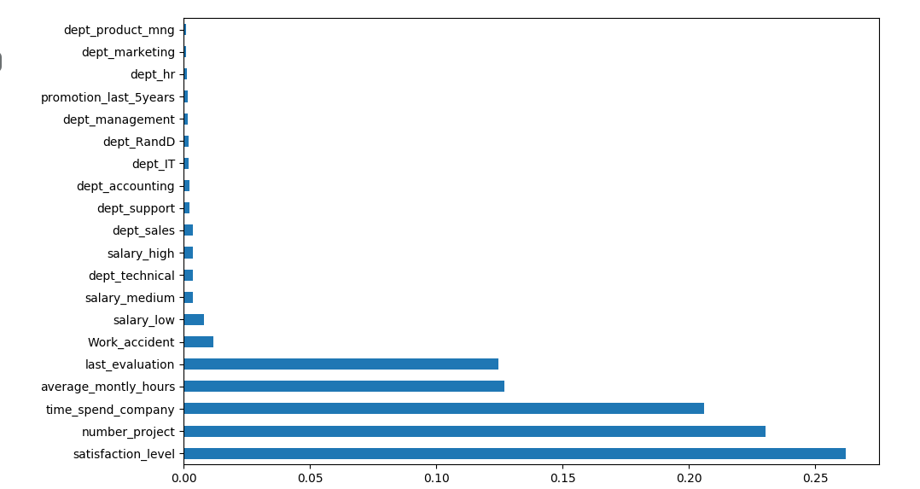
What type of employees are leaving?

Slide 8
Employees Leaving share the following characterisitcs
High dissatisfaction level
High number of projects
Spent a long time with the company
High monthly hours

