Slide 1
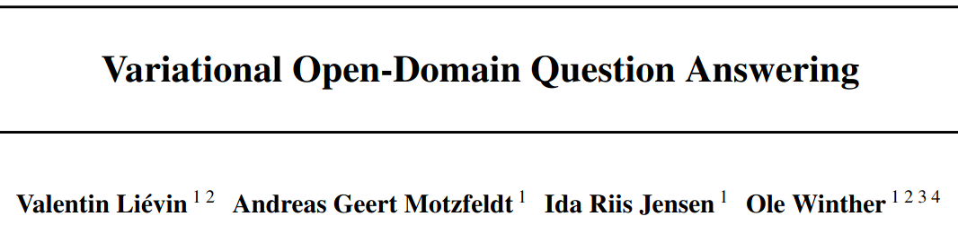

Slide 2
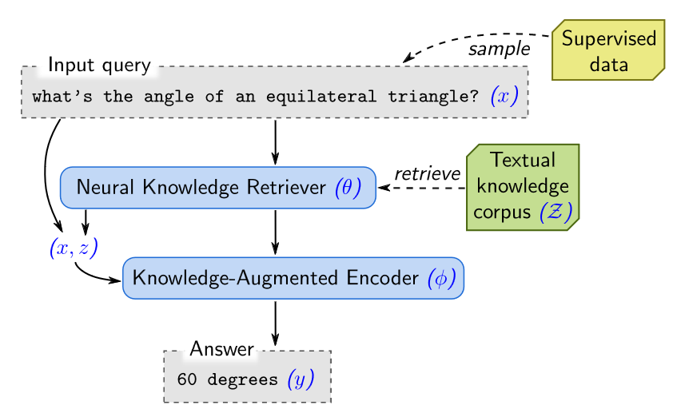
Open-Domain Question Answering (ODQA)
LLMs are limited by the implicit knowledge they possess
Incomplete, flawed, out of date etc.
Retrieval-augmented models:
Augmenting LMs with external knowledge bases indexed with a retrieval mechanism
Popular for ODQA (e.g. REALM (Guu et al. 2020))
This paper:
Proposes a probabilistic framework for retrieval-augmented tasks with end-to-end learning
Based on Rényi divergence variational inference
REALM: Retrieval-Augmented Language Model Pre-Training. Guu, K., Lee, K., Tung, Z., Pasupat, P., and Chang, M. (2020)

Slide 3



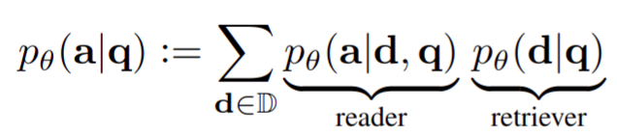
Reader-Retrieval Model
For a question and answer ( is the space of sequences of tokens)
and a corpus of documents
the reader-retrieval model is given by:
(where both reader and retriever are BERT models)

Slide 4

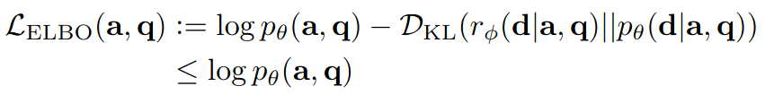
Reader-Retrieval Model with Traditional VI
Traditional variational inference:
Estimate by drawing samples from an approximate posterior (a "static retriever")
and evaluating the ELBO
But the authors suggest that Rényi divergence VI may be better...

Slide 5

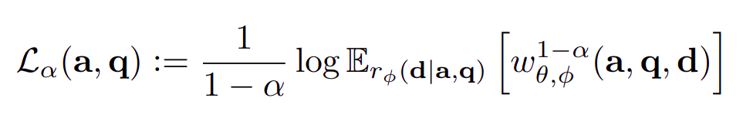



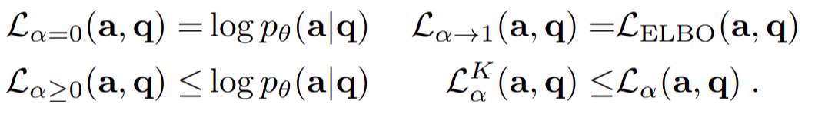
Variational Rényi Bound (RVB)
A generalisation of the ELBO with a parameter
Can be extended for
Gives a lower bound on the marginal task log-likelihood

Slide 6
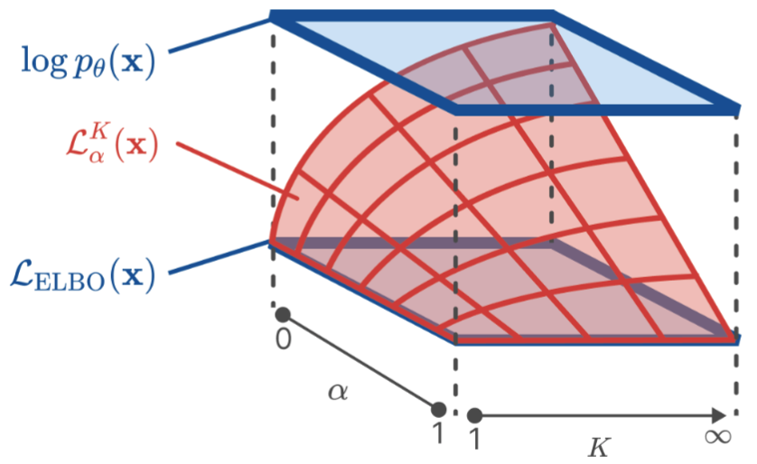
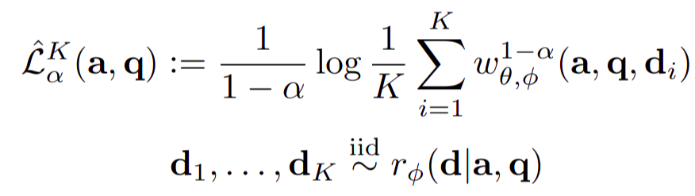
Importance-Weighted RVB (IW-RVB)
RVB is usually intractable
(RVB)
So we often use the importance-weighted RVB:
(IW-RVB)
For which we still have:

Slide 7


The RVB & IW-RVB
The idea is that we can control to improve our model's training
Evaluating the IW-RVB (and its gradient w.r.t. ) has complexity
Requires importance weights for every document in the corpus
This is problematic in ODQA applications, where is often very large
Solution: use priority sampling instead of regular importance sampling

Slide 8


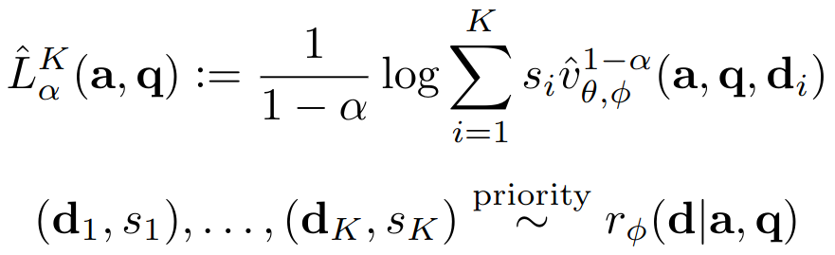
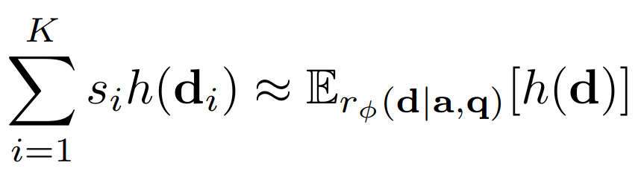





Priority Sampling
Main point: priority sampling allows us to sample documents (and corresponding importance weights ) without computing sums over the whole corpus
Such that for a function we have a consistent estimator
We have documents, each weighted by
Sample random weights
Generate "priorities"
Let be the th largest priority
Select the items with the largest priorities, return these alongside their corresponding importance weights

Slide 9
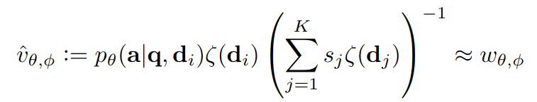
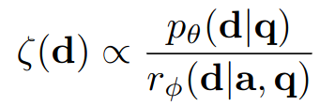

Variational Open-Domain (VOD) Objective
So instead of IW-RVB ( due to importance sampling):
We use the VOD objective ( because of priority sampling):
Technical details:
1 reader evaluation
1 retriever and approx. posterior evaluation per document

Slide 10



Q: How are we actually modelling the retriever(s)?
Via score functions, and for retriever and approx. posterior respectively
BERT (language model)
BM25 (bag-of-words document ranking algorithm)
(where is a saved version of at a certain point in training and initially )

Slide 11
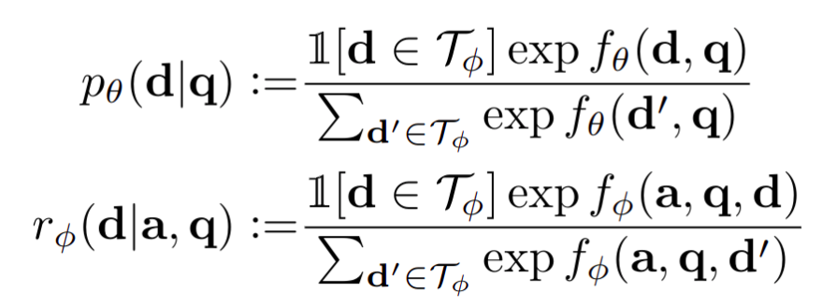





Q: How are we actually modelling the retriever(s)?
Then softmax over the scores to get distributions
is the set of documents with highest scores, which we can put in cache:
So in priority sampling, we only sample from documents ( )
Good for memory management
Also serves as an "exploration/exploitation threshold"
The reader is modelled with BERT in a similar way, with softmax over a scoring function

Slide 12
Training Intuition from the RVB
Ultimately, using should give us a tighter bound on the marginal log-likelihood, since
But, a looser bound may be better at the start of training, e.g. the ELBO/RVB :
Encourages knowledge transfer from approx. posterior to retriever
This is useful if we set the initial approx. posterior to a domain specific baseline:
Also maximises the answer likelihood independently of the retriever (in expectation over the approx. posterior)

Slide 13
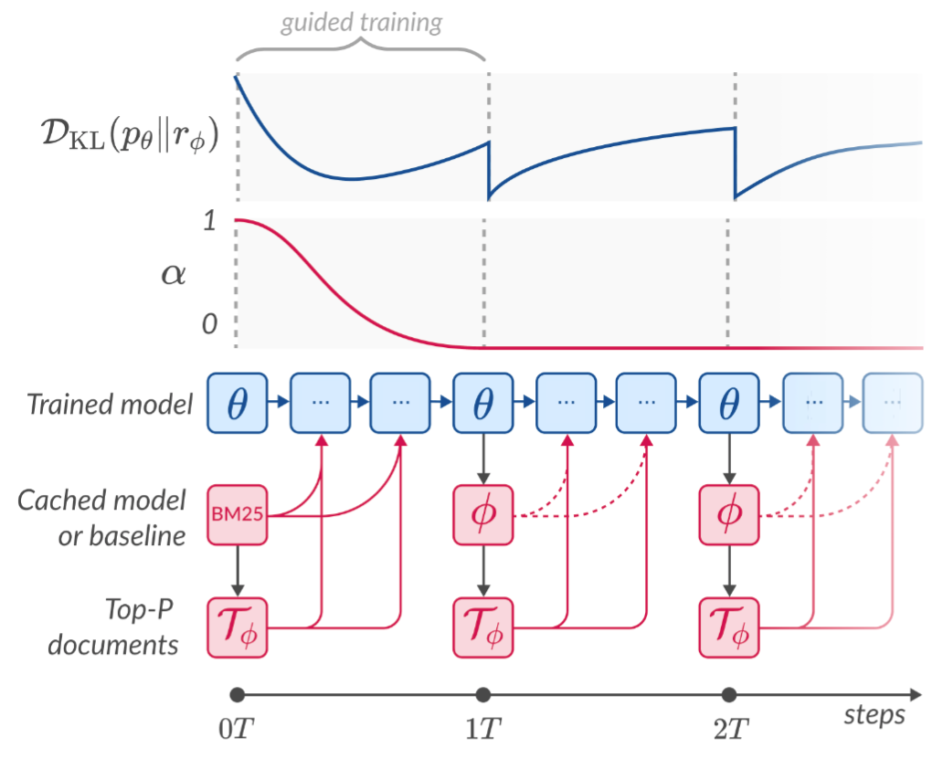


Training Procedure
So, for the first training steps we move from to
Allows for initial knowledge distillation from BM25 to the retriever
Then able to train on tighter bound
At each iteration we use (fixed) to sample documents, then we evaluate the VOD objective & gradients to update
Every steps we update by setting

Slide 14


Evaluation on Multiple-Choice Q&A
Given a question and each potential answer , evaluate 10 Monte Carlo estimates of the VOD and choose most likely answer.

Slide 15
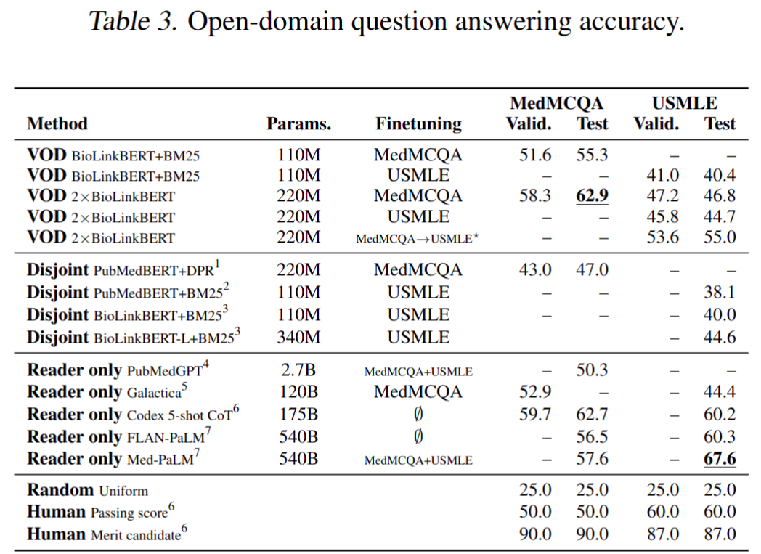
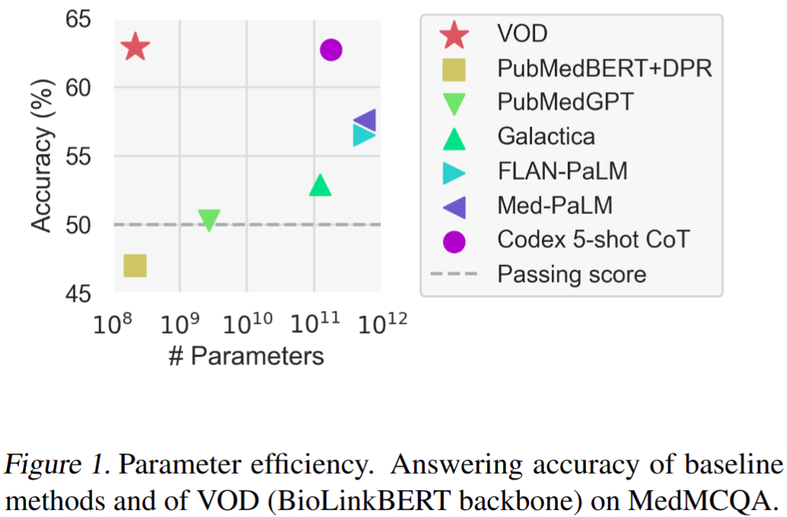





Experiments
Better results on MedMCQA (entry-level med-student knowledge) than USMLE (trained medical professional knowledge)
"BERT-sized model may not be sufficient for handling reasoning-intensive questions"

Slide 16
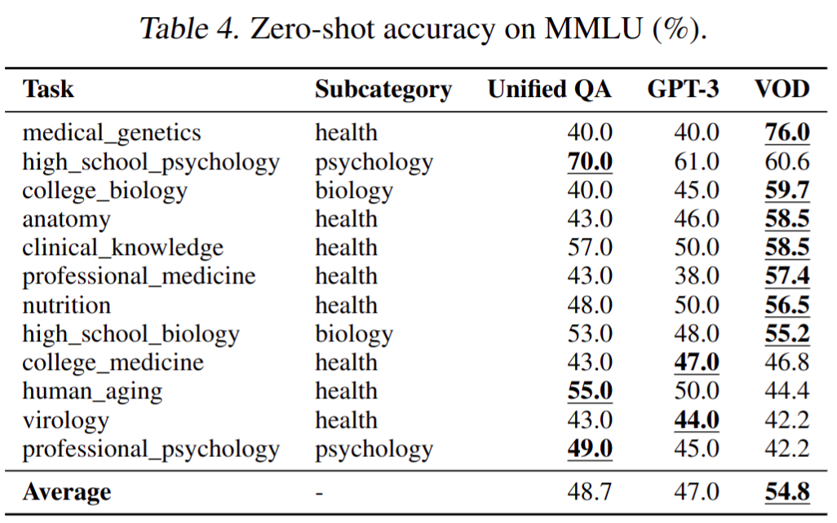
Experiments
Trained on MedMCQA only and evaluated on MMLU

Slide 17
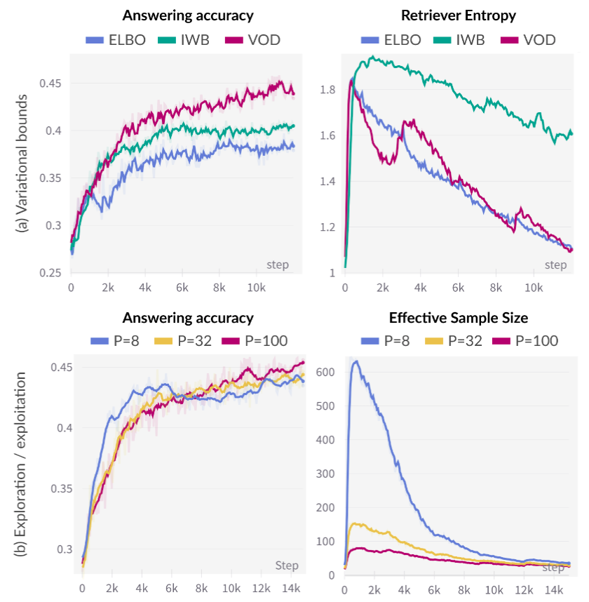
Ablation Study
Better performance when trained on VOD (interpolating from 1 to 0) than with IWB ( ) and ELBO ( )
Larger leads to:
Smaller effective sample size (measure of importance sampling quality, higher is generally better)
Slower learning
Better end performances

Slide 18
Ablation Study
Better performance when trained on VOD (interpolating from 1 to 0) than with IWB ( ) and ELBO ( )
Larger leads to:
Smaller effective sample size (measure of importance sampling quality, higher is generally better)
Slower learning
Better end performances

Slide 19
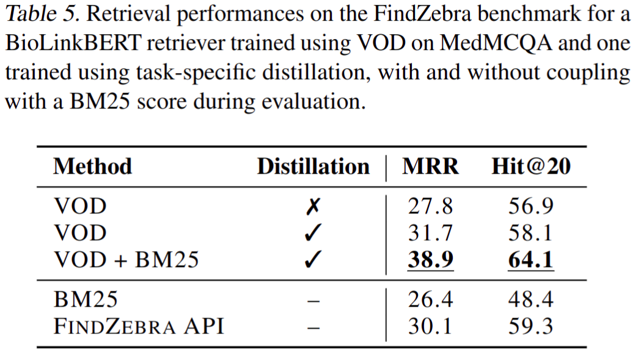
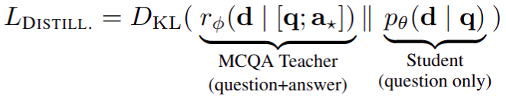
Re-purposing MCQA Retrievers for Sematic Search
Using the trained VOD retriever to teach a query-only retriever "student" model by minimising:
MRR = 100 * mean reciprocal rank (of first document with correct "disease concept" label)
Hit@20 = fraction of queries for which correct document is in top-20 returned articles

Slide 20

Conclusion
Good results, authors hope more attention will be given to Rényi divergence VI in NLP
VOD could be used in areas other than the ODQA presented here:
Generative and extractive ODQA outside of multiple-choice ODQA
Retrieval-augmented language modelling: retrieve one document per input token
Fusion-in-Decode (FiD): using a reader model that takes in multiple documents
Authors want more training (on larger datasets) and to use larger models than BERT
"Additional theoretical analysis is required" to investigate bias induced in VOD objective via self-normalised priority sampling.

