Slide 1

World University of Bangladesh
Department of Computer Science and Engineering
B.Sc. In CSE
Explainable Diabetes Prediction
SUPERVISED BY
Supriya Sarker
Lecturer
Department of CSE.
PRESENTED BY
Name: Md. Masum Billah Opu
ID: WUB 03/18/42/2671
Name: Md. Saiham
ID: WUB 03/18/42/2674

Slide 2
Table of Content
Introduction
Key Problem
Objective
Justification of Study
Main Contribution
Scope of Study
Literature Review
Methodology
Dataset
Machine Learning Algorithms
Explainable AI Tools
Evaluation Metrics
Conclusion
Limitation
Future Work
1

Slide 3
Introduction
Diabetes-
A chronic disease, creator of many other disease, comparative prevalence could increase to 7.37% (IDF)
Creates feeling of extreme thirst, excessive urination, visual disturbance, high blood pressure, dry skin etc.
Early prediction may delay or even stop the overall progression of diabetes and save lives
Several machine learning techniques has been applied for early diabetic prediction
2

Slide 4
Key Problems
Most of the ML techniques are black box techniques
The reason behind their outcomes are not interpretable to people
If a model wrongly predict diabetic patient as non-diabetic, s/he faces life risk
If a model wrongly predicts a non-diabetic person as diabetic, s/he will undergo unnecessary treatment
Therefore, to enhance trust on the models’ outcome and optimization of model explainability is very crucial in healthcare system
3

Slide 5
Objective
To develop an explainable AI model that can predict diabetes
6

Slide 6
Justification of Study
We proposed the use of machine learning algorithms to design a model to detect the probability of diabetes in patients at an early stage
In this model, explainability and interpretability are also much emphasized
5

Slide 7
Main Contributions
We have used different machine learning techniques which can make an early prediction for patients
Various XAI tools have been used to improve the interpretability and explainability of ML models
4

Slide 8
Scope of Study
In medical and healthcare sector
Our study can be used in early diagnosis of other prolonged disease such as cancer, arthritis etc.
7

Slide 9
Literature Review
.
Related Paper | Adopted Approach/ Method
Khan, P.F. Meehan, Kevin, 2021 | Prediction of diabetes using ML
Shetty, D., Rit, K., Shaikh, S. and Patil, N., 2017 | Intelligent diabetes disease prediction system using KNN
Reddy, S.K., Krishnaveni, T., Nikitha, G. and Vijaykanth, E., 2021 | Early Prediction of the occurrence of diabetes using ML
Lei, L., 2020 | Disease index grading method in diabetes prediction
Diab, M.S., Husain, S. and Jarndal, A., 2020 | Automatic diagnosis of diabetes using ANN
Yadav, S., Maravi, Y.P., Agrawal, J. and Mishra, N., 2021 | NN model to predict diabetes
Costea, N.E., Moisi, E.V. and Popescu, D.E., 2021 | Performance evaluation of ML models on diabetes prediction
Table 1: Summary of Related Papers
8

Slide 10
Methodology
Data
Collection
Preprocess
Feed
Built Model
Test Data
Train Data
Trained Model
Prediction
Eplain with XAI Tools
Fig I: Diagram of the Proposed Model
Fig 1: Model Overview
9

Slide 11
Dataset
Dataset | Features | Attributes
Pima Indians Dataset | Source: National Institute of Diabetes and Digestive and Kidney Diseases of India No. of instances: 768 No. of attributes: 8 | Number of Pregnancy, Glucose Concentration, Blood Pressure, Skin Thickness, Two Hour Insulin, BMI, Diabetes Pedigree, Age
Diabetes Dataset of Sylhet | Source: Sylhet Diabetes Hospital No. of instances: 520 No. of attributes: 16 | Sex, Polyuria, Polydipsia, Sudden Weight Loss, Weakness, Polyphagia, Genital Thrush, Visual Blurring, Itching, Irritability, Delayed Healing, Partial Paresis, Muscle Stiffness, Alopacia
Table 2: Dataset Features & Atributes
10

Slide 12
Machine Learning Algorithms
Logistic Regression
Random Forest
Decision Tree
XgBoost Classifier
Support Vector Machine
11

Slide 13
Explainable AI Tools
SHAP (SHapley Additive exPlanations)
LIME (Local Interpretable Model-Agnostic Explanations)
ELI5
12

Slide 14
SHAP
SHAP (SHapley Additive exPlanations) is a game theoretic approach to explain the output of any machine learning model
SHAP values are used to provide a direct measure of the influence of patient variables on the actual predictions under the interaction with other variables
13

Slide 15
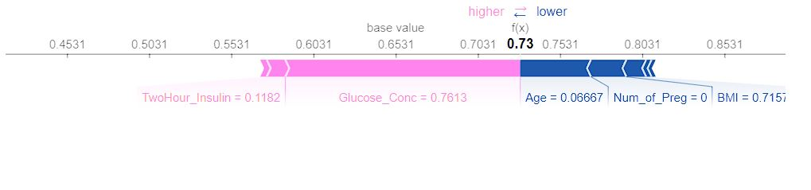
Fig 2: Contribution of Each Feature on the Prediction
13

Slide 16
LIME
It can give explanations for any given supervised learning model
LIME gives explanations that are locally faithful within the surroundings or vicinity of the observation/sample being explained.
14

Slide 17
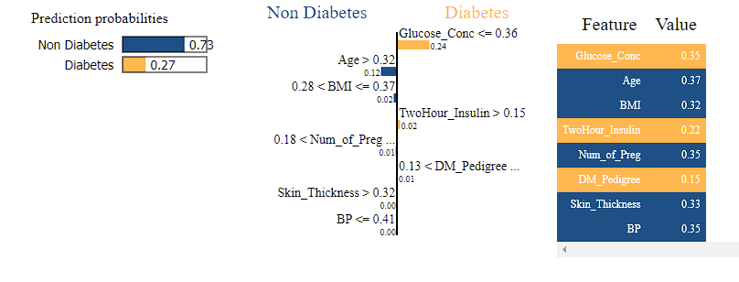
Fig 3: LIME plot- Explaining feature contribution to patients with high and low risk probability
14

Slide 18
ELI5
ELI5 is a python package that is used to inspect ML classifiers and explain their predictions
ELI5 shows weights for each feature depicting how influential it might have been in contributing to the final prediction decision
15

Slide 19
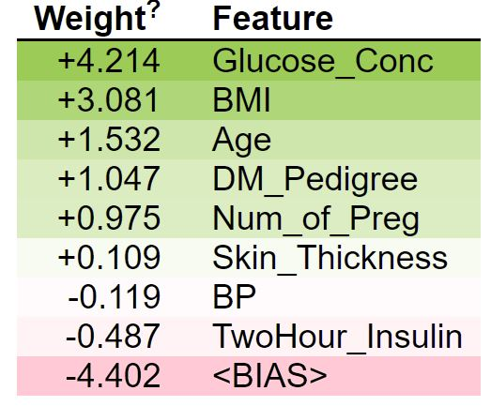
Fig 4: ELI5 – Feature Importance Plot
15

Slide 20
Evaluation Metrics
Evaluation Metric | Logistic Regression | Random Forest | Decision Tree | XgBoost Classifier | SVM
Precision | 0.79 | 0.81 | 0.78 | 0.77 | 0.76
Recall | 0.91 | 0.90 | 0.82 | 0.84 | 0.94
F-1 Score | 0.85 | 0.85 | 0.80 | 0.80 | 0.84
Accuracy | 0.79 | 0.81 | 0.74 | 0.74 | 0.77
Table 3: Evaluation Metrics for Dataset I
16

Slide 21
Evaluation Metrics
Evaluation Metric | Logistic Regression | Random Forest | Decision Tree | XgBoost Classifier | SVM
Precision | 0.90 | 0.95 | 0.91 | 0.95 | 0.58
Recall | 0.85 | 0.94 | 0.95 | 0.92 | 1.00
F-1 Score | 0.87 | 0.95 | 0.93 | 0.94 | 0.74
Accuracy | 0.90 | 0.96 | 0.94 | 0.94 | 0.58
Table 3: Evaluation Metrics for Dataset II
16

Slide 22
Conclusion
We have used different machine learning algorithm to make an early prediction on whether or not the patients may have diabetes
Various explainable AI tools are used to improve the explainability of our model
Our model shows which features are more responsible for the prediction
Logistic Regression and Random Forest model gives higher accuracy than other ML models
17

Slide 23
Limitation
In case of medical prediction, the higher the accuracy, the better the reliability. Machine learning methods always give some false positive and false negative values in their prediction. More trusted and reliable models could be built if we could explain the reason behind these false values.
17

Slide 24
Future Work
Attributes such as physical activity, ancestral health condition, body weight, and energy levels, can be considered in the future to diagnose diabetes
Applying our model to early predict other prolonged chronic diseases such as cancer, heart diseases, arthritis etc.
Developing a mobile application for predicting and monitoring diabetes for new and old patients using our model.
18

Slide 25
References
Alghamdi, M., Al-Mallah, M., Keteyian, S., Brawner, C., Ehrman, J. and Sakr, S., 2017. Predicting diabetes mellitus using SMOTE and ensemble machine learning approach: The Henry Ford ExercIse Testing (FIT) project. PloS one, 12(7), p.e0179805.
Costea, N.E., Moisi, E.V. and Popescu, D.E., 2021, June. Comparison of Machine Learning Algorithms for Prediction of Diabetes. In 2021 16th International Conference on Engineering of Modern Electric Systems (EMES) (pp. 1-4). IEEE.
Diab, M.S., Husain, S. and Jarndal, A., 2020, November. On Diabetes Classification and Prediction using Artificial Neural Networks. In 2020 International Conference on Communications, Computing, Cybersecurity, and Informatics (CCCI) (pp. 1-5). IEEE.
Fuchsberger, C., Flannick, J., Teslovich, T.M., Mahajan, A., Agarwala, V., Gaulton, K.J., Ma, C., Fontanillas, P., Moutsianas, L., McCarthy, D.J. and Rivas, M.A., 2016. The genetic architecture of type 2 diabetes. Nature, 536(7614), pp.41-47.
Khan, P.F. and Meehan, K., 2021, January. Diabetes prognosis using white-box machine learning framework for interpretability of results. In 2021 IEEE 11th Annual Computing and Communication Workshop and Conference (CCWC) (pp. 1501-1506). IEEE.
Lei, L., 2020, July. Prediction of Score of Diabetes Progression Index Based on Logistic Regression Algorithm. In 2020 International Conference on Virtual Reality and Intelligent Systems (ICVRIS) (pp. 954-956). IEEE.
Liu, Y., Michael, M.D., Kash, S., Bensch, W.R., Monia, B.P., Murray, S.F., Otto, K.A., Syed, S.K., Bhanot, S., Sloop, K.W. and Sullivan, J.M., 2007. Deficiency of adiponectin receptor 2 reduces diet-induced insulin resistance but promotes type 2 diabetes. Endocrinology, 148(2), pp.683-692.
19

Slide 26
Thank You

