Slide 1

COVID-19 Research Articles Analysis

Slide 2

Number of scientific papers and researches on COVID-19 constantly increasing
It becomes much harder for medical professionals to digest and understand important aspects of the data
Solution is needed to extract useful insights from these vast resources and provide the medical community the required information

Slide 3
DATA
CORD – 19 Open Research Dataset
200 000 + research articles and constantly growing
Subset for analysis - 4 561 articles (2020 – 2021)

Slide 4
METHODOLOGY
Data acquisition
CORD - 19 (available from kaggle.com)

Slide 5
METHODOLOGY
Data acquisition
CORD - 19 (available from kaggle.com)
EDA
Handling missing values, initial analysis, graphical representation

Slide 6
METHODOLOGY
Data acquisition
CORD - 19 (available from kaggle.com)
EDA
Handling missing values, initial analysis, graphical representation
Text Preprocessing
Lemmatization, stop words and punctuation removal, tokenization

Slide 7
METHODOLOGY
Data acquisition
CORD - 19 (available from kaggle.com)
EDA
Handling missing values, initial analysis, graphical representation
Text Preprocessing
Lemmatization, stop words and punctuation removal, tokenization
Topic Modeling
LDA with GridSearchCV to determine the optimal number of components

Slide 8
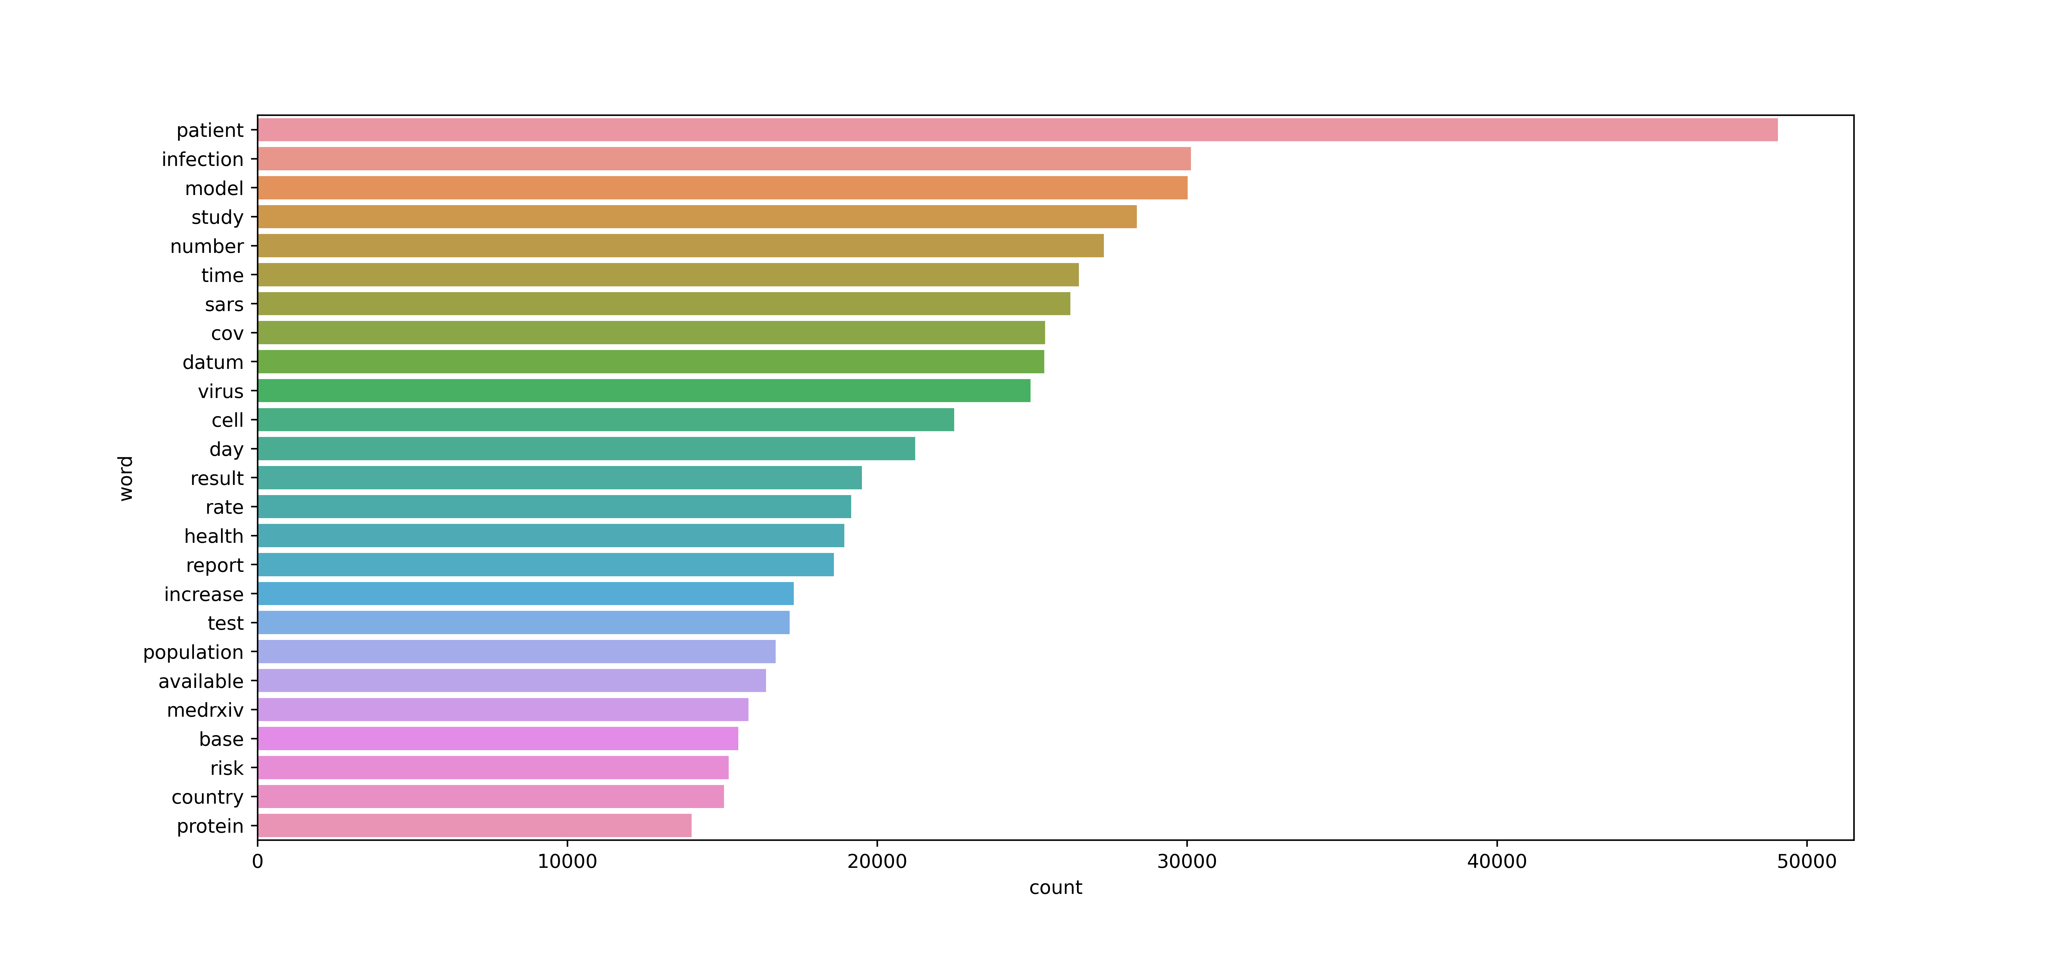
Top 25 most commonly used words

Slide 9
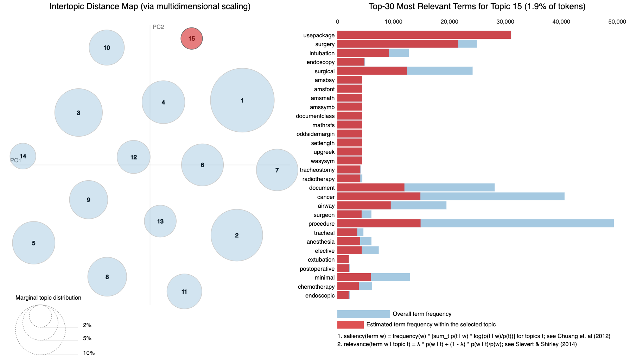
Results of Topic Modeling: LDA with 15 components

Slide 10
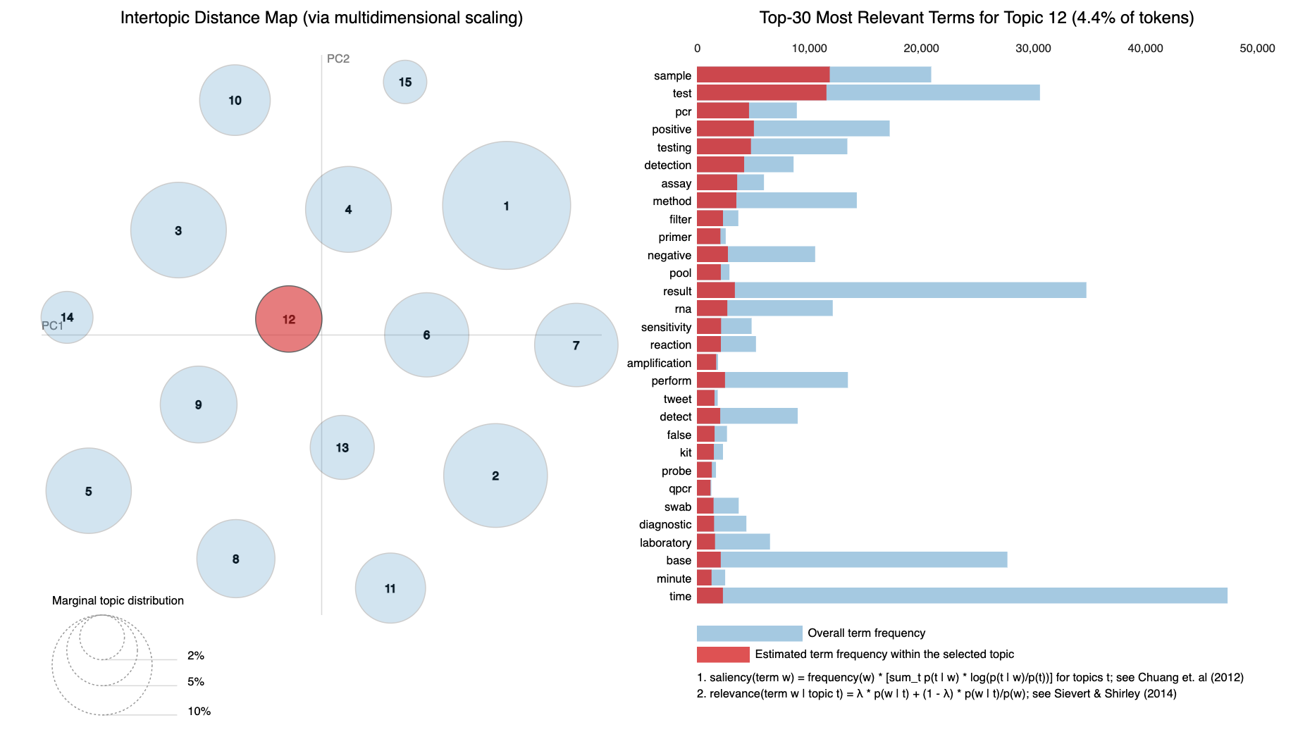
Results of Topic Modeling: LDA with 15 components

Slide 11
15 Topics

Slide 12
15 Topics
Title: SARS-COV-2 infection (coronavirus disease 2019) for the gastrointestinal consultant
Abstract: The current pandemic due to the severe acute respiratory syndrome coronavirus 2 has caused an extreme burden for health care systems globally, and the number of cases is expected to continue to increase…
Results: Pneumonia is the most common serious clinical manifestation of COVID-19, with fever, fatigue, myalgia, and dry cough being the most common features[6]. Other common symptoms include the anorexia…
Text: Since its emergence in December 2019, the coronavirus disease 2019 (COVID-19) has spread to over 146 countries and has been declared a pandemic by the World Health Organization (WHO). The virus…

Slide 13
15 Topics
Title: SARS-COV-2 infection (coronavirus disease 2019) for the gastrointestinal consultant
Abstract: The current pandemic due to the severe acute respiratory syndrome coronavirus 2 has caused an extreme burden for health care systems globally, and the number of cases is expected to continue to increase…
Results: Pneumonia is the most common serious clinical manifestation of COVID-19, with fever, fatigue, myalgia, and dry cough being the most common features[6]. Other common symptoms include the anorexia…
Text: Since its emergence in December 2019, the coronavirus disease 2019 (COVID-19) has spread to over 146 countries and has been declared a pandemic by the World Health Organization (WHO). The virus…
Topic 9 - Symptoms Analysis

Slide 14
15 Topics
Title: SARS-COV-2 infection (coronavirus disease 2019) for the gastrointestinal consultant
Abstract: The current pandemic due to the severe acute respiratory syndrome coronavirus 2 has caused an extreme burden for health care systems globally, and the number of cases is expected to continue to increase…
Results: Pneumonia is the most common serious clinical manifestation of COVID-19, with fever, fatigue, myalgia, and dry cough being the most common features[6]. Other common symptoms include the anorexia…
Text: Since its emergence in December 2019, the coronavirus disease 2019 (COVID-19) has spread to over 146 countries and has been declared a pandemic by the World Health Organization (WHO). The virus…
Topic 9 - Symptoms Analysis
Can be found by: ['study', 'respiratory', 'symptom', 'infection’, 'patient’, ‘cough’, ‘chest’,…]

Slide 15
FUTURE WORK
Build an app that will be showing articles based on topics and words used in the text of those articles
Build a recommendation system that will be showing research articles similar to the current one

Slide 16
Thank you

