Slide 1
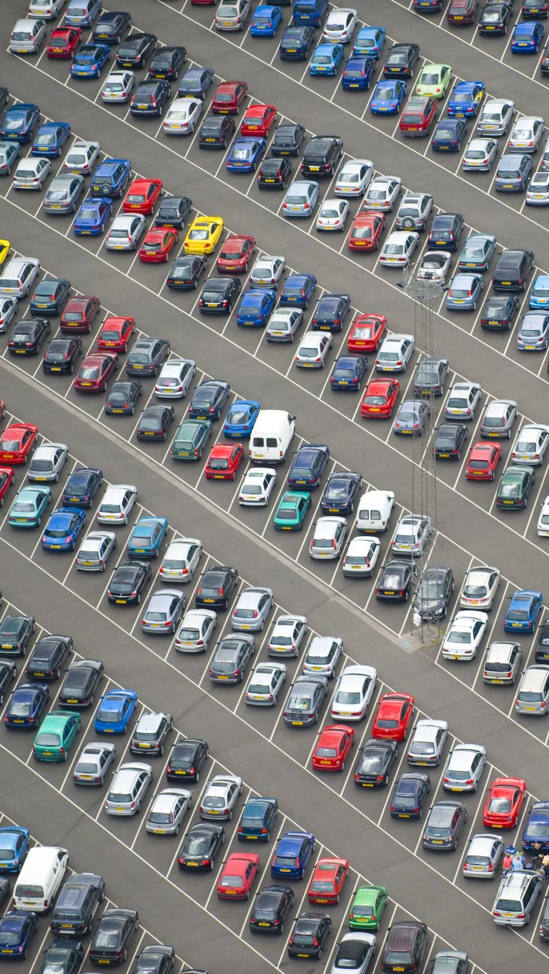
Car Identification

Slide 2
The traditional vehicle identification system relies on manual human observation or plate number recognition
It is laborious and time-consuming task for a human to monitor every vehicle on screen
Can be automated by leveraging the machine learning

Slide 3
data
8218 images of 100 classes of cars

Slide 4
methodology
Data acquisition
kaggle.com

Slide 5
methodology
Data acquisition
kaggle.com
Preliminary analysis and image preprocessing

Slide 6
methodology
Data acquisition
kaggle.com
Preliminary analysis and image preprocessing
Baseline model (CNN)

Slide 7
methodology
Data acquisition
kaggle.com
Preliminary analysis and image preprocessing
Baseline model (CNN)
Transfer learning applied (InceptionV3)

Slide 8
methodology
Data acquisition
kaggle.com
Preliminary analysis and image preprocessing
Baseline model (CNN)
Transfer learning applied (InceptionV3)
Final model tuning

Slide 9
Baseline model
CNN model
Input layer
3 convolutional layers with max pooling
2 fully connected dense layers
Accuracy – 0.3

Slide 10
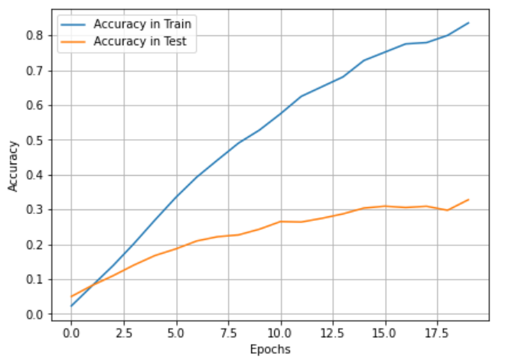
Model tuning
InceptionV3 with pretrained imagenet weights

Slide 11
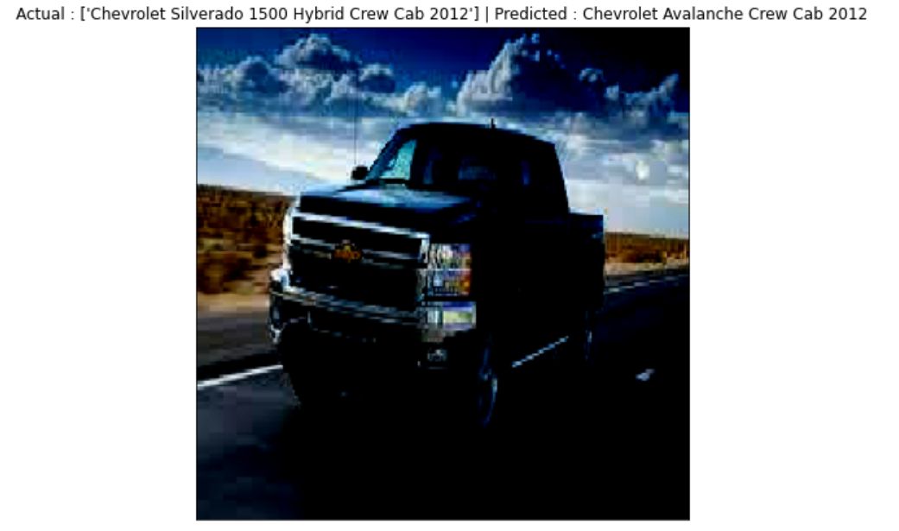
Predicts make of the car correctly

Slide 12
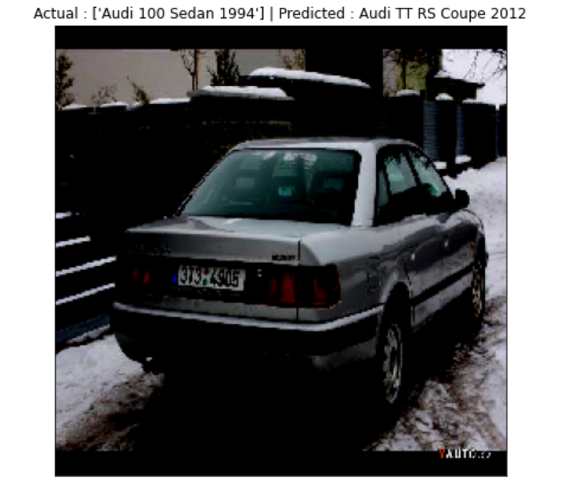
Predicts make of the car correctly

Slide 13
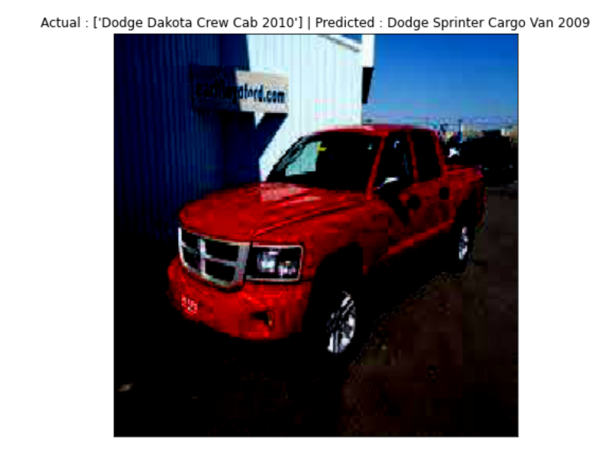
Predicts make of the car correctly

Slide 14
Future work
More data (good quality images, more images)
More computing power
Apply different transfer learning algorithms

Slide 15
Thank you

