Slide 1
Credit Card Fraud Detection

Slide 2
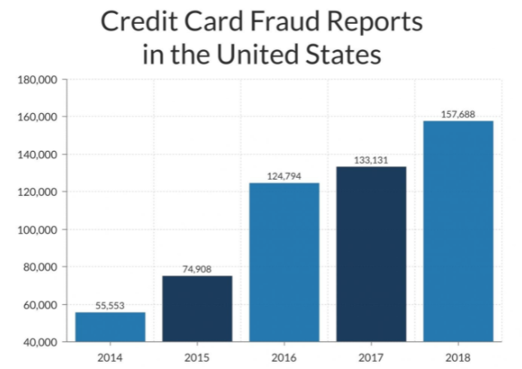
Problem statement
There were over 390,000 reports of credit card fraud in 2020
In 2020, credit cards were most frequently identified as the payment method in fraud reports

Slide 3
data
Dataset from Kaggle.com
1852394 observations
1842743 legit transactions
9651 fraud transaction
Target: true class – fraudulent transaction
false class – legit transaction

Slide 4
methodology
Data acquisition
kaggle.com

Slide 5
methodology
Data acquisition
kaggle.com
EDA
Dealing with missing values
Categorical features conversion
Handling class imbalance

Slide 6
methodology
Data acquisition
kaggle.com
EDA
Dealing with missing values
Categorical features conversion
Handling class imbalance
Model Selection and Training
Logistic Regression
Random Forest
XGBoost

Slide 7
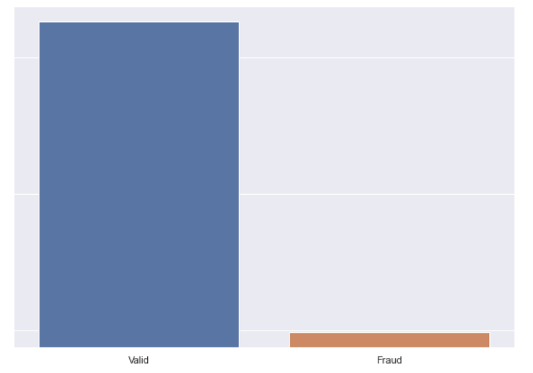
Handling class imbalance
1842743
9651
Stratified Train – Test Split
SMOTE to correct class imbalance

Slide 8
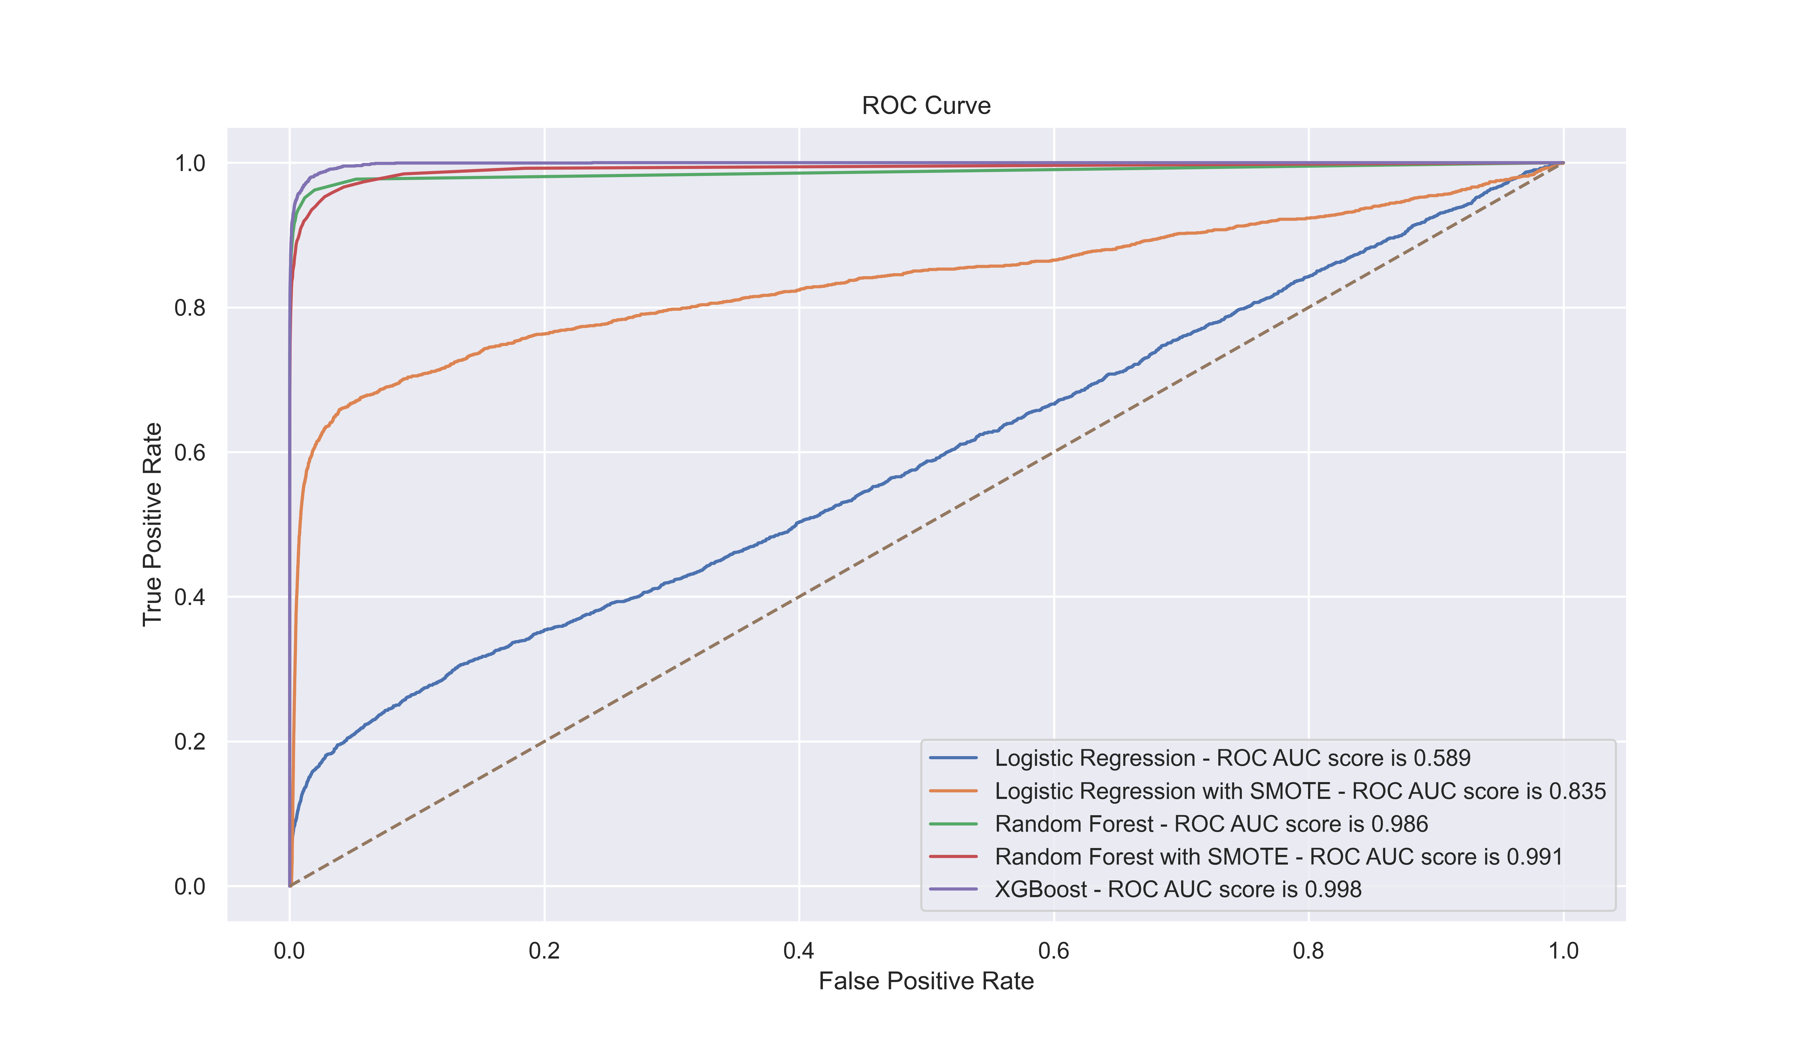
modeling

Slide 9
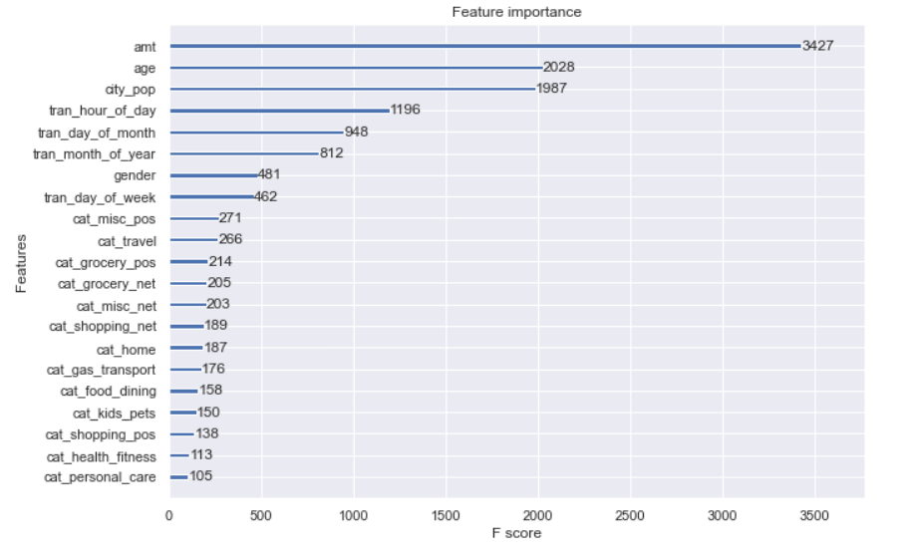
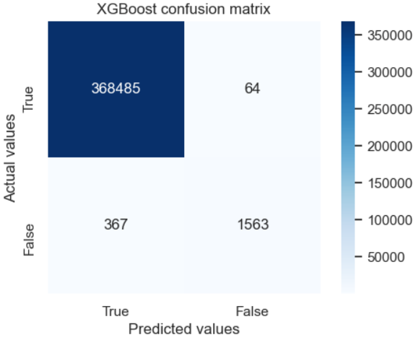
Final model - xgboost

Slide 10
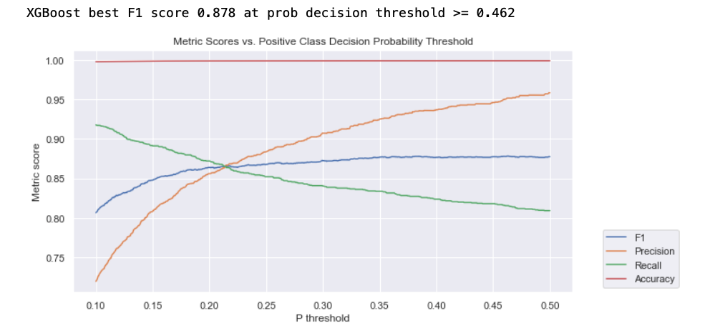
Model tuning

Slide 11
Conclusions and future work
Classification models are good with identifying credit card fraud
Spend more time on model tuning
Explore more data, add more features to the analysis

Slide 12
Thank you

