Slide 1

Credit Card Fraud Detection

Slide 2
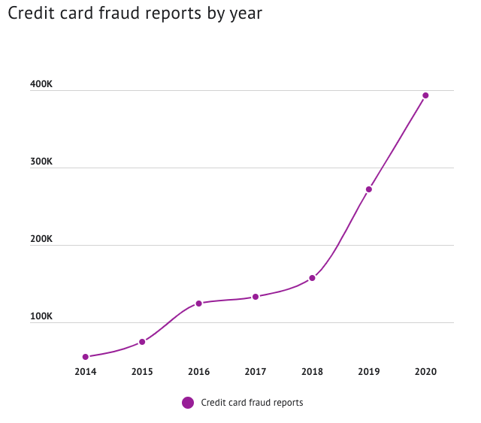
Problem statement
There were over 390 000 reports of credit card fraud in 2020
It is a 44,7 percent increase from the 2019

Slide 3
data
1.85 million of transactions
1.84 million – legit transactions
10 000 - fraudulent transactions

Slide 4
methodology
- Data acquisition

Slide 5
methodology
- Data acquisition
- EDA
SQL and Pandas

Slide 6
methodology
- Data acquisition
- EDA
SQL and Pandas
- Model selection
and training
pyspark

Slide 7
methodology
- Data acquisition
- EDA
SQL and Pandas
- Model selection
and training
pyspark
- Model tuning
pyspark

Slide 8
Process flow
eda
SQL
Pandas
Dealing with missing values
Categorical features conversion
Feature selection

Slide 9
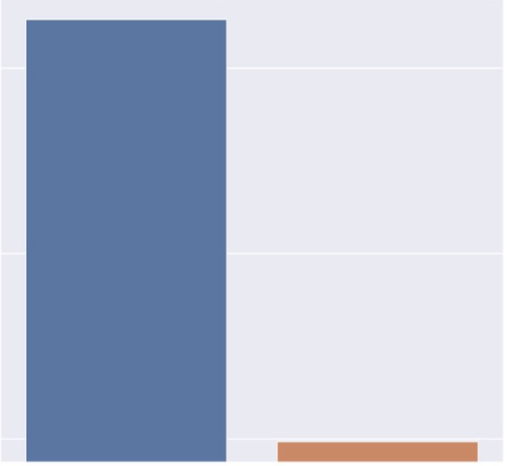
Process flow
Handling class imbalance
1.8 mil
10 000
Stratified train – test split
Oversample minority class
Valid
Fraud

Slide 10
Model selection and tuning
Logistic Regression - ROC AUC 0.825670
Random Forest - ROC AUC 0.857615
GBTClassifier - ROC AUC 0.928379

Slide 11
Model selection and tuning
Logistic Regression - ROC AUC 0.825670
Random Forest - ROC AUC 0.857615
GBTClassifier - ROC AUC 0.928379
Grid Search with Cross Validation for tuning the model

Slide 12
Final model
Accurracy - 0.974
Precision – 0.983
Recall – 0.926
F1 score – 0.953
ROC AUC – 0.923
GBTClassifier

Slide 13
Future work
Train model on more data
Spend more time on model tuning
Deploy the model

Slide 14
Thank you

