Slide 1

Movies
Domestic box office prediction

Slide 2
introduction

Slide 3
$42.2 billion
Global box office in 2019

Slide 4
methodology

Slide 5
Predict total domestic box office gross
Features:
Budget
Running time
Number of theaters
Rating
Genres

Slide 6

DATa
Web-scraped from BoxOfficeMojo.com
Top grossing movies for 2012 – 2019 years
917 movies

Slide 7
Results

Slide 8
Key features
Budget (invest more money into your movie)
Theaters (get your movie to as many theaters as you can)
PG – 13
Make thrillers, comedies, or romances

Slide 9
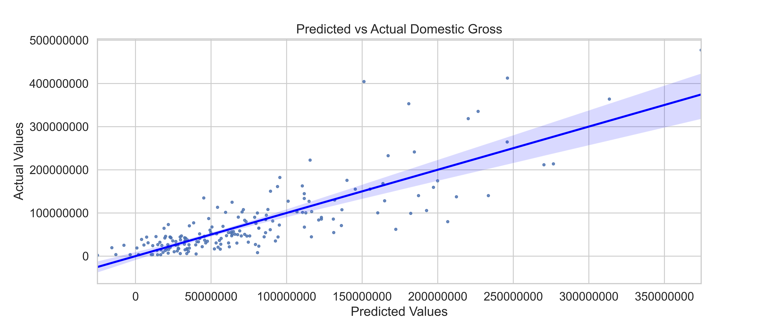
R squared = 0.679

Slide 10
Future work
Add more features to the model to investigate what other factors will play a role in box office gross
Add time series analysis to identify how changes in release date affects the target
Add data from other recourses to the analysis (imdb.com, rottentomatoes.com, etc)

Slide 11
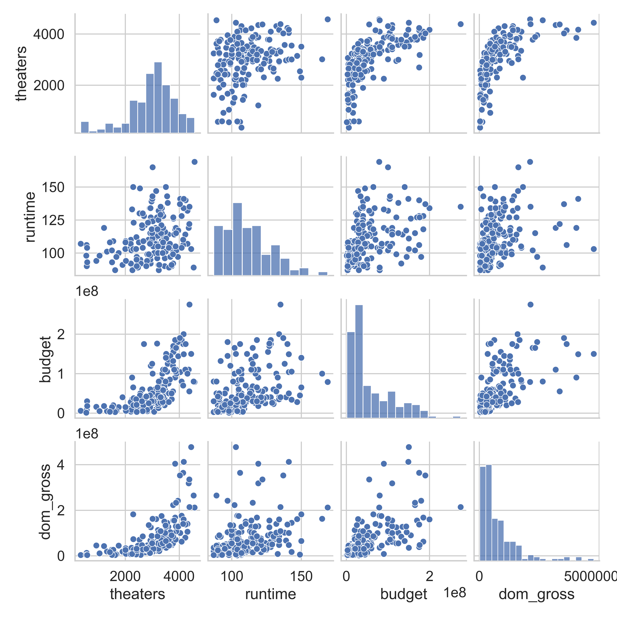
Appendix A

Slide 12
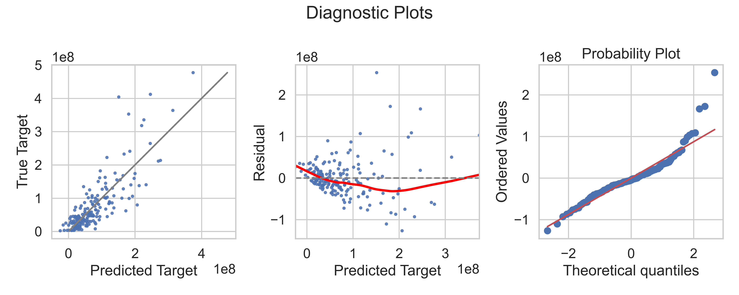
Appendix b

Slide 13
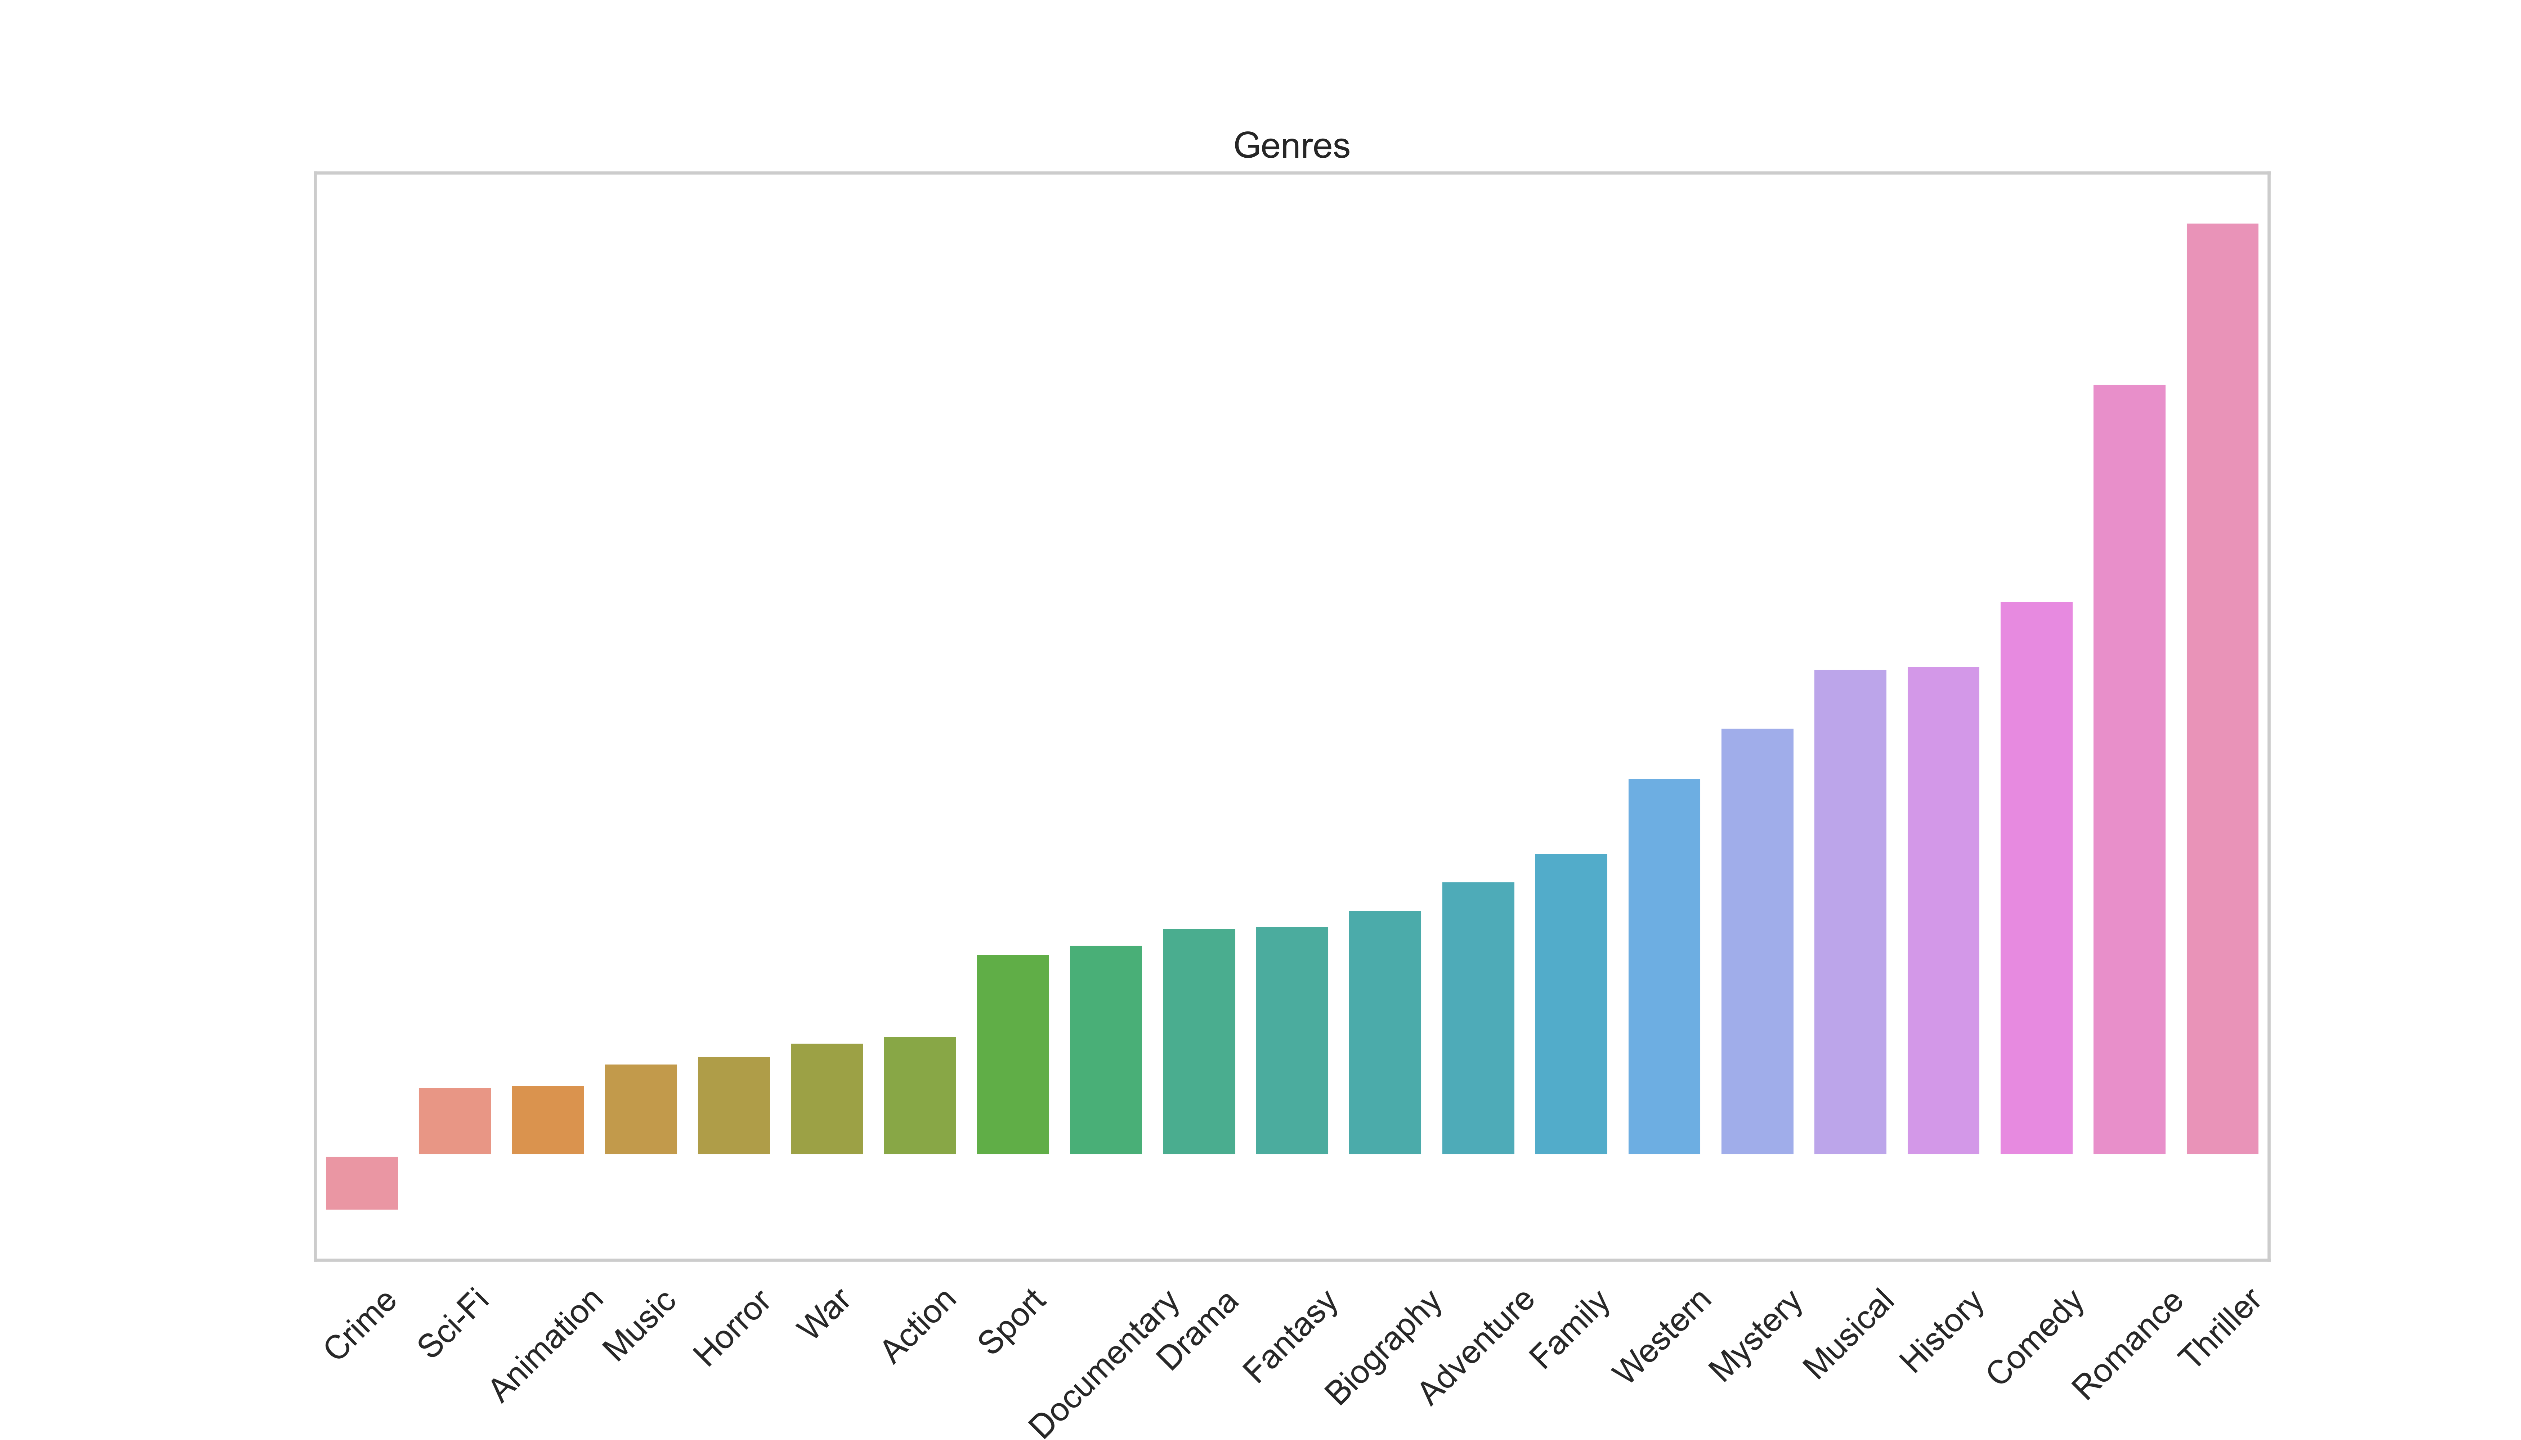
Appendix c

Slide 14
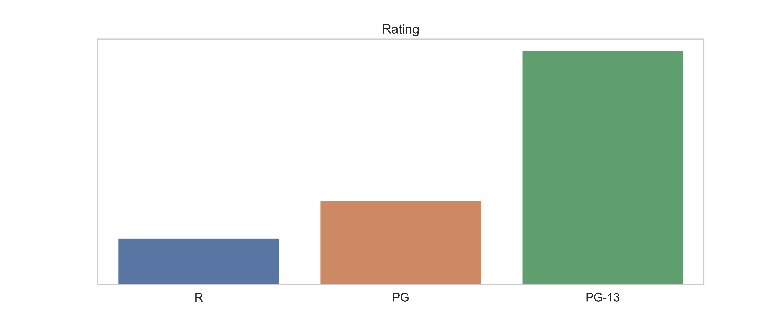
Appendix d

Slide 15
Appendix e
Lasso Regularization - alpha = 0.01 R squared = 0.529
Ridge Regularization - alpha = 0.01 R squared = 0.533

Slide 16
Questions?

