Slide 1
Unleashing the Power of SIEM
Security Information Event Management

Slide 2
Introduction to SIEM
Security Information Event Management (SIEM) tools are software solutions designed to help organizations monitor and manage their IT infrastructure security. SIEM tools gather data from various sources, including network devices, servers, and applications, and analyze it to detect security incidents and threats.
The main goal of SIEM tools is to provide a centralized view of an organization's security posture, allowing security teams to quickly identify and respond to security incidents.

Slide 3
Key Features
SIEM
Key Features of SIEM Tools
SIEM tools typically offer several key features, including log management, event correlation, and real-time monitoring. Log management involves collecting and storing logs from various sources, while event correlation involves analyzing these logs to identify patterns and potential security incidents.
Real-time monitoring allows security teams to receive alerts and notifications as soon as an incident is detected, enabling them to take immediate action to mitigate the threat.

Slide 4
Unleashing the Power of
SIEM
Time-honored technology and modern-day innovation come together in a dynamic symphony of security with SIEM tools.
Advanced analytics and automated processes are the driving force behind this powerful and comprehensive solution.
SIEM tools are honed to detect threats and trigger high fidelity alerts by leveraging the power of Artificial Intelligence, Machine Learning, and advanced analytic algorithms.

Slide 5
AlienVault OSSIM
Wazuh
01
04
ELK Stack
MozDef
02
05
OSSEC
SIEMonster
03
06
Few Open Source SIEM Tools
This is one of the oldest SIEM systems around but it is very well supported by AT&T
A fork of OSSEC that has better logfile management services than the original and relies on ELK.
A free suite of data collection, sorting, and visualization tools that let you create your own SIEM threat detection rules.
A basic SIEM for small businesses that integrates ELK Stack. Run it on Docker or CentOS Linux.
This tool has good threat detection routines but weak log management functions so splice it with ELK Stack for the best of breed
A competent SIEM for small businesses with a paid version for larger organizations

Slide 6

Features & Capabilities
The Open Source SIEM (OSSIM) software by AT&T Cybersecurity, prides itself as the world’s most widely used open-source SIEM. OSSIM leverages the power of the AT&T Open Threat Exchange (OTX)—which provides open access to a global community of threat researchers and security professionals; thereby allowing users to both contribute and receive real-time information about malicious activities. AT&T provides ongoing development and maintenance for OSSIM.
Pros
Available for Mac and Windows
Can scan log files as well as provide vulnerability assessment reports based on devices and applications scanned on the network
User powered portal allows customers to share their threat data to improve the system
Uses artificial intelligence to aid administrators in hunting down threats
Asset discovery and inventory
Vulnerability assessment
Intrusion detection
Behavioral monitoring
SIEM event correlation

Slide 7

Key Features
In the world of open-source security, OSSEC is the major brand rival to AlienVault OSSIM. This project has been running since 2004. The project is currently managed by Atomicorp, which offers paid additions to the free OSSEC, but the base package is still free to use. OSSEC is a host-based intrusion detection system (HIDS). This is part of a SIEM – the SIM part – because a full SIEM also includes live network activity data as a source for its security searches, which is the SEM of SIEM. The free tool provides a system inventory, log processing, file integrity monitoring, and intrusion detection. It can also be set up to implement automated responses.
Pros
Can be used on a wide range of operating systems, Linux, Windows, Unix, and Mac
Can function as a combination of SIEM and HIDS
The interface is easy to customize and highly visual
Community-built templates allow administrators to get started quickly
Works well with ELK
Threat detection rules
Adaptable for different source data feeds

Slide 8
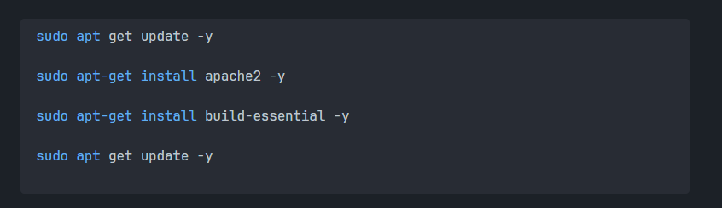
Installation Steps
For OSSEC
In this I would be guiding the steps to install on a Linux Machine (Debian based)
First Install the necessary packages

Slide 9
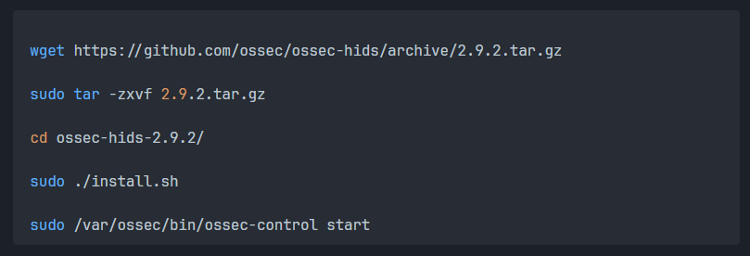
For OSSEC
Installation Steps
Get the OSSEC tools and Install (I am using CUI for all the tasks)

Slide 10
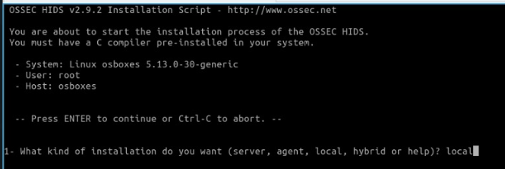
For OSSEC
Installation Steps
Enter local when prompted, and wait till it finishes the installation

Slide 11
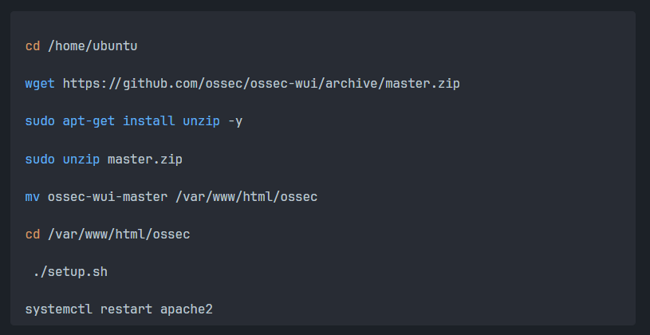
For OSSEC
Installation Steps
Navigate to home directory and install Web User Interface for OSSEC and make it available globally

Slide 12
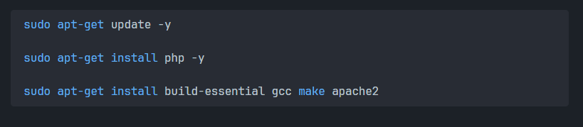
For OSSEC
Installation Steps
Install additional dependencies for the proper working of OSSEC

Slide 13
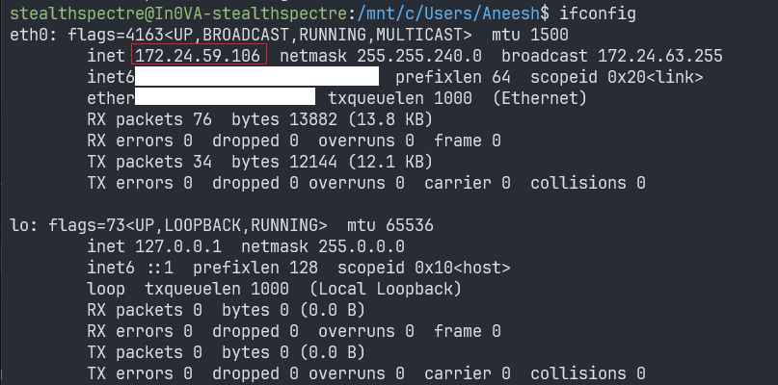
OSSEC
Opening
Using `ifconfig` command note the IP address so that you can open WEB UI in the browser

Slide 14
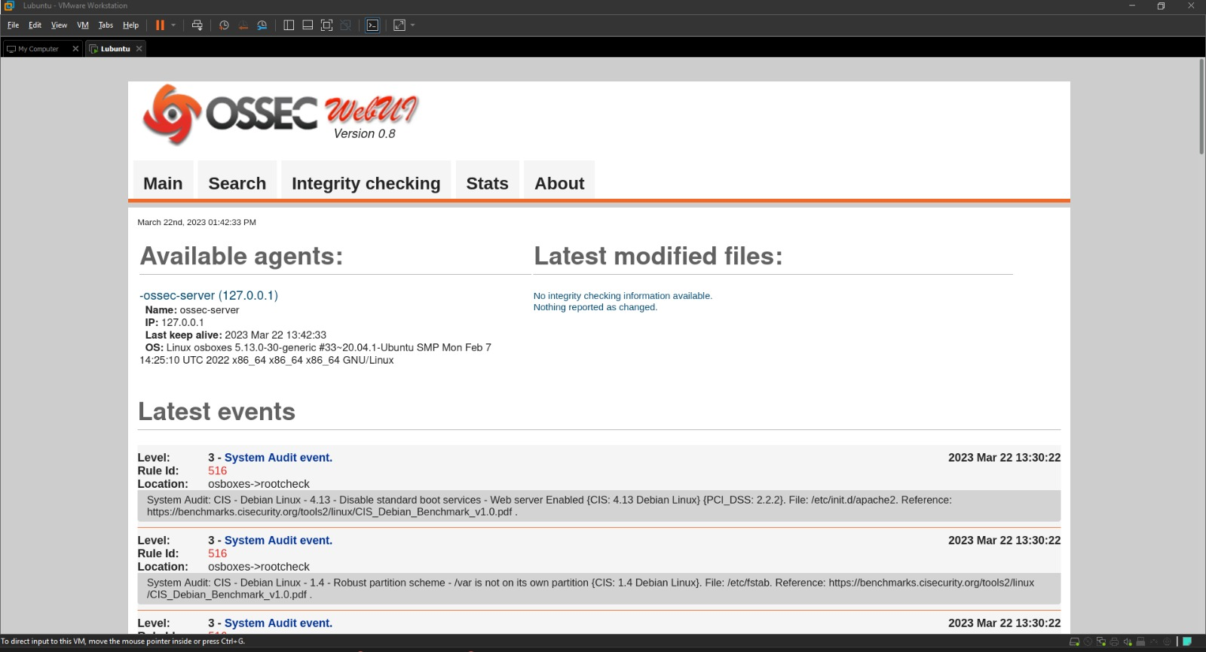
OSSEC
Opening
Navigate to “http://<ip_address>/ossec” to view the home page

Slide 15
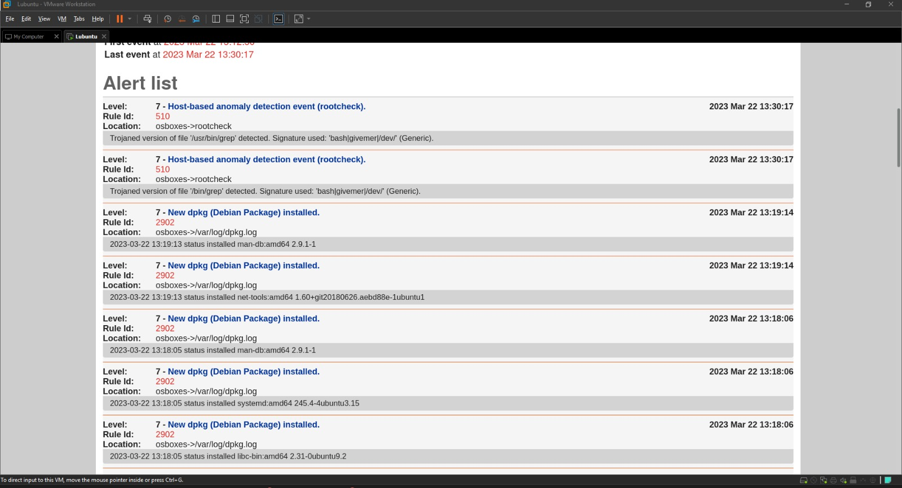
OSSEC
Opening
You can view all the Alert Lists here and can have complete Log of your machine

Slide 16
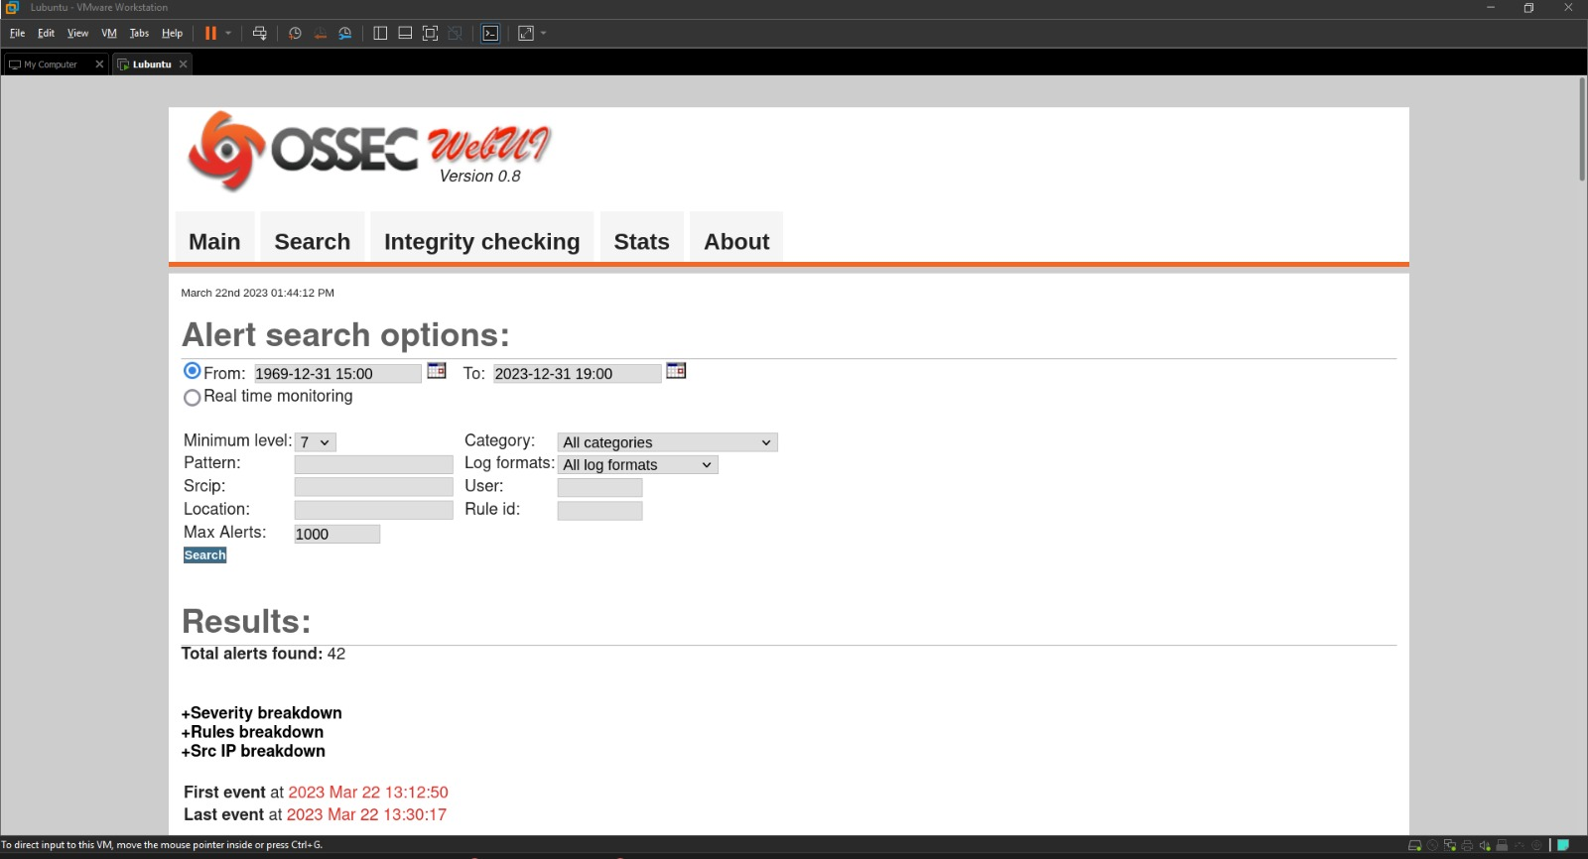
OSSEC
Opening
You can also view the alerts using a range of Dates

Slide 17
Conclusion
In conclusion, Security Information and Event Management (SIEM) tools play a vital role in protecting organizations from cyber threats by providing real-time monitoring, detection, and analysis of security events.
In today's ever-evolving threat landscape, organizations must take a proactive approach to cybersecurity. Deploying a SIEM tool like OSSEC can help organizations stay ahead of potential threats, ensuring the security of their critical data and systems.
Additionally, SIEM tools should be integrated with other security solutions, such as firewalls, anti-virus software, and vulnerability scanners, to provide comprehensive protection against cyber threats.
Threat!!

