Slide 1
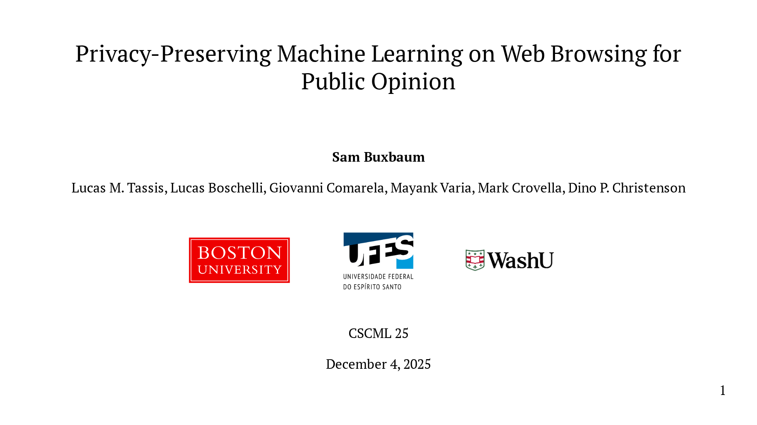
Notes:
Hello, I'm Sam Buxbaum I'm a PhD student at Boston University And today I'll be presenting a deployment of privacy-preserving machine learning on web browsing for political polling in the 2024 presidential election.

Slide 2

Notes:
This project is joint work with a great team of - cryptographers - political scientists - machine learning researchers

Slide 3
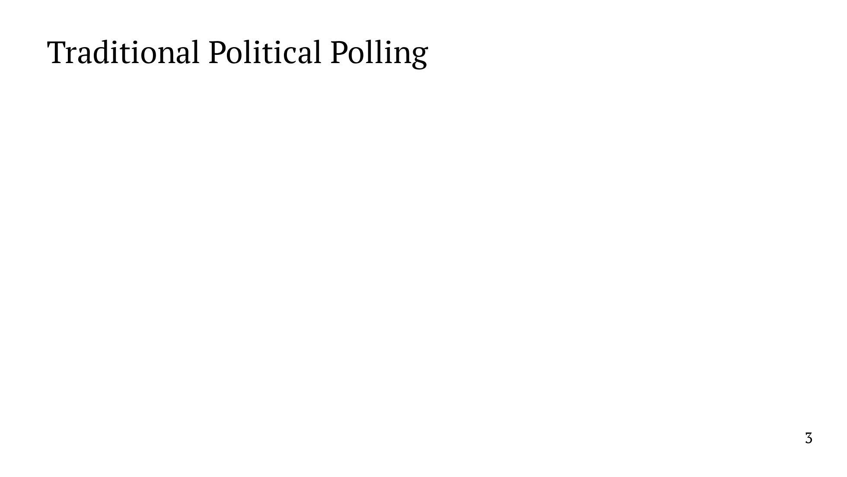
Notes:
This project is about a new way to do political polling. So I'll start with some background on traditional approaches to polling. In a typical poll, we collect data by either calling people or getting them to fill out a survey. This means that data collection takes time. There's typically a high latency between commissioning a poll and getting results. Second, data collection is a human-intensive process, so scaling to collect more data can be quite costly. Finally, traditional polling offers limited geographic and temporal coverage. Polls are restricted to a few key areas immediately before an election, which means many locations go unpolled for weeks or months. What I'm about to show is the complete list of polls commissioned in the state of WV in the last 3 months before the election. Just one. Now here's the same list... In the context of US presidential elections, this discrepancy makes sense. Pollster time is a scarce resource, and they want to spend that time on states they think will be competitive. But it does mean that we're leaving potentially valuable data and valuable insights on the table. If we were to have access to much more data, we might be able to learn quite a bit more and make more accurate predictions.

Slide 4
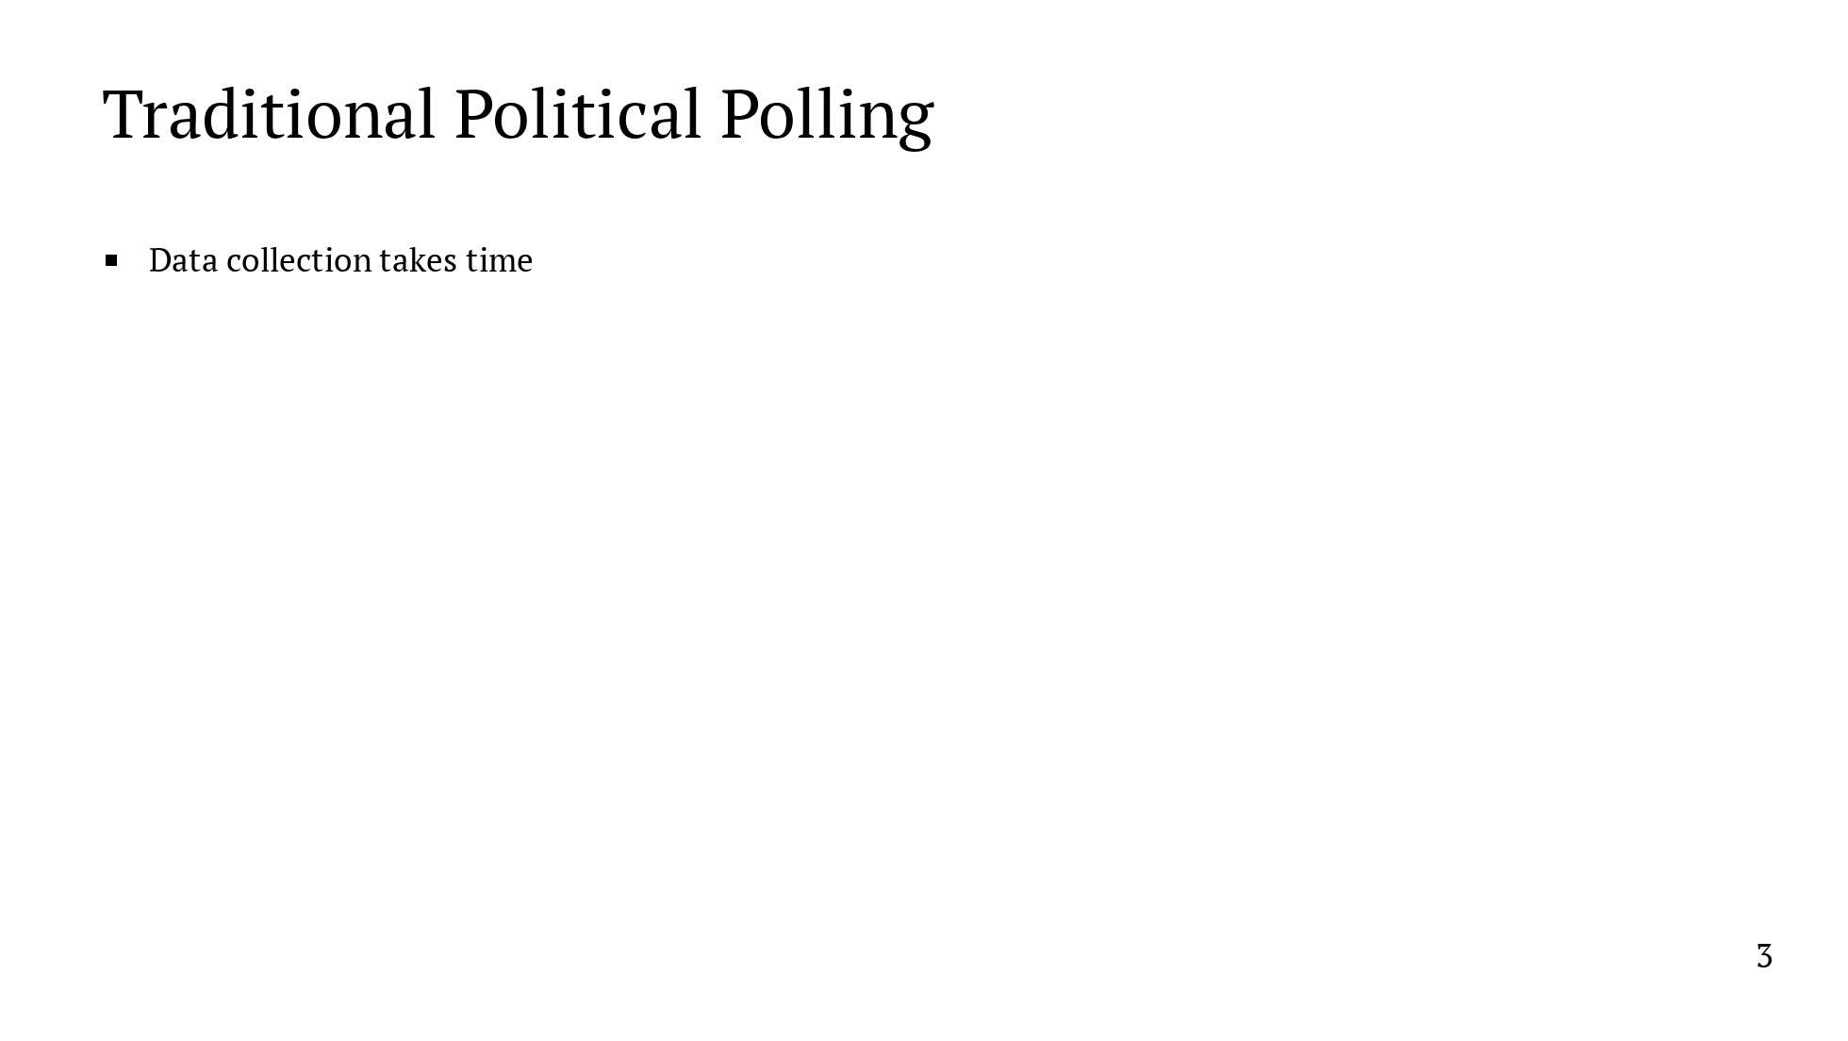
Notes:
This project is about a new way to do political polling. So I'll start with some background on traditional approaches to polling. In a typical poll, we collect data by either calling people or getting them to fill out a survey. This means that data collection takes time. There's typically a high latency between commissioning a poll and getting results. Second, data collection is a human-intensive process, so scaling to collect more data can be quite costly. Finally, traditional polling offers limited geographic and temporal coverage. Polls are restricted to a few key areas immediately before an election, which means many locations go unpolled for weeks or months. What I'm about to show is the complete list of polls commissioned in the state of WV in the last 3 months before the election. Just one. Now here's the same list... In the context of US presidential elections, this discrepancy makes sense. Pollster time is a scarce resource, and they want to spend that time on states they think will be competitive. But it does mean that we're leaving potentially valuable data and valuable insights on the table. If we were to have access to much more data, we might be able to learn quite a bit more and make more accurate predictions.

Slide 5
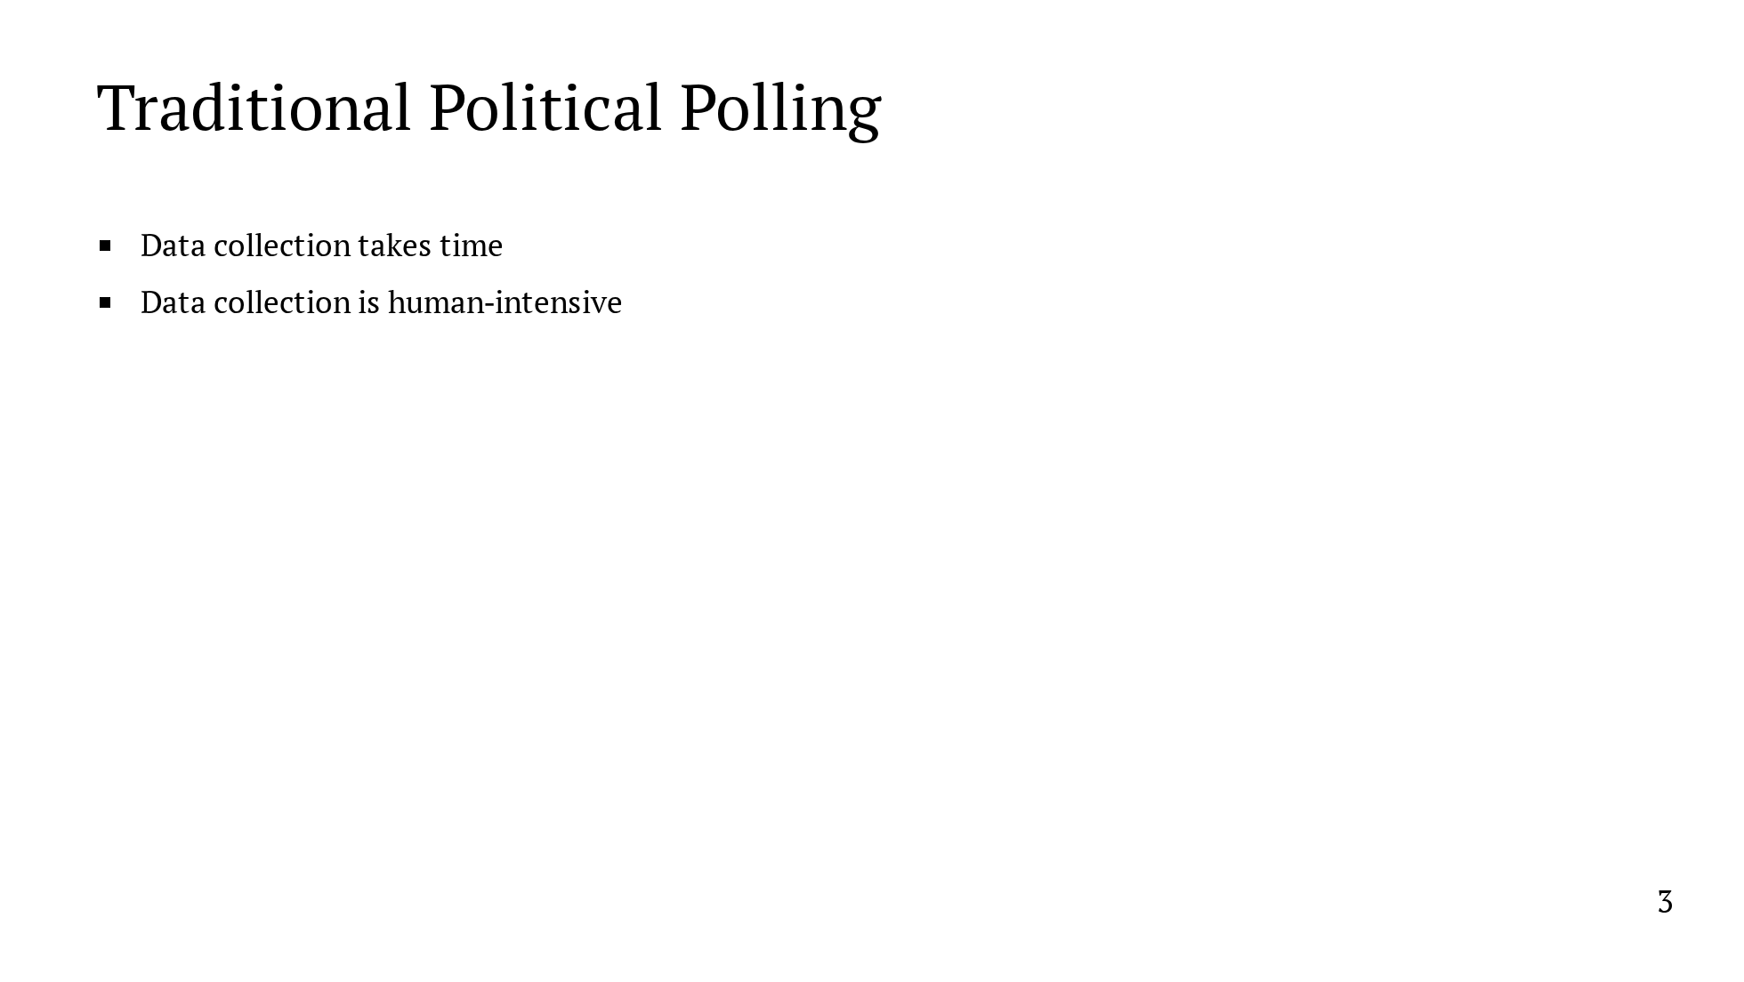
Notes:
This project is about a new way to do political polling. So I'll start with some background on traditional approaches to polling. In a typical poll, we collect data by either calling people or getting them to fill out a survey. This means that data collection takes time. There's typically a high latency between commissioning a poll and getting results. Second, data collection is a human-intensive process, so scaling to collect more data can be quite costly. Finally, traditional polling offers limited geographic and temporal coverage. Polls are restricted to a few key areas immediately before an election, which means many locations go unpolled for weeks or months. What I'm about to show is the complete list of polls commissioned in the state of WV in the last 3 months before the election. Just one. Now here's the same list... In the context of US presidential elections, this discrepancy makes sense. Pollster time is a scarce resource, and they want to spend that time on states they think will be competitive. But it does mean that we're leaving potentially valuable data and valuable insights on the table. If we were to have access to much more data, we might be able to learn quite a bit more and make more accurate predictions.

Slide 6
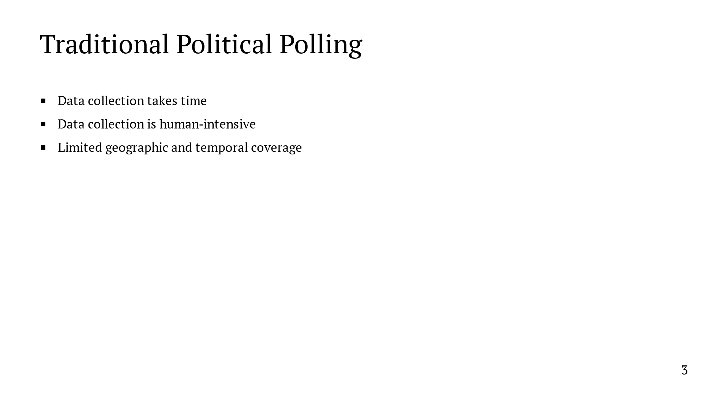
Notes:
This project is about a new way to do political polling. So I'll start with some background on traditional approaches to polling. In a typical poll, we collect data by either calling people or getting them to fill out a survey. This means that data collection takes time. There's typically a high latency between commissioning a poll and getting results. Second, data collection is a human-intensive process, so scaling to collect more data can be quite costly. Finally, traditional polling offers limited geographic and temporal coverage. Polls are restricted to a few key areas immediately before an election, which means many locations go unpolled for weeks or months. What I'm about to show is the complete list of polls commissioned in the state of WV in the last 3 months before the election. Just one. Now here's the same list... In the context of US presidential elections, this discrepancy makes sense. Pollster time is a scarce resource, and they want to spend that time on states they think will be competitive. But it does mean that we're leaving potentially valuable data and valuable insights on the table. If we were to have access to much more data, we might be able to learn quite a bit more and make more accurate predictions.

Slide 7
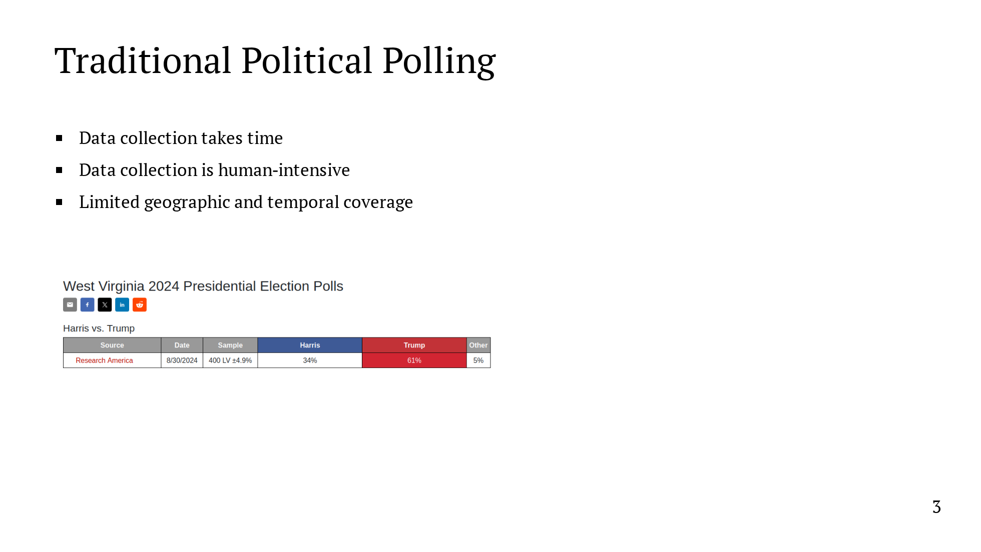
Notes:
This project is about a new way to do political polling. So I'll start with some background on traditional approaches to polling. In a typical poll, we collect data by either calling people or getting them to fill out a survey. This means that data collection takes time. There's typically a high latency between commissioning a poll and getting results. Second, data collection is a human-intensive process, so scaling to collect more data can be quite costly. Finally, traditional polling offers limited geographic and temporal coverage. Polls are restricted to a few key areas immediately before an election, which means many locations go unpolled for weeks or months. What I'm about to show is the complete list of polls commissioned in the state of WV in the last 3 months before the election. Just one. Now here's the same list... In the context of US presidential elections, this discrepancy makes sense. Pollster time is a scarce resource, and they want to spend that time on states they think will be competitive. But it does mean that we're leaving potentially valuable data and valuable insights on the table. If we were to have access to much more data, we might be able to learn quite a bit more and make more accurate predictions.

Slide 8
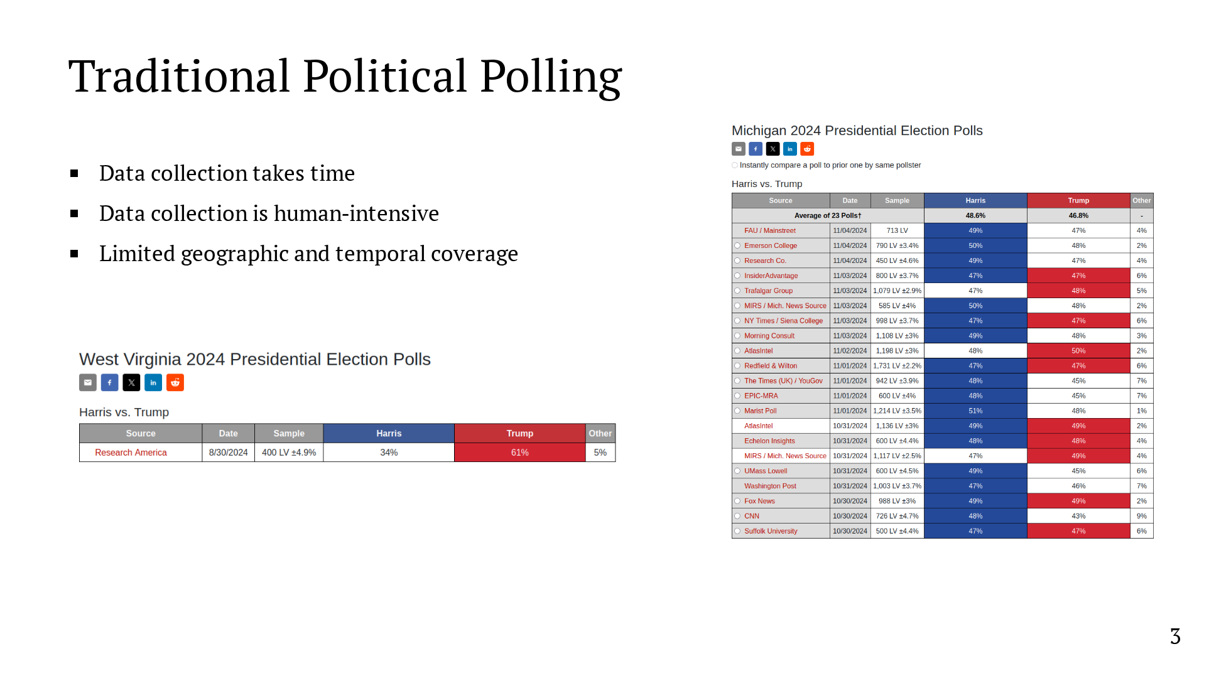
Notes:
This project is about a new way to do political polling. So I'll start with some background on traditional approaches to polling. In a typical poll, we collect data by either calling people or getting them to fill out a survey. This means that data collection takes time. There's typically a high latency between commissioning a poll and getting results. Second, data collection is a human-intensive process, so scaling to collect more data can be quite costly. Finally, traditional polling offers limited geographic and temporal coverage. Polls are restricted to a few key areas immediately before an election, which means many locations go unpolled for weeks or months. What I'm about to show is the complete list of polls commissioned in the state of WV in the last 3 months before the election. Just one. Now here's the same list... In the context of US presidential elections, this discrepancy makes sense. Pollster time is a scarce resource, and they want to spend that time on states they think will be competitive. But it does mean that we're leaving potentially valuable data and valuable insights on the table. If we were to have access to much more data, we might be able to learn quite a bit more and make more accurate predictions.

Slide 9
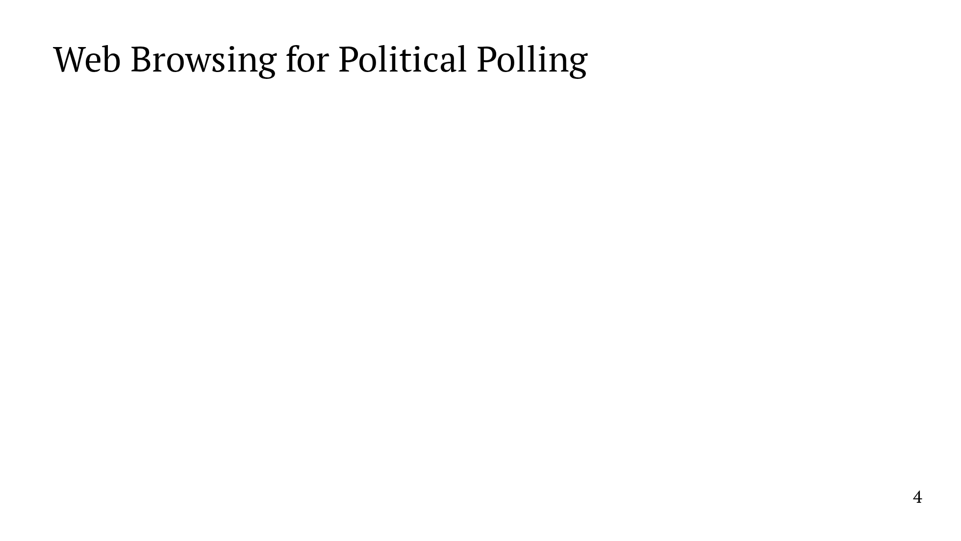
Notes:
With that in mind, we seek to conduct political polls based on web browsing data. The starting point is the following question: can website visits predict political leanings? It's not hard to see why this might be the case. The media you consume can say a lot about your politics. Take, for example, where you get your news. If you spend a lot of time on the New York Times website, that might be an indication that you lean more Democratic. If you frequent Fox News, that might indicate that you lean more Republican. In addition to providing a good signal for political beliefs, monitoring web browsing allows us to collect a lot more data. And, equally importantly, we can do so with a fully automated system.

Slide 10
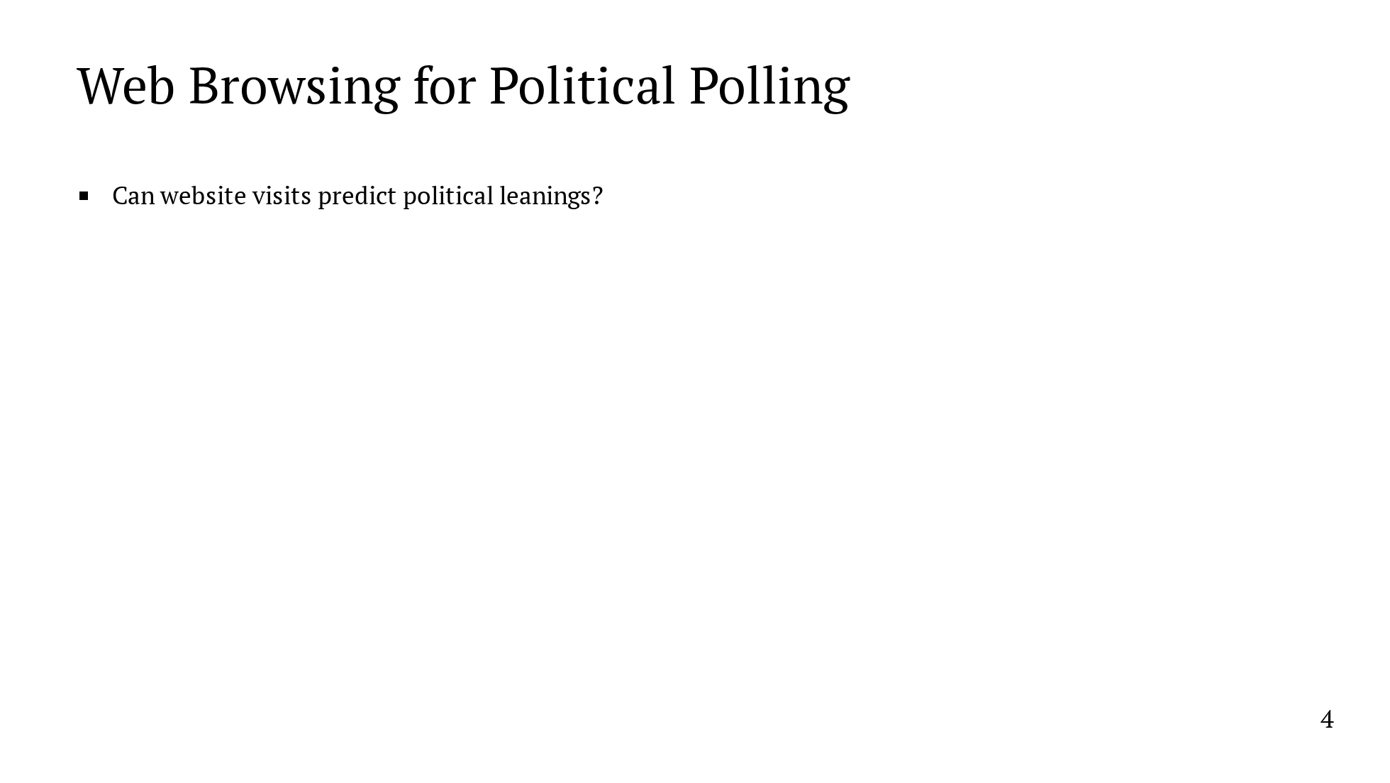
Notes:
With that in mind, we seek to conduct political polls based on web browsing data. The starting point is the following question: can website visits predict political leanings? It's not hard to see why this might be the case. The media you consume can say a lot about your politics. Take, for example, where you get your news. If you spend a lot of time on the New York Times website, that might be an indication that you lean more Democratic. If you frequent Fox News, that might indicate that you lean more Republican. In addition to providing a good signal for political beliefs, monitoring web browsing allows us to collect a lot more data. And, equally importantly, we can do so with a fully automated system.

Slide 11
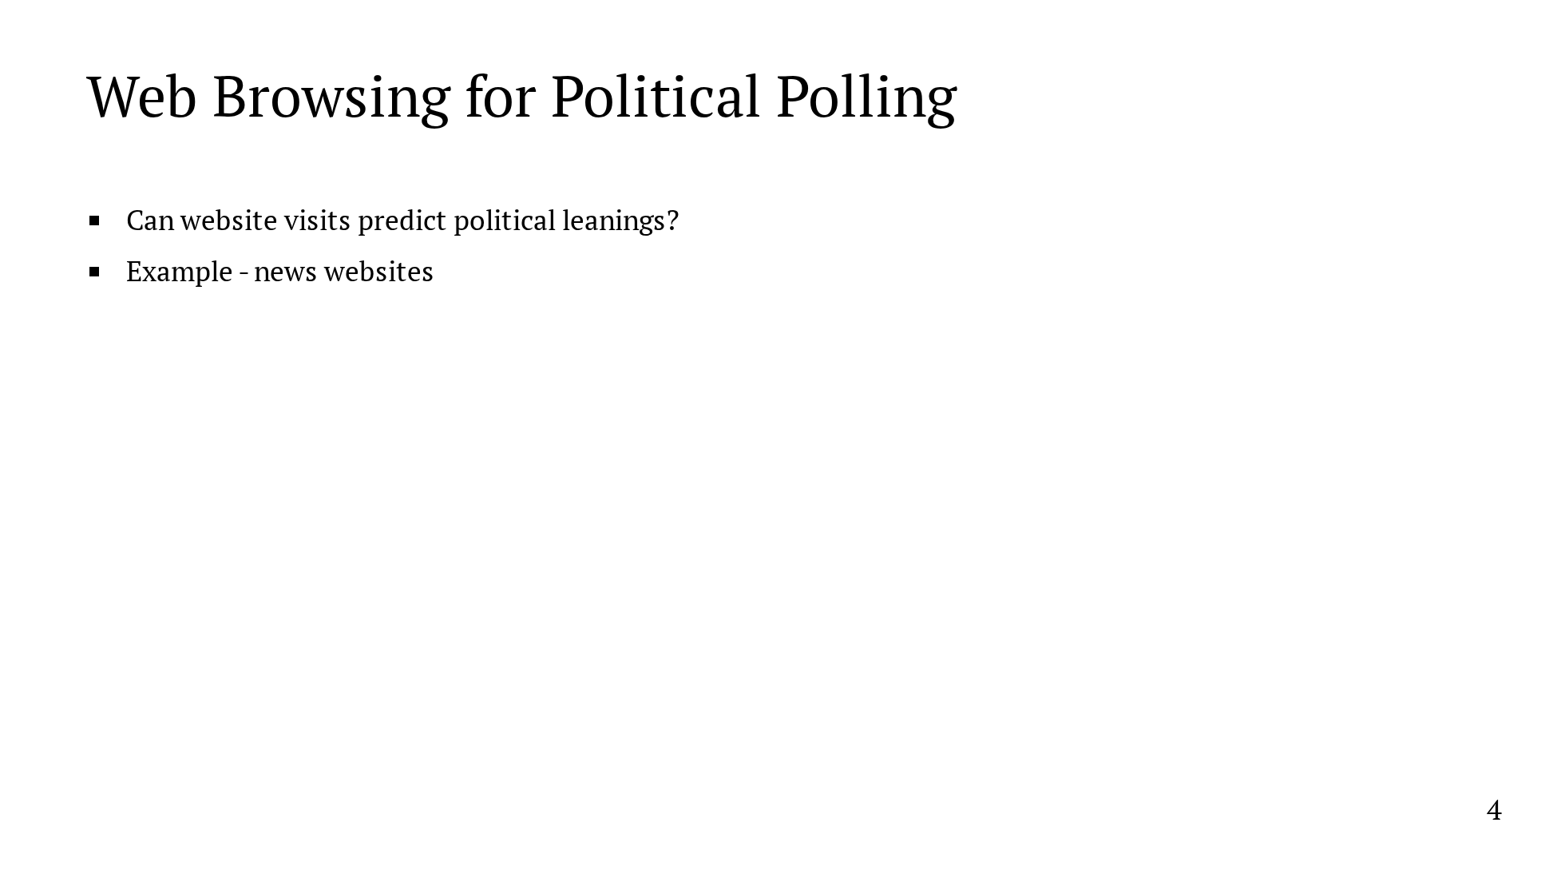
Notes:
With that in mind, we seek to conduct political polls based on web browsing data. The starting point is the following question: can website visits predict political leanings? It's not hard to see why this might be the case. The media you consume can say a lot about your politics. Take, for example, where you get your news. If you spend a lot of time on the New York Times website, that might be an indication that you lean more Democratic. If you frequent Fox News, that might indicate that you lean more Republican. In addition to providing a good signal for political beliefs, monitoring web browsing allows us to collect a lot more data. And, equally importantly, we can do so with a fully automated system.

Slide 12
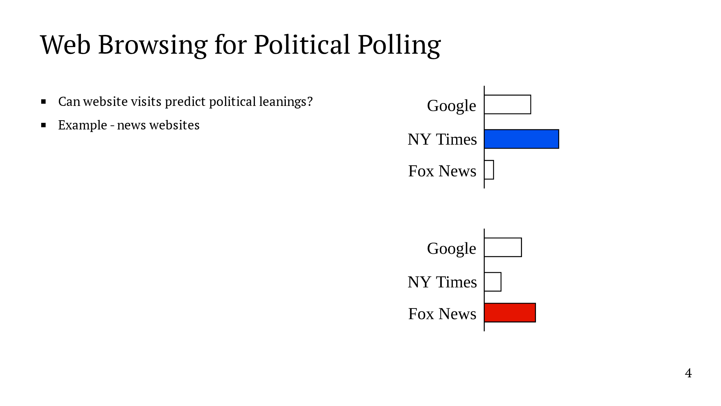
Notes:
With that in mind, we seek to conduct political polls based on web browsing data. The starting point is the following question: can website visits predict political leanings? It's not hard to see why this might be the case. The media you consume can say a lot about your politics. Take, for example, where you get your news. If you spend a lot of time on the New York Times website, that might be an indication that you lean more Democratic. If you frequent Fox News, that might indicate that you lean more Republican. In addition to providing a good signal for political beliefs, monitoring web browsing allows us to collect a lot more data. And, equally importantly, we can do so with a fully automated system.

Slide 13
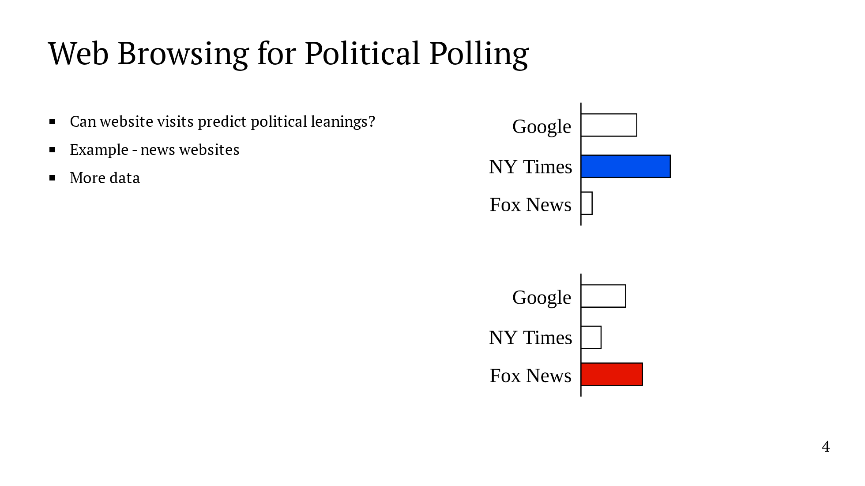
Notes:
With that in mind, we seek to conduct political polls based on web browsing data. The starting point is the following question: can website visits predict political leanings? It's not hard to see why this might be the case. The media you consume can say a lot about your politics. Take, for example, where you get your news. If you spend a lot of time on the New York Times website, that might be an indication that you lean more Democratic. If you frequent Fox News, that might indicate that you lean more Republican. In addition to providing a good signal for political beliefs, monitoring web browsing allows us to collect a lot more data. And, equally importantly, we can do so with a fully automated system.

Slide 14
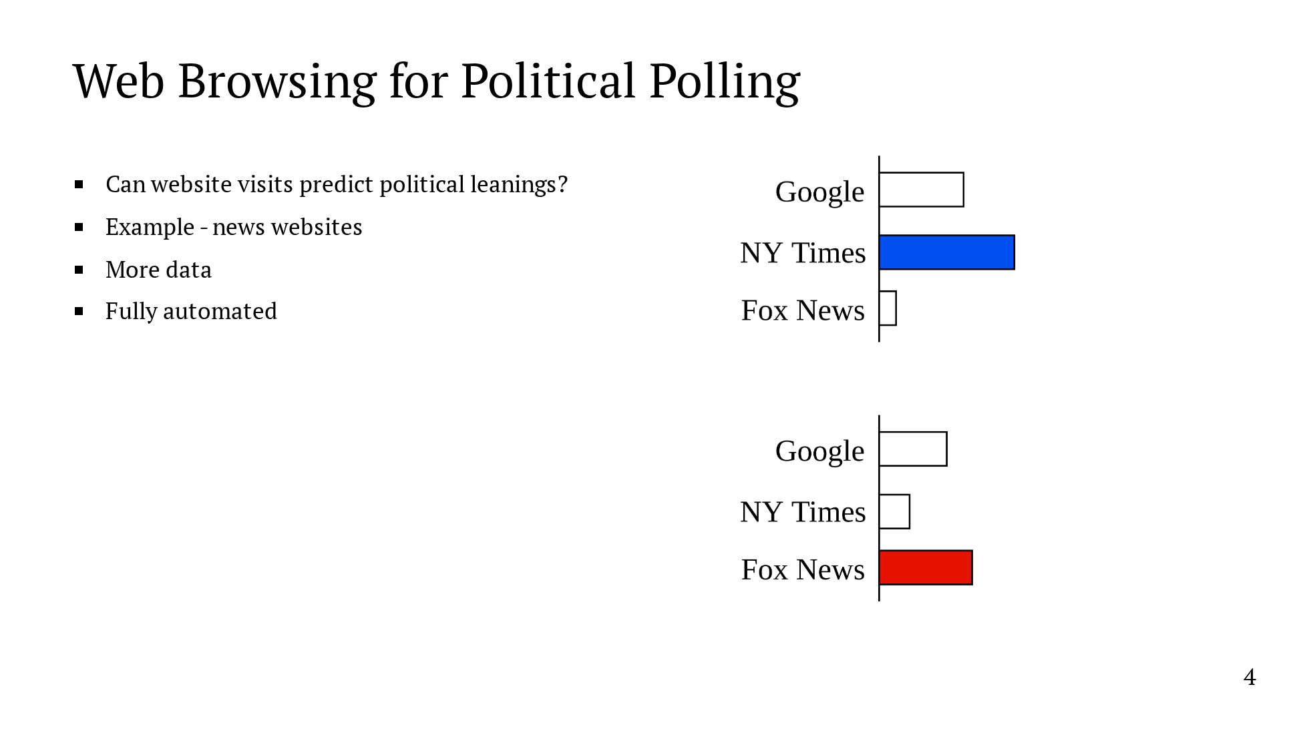
Notes:
With that in mind, we seek to conduct political polls based on web browsing data. The starting point is the following question: can website visits predict political leanings? It's not hard to see why this might be the case. The media you consume can say a lot about your politics. Take, for example, where you get your news. If you spend a lot of time on the New York Times website, that might be an indication that you lean more Democratic. If you frequent Fox News, that might indicate that you lean more Republican. In addition to providing a good signal for political beliefs, monitoring web browsing allows us to collect a lot more data. And, equally importantly, we can do so with a fully automated system.

Slide 15

Notes:
We're not the first to study this problem. Prior work in both machine learning and political science has shown that web browsing behavior can predict political sentiment and voting results. As an example that demonstrates the power of this approach to polling, Comarela et al. use web browsing data to quantify the effect of the 2016 "Comey Letter" on a state-by-state basis. What matters to us is that the event was too close to the election for other polling methods to detect the effect in time. You can see the impact at a state level on the right. And you can see a noticeable shift in the time series on the left. They also found that social media provides the best signal. By this, I mean not whether you visited a certain website, but whether you did so by clicking on a link on social media. And it's worth noting that this paper used a large plaintext dataset, and privacy was not a concern of this paper.

Slide 16
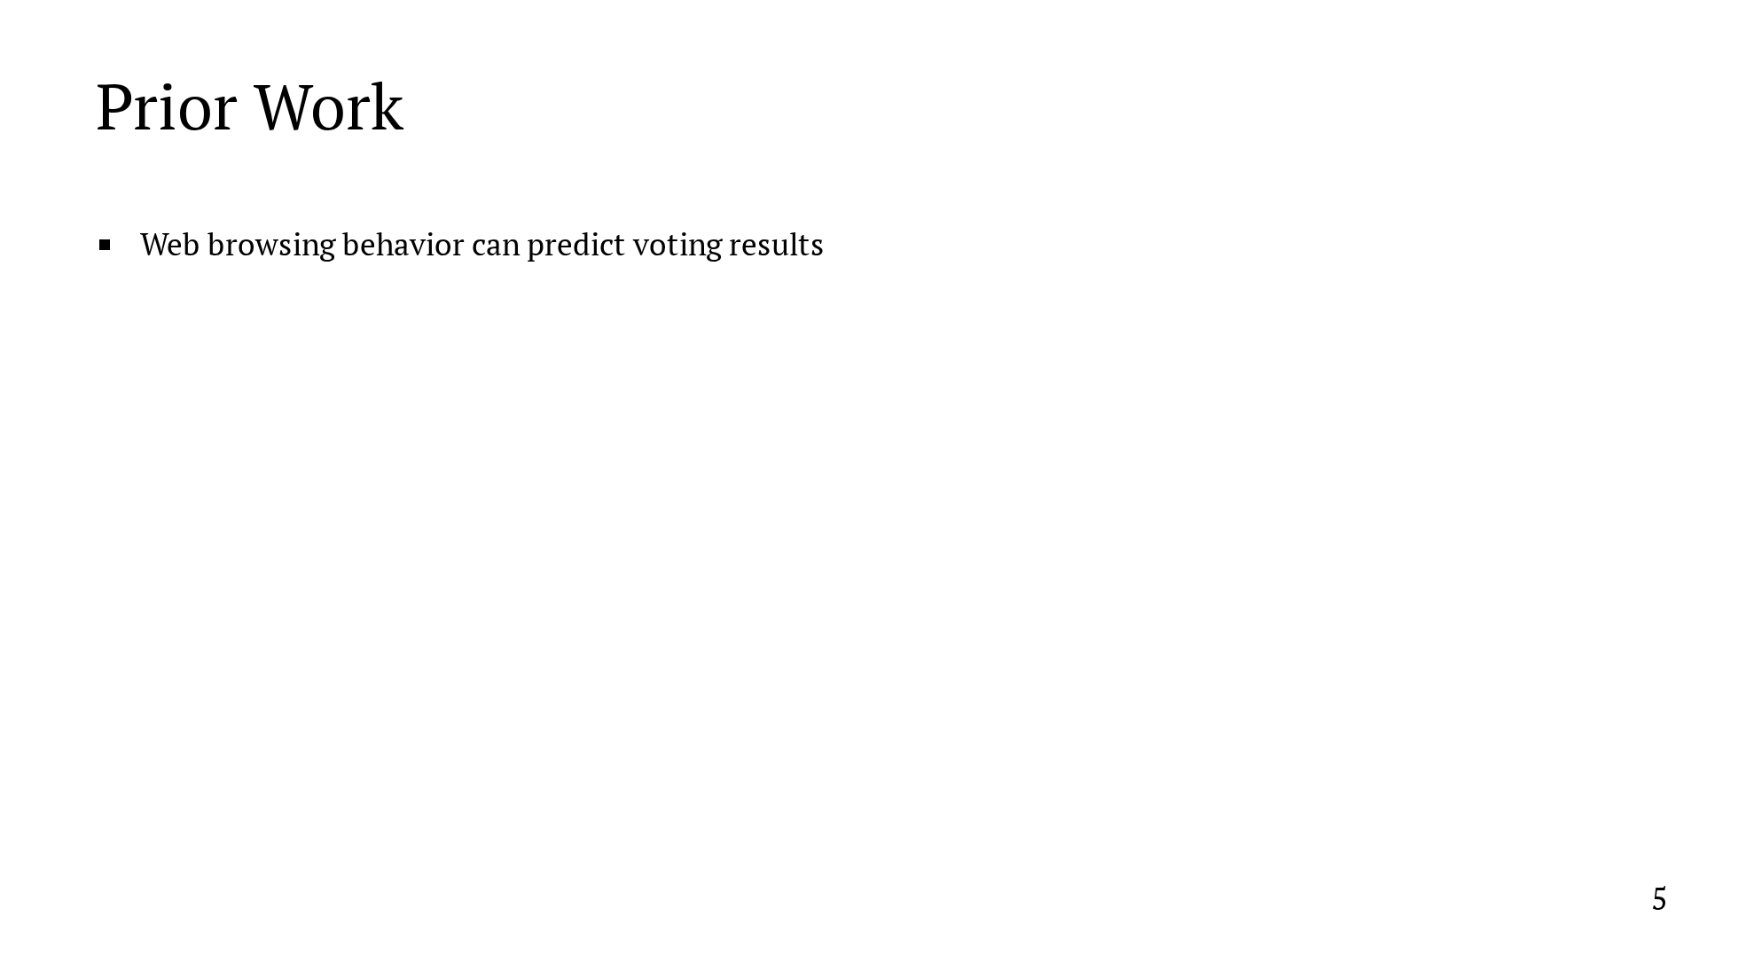
Notes:
We're not the first to study this problem. Prior work in both machine learning and political science has shown that web browsing behavior can predict political sentiment and voting results. As an example that demonstrates the power of this approach to polling, Comarela et al. use web browsing data to quantify the effect of the 2016 "Comey Letter" on a state-by-state basis. What matters to us is that the event was too close to the election for other polling methods to detect the effect in time. You can see the impact at a state level on the right. And you can see a noticeable shift in the time series on the left. They also found that social media provides the best signal. By this, I mean not whether you visited a certain website, but whether you did so by clicking on a link on social media. And it's worth noting that this paper used a large plaintext dataset, and privacy was not a concern of this paper.

Slide 17
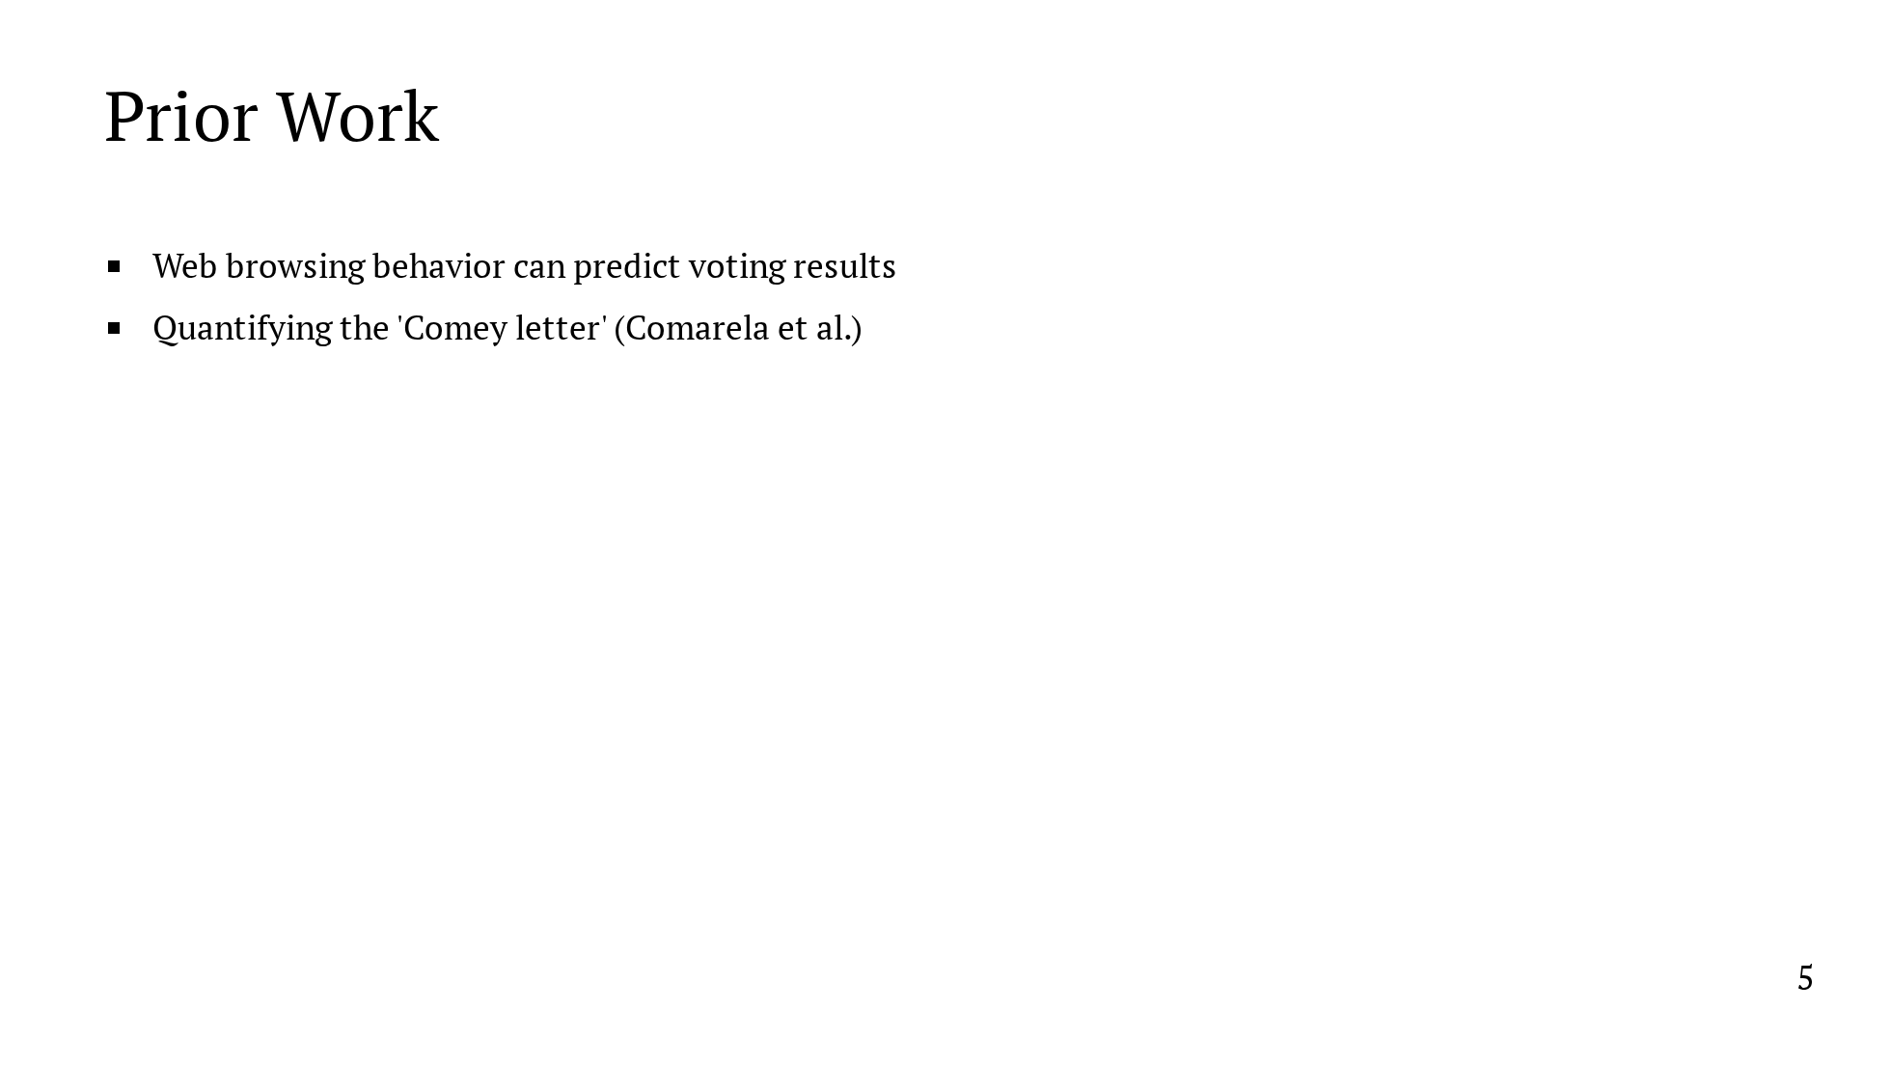
Notes:
We're not the first to study this problem. Prior work in both machine learning and political science has shown that web browsing behavior can predict political sentiment and voting results. As an example that demonstrates the power of this approach to polling, Comarela et al. use web browsing data to quantify the effect of the 2016 "Comey Letter" on a state-by-state basis. What matters to us is that the event was too close to the election for other polling methods to detect the effect in time. You can see the impact at a state level on the right. And you can see a noticeable shift in the time series on the left. They also found that social media provides the best signal. By this, I mean not whether you visited a certain website, but whether you did so by clicking on a link on social media. And it's worth noting that this paper used a large plaintext dataset, and privacy was not a concern of this paper.

Slide 18
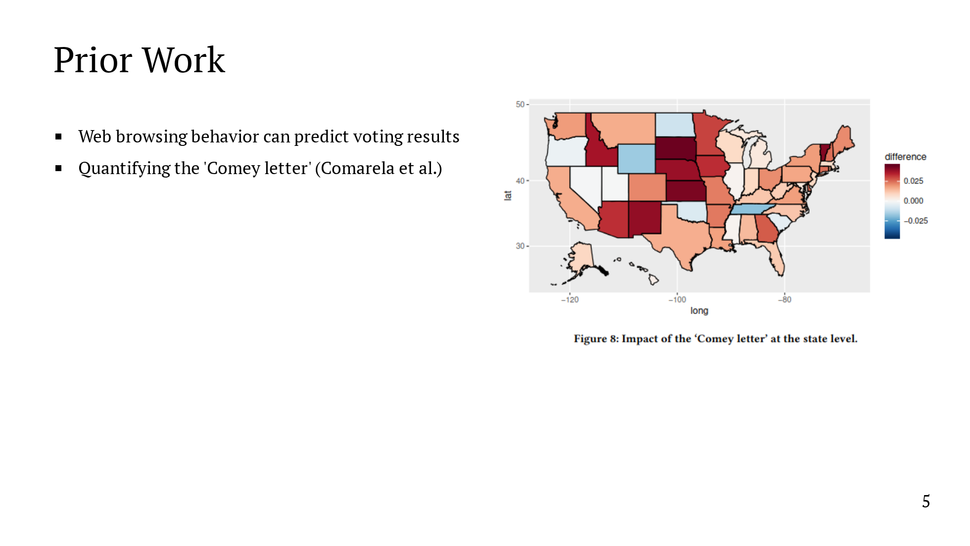
Notes:
We're not the first to study this problem. Prior work in both machine learning and political science has shown that web browsing behavior can predict political sentiment and voting results. As an example that demonstrates the power of this approach to polling, Comarela et al. use web browsing data to quantify the effect of the 2016 "Comey Letter" on a state-by-state basis. What matters to us is that the event was too close to the election for other polling methods to detect the effect in time. You can see the impact at a state level on the right. And you can see a noticeable shift in the time series on the left. They also found that social media provides the best signal. By this, I mean not whether you visited a certain website, but whether you did so by clicking on a link on social media. And it's worth noting that this paper used a large plaintext dataset, and privacy was not a concern of this paper.

Slide 19
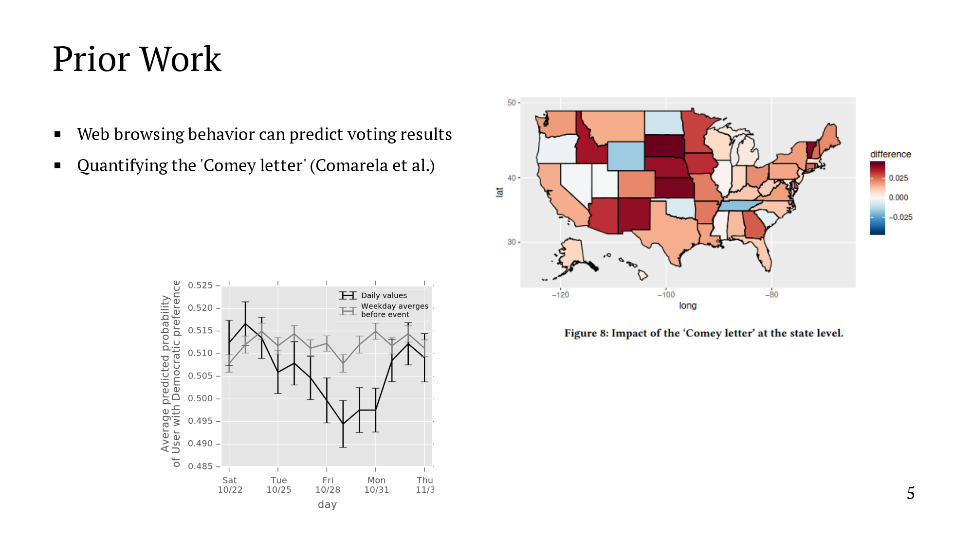
Notes:
We're not the first to study this problem. Prior work in both machine learning and political science has shown that web browsing behavior can predict political sentiment and voting results. As an example that demonstrates the power of this approach to polling, Comarela et al. use web browsing data to quantify the effect of the 2016 "Comey Letter" on a state-by-state basis. What matters to us is that the event was too close to the election for other polling methods to detect the effect in time. You can see the impact at a state level on the right. And you can see a noticeable shift in the time series on the left. They also found that social media provides the best signal. By this, I mean not whether you visited a certain website, but whether you did so by clicking on a link on social media. And it's worth noting that this paper used a large plaintext dataset, and privacy was not a concern of this paper.

Slide 20

Notes:
We're not the first to study this problem. Prior work in both machine learning and political science has shown that web browsing behavior can predict political sentiment and voting results. As an example that demonstrates the power of this approach to polling, Comarela et al. use web browsing data to quantify the effect of the 2016 "Comey Letter" on a state-by-state basis. What matters to us is that the event was too close to the election for other polling methods to detect the effect in time. You can see the impact at a state level on the right. And you can see a noticeable shift in the time series on the left. They also found that social media provides the best signal. By this, I mean not whether you visited a certain website, but whether you did so by clicking on a link on social media. And it's worth noting that this paper used a large plaintext dataset, and privacy was not a concern of this paper.

Slide 21
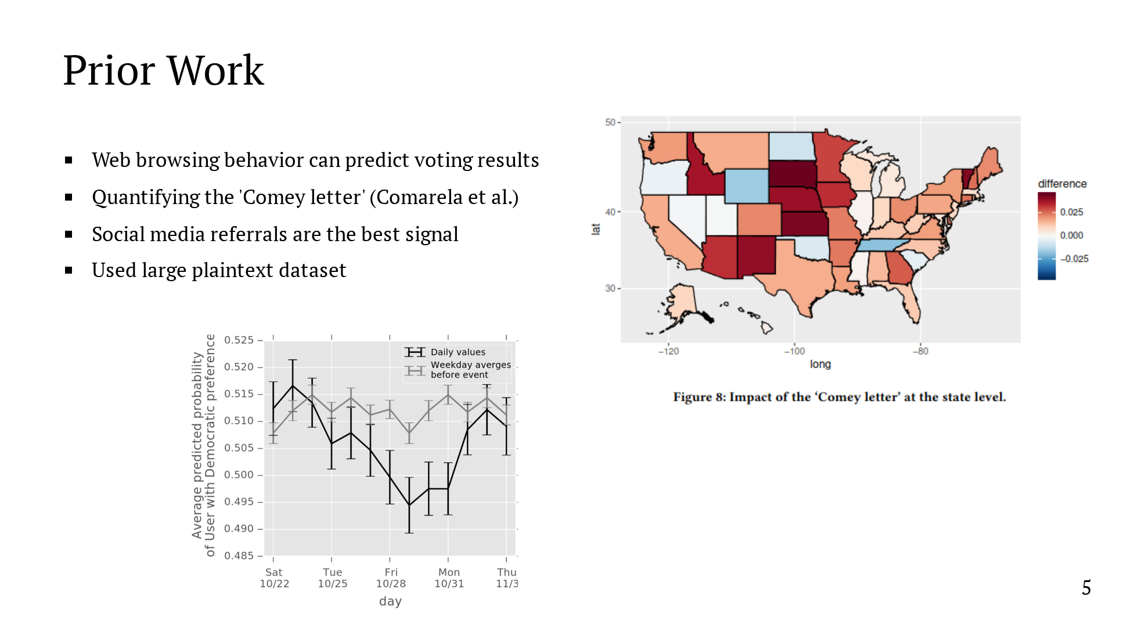
Notes:
We're not the first to study this problem. Prior work in both machine learning and political science has shown that web browsing behavior can predict political sentiment and voting results. As an example that demonstrates the power of this approach to polling, Comarela et al. use web browsing data to quantify the effect of the 2016 "Comey Letter" on a state-by-state basis. What matters to us is that the event was too close to the election for other polling methods to detect the effect in time. You can see the impact at a state level on the right. And you can see a noticeable shift in the time series on the left. They also found that social media provides the best signal. By this, I mean not whether you visited a certain website, but whether you did so by clicking on a link on social media. And it's worth noting that this paper used a large plaintext dataset, and privacy was not a concern of this paper.

Slide 22
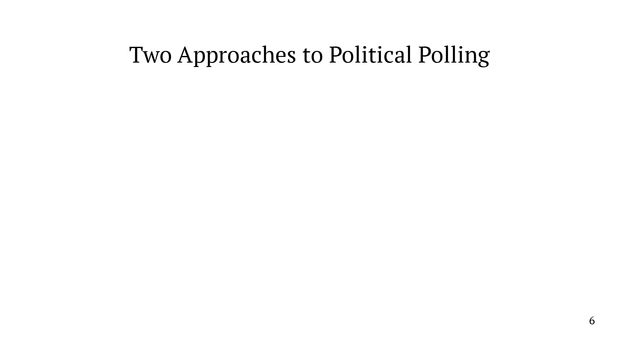
Notes:
To summarize, I'll compare the traditional approach to polling with one based on collecting web browsing data. Traditional polling is - slow and expensive, because data collection is a human-intensive process - the results we get are coarse-grained, we only learn whether you support candidate A or B, but not the data informing the choice In contrast, a system based on analyzing web browsing data can be fully automated - which gives us immediate results - and is cheap, allowing us to scale to much more data - the results are much more fine-grained because we collect much richer data. Not only can we learn who an individual supports, but we might get an idea for why and how that changes over time. The richness of the data poses the following question - what are we going to do about privacy? Clearly, we don't want to be collecting all this data in plaintext. - can we predict political preferences while respecting user privacy? We show that the answer is yes.

Slide 23
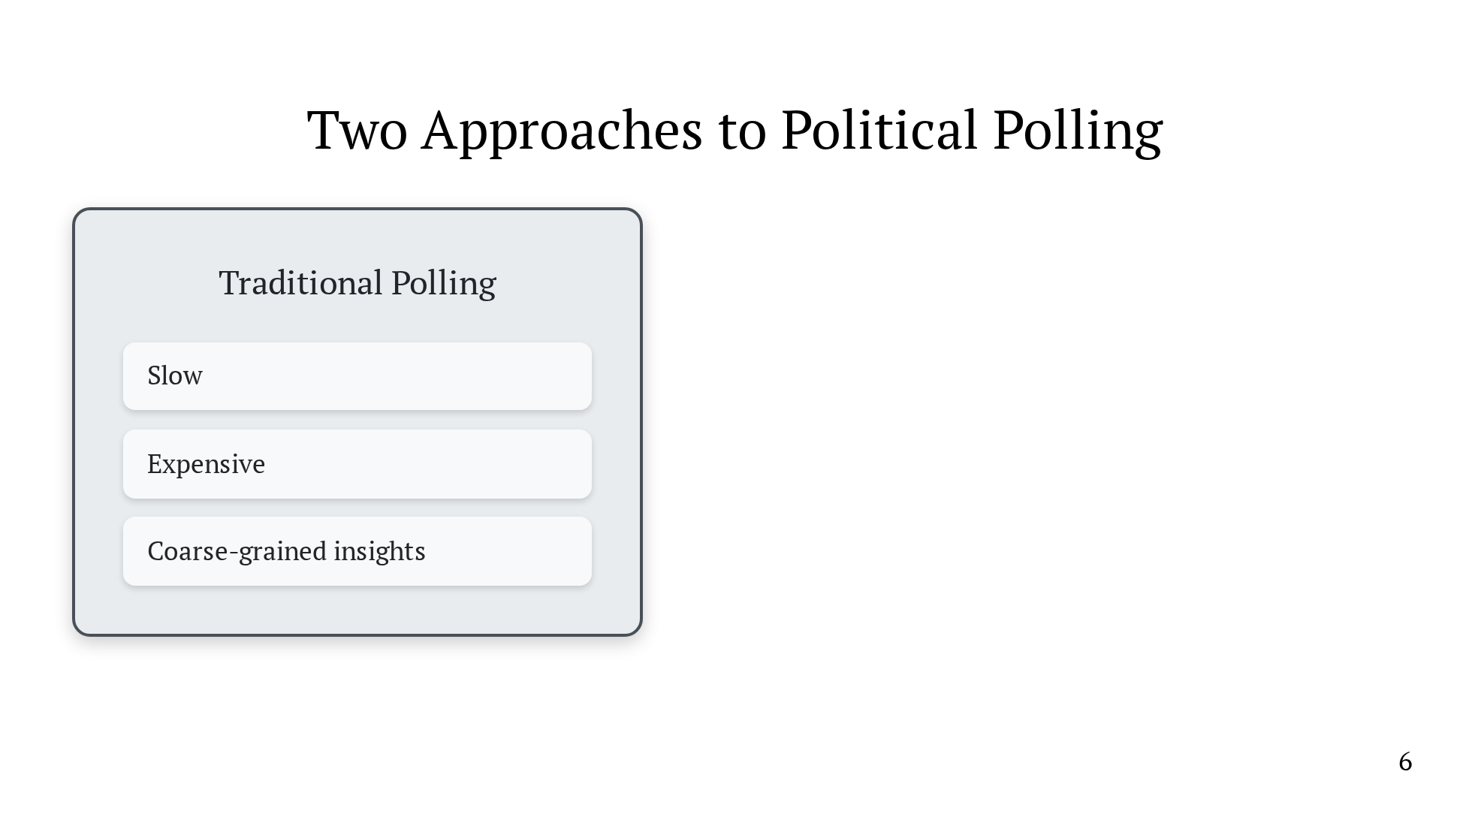
Notes:
To summarize, I'll compare the traditional approach to polling with one based on collecting web browsing data. Traditional polling is - slow and expensive, because data collection is a human-intensive process - the results we get are coarse-grained, we only learn whether you support candidate A or B, but not the data informing the choice In contrast, a system based on analyzing web browsing data can be fully automated - which gives us immediate results - and is cheap, allowing us to scale to much more data - the results are much more fine-grained because we collect much richer data. Not only can we learn who an individual supports, but we might get an idea for why and how that changes over time. The richness of the data poses the following question - what are we going to do about privacy? Clearly, we don't want to be collecting all this data in plaintext. - can we predict political preferences while respecting user privacy? We show that the answer is yes.

Slide 24
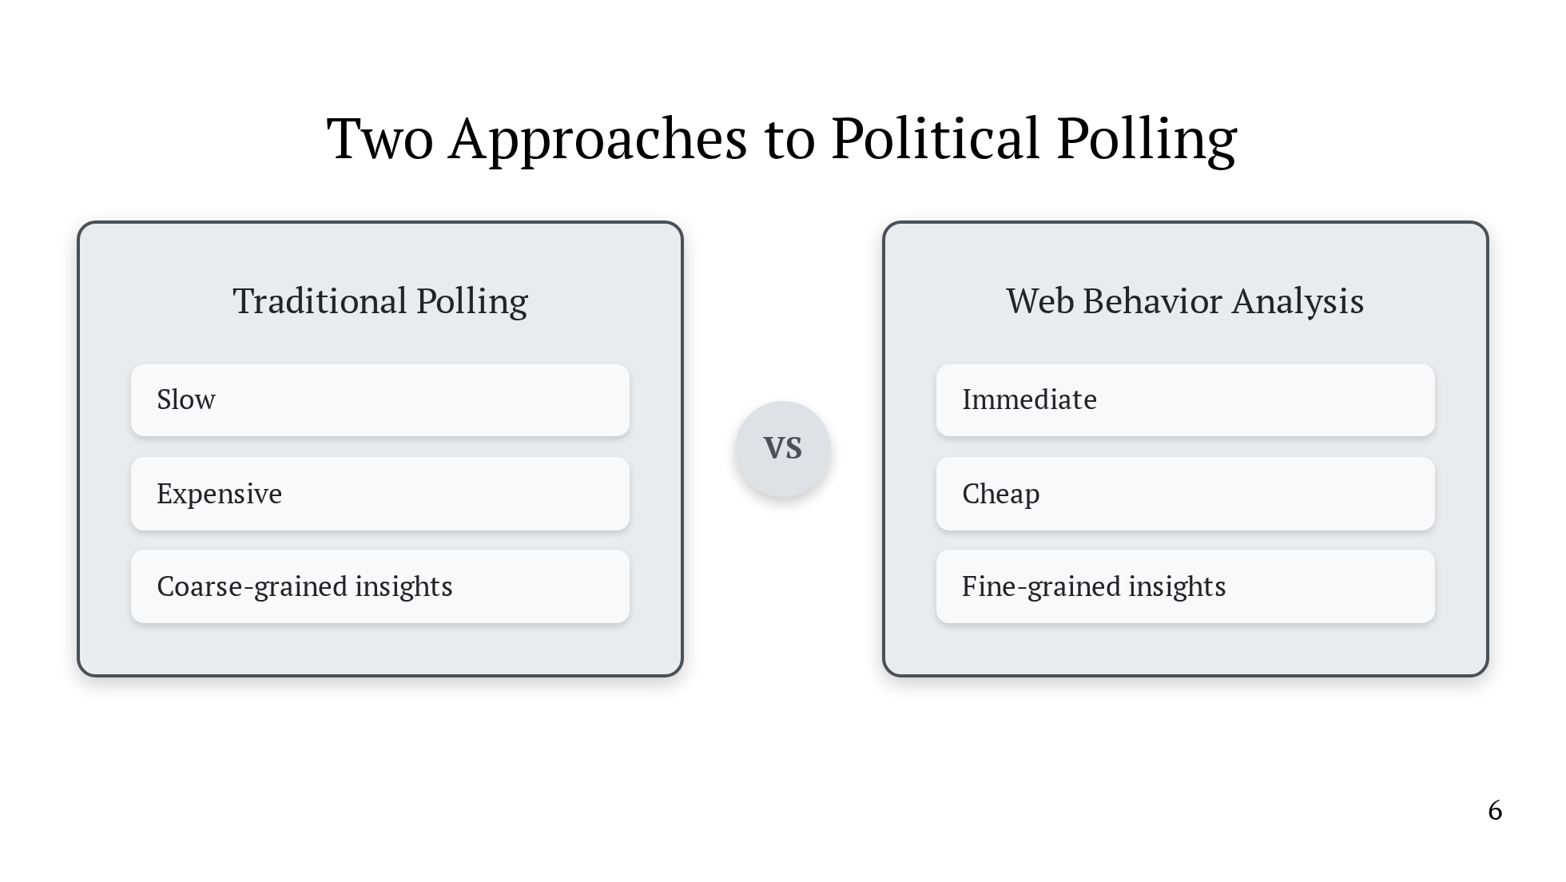
Notes:
To summarize, I'll compare the traditional approach to polling with one based on collecting web browsing data. Traditional polling is - slow and expensive, because data collection is a human-intensive process - the results we get are coarse-grained, we only learn whether you support candidate A or B, but not the data informing the choice In contrast, a system based on analyzing web browsing data can be fully automated - which gives us immediate results - and is cheap, allowing us to scale to much more data - the results are much more fine-grained because we collect much richer data. Not only can we learn who an individual supports, but we might get an idea for why and how that changes over time. The richness of the data poses the following question - what are we going to do about privacy? Clearly, we don't want to be collecting all this data in plaintext. - can we predict political preferences while respecting user privacy? We show that the answer is yes.

Slide 25
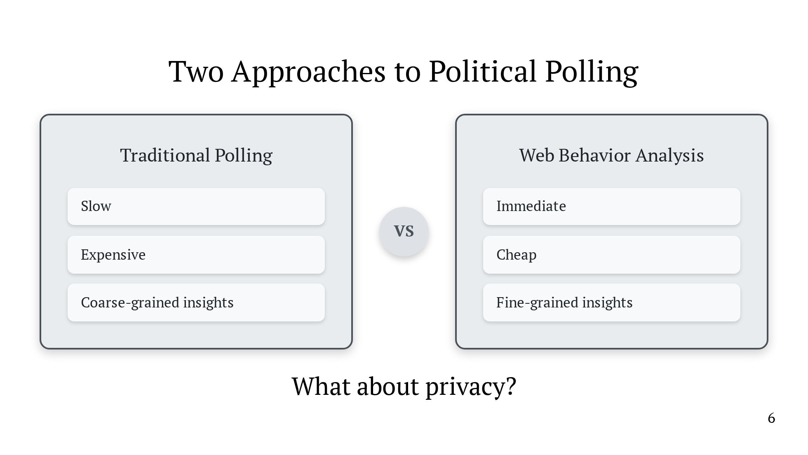
Notes:
To summarize, I'll compare the traditional approach to polling with one based on collecting web browsing data. Traditional polling is - slow and expensive, because data collection is a human-intensive process - the results we get are coarse-grained, we only learn whether you support candidate A or B, but not the data informing the choice In contrast, a system based on analyzing web browsing data can be fully automated - which gives us immediate results - and is cheap, allowing us to scale to much more data - the results are much more fine-grained because we collect much richer data. Not only can we learn who an individual supports, but we might get an idea for why and how that changes over time. The richness of the data poses the following question - what are we going to do about privacy? Clearly, we don't want to be collecting all this data in plaintext. - can we predict political preferences while respecting user privacy? We show that the answer is yes.

Slide 26

Notes:
To solve this problem, we built a system for securely predicting political preferences from web browsing data, and we deployed this system during the 2024 United States presidential election. In doing so, we collected and analyzed data from ALMOST 8000 unique users, including over 2000 daily active users. And, to address the privacy question, all analysis took place under MPC.

Slide 27
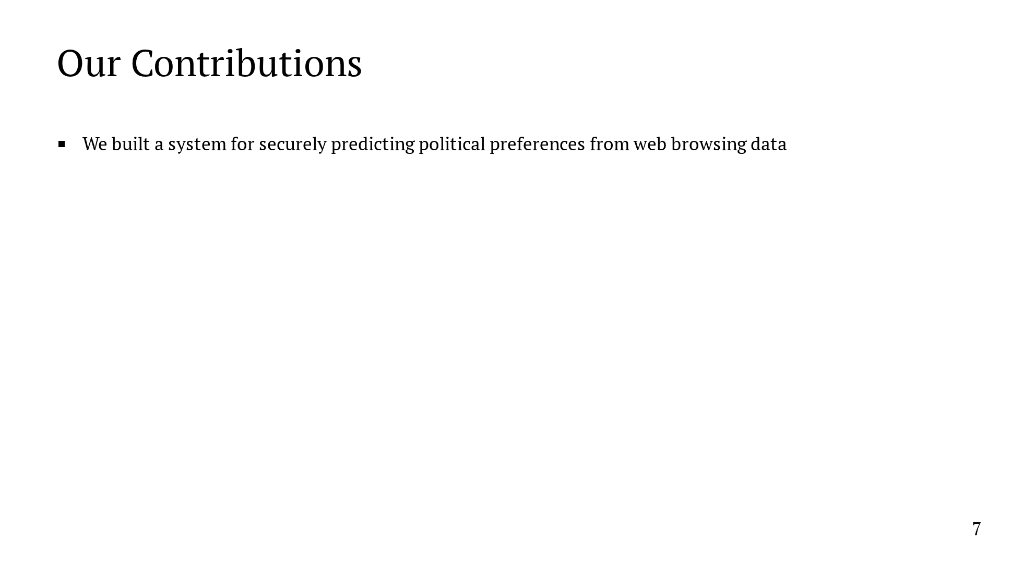
Notes:
To solve this problem, we built a system for securely predicting political preferences from web browsing data, and we deployed this system during the 2024 United States presidential election. In doing so, we collected and analyzed data from ALMOST 8000 unique users, including over 2000 daily active users. And, to address the privacy question, all analysis took place under MPC.

Slide 28
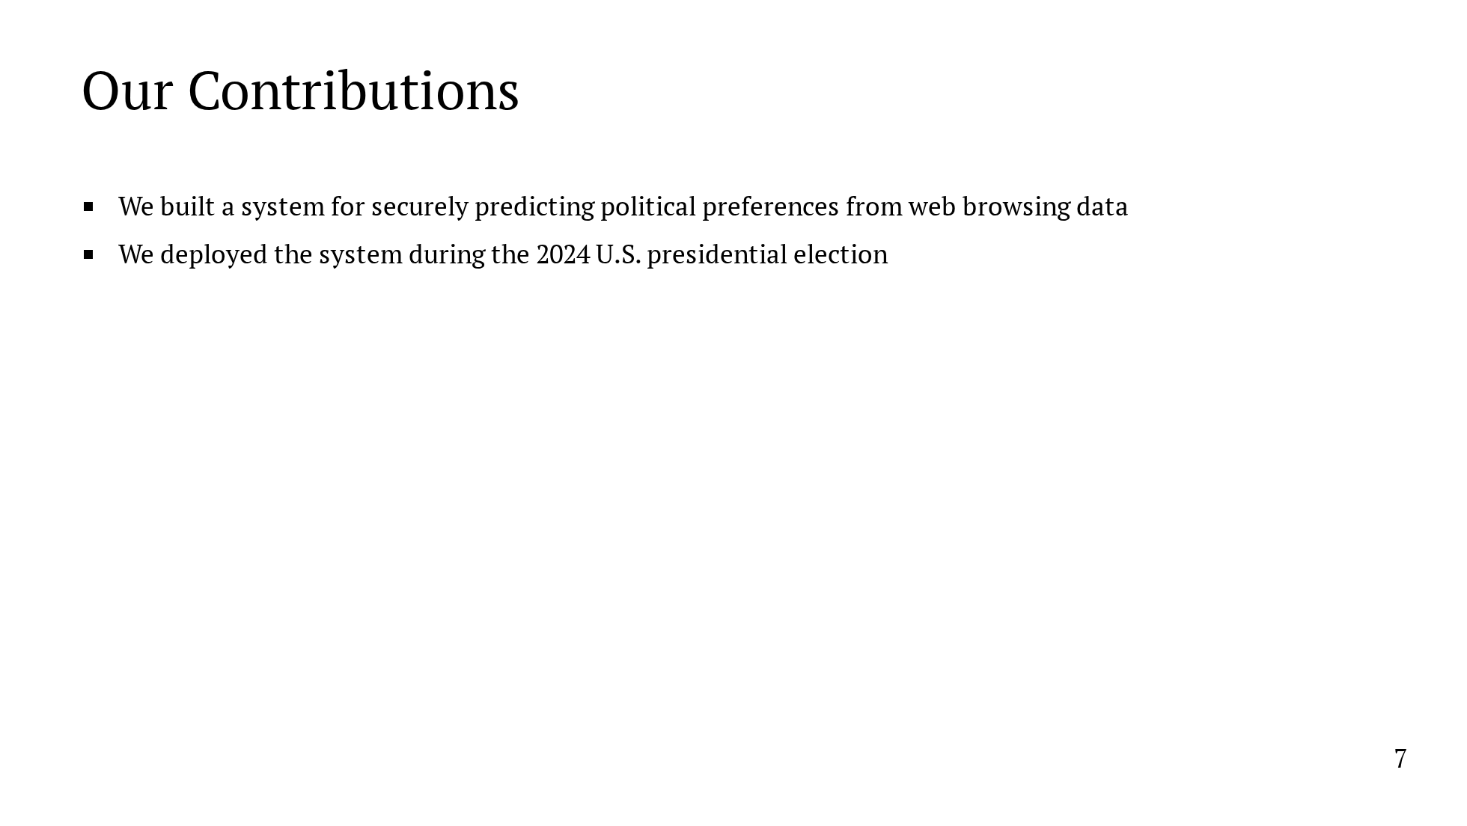
Notes:
To solve this problem, we built a system for securely predicting political preferences from web browsing data, and we deployed this system during the 2024 United States presidential election. In doing so, we collected and analyzed data from ALMOST 8000 unique users, including over 2000 daily active users. And, to address the privacy question, all analysis took place under MPC.

Slide 29
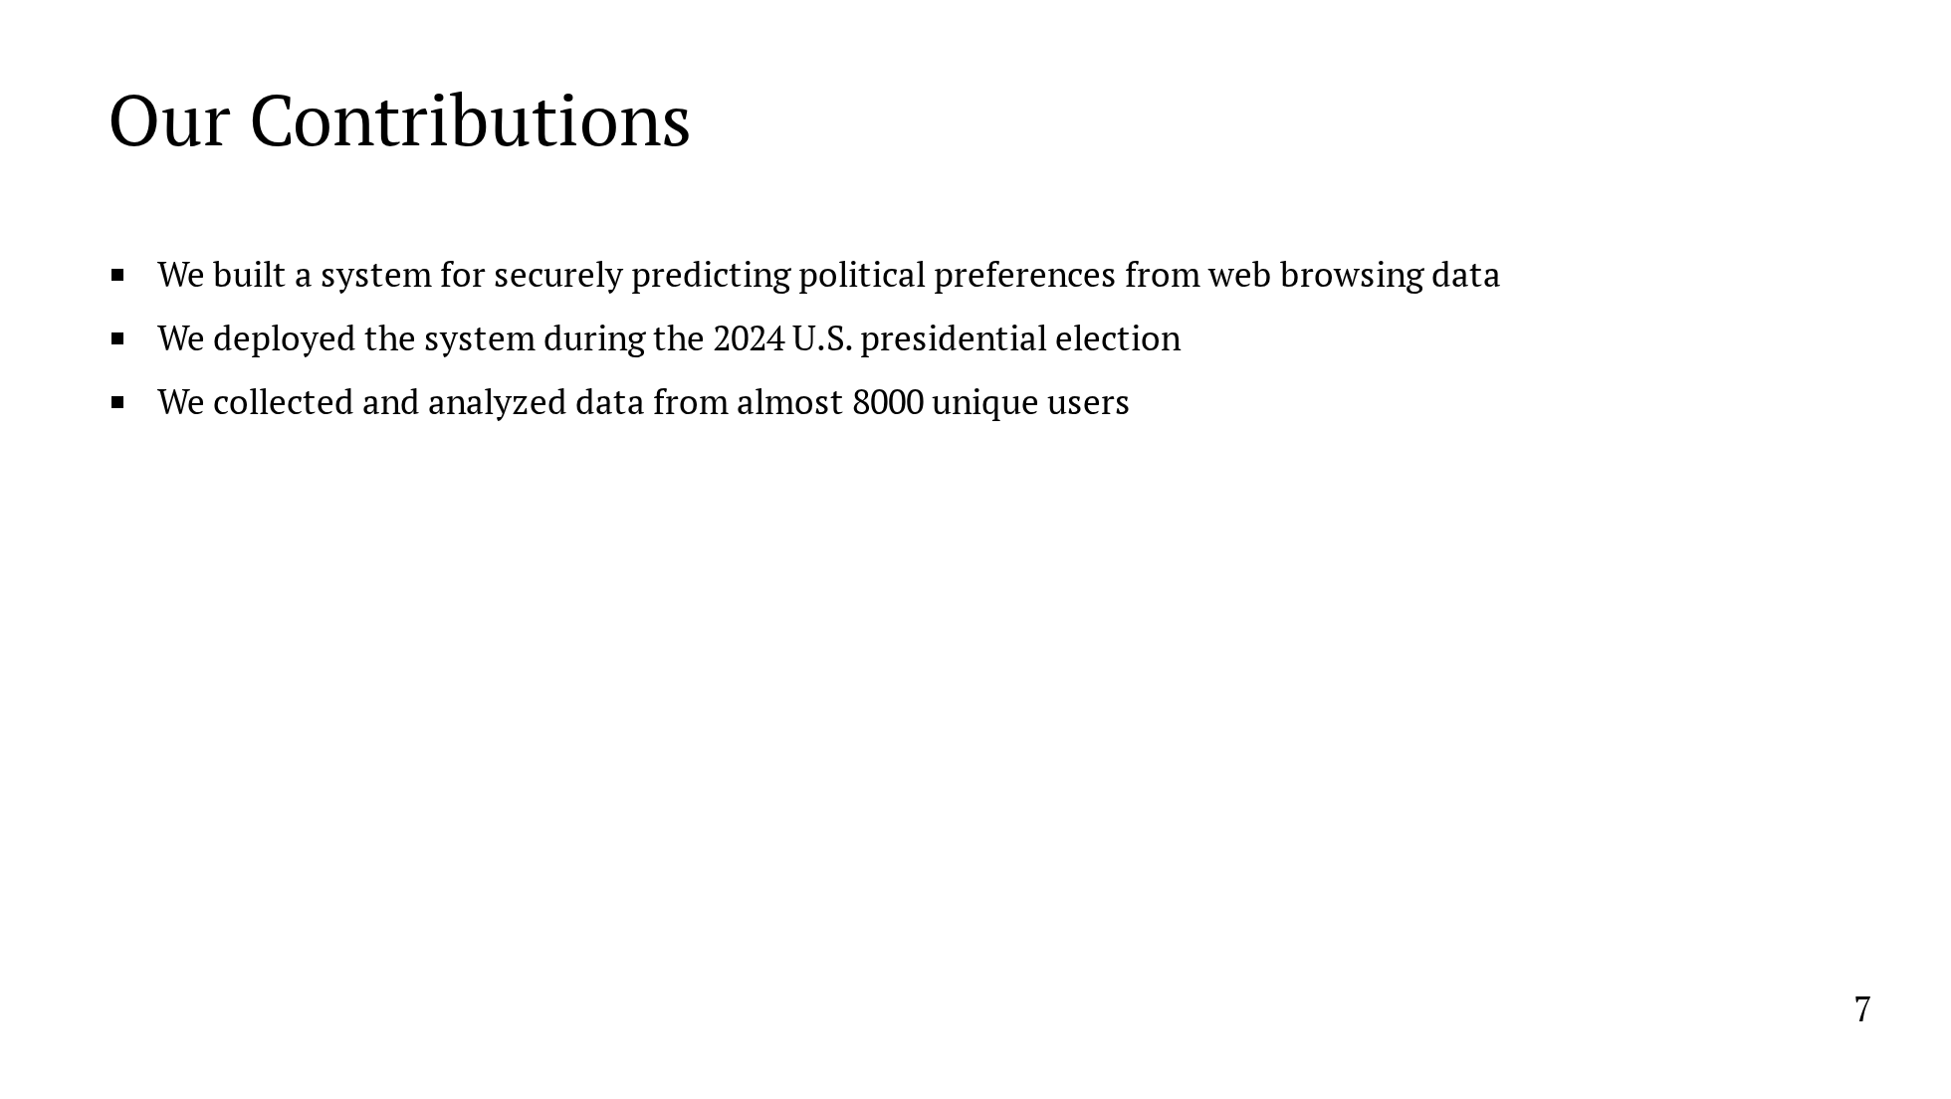
Notes:
To solve this problem, we built a system for securely predicting political preferences from web browsing data, and we deployed this system during the 2024 United States presidential election. In doing so, we collected and analyzed data from ALMOST 8000 unique users, including over 2000 daily active users. And, to address the privacy question, all analysis took place under MPC.

Slide 30
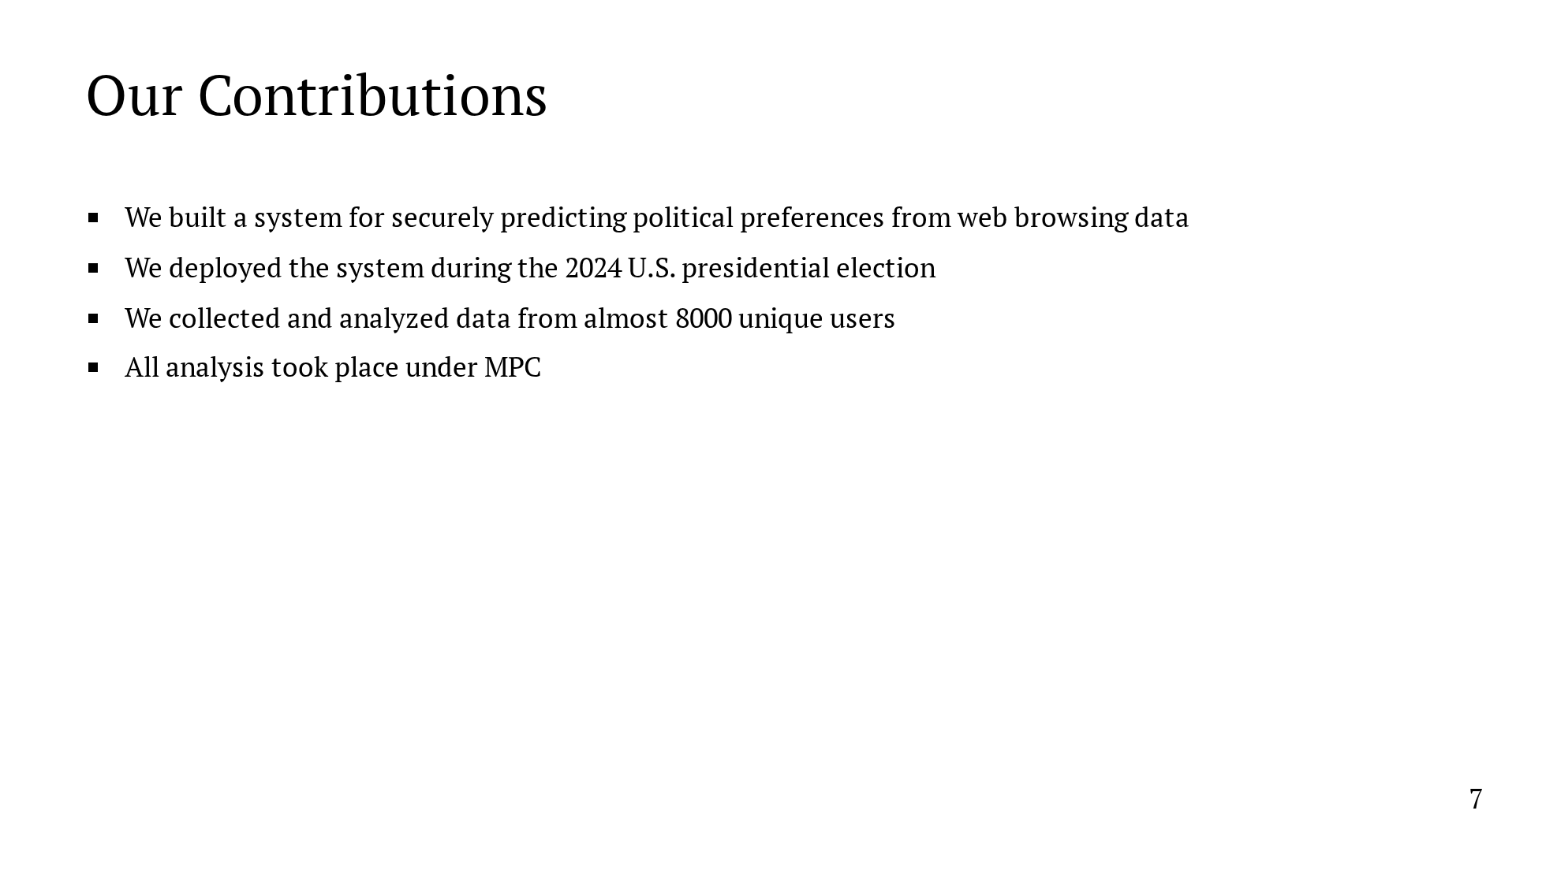
Notes:
To solve this problem, we built a system for securely predicting political preferences from web browsing data, and we deployed this system during the 2024 United States presidential election. In doing so, we collected and analyzed data from ALMOST 8000 unique users, including over 2000 daily active users. And, to address the privacy question, all analysis took place under MPC.

Slide 31
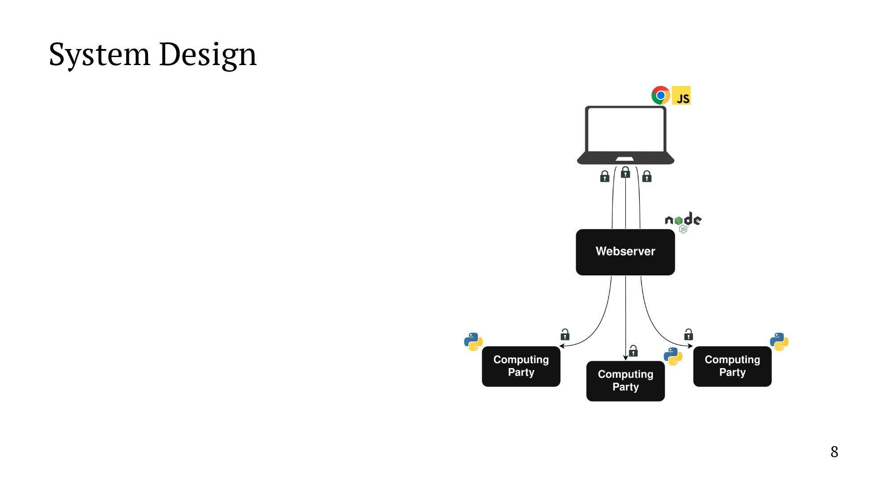
Notes:
I'll now give an overview of our system. The system has 3 major components. First, there's a browser plugin that users install which monitors their web browsing. Then, there's an intermediate webserver which simplifies the interaction between clients and MPC servers. Finally, there's the MPC backend which performs the computation.

Slide 32
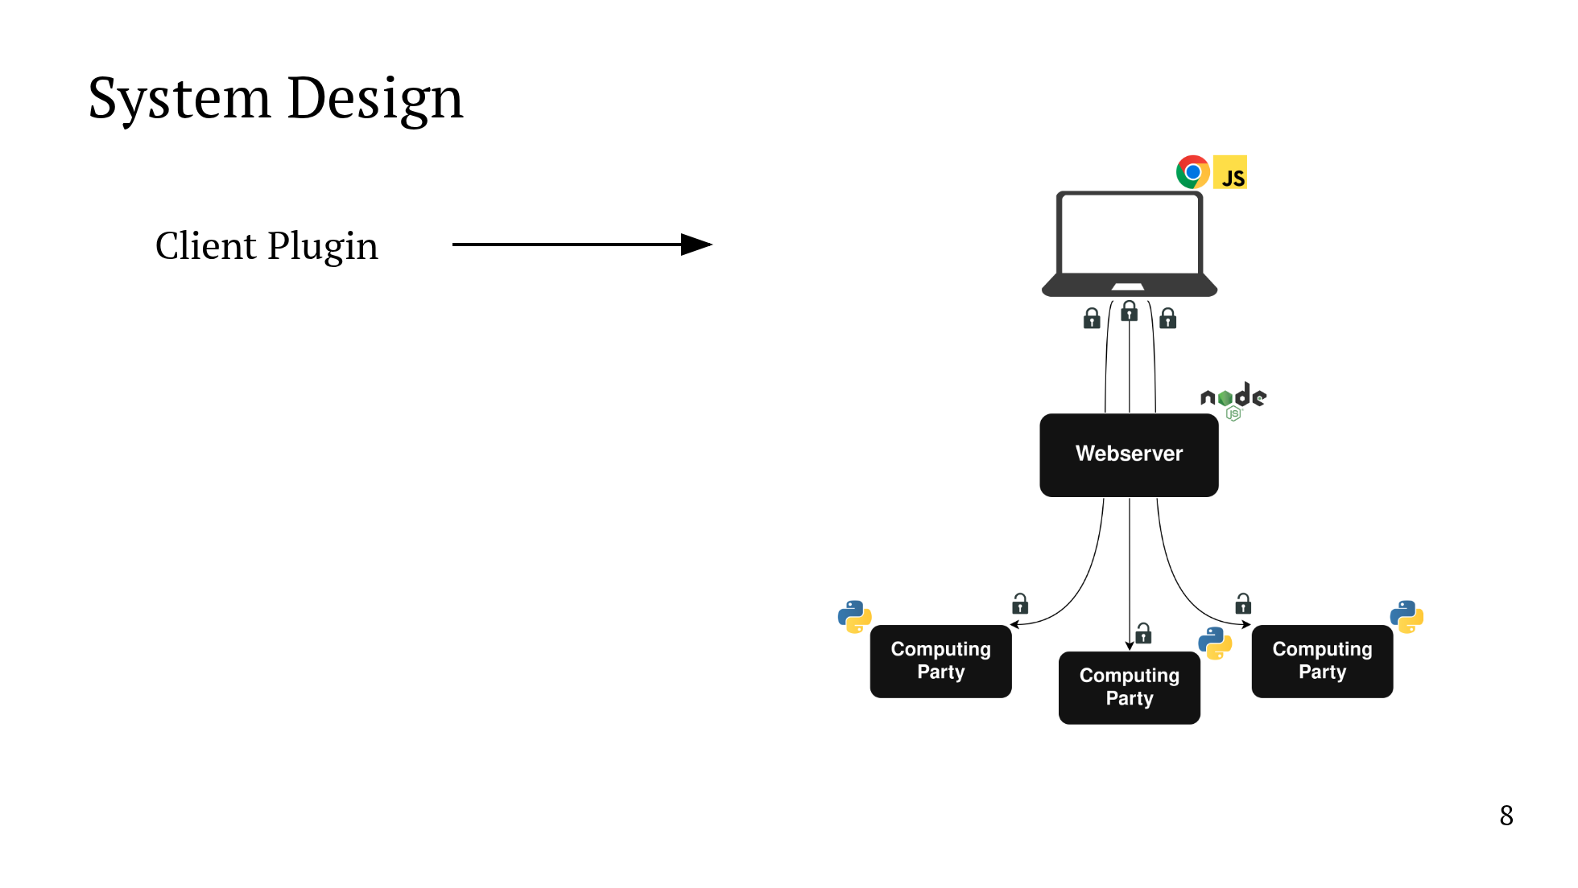
Notes:
I'll now give an overview of our system. The system has 3 major components. First, there's a browser plugin that users install which monitors their web browsing. Then, there's an intermediate webserver which simplifies the interaction between clients and MPC servers. Finally, there's the MPC backend which performs the computation.

Slide 33
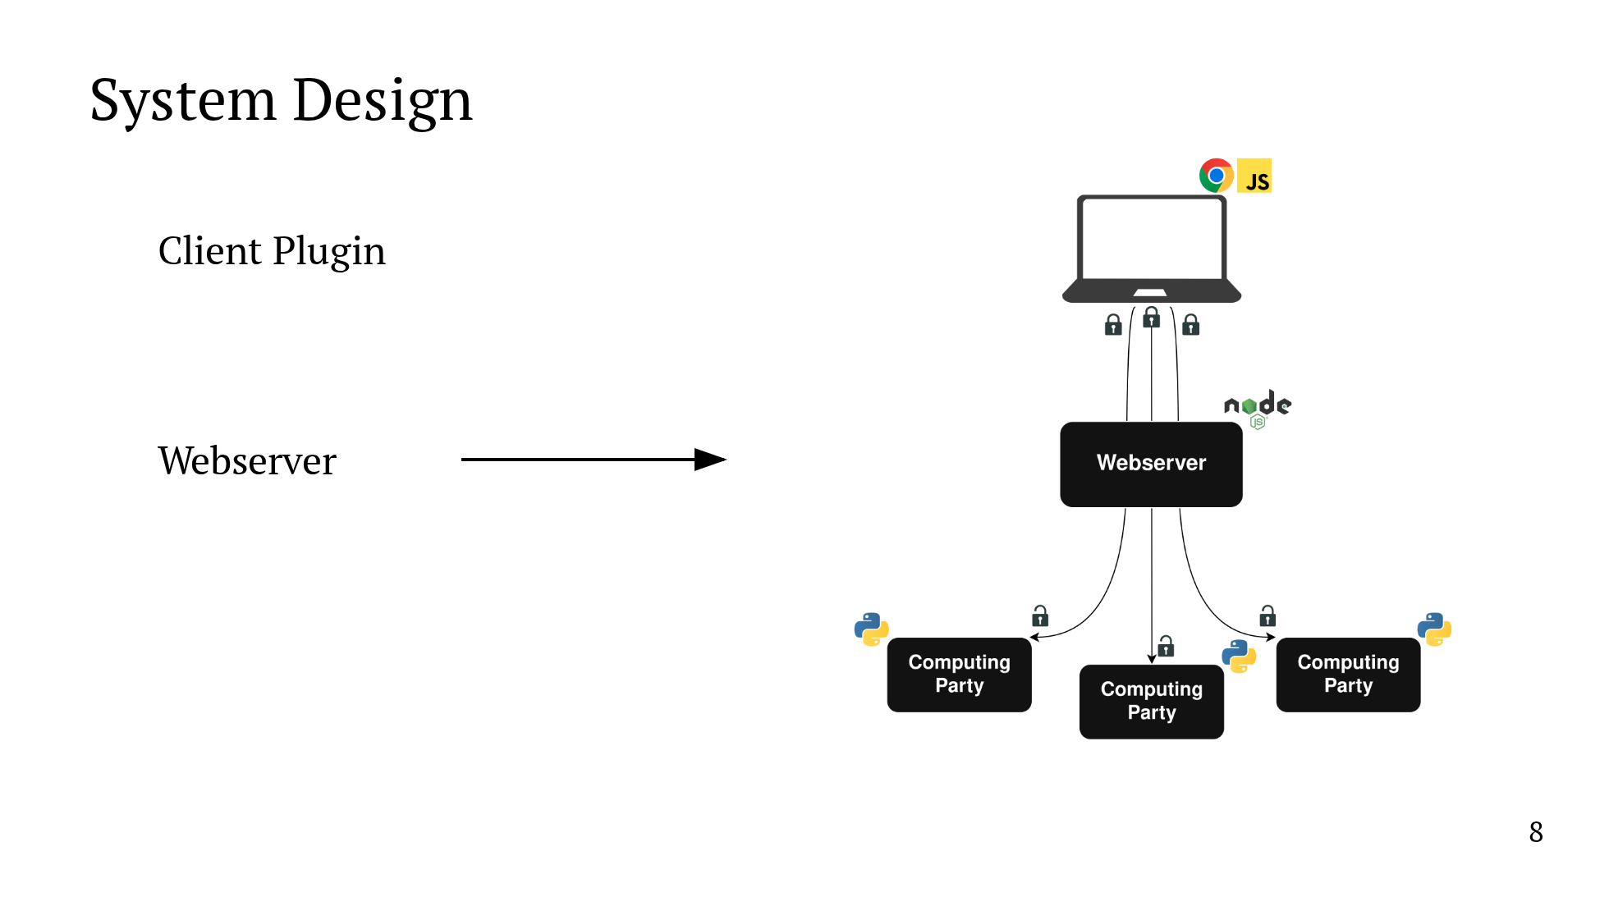
Notes:
I'll now give an overview of our system. The system has 3 major components. First, there's a browser plugin that users install which monitors their web browsing. Then, there's an intermediate webserver which simplifies the interaction between clients and MPC servers. Finally, there's the MPC backend which performs the computation.

Slide 34

Notes:
I'll now give an overview of our system. The system has 3 major components. First, there's a browser plugin that users install which monitors their web browsing. Then, there's an intermediate webserver which simplifies the interaction between clients and MPC servers. Finally, there's the MPC backend which performs the computation.

Slide 35

Notes:
I'll now give an overview of our system. The system has 3 major components. First, there's a browser plugin that users install which monitors their web browsing. Then, there's an intermediate webserver which simplifies the interaction between clients and MPC servers. Finally, there's the MPC backend which performs the computation.

Slide 36
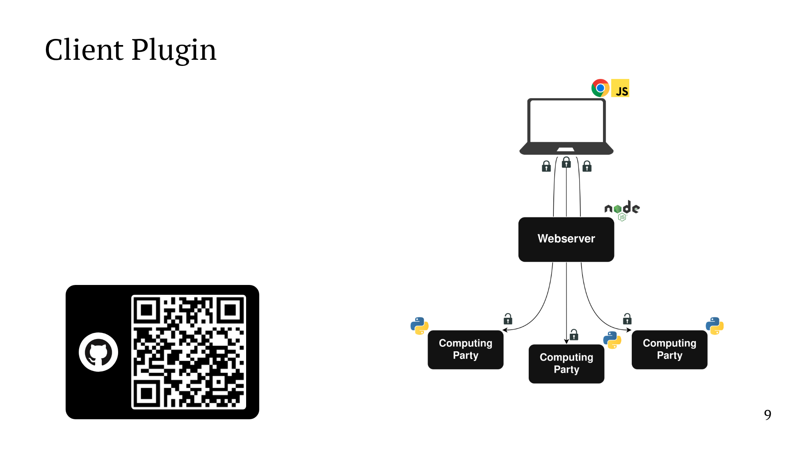
Notes:
Let's start with the client plugin. We built a custom Chrome plugin from scratch which monitors both website visits and referrals. Every day, the plugin puts together a histogram of the number of visits and referrals to each website. Then it secret shares the histogram and sends the shares to the computing parties. The shares are encrypted under the public key of the destination party. All secret sharing and encryption takes place on the client side. And finally, the plugin code is open source and can be found at the link at the bottom.

Slide 37

Notes:
Let's start with the client plugin. We built a custom Chrome plugin from scratch which monitors both website visits and referrals. Every day, the plugin puts together a histogram of the number of visits and referrals to each website. Then it secret shares the histogram and sends the shares to the computing parties. The shares are encrypted under the public key of the destination party. All secret sharing and encryption takes place on the client side. And finally, the plugin code is open source and can be found at the link at the bottom.

Slide 38

Notes:
Let's start with the client plugin. We built a custom Chrome plugin from scratch which monitors both website visits and referrals. Every day, the plugin puts together a histogram of the number of visits and referrals to each website. Then it secret shares the histogram and sends the shares to the computing parties. The shares are encrypted under the public key of the destination party. All secret sharing and encryption takes place on the client side. And finally, the plugin code is open source and can be found at the link at the bottom.

Slide 39
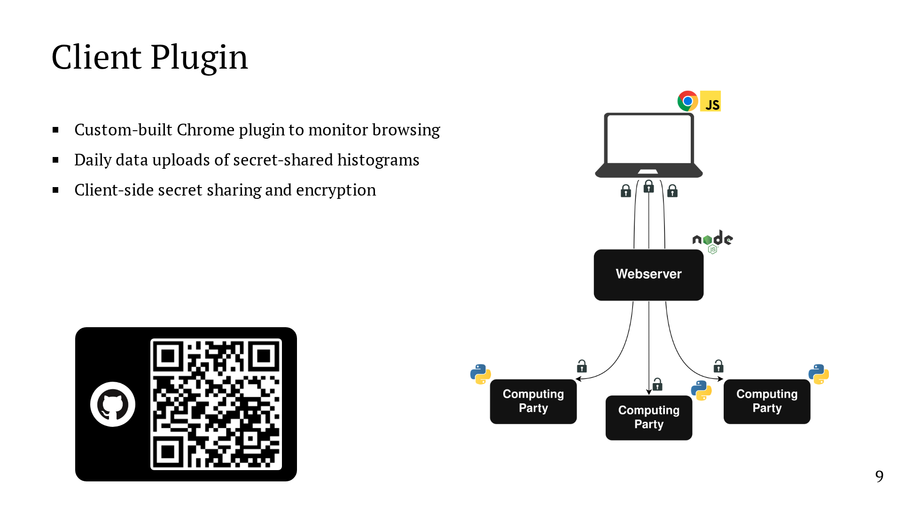
Notes:
Let's start with the client plugin. We built a custom Chrome plugin from scratch which monitors both website visits and referrals. Every day, the plugin puts together a histogram of the number of visits and referrals to each website. Then it secret shares the histogram and sends the shares to the computing parties. The shares are encrypted under the public key of the destination party. All secret sharing and encryption takes place on the client side. And finally, the plugin code is open source and can be found at the link at the bottom.

Slide 40

Notes:
Let's start with the client plugin. We built a custom Chrome plugin from scratch which monitors both website visits and referrals. Every day, the plugin puts together a histogram of the number of visits and referrals to each website. Then it secret shares the histogram and sends the shares to the computing parties. The shares are encrypted under the public key of the destination party. All secret sharing and encryption takes place on the client side. And finally, the plugin code is open source and can be found at the link at the bottom.

Slide 41
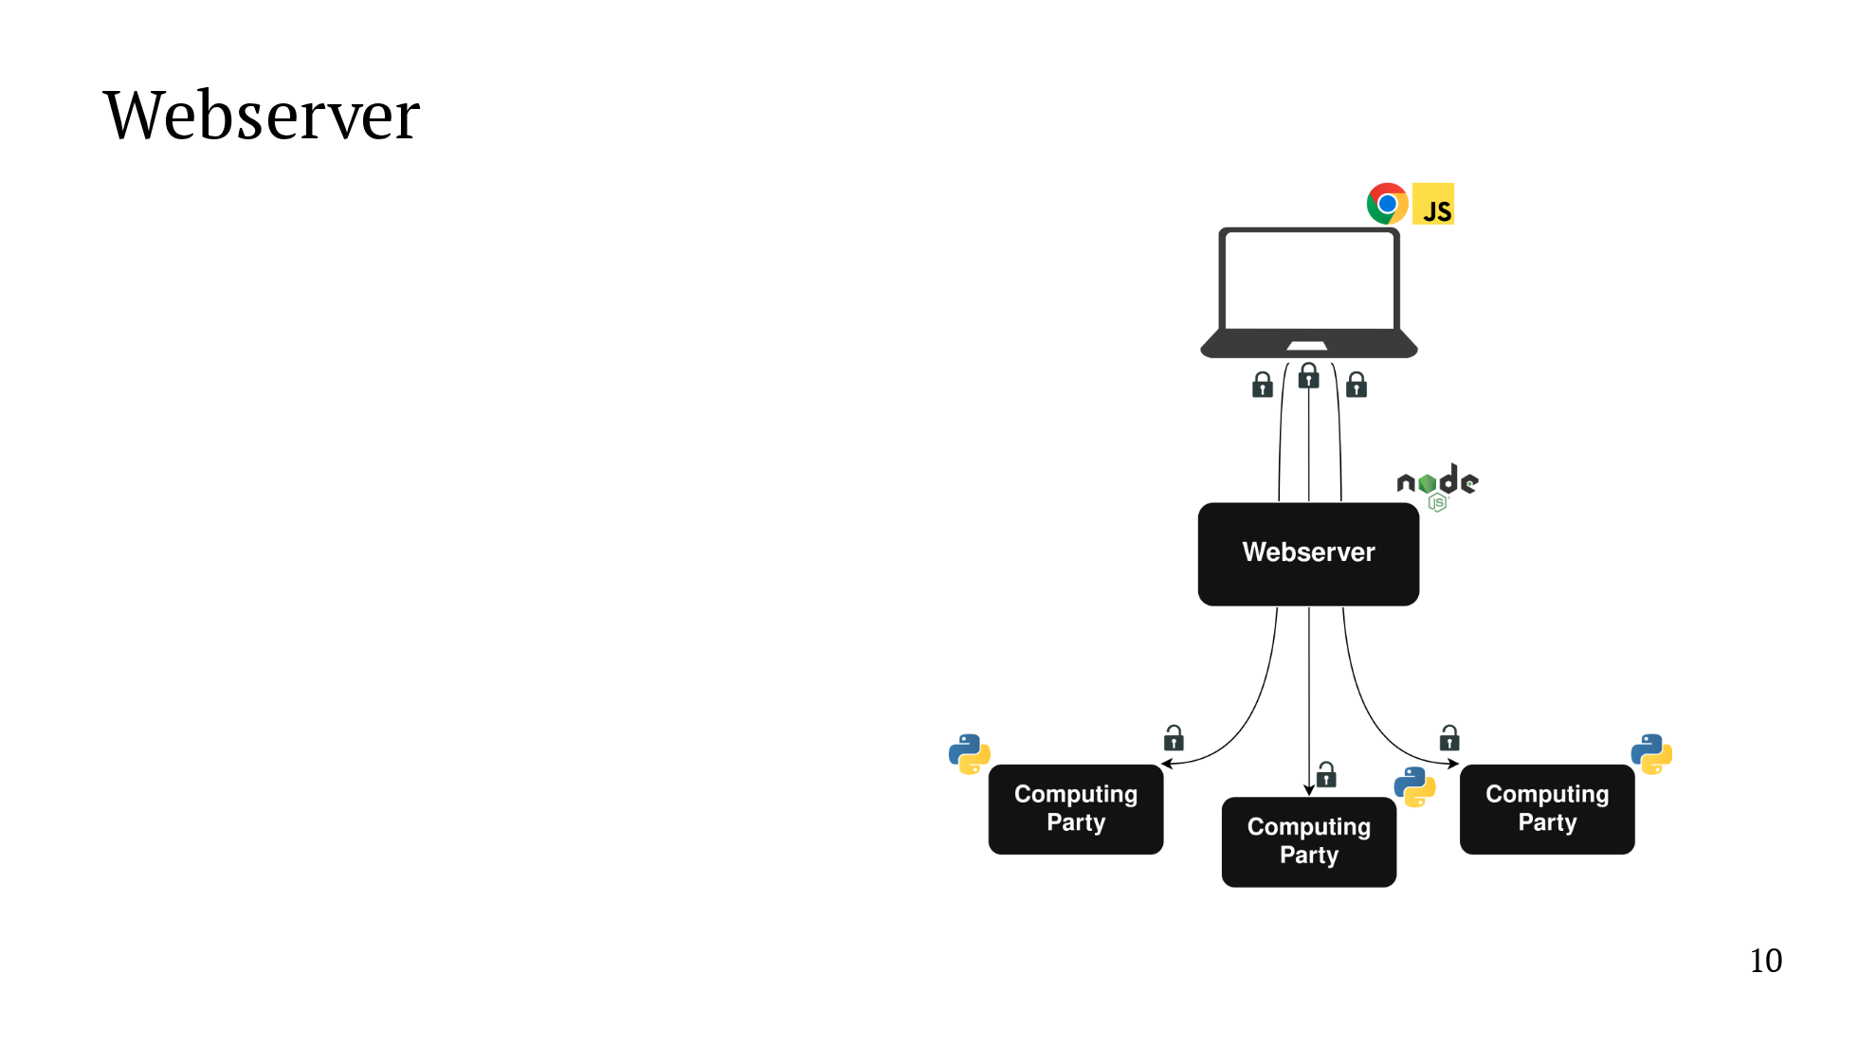
Notes:
Next, we have an intermediate webserver which exists to simplify the interaction with the clients. We don't want to have the MPC servers running all the time, and we don't want the client to have to manage 3 connections. The webserver also collects basic metadata, for example, so that we can pay users for their participation. We emphasize that because secret shares are end-to-end encrypted from clients to the computing parties, the webserver never sees any private data.

Slide 42
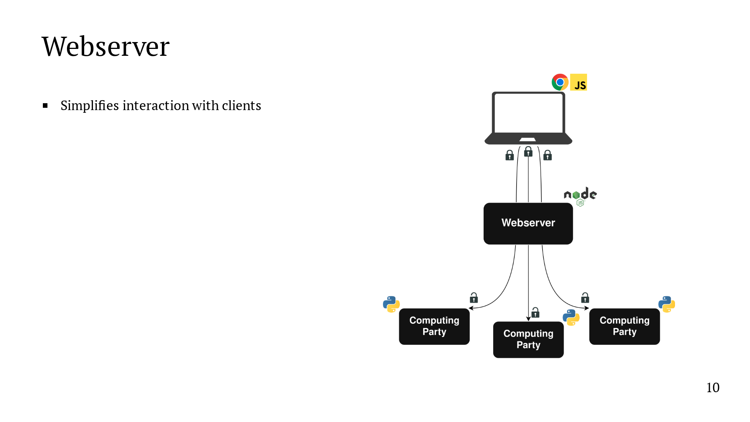
Notes:
Next, we have an intermediate webserver which exists to simplify the interaction with the clients. We don't want to have the MPC servers running all the time, and we don't want the client to have to manage 3 connections. The webserver also collects basic metadata, for example, so that we can pay users for their participation. We emphasize that because secret shares are end-to-end encrypted from clients to the computing parties, the webserver never sees any private data.

Slide 43
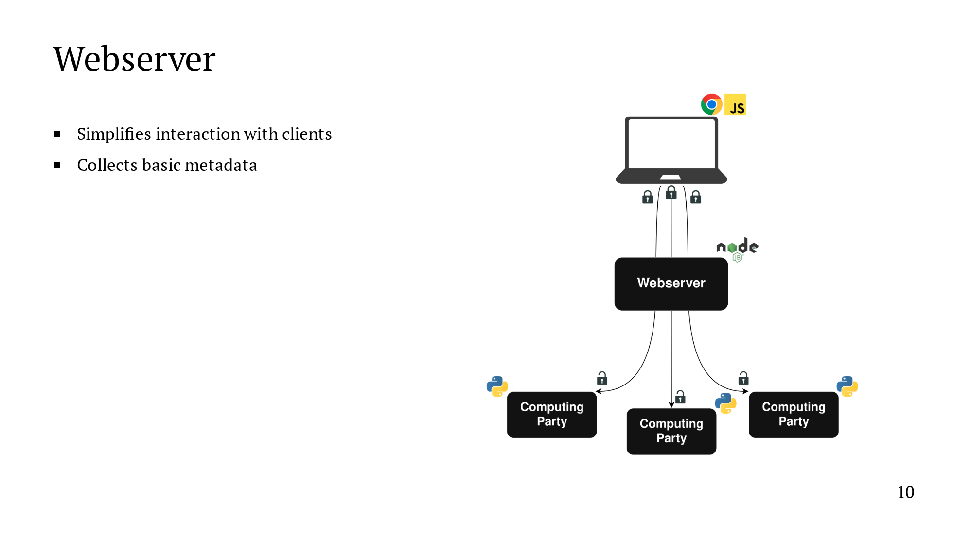
Notes:
Next, we have an intermediate webserver which exists to simplify the interaction with the clients. We don't want to have the MPC servers running all the time, and we don't want the client to have to manage 3 connections. The webserver also collects basic metadata, for example, so that we can pay users for their participation. We emphasize that because secret shares are end-to-end encrypted from clients to the computing parties, the webserver never sees any private data.

Slide 44

Notes:
Next, we have an intermediate webserver which exists to simplify the interaction with the clients. We don't want to have the MPC servers running all the time, and we don't want the client to have to manage 3 connections. The webserver also collects basic metadata, for example, so that we can pay users for their participation. We emphasize that because secret shares are end-to-end encrypted from clients to the computing parties, the webserver never sees any private data.

Slide 45
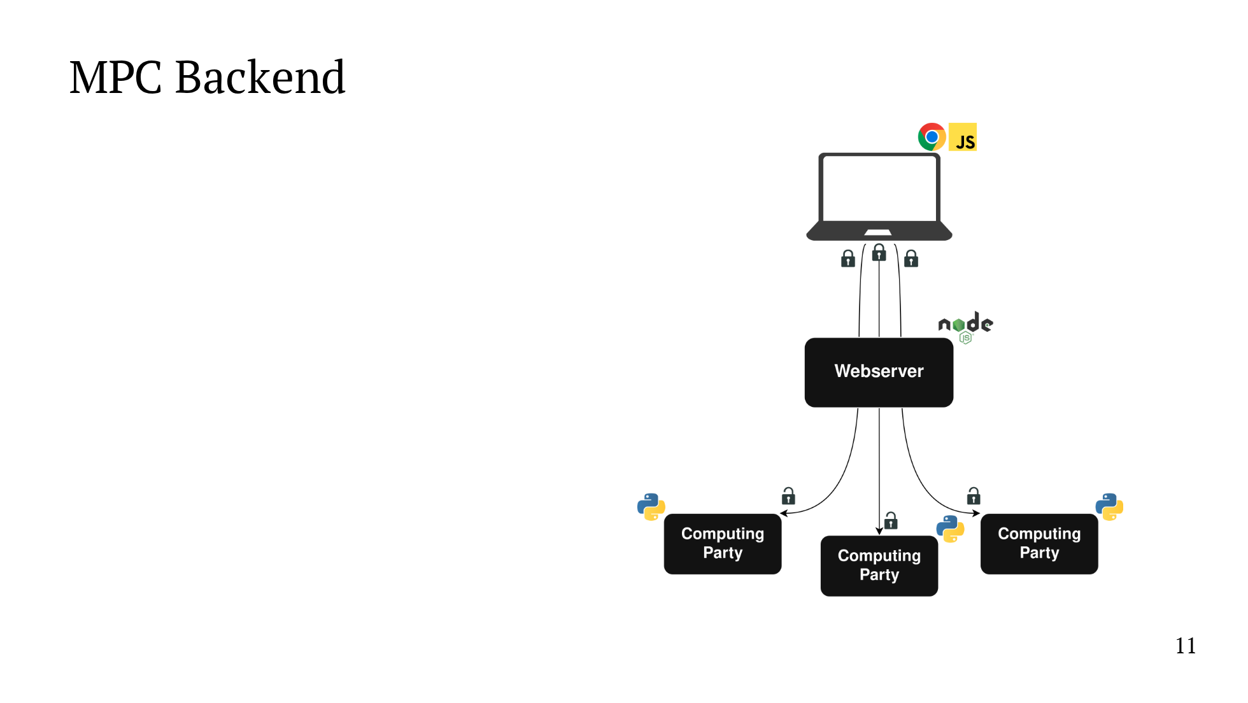
Notes:
The final component is the MPC backend. We run the MPC in the three party setting with an honest majority. And we built our implementation on top of the CrypTen library. We implemented an algorithm for the learning from label proportions problem under MPC. This is the first MPC implementation of a model for this particular problem. I'll talk more about the details of the implementation in the next slides.

Slide 46
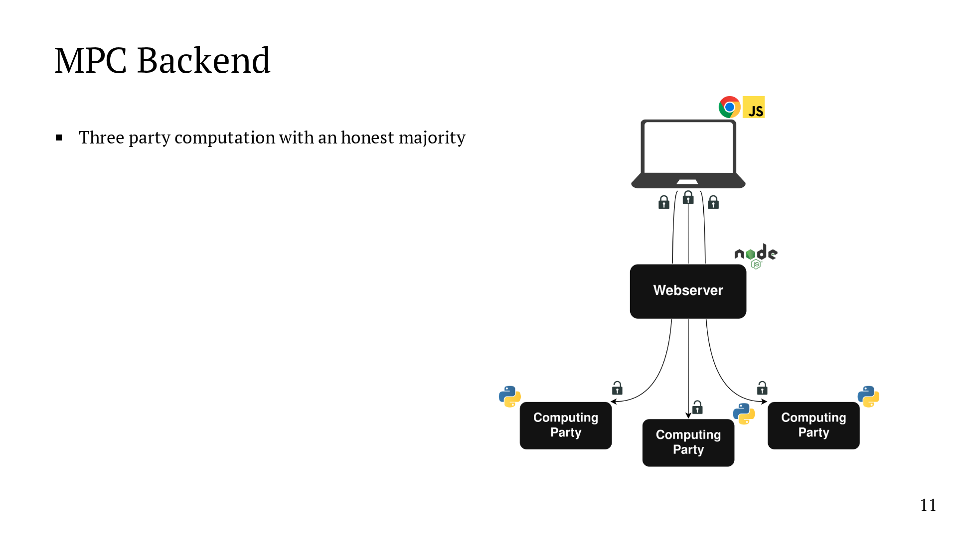
Notes:
The final component is the MPC backend. We run the MPC in the three party setting with an honest majority. And we built our implementation on top of the CrypTen library. We implemented an algorithm for the learning from label proportions problem under MPC. This is the first MPC implementation of a model for this particular problem. I'll talk more about the details of the implementation in the next slides.

Slide 47
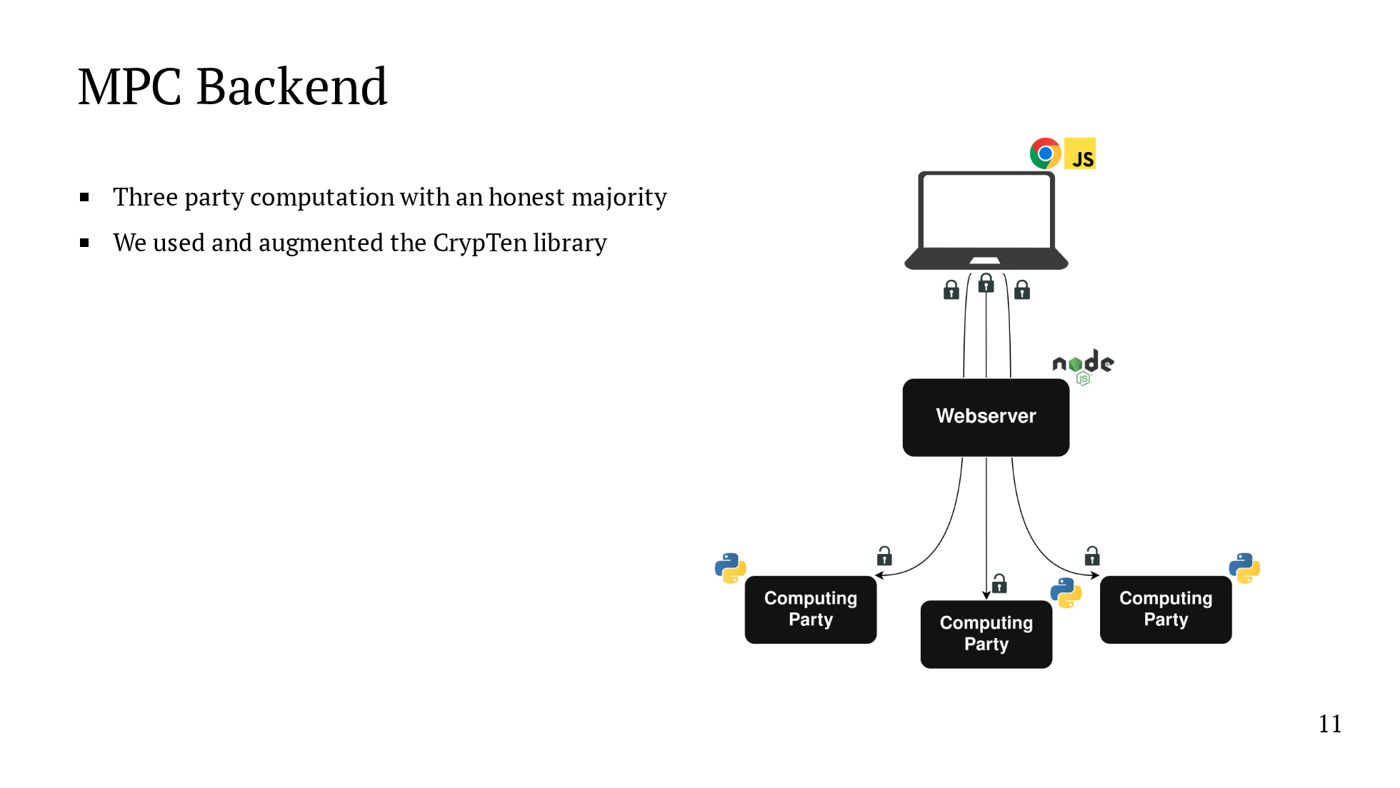
Notes:
The final component is the MPC backend. We run the MPC in the three party setting with an honest majority. And we built our implementation on top of the CrypTen library. We implemented an algorithm for the learning from label proportions problem under MPC. This is the first MPC implementation of a model for this particular problem. I'll talk more about the details of the implementation in the next slides.

Slide 48

Notes:
The final component is the MPC backend. We run the MPC in the three party setting with an honest majority. And we built our implementation on top of the CrypTen library. We implemented an algorithm for the learning from label proportions problem under MPC. This is the first MPC implementation of a model for this particular problem. I'll talk more about the details of the implementation in the next slides.

Slide 49
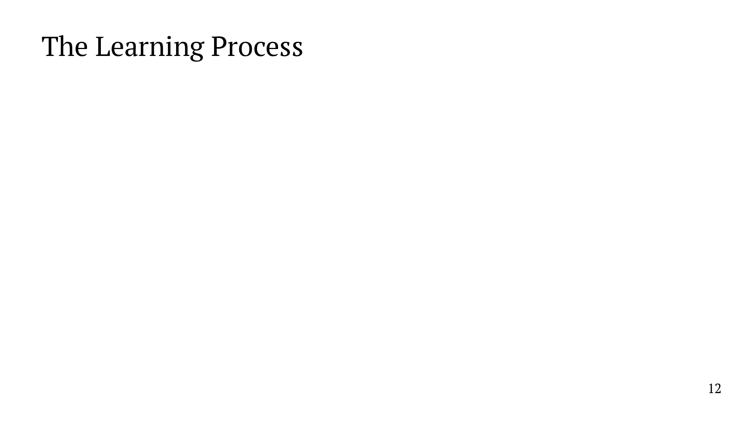
Notes:
So, let's turn now to the learning process. The problem that we're interested in is the Learning from Label Proportions problem, or the LLP problem. I'll define this problem and show a plaintext algorithm to solve it, and then I'll show to translate the plaintext algorithm to MPC. To our knowledge, this is the first implementation under MPC of a model for this particular problem. Our implementation builds on the CrypTen library, and as a result, we're able to take advantage of a lot of existing building blocks. But there are some pieces that we have to implement from scratch.

Slide 50
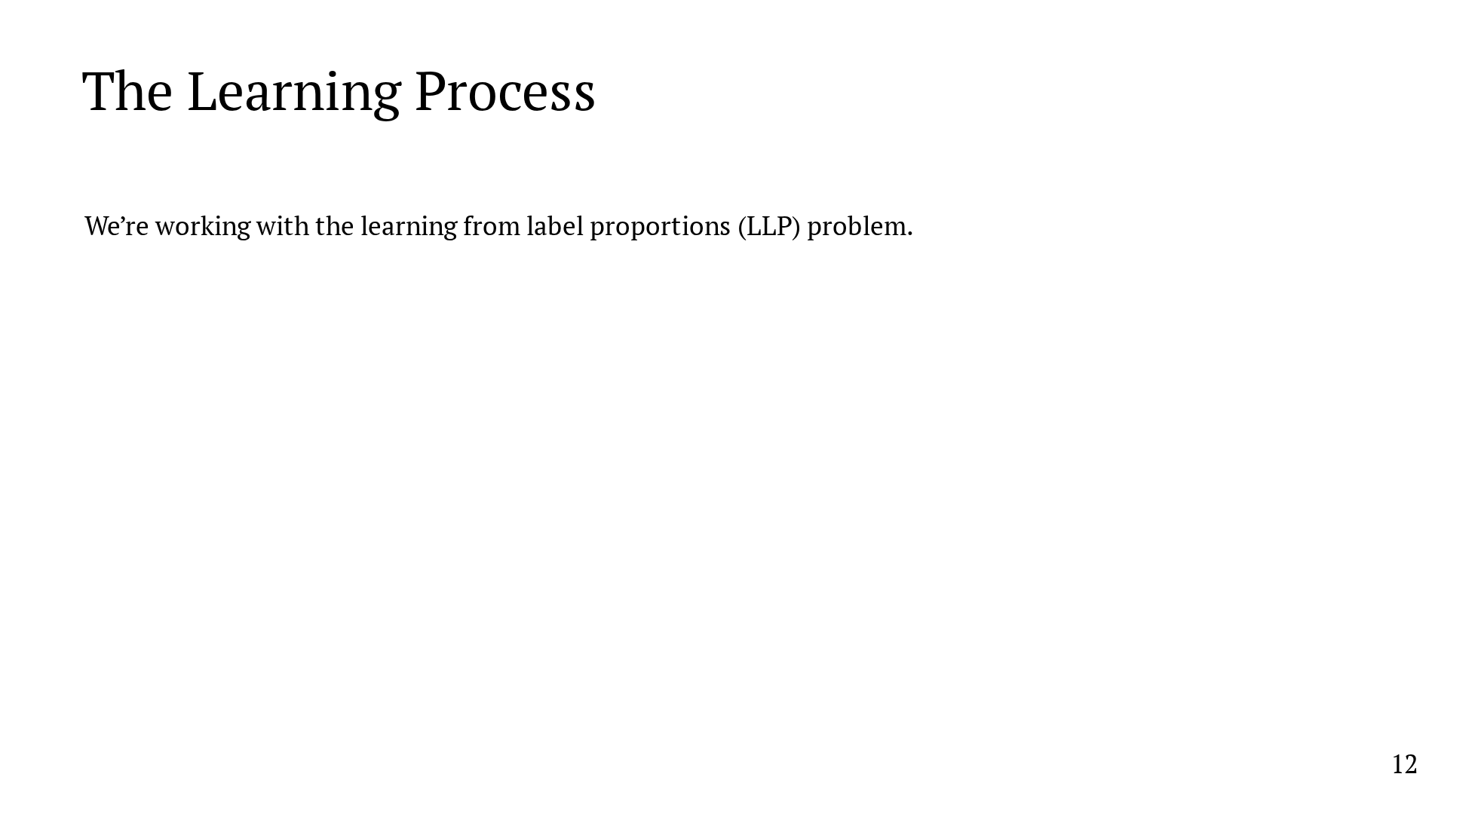
Notes:
So, let's turn now to the learning process. The problem that we're interested in is the Learning from Label Proportions problem, or the LLP problem. I'll define this problem and show a plaintext algorithm to solve it, and then I'll show to translate the plaintext algorithm to MPC. To our knowledge, this is the first implementation under MPC of a model for this particular problem. Our implementation builds on the CrypTen library, and as a result, we're able to take advantage of a lot of existing building blocks. But there are some pieces that we have to implement from scratch.

Slide 51
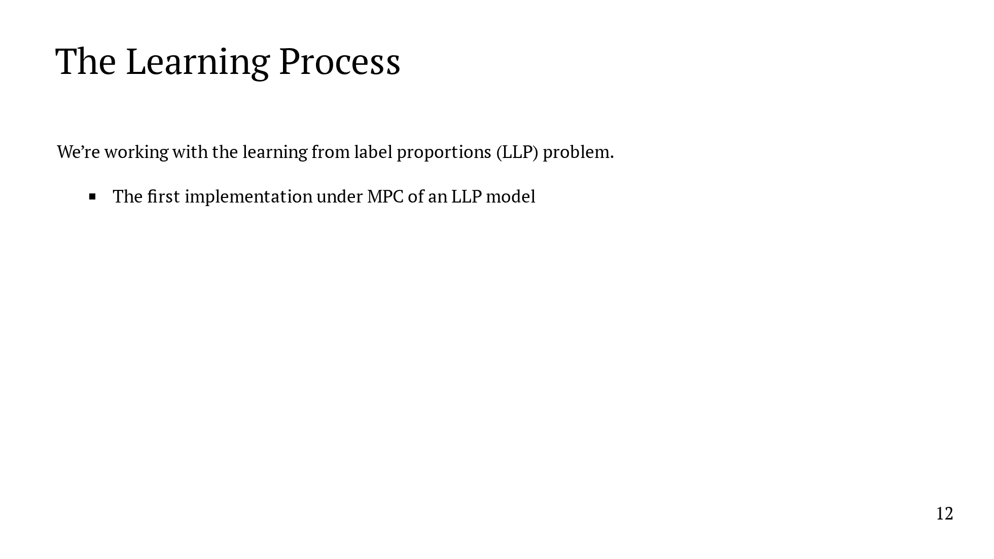
Notes:
So, let's turn now to the learning process. The problem that we're interested in is the Learning from Label Proportions problem, or the LLP problem. I'll define this problem and show a plaintext algorithm to solve it, and then I'll show to translate the plaintext algorithm to MPC. To our knowledge, this is the first implementation under MPC of a model for this particular problem. Our implementation builds on the CrypTen library, and as a result, we're able to take advantage of a lot of existing building blocks. But there are some pieces that we have to implement from scratch.

Slide 52
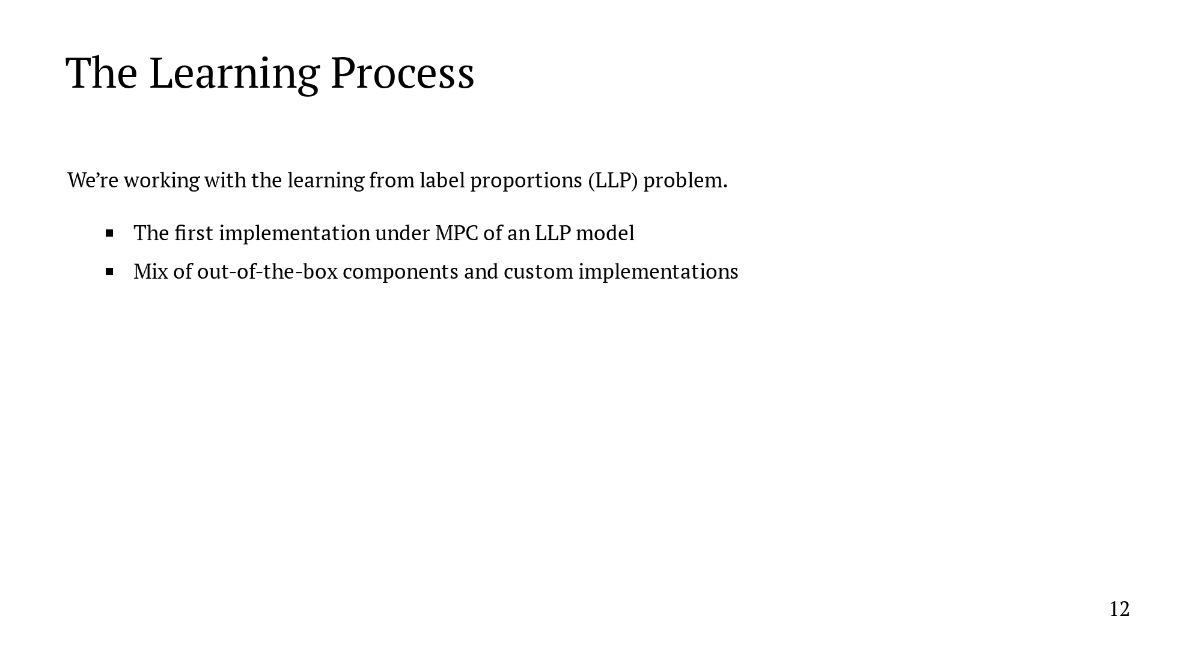
Notes:
So, let's turn now to the learning process. The problem that we're interested in is the Learning from Label Proportions problem, or the LLP problem. I'll define this problem and show a plaintext algorithm to solve it, and then I'll show to translate the plaintext algorithm to MPC. To our knowledge, this is the first implementation under MPC of a model for this particular problem. Our implementation builds on the CrypTen library, and as a result, we're able to take advantage of a lot of existing building blocks. But there are some pieces that we have to implement from scratch.

Slide 53
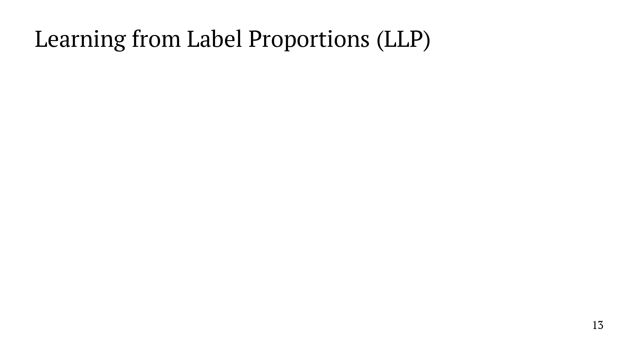
Notes:
Let's look at the LLP problem as it appears in our system. Every day, each user in the system is going to send us a unlabeled vector with about 1000 elements. We don't know their political preference. The vector contains the number of visits to each of the top 517 websites in the US and the number of times referred to each of the top 517 websites from a popular social media website. The unlabeled vectors are grouped together by state, and each state has a ground truth, which can be either the real election results or a prior poll. Here are two example states. The left might be Massachusetts. We don't know who the individual users prefer, but we know that the state as a whole voted 60% for the Democratic candidate. On the right might be Florida. Again, we don't know the individual preferences, but we know that the state as a whole voted 55% for the Republican candidate. The goal of the problem is to train on an aggregate ground truth. So, what did we do?

Slide 54
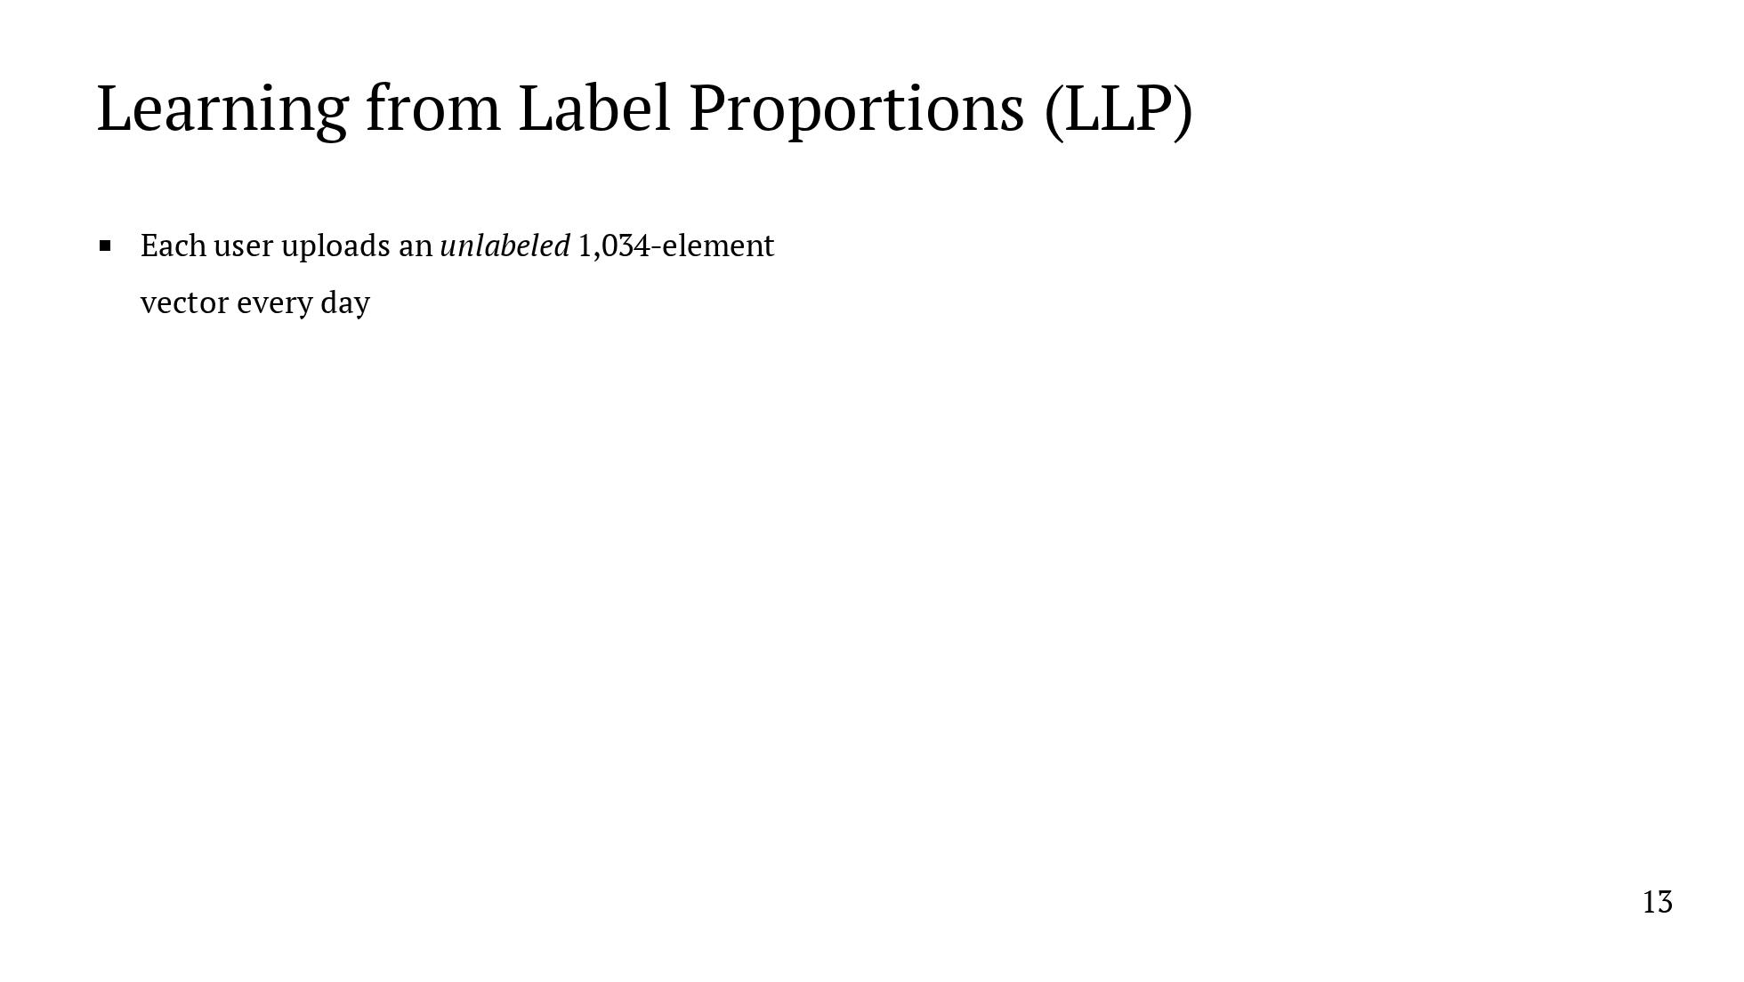
Notes:
Let's look at the LLP problem as it appears in our system. Every day, each user in the system is going to send us a unlabeled vector with about 1000 elements. We don't know their political preference. The vector contains the number of visits to each of the top 517 websites in the US and the number of times referred to each of the top 517 websites from a popular social media website. The unlabeled vectors are grouped together by state, and each state has a ground truth, which can be either the real election results or a prior poll. Here are two example states. The left might be Massachusetts. We don't know who the individual users prefer, but we know that the state as a whole voted 60% for the Democratic candidate. On the right might be Florida. Again, we don't know the individual preferences, but we know that the state as a whole voted 55% for the Republican candidate. The goal of the problem is to train on an aggregate ground truth. So, what did we do?

Slide 55
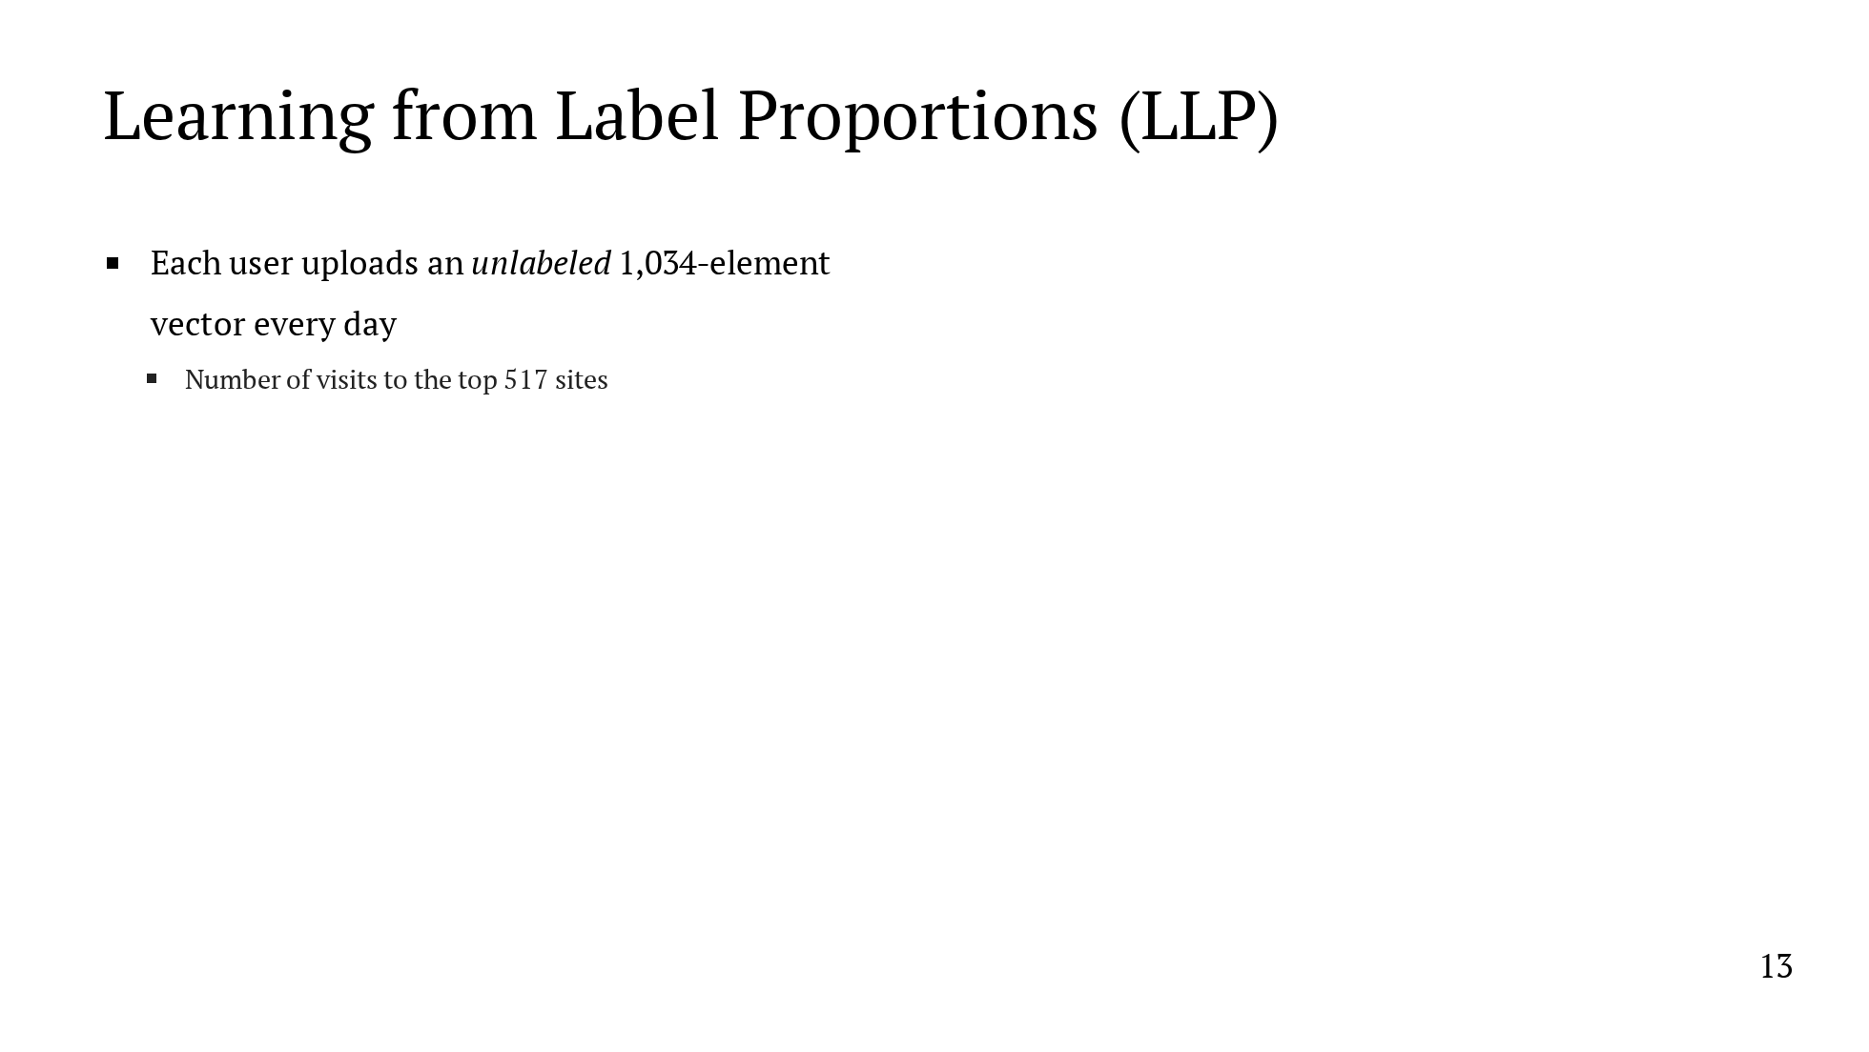
Notes:
Let's look at the LLP problem as it appears in our system. Every day, each user in the system is going to send us a unlabeled vector with about 1000 elements. We don't know their political preference. The vector contains the number of visits to each of the top 517 websites in the US and the number of times referred to each of the top 517 websites from a popular social media website. The unlabeled vectors are grouped together by state, and each state has a ground truth, which can be either the real election results or a prior poll. Here are two example states. The left might be Massachusetts. We don't know who the individual users prefer, but we know that the state as a whole voted 60% for the Democratic candidate. On the right might be Florida. Again, we don't know the individual preferences, but we know that the state as a whole voted 55% for the Republican candidate. The goal of the problem is to train on an aggregate ground truth. So, what did we do?

Slide 56
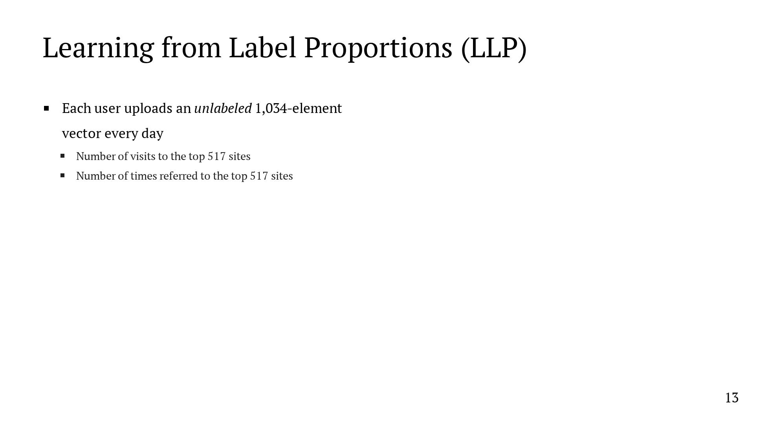
Notes:
Let's look at the LLP problem as it appears in our system. Every day, each user in the system is going to send us a unlabeled vector with about 1000 elements. We don't know their political preference. The vector contains the number of visits to each of the top 517 websites in the US and the number of times referred to each of the top 517 websites from a popular social media website. The unlabeled vectors are grouped together by state, and each state has a ground truth, which can be either the real election results or a prior poll. Here are two example states. The left might be Massachusetts. We don't know who the individual users prefer, but we know that the state as a whole voted 60% for the Democratic candidate. On the right might be Florida. Again, we don't know the individual preferences, but we know that the state as a whole voted 55% for the Republican candidate. The goal of the problem is to train on an aggregate ground truth. So, what did we do?

Slide 57
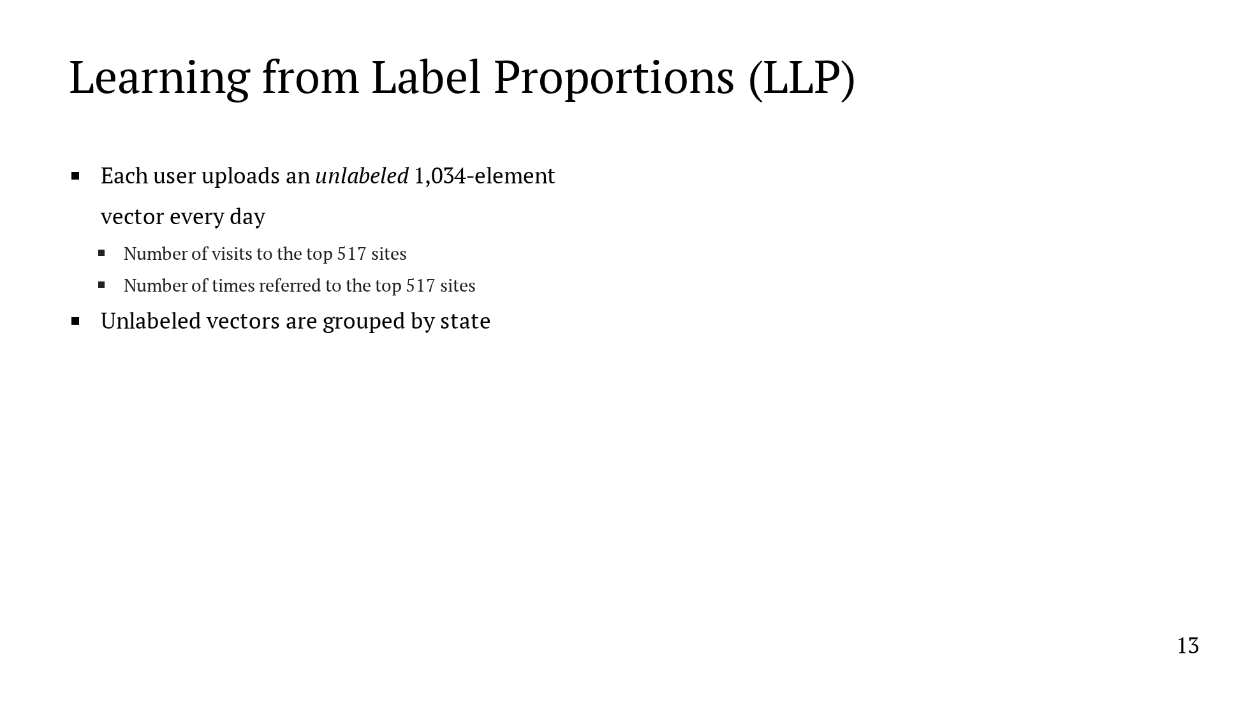
Notes:
Let's look at the LLP problem as it appears in our system. Every day, each user in the system is going to send us a unlabeled vector with about 1000 elements. We don't know their political preference. The vector contains the number of visits to each of the top 517 websites in the US and the number of times referred to each of the top 517 websites from a popular social media website. The unlabeled vectors are grouped together by state, and each state has a ground truth, which can be either the real election results or a prior poll. Here are two example states. The left might be Massachusetts. We don't know who the individual users prefer, but we know that the state as a whole voted 60% for the Democratic candidate. On the right might be Florida. Again, we don't know the individual preferences, but we know that the state as a whole voted 55% for the Republican candidate. The goal of the problem is to train on an aggregate ground truth. So, what did we do?

Slide 58
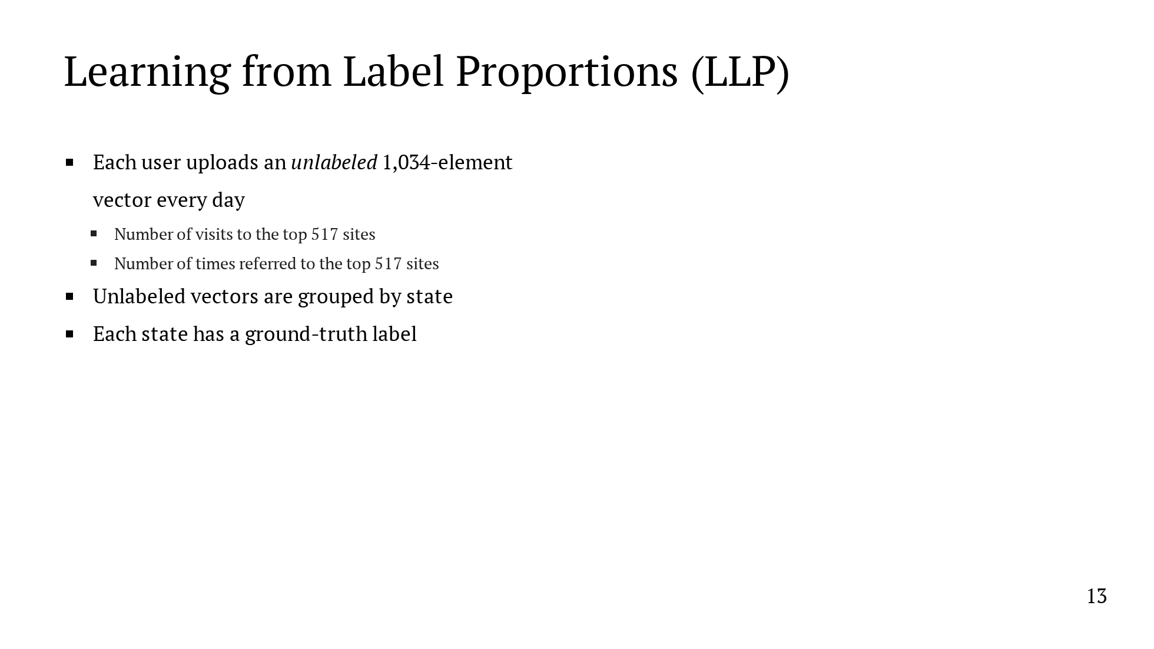
Notes:
Let's look at the LLP problem as it appears in our system. Every day, each user in the system is going to send us a unlabeled vector with about 1000 elements. We don't know their political preference. The vector contains the number of visits to each of the top 517 websites in the US and the number of times referred to each of the top 517 websites from a popular social media website. The unlabeled vectors are grouped together by state, and each state has a ground truth, which can be either the real election results or a prior poll. Here are two example states. The left might be Massachusetts. We don't know who the individual users prefer, but we know that the state as a whole voted 60% for the Democratic candidate. On the right might be Florida. Again, we don't know the individual preferences, but we know that the state as a whole voted 55% for the Republican candidate. The goal of the problem is to train on an aggregate ground truth. So, what did we do?

Slide 59
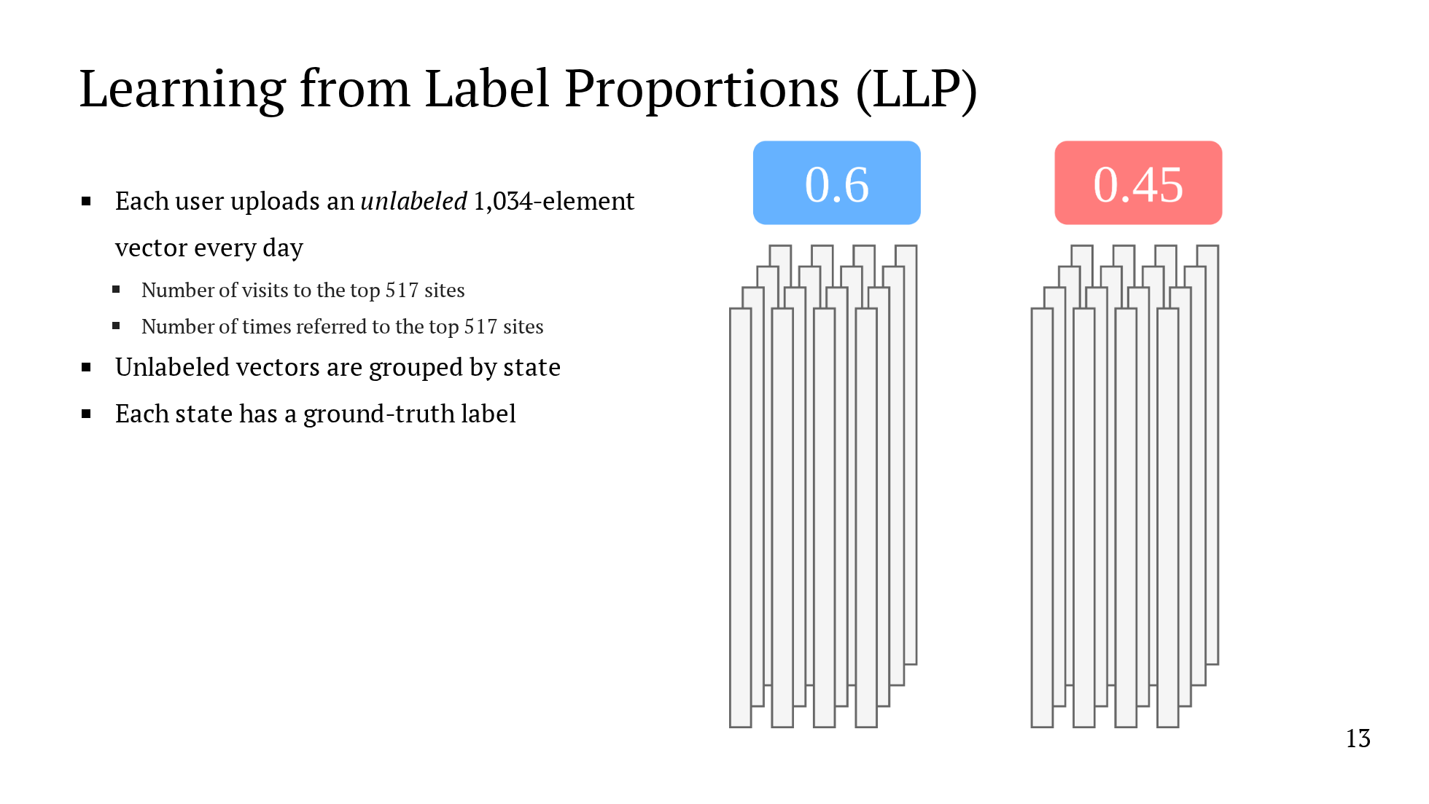
Notes:
Let's look at the LLP problem as it appears in our system. Every day, each user in the system is going to send us a unlabeled vector with about 1000 elements. We don't know their political preference. The vector contains the number of visits to each of the top 517 websites in the US and the number of times referred to each of the top 517 websites from a popular social media website. The unlabeled vectors are grouped together by state, and each state has a ground truth, which can be either the real election results or a prior poll. Here are two example states. The left might be Massachusetts. We don't know who the individual users prefer, but we know that the state as a whole voted 60% for the Democratic candidate. On the right might be Florida. Again, we don't know the individual preferences, but we know that the state as a whole voted 55% for the Republican candidate. The goal of the problem is to train on an aggregate ground truth. So, what did we do?

Slide 60
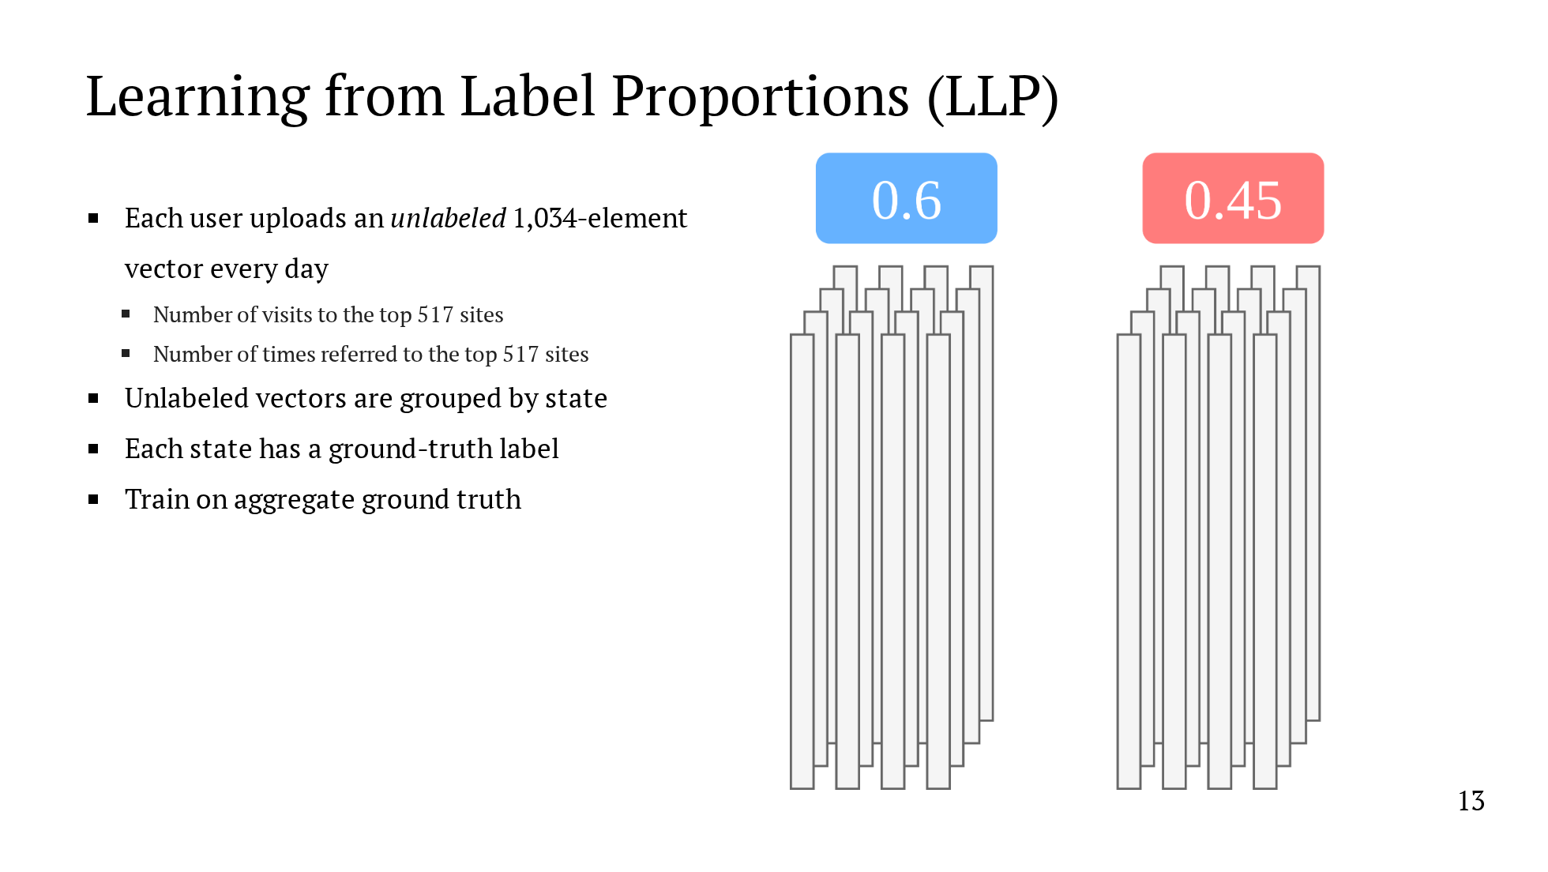
Notes:
Let's look at the LLP problem as it appears in our system. Every day, each user in the system is going to send us a unlabeled vector with about 1000 elements. We don't know their political preference. The vector contains the number of visits to each of the top 517 websites in the US and the number of times referred to each of the top 517 websites from a popular social media website. The unlabeled vectors are grouped together by state, and each state has a ground truth, which can be either the real election results or a prior poll. Here are two example states. The left might be Massachusetts. We don't know who the individual users prefer, but we know that the state as a whole voted 60% for the Democratic candidate. On the right might be Florida. Again, we don't know the individual preferences, but we know that the state as a whole voted 55% for the Republican candidate. The goal of the problem is to train on an aggregate ground truth. So, what did we do?

Slide 61
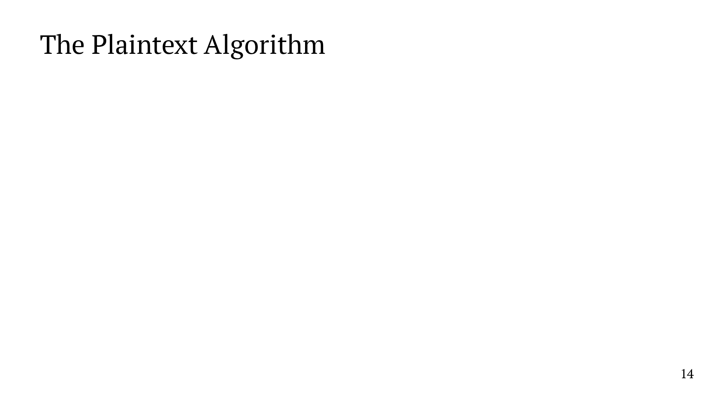
Notes:
We'll now talk about a plaintext algorithm for this problem, and then we'll see how to translate it to MPC. As a reminder, the input to the model is a group of unlabeled histograms grouped together by state, where each state has a ground-truth label. The learning algorithm follows a train update loop until it converges. We repeat the following steps until we reach convergence. We train a logistic regression model on the data. Logistic regression requires each user to have a label, so we're going to assign each user a label. We start with some initial predictions which can either be random or based on their state's label. We're going to update these predictions in each iteration and retrain the logistic regression model. After training a model for the iteration, we run inference with the model. Then, we sort each state's users by their prediction. We set a threshold for the output, and we update individual predictions by comparing them with the threshold. So, after this step, if a state voted 60% Democratic in the election, we would assign a Democrat label to the 60% of users predicted to be most likely to vote Democratic. We repeat this process until the predictions converge.

Slide 62

Notes:
We'll now talk about a plaintext algorithm for this problem, and then we'll see how to translate it to MPC. As a reminder, the input to the model is a group of unlabeled histograms grouped together by state, where each state has a ground-truth label. The learning algorithm follows a train update loop until it converges. We repeat the following steps until we reach convergence. We train a logistic regression model on the data. Logistic regression requires each user to have a label, so we're going to assign each user a label. We start with some initial predictions which can either be random or based on their state's label. We're going to update these predictions in each iteration and retrain the logistic regression model. After training a model for the iteration, we run inference with the model. Then, we sort each state's users by their prediction. We set a threshold for the output, and we update individual predictions by comparing them with the threshold. So, after this step, if a state voted 60% Democratic in the election, we would assign a Democrat label to the 60% of users predicted to be most likely to vote Democratic. We repeat this process until the predictions converge.

Slide 63

Notes:
We'll now talk about a plaintext algorithm for this problem, and then we'll see how to translate it to MPC. As a reminder, the input to the model is a group of unlabeled histograms grouped together by state, where each state has a ground-truth label. The learning algorithm follows a train update loop until it converges. We repeat the following steps until we reach convergence. We train a logistic regression model on the data. Logistic regression requires each user to have a label, so we're going to assign each user a label. We start with some initial predictions which can either be random or based on their state's label. We're going to update these predictions in each iteration and retrain the logistic regression model. After training a model for the iteration, we run inference with the model. Then, we sort each state's users by their prediction. We set a threshold for the output, and we update individual predictions by comparing them with the threshold. So, after this step, if a state voted 60% Democratic in the election, we would assign a Democrat label to the 60% of users predicted to be most likely to vote Democratic. We repeat this process until the predictions converge.

Slide 64

Notes:
Here is that same algorithm expressed in pseudocode. We can use the same pseudocode for both the plaintext and MPC algorithms, but we need to replace individual components, those highlighted in yellow, with their oblivious counterparts. I'll go through each step and show how we translate it to MPC. First, we initialize the labels, and this can be done in plaintext. The initialization is either randomized or fixed based on the user's state. The next step is to train a model with the current labels and run inference on the data using the new model. Machine learning under MPC is complex and there's been a ton of work on this, so we just use the existing work as a black box and state that it can be done under MPC. The key step in updating the labels in each iteration is to determine the threshold separating a Democratic prediction from a Republican prediction. This involves computing percentiles, which effectively requires oblivious sorting, making this a very expensive step. More to come on that point. Then we need to actually update the labels for each user by comparing it with the state threshold. This can be done with a simple oblivious comparison circuit. Finally, we need to check for convergence after every iteration to tell when we should stop the training. All we reveal is whether we should stop or not, so a single bit. We do this by taking the current label vector and comparing it with the last label vector, giving us a vector of bits indicating which indices are the same as the last iteration. We can sum the result vector and then do a single comparison between the sum and a convergence threshold. Then we reveal the result of that final comparison.

Slide 65

Notes:
Here is that same algorithm expressed in pseudocode. We can use the same pseudocode for both the plaintext and MPC algorithms, but we need to replace individual components, those highlighted in yellow, with their oblivious counterparts. I'll go through each step and show how we translate it to MPC. First, we initialize the labels, and this can be done in plaintext. The initialization is either randomized or fixed based on the user's state. The next step is to train a model with the current labels and run inference on the data using the new model. Machine learning under MPC is complex and there's been a ton of work on this, so we just use the existing work as a black box and state that it can be done under MPC. The key step in updating the labels in each iteration is to determine the threshold separating a Democratic prediction from a Republican prediction. This involves computing percentiles, which effectively requires oblivious sorting, making this a very expensive step. More to come on that point. Then we need to actually update the labels for each user by comparing it with the state threshold. This can be done with a simple oblivious comparison circuit. Finally, we need to check for convergence after every iteration to tell when we should stop the training. All we reveal is whether we should stop or not, so a single bit. We do this by taking the current label vector and comparing it with the last label vector, giving us a vector of bits indicating which indices are the same as the last iteration. We can sum the result vector and then do a single comparison between the sum and a convergence threshold. Then we reveal the result of that final comparison.

Slide 66

Notes:
Here is that same algorithm expressed in pseudocode. We can use the same pseudocode for both the plaintext and MPC algorithms, but we need to replace individual components, those highlighted in yellow, with their oblivious counterparts. I'll go through each step and show how we translate it to MPC. First, we initialize the labels, and this can be done in plaintext. The initialization is either randomized or fixed based on the user's state. The next step is to train a model with the current labels and run inference on the data using the new model. Machine learning under MPC is complex and there's been a ton of work on this, so we just use the existing work as a black box and state that it can be done under MPC. The key step in updating the labels in each iteration is to determine the threshold separating a Democratic prediction from a Republican prediction. This involves computing percentiles, which effectively requires oblivious sorting, making this a very expensive step. More to come on that point. Then we need to actually update the labels for each user by comparing it with the state threshold. This can be done with a simple oblivious comparison circuit. Finally, we need to check for convergence after every iteration to tell when we should stop the training. All we reveal is whether we should stop or not, so a single bit. We do this by taking the current label vector and comparing it with the last label vector, giving us a vector of bits indicating which indices are the same as the last iteration. We can sum the result vector and then do a single comparison between the sum and a convergence threshold. Then we reveal the result of that final comparison.

Slide 67

Notes:
Here is that same algorithm expressed in pseudocode. We can use the same pseudocode for both the plaintext and MPC algorithms, but we need to replace individual components, those highlighted in yellow, with their oblivious counterparts. I'll go through each step and show how we translate it to MPC. First, we initialize the labels, and this can be done in plaintext. The initialization is either randomized or fixed based on the user's state. The next step is to train a model with the current labels and run inference on the data using the new model. Machine learning under MPC is complex and there's been a ton of work on this, so we just use the existing work as a black box and state that it can be done under MPC. The key step in updating the labels in each iteration is to determine the threshold separating a Democratic prediction from a Republican prediction. This involves computing percentiles, which effectively requires oblivious sorting, making this a very expensive step. More to come on that point. Then we need to actually update the labels for each user by comparing it with the state threshold. This can be done with a simple oblivious comparison circuit. Finally, we need to check for convergence after every iteration to tell when we should stop the training. All we reveal is whether we should stop or not, so a single bit. We do this by taking the current label vector and comparing it with the last label vector, giving us a vector of bits indicating which indices are the same as the last iteration. We can sum the result vector and then do a single comparison between the sum and a convergence threshold. Then we reveal the result of that final comparison.

Slide 68

Notes:
Here is that same algorithm expressed in pseudocode. We can use the same pseudocode for both the plaintext and MPC algorithms, but we need to replace individual components, those highlighted in yellow, with their oblivious counterparts. I'll go through each step and show how we translate it to MPC. First, we initialize the labels, and this can be done in plaintext. The initialization is either randomized or fixed based on the user's state. The next step is to train a model with the current labels and run inference on the data using the new model. Machine learning under MPC is complex and there's been a ton of work on this, so we just use the existing work as a black box and state that it can be done under MPC. The key step in updating the labels in each iteration is to determine the threshold separating a Democratic prediction from a Republican prediction. This involves computing percentiles, which effectively requires oblivious sorting, making this a very expensive step. More to come on that point. Then we need to actually update the labels for each user by comparing it with the state threshold. This can be done with a simple oblivious comparison circuit. Finally, we need to check for convergence after every iteration to tell when we should stop the training. All we reveal is whether we should stop or not, so a single bit. We do this by taking the current label vector and comparing it with the last label vector, giving us a vector of bits indicating which indices are the same as the last iteration. We can sum the result vector and then do a single comparison between the sum and a convergence threshold. Then we reveal the result of that final comparison.

Slide 69

Notes:
Here is that same algorithm expressed in pseudocode. We can use the same pseudocode for both the plaintext and MPC algorithms, but we need to replace individual components, those highlighted in yellow, with their oblivious counterparts. I'll go through each step and show how we translate it to MPC. First, we initialize the labels, and this can be done in plaintext. The initialization is either randomized or fixed based on the user's state. The next step is to train a model with the current labels and run inference on the data using the new model. Machine learning under MPC is complex and there's been a ton of work on this, so we just use the existing work as a black box and state that it can be done under MPC. The key step in updating the labels in each iteration is to determine the threshold separating a Democratic prediction from a Republican prediction. This involves computing percentiles, which effectively requires oblivious sorting, making this a very expensive step. More to come on that point. Then we need to actually update the labels for each user by comparing it with the state threshold. This can be done with a simple oblivious comparison circuit. Finally, we need to check for convergence after every iteration to tell when we should stop the training. All we reveal is whether we should stop or not, so a single bit. We do this by taking the current label vector and comparing it with the last label vector, giving us a vector of bits indicating which indices are the same as the last iteration. We can sum the result vector and then do a single comparison between the sum and a convergence threshold. Then we reveal the result of that final comparison.

Slide 70

Notes:
Here is that same algorithm expressed in pseudocode. We can use the same pseudocode for both the plaintext and MPC algorithms, but we need to replace individual components, those highlighted in yellow, with their oblivious counterparts. I'll go through each step and show how we translate it to MPC. First, we initialize the labels, and this can be done in plaintext. The initialization is either randomized or fixed based on the user's state. The next step is to train a model with the current labels and run inference on the data using the new model. Machine learning under MPC is complex and there's been a ton of work on this, so we just use the existing work as a black box and state that it can be done under MPC. The key step in updating the labels in each iteration is to determine the threshold separating a Democratic prediction from a Republican prediction. This involves computing percentiles, which effectively requires oblivious sorting, making this a very expensive step. More to come on that point. Then we need to actually update the labels for each user by comparing it with the state threshold. This can be done with a simple oblivious comparison circuit. Finally, we need to check for convergence after every iteration to tell when we should stop the training. All we reveal is whether we should stop or not, so a single bit. We do this by taking the current label vector and comparing it with the last label vector, giving us a vector of bits indicating which indices are the same as the last iteration. We can sum the result vector and then do a single comparison between the sum and a convergence threshold. Then we reveal the result of that final comparison.

Slide 71

Notes:
Here is that same algorithm expressed in pseudocode. We can use the same pseudocode for both the plaintext and MPC algorithms, but we need to replace individual components, those highlighted in yellow, with their oblivious counterparts. I'll go through each step and show how we translate it to MPC. First, we initialize the labels, and this can be done in plaintext. The initialization is either randomized or fixed based on the user's state. The next step is to train a model with the current labels and run inference on the data using the new model. Machine learning under MPC is complex and there's been a ton of work on this, so we just use the existing work as a black box and state that it can be done under MPC. The key step in updating the labels in each iteration is to determine the threshold separating a Democratic prediction from a Republican prediction. This involves computing percentiles, which effectively requires oblivious sorting, making this a very expensive step. More to come on that point. Then we need to actually update the labels for each user by comparing it with the state threshold. This can be done with a simple oblivious comparison circuit. Finally, we need to check for convergence after every iteration to tell when we should stop the training. All we reveal is whether we should stop or not, so a single bit. We do this by taking the current label vector and comparing it with the last label vector, giving us a vector of bits indicating which indices are the same as the last iteration. We can sum the result vector and then do a single comparison between the sum and a convergence threshold. Then we reveal the result of that final comparison.

Slide 72

Notes:
Here is that same algorithm expressed in pseudocode. We can use the same pseudocode for both the plaintext and MPC algorithms, but we need to replace individual components, those highlighted in yellow, with their oblivious counterparts. I'll go through each step and show how we translate it to MPC. First, we initialize the labels, and this can be done in plaintext. The initialization is either randomized or fixed based on the user's state. The next step is to train a model with the current labels and run inference on the data using the new model. Machine learning under MPC is complex and there's been a ton of work on this, so we just use the existing work as a black box and state that it can be done under MPC. The key step in updating the labels in each iteration is to determine the threshold separating a Democratic prediction from a Republican prediction. This involves computing percentiles, which effectively requires oblivious sorting, making this a very expensive step. More to come on that point. Then we need to actually update the labels for each user by comparing it with the state threshold. This can be done with a simple oblivious comparison circuit. Finally, we need to check for convergence after every iteration to tell when we should stop the training. All we reveal is whether we should stop or not, so a single bit. We do this by taking the current label vector and comparing it with the last label vector, giving us a vector of bits indicating which indices are the same as the last iteration. We can sum the result vector and then do a single comparison between the sum and a convergence threshold. Then we reveal the result of that final comparison.

Slide 73

Notes:
While a detailed analysis from a political science perspective is outside the scope of this talk, I can give a glimpse of what the results look like. A couple months before the election, our map is quite blue. Then, a week before the election, it's become pretty red, which lines up pretty well with the actual outcomes in the bottom left. After the election, we see a substantial swing back to the blue.

Slide 74

Notes:
Now, in the last few minutes, I want to talk about some lessons we learned from the deployment and some areas for future work.

Slide 75

Notes:
The main lesson we learned was that data integrity matters. Our initial advertisement targeted the swing states, which we realize gave users an incentive to report their state of residence dishonestly. We sought to validate users' self-reported locations with IP addresses and geolocation, and we got mixed results. While 98% of our users were in the United States, the state-level results are more concerning. We were only able to validate the honesty of 15% of users. So, we dug deeper on the data, and we found 2 things. First, users who are in the sample for a longer period of time tend to be more honest. We had many ephemeral dishonest users and a smaller number of consistent honest users. And second, honest users contribute much richer data. The 15% of users who were confirmed to be reporting honestly accounted for over half of the total visits and almost 90% of the total referrals. From this, we learn 2 things. First, in future deployments, verifying user honesty and enforcing it where possible should be a priority. And second, while we should seek to maximize the integrity of the data, the fact that honest users tend to contribute more valuable data means our learning process is surprisingly robust to dishonest users.

Slide 76

Notes:
The main lesson we learned was that data integrity matters. Our initial advertisement targeted the swing states, which we realize gave users an incentive to report their state of residence dishonestly. We sought to validate users' self-reported locations with IP addresses and geolocation, and we got mixed results. While 98% of our users were in the United States, the state-level results are more concerning. We were only able to validate the honesty of 15% of users. So, we dug deeper on the data, and we found 2 things. First, users who are in the sample for a longer period of time tend to be more honest. We had many ephemeral dishonest users and a smaller number of consistent honest users. And second, honest users contribute much richer data. The 15% of users who were confirmed to be reporting honestly accounted for over half of the total visits and almost 90% of the total referrals. From this, we learn 2 things. First, in future deployments, verifying user honesty and enforcing it where possible should be a priority. And second, while we should seek to maximize the integrity of the data, the fact that honest users tend to contribute more valuable data means our learning process is surprisingly robust to dishonest users.

Slide 77

Notes:
The main lesson we learned was that data integrity matters. Our initial advertisement targeted the swing states, which we realize gave users an incentive to report their state of residence dishonestly. We sought to validate users' self-reported locations with IP addresses and geolocation, and we got mixed results. While 98% of our users were in the United States, the state-level results are more concerning. We were only able to validate the honesty of 15% of users. So, we dug deeper on the data, and we found 2 things. First, users who are in the sample for a longer period of time tend to be more honest. We had many ephemeral dishonest users and a smaller number of consistent honest users. And second, honest users contribute much richer data. The 15% of users who were confirmed to be reporting honestly accounted for over half of the total visits and almost 90% of the total referrals. From this, we learn 2 things. First, in future deployments, verifying user honesty and enforcing it where possible should be a priority. And second, while we should seek to maximize the integrity of the data, the fact that honest users tend to contribute more valuable data means our learning process is surprisingly robust to dishonest users.

Slide 78

Notes:
The main lesson we learned was that data integrity matters. Our initial advertisement targeted the swing states, which we realize gave users an incentive to report their state of residence dishonestly. We sought to validate users' self-reported locations with IP addresses and geolocation, and we got mixed results. While 98% of our users were in the United States, the state-level results are more concerning. We were only able to validate the honesty of 15% of users. So, we dug deeper on the data, and we found 2 things. First, users who are in the sample for a longer period of time tend to be more honest. We had many ephemeral dishonest users and a smaller number of consistent honest users. And second, honest users contribute much richer data. The 15% of users who were confirmed to be reporting honestly accounted for over half of the total visits and almost 90% of the total referrals. From this, we learn 2 things. First, in future deployments, verifying user honesty and enforcing it where possible should be a priority. And second, while we should seek to maximize the integrity of the data, the fact that honest users tend to contribute more valuable data means our learning process is surprisingly robust to dishonest users.

Slide 79

Notes:
The main lesson we learned was that data integrity matters. Our initial advertisement targeted the swing states, which we realize gave users an incentive to report their state of residence dishonestly. We sought to validate users' self-reported locations with IP addresses and geolocation, and we got mixed results. While 98% of our users were in the United States, the state-level results are more concerning. We were only able to validate the honesty of 15% of users. So, we dug deeper on the data, and we found 2 things. First, users who are in the sample for a longer period of time tend to be more honest. We had many ephemeral dishonest users and a smaller number of consistent honest users. And second, honest users contribute much richer data. The 15% of users who were confirmed to be reporting honestly accounted for over half of the total visits and almost 90% of the total referrals. From this, we learn 2 things. First, in future deployments, verifying user honesty and enforcing it where possible should be a priority. And second, while we should seek to maximize the integrity of the data, the fact that honest users tend to contribute more valuable data means our learning process is surprisingly robust to dishonest users.

Slide 80

Notes:
The main lesson we learned was that data integrity matters. Our initial advertisement targeted the swing states, which we realize gave users an incentive to report their state of residence dishonestly. We sought to validate users' self-reported locations with IP addresses and geolocation, and we got mixed results. While 98% of our users were in the United States, the state-level results are more concerning. We were only able to validate the honesty of 15% of users. So, we dug deeper on the data, and we found 2 things. First, users who are in the sample for a longer period of time tend to be more honest. We had many ephemeral dishonest users and a smaller number of consistent honest users. And second, honest users contribute much richer data. The 15% of users who were confirmed to be reporting honestly accounted for over half of the total visits and almost 90% of the total referrals. From this, we learn 2 things. First, in future deployments, verifying user honesty and enforcing it where possible should be a priority. And second, while we should seek to maximize the integrity of the data, the fact that honest users tend to contribute more valuable data means our learning process is surprisingly robust to dishonest users.

Slide 81

Notes:
The main lesson we learned was that data integrity matters. Our initial advertisement targeted the swing states, which we realize gave users an incentive to report their state of residence dishonestly. We sought to validate users' self-reported locations with IP addresses and geolocation, and we got mixed results. While 98% of our users were in the United States, the state-level results are more concerning. We were only able to validate the honesty of 15% of users. So, we dug deeper on the data, and we found 2 things. First, users who are in the sample for a longer period of time tend to be more honest. We had many ephemeral dishonest users and a smaller number of consistent honest users. And second, honest users contribute much richer data. The 15% of users who were confirmed to be reporting honestly accounted for over half of the total visits and almost 90% of the total referrals. From this, we learn 2 things. First, in future deployments, verifying user honesty and enforcing it where possible should be a priority. And second, while we should seek to maximize the integrity of the data, the fact that honest users tend to contribute more valuable data means our learning process is surprisingly robust to dishonest users.

Slide 82

Notes:
The main lesson we learned was that data integrity matters. Our initial advertisement targeted the swing states, which we realize gave users an incentive to report their state of residence dishonestly. We sought to validate users' self-reported locations with IP addresses and geolocation, and we got mixed results. While 98% of our users were in the United States, the state-level results are more concerning. We were only able to validate the honesty of 15% of users. So, we dug deeper on the data, and we found 2 things. First, users who are in the sample for a longer period of time tend to be more honest. We had many ephemeral dishonest users and a smaller number of consistent honest users. And second, honest users contribute much richer data. The 15% of users who were confirmed to be reporting honestly accounted for over half of the total visits and almost 90% of the total referrals. From this, we learn 2 things. First, in future deployments, verifying user honesty and enforcing it where possible should be a priority. And second, while we should seek to maximize the integrity of the data, the fact that honest users tend to contribute more valuable data means our learning process is surprisingly robust to dishonest users.

Slide 83

Notes:
The main lesson we learned was that data integrity matters. Our initial advertisement targeted the swing states, which we realize gave users an incentive to report their state of residence dishonestly. We sought to validate users' self-reported locations with IP addresses and geolocation, and we got mixed results. While 98% of our users were in the United States, the state-level results are more concerning. We were only able to validate the honesty of 15% of users. So, we dug deeper on the data, and we found 2 things. First, users who are in the sample for a longer period of time tend to be more honest. We had many ephemeral dishonest users and a smaller number of consistent honest users. And second, honest users contribute much richer data. The 15% of users who were confirmed to be reporting honestly accounted for over half of the total visits and almost 90% of the total referrals. From this, we learn 2 things. First, in future deployments, verifying user honesty and enforcing it where possible should be a priority. And second, while we should seek to maximize the integrity of the data, the fact that honest users tend to contribute more valuable data means our learning process is surprisingly robust to dishonest users.

Slide 84

Notes:
The main lesson we learned was that data integrity matters. Our initial advertisement targeted the swing states, which we realize gave users an incentive to report their state of residence dishonestly. We sought to validate users' self-reported locations with IP addresses and geolocation, and we got mixed results. While 98% of our users were in the United States, the state-level results are more concerning. We were only able to validate the honesty of 15% of users. So, we dug deeper on the data, and we found 2 things. First, users who are in the sample for a longer period of time tend to be more honest. We had many ephemeral dishonest users and a smaller number of consistent honest users. And second, honest users contribute much richer data. The 15% of users who were confirmed to be reporting honestly accounted for over half of the total visits and almost 90% of the total referrals. From this, we learn 2 things. First, in future deployments, verifying user honesty and enforcing it where possible should be a priority. And second, while we should seek to maximize the integrity of the data, the fact that honest users tend to contribute more valuable data means our learning process is surprisingly robust to dishonest users.

Slide 85

Notes:
The main lesson we learned was that data integrity matters. Our initial advertisement targeted the swing states, which we realize gave users an incentive to report their state of residence dishonestly. We sought to validate users' self-reported locations with IP addresses and geolocation, and we got mixed results. While 98% of our users were in the United States, the state-level results are more concerning. We were only able to validate the honesty of 15% of users. So, we dug deeper on the data, and we found 2 things. First, users who are in the sample for a longer period of time tend to be more honest. We had many ephemeral dishonest users and a smaller number of consistent honest users. And second, honest users contribute much richer data. The 15% of users who were confirmed to be reporting honestly accounted for over half of the total visits and almost 90% of the total referrals. From this, we learn 2 things. First, in future deployments, verifying user honesty and enforcing it where possible should be a priority. And second, while we should seek to maximize the integrity of the data, the fact that honest users tend to contribute more valuable data means our learning process is surprisingly robust to dishonest users.

Slide 86

Notes:
The main lesson we learned was that data integrity matters. Our initial advertisement targeted the swing states, which we realize gave users an incentive to report their state of residence dishonestly. We sought to validate users' self-reported locations with IP addresses and geolocation, and we got mixed results. While 98% of our users were in the United States, the state-level results are more concerning. We were only able to validate the honesty of 15% of users. So, we dug deeper on the data, and we found 2 things. First, users who are in the sample for a longer period of time tend to be more honest. We had many ephemeral dishonest users and a smaller number of consistent honest users. And second, honest users contribute much richer data. The 15% of users who were confirmed to be reporting honestly accounted for over half of the total visits and almost 90% of the total referrals. From this, we learn 2 things. First, in future deployments, verifying user honesty and enforcing it where possible should be a priority. And second, while we should seek to maximize the integrity of the data, the fact that honest users tend to contribute more valuable data means our learning process is surprisingly robust to dishonest users.

Slide 87

Notes:
The main area for future work is broadly to strengthen the threat model. The use of CrypTen out-of-the-box meant that all computing parties had to be in AWS, which leaves AWS as a single point of failure. More generally, we hope to reduce the level of trust in the core computation. To do so, two general directions are either to incorporate more external organizations in the MPC or to explore the possibility of using different cryptographic primitives. Finally, our payment system gave us the ability to learn which users were in the sample and on which days. This can be avoided by incorporating anonymous payments.

Slide 88

Notes:
The main area for future work is broadly to strengthen the threat model. The use of CrypTen out-of-the-box meant that all computing parties had to be in AWS, which leaves AWS as a single point of failure. More generally, we hope to reduce the level of trust in the core computation. To do so, two general directions are either to incorporate more external organizations in the MPC or to explore the possibility of using different cryptographic primitives. Finally, our payment system gave us the ability to learn which users were in the sample and on which days. This can be avoided by incorporating anonymous payments.

Slide 89

Notes:
The main area for future work is broadly to strengthen the threat model. The use of CrypTen out-of-the-box meant that all computing parties had to be in AWS, which leaves AWS as a single point of failure. More generally, we hope to reduce the level of trust in the core computation. To do so, two general directions are either to incorporate more external organizations in the MPC or to explore the possibility of using different cryptographic primitives. Finally, our payment system gave us the ability to learn which users were in the sample and on which days. This can be avoided by incorporating anonymous payments.

Slide 90

Notes:
The main area for future work is broadly to strengthen the threat model. The use of CrypTen out-of-the-box meant that all computing parties had to be in AWS, which leaves AWS as a single point of failure. More generally, we hope to reduce the level of trust in the core computation. To do so, two general directions are either to incorporate more external organizations in the MPC or to explore the possibility of using different cryptographic primitives. Finally, our payment system gave us the ability to learn which users were in the sample and on which days. This can be avoided by incorporating anonymous payments.

Slide 91


Slide 92

Notes:
Now I want to transition a little bit and talk about payment. Paying our users was unexpectedly one of the most interesting parts of this project. We didn't really realize it until we started writing the paper, but we wound up doing something that amounted to a weird form of secure computation. To start with the basics, we paid our users for their participation, that's how we managed to get thousands of users. And we recruited them and paid them through Amazon Mechanical Turk, which is a service for finding gig workers. The important points are that in order to pay users, we need to know their MTurk ID, which is not anonymous, and we need to know which users were active on which days. This seems like it should be pretty straightforward, but there was a little wrinkle. The BU IRB process was taking too long, so we didn't end up getting approval in time for the deployment. The only IRB approval was for WashU, which meant that we at BU were not allowed to hold any personally identifiable information, like user IDs. To make things a little bit more interesting, all communication took place by email.

Slide 93

Notes:
Now I want to transition a little bit and talk about payment. Paying our users was unexpectedly one of the most interesting parts of this project. We didn't really realize it until we started writing the paper, but we wound up doing something that amounted to a weird form of secure computation. To start with the basics, we paid our users for their participation, that's how we managed to get thousands of users. And we recruited them and paid them through Amazon Mechanical Turk, which is a service for finding gig workers. The important points are that in order to pay users, we need to know their MTurk ID, which is not anonymous, and we need to know which users were active on which days. This seems like it should be pretty straightforward, but there was a little wrinkle. The BU IRB process was taking too long, so we didn't end up getting approval in time for the deployment. The only IRB approval was for WashU, which meant that we at BU were not allowed to hold any personally identifiable information, like user IDs. To make things a little bit more interesting, all communication took place by email.

Slide 94

Notes:
Now I want to transition a little bit and talk about payment. Paying our users was unexpectedly one of the most interesting parts of this project. We didn't really realize it until we started writing the paper, but we wound up doing something that amounted to a weird form of secure computation. To start with the basics, we paid our users for their participation, that's how we managed to get thousands of users. And we recruited them and paid them through Amazon Mechanical Turk, which is a service for finding gig workers. The important points are that in order to pay users, we need to know their MTurk ID, which is not anonymous, and we need to know which users were active on which days. This seems like it should be pretty straightforward, but there was a little wrinkle. The BU IRB process was taking too long, so we didn't end up getting approval in time for the deployment. The only IRB approval was for WashU, which meant that we at BU were not allowed to hold any personally identifiable information, like user IDs. To make things a little bit more interesting, all communication took place by email.

Slide 95

Notes:
Now I want to transition a little bit and talk about payment. Paying our users was unexpectedly one of the most interesting parts of this project. We didn't really realize it until we started writing the paper, but we wound up doing something that amounted to a weird form of secure computation. To start with the basics, we paid our users for their participation, that's how we managed to get thousands of users. And we recruited them and paid them through Amazon Mechanical Turk, which is a service for finding gig workers. The important points are that in order to pay users, we need to know their MTurk ID, which is not anonymous, and we need to know which users were active on which days. This seems like it should be pretty straightforward, but there was a little wrinkle. The BU IRB process was taking too long, so we didn't end up getting approval in time for the deployment. The only IRB approval was for WashU, which meant that we at BU were not allowed to hold any personally identifiable information, like user IDs. To make things a little bit more interesting, all communication took place by email.

Slide 96

Notes:
Now I want to transition a little bit and talk about payment. Paying our users was unexpectedly one of the most interesting parts of this project. We didn't really realize it until we started writing the paper, but we wound up doing something that amounted to a weird form of secure computation. To start with the basics, we paid our users for their participation, that's how we managed to get thousands of users. And we recruited them and paid them through Amazon Mechanical Turk, which is a service for finding gig workers. The important points are that in order to pay users, we need to know their MTurk ID, which is not anonymous, and we need to know which users were active on which days. This seems like it should be pretty straightforward, but there was a little wrinkle. The BU IRB process was taking too long, so we didn't end up getting approval in time for the deployment. The only IRB approval was for WashU, which meant that we at BU were not allowed to hold any personally identifiable information, like user IDs. To make things a little bit more interesting, all communication took place by email.

Slide 97

Notes:
Now I want to transition a little bit and talk about payment. Paying our users was unexpectedly one of the most interesting parts of this project. We didn't really realize it until we started writing the paper, but we wound up doing something that amounted to a weird form of secure computation. To start with the basics, we paid our users for their participation, that's how we managed to get thousands of users. And we recruited them and paid them through Amazon Mechanical Turk, which is a service for finding gig workers. The important points are that in order to pay users, we need to know their MTurk ID, which is not anonymous, and we need to know which users were active on which days. This seems like it should be pretty straightforward, but there was a little wrinkle. The BU IRB process was taking too long, so we didn't end up getting approval in time for the deployment. The only IRB approval was for WashU, which meant that we at BU were not allowed to hold any personally identifiable information, like user IDs. To make things a little bit more interesting, all communication took place by email.

Slide 98

Notes:
Now I want to transition a little bit and talk about payment. Paying our users was unexpectedly one of the most interesting parts of this project. We didn't really realize it until we started writing the paper, but we wound up doing something that amounted to a weird form of secure computation. To start with the basics, we paid our users for their participation, that's how we managed to get thousands of users. And we recruited them and paid them through Amazon Mechanical Turk, which is a service for finding gig workers. The important points are that in order to pay users, we need to know their MTurk ID, which is not anonymous, and we need to know which users were active on which days. This seems like it should be pretty straightforward, but there was a little wrinkle. The BU IRB process was taking too long, so we didn't end up getting approval in time for the deployment. The only IRB approval was for WashU, which meant that we at BU were not allowed to hold any personally identifiable information, like user IDs. To make things a little bit more interesting, all communication took place by email.

Slide 99

Notes:
Let's formalize the problem. Our "secure computation" (if we can call it that), has two parties, BU and WashU. As input, BU has the complete secret-shared dataset of web browsing data. WashU has the set of all registered IDs. As output, both parties want something. Starting with WashU, they want to know which users were involved in the data sample on each day. Additionally, we at BU wanted to be able to aggregate data uploads from the same user over multiple days. The reason here is that web browsing fluctuates quite a lot from day to day, and there can be pretty strong swings just based on the day of the week. For example, your browsing pattern might look a lot different if you spend all day at work than if you're just on your laptop at home on a weekend. So we ended up wanting to aggregate on a weekly basis to smooth over these daily fluctuations.

Slide 100

Notes:
Let's formalize the problem. Our "secure computation" (if we can call it that), has two parties, BU and WashU. As input, BU has the complete secret-shared dataset of web browsing data. WashU has the set of all registered IDs. As output, both parties want something. Starting with WashU, they want to know which users were involved in the data sample on each day. Additionally, we at BU wanted to be able to aggregate data uploads from the same user over multiple days. The reason here is that web browsing fluctuates quite a lot from day to day, and there can be pretty strong swings just based on the day of the week. For example, your browsing pattern might look a lot different if you spend all day at work than if you're just on your laptop at home on a weekend. So we ended up wanting to aggregate on a weekly basis to smooth over these daily fluctuations.

Slide 101

Notes:
Let's formalize the problem. Our "secure computation" (if we can call it that), has two parties, BU and WashU. As input, BU has the complete secret-shared dataset of web browsing data. WashU has the set of all registered IDs. As output, both parties want something. Starting with WashU, they want to know which users were involved in the data sample on each day. Additionally, we at BU wanted to be able to aggregate data uploads from the same user over multiple days. The reason here is that web browsing fluctuates quite a lot from day to day, and there can be pretty strong swings just based on the day of the week. For example, your browsing pattern might look a lot different if you spend all day at work than if you're just on your laptop at home on a weekend. So we ended up wanting to aggregate on a weekly basis to smooth over these daily fluctuations.

Slide 102

Notes:
Let's formalize the problem. Our "secure computation" (if we can call it that), has two parties, BU and WashU. As input, BU has the complete secret-shared dataset of web browsing data. WashU has the set of all registered IDs. As output, both parties want something. Starting with WashU, they want to know which users were involved in the data sample on each day. Additionally, we at BU wanted to be able to aggregate data uploads from the same user over multiple days. The reason here is that web browsing fluctuates quite a lot from day to day, and there can be pretty strong swings just based on the day of the week. For example, your browsing pattern might look a lot different if you spend all day at work than if you're just on your laptop at home on a weekend. So we ended up wanting to aggregate on a weekly basis to smooth over these daily fluctuations.

Slide 103

Notes:
We'll start with the computation of WashU's output, which is the users that were active in the sample on a given day. The mechanism we use to solve the problem is we have users attach a private tag to each upload. This tag is the hash of their ID concatenated with the current date. This is a form of message-locked encryption. The IDs have about 96 bits of entropy. This isn't super high, but our adversary here is me on my own computer, so that's comfortably beyond my own brute force capabilities. By operating the webserver that clients interact with, BU collects all the private tags, and then we just send all the tags to WashU. Then, for each user in the user list, the folks at WashU check if they submitted data on a given date by computing the hash for that day and checking whether it appears in the set they receive from BU. For this side of the problem, we could have just had users send all tags directly to WashU to let them sort through it all, but we didn't want to bother the WashU people with that. We wanted me to be responsible for most of the work. You can look at this setup as a form of asymmetric MPC where I do most of the work, and WashU only participates to protect their secret information.

Slide 104

Notes:
We'll start with the computation of WashU's output, which is the users that were active in the sample on a given day. The mechanism we use to solve the problem is we have users attach a private tag to each upload. This tag is the hash of their ID concatenated with the current date. This is a form of message-locked encryption. The IDs have about 96 bits of entropy. This isn't super high, but our adversary here is me on my own computer, so that's comfortably beyond my own brute force capabilities. By operating the webserver that clients interact with, BU collects all the private tags, and then we just send all the tags to WashU. Then, for each user in the user list, the folks at WashU check if they submitted data on a given date by computing the hash for that day and checking whether it appears in the set they receive from BU. For this side of the problem, we could have just had users send all tags directly to WashU to let them sort through it all, but we didn't want to bother the WashU people with that. We wanted me to be responsible for most of the work. You can look at this setup as a form of asymmetric MPC where I do most of the work, and WashU only participates to protect their secret information.

Slide 105

Notes:
We'll start with the computation of WashU's output, which is the users that were active in the sample on a given day. The mechanism we use to solve the problem is we have users attach a private tag to each upload. This tag is the hash of their ID concatenated with the current date. This is a form of message-locked encryption. The IDs have about 96 bits of entropy. This isn't super high, but our adversary here is me on my own computer, so that's comfortably beyond my own brute force capabilities. By operating the webserver that clients interact with, BU collects all the private tags, and then we just send all the tags to WashU. Then, for each user in the user list, the folks at WashU check if they submitted data on a given date by computing the hash for that day and checking whether it appears in the set they receive from BU. For this side of the problem, we could have just had users send all tags directly to WashU to let them sort through it all, but we didn't want to bother the WashU people with that. We wanted me to be responsible for most of the work. You can look at this setup as a form of asymmetric MPC where I do most of the work, and WashU only participates to protect their secret information.

Slide 106

Notes:
We'll start with the computation of WashU's output, which is the users that were active in the sample on a given day. The mechanism we use to solve the problem is we have users attach a private tag to each upload. This tag is the hash of their ID concatenated with the current date. This is a form of message-locked encryption. The IDs have about 96 bits of entropy. This isn't super high, but our adversary here is me on my own computer, so that's comfortably beyond my own brute force capabilities. By operating the webserver that clients interact with, BU collects all the private tags, and then we just send all the tags to WashU. Then, for each user in the user list, the folks at WashU check if they submitted data on a given date by computing the hash for that day and checking whether it appears in the set they receive from BU. For this side of the problem, we could have just had users send all tags directly to WashU to let them sort through it all, but we didn't want to bother the WashU people with that. We wanted me to be responsible for most of the work. You can look at this setup as a form of asymmetric MPC where I do most of the work, and WashU only participates to protect their secret information.

Slide 107

Notes:
We'll start with the computation of WashU's output, which is the users that were active in the sample on a given day. The mechanism we use to solve the problem is we have users attach a private tag to each upload. This tag is the hash of their ID concatenated with the current date. This is a form of message-locked encryption. The IDs have about 96 bits of entropy. This isn't super high, but our adversary here is me on my own computer, so that's comfortably beyond my own brute force capabilities. By operating the webserver that clients interact with, BU collects all the private tags, and then we just send all the tags to WashU. Then, for each user in the user list, the folks at WashU check if they submitted data on a given date by computing the hash for that day and checking whether it appears in the set they receive from BU. For this side of the problem, we could have just had users send all tags directly to WashU to let them sort through it all, but we didn't want to bother the WashU people with that. We wanted me to be responsible for most of the work. You can look at this setup as a form of asymmetric MPC where I do most of the work, and WashU only participates to protect their secret information.

Slide 108

Notes:
We'll start with the computation of WashU's output, which is the users that were active in the sample on a given day. The mechanism we use to solve the problem is we have users attach a private tag to each upload. This tag is the hash of their ID concatenated with the current date. This is a form of message-locked encryption. The IDs have about 96 bits of entropy. This isn't super high, but our adversary here is me on my own computer, so that's comfortably beyond my own brute force capabilities. By operating the webserver that clients interact with, BU collects all the private tags, and then we just send all the tags to WashU. Then, for each user in the user list, the folks at WashU check if they submitted data on a given date by computing the hash for that day and checking whether it appears in the set they receive from BU. For this side of the problem, we could have just had users send all tags directly to WashU to let them sort through it all, but we didn't want to bother the WashU people with that. We wanted me to be responsible for most of the work. You can look at this setup as a form of asymmetric MPC where I do most of the work, and WashU only participates to protect their secret information.

Slide 109

Notes:
We'll start with the computation of WashU's output, which is the users that were active in the sample on a given day. The mechanism we use to solve the problem is we have users attach a private tag to each upload. This tag is the hash of their ID concatenated with the current date. This is a form of message-locked encryption. The IDs have about 96 bits of entropy. This isn't super high, but our adversary here is me on my own computer, so that's comfortably beyond my own brute force capabilities. By operating the webserver that clients interact with, BU collects all the private tags, and then we just send all the tags to WashU. Then, for each user in the user list, the folks at WashU check if they submitted data on a given date by computing the hash for that day and checking whether it appears in the set they receive from BU. For this side of the problem, we could have just had users send all tags directly to WashU to let them sort through it all, but we didn't want to bother the WashU people with that. We wanted me to be responsible for most of the work. You can look at this setup as a form of asymmetric MPC where I do most of the work, and WashU only participates to protect their secret information.

Slide 110

Notes:
The other half of this setup is more of a real secure computation, although it still took place my email. For BU's output, we want the aggregation of users over weekly intervals. What we're going to do is create anonymized IDs. WashU maps the real user IDs onto anonymized IDs between 1 and n where n is the total number of users. Again, we're going to use the private tags. For each user, WashU computes the tag for them for each possible date, and they send that set to BU along with the anonymous ID. From there, BU can attach an anonymous ID to each data upload, and aggregating data from the same user becomes easy.

Slide 111

Notes:
The other half of this setup is more of a real secure computation, although it still took place my email. For BU's output, we want the aggregation of users over weekly intervals. What we're going to do is create anonymized IDs. WashU maps the real user IDs onto anonymized IDs between 1 and n where n is the total number of users. Again, we're going to use the private tags. For each user, WashU computes the tag for them for each possible date, and they send that set to BU along with the anonymous ID. From there, BU can attach an anonymous ID to each data upload, and aggregating data from the same user becomes easy.

Slide 112

Notes:
The other half of this setup is more of a real secure computation, although it still took place my email. For BU's output, we want the aggregation of users over weekly intervals. What we're going to do is create anonymized IDs. WashU maps the real user IDs onto anonymized IDs between 1 and n where n is the total number of users. Again, we're going to use the private tags. For each user, WashU computes the tag for them for each possible date, and they send that set to BU along with the anonymous ID. From there, BU can attach an anonymous ID to each data upload, and aggregating data from the same user becomes easy.

Slide 113

Notes:
The other half of this setup is more of a real secure computation, although it still took place my email. For BU's output, we want the aggregation of users over weekly intervals. What we're going to do is create anonymized IDs. WashU maps the real user IDs onto anonymized IDs between 1 and n where n is the total number of users. Again, we're going to use the private tags. For each user, WashU computes the tag for them for each possible date, and they send that set to BU along with the anonymous ID. From there, BU can attach an anonymous ID to each data upload, and aggregating data from the same user becomes easy.

Slide 114

Notes:
The other half of this setup is more of a real secure computation, although it still took place my email. For BU's output, we want the aggregation of users over weekly intervals. What we're going to do is create anonymized IDs. WashU maps the real user IDs onto anonymized IDs between 1 and n where n is the total number of users. Again, we're going to use the private tags. For each user, WashU computes the tag for them for each possible date, and they send that set to BU along with the anonymous ID. From there, BU can attach an anonymous ID to each data upload, and aggregating data from the same user becomes easy.

Slide 115

Notes:
The other half of this setup is more of a real secure computation, although it still took place my email. For BU's output, we want the aggregation of users over weekly intervals. What we're going to do is create anonymized IDs. WashU maps the real user IDs onto anonymized IDs between 1 and n where n is the total number of users. Again, we're going to use the private tags. For each user, WashU computes the tag for them for each possible date, and they send that set to BU along with the anonymous ID. From there, BU can attach an anonymous ID to each data upload, and aggregating data from the same user becomes easy.

