Slide 1


Slide 2
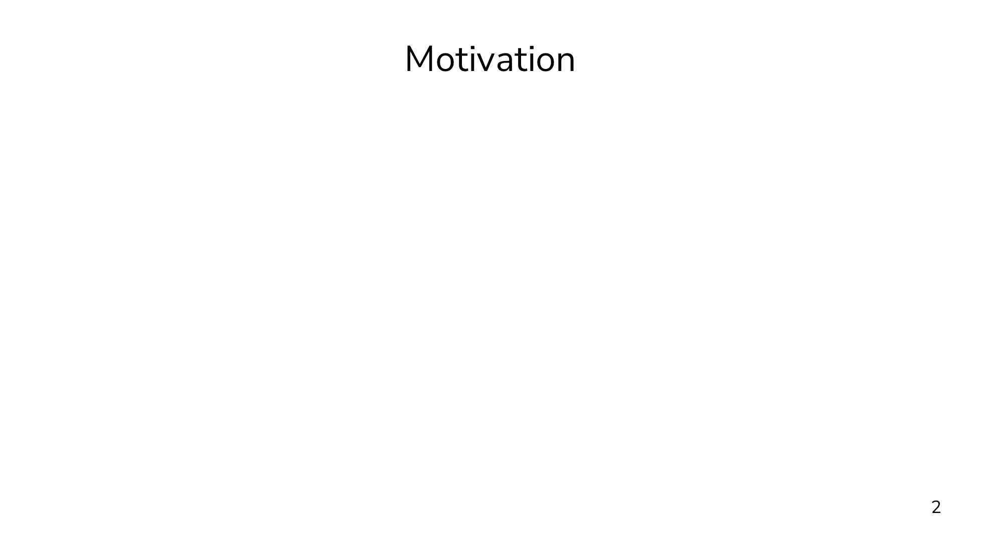
Notes:
My research is on secure multiparty computation. The field of secure computation has taken great leaps in recent years... but it's still impractical in many scenarios. That is to say, there's a lot of work left to do to keep applying these techniques to more and more real world problems. The goal that's going to motivate everything else in this talk is that we want to fill the gaps that are preventing MPC from taking the next step toward practical realization.

Slide 3
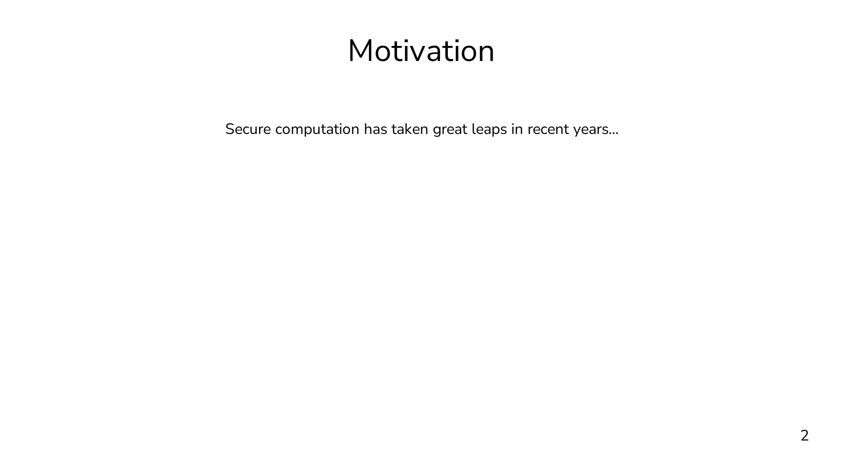
Notes:
My research is on secure multiparty computation. The field of secure computation has taken great leaps in recent years... but it's still impractical in many scenarios. That is to say, there's a lot of work left to do to keep applying these techniques to more and more real world problems. The goal that's going to motivate everything else in this talk is that we want to fill the gaps that are preventing MPC from taking the next step toward practical realization.

Slide 4
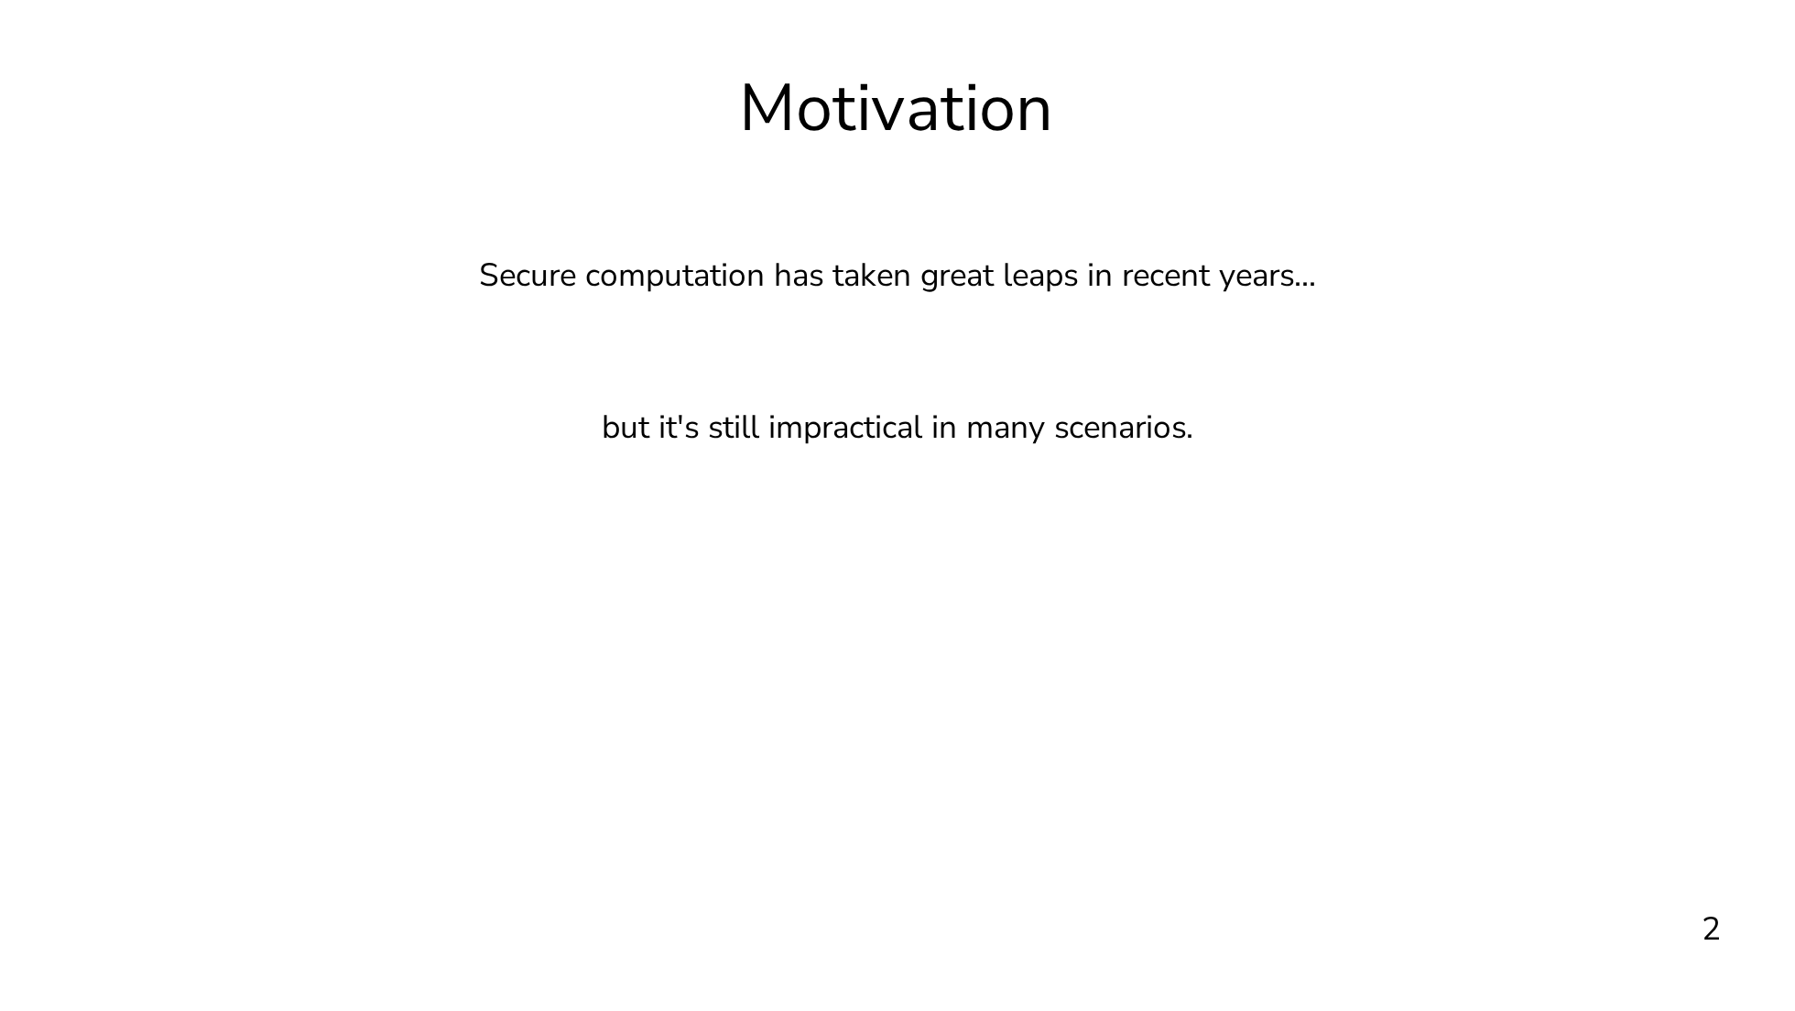
Notes:
My research is on secure multiparty computation. The field of secure computation has taken great leaps in recent years... but it's still impractical in many scenarios. That is to say, there's a lot of work left to do to keep applying these techniques to more and more real world problems. The goal that's going to motivate everything else in this talk is that we want to fill the gaps that are preventing MPC from taking the next step toward practical realization.

Slide 5
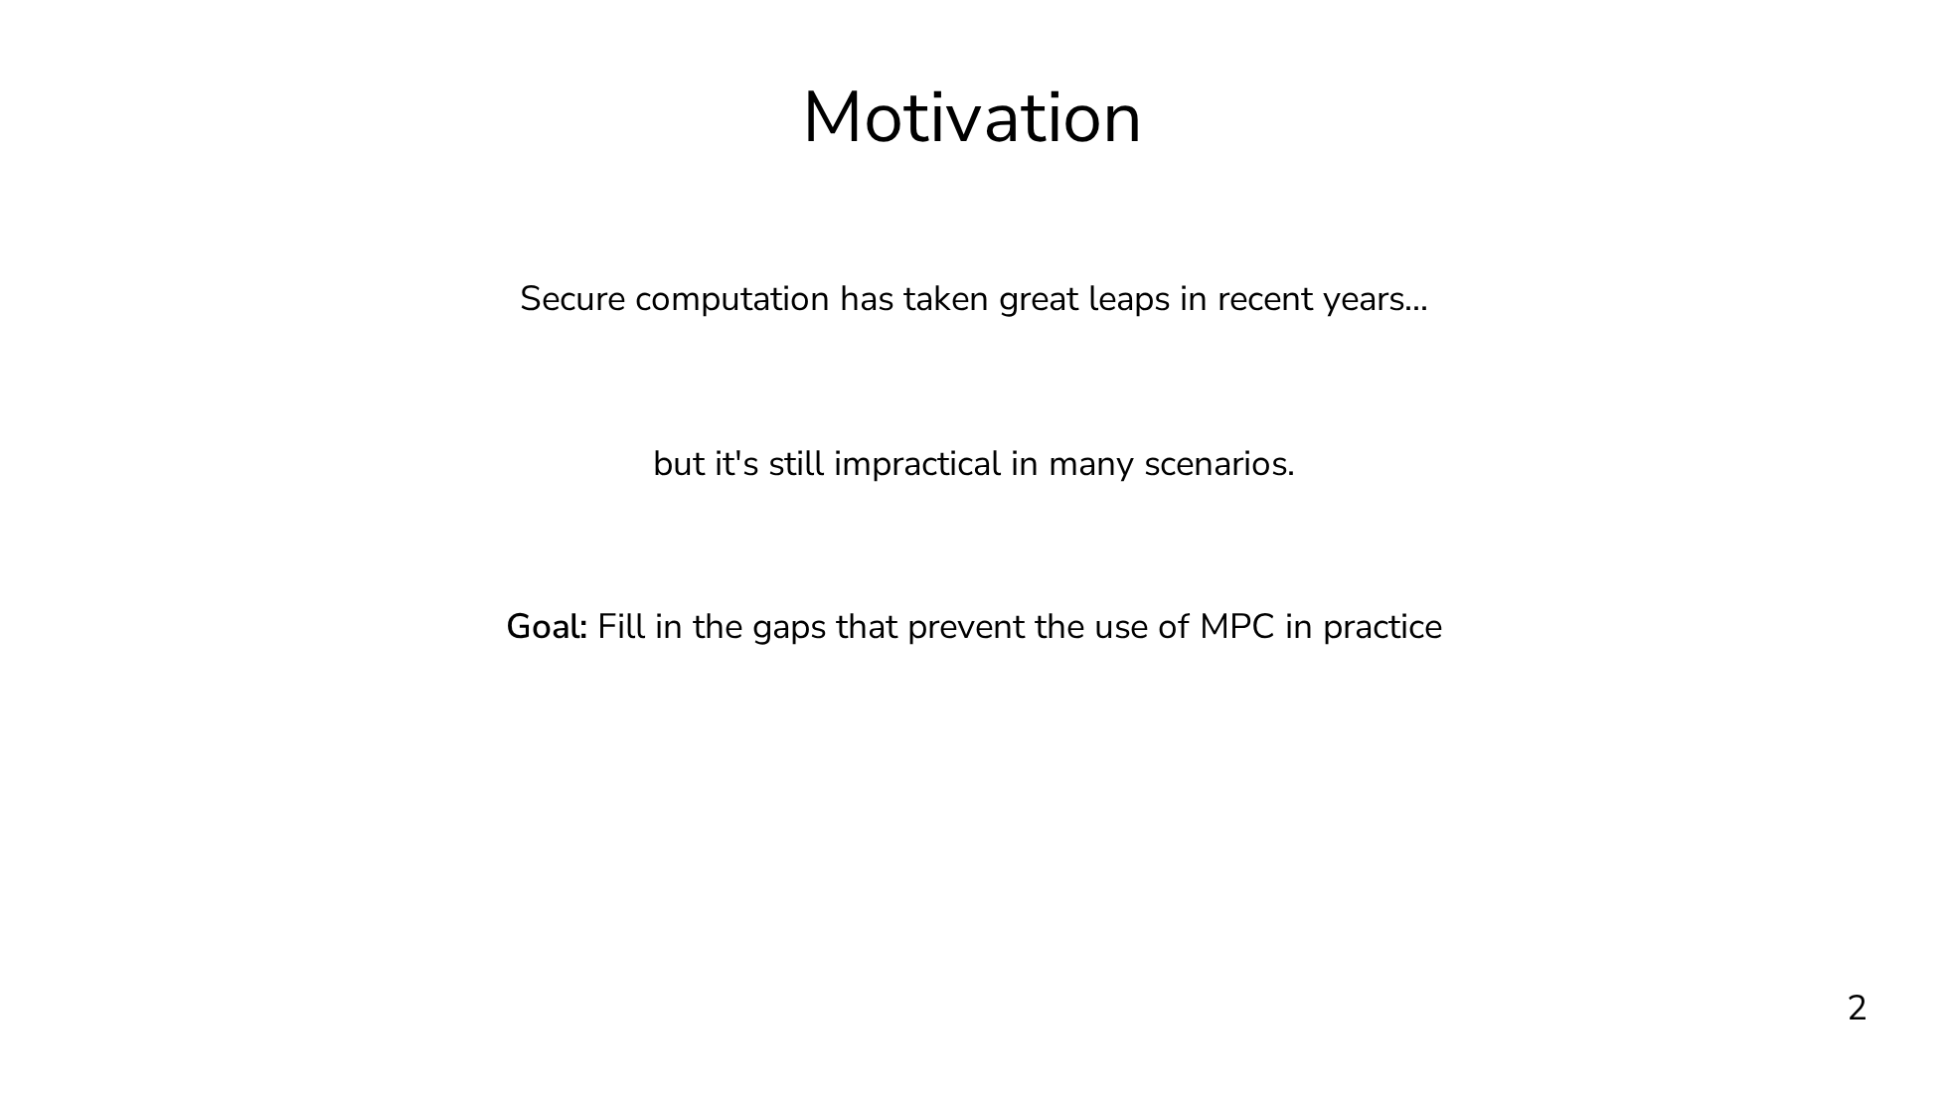
Notes:
My research is on secure multiparty computation. The field of secure computation has taken great leaps in recent years... but it's still impractical in many scenarios. That is to say, there's a lot of work left to do to keep applying these techniques to more and more real world problems. The goal that's going to motivate everything else in this talk is that we want to fill the gaps that are preventing MPC from taking the next step toward practical realization.

Slide 6
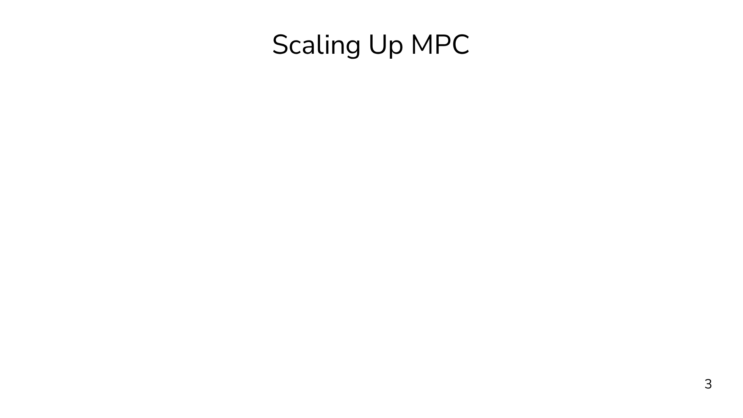
Notes:
The overarching theme of this talk and of my future research plans is that we want to scale up MPC. I mean this in two senses. First, I mean this in the sense that we want to be able to support more expressive and more sophisticated functions. In particular, we'll be looking at a primitive known as oblivious shuffling, which appears in a wide variety of difficult workloads. For some problems, blivious shuffling can allow for much more efficient and much more natural expression under MPC. The goal of this half of the talk is to improve the expressivity of MPC. Any computation can be performed securely, so what I mean by improving the expressivity is not enabling entirely new computations, but enabling far more natural approaches to a variety of problems. I'll hopefully convince you that oblivious shuffling is an important building block that improves our ability to translate complex functions to MPC. For the second direction, I mean scaling up in a more literal sense. We want to directly incorporate more parties in the secure computation. MPC with, for example, thousands of parties is known to be possible from a theoretical standpoint, but this scale has been elusive in practice. The reason we want to scale to directly incorporate more parties is that it allows us to distribute the trust more widely than we could if we have a small set of servers with a non-collusion assumption. I think both of these directions are necessary to help MPC take that next step toward practicality and deployment.

Slide 7
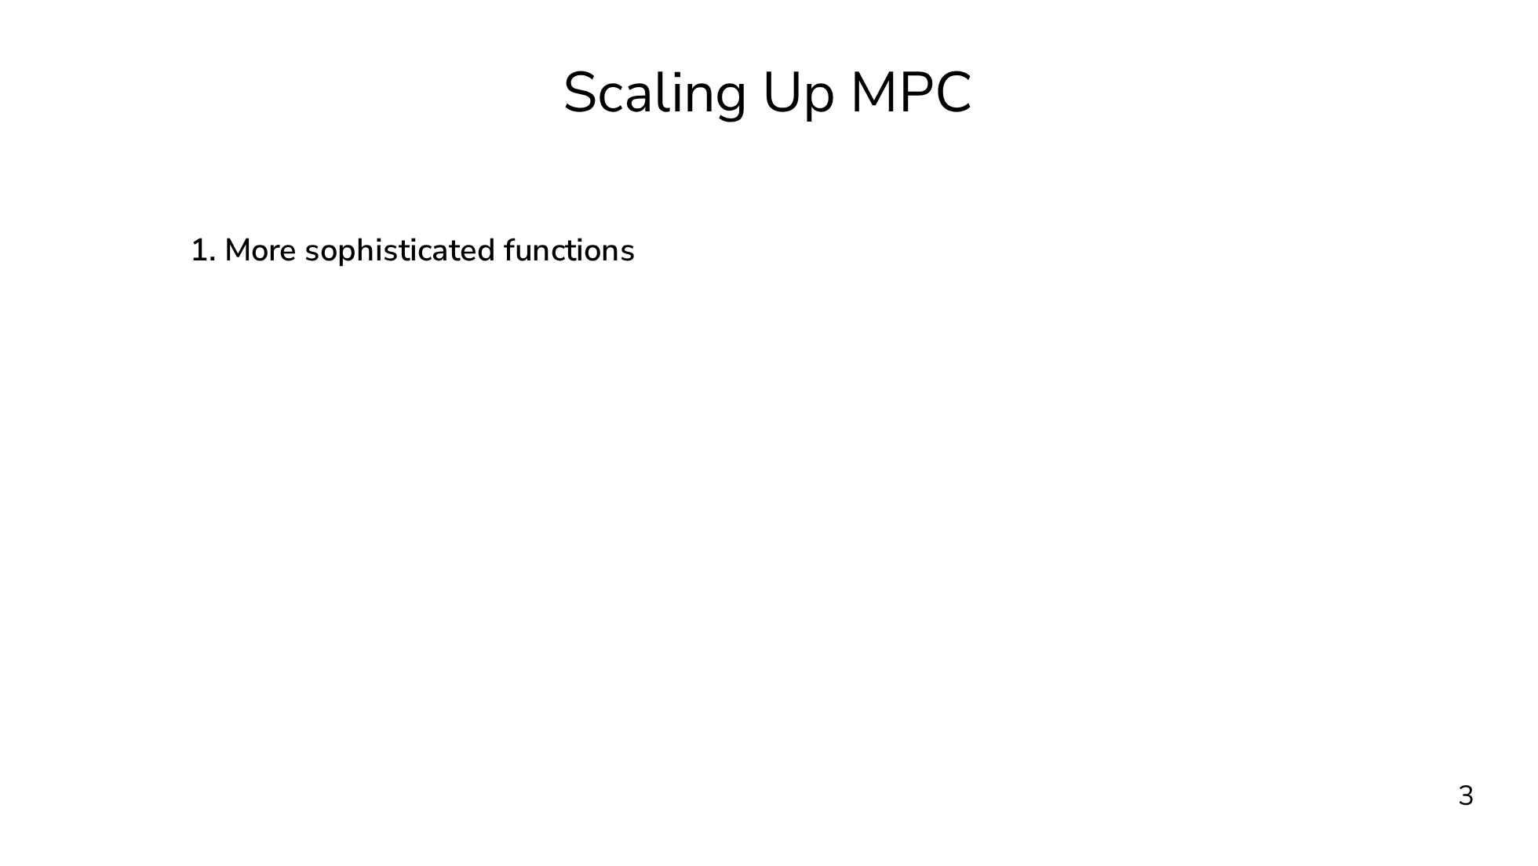
Notes:
The overarching theme of this talk and of my future research plans is that we want to scale up MPC. I mean this in two senses. First, I mean this in the sense that we want to be able to support more expressive and more sophisticated functions. In particular, we'll be looking at a primitive known as oblivious shuffling, which appears in a wide variety of difficult workloads. For some problems, blivious shuffling can allow for much more efficient and much more natural expression under MPC. The goal of this half of the talk is to improve the expressivity of MPC. Any computation can be performed securely, so what I mean by improving the expressivity is not enabling entirely new computations, but enabling far more natural approaches to a variety of problems. I'll hopefully convince you that oblivious shuffling is an important building block that improves our ability to translate complex functions to MPC. For the second direction, I mean scaling up in a more literal sense. We want to directly incorporate more parties in the secure computation. MPC with, for example, thousands of parties is known to be possible from a theoretical standpoint, but this scale has been elusive in practice. The reason we want to scale to directly incorporate more parties is that it allows us to distribute the trust more widely than we could if we have a small set of servers with a non-collusion assumption. I think both of these directions are necessary to help MPC take that next step toward practicality and deployment.

Slide 8
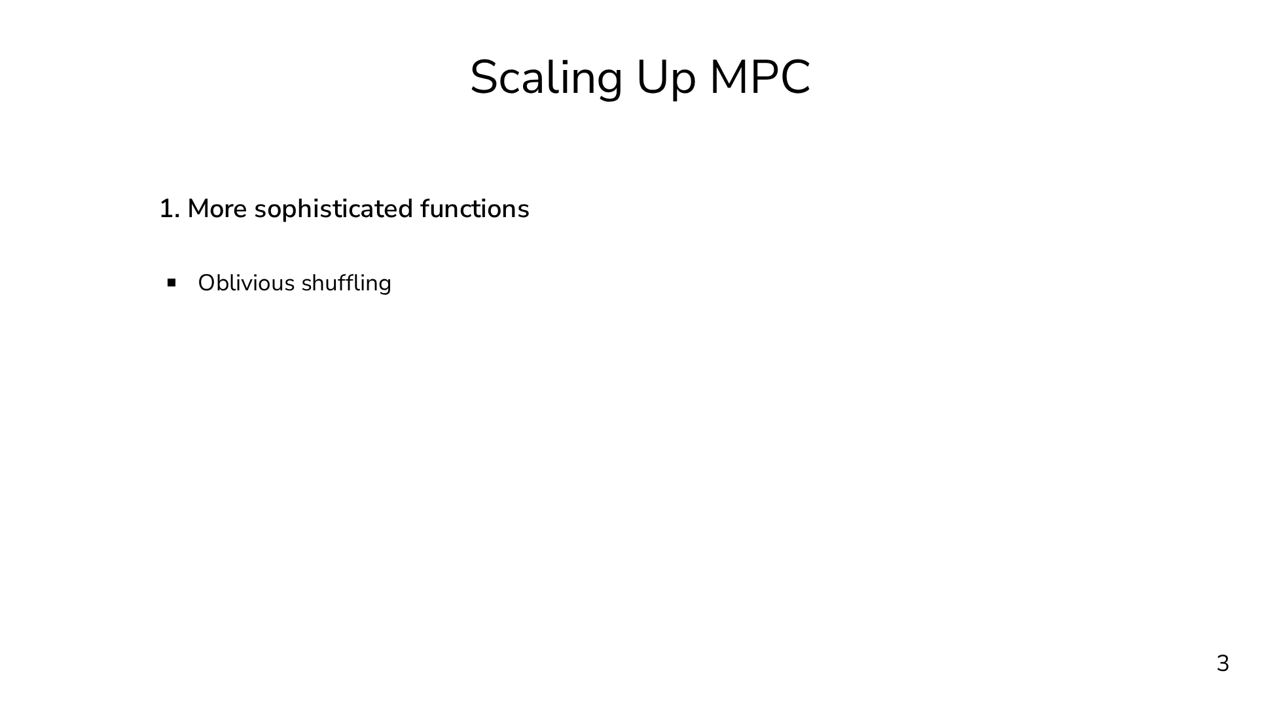
Notes:
The overarching theme of this talk and of my future research plans is that we want to scale up MPC. I mean this in two senses. First, I mean this in the sense that we want to be able to support more expressive and more sophisticated functions. In particular, we'll be looking at a primitive known as oblivious shuffling, which appears in a wide variety of difficult workloads. For some problems, blivious shuffling can allow for much more efficient and much more natural expression under MPC. The goal of this half of the talk is to improve the expressivity of MPC. Any computation can be performed securely, so what I mean by improving the expressivity is not enabling entirely new computations, but enabling far more natural approaches to a variety of problems. I'll hopefully convince you that oblivious shuffling is an important building block that improves our ability to translate complex functions to MPC. For the second direction, I mean scaling up in a more literal sense. We want to directly incorporate more parties in the secure computation. MPC with, for example, thousands of parties is known to be possible from a theoretical standpoint, but this scale has been elusive in practice. The reason we want to scale to directly incorporate more parties is that it allows us to distribute the trust more widely than we could if we have a small set of servers with a non-collusion assumption. I think both of these directions are necessary to help MPC take that next step toward practicality and deployment.

Slide 9
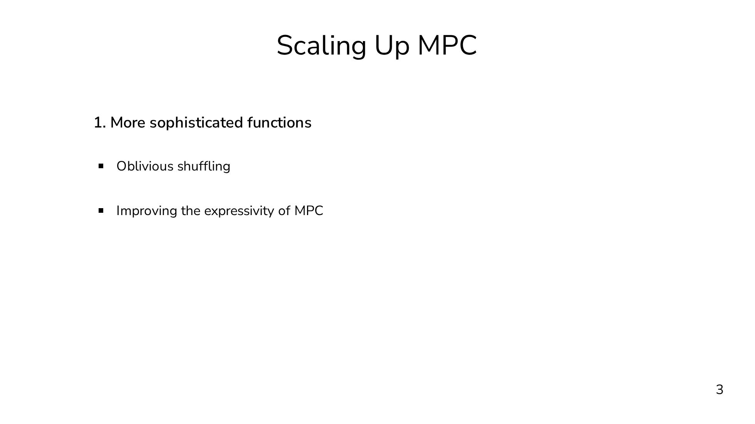
Notes:
The overarching theme of this talk and of my future research plans is that we want to scale up MPC. I mean this in two senses. First, I mean this in the sense that we want to be able to support more expressive and more sophisticated functions. In particular, we'll be looking at a primitive known as oblivious shuffling, which appears in a wide variety of difficult workloads. For some problems, blivious shuffling can allow for much more efficient and much more natural expression under MPC. The goal of this half of the talk is to improve the expressivity of MPC. Any computation can be performed securely, so what I mean by improving the expressivity is not enabling entirely new computations, but enabling far more natural approaches to a variety of problems. I'll hopefully convince you that oblivious shuffling is an important building block that improves our ability to translate complex functions to MPC. For the second direction, I mean scaling up in a more literal sense. We want to directly incorporate more parties in the secure computation. MPC with, for example, thousands of parties is known to be possible from a theoretical standpoint, but this scale has been elusive in practice. The reason we want to scale to directly incorporate more parties is that it allows us to distribute the trust more widely than we could if we have a small set of servers with a non-collusion assumption. I think both of these directions are necessary to help MPC take that next step toward practicality and deployment.

Slide 10
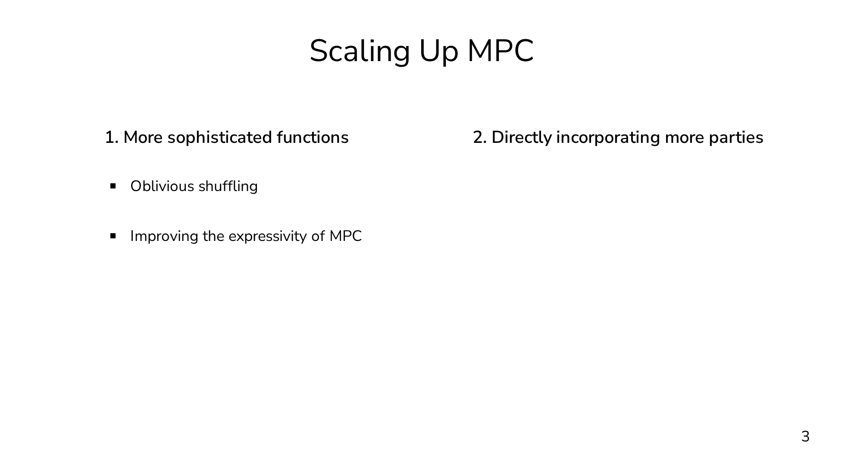
Notes:
The overarching theme of this talk and of my future research plans is that we want to scale up MPC. I mean this in two senses. First, I mean this in the sense that we want to be able to support more expressive and more sophisticated functions. In particular, we'll be looking at a primitive known as oblivious shuffling, which appears in a wide variety of difficult workloads. For some problems, blivious shuffling can allow for much more efficient and much more natural expression under MPC. The goal of this half of the talk is to improve the expressivity of MPC. Any computation can be performed securely, so what I mean by improving the expressivity is not enabling entirely new computations, but enabling far more natural approaches to a variety of problems. I'll hopefully convince you that oblivious shuffling is an important building block that improves our ability to translate complex functions to MPC. For the second direction, I mean scaling up in a more literal sense. We want to directly incorporate more parties in the secure computation. MPC with, for example, thousands of parties is known to be possible from a theoretical standpoint, but this scale has been elusive in practice. The reason we want to scale to directly incorporate more parties is that it allows us to distribute the trust more widely than we could if we have a small set of servers with a non-collusion assumption. I think both of these directions are necessary to help MPC take that next step toward practicality and deployment.

Slide 11
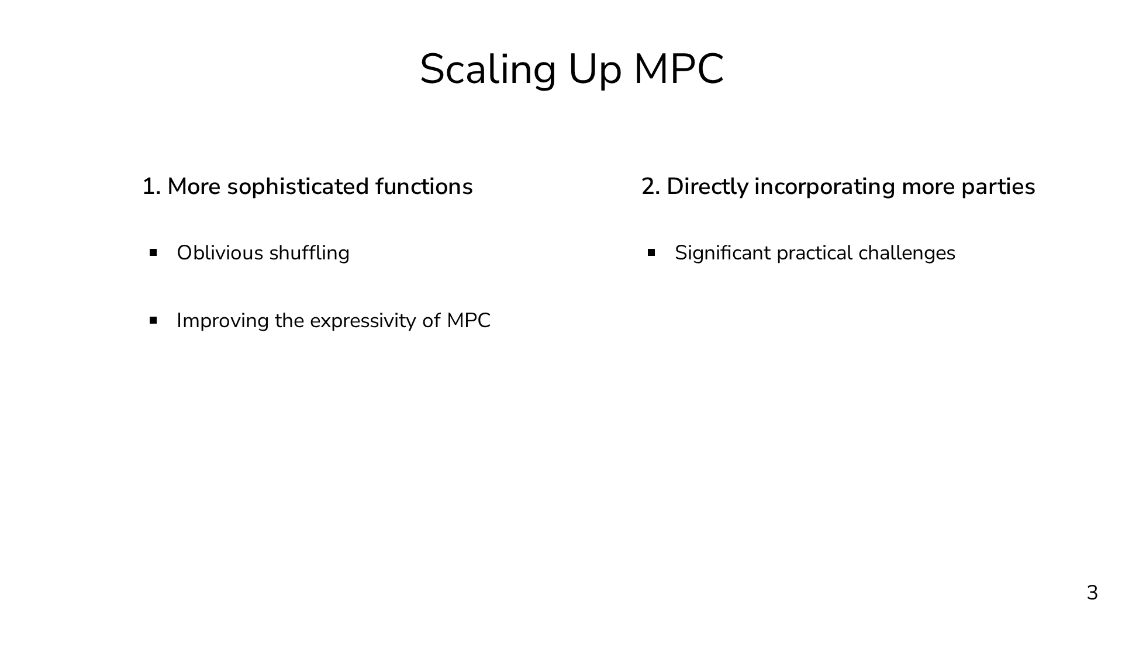
Notes:
The overarching theme of this talk and of my future research plans is that we want to scale up MPC. I mean this in two senses. First, I mean this in the sense that we want to be able to support more expressive and more sophisticated functions. In particular, we'll be looking at a primitive known as oblivious shuffling, which appears in a wide variety of difficult workloads. For some problems, blivious shuffling can allow for much more efficient and much more natural expression under MPC. The goal of this half of the talk is to improve the expressivity of MPC. Any computation can be performed securely, so what I mean by improving the expressivity is not enabling entirely new computations, but enabling far more natural approaches to a variety of problems. I'll hopefully convince you that oblivious shuffling is an important building block that improves our ability to translate complex functions to MPC. For the second direction, I mean scaling up in a more literal sense. We want to directly incorporate more parties in the secure computation. MPC with, for example, thousands of parties is known to be possible from a theoretical standpoint, but this scale has been elusive in practice. The reason we want to scale to directly incorporate more parties is that it allows us to distribute the trust more widely than we could if we have a small set of servers with a non-collusion assumption. I think both of these directions are necessary to help MPC take that next step toward practicality and deployment.

Slide 12
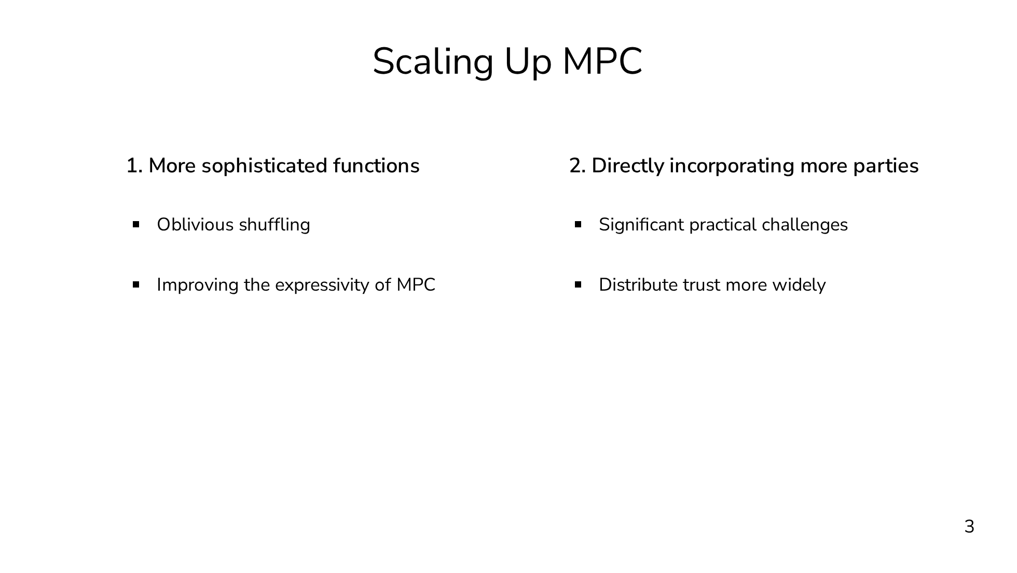
Notes:
The overarching theme of this talk and of my future research plans is that we want to scale up MPC. I mean this in two senses. First, I mean this in the sense that we want to be able to support more expressive and more sophisticated functions. In particular, we'll be looking at a primitive known as oblivious shuffling, which appears in a wide variety of difficult workloads. For some problems, blivious shuffling can allow for much more efficient and much more natural expression under MPC. The goal of this half of the talk is to improve the expressivity of MPC. Any computation can be performed securely, so what I mean by improving the expressivity is not enabling entirely new computations, but enabling far more natural approaches to a variety of problems. I'll hopefully convince you that oblivious shuffling is an important building block that improves our ability to translate complex functions to MPC. For the second direction, I mean scaling up in a more literal sense. We want to directly incorporate more parties in the secure computation. MPC with, for example, thousands of parties is known to be possible from a theoretical standpoint, but this scale has been elusive in practice. The reason we want to scale to directly incorporate more parties is that it allows us to distribute the trust more widely than we could if we have a small set of servers with a non-collusion assumption. I think both of these directions are necessary to help MPC take that next step toward practicality and deployment.

Slide 13

Notes:
The long-term vision would be to have efficient secure computation with millions of parties evaluating complex functions. You can think of the current state of MPC as having two out of the three of efficiency, many parties, and complex operations, where any two preclude the third. The goal is to have all three simultaneously, and there's nothing stopping us from achieving this, except that we just have to do the work. This is too big of a problem to try to solve all in one shot, so we're going to have to chip away at it. This talk focuses on two technical challenges that chip away at the bigger problem from different directions. In part 1 of this talk, we're going to fix a system model, and we'll choose the two party setting, and our goal is to improve the efficiency of a fundamental and complex building block, oblivious shuffling. In part 2, we're instead going to choose a moderately complex workload, not too complex but not trivial either, and our goal is to scale up the number of parties. Part 1 will be heavier on the cryptography side of things, and part 2 will be heavier on the systems side. With that said, let's get started on part 1 of the talk...

Slide 14
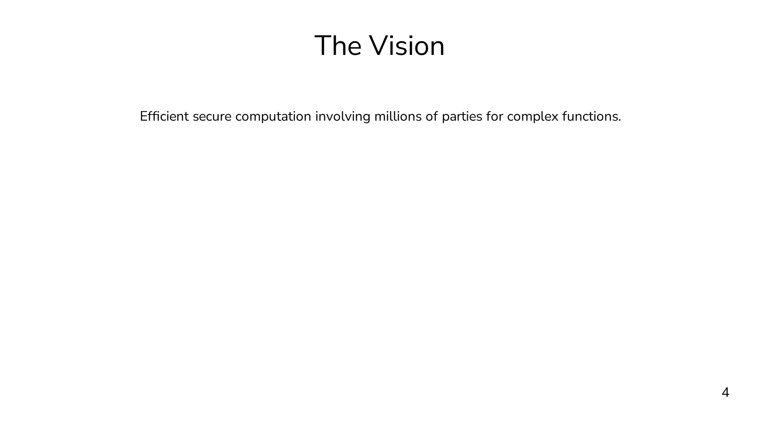
Notes:
The long-term vision would be to have efficient secure computation with millions of parties evaluating complex functions. You can think of the current state of MPC as having two out of the three of efficiency, many parties, and complex operations, where any two preclude the third. The goal is to have all three simultaneously, and there's nothing stopping us from achieving this, except that we just have to do the work. This is too big of a problem to try to solve all in one shot, so we're going to have to chip away at it. This talk focuses on two technical challenges that chip away at the bigger problem from different directions. In part 1 of this talk, we're going to fix a system model, and we'll choose the two party setting, and our goal is to improve the efficiency of a fundamental and complex building block, oblivious shuffling. In part 2, we're instead going to choose a moderately complex workload, not too complex but not trivial either, and our goal is to scale up the number of parties. Part 1 will be heavier on the cryptography side of things, and part 2 will be heavier on the systems side. With that said, let's get started on part 1 of the talk...

Slide 15
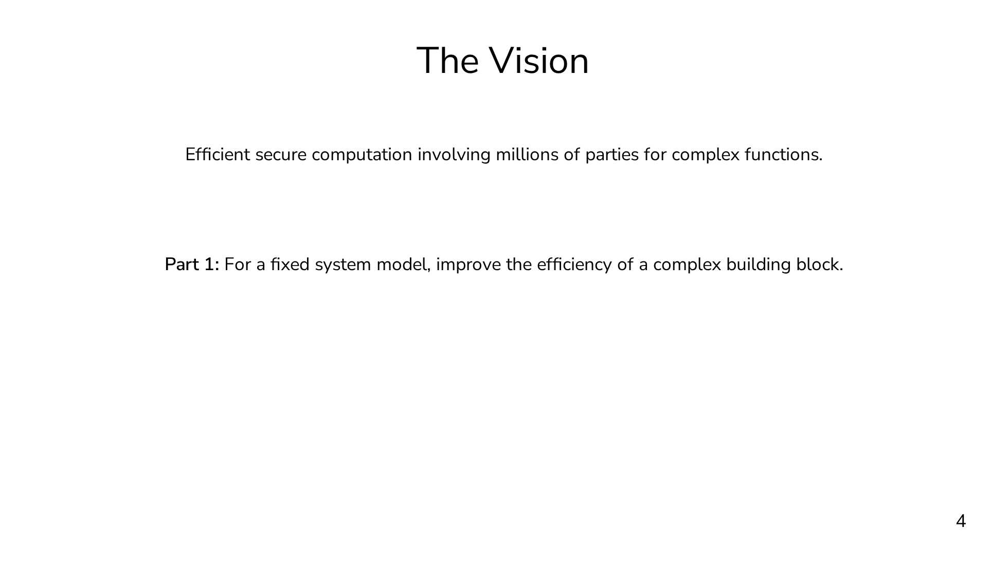
Notes:
The long-term vision would be to have efficient secure computation with millions of parties evaluating complex functions. You can think of the current state of MPC as having two out of the three of efficiency, many parties, and complex operations, where any two preclude the third. The goal is to have all three simultaneously, and there's nothing stopping us from achieving this, except that we just have to do the work. This is too big of a problem to try to solve all in one shot, so we're going to have to chip away at it. This talk focuses on two technical challenges that chip away at the bigger problem from different directions. In part 1 of this talk, we're going to fix a system model, and we'll choose the two party setting, and our goal is to improve the efficiency of a fundamental and complex building block, oblivious shuffling. In part 2, we're instead going to choose a moderately complex workload, not too complex but not trivial either, and our goal is to scale up the number of parties. Part 1 will be heavier on the cryptography side of things, and part 2 will be heavier on the systems side. With that said, let's get started on part 1 of the talk...

Slide 16
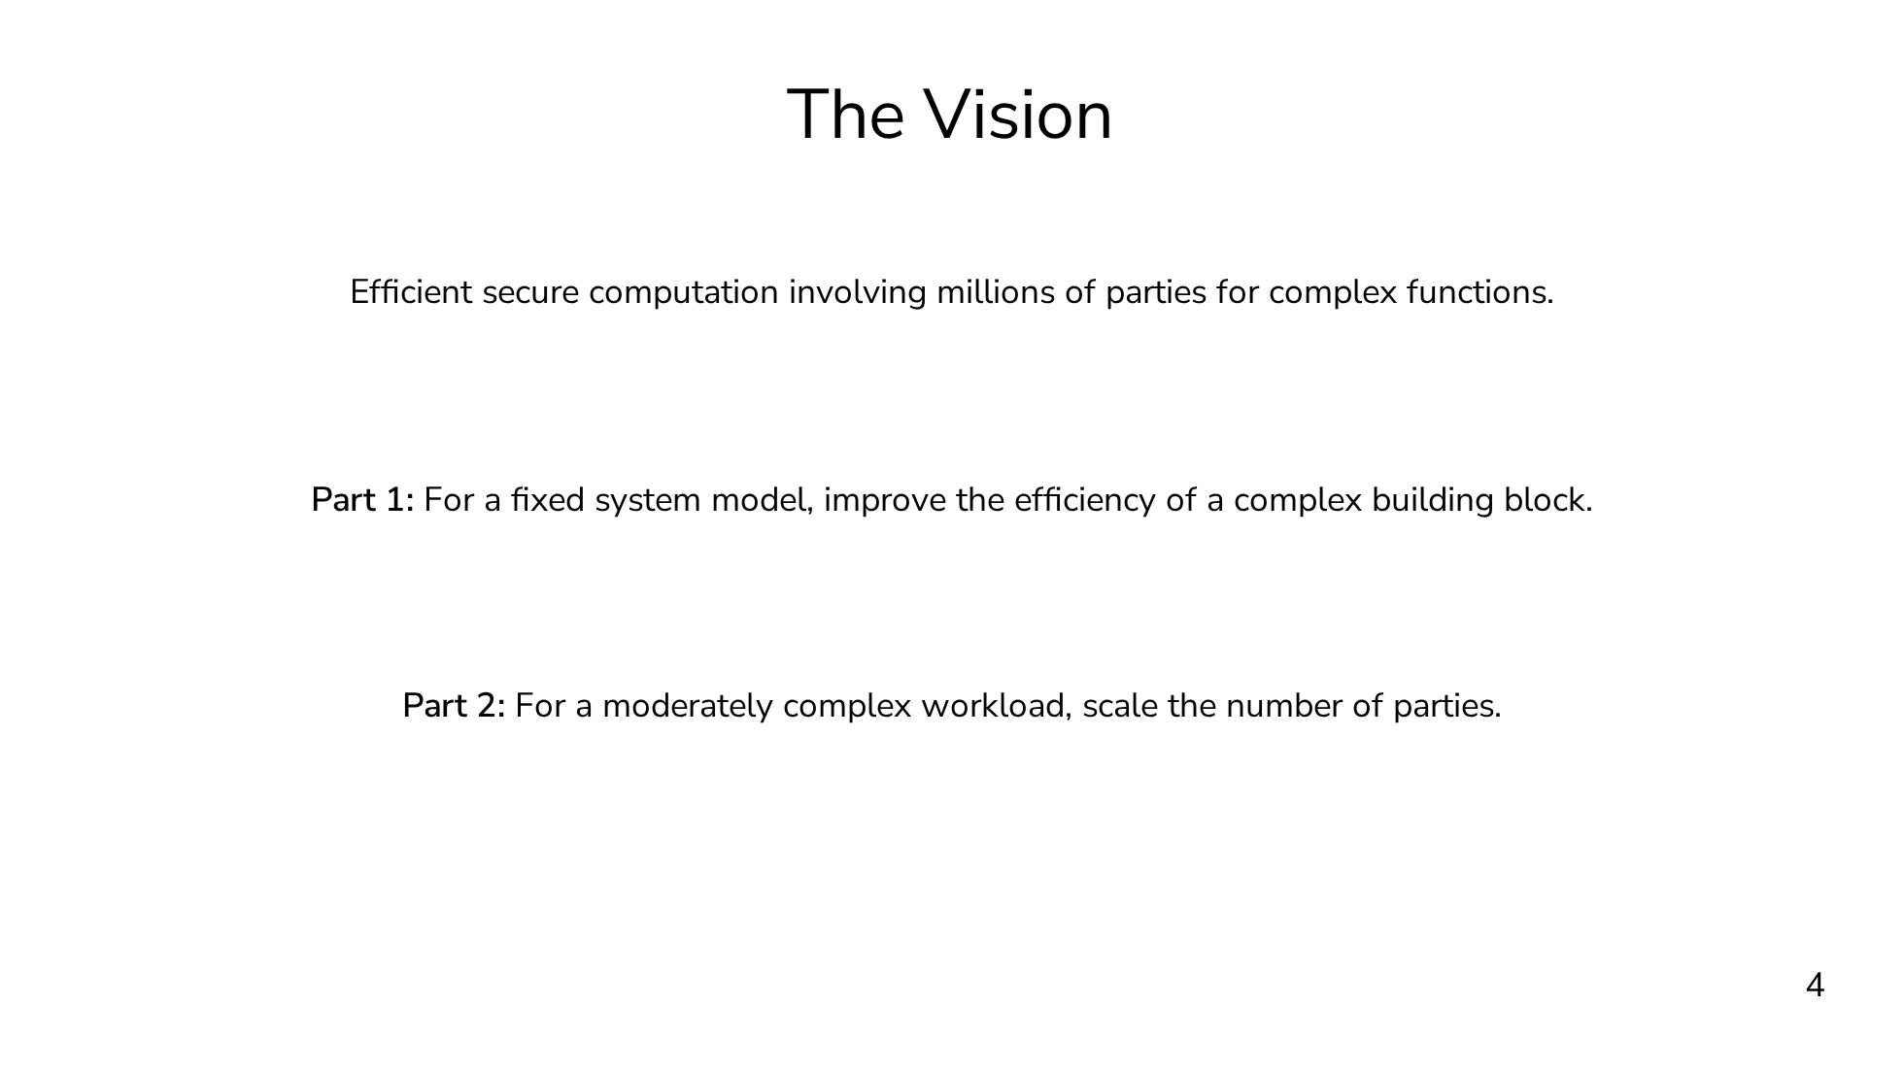
Notes:
The long-term vision would be to have efficient secure computation with millions of parties evaluating complex functions. You can think of the current state of MPC as having two out of the three of efficiency, many parties, and complex operations, where any two preclude the third. The goal is to have all three simultaneously, and there's nothing stopping us from achieving this, except that we just have to do the work. This is too big of a problem to try to solve all in one shot, so we're going to have to chip away at it. This talk focuses on two technical challenges that chip away at the bigger problem from different directions. In part 1 of this talk, we're going to fix a system model, and we'll choose the two party setting, and our goal is to improve the efficiency of a fundamental and complex building block, oblivious shuffling. In part 2, we're instead going to choose a moderately complex workload, not too complex but not trivial either, and our goal is to scale up the number of parties. Part 1 will be heavier on the cryptography side of things, and part 2 will be heavier on the systems side. With that said, let's get started on part 1 of the talk...

Slide 17
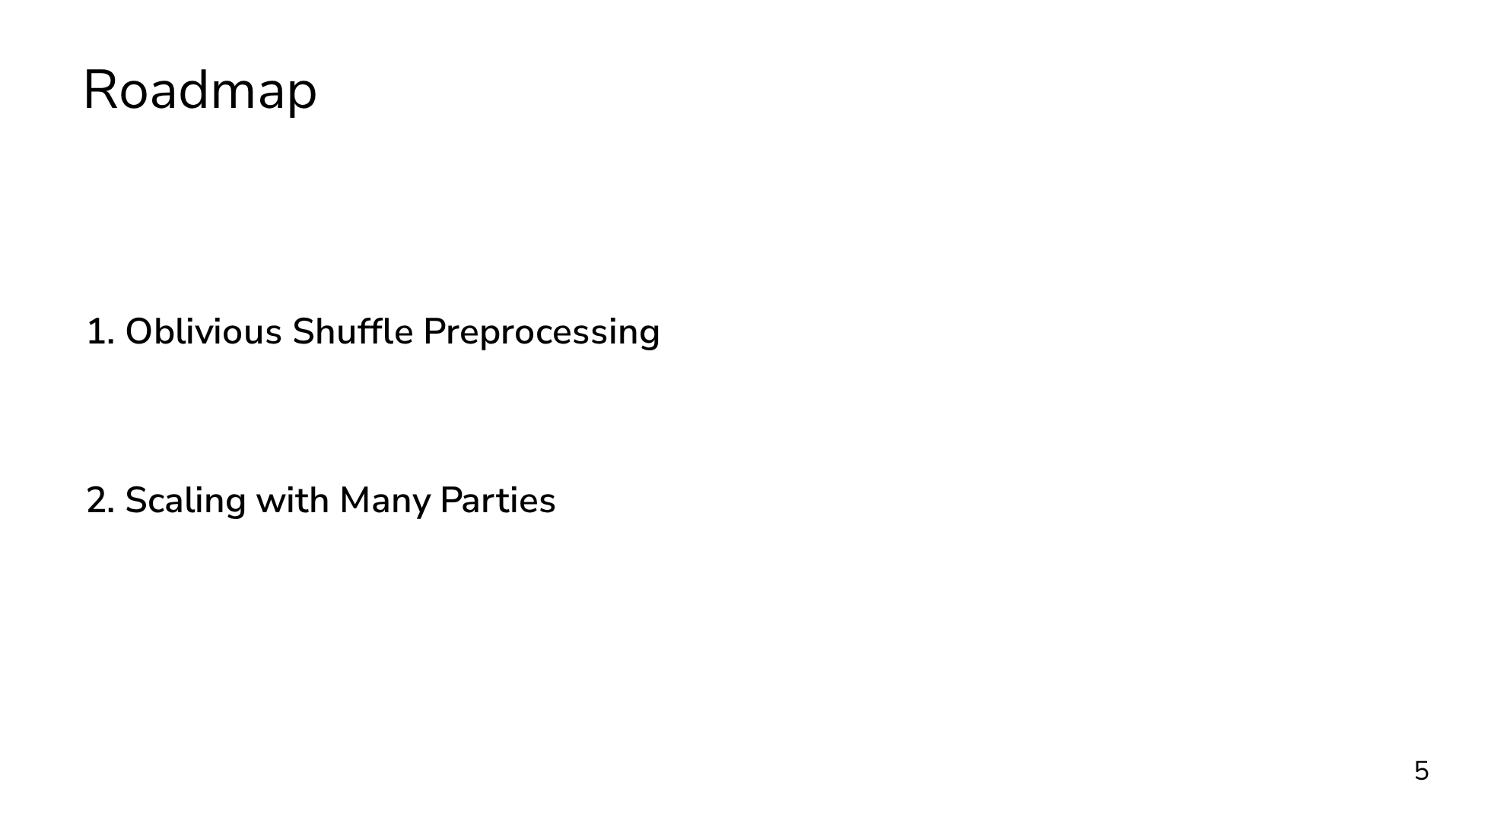

Slide 18
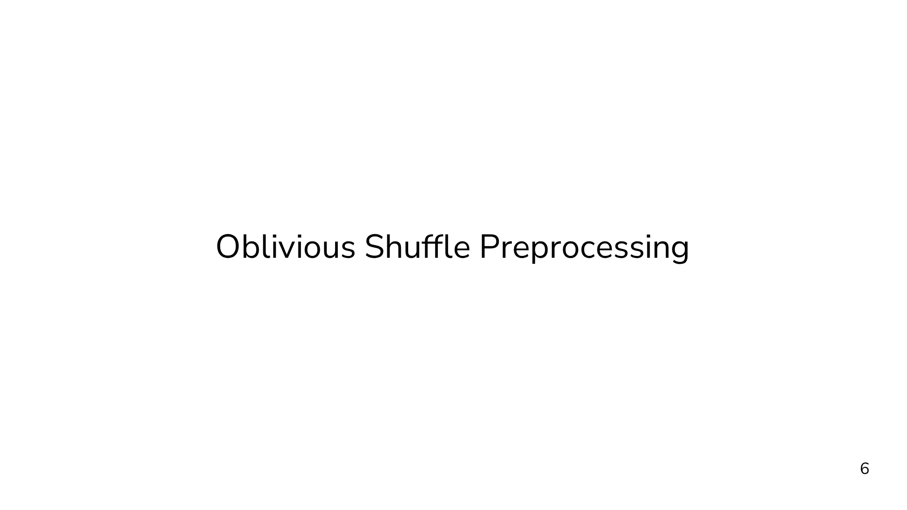
Notes:
The first major direction is oblivious shuffle preprocessing.

Slide 19
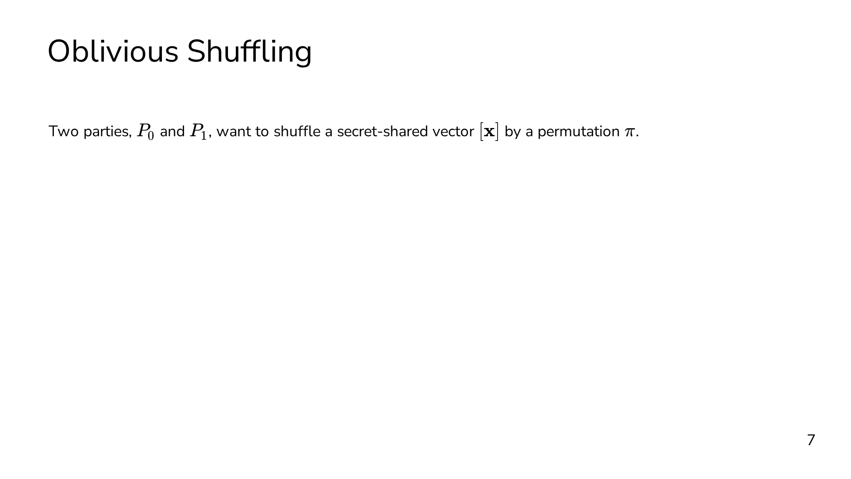
Notes:
We'll start by defining the oblivious shuffling problem. In oblivious shuffling, we have two parties, P0 and P1, that want to shuffle a secret-shared vector x by some permutation pi. The constraint is that neither party should learn anything about pi from the protocol. The output is a secret sharing of the permuted vector.

Slide 20
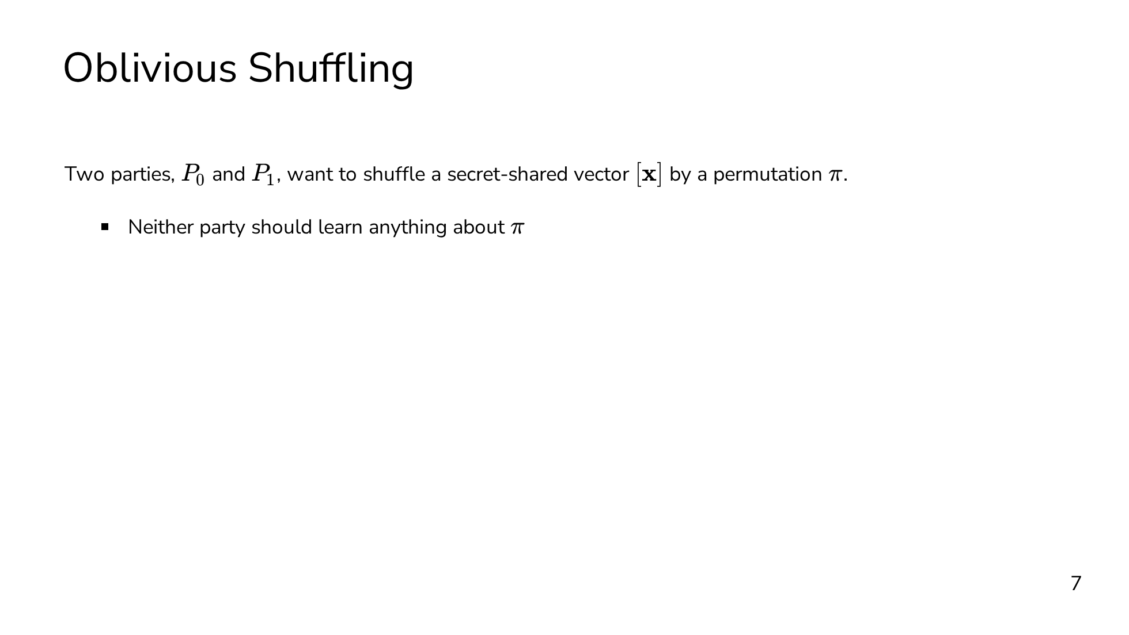
Notes:
We'll start by defining the oblivious shuffling problem. In oblivious shuffling, we have two parties, P0 and P1, that want to shuffle a secret-shared vector x by some permutation pi. The constraint is that neither party should learn anything about pi from the protocol. The output is a secret sharing of the permuted vector.

Slide 21
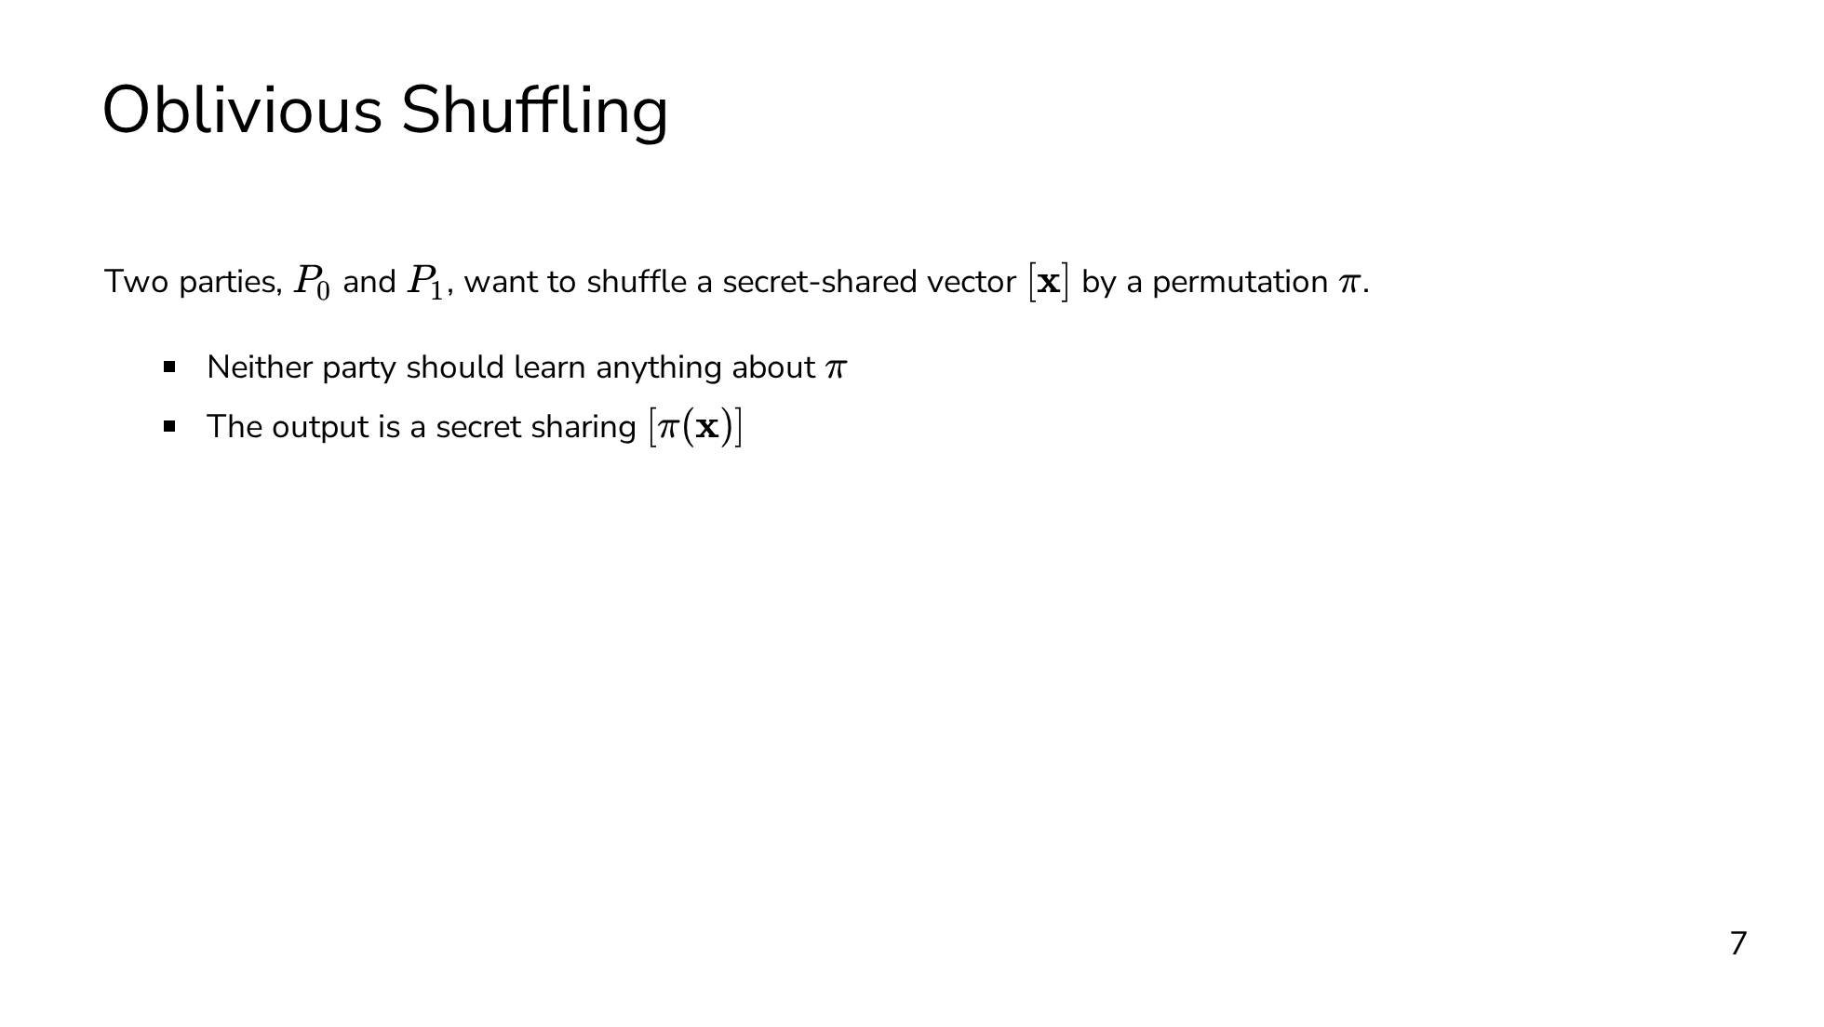
Notes:
We'll start by defining the oblivious shuffling problem. In oblivious shuffling, we have two parties, P0 and P1, that want to shuffle a secret-shared vector x by some permutation pi. The constraint is that neither party should learn anything about pi from the protocol. The output is a secret sharing of the permuted vector.

Slide 22
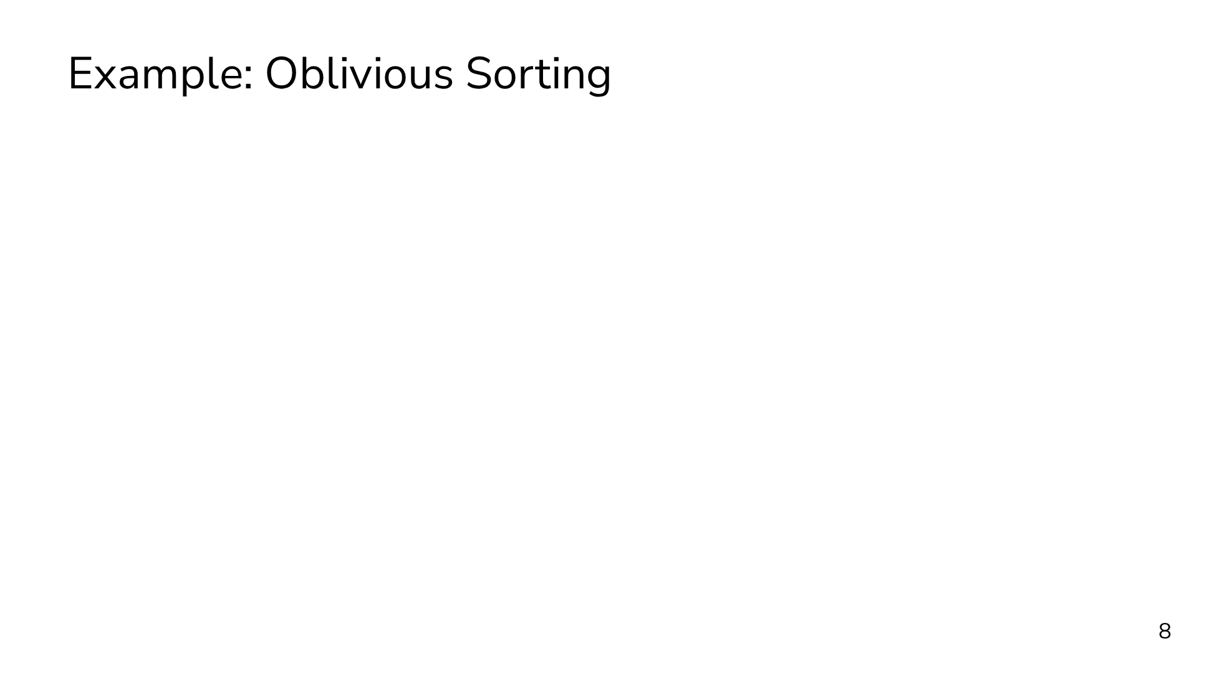
Notes:
Before getting into the weeds of how we do this, I think it's important to see a couple of examples of why we even want to do this in the first place. The first example is oblivious sorting. There are circuits for oblivious sorting, typically called sorting networks, and these translate very naturally to the MPC setting, but they require O(n log^2 n) comparison gates (or have horrible constant factors). Ideally, we'd be able to match the plaintext algorithms which require only O(n log n) comparisons. We're already going to be sacrificing performance by executing the computation securely, so we can't afford to make it worse with a suboptimal algorithm. The solution to this is the shuffle-then-sort paradigm. The idea is that we first obliviously shuffle the input vector, and then we're free to use a data-dependent sorting algorithm, like quicksort. The data-dependent algorithm fully reveals the sorting permutation, but the shuffle ensures that the revealed permutation is uncorrelated with the input. As a result, we're able to achieve a sorting algorithm with only O(n log n) secure comparisons.

Slide 23
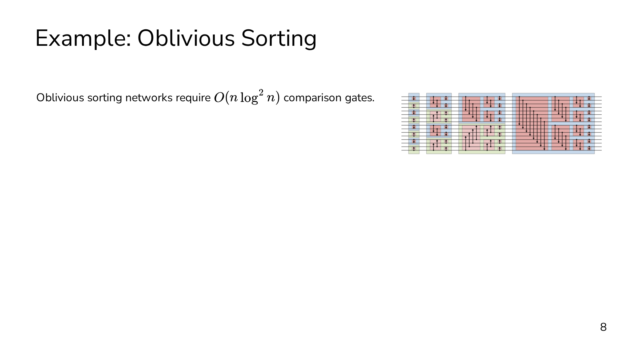
Notes:
Before getting into the weeds of how we do this, I think it's important to see a couple of examples of why we even want to do this in the first place. The first example is oblivious sorting. There are circuits for oblivious sorting, typically called sorting networks, and these translate very naturally to the MPC setting, but they require O(n log^2 n) comparison gates (or have horrible constant factors). Ideally, we'd be able to match the plaintext algorithms which require only O(n log n) comparisons. We're already going to be sacrificing performance by executing the computation securely, so we can't afford to make it worse with a suboptimal algorithm. The solution to this is the shuffle-then-sort paradigm. The idea is that we first obliviously shuffle the input vector, and then we're free to use a data-dependent sorting algorithm, like quicksort. The data-dependent algorithm fully reveals the sorting permutation, but the shuffle ensures that the revealed permutation is uncorrelated with the input. As a result, we're able to achieve a sorting algorithm with only O(n log n) secure comparisons.

Slide 24
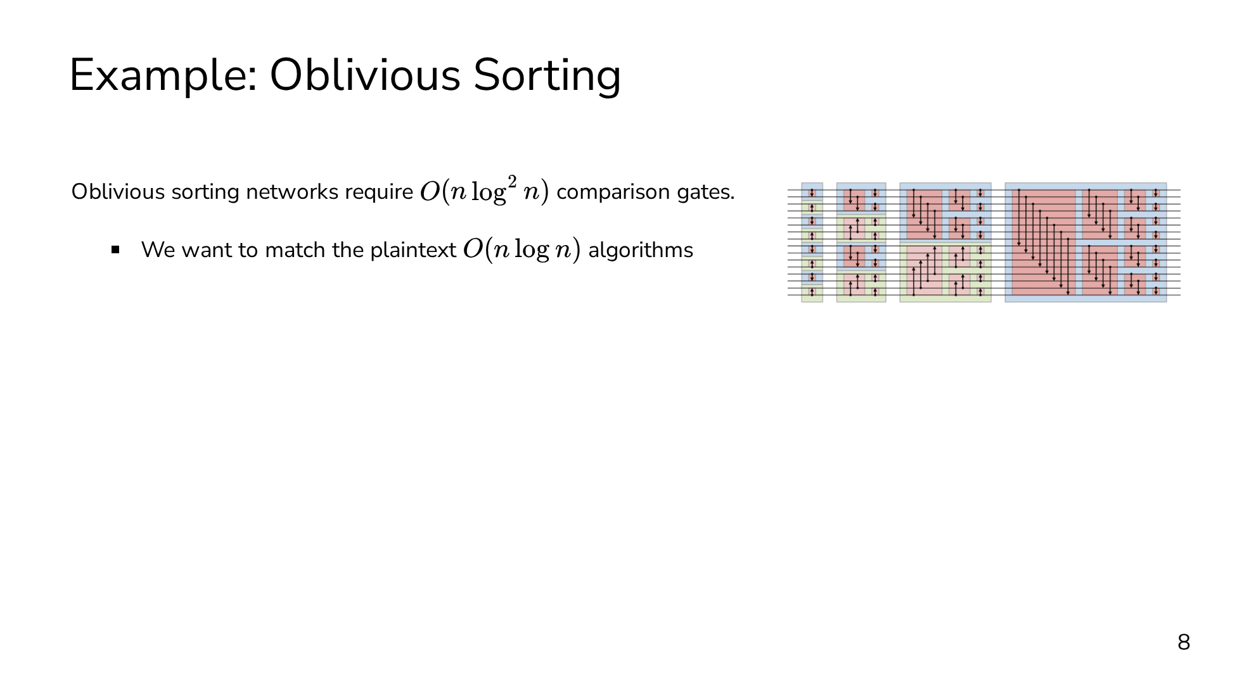
Notes:
Before getting into the weeds of how we do this, I think it's important to see a couple of examples of why we even want to do this in the first place. The first example is oblivious sorting. There are circuits for oblivious sorting, typically called sorting networks, and these translate very naturally to the MPC setting, but they require O(n log^2 n) comparison gates (or have horrible constant factors). Ideally, we'd be able to match the plaintext algorithms which require only O(n log n) comparisons. We're already going to be sacrificing performance by executing the computation securely, so we can't afford to make it worse with a suboptimal algorithm. The solution to this is the shuffle-then-sort paradigm. The idea is that we first obliviously shuffle the input vector, and then we're free to use a data-dependent sorting algorithm, like quicksort. The data-dependent algorithm fully reveals the sorting permutation, but the shuffle ensures that the revealed permutation is uncorrelated with the input. As a result, we're able to achieve a sorting algorithm with only O(n log n) secure comparisons.

Slide 25

Notes:
Before getting into the weeds of how we do this, I think it's important to see a couple of examples of why we even want to do this in the first place. The first example is oblivious sorting. There are circuits for oblivious sorting, typically called sorting networks, and these translate very naturally to the MPC setting, but they require O(n log^2 n) comparison gates (or have horrible constant factors). Ideally, we'd be able to match the plaintext algorithms which require only O(n log n) comparisons. We're already going to be sacrificing performance by executing the computation securely, so we can't afford to make it worse with a suboptimal algorithm. The solution to this is the shuffle-then-sort paradigm. The idea is that we first obliviously shuffle the input vector, and then we're free to use a data-dependent sorting algorithm, like quicksort. The data-dependent algorithm fully reveals the sorting permutation, but the shuffle ensures that the revealed permutation is uncorrelated with the input. As a result, we're able to achieve a sorting algorithm with only O(n log n) secure comparisons.

Slide 26
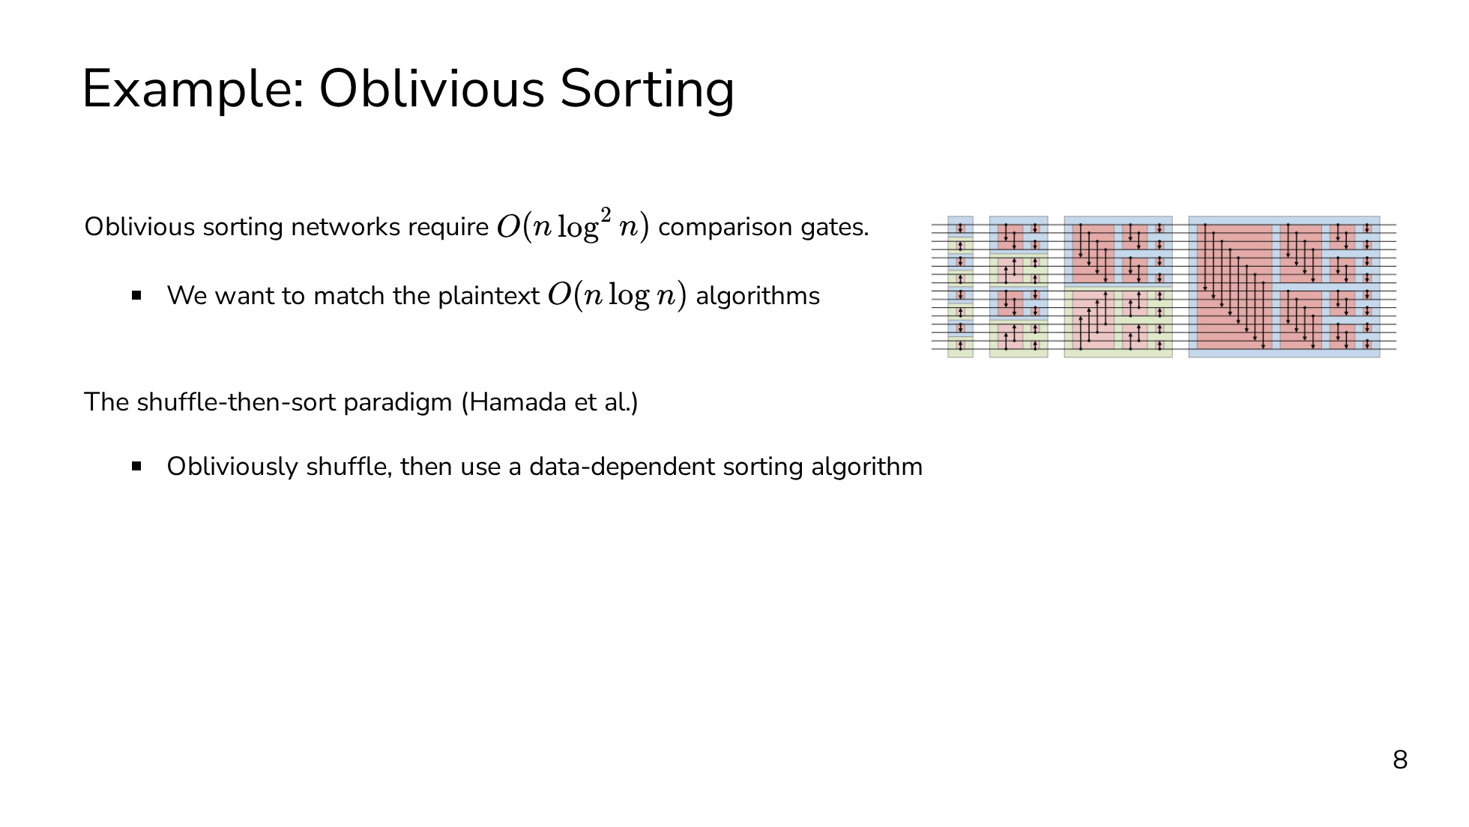
Notes:
Before getting into the weeds of how we do this, I think it's important to see a couple of examples of why we even want to do this in the first place. The first example is oblivious sorting. There are circuits for oblivious sorting, typically called sorting networks, and these translate very naturally to the MPC setting, but they require O(n log^2 n) comparison gates (or have horrible constant factors). Ideally, we'd be able to match the plaintext algorithms which require only O(n log n) comparisons. We're already going to be sacrificing performance by executing the computation securely, so we can't afford to make it worse with a suboptimal algorithm. The solution to this is the shuffle-then-sort paradigm. The idea is that we first obliviously shuffle the input vector, and then we're free to use a data-dependent sorting algorithm, like quicksort. The data-dependent algorithm fully reveals the sorting permutation, but the shuffle ensures that the revealed permutation is uncorrelated with the input. As a result, we're able to achieve a sorting algorithm with only O(n log n) secure comparisons.

Slide 27
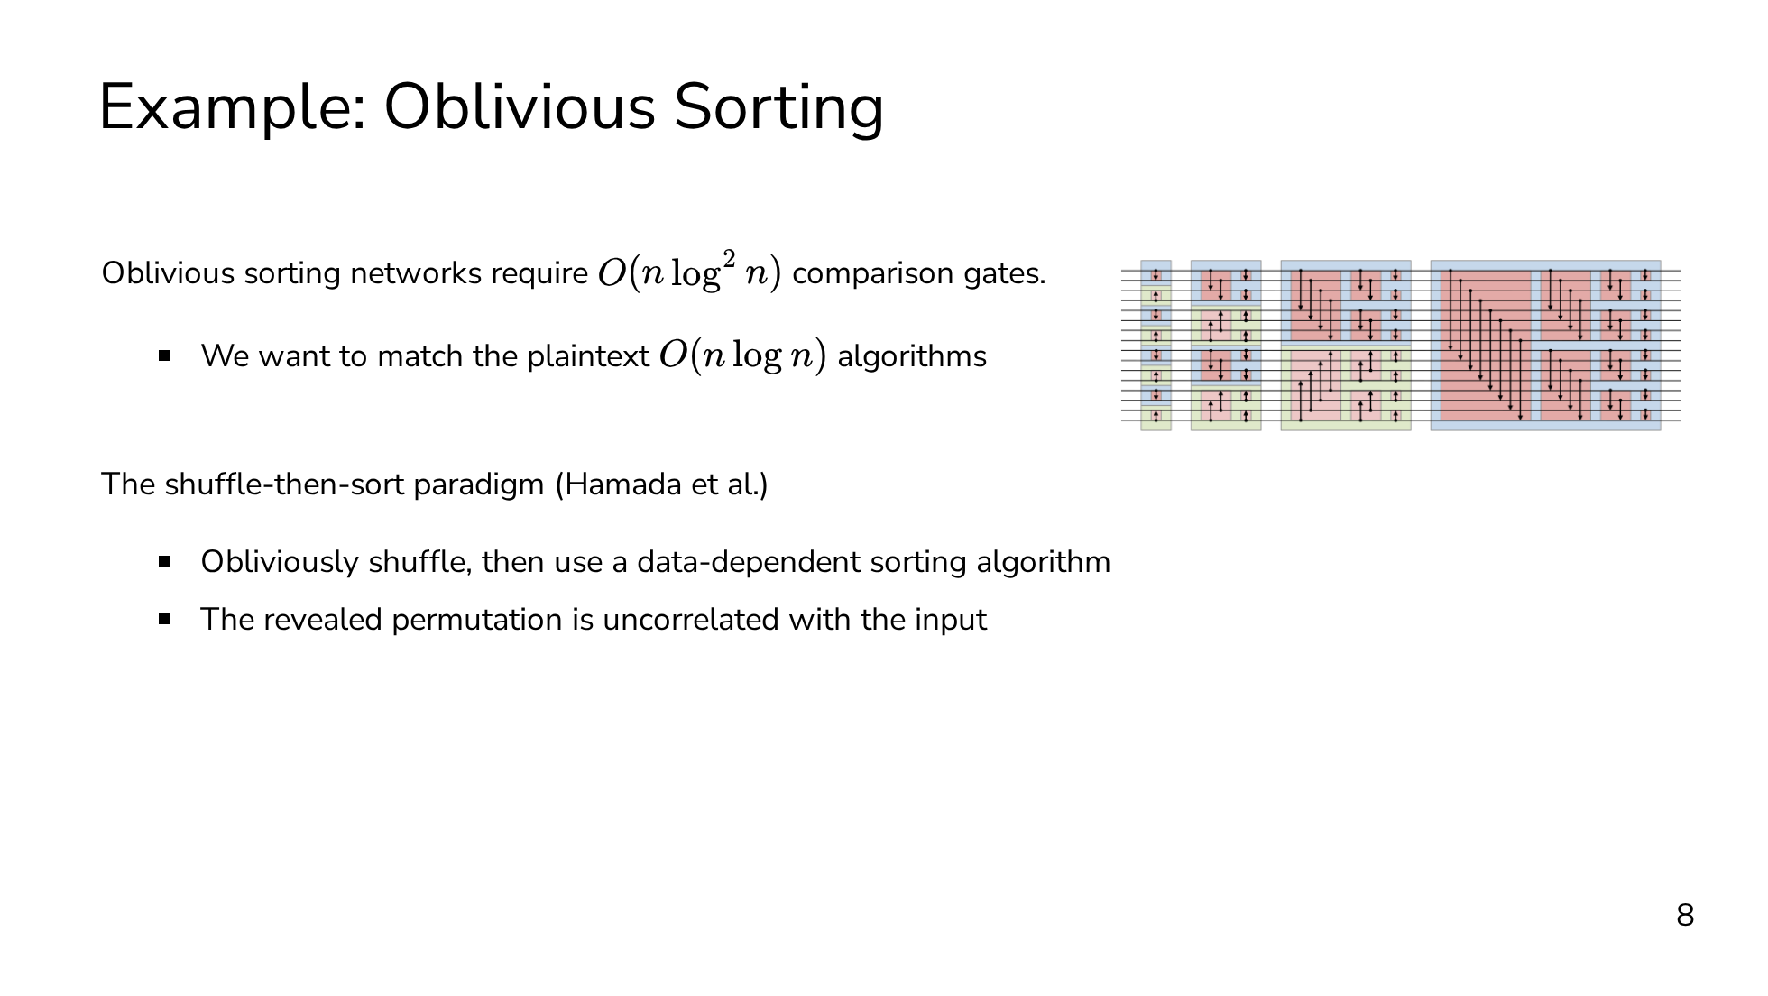
Notes:
Before getting into the weeds of how we do this, I think it's important to see a couple of examples of why we even want to do this in the first place. The first example is oblivious sorting. There are circuits for oblivious sorting, typically called sorting networks, and these translate very naturally to the MPC setting, but they require O(n log^2 n) comparison gates (or have horrible constant factors). Ideally, we'd be able to match the plaintext algorithms which require only O(n log n) comparisons. We're already going to be sacrificing performance by executing the computation securely, so we can't afford to make it worse with a suboptimal algorithm. The solution to this is the shuffle-then-sort paradigm. The idea is that we first obliviously shuffle the input vector, and then we're free to use a data-dependent sorting algorithm, like quicksort. The data-dependent algorithm fully reveals the sorting permutation, but the shuffle ensures that the revealed permutation is uncorrelated with the input. As a result, we're able to achieve a sorting algorithm with only O(n log n) secure comparisons.

Slide 28
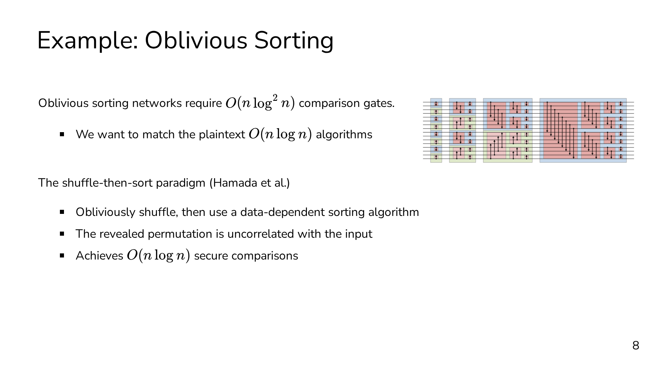
Notes:
Before getting into the weeds of how we do this, I think it's important to see a couple of examples of why we even want to do this in the first place. The first example is oblivious sorting. There are circuits for oblivious sorting, typically called sorting networks, and these translate very naturally to the MPC setting, but they require O(n log^2 n) comparison gates (or have horrible constant factors). Ideally, we'd be able to match the plaintext algorithms which require only O(n log n) comparisons. We're already going to be sacrificing performance by executing the computation securely, so we can't afford to make it worse with a suboptimal algorithm. The solution to this is the shuffle-then-sort paradigm. The idea is that we first obliviously shuffle the input vector, and then we're free to use a data-dependent sorting algorithm, like quicksort. The data-dependent algorithm fully reveals the sorting permutation, but the shuffle ensures that the revealed permutation is uncorrelated with the input. As a result, we're able to achieve a sorting algorithm with only O(n log n) secure comparisons.

Slide 29
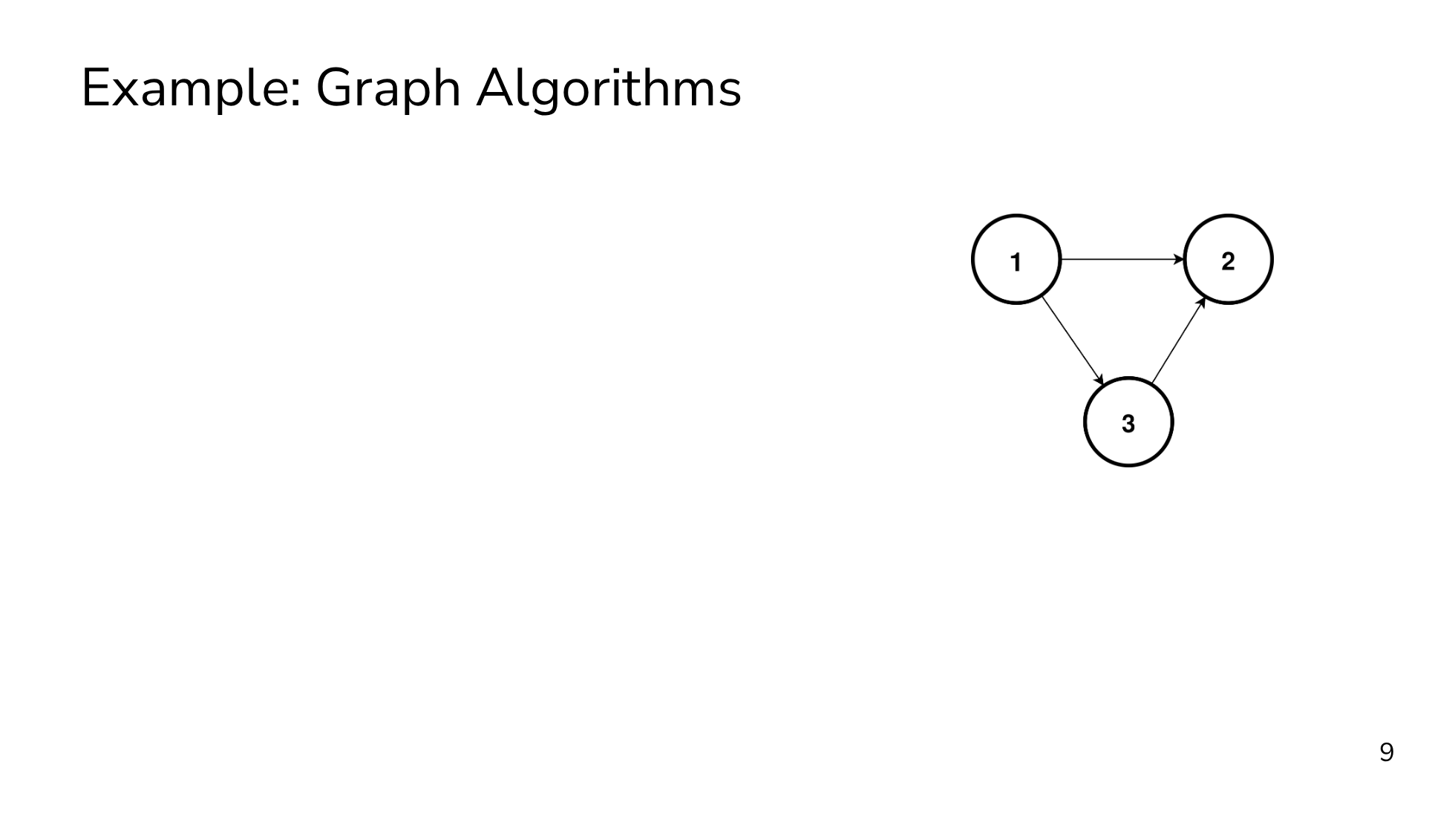
Notes:
Another example where shuffle can be really helpful is for oblivious graph algorithms. It's not easy to express a graph and operate over it obliviously. The typical graph algorithms that you're probably familiar with all require you to know which vertex you're operating on, as well as its set of edges. Of course, we could always express the graph as a matrix, but for real world graphs which aren't fully connected, this is going to be far too slow because of the quadratic blowup in time and space. The standard way of dealing with graphs obliviously is through the GraphSC paradigm. The core idea is to encode the graph as a single list containing all the vertices and edges as elements in the list. And the list has two orderings: a source ordering, where vertices appear before their outgoing edges, and a destination ordering, where vertices appear after their incoming edges. The GraphSC paradigm requires us to support only two operations, scatter and gather. Each operation is efficient in only one of the orderings. Scatter is efficient in the source ordering but not the destination ordering, and gather is efficient in the destination ordering but not the source ordering. What we want is the ability to swap between these two orderings without revealing the structure of the graph, and oblivious shuffling gives us this ability.

Slide 30
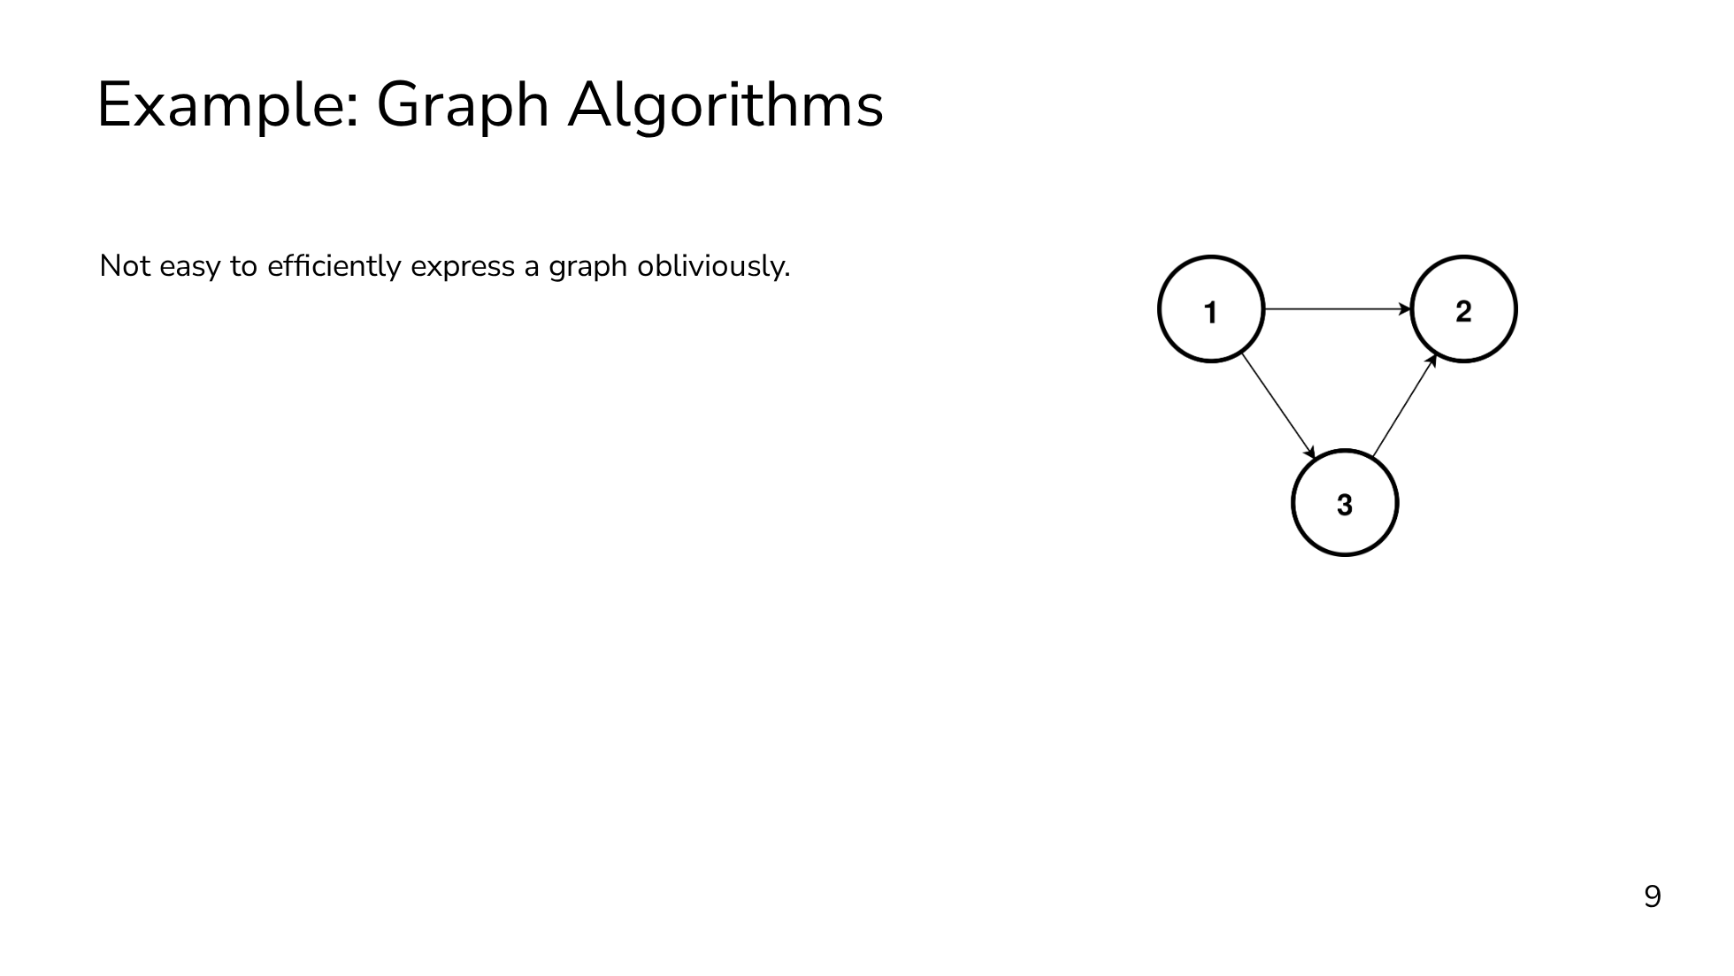
Notes:
Another example where shuffle can be really helpful is for oblivious graph algorithms. It's not easy to express a graph and operate over it obliviously. The typical graph algorithms that you're probably familiar with all require you to know which vertex you're operating on, as well as its set of edges. Of course, we could always express the graph as a matrix, but for real world graphs which aren't fully connected, this is going to be far too slow because of the quadratic blowup in time and space. The standard way of dealing with graphs obliviously is through the GraphSC paradigm. The core idea is to encode the graph as a single list containing all the vertices and edges as elements in the list. And the list has two orderings: a source ordering, where vertices appear before their outgoing edges, and a destination ordering, where vertices appear after their incoming edges. The GraphSC paradigm requires us to support only two operations, scatter and gather. Each operation is efficient in only one of the orderings. Scatter is efficient in the source ordering but not the destination ordering, and gather is efficient in the destination ordering but not the source ordering. What we want is the ability to swap between these two orderings without revealing the structure of the graph, and oblivious shuffling gives us this ability.

Slide 31
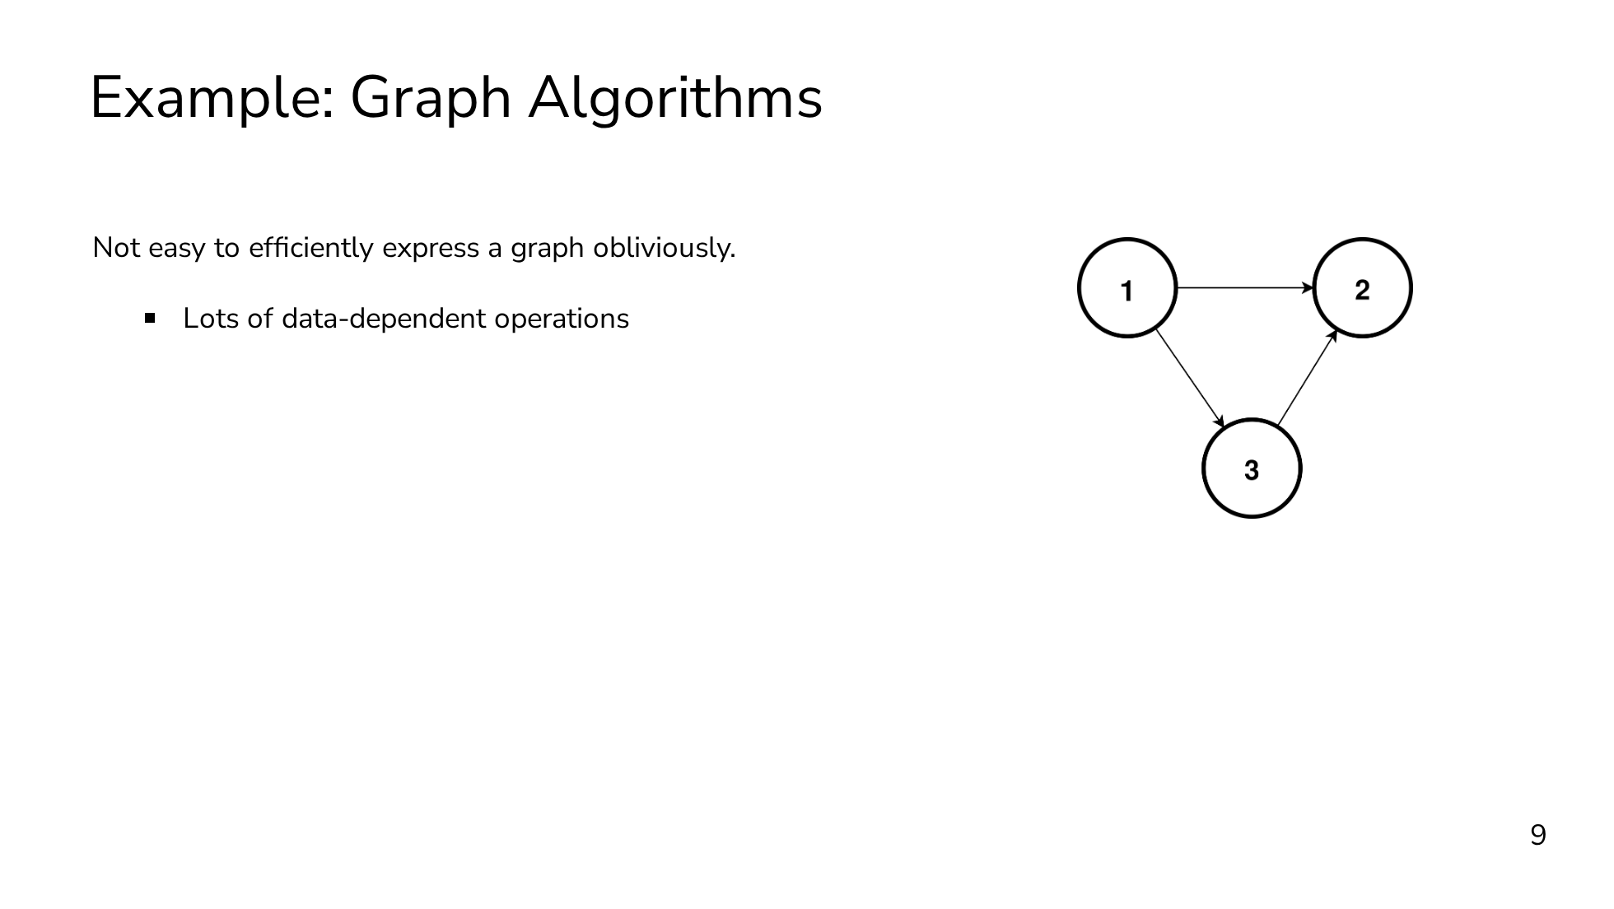
Notes:
Another example where shuffle can be really helpful is for oblivious graph algorithms. It's not easy to express a graph and operate over it obliviously. The typical graph algorithms that you're probably familiar with all require you to know which vertex you're operating on, as well as its set of edges. Of course, we could always express the graph as a matrix, but for real world graphs which aren't fully connected, this is going to be far too slow because of the quadratic blowup in time and space. The standard way of dealing with graphs obliviously is through the GraphSC paradigm. The core idea is to encode the graph as a single list containing all the vertices and edges as elements in the list. And the list has two orderings: a source ordering, where vertices appear before their outgoing edges, and a destination ordering, where vertices appear after their incoming edges. The GraphSC paradigm requires us to support only two operations, scatter and gather. Each operation is efficient in only one of the orderings. Scatter is efficient in the source ordering but not the destination ordering, and gather is efficient in the destination ordering but not the source ordering. What we want is the ability to swap between these two orderings without revealing the structure of the graph, and oblivious shuffling gives us this ability.

Slide 32
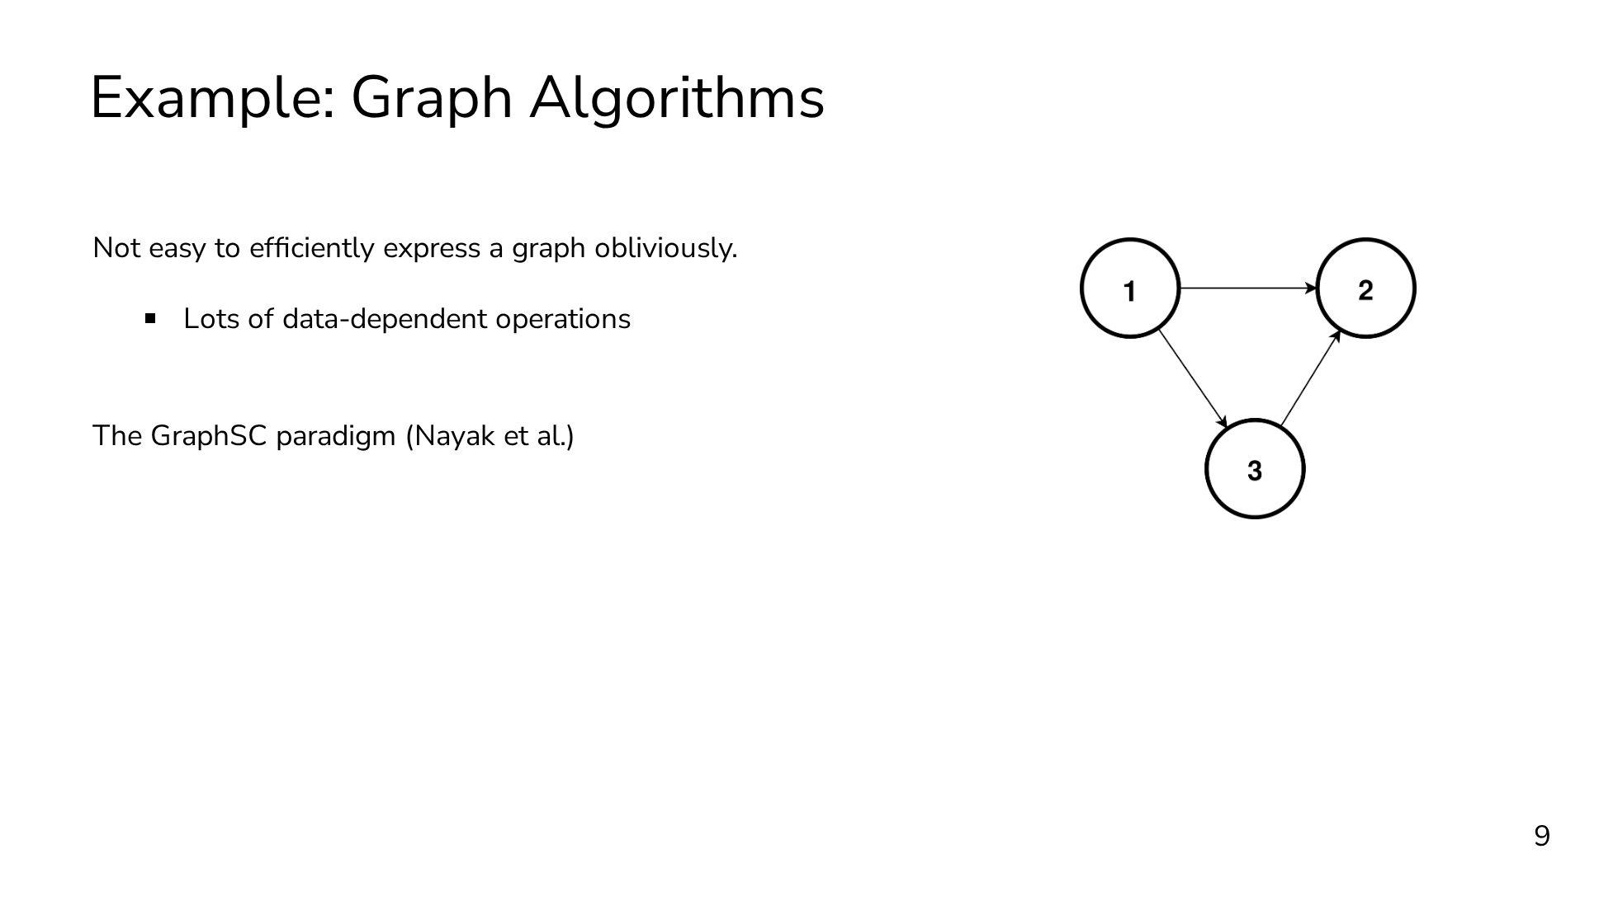
Notes:
Another example where shuffle can be really helpful is for oblivious graph algorithms. It's not easy to express a graph and operate over it obliviously. The typical graph algorithms that you're probably familiar with all require you to know which vertex you're operating on, as well as its set of edges. Of course, we could always express the graph as a matrix, but for real world graphs which aren't fully connected, this is going to be far too slow because of the quadratic blowup in time and space. The standard way of dealing with graphs obliviously is through the GraphSC paradigm. The core idea is to encode the graph as a single list containing all the vertices and edges as elements in the list. And the list has two orderings: a source ordering, where vertices appear before their outgoing edges, and a destination ordering, where vertices appear after their incoming edges. The GraphSC paradigm requires us to support only two operations, scatter and gather. Each operation is efficient in only one of the orderings. Scatter is efficient in the source ordering but not the destination ordering, and gather is efficient in the destination ordering but not the source ordering. What we want is the ability to swap between these two orderings without revealing the structure of the graph, and oblivious shuffling gives us this ability.

Slide 33
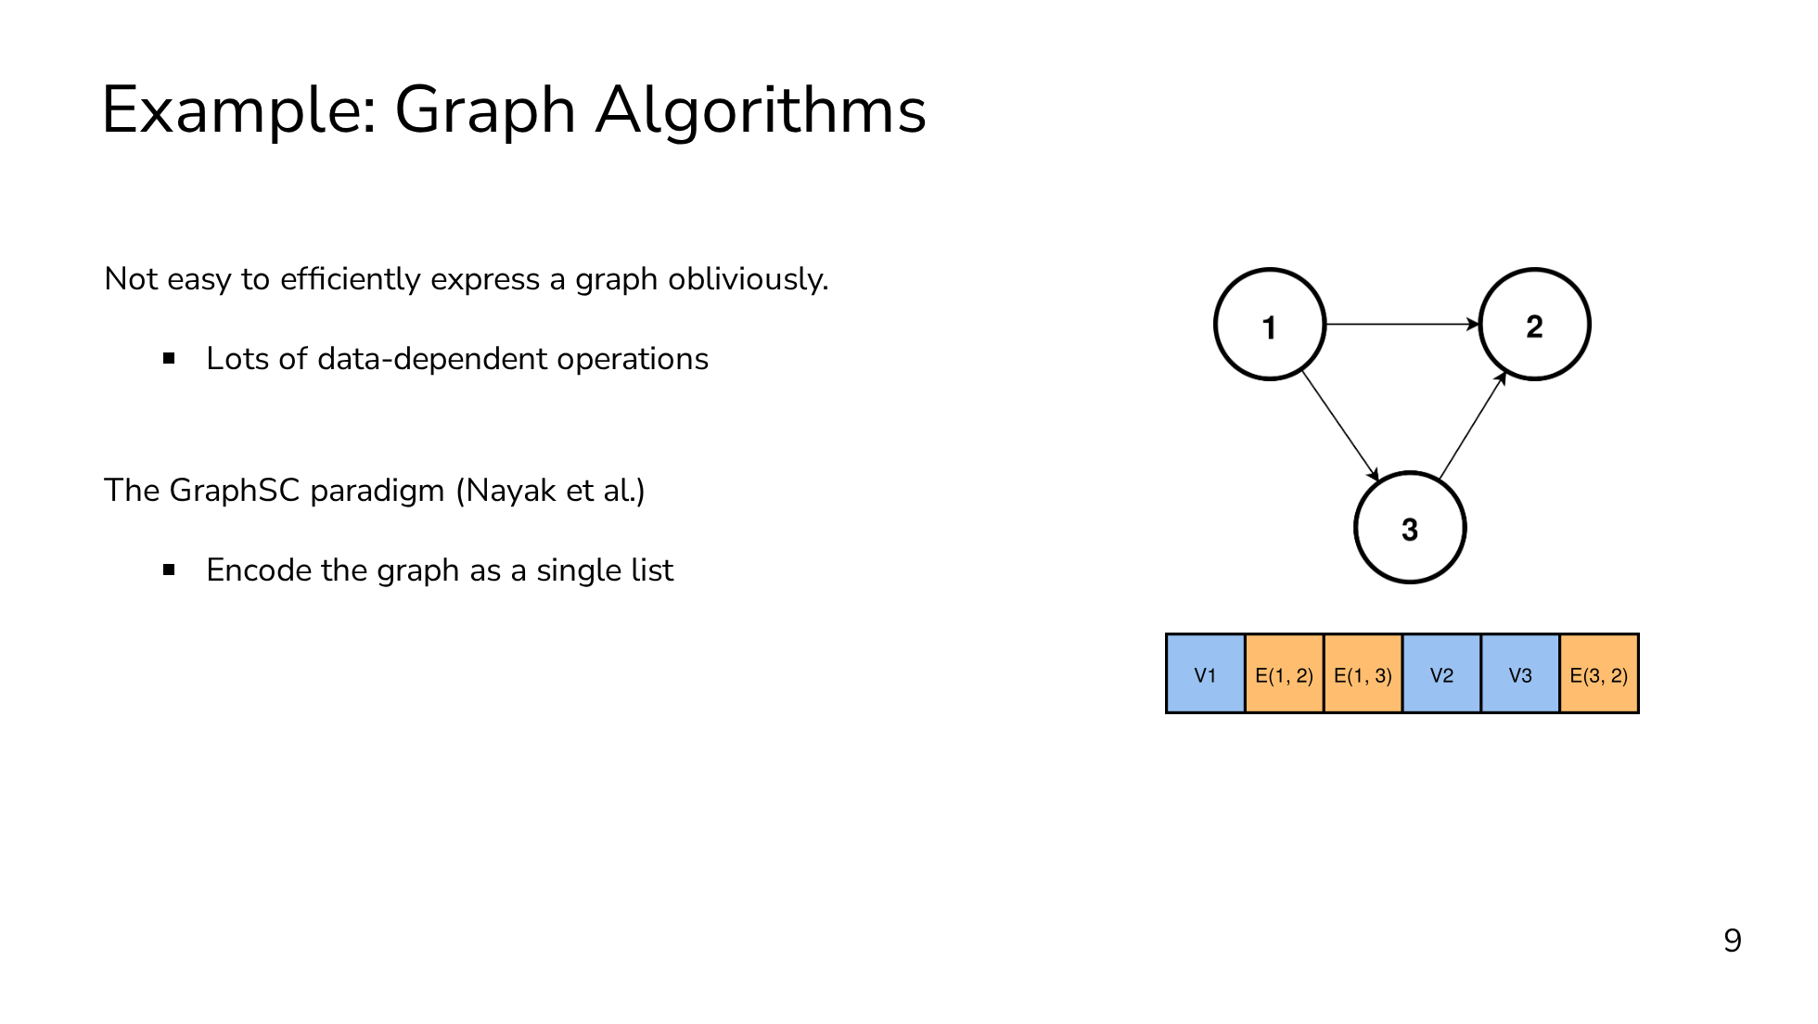
Notes:
Another example where shuffle can be really helpful is for oblivious graph algorithms. It's not easy to express a graph and operate over it obliviously. The typical graph algorithms that you're probably familiar with all require you to know which vertex you're operating on, as well as its set of edges. Of course, we could always express the graph as a matrix, but for real world graphs which aren't fully connected, this is going to be far too slow because of the quadratic blowup in time and space. The standard way of dealing with graphs obliviously is through the GraphSC paradigm. The core idea is to encode the graph as a single list containing all the vertices and edges as elements in the list. And the list has two orderings: a source ordering, where vertices appear before their outgoing edges, and a destination ordering, where vertices appear after their incoming edges. The GraphSC paradigm requires us to support only two operations, scatter and gather. Each operation is efficient in only one of the orderings. Scatter is efficient in the source ordering but not the destination ordering, and gather is efficient in the destination ordering but not the source ordering. What we want is the ability to swap between these two orderings without revealing the structure of the graph, and oblivious shuffling gives us this ability.

Slide 34
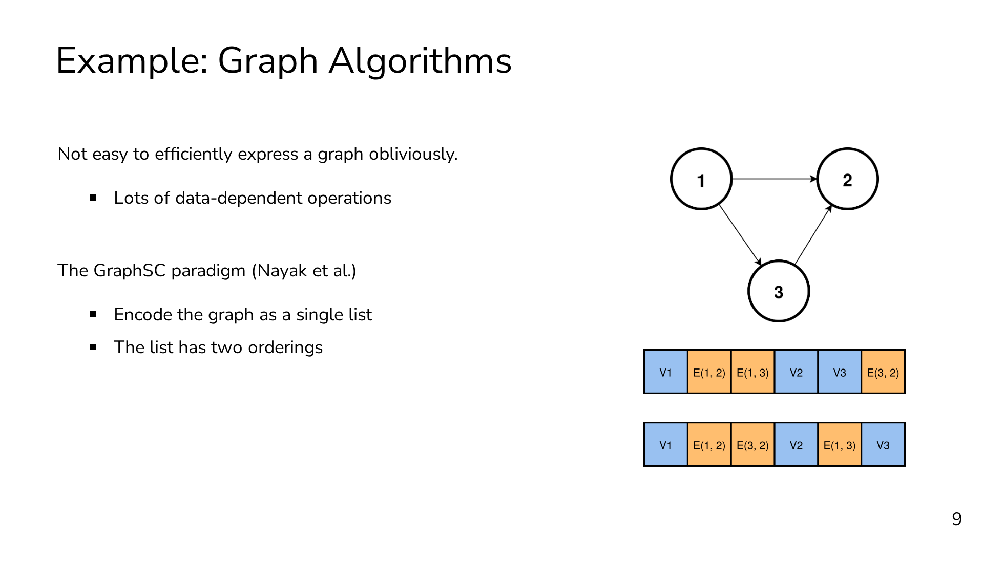
Notes:
Another example where shuffle can be really helpful is for oblivious graph algorithms. It's not easy to express a graph and operate over it obliviously. The typical graph algorithms that you're probably familiar with all require you to know which vertex you're operating on, as well as its set of edges. Of course, we could always express the graph as a matrix, but for real world graphs which aren't fully connected, this is going to be far too slow because of the quadratic blowup in time and space. The standard way of dealing with graphs obliviously is through the GraphSC paradigm. The core idea is to encode the graph as a single list containing all the vertices and edges as elements in the list. And the list has two orderings: a source ordering, where vertices appear before their outgoing edges, and a destination ordering, where vertices appear after their incoming edges. The GraphSC paradigm requires us to support only two operations, scatter and gather. Each operation is efficient in only one of the orderings. Scatter is efficient in the source ordering but not the destination ordering, and gather is efficient in the destination ordering but not the source ordering. What we want is the ability to swap between these two orderings without revealing the structure of the graph, and oblivious shuffling gives us this ability.

Slide 35
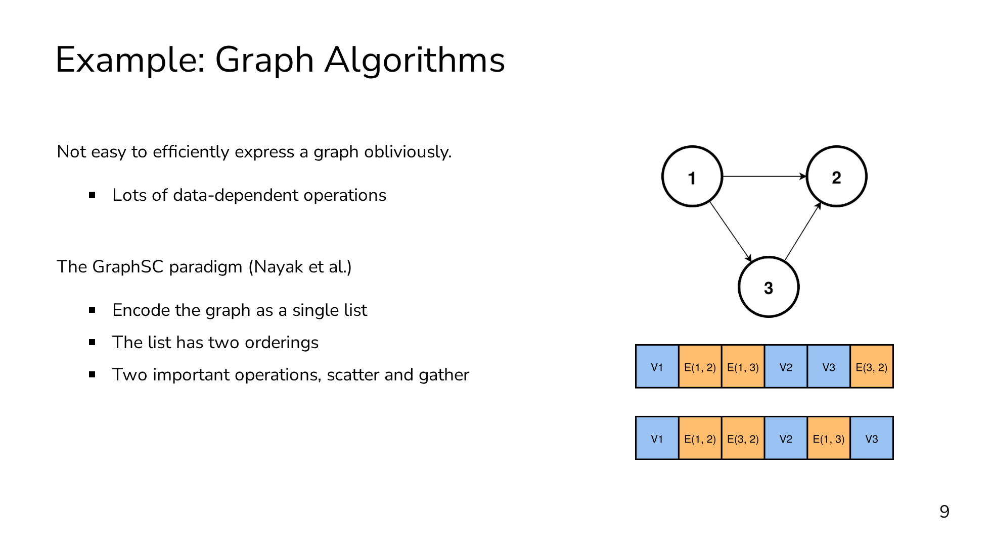
Notes:
Another example where shuffle can be really helpful is for oblivious graph algorithms. It's not easy to express a graph and operate over it obliviously. The typical graph algorithms that you're probably familiar with all require you to know which vertex you're operating on, as well as its set of edges. Of course, we could always express the graph as a matrix, but for real world graphs which aren't fully connected, this is going to be far too slow because of the quadratic blowup in time and space. The standard way of dealing with graphs obliviously is through the GraphSC paradigm. The core idea is to encode the graph as a single list containing all the vertices and edges as elements in the list. And the list has two orderings: a source ordering, where vertices appear before their outgoing edges, and a destination ordering, where vertices appear after their incoming edges. The GraphSC paradigm requires us to support only two operations, scatter and gather. Each operation is efficient in only one of the orderings. Scatter is efficient in the source ordering but not the destination ordering, and gather is efficient in the destination ordering but not the source ordering. What we want is the ability to swap between these two orderings without revealing the structure of the graph, and oblivious shuffling gives us this ability.

Slide 36
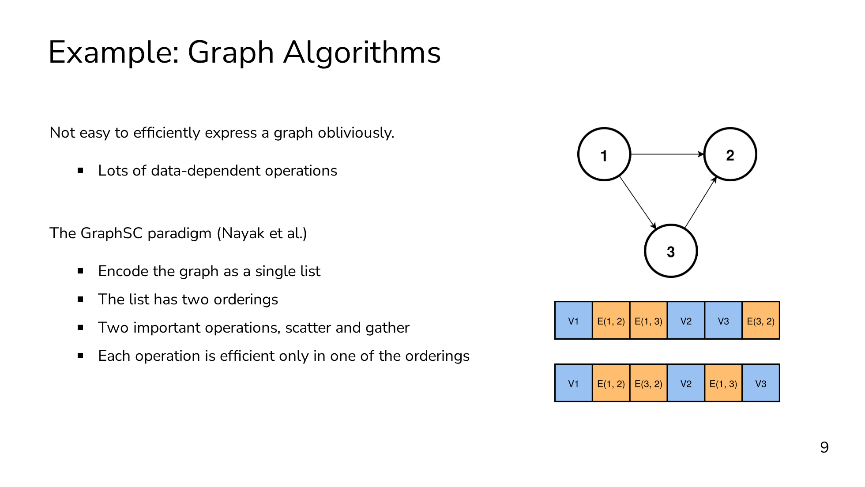
Notes:
Another example where shuffle can be really helpful is for oblivious graph algorithms. It's not easy to express a graph and operate over it obliviously. The typical graph algorithms that you're probably familiar with all require you to know which vertex you're operating on, as well as its set of edges. Of course, we could always express the graph as a matrix, but for real world graphs which aren't fully connected, this is going to be far too slow because of the quadratic blowup in time and space. The standard way of dealing with graphs obliviously is through the GraphSC paradigm. The core idea is to encode the graph as a single list containing all the vertices and edges as elements in the list. And the list has two orderings: a source ordering, where vertices appear before their outgoing edges, and a destination ordering, where vertices appear after their incoming edges. The GraphSC paradigm requires us to support only two operations, scatter and gather. Each operation is efficient in only one of the orderings. Scatter is efficient in the source ordering but not the destination ordering, and gather is efficient in the destination ordering but not the source ordering. What we want is the ability to swap between these two orderings without revealing the structure of the graph, and oblivious shuffling gives us this ability.

Slide 37
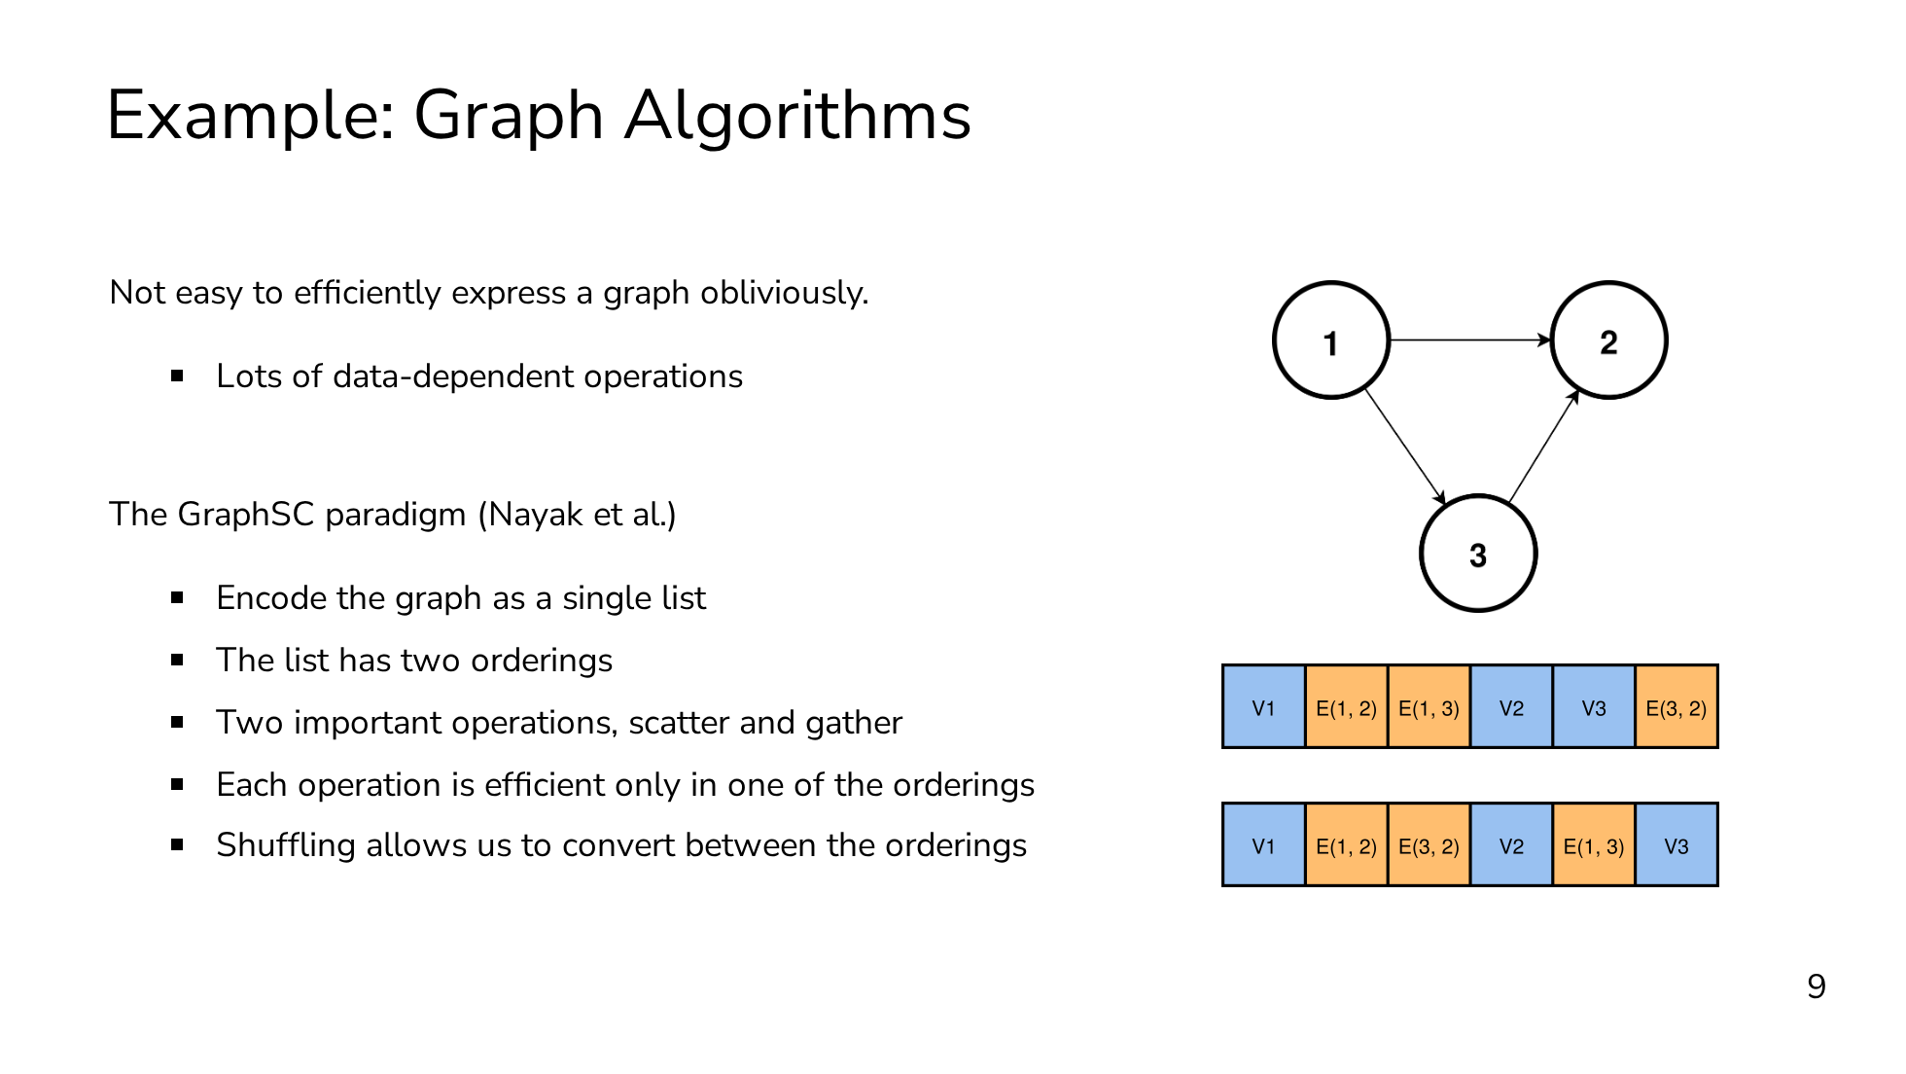
Notes:
Another example where shuffle can be really helpful is for oblivious graph algorithms. It's not easy to express a graph and operate over it obliviously. The typical graph algorithms that you're probably familiar with all require you to know which vertex you're operating on, as well as its set of edges. Of course, we could always express the graph as a matrix, but for real world graphs which aren't fully connected, this is going to be far too slow because of the quadratic blowup in time and space. The standard way of dealing with graphs obliviously is through the GraphSC paradigm. The core idea is to encode the graph as a single list containing all the vertices and edges as elements in the list. And the list has two orderings: a source ordering, where vertices appear before their outgoing edges, and a destination ordering, where vertices appear after their incoming edges. The GraphSC paradigm requires us to support only two operations, scatter and gather. Each operation is efficient in only one of the orderings. Scatter is efficient in the source ordering but not the destination ordering, and gather is efficient in the destination ordering but not the source ordering. What we want is the ability to swap between these two orderings without revealing the structure of the graph, and oblivious shuffling gives us this ability.

Slide 38

Notes:
To take a step back, most MPC programs are expressed as a circuit. But as we saw with sorting, sometimes a pure circuit approach is suboptimal. The other extreme is to use oblivious RAM, but ORAM has its own performance issues. What we really want is a way to opportunistically pick-and-choose between the circuit model of computation and the RAM model of computation. Oblivious shuffle gives us this ability and acts as our bridge between the two worlds. And it's this expressivity that makes it a central primitive for complex workloads. Hopefully by this point I've motivated shuffle well enough that you're wondering "how do we do it?"

Slide 39
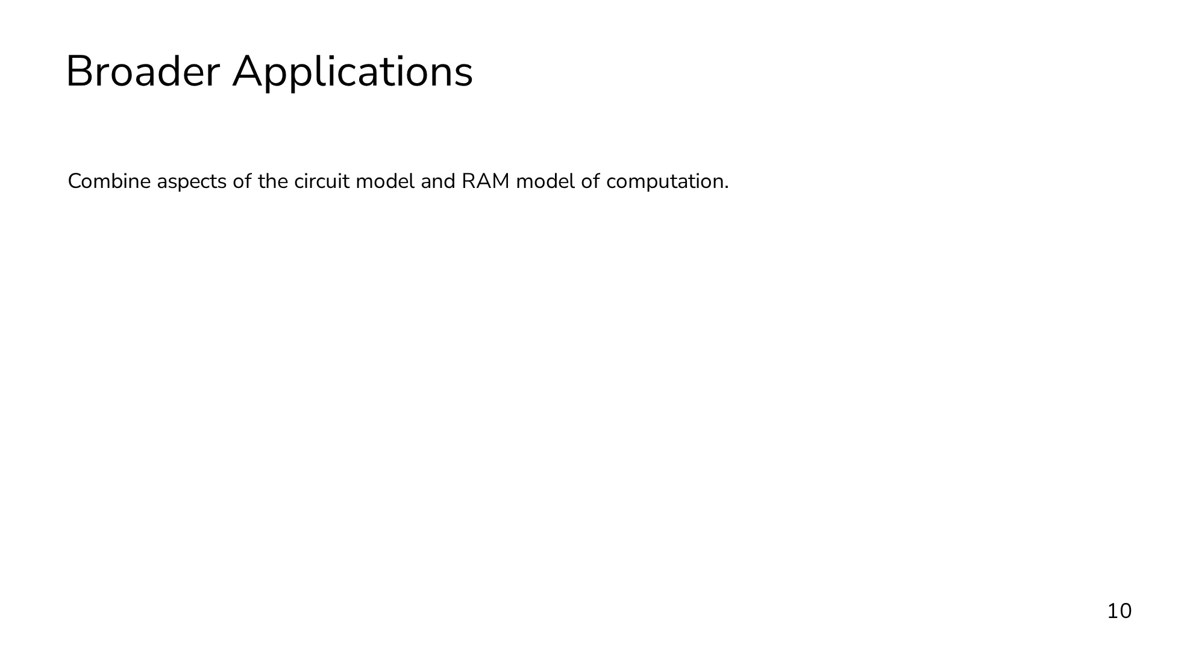
Notes:
To take a step back, most MPC programs are expressed as a circuit. But as we saw with sorting, sometimes a pure circuit approach is suboptimal. The other extreme is to use oblivious RAM, but ORAM has its own performance issues. What we really want is a way to opportunistically pick-and-choose between the circuit model of computation and the RAM model of computation. Oblivious shuffle gives us this ability and acts as our bridge between the two worlds. And it's this expressivity that makes it a central primitive for complex workloads. Hopefully by this point I've motivated shuffle well enough that you're wondering "how do we do it?"

Slide 40
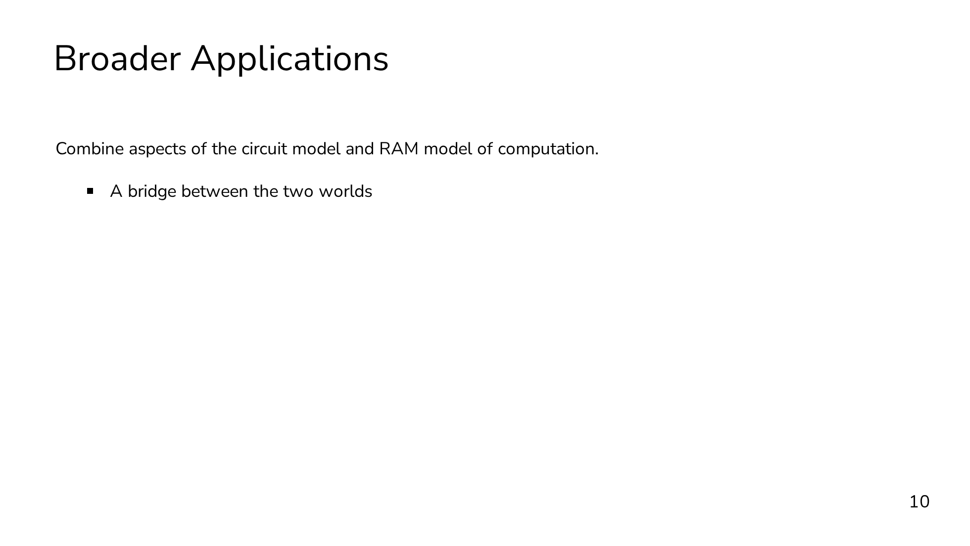
Notes:
To take a step back, most MPC programs are expressed as a circuit. But as we saw with sorting, sometimes a pure circuit approach is suboptimal. The other extreme is to use oblivious RAM, but ORAM has its own performance issues. What we really want is a way to opportunistically pick-and-choose between the circuit model of computation and the RAM model of computation. Oblivious shuffle gives us this ability and acts as our bridge between the two worlds. And it's this expressivity that makes it a central primitive for complex workloads. Hopefully by this point I've motivated shuffle well enough that you're wondering "how do we do it?"

Slide 41
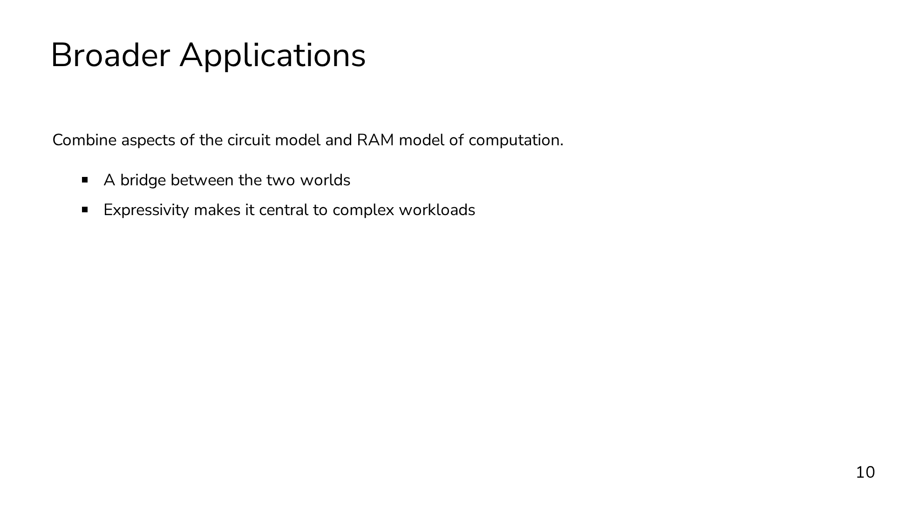
Notes:
To take a step back, most MPC programs are expressed as a circuit. But as we saw with sorting, sometimes a pure circuit approach is suboptimal. The other extreme is to use oblivious RAM, but ORAM has its own performance issues. What we really want is a way to opportunistically pick-and-choose between the circuit model of computation and the RAM model of computation. Oblivious shuffle gives us this ability and acts as our bridge between the two worlds. And it's this expressivity that makes it a central primitive for complex workloads. Hopefully by this point I've motivated shuffle well enough that you're wondering "how do we do it?"

Slide 42
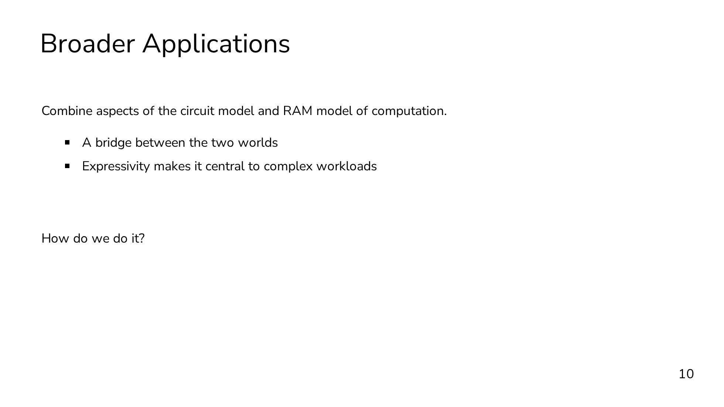
Notes:
To take a step back, most MPC programs are expressed as a circuit. But as we saw with sorting, sometimes a pure circuit approach is suboptimal. The other extreme is to use oblivious RAM, but ORAM has its own performance issues. What we really want is a way to opportunistically pick-and-choose between the circuit model of computation and the RAM model of computation. Oblivious shuffle gives us this ability and acts as our bridge between the two worlds. And it's this expressivity that makes it a central primitive for complex workloads. Hopefully by this point I've motivated shuffle well enough that you're wondering "how do we do it?"

Slide 43
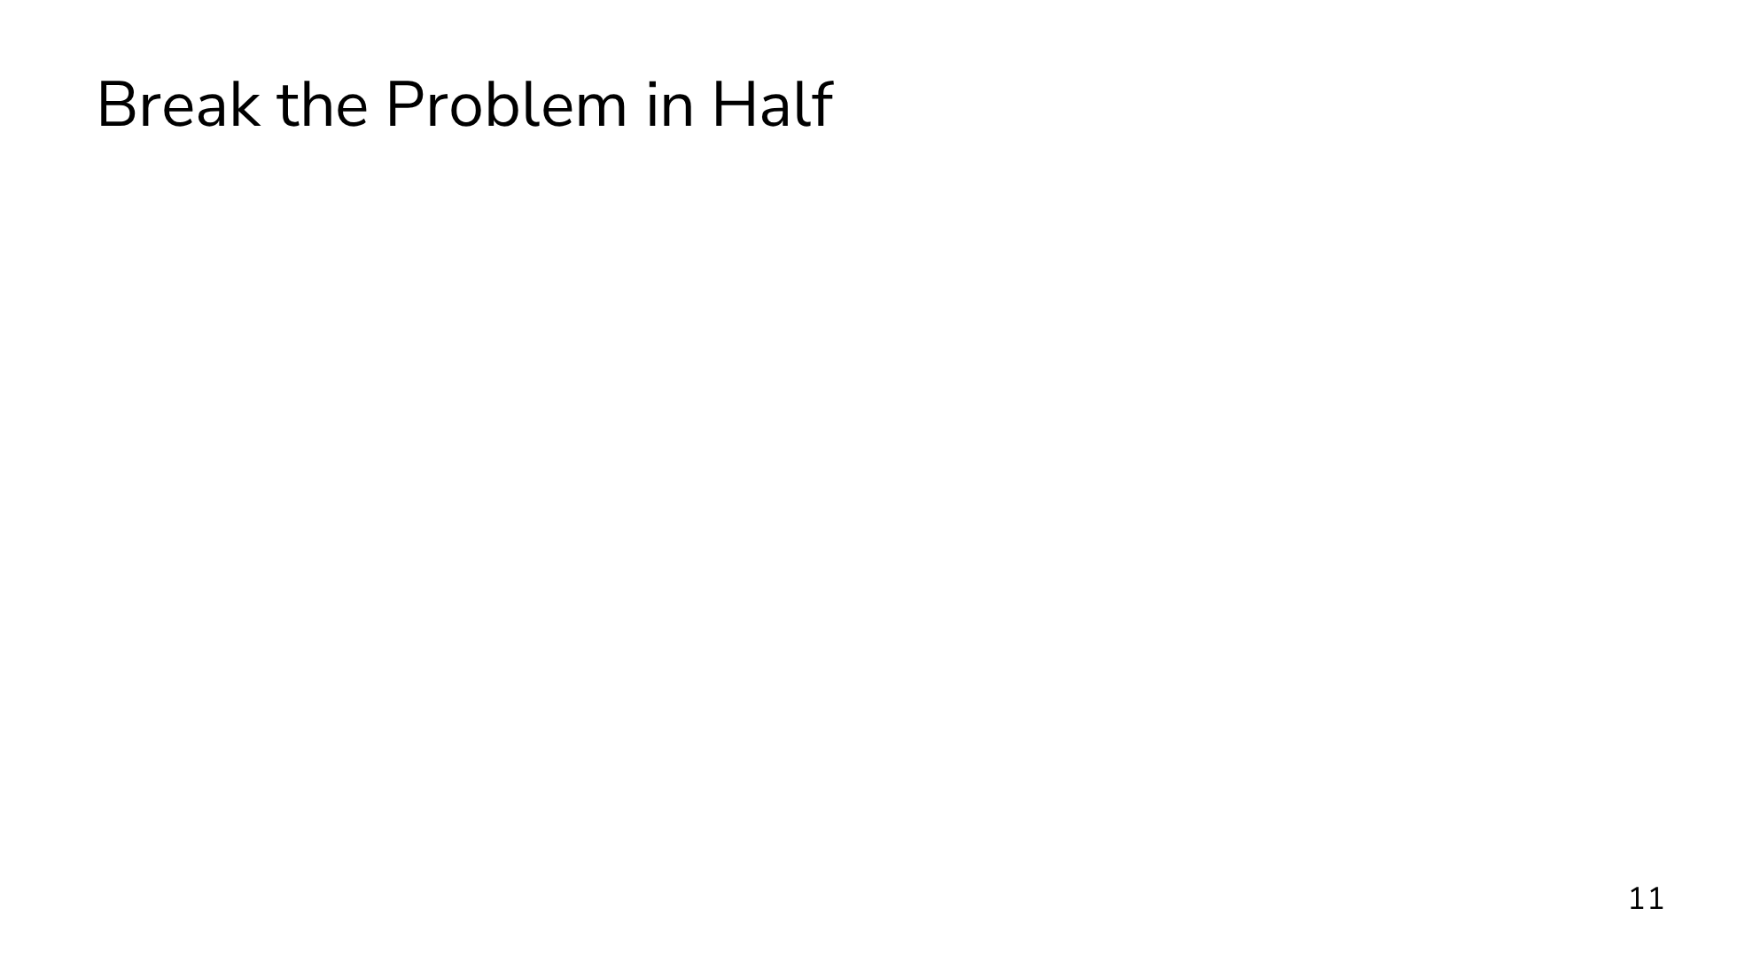
Notes:
Our starting point is going to be to break the problem in half. Remember that our goal is to shuffle by a permutation that neither party knows. We can express the unknown permutation pi as a composition of two permutations, pi0 and pi1, where each party knows one of the permutations. P0 knows pi0, and P1 knows pi1. Neither party knows anything about the composition, because the other party's permutation perfectly masks their own. In one half of the protocol, one party will apply their permutation obliviously. We will have a sender that inputs a permutation, and a receiver that inputs a vector to be permuted. The output is a secret-sharing of the permuted input. The "half protocol" is typically called "Permute+Share".

Slide 44
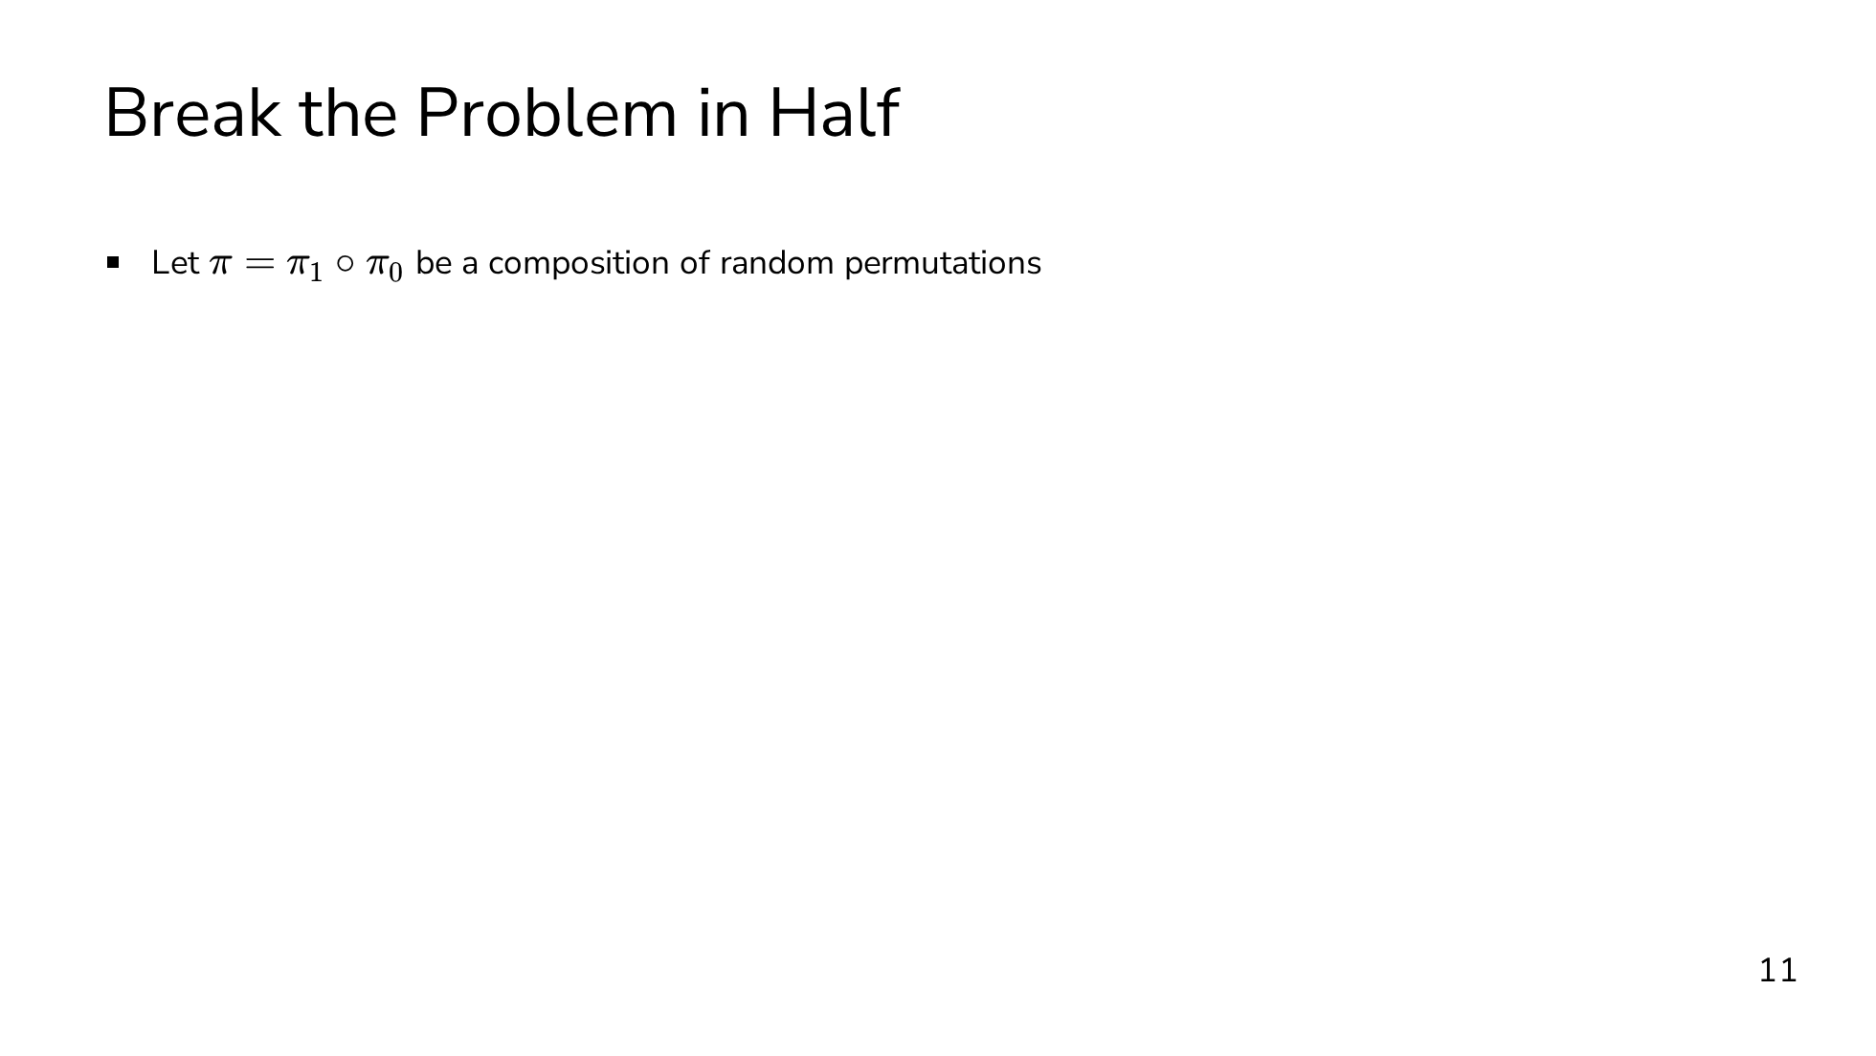
Notes:
Our starting point is going to be to break the problem in half. Remember that our goal is to shuffle by a permutation that neither party knows. We can express the unknown permutation pi as a composition of two permutations, pi0 and pi1, where each party knows one of the permutations. P0 knows pi0, and P1 knows pi1. Neither party knows anything about the composition, because the other party's permutation perfectly masks their own. In one half of the protocol, one party will apply their permutation obliviously. We will have a sender that inputs a permutation, and a receiver that inputs a vector to be permuted. The output is a secret-sharing of the permuted input. The "half protocol" is typically called "Permute+Share".

Slide 45
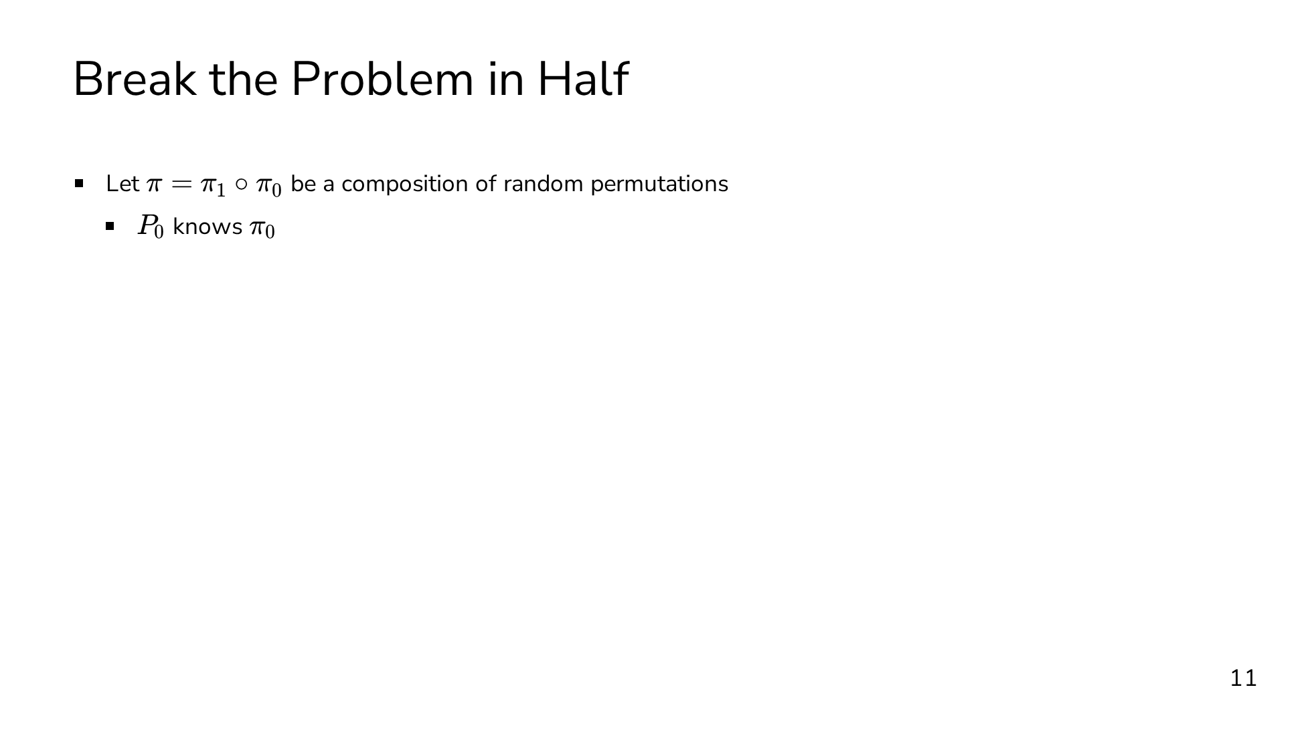
Notes:
Our starting point is going to be to break the problem in half. Remember that our goal is to shuffle by a permutation that neither party knows. We can express the unknown permutation pi as a composition of two permutations, pi0 and pi1, where each party knows one of the permutations. P0 knows pi0, and P1 knows pi1. Neither party knows anything about the composition, because the other party's permutation perfectly masks their own. In one half of the protocol, one party will apply their permutation obliviously. We will have a sender that inputs a permutation, and a receiver that inputs a vector to be permuted. The output is a secret-sharing of the permuted input. The "half protocol" is typically called "Permute+Share".

Slide 46
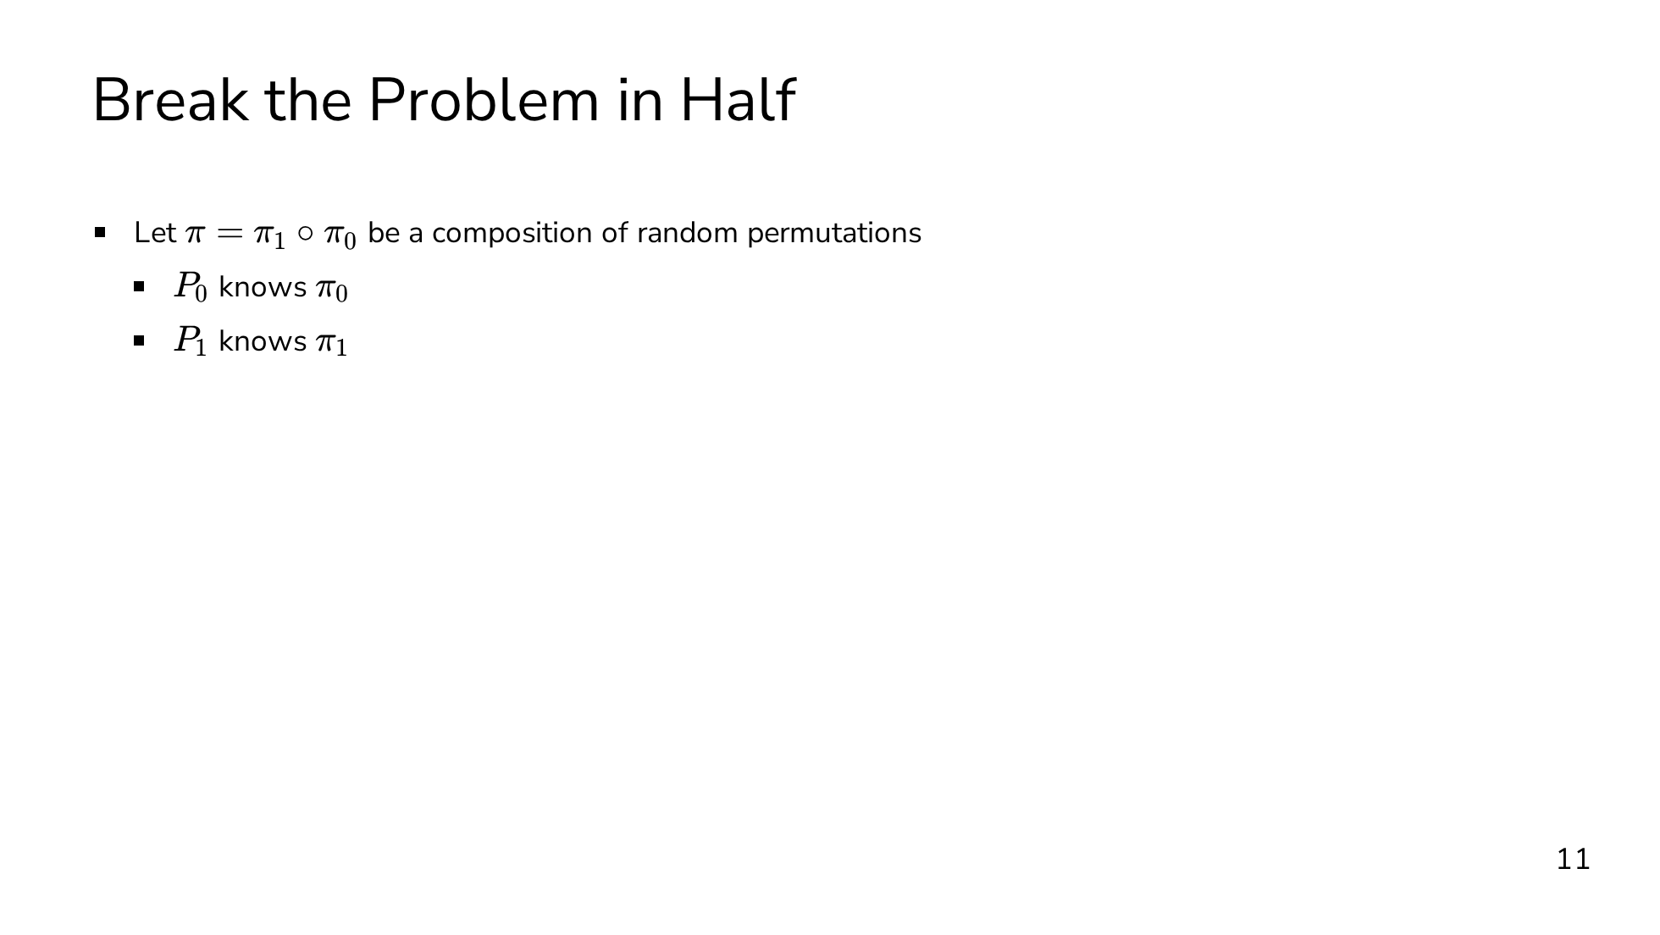
Notes:
Our starting point is going to be to break the problem in half. Remember that our goal is to shuffle by a permutation that neither party knows. We can express the unknown permutation pi as a composition of two permutations, pi0 and pi1, where each party knows one of the permutations. P0 knows pi0, and P1 knows pi1. Neither party knows anything about the composition, because the other party's permutation perfectly masks their own. In one half of the protocol, one party will apply their permutation obliviously. We will have a sender that inputs a permutation, and a receiver that inputs a vector to be permuted. The output is a secret-sharing of the permuted input. The "half protocol" is typically called "Permute+Share".

Slide 47
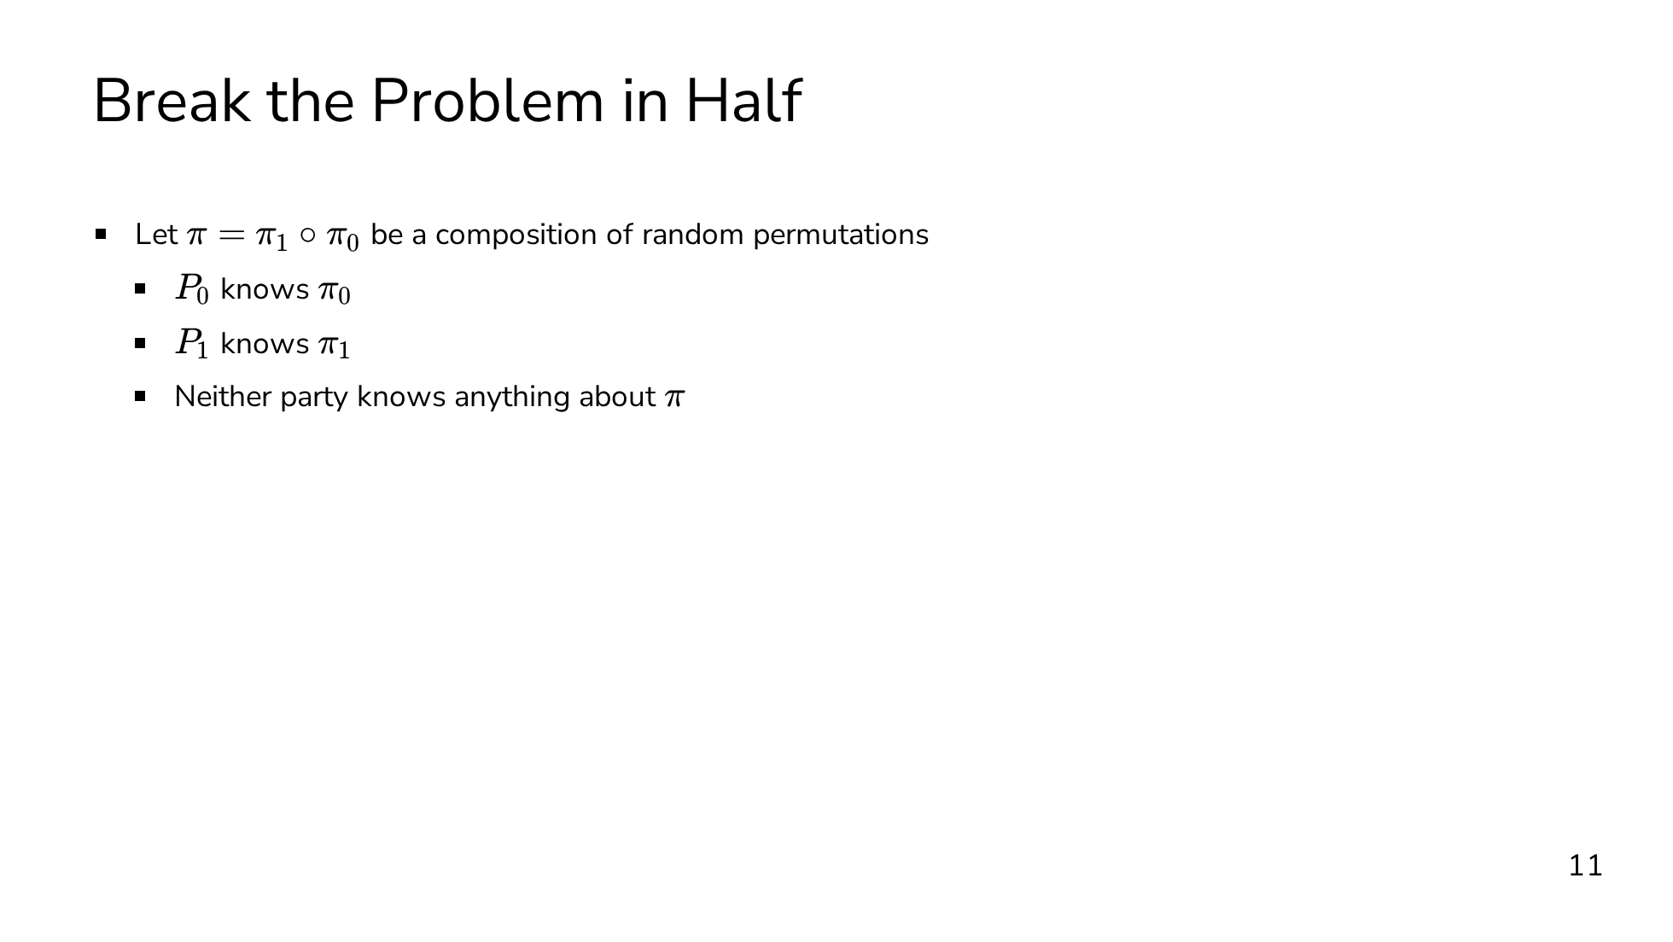
Notes:
Our starting point is going to be to break the problem in half. Remember that our goal is to shuffle by a permutation that neither party knows. We can express the unknown permutation pi as a composition of two permutations, pi0 and pi1, where each party knows one of the permutations. P0 knows pi0, and P1 knows pi1. Neither party knows anything about the composition, because the other party's permutation perfectly masks their own. In one half of the protocol, one party will apply their permutation obliviously. We will have a sender that inputs a permutation, and a receiver that inputs a vector to be permuted. The output is a secret-sharing of the permuted input. The "half protocol" is typically called "Permute+Share".

Slide 48
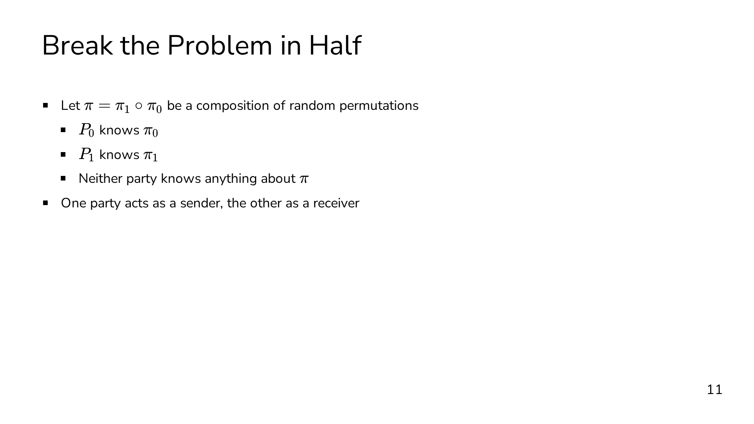
Notes:
Our starting point is going to be to break the problem in half. Remember that our goal is to shuffle by a permutation that neither party knows. We can express the unknown permutation pi as a composition of two permutations, pi0 and pi1, where each party knows one of the permutations. P0 knows pi0, and P1 knows pi1. Neither party knows anything about the composition, because the other party's permutation perfectly masks their own. In one half of the protocol, one party will apply their permutation obliviously. We will have a sender that inputs a permutation, and a receiver that inputs a vector to be permuted. The output is a secret-sharing of the permuted input. The "half protocol" is typically called "Permute+Share".

Slide 49
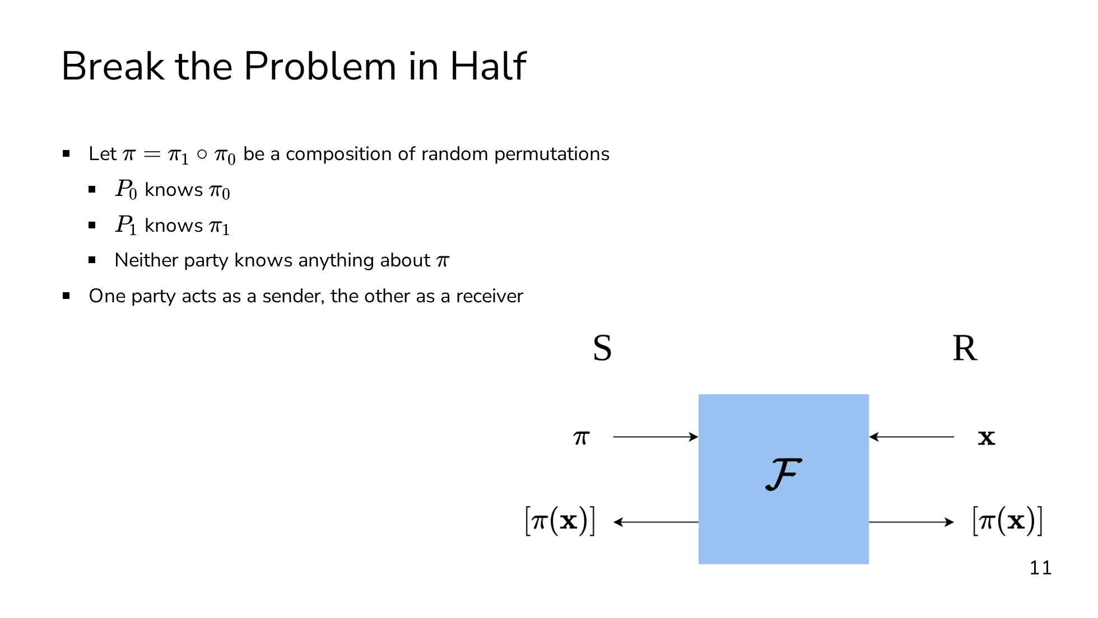
Notes:
Our starting point is going to be to break the problem in half. Remember that our goal is to shuffle by a permutation that neither party knows. We can express the unknown permutation pi as a composition of two permutations, pi0 and pi1, where each party knows one of the permutations. P0 knows pi0, and P1 knows pi1. Neither party knows anything about the composition, because the other party's permutation perfectly masks their own. In one half of the protocol, one party will apply their permutation obliviously. We will have a sender that inputs a permutation, and a receiver that inputs a vector to be permuted. The output is a secret-sharing of the permuted input. The "half protocol" is typically called "Permute+Share".

Slide 50
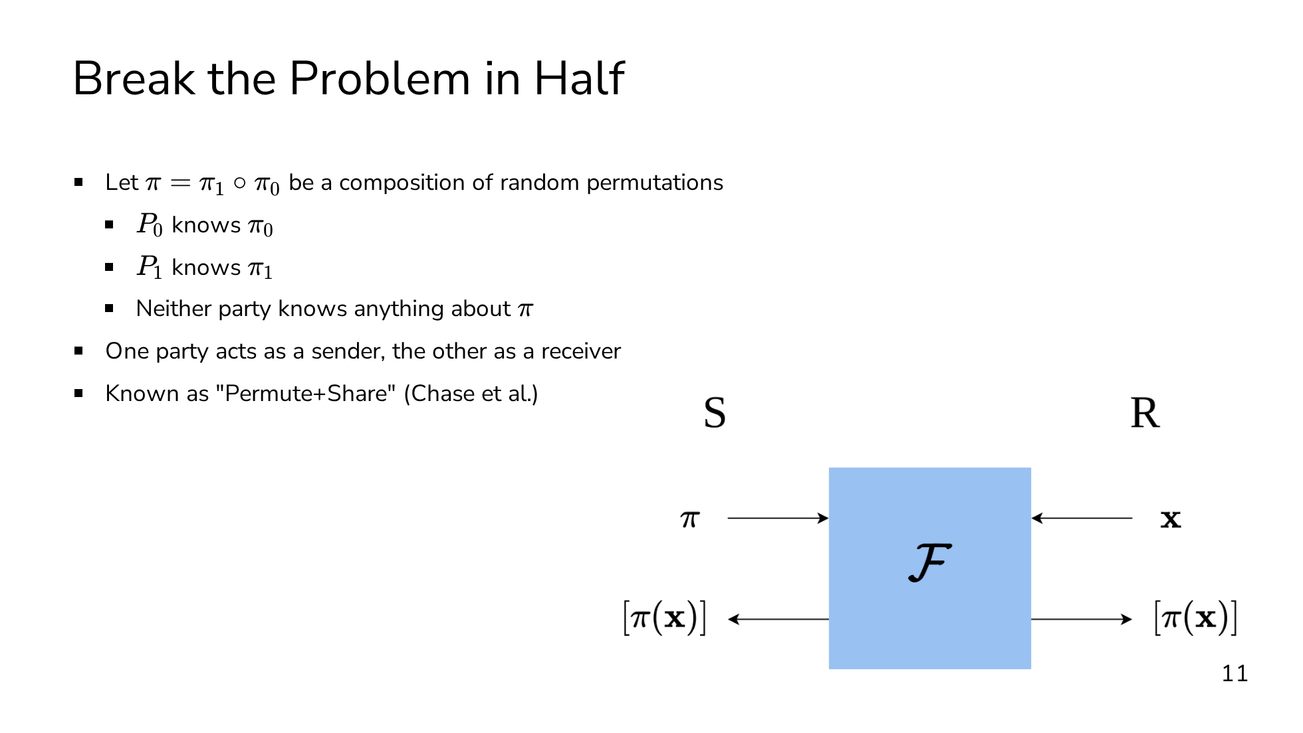
Notes:
Our starting point is going to be to break the problem in half. Remember that our goal is to shuffle by a permutation that neither party knows. We can express the unknown permutation pi as a composition of two permutations, pi0 and pi1, where each party knows one of the permutations. P0 knows pi0, and P1 knows pi1. Neither party knows anything about the composition, because the other party's permutation perfectly masks their own. In one half of the protocol, one party will apply their permutation obliviously. We will have a sender that inputs a permutation, and a receiver that inputs a vector to be permuted. The output is a secret-sharing of the permuted input. The "half protocol" is typically called "Permute+Share".

Slide 51
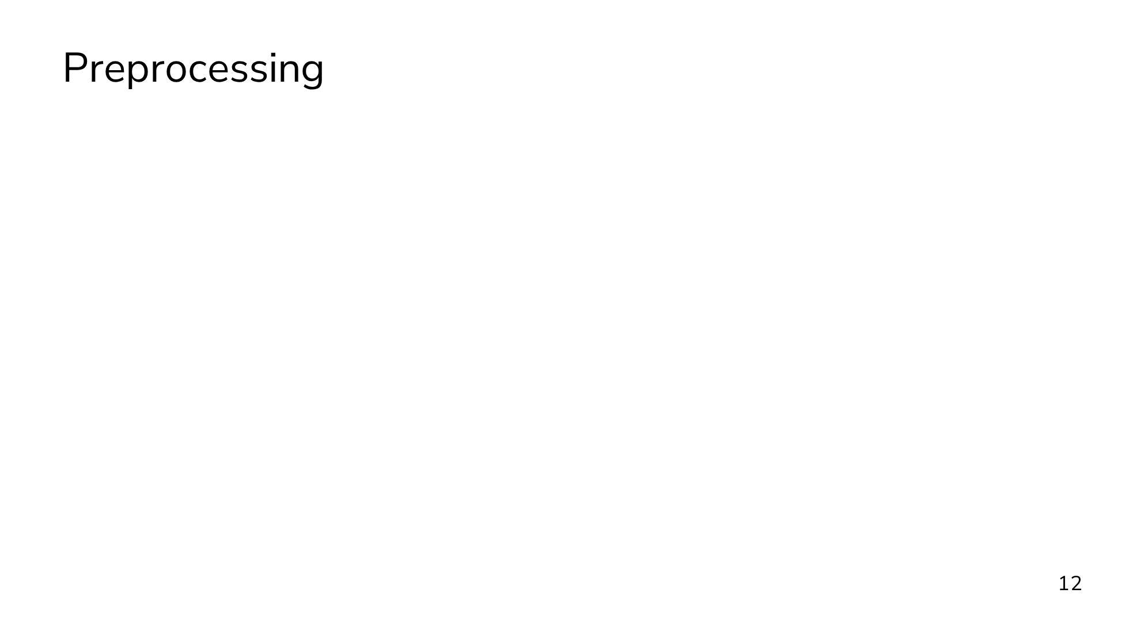
Notes:
A crucial realization by Chase et al. was that Permute+Share can be broken into a preprocessing phase and an online phase. In the preprocessing phase, we only need to shuffle pseudorandom values. Then in the online phase, we can derandomize the preprocessed random correlation with a single message. The correlation produced in the preprocessing phase is known as a permutation correlation. A permutation correlation is a pair of tuples, where the sender gets (pi, C), and the receiver gets (A, B). The correlation is that pi(A) = B + C. In other words, the sender gets the permutation pi, the receiver gets the pseudorandom vector to be shuffled A, and the parties each get a secret share of pi(A).

Slide 52

Notes:
A crucial realization by Chase et al. was that Permute+Share can be broken into a preprocessing phase and an online phase. In the preprocessing phase, we only need to shuffle pseudorandom values. Then in the online phase, we can derandomize the preprocessed random correlation with a single message. The correlation produced in the preprocessing phase is known as a permutation correlation. A permutation correlation is a pair of tuples, where the sender gets (pi, C), and the receiver gets (A, B). The correlation is that pi(A) = B + C. In other words, the sender gets the permutation pi, the receiver gets the pseudorandom vector to be shuffled A, and the parties each get a secret share of pi(A).

Slide 53
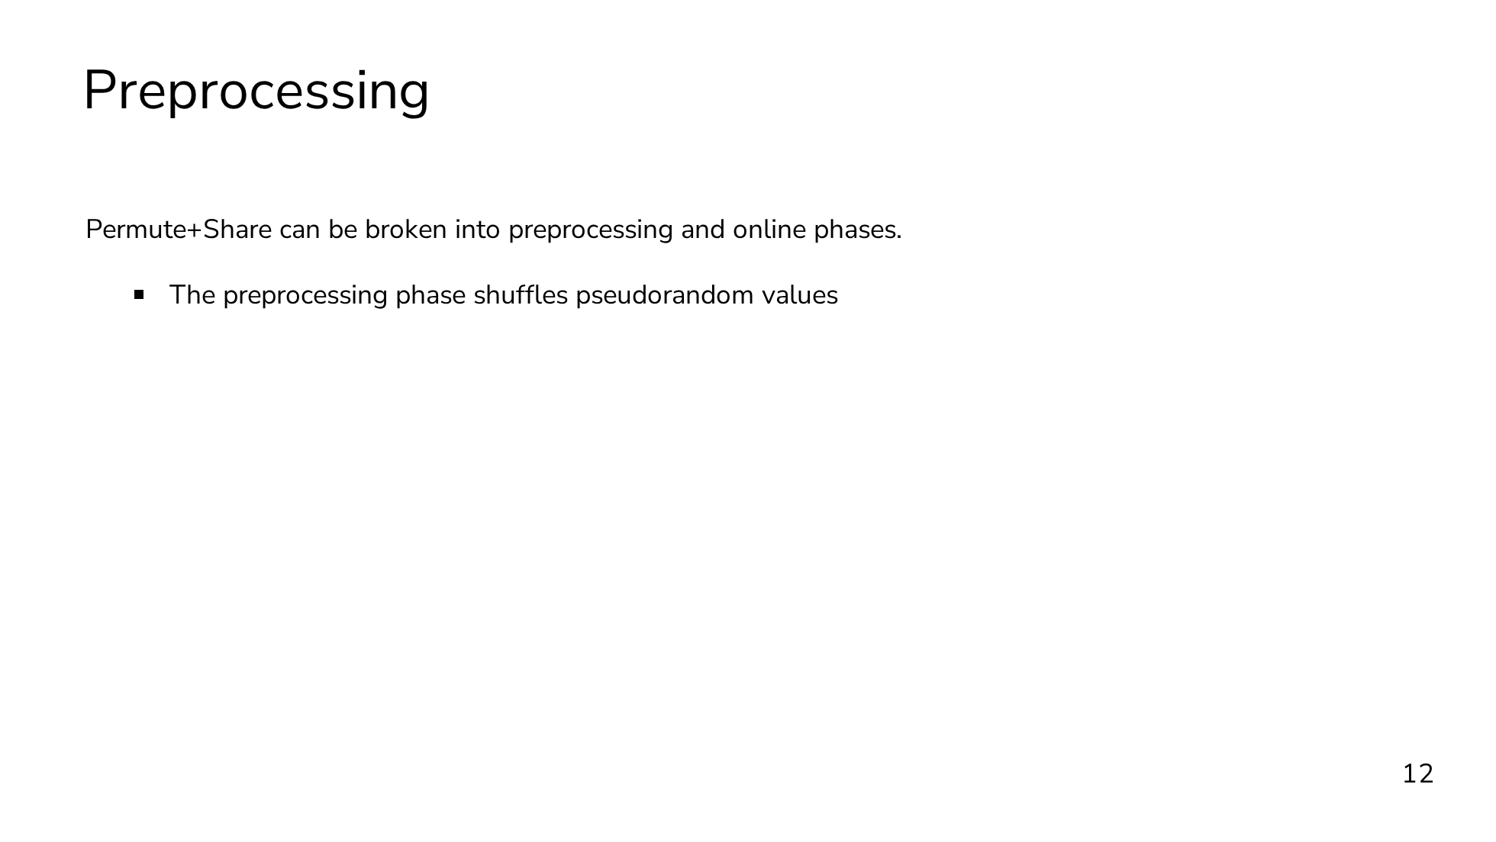
Notes:
A crucial realization by Chase et al. was that Permute+Share can be broken into a preprocessing phase and an online phase. In the preprocessing phase, we only need to shuffle pseudorandom values. Then in the online phase, we can derandomize the preprocessed random correlation with a single message. The correlation produced in the preprocessing phase is known as a permutation correlation. A permutation correlation is a pair of tuples, where the sender gets (pi, C), and the receiver gets (A, B). The correlation is that pi(A) = B + C. In other words, the sender gets the permutation pi, the receiver gets the pseudorandom vector to be shuffled A, and the parties each get a secret share of pi(A).

Slide 54
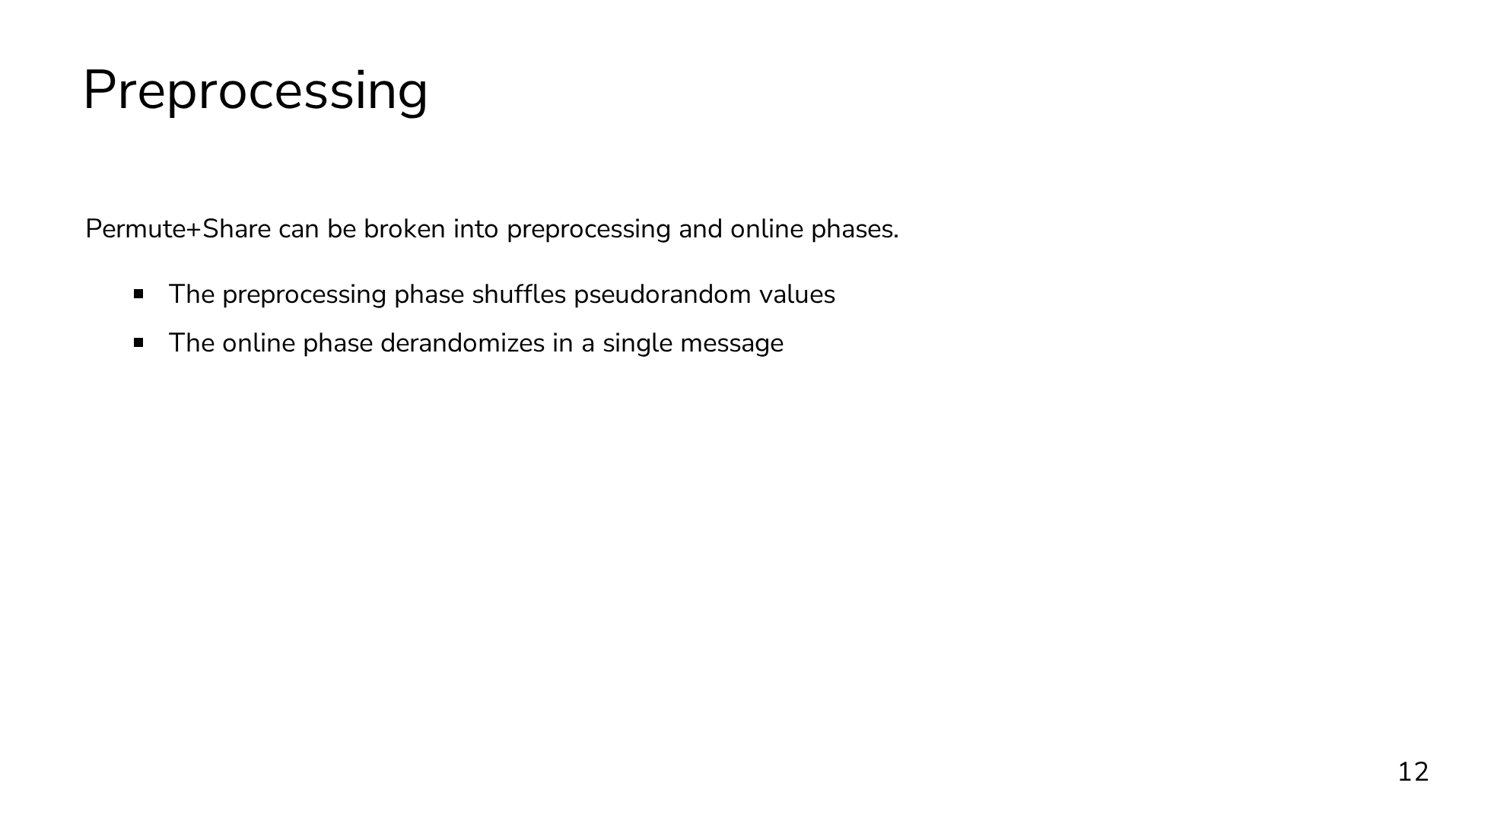
Notes:
A crucial realization by Chase et al. was that Permute+Share can be broken into a preprocessing phase and an online phase. In the preprocessing phase, we only need to shuffle pseudorandom values. Then in the online phase, we can derandomize the preprocessed random correlation with a single message. The correlation produced in the preprocessing phase is known as a permutation correlation. A permutation correlation is a pair of tuples, where the sender gets (pi, C), and the receiver gets (A, B). The correlation is that pi(A) = B + C. In other words, the sender gets the permutation pi, the receiver gets the pseudorandom vector to be shuffled A, and the parties each get a secret share of pi(A).

Slide 55
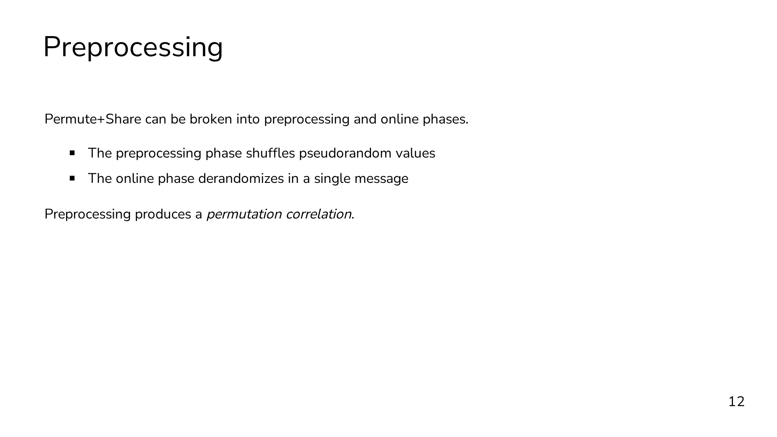
Notes:
A crucial realization by Chase et al. was that Permute+Share can be broken into a preprocessing phase and an online phase. In the preprocessing phase, we only need to shuffle pseudorandom values. Then in the online phase, we can derandomize the preprocessed random correlation with a single message. The correlation produced in the preprocessing phase is known as a permutation correlation. A permutation correlation is a pair of tuples, where the sender gets (pi, C), and the receiver gets (A, B). The correlation is that pi(A) = B + C. In other words, the sender gets the permutation pi, the receiver gets the pseudorandom vector to be shuffled A, and the parties each get a secret share of pi(A).

Slide 56

Notes:
A crucial realization by Chase et al. was that Permute+Share can be broken into a preprocessing phase and an online phase. In the preprocessing phase, we only need to shuffle pseudorandom values. Then in the online phase, we can derandomize the preprocessed random correlation with a single message. The correlation produced in the preprocessing phase is known as a permutation correlation. A permutation correlation is a pair of tuples, where the sender gets (pi, C), and the receiver gets (A, B). The correlation is that pi(A) = B + C. In other words, the sender gets the permutation pi, the receiver gets the pseudorandom vector to be shuffled A, and the parties each get a secret share of pi(A).

Slide 57

Notes:
A crucial realization by Chase et al. was that Permute+Share can be broken into a preprocessing phase and an online phase. In the preprocessing phase, we only need to shuffle pseudorandom values. Then in the online phase, we can derandomize the preprocessed random correlation with a single message. The correlation produced in the preprocessing phase is known as a permutation correlation. A permutation correlation is a pair of tuples, where the sender gets (pi, C), and the receiver gets (A, B). The correlation is that pi(A) = B + C. In other words, the sender gets the permutation pi, the receiver gets the pseudorandom vector to be shuffled A, and the parties each get a secret share of pi(A).

Slide 58

Notes:
I told you that we can very easily derandomize a correlation to get an online shuffle protocol, so now I'll show you what that online phase looks like. As promised, it's just a single message. The sender takes as input their half of the permutation correlation consisting of pi and C. The receiver takes as input both their half of the permutation correlation and a vector x to shuffle. The receiver uses the pseudorandom vector A to mask x and sends the masked value to the sender. The receiver outputs B and is done with the protocol. The sender permutes its received value by pi and adds C, and that's its output. How can we verify that this is correct? Here, correctness means that the output values form a secret sharing of pi(x). So if we add the two output shares, we can show that we get pi(x). B plus C is just pi(A). And the permutation over x minus A can be separated into the permutation over x minus the permutation over A. The pi(A)'s cancel, and we're left with pi(x).

Slide 59

Notes:
I told you that we can very easily derandomize a correlation to get an online shuffle protocol, so now I'll show you what that online phase looks like. As promised, it's just a single message. The sender takes as input their half of the permutation correlation consisting of pi and C. The receiver takes as input both their half of the permutation correlation and a vector x to shuffle. The receiver uses the pseudorandom vector A to mask x and sends the masked value to the sender. The receiver outputs B and is done with the protocol. The sender permutes its received value by pi and adds C, and that's its output. How can we verify that this is correct? Here, correctness means that the output values form a secret sharing of pi(x). So if we add the two output shares, we can show that we get pi(x). B plus C is just pi(A). And the permutation over x minus A can be separated into the permutation over x minus the permutation over A. The pi(A)'s cancel, and we're left with pi(x).

Slide 60

Notes:
I told you that we can very easily derandomize a correlation to get an online shuffle protocol, so now I'll show you what that online phase looks like. As promised, it's just a single message. The sender takes as input their half of the permutation correlation consisting of pi and C. The receiver takes as input both their half of the permutation correlation and a vector x to shuffle. The receiver uses the pseudorandom vector A to mask x and sends the masked value to the sender. The receiver outputs B and is done with the protocol. The sender permutes its received value by pi and adds C, and that's its output. How can we verify that this is correct? Here, correctness means that the output values form a secret sharing of pi(x). So if we add the two output shares, we can show that we get pi(x). B plus C is just pi(A). And the permutation over x minus A can be separated into the permutation over x minus the permutation over A. The pi(A)'s cancel, and we're left with pi(x).

Slide 61

Notes:
Now to be overly formal, we can define an ideal functionality that captures the generation of the preprocessed correlations. The precise details here don't matter two much. The main point is that for a given length of the permutation n and a given bitwidth ell, the ideal functionality samples a random permutation pi and three random vectors subject to the correlation. When it comes to performance, which we'll be thinking about closely in the coming slides, there are three parameters that we care about. The first is the number of elements in the correlation, n. The second is the bitwidth of each pseudorandom value in the correlation, ell. And the final is the number of correlations we want to generate, which we'll call p. For many applications, we'll want to generate many permutation correlations, so generating in batches becomes important.

Slide 62

Notes:
Now to be overly formal, we can define an ideal functionality that captures the generation of the preprocessed correlations. The precise details here don't matter two much. The main point is that for a given length of the permutation n and a given bitwidth ell, the ideal functionality samples a random permutation pi and three random vectors subject to the correlation. When it comes to performance, which we'll be thinking about closely in the coming slides, there are three parameters that we care about. The first is the number of elements in the correlation, n. The second is the bitwidth of each pseudorandom value in the correlation, ell. And the final is the number of correlations we want to generate, which we'll call p. For many applications, we'll want to generate many permutation correlations, so generating in batches becomes important.

Slide 63

Notes:
Now to be overly formal, we can define an ideal functionality that captures the generation of the preprocessed correlations. The precise details here don't matter two much. The main point is that for a given length of the permutation n and a given bitwidth ell, the ideal functionality samples a random permutation pi and three random vectors subject to the correlation. When it comes to performance, which we'll be thinking about closely in the coming slides, there are three parameters that we care about. The first is the number of elements in the correlation, n. The second is the bitwidth of each pseudorandom value in the correlation, ell. And the final is the number of correlations we want to generate, which we'll call p. For many applications, we'll want to generate many permutation correlations, so generating in batches becomes important.

Slide 64

Notes:
Now to be overly formal, we can define an ideal functionality that captures the generation of the preprocessed correlations. The precise details here don't matter two much. The main point is that for a given length of the permutation n and a given bitwidth ell, the ideal functionality samples a random permutation pi and three random vectors subject to the correlation. When it comes to performance, which we'll be thinking about closely in the coming slides, there are three parameters that we care about. The first is the number of elements in the correlation, n. The second is the bitwidth of each pseudorandom value in the correlation, ell. And the final is the number of correlations we want to generate, which we'll call p. For many applications, we'll want to generate many permutation correlations, so generating in batches becomes important.

Slide 65

Notes:
Now to be overly formal, we can define an ideal functionality that captures the generation of the preprocessed correlations. The precise details here don't matter two much. The main point is that for a given length of the permutation n and a given bitwidth ell, the ideal functionality samples a random permutation pi and three random vectors subject to the correlation. When it comes to performance, which we'll be thinking about closely in the coming slides, there are three parameters that we care about. The first is the number of elements in the correlation, n. The second is the bitwidth of each pseudorandom value in the correlation, ell. And the final is the number of correlations we want to generate, which we'll call p. For many applications, we'll want to generate many permutation correlations, so generating in batches becomes important.

Slide 66

Notes:
Now to be overly formal, we can define an ideal functionality that captures the generation of the preprocessed correlations. The precise details here don't matter two much. The main point is that for a given length of the permutation n and a given bitwidth ell, the ideal functionality samples a random permutation pi and three random vectors subject to the correlation. When it comes to performance, which we'll be thinking about closely in the coming slides, there are three parameters that we care about. The first is the number of elements in the correlation, n. The second is the bitwidth of each pseudorandom value in the correlation, ell. And the final is the number of correlations we want to generate, which we'll call p. For many applications, we'll want to generate many permutation correlations, so generating in batches becomes important.

Slide 67

Notes:
Now I want to talk about what the state of the art constructions for permutation correlations look like. In particular, we'll be looking at two related constructions from a paper by Peceny, Raghuraman, Rindal, and Shah, from PKC 2025. Both of their constructions fundamentally rely on oblivious pseudorandom functions. Each construction will make some number of calls to the OPRF for each element in the correlation, so both have linear complexity in n. One of the constructions has linear communication in ell and is more practically efficient for most reasonable bitwidths. The other construction has primarily been of theoretical interest so far, because it uses pseudorandom correlation generators to obtain sublinear communication in the bitwidth at the cost of significantly higher constant factors.

Slide 68

Notes:
Now I want to talk about what the state of the art constructions for permutation correlations look like. In particular, we'll be looking at two related constructions from a paper by Peceny, Raghuraman, Rindal, and Shah, from PKC 2025. Both of their constructions fundamentally rely on oblivious pseudorandom functions. Each construction will make some number of calls to the OPRF for each element in the correlation, so both have linear complexity in n. One of the constructions has linear communication in ell and is more practically efficient for most reasonable bitwidths. The other construction has primarily been of theoretical interest so far, because it uses pseudorandom correlation generators to obtain sublinear communication in the bitwidth at the cost of significantly higher constant factors.

Slide 69

Notes:
Now I want to talk about what the state of the art constructions for permutation correlations look like. In particular, we'll be looking at two related constructions from a paper by Peceny, Raghuraman, Rindal, and Shah, from PKC 2025. Both of their constructions fundamentally rely on oblivious pseudorandom functions. Each construction will make some number of calls to the OPRF for each element in the correlation, so both have linear complexity in n. One of the constructions has linear communication in ell and is more practically efficient for most reasonable bitwidths. The other construction has primarily been of theoretical interest so far, because it uses pseudorandom correlation generators to obtain sublinear communication in the bitwidth at the cost of significantly higher constant factors.

Slide 70

Notes:
Now I want to talk about what the state of the art constructions for permutation correlations look like. In particular, we'll be looking at two related constructions from a paper by Peceny, Raghuraman, Rindal, and Shah, from PKC 2025. Both of their constructions fundamentally rely on oblivious pseudorandom functions. Each construction will make some number of calls to the OPRF for each element in the correlation, so both have linear complexity in n. One of the constructions has linear communication in ell and is more practically efficient for most reasonable bitwidths. The other construction has primarily been of theoretical interest so far, because it uses pseudorandom correlation generators to obtain sublinear communication in the bitwidth at the cost of significantly higher constant factors.

Slide 71

Notes:
Now I want to talk about what the state of the art constructions for permutation correlations look like. In particular, we'll be looking at two related constructions from a paper by Peceny, Raghuraman, Rindal, and Shah, from PKC 2025. Both of their constructions fundamentally rely on oblivious pseudorandom functions. Each construction will make some number of calls to the OPRF for each element in the correlation, so both have linear complexity in n. One of the constructions has linear communication in ell and is more practically efficient for most reasonable bitwidths. The other construction has primarily been of theoretical interest so far, because it uses pseudorandom correlation generators to obtain sublinear communication in the bitwidth at the cost of significantly higher constant factors.

Slide 72

Notes:
I mentioned that both constructions use oblivious pseudorandom functions as their core building block. Now we'll look at what these are. We're particularly interested in OPRFs with secret-shared output, meaning the output is a secret sharing of the PRF evaluation, as opposed to one party getting the output in plaintext, which is the more common setting for OPRFs. The input and output of this type of OPRF is shown in the figure in the corner. The sender provides an input x. And the receiver provides a randomly sampled key k to the underlying PRF. The underlying PRF is instantiated with the alternating-moduli family of PRFs, which is a family that has been custom-designed to be efficient under MPC. As output, both parties receive a secret sharing of the PRF evaluated on the specified input and key.

Slide 73

Notes:
I mentioned that both constructions use oblivious pseudorandom functions as their core building block. Now we'll look at what these are. We're particularly interested in OPRFs with secret-shared output, meaning the output is a secret sharing of the PRF evaluation, as opposed to one party getting the output in plaintext, which is the more common setting for OPRFs. The input and output of this type of OPRF is shown in the figure in the corner. The sender provides an input x. And the receiver provides a randomly sampled key k to the underlying PRF. The underlying PRF is instantiated with the alternating-moduli family of PRFs, which is a family that has been custom-designed to be efficient under MPC. As output, both parties receive a secret sharing of the PRF evaluated on the specified input and key.

Slide 74

Notes:
I mentioned that both constructions use oblivious pseudorandom functions as their core building block. Now we'll look at what these are. We're particularly interested in OPRFs with secret-shared output, meaning the output is a secret sharing of the PRF evaluation, as opposed to one party getting the output in plaintext, which is the more common setting for OPRFs. The input and output of this type of OPRF is shown in the figure in the corner. The sender provides an input x. And the receiver provides a randomly sampled key k to the underlying PRF. The underlying PRF is instantiated with the alternating-moduli family of PRFs, which is a family that has been custom-designed to be efficient under MPC. As output, both parties receive a secret sharing of the PRF evaluated on the specified input and key.

Slide 75

Notes:
I mentioned that both constructions use oblivious pseudorandom functions as their core building block. Now we'll look at what these are. We're particularly interested in OPRFs with secret-shared output, meaning the output is a secret sharing of the PRF evaluation, as opposed to one party getting the output in plaintext, which is the more common setting for OPRFs. The input and output of this type of OPRF is shown in the figure in the corner. The sender provides an input x. And the receiver provides a randomly sampled key k to the underlying PRF. The underlying PRF is instantiated with the alternating-moduli family of PRFs, which is a family that has been custom-designed to be efficient under MPC. As output, both parties receive a secret sharing of the PRF evaluated on the specified input and key.

Slide 76

Notes:
I mentioned that both constructions use oblivious pseudorandom functions as their core building block. Now we'll look at what these are. We're particularly interested in OPRFs with secret-shared output, meaning the output is a secret sharing of the PRF evaluation, as opposed to one party getting the output in plaintext, which is the more common setting for OPRFs. The input and output of this type of OPRF is shown in the figure in the corner. The sender provides an input x. And the receiver provides a randomly sampled key k to the underlying PRF. The underlying PRF is instantiated with the alternating-moduli family of PRFs, which is a family that has been custom-designed to be efficient under MPC. As output, both parties receive a secret sharing of the PRF evaluated on the specified input and key.

Slide 77

Notes:
I mentioned that both constructions use oblivious pseudorandom functions as their core building block. Now we'll look at what these are. We're particularly interested in OPRFs with secret-shared output, meaning the output is a secret sharing of the PRF evaluation, as opposed to one party getting the output in plaintext, which is the more common setting for OPRFs. The input and output of this type of OPRF is shown in the figure in the corner. The sender provides an input x. And the receiver provides a randomly sampled key k to the underlying PRF. The underlying PRF is instantiated with the alternating-moduli family of PRFs, which is a family that has been custom-designed to be efficient under MPC. As output, both parties receive a secret sharing of the PRF evaluated on the specified input and key.

Slide 78

Notes:
Here's a look at the primary construction, the one designed for practical performance. A visualization of the protocol is here on the left. The high level idea is that the sender permutes its input vector and uses the permtued result as its input to the OPRF. The protocol involves local computation by both parties followed by a single invocation of the OPRF for each element. At least in my opinion, and I hope to convince you of this too, this is a very elegant construction, with no wasted or redundant operations. First, the parties agree on a random vector x by querying a random oracle n times, instantiated with a standard collision-resistant hash function. We need this vector to be random, because the PRF family we're using is only weakly pseudorandom, meaning it produces pseudorandom outputs only for random inputs. Next, the sender samples a random permutation of appropriate length, and this becomes one of their two outputs. The sender also permutes the vector x by pi and sets the result as its vector of inputs to the OPRF queries. On the other side of things, the receiver samples a random PRF key k. Then the receiver evaluates the PRF on the entire x vector using the sampled key to obtain the A vector that forms the first of its two outputs. So by this point, both parties have locally computed one of their two outputs, and we need to compute the second output. The second output is going to be a secret sharing of the A vector of the receiver, permuted by the permutation pi of the sender. To obtain this secret sharing, the sender inputs its permuted vector to the OPRF, and the receiver inputs its PRF key. Using the OPRF as a black-box, each party gets their secret share as output, and the protocol is complete.

Slide 79

Notes:
Here's a look at the primary construction, the one designed for practical performance. A visualization of the protocol is here on the left. The high level idea is that the sender permutes its input vector and uses the permtued result as its input to the OPRF. The protocol involves local computation by both parties followed by a single invocation of the OPRF for each element. At least in my opinion, and I hope to convince you of this too, this is a very elegant construction, with no wasted or redundant operations. First, the parties agree on a random vector x by querying a random oracle n times, instantiated with a standard collision-resistant hash function. We need this vector to be random, because the PRF family we're using is only weakly pseudorandom, meaning it produces pseudorandom outputs only for random inputs. Next, the sender samples a random permutation of appropriate length, and this becomes one of their two outputs. The sender also permutes the vector x by pi and sets the result as its vector of inputs to the OPRF queries. On the other side of things, the receiver samples a random PRF key k. Then the receiver evaluates the PRF on the entire x vector using the sampled key to obtain the A vector that forms the first of its two outputs. So by this point, both parties have locally computed one of their two outputs, and we need to compute the second output. The second output is going to be a secret sharing of the A vector of the receiver, permuted by the permutation pi of the sender. To obtain this secret sharing, the sender inputs its permuted vector to the OPRF, and the receiver inputs its PRF key. Using the OPRF as a black-box, each party gets their secret share as output, and the protocol is complete.

Slide 80

Notes:
Here's a look at the primary construction, the one designed for practical performance. A visualization of the protocol is here on the left. The high level idea is that the sender permutes its input vector and uses the permtued result as its input to the OPRF. The protocol involves local computation by both parties followed by a single invocation of the OPRF for each element. At least in my opinion, and I hope to convince you of this too, this is a very elegant construction, with no wasted or redundant operations. First, the parties agree on a random vector x by querying a random oracle n times, instantiated with a standard collision-resistant hash function. We need this vector to be random, because the PRF family we're using is only weakly pseudorandom, meaning it produces pseudorandom outputs only for random inputs. Next, the sender samples a random permutation of appropriate length, and this becomes one of their two outputs. The sender also permutes the vector x by pi and sets the result as its vector of inputs to the OPRF queries. On the other side of things, the receiver samples a random PRF key k. Then the receiver evaluates the PRF on the entire x vector using the sampled key to obtain the A vector that forms the first of its two outputs. So by this point, both parties have locally computed one of their two outputs, and we need to compute the second output. The second output is going to be a secret sharing of the A vector of the receiver, permuted by the permutation pi of the sender. To obtain this secret sharing, the sender inputs its permuted vector to the OPRF, and the receiver inputs its PRF key. Using the OPRF as a black-box, each party gets their secret share as output, and the protocol is complete.

Slide 81

Notes:
Here's a look at the primary construction, the one designed for practical performance. A visualization of the protocol is here on the left. The high level idea is that the sender permutes its input vector and uses the permtued result as its input to the OPRF. The protocol involves local computation by both parties followed by a single invocation of the OPRF for each element. At least in my opinion, and I hope to convince you of this too, this is a very elegant construction, with no wasted or redundant operations. First, the parties agree on a random vector x by querying a random oracle n times, instantiated with a standard collision-resistant hash function. We need this vector to be random, because the PRF family we're using is only weakly pseudorandom, meaning it produces pseudorandom outputs only for random inputs. Next, the sender samples a random permutation of appropriate length, and this becomes one of their two outputs. The sender also permutes the vector x by pi and sets the result as its vector of inputs to the OPRF queries. On the other side of things, the receiver samples a random PRF key k. Then the receiver evaluates the PRF on the entire x vector using the sampled key to obtain the A vector that forms the first of its two outputs. So by this point, both parties have locally computed one of their two outputs, and we need to compute the second output. The second output is going to be a secret sharing of the A vector of the receiver, permuted by the permutation pi of the sender. To obtain this secret sharing, the sender inputs its permuted vector to the OPRF, and the receiver inputs its PRF key. Using the OPRF as a black-box, each party gets their secret share as output, and the protocol is complete.

Slide 82

Notes:
Here's a look at the primary construction, the one designed for practical performance. A visualization of the protocol is here on the left. The high level idea is that the sender permutes its input vector and uses the permtued result as its input to the OPRF. The protocol involves local computation by both parties followed by a single invocation of the OPRF for each element. At least in my opinion, and I hope to convince you of this too, this is a very elegant construction, with no wasted or redundant operations. First, the parties agree on a random vector x by querying a random oracle n times, instantiated with a standard collision-resistant hash function. We need this vector to be random, because the PRF family we're using is only weakly pseudorandom, meaning it produces pseudorandom outputs only for random inputs. Next, the sender samples a random permutation of appropriate length, and this becomes one of their two outputs. The sender also permutes the vector x by pi and sets the result as its vector of inputs to the OPRF queries. On the other side of things, the receiver samples a random PRF key k. Then the receiver evaluates the PRF on the entire x vector using the sampled key to obtain the A vector that forms the first of its two outputs. So by this point, both parties have locally computed one of their two outputs, and we need to compute the second output. The second output is going to be a secret sharing of the A vector of the receiver, permuted by the permutation pi of the sender. To obtain this secret sharing, the sender inputs its permuted vector to the OPRF, and the receiver inputs its PRF key. Using the OPRF as a black-box, each party gets their secret share as output, and the protocol is complete.

Slide 83

Notes:
Here's a look at the primary construction, the one designed for practical performance. A visualization of the protocol is here on the left. The high level idea is that the sender permutes its input vector and uses the permtued result as its input to the OPRF. The protocol involves local computation by both parties followed by a single invocation of the OPRF for each element. At least in my opinion, and I hope to convince you of this too, this is a very elegant construction, with no wasted or redundant operations. First, the parties agree on a random vector x by querying a random oracle n times, instantiated with a standard collision-resistant hash function. We need this vector to be random, because the PRF family we're using is only weakly pseudorandom, meaning it produces pseudorandom outputs only for random inputs. Next, the sender samples a random permutation of appropriate length, and this becomes one of their two outputs. The sender also permutes the vector x by pi and sets the result as its vector of inputs to the OPRF queries. On the other side of things, the receiver samples a random PRF key k. Then the receiver evaluates the PRF on the entire x vector using the sampled key to obtain the A vector that forms the first of its two outputs. So by this point, both parties have locally computed one of their two outputs, and we need to compute the second output. The second output is going to be a secret sharing of the A vector of the receiver, permuted by the permutation pi of the sender. To obtain this secret sharing, the sender inputs its permuted vector to the OPRF, and the receiver inputs its PRF key. Using the OPRF as a black-box, each party gets their secret share as output, and the protocol is complete.

Slide 84

Notes:
Here's a look at the primary construction, the one designed for practical performance. A visualization of the protocol is here on the left. The high level idea is that the sender permutes its input vector and uses the permtued result as its input to the OPRF. The protocol involves local computation by both parties followed by a single invocation of the OPRF for each element. At least in my opinion, and I hope to convince you of this too, this is a very elegant construction, with no wasted or redundant operations. First, the parties agree on a random vector x by querying a random oracle n times, instantiated with a standard collision-resistant hash function. We need this vector to be random, because the PRF family we're using is only weakly pseudorandom, meaning it produces pseudorandom outputs only for random inputs. Next, the sender samples a random permutation of appropriate length, and this becomes one of their two outputs. The sender also permutes the vector x by pi and sets the result as its vector of inputs to the OPRF queries. On the other side of things, the receiver samples a random PRF key k. Then the receiver evaluates the PRF on the entire x vector using the sampled key to obtain the A vector that forms the first of its two outputs. So by this point, both parties have locally computed one of their two outputs, and we need to compute the second output. The second output is going to be a secret sharing of the A vector of the receiver, permuted by the permutation pi of the sender. To obtain this secret sharing, the sender inputs its permuted vector to the OPRF, and the receiver inputs its PRF key. Using the OPRF as a black-box, each party gets their secret share as output, and the protocol is complete.

Slide 85

Notes:
The analysis of this construction is pretty straightforward. We make exactly n calls to the OPRF, assuming that our correlation length is less than the PRF output length. And each call to the OPRF has Oh of ell communication, so the total communication is Oh of n times ell. In terms of concrete performance, this construction is the state of the art. I've implemented this protocol and optimized it quite a bit, so my implementation is the state of the art. To give you a rough sense on the numbers, when generating many correlations with many threads, the amortized cost per million elements of a correlation is roughly 4 seconds.

Slide 86

Notes:
The analysis of this construction is pretty straightforward. We make exactly n calls to the OPRF, assuming that our correlation length is less than the PRF output length. And each call to the OPRF has Oh of ell communication, so the total communication is Oh of n times ell. In terms of concrete performance, this construction is the state of the art. I've implemented this protocol and optimized it quite a bit, so my implementation is the state of the art. To give you a rough sense on the numbers, when generating many correlations with many threads, the amortized cost per million elements of a correlation is roughly 4 seconds.

Slide 87

Notes:
The analysis of this construction is pretty straightforward. We make exactly n calls to the OPRF, assuming that our correlation length is less than the PRF output length. And each call to the OPRF has Oh of ell communication, so the total communication is Oh of n times ell. In terms of concrete performance, this construction is the state of the art. I've implemented this protocol and optimized it quite a bit, so my implementation is the state of the art. To give you a rough sense on the numbers, when generating many correlations with many threads, the amortized cost per million elements of a correlation is roughly 4 seconds.

Slide 88

Notes:
The analysis of this construction is pretty straightforward. We make exactly n calls to the OPRF, assuming that our correlation length is less than the PRF output length. And each call to the OPRF has Oh of ell communication, so the total communication is Oh of n times ell. In terms of concrete performance, this construction is the state of the art. I've implemented this protocol and optimized it quite a bit, so my implementation is the state of the art. To give you a rough sense on the numbers, when generating many correlations with many threads, the amortized cost per million elements of a correlation is roughly 4 seconds.

Slide 89

Notes:
The analysis of this construction is pretty straightforward. We make exactly n calls to the OPRF, assuming that our correlation length is less than the PRF output length. And each call to the OPRF has Oh of ell communication, so the total communication is Oh of n times ell. In terms of concrete performance, this construction is the state of the art. I've implemented this protocol and optimized it quite a bit, so my implementation is the state of the art. To give you a rough sense on the numbers, when generating many correlations with many threads, the amortized cost per million elements of a correlation is roughly 4 seconds.

Slide 90

Notes:
There's also a really interest extension to the first construction which is able to expand each element with sublinear communication. The idea is that we run the first construction to get a permutation correlation with fairly short elements (say 500 bits each), and then we treat the elements in the correlation as seeds to pseudorandom correlation generators. Pseudorandom correlation generators are a fairly recent primitive which allow the generation of correlation randomness with sublinear communication. The goal is typically to shift more of the burden of a protocol from communication to computation. I'll show how we do the sublinear expansion. First, let t be some sparsity parameter. As an example, if our sparsity parameter is 8, then we're going to be working with vectors that have length 8 and Hamming weight 1. We take our input and chop it up into a bunch of short pieces, where each piece has length log(2 ell over t) for a final output length of ell. Each log(2 ell over t) bits of uniform randomness encode a unit vector of length 2 ell over t. So we're turning short dense randomness into long one-hot vectors, where the position of the hot element is defined by the short dense string. We only have secret sharings of the short dense randomness, so we need to compute secret sharings of the sparse vectors. We can do this with distributed point functions. A distributed point function is an optimized construction that computes exactly this function. This function comes up a lot in this line of work on pseudorandom correlation generators, so these constructions have gotten quite fast. At the end, we want to take our t independent unit vectors and concatenate them together to get a vector of total length 2 ell, with sparsity exactly t. This is where that sparsity parameter comes back in. Then, we want to take the long sparse vector and compress it to half the length to obtain a shorter pseudorandom vector. The pseudorandomness property holds under cryptographic assumptions, specifically by a reduction to the syndrome decoding assumption. So to sum up, we take a random string and expand it to an exponential length sparse string, then we compress that by half to get a still exponential length random string. That's how we can exponentially expand the randomness of each individual element in the correlation with sublinear communication.

Slide 91

Notes:
There's also a really interest extension to the first construction which is able to expand each element with sublinear communication. The idea is that we run the first construction to get a permutation correlation with fairly short elements (say 500 bits each), and then we treat the elements in the correlation as seeds to pseudorandom correlation generators. Pseudorandom correlation generators are a fairly recent primitive which allow the generation of correlation randomness with sublinear communication. The goal is typically to shift more of the burden of a protocol from communication to computation. I'll show how we do the sublinear expansion. First, let t be some sparsity parameter. As an example, if our sparsity parameter is 8, then we're going to be working with vectors that have length 8 and Hamming weight 1. We take our input and chop it up into a bunch of short pieces, where each piece has length log(2 ell over t) for a final output length of ell. Each log(2 ell over t) bits of uniform randomness encode a unit vector of length 2 ell over t. So we're turning short dense randomness into long one-hot vectors, where the position of the hot element is defined by the short dense string. We only have secret sharings of the short dense randomness, so we need to compute secret sharings of the sparse vectors. We can do this with distributed point functions. A distributed point function is an optimized construction that computes exactly this function. This function comes up a lot in this line of work on pseudorandom correlation generators, so these constructions have gotten quite fast. At the end, we want to take our t independent unit vectors and concatenate them together to get a vector of total length 2 ell, with sparsity exactly t. This is where that sparsity parameter comes back in. Then, we want to take the long sparse vector and compress it to half the length to obtain a shorter pseudorandom vector. The pseudorandomness property holds under cryptographic assumptions, specifically by a reduction to the syndrome decoding assumption. So to sum up, we take a random string and expand it to an exponential length sparse string, then we compress that by half to get a still exponential length random string. That's how we can exponentially expand the randomness of each individual element in the correlation with sublinear communication.

Slide 92

Notes:
There's also a really interest extension to the first construction which is able to expand each element with sublinear communication. The idea is that we run the first construction to get a permutation correlation with fairly short elements (say 500 bits each), and then we treat the elements in the correlation as seeds to pseudorandom correlation generators. Pseudorandom correlation generators are a fairly recent primitive which allow the generation of correlation randomness with sublinear communication. The goal is typically to shift more of the burden of a protocol from communication to computation. I'll show how we do the sublinear expansion. First, let t be some sparsity parameter. As an example, if our sparsity parameter is 8, then we're going to be working with vectors that have length 8 and Hamming weight 1. We take our input and chop it up into a bunch of short pieces, where each piece has length log(2 ell over t) for a final output length of ell. Each log(2 ell over t) bits of uniform randomness encode a unit vector of length 2 ell over t. So we're turning short dense randomness into long one-hot vectors, where the position of the hot element is defined by the short dense string. We only have secret sharings of the short dense randomness, so we need to compute secret sharings of the sparse vectors. We can do this with distributed point functions. A distributed point function is an optimized construction that computes exactly this function. This function comes up a lot in this line of work on pseudorandom correlation generators, so these constructions have gotten quite fast. At the end, we want to take our t independent unit vectors and concatenate them together to get a vector of total length 2 ell, with sparsity exactly t. This is where that sparsity parameter comes back in. Then, we want to take the long sparse vector and compress it to half the length to obtain a shorter pseudorandom vector. The pseudorandomness property holds under cryptographic assumptions, specifically by a reduction to the syndrome decoding assumption. So to sum up, we take a random string and expand it to an exponential length sparse string, then we compress that by half to get a still exponential length random string. That's how we can exponentially expand the randomness of each individual element in the correlation with sublinear communication.

Slide 93

Notes:
There's also a really interest extension to the first construction which is able to expand each element with sublinear communication. The idea is that we run the first construction to get a permutation correlation with fairly short elements (say 500 bits each), and then we treat the elements in the correlation as seeds to pseudorandom correlation generators. Pseudorandom correlation generators are a fairly recent primitive which allow the generation of correlation randomness with sublinear communication. The goal is typically to shift more of the burden of a protocol from communication to computation. I'll show how we do the sublinear expansion. First, let t be some sparsity parameter. As an example, if our sparsity parameter is 8, then we're going to be working with vectors that have length 8 and Hamming weight 1. We take our input and chop it up into a bunch of short pieces, where each piece has length log(2 ell over t) for a final output length of ell. Each log(2 ell over t) bits of uniform randomness encode a unit vector of length 2 ell over t. So we're turning short dense randomness into long one-hot vectors, where the position of the hot element is defined by the short dense string. We only have secret sharings of the short dense randomness, so we need to compute secret sharings of the sparse vectors. We can do this with distributed point functions. A distributed point function is an optimized construction that computes exactly this function. This function comes up a lot in this line of work on pseudorandom correlation generators, so these constructions have gotten quite fast. At the end, we want to take our t independent unit vectors and concatenate them together to get a vector of total length 2 ell, with sparsity exactly t. This is where that sparsity parameter comes back in. Then, we want to take the long sparse vector and compress it to half the length to obtain a shorter pseudorandom vector. The pseudorandomness property holds under cryptographic assumptions, specifically by a reduction to the syndrome decoding assumption. So to sum up, we take a random string and expand it to an exponential length sparse string, then we compress that by half to get a still exponential length random string. That's how we can exponentially expand the randomness of each individual element in the correlation with sublinear communication.

Slide 94

Notes:
There's also a really interest extension to the first construction which is able to expand each element with sublinear communication. The idea is that we run the first construction to get a permutation correlation with fairly short elements (say 500 bits each), and then we treat the elements in the correlation as seeds to pseudorandom correlation generators. Pseudorandom correlation generators are a fairly recent primitive which allow the generation of correlation randomness with sublinear communication. The goal is typically to shift more of the burden of a protocol from communication to computation. I'll show how we do the sublinear expansion. First, let t be some sparsity parameter. As an example, if our sparsity parameter is 8, then we're going to be working with vectors that have length 8 and Hamming weight 1. We take our input and chop it up into a bunch of short pieces, where each piece has length log(2 ell over t) for a final output length of ell. Each log(2 ell over t) bits of uniform randomness encode a unit vector of length 2 ell over t. So we're turning short dense randomness into long one-hot vectors, where the position of the hot element is defined by the short dense string. We only have secret sharings of the short dense randomness, so we need to compute secret sharings of the sparse vectors. We can do this with distributed point functions. A distributed point function is an optimized construction that computes exactly this function. This function comes up a lot in this line of work on pseudorandom correlation generators, so these constructions have gotten quite fast. At the end, we want to take our t independent unit vectors and concatenate them together to get a vector of total length 2 ell, with sparsity exactly t. This is where that sparsity parameter comes back in. Then, we want to take the long sparse vector and compress it to half the length to obtain a shorter pseudorandom vector. The pseudorandomness property holds under cryptographic assumptions, specifically by a reduction to the syndrome decoding assumption. So to sum up, we take a random string and expand it to an exponential length sparse string, then we compress that by half to get a still exponential length random string. That's how we can exponentially expand the randomness of each individual element in the correlation with sublinear communication.

Slide 95

Notes:
There's also a really interest extension to the first construction which is able to expand each element with sublinear communication. The idea is that we run the first construction to get a permutation correlation with fairly short elements (say 500 bits each), and then we treat the elements in the correlation as seeds to pseudorandom correlation generators. Pseudorandom correlation generators are a fairly recent primitive which allow the generation of correlation randomness with sublinear communication. The goal is typically to shift more of the burden of a protocol from communication to computation. I'll show how we do the sublinear expansion. First, let t be some sparsity parameter. As an example, if our sparsity parameter is 8, then we're going to be working with vectors that have length 8 and Hamming weight 1. We take our input and chop it up into a bunch of short pieces, where each piece has length log(2 ell over t) for a final output length of ell. Each log(2 ell over t) bits of uniform randomness encode a unit vector of length 2 ell over t. So we're turning short dense randomness into long one-hot vectors, where the position of the hot element is defined by the short dense string. We only have secret sharings of the short dense randomness, so we need to compute secret sharings of the sparse vectors. We can do this with distributed point functions. A distributed point function is an optimized construction that computes exactly this function. This function comes up a lot in this line of work on pseudorandom correlation generators, so these constructions have gotten quite fast. At the end, we want to take our t independent unit vectors and concatenate them together to get a vector of total length 2 ell, with sparsity exactly t. This is where that sparsity parameter comes back in. Then, we want to take the long sparse vector and compress it to half the length to obtain a shorter pseudorandom vector. The pseudorandomness property holds under cryptographic assumptions, specifically by a reduction to the syndrome decoding assumption. So to sum up, we take a random string and expand it to an exponential length sparse string, then we compress that by half to get a still exponential length random string. That's how we can exponentially expand the randomness of each individual element in the correlation with sublinear communication.

Slide 96

Notes:
There's also a really interest extension to the first construction which is able to expand each element with sublinear communication. The idea is that we run the first construction to get a permutation correlation with fairly short elements (say 500 bits each), and then we treat the elements in the correlation as seeds to pseudorandom correlation generators. Pseudorandom correlation generators are a fairly recent primitive which allow the generation of correlation randomness with sublinear communication. The goal is typically to shift more of the burden of a protocol from communication to computation. I'll show how we do the sublinear expansion. First, let t be some sparsity parameter. As an example, if our sparsity parameter is 8, then we're going to be working with vectors that have length 8 and Hamming weight 1. We take our input and chop it up into a bunch of short pieces, where each piece has length log(2 ell over t) for a final output length of ell. Each log(2 ell over t) bits of uniform randomness encode a unit vector of length 2 ell over t. So we're turning short dense randomness into long one-hot vectors, where the position of the hot element is defined by the short dense string. We only have secret sharings of the short dense randomness, so we need to compute secret sharings of the sparse vectors. We can do this with distributed point functions. A distributed point function is an optimized construction that computes exactly this function. This function comes up a lot in this line of work on pseudorandom correlation generators, so these constructions have gotten quite fast. At the end, we want to take our t independent unit vectors and concatenate them together to get a vector of total length 2 ell, with sparsity exactly t. This is where that sparsity parameter comes back in. Then, we want to take the long sparse vector and compress it to half the length to obtain a shorter pseudorandom vector. The pseudorandomness property holds under cryptographic assumptions, specifically by a reduction to the syndrome decoding assumption. So to sum up, we take a random string and expand it to an exponential length sparse string, then we compress that by half to get a still exponential length random string. That's how we can exponentially expand the randomness of each individual element in the correlation with sublinear communication.

Slide 97

Notes:
There's also a really interest extension to the first construction which is able to expand each element with sublinear communication. The idea is that we run the first construction to get a permutation correlation with fairly short elements (say 500 bits each), and then we treat the elements in the correlation as seeds to pseudorandom correlation generators. Pseudorandom correlation generators are a fairly recent primitive which allow the generation of correlation randomness with sublinear communication. The goal is typically to shift more of the burden of a protocol from communication to computation. I'll show how we do the sublinear expansion. First, let t be some sparsity parameter. As an example, if our sparsity parameter is 8, then we're going to be working with vectors that have length 8 and Hamming weight 1. We take our input and chop it up into a bunch of short pieces, where each piece has length log(2 ell over t) for a final output length of ell. Each log(2 ell over t) bits of uniform randomness encode a unit vector of length 2 ell over t. So we're turning short dense randomness into long one-hot vectors, where the position of the hot element is defined by the short dense string. We only have secret sharings of the short dense randomness, so we need to compute secret sharings of the sparse vectors. We can do this with distributed point functions. A distributed point function is an optimized construction that computes exactly this function. This function comes up a lot in this line of work on pseudorandom correlation generators, so these constructions have gotten quite fast. At the end, we want to take our t independent unit vectors and concatenate them together to get a vector of total length 2 ell, with sparsity exactly t. This is where that sparsity parameter comes back in. Then, we want to take the long sparse vector and compress it to half the length to obtain a shorter pseudorandom vector. The pseudorandomness property holds under cryptographic assumptions, specifically by a reduction to the syndrome decoding assumption. So to sum up, we take a random string and expand it to an exponential length sparse string, then we compress that by half to get a still exponential length random string. That's how we can exponentially expand the randomness of each individual element in the correlation with sublinear communication.

Slide 98

Notes:
There's also a really interest extension to the first construction which is able to expand each element with sublinear communication. The idea is that we run the first construction to get a permutation correlation with fairly short elements (say 500 bits each), and then we treat the elements in the correlation as seeds to pseudorandom correlation generators. Pseudorandom correlation generators are a fairly recent primitive which allow the generation of correlation randomness with sublinear communication. The goal is typically to shift more of the burden of a protocol from communication to computation. I'll show how we do the sublinear expansion. First, let t be some sparsity parameter. As an example, if our sparsity parameter is 8, then we're going to be working with vectors that have length 8 and Hamming weight 1. We take our input and chop it up into a bunch of short pieces, where each piece has length log(2 ell over t) for a final output length of ell. Each log(2 ell over t) bits of uniform randomness encode a unit vector of length 2 ell over t. So we're turning short dense randomness into long one-hot vectors, where the position of the hot element is defined by the short dense string. We only have secret sharings of the short dense randomness, so we need to compute secret sharings of the sparse vectors. We can do this with distributed point functions. A distributed point function is an optimized construction that computes exactly this function. This function comes up a lot in this line of work on pseudorandom correlation generators, so these constructions have gotten quite fast. At the end, we want to take our t independent unit vectors and concatenate them together to get a vector of total length 2 ell, with sparsity exactly t. This is where that sparsity parameter comes back in. Then, we want to take the long sparse vector and compress it to half the length to obtain a shorter pseudorandom vector. The pseudorandomness property holds under cryptographic assumptions, specifically by a reduction to the syndrome decoding assumption. So to sum up, we take a random string and expand it to an exponential length sparse string, then we compress that by half to get a still exponential length random string. That's how we can exponentially expand the randomness of each individual element in the correlation with sublinear communication.

Slide 99

Notes:
There's also a really interest extension to the first construction which is able to expand each element with sublinear communication. The idea is that we run the first construction to get a permutation correlation with fairly short elements (say 500 bits each), and then we treat the elements in the correlation as seeds to pseudorandom correlation generators. Pseudorandom correlation generators are a fairly recent primitive which allow the generation of correlation randomness with sublinear communication. The goal is typically to shift more of the burden of a protocol from communication to computation. I'll show how we do the sublinear expansion. First, let t be some sparsity parameter. As an example, if our sparsity parameter is 8, then we're going to be working with vectors that have length 8 and Hamming weight 1. We take our input and chop it up into a bunch of short pieces, where each piece has length log(2 ell over t) for a final output length of ell. Each log(2 ell over t) bits of uniform randomness encode a unit vector of length 2 ell over t. So we're turning short dense randomness into long one-hot vectors, where the position of the hot element is defined by the short dense string. We only have secret sharings of the short dense randomness, so we need to compute secret sharings of the sparse vectors. We can do this with distributed point functions. A distributed point function is an optimized construction that computes exactly this function. This function comes up a lot in this line of work on pseudorandom correlation generators, so these constructions have gotten quite fast. At the end, we want to take our t independent unit vectors and concatenate them together to get a vector of total length 2 ell, with sparsity exactly t. This is where that sparsity parameter comes back in. Then, we want to take the long sparse vector and compress it to half the length to obtain a shorter pseudorandom vector. The pseudorandomness property holds under cryptographic assumptions, specifically by a reduction to the syndrome decoding assumption. So to sum up, we take a random string and expand it to an exponential length sparse string, then we compress that by half to get a still exponential length random string. That's how we can exponentially expand the randomness of each individual element in the correlation with sublinear communication.

Slide 100

Notes:
The key selling point of this protocol is the ability to reduce asymptotic communication from Oh of n times ell to Oh of n times log ell. There are pretty large constant factors here. After all, we have to run the entire linear-time construction as a subroutine to generate the base randomness. So this protocol is only going to be efficient for very long correlations, typically many thousands of bits. The paper that proposed this didn't actually include an implementation. I actually have the first implementation of this construction. And I can say that empirically, the crossover point where this construction is faster than the prior construction is somewhere around 4000 bits in the local area network setting. This might seem like a not terribly useful construction, and in many instances it's not, but I want to highlight one instance where it could be quite useful, and that application is graph algorithms. In oblivious graph algorithms, as I mentioned earlier, we need to shuffle back and forth between different views of an adjacency list, and we're applying the same permutation each time, or a permutation and its inverse each time.

Slide 101

Notes:
The key selling point of this protocol is the ability to reduce asymptotic communication from Oh of n times ell to Oh of n times log ell. There are pretty large constant factors here. After all, we have to run the entire linear-time construction as a subroutine to generate the base randomness. So this protocol is only going to be efficient for very long correlations, typically many thousands of bits. The paper that proposed this didn't actually include an implementation. I actually have the first implementation of this construction. And I can say that empirically, the crossover point where this construction is faster than the prior construction is somewhere around 4000 bits in the local area network setting. This might seem like a not terribly useful construction, and in many instances it's not, but I want to highlight one instance where it could be quite useful, and that application is graph algorithms. In oblivious graph algorithms, as I mentioned earlier, we need to shuffle back and forth between different views of an adjacency list, and we're applying the same permutation each time, or a permutation and its inverse each time.

Slide 102

Notes:
The key selling point of this protocol is the ability to reduce asymptotic communication from Oh of n times ell to Oh of n times log ell. There are pretty large constant factors here. After all, we have to run the entire linear-time construction as a subroutine to generate the base randomness. So this protocol is only going to be efficient for very long correlations, typically many thousands of bits. The paper that proposed this didn't actually include an implementation. I actually have the first implementation of this construction. And I can say that empirically, the crossover point where this construction is faster than the prior construction is somewhere around 4000 bits in the local area network setting. This might seem like a not terribly useful construction, and in many instances it's not, but I want to highlight one instance where it could be quite useful, and that application is graph algorithms. In oblivious graph algorithms, as I mentioned earlier, we need to shuffle back and forth between different views of an adjacency list, and we're applying the same permutation each time, or a permutation and its inverse each time.

Slide 103

Notes:
The key selling point of this protocol is the ability to reduce asymptotic communication from Oh of n times ell to Oh of n times log ell. There are pretty large constant factors here. After all, we have to run the entire linear-time construction as a subroutine to generate the base randomness. So this protocol is only going to be efficient for very long correlations, typically many thousands of bits. The paper that proposed this didn't actually include an implementation. I actually have the first implementation of this construction. And I can say that empirically, the crossover point where this construction is faster than the prior construction is somewhere around 4000 bits in the local area network setting. This might seem like a not terribly useful construction, and in many instances it's not, but I want to highlight one instance where it could be quite useful, and that application is graph algorithms. In oblivious graph algorithms, as I mentioned earlier, we need to shuffle back and forth between different views of an adjacency list, and we're applying the same permutation each time, or a permutation and its inverse each time.

Slide 104

Notes:
The key selling point of this protocol is the ability to reduce asymptotic communication from Oh of n times ell to Oh of n times log ell. There are pretty large constant factors here. After all, we have to run the entire linear-time construction as a subroutine to generate the base randomness. So this protocol is only going to be efficient for very long correlations, typically many thousands of bits. The paper that proposed this didn't actually include an implementation. I actually have the first implementation of this construction. And I can say that empirically, the crossover point where this construction is faster than the prior construction is somewhere around 4000 bits in the local area network setting. This might seem like a not terribly useful construction, and in many instances it's not, but I want to highlight one instance where it could be quite useful, and that application is graph algorithms. In oblivious graph algorithms, as I mentioned earlier, we need to shuffle back and forth between different views of an adjacency list, and we're applying the same permutation each time, or a permutation and its inverse each time.

Slide 105

Notes:
The key selling point of this protocol is the ability to reduce asymptotic communication from Oh of n times ell to Oh of n times log ell. There are pretty large constant factors here. After all, we have to run the entire linear-time construction as a subroutine to generate the base randomness. So this protocol is only going to be efficient for very long correlations, typically many thousands of bits. The paper that proposed this didn't actually include an implementation. I actually have the first implementation of this construction. And I can say that empirically, the crossover point where this construction is faster than the prior construction is somewhere around 4000 bits in the local area network setting. This might seem like a not terribly useful construction, and in many instances it's not, but I want to highlight one instance where it could be quite useful, and that application is graph algorithms. In oblivious graph algorithms, as I mentioned earlier, we need to shuffle back and forth between different views of an adjacency list, and we're applying the same permutation each time, or a permutation and its inverse each time.

Slide 106

Notes:
Now we've seen what the state of the art looks like, and I want to take some time to talk about what I think are the most promising directions for future work in this area. In the past few years, this field has seen the rise of pseudorandom correlation generators, which allow us to generate large volumes of preprocessed correlations with sublinear communication. Broadly speaking, our goal is to extend the line of work on PCGs into the domain of oblivious shuffling. In other words, we want to do to oblivious shuffling what pseudorandom correlation generators did to oblivious transfer. OT was once considered to be pretty expensive. Now, we try to reduce as many problems as we can to OT, because OT is a cheap commodity resource. In effect, we want to commoditize permutation corrrelations. As three concrete technical problems, we want to achieve: - sublinearity in the bitwidth in a practical sense, and I'll cover what I mean by this in a moment - sublinearity in the number of correlations - and finally, what I believe is the holy grail of this line of work, sublinearity in the size of a single permutation correlation

Slide 107

Notes:
Now we've seen what the state of the art looks like, and I want to take some time to talk about what I think are the most promising directions for future work in this area. In the past few years, this field has seen the rise of pseudorandom correlation generators, which allow us to generate large volumes of preprocessed correlations with sublinear communication. Broadly speaking, our goal is to extend the line of work on PCGs into the domain of oblivious shuffling. In other words, we want to do to oblivious shuffling what pseudorandom correlation generators did to oblivious transfer. OT was once considered to be pretty expensive. Now, we try to reduce as many problems as we can to OT, because OT is a cheap commodity resource. In effect, we want to commoditize permutation corrrelations. As three concrete technical problems, we want to achieve: - sublinearity in the bitwidth in a practical sense, and I'll cover what I mean by this in a moment - sublinearity in the number of correlations - and finally, what I believe is the holy grail of this line of work, sublinearity in the size of a single permutation correlation

Slide 108

Notes:
Now we've seen what the state of the art looks like, and I want to take some time to talk about what I think are the most promising directions for future work in this area. In the past few years, this field has seen the rise of pseudorandom correlation generators, which allow us to generate large volumes of preprocessed correlations with sublinear communication. Broadly speaking, our goal is to extend the line of work on PCGs into the domain of oblivious shuffling. In other words, we want to do to oblivious shuffling what pseudorandom correlation generators did to oblivious transfer. OT was once considered to be pretty expensive. Now, we try to reduce as many problems as we can to OT, because OT is a cheap commodity resource. In effect, we want to commoditize permutation corrrelations. As three concrete technical problems, we want to achieve: - sublinearity in the bitwidth in a practical sense, and I'll cover what I mean by this in a moment - sublinearity in the number of correlations - and finally, what I believe is the holy grail of this line of work, sublinearity in the size of a single permutation correlation

Slide 109

Notes:
Now we've seen what the state of the art looks like, and I want to take some time to talk about what I think are the most promising directions for future work in this area. In the past few years, this field has seen the rise of pseudorandom correlation generators, which allow us to generate large volumes of preprocessed correlations with sublinear communication. Broadly speaking, our goal is to extend the line of work on PCGs into the domain of oblivious shuffling. In other words, we want to do to oblivious shuffling what pseudorandom correlation generators did to oblivious transfer. OT was once considered to be pretty expensive. Now, we try to reduce as many problems as we can to OT, because OT is a cheap commodity resource. In effect, we want to commoditize permutation corrrelations. As three concrete technical problems, we want to achieve: - sublinearity in the bitwidth in a practical sense, and I'll cover what I mean by this in a moment - sublinearity in the number of correlations - and finally, what I believe is the holy grail of this line of work, sublinearity in the size of a single permutation correlation

Slide 110

Notes:
Now we've seen what the state of the art looks like, and I want to take some time to talk about what I think are the most promising directions for future work in this area. In the past few years, this field has seen the rise of pseudorandom correlation generators, which allow us to generate large volumes of preprocessed correlations with sublinear communication. Broadly speaking, our goal is to extend the line of work on PCGs into the domain of oblivious shuffling. In other words, we want to do to oblivious shuffling what pseudorandom correlation generators did to oblivious transfer. OT was once considered to be pretty expensive. Now, we try to reduce as many problems as we can to OT, because OT is a cheap commodity resource. In effect, we want to commoditize permutation corrrelations. As three concrete technical problems, we want to achieve: - sublinearity in the bitwidth in a practical sense, and I'll cover what I mean by this in a moment - sublinearity in the number of correlations - and finally, what I believe is the holy grail of this line of work, sublinearity in the size of a single permutation correlation

Slide 111

Notes:
Now we've seen what the state of the art looks like, and I want to take some time to talk about what I think are the most promising directions for future work in this area. In the past few years, this field has seen the rise of pseudorandom correlation generators, which allow us to generate large volumes of preprocessed correlations with sublinear communication. Broadly speaking, our goal is to extend the line of work on PCGs into the domain of oblivious shuffling. In other words, we want to do to oblivious shuffling what pseudorandom correlation generators did to oblivious transfer. OT was once considered to be pretty expensive. Now, we try to reduce as many problems as we can to OT, because OT is a cheap commodity resource. In effect, we want to commoditize permutation corrrelations. As three concrete technical problems, we want to achieve: - sublinearity in the bitwidth in a practical sense, and I'll cover what I mean by this in a moment - sublinearity in the number of correlations - and finally, what I believe is the holy grail of this line of work, sublinearity in the size of a single permutation correlation

Slide 112

Notes:
Now we've seen what the state of the art looks like, and I want to take some time to talk about what I think are the most promising directions for future work in this area. In the past few years, this field has seen the rise of pseudorandom correlation generators, which allow us to generate large volumes of preprocessed correlations with sublinear communication. Broadly speaking, our goal is to extend the line of work on PCGs into the domain of oblivious shuffling. In other words, we want to do to oblivious shuffling what pseudorandom correlation generators did to oblivious transfer. OT was once considered to be pretty expensive. Now, we try to reduce as many problems as we can to OT, because OT is a cheap commodity resource. In effect, we want to commoditize permutation corrrelations. As three concrete technical problems, we want to achieve: - sublinearity in the bitwidth in a practical sense, and I'll cover what I mean by this in a moment - sublinearity in the number of correlations - and finally, what I believe is the holy grail of this line of work, sublinearity in the size of a single permutation correlation

Slide 113

Notes:
The first and probably most tangible future direction is to improve the existing constructions with sublinearity in the bitwidth and build them out in practice. As I mentioned, the Peceny et al. paper didn't include an implementation of the sublinear construction, so I did that myself. There's a lot of work to do to improve parameters and explore different tradeoffs to get the best practical efficiency. I also intend to actually apply this to graph algorithms. Again, oblivious graph algorithms require thousands of bits of permutation correlations for the same underlying permutation, so the existing sublinear constructions can be quite practical here.

Slide 114

Notes:
The first and probably most tangible future direction is to improve the existing constructions with sublinearity in the bitwidth and build them out in practice. As I mentioned, the Peceny et al. paper didn't include an implementation of the sublinear construction, so I did that myself. There's a lot of work to do to improve parameters and explore different tradeoffs to get the best practical efficiency. I also intend to actually apply this to graph algorithms. Again, oblivious graph algorithms require thousands of bits of permutation correlations for the same underlying permutation, so the existing sublinear constructions can be quite practical here.

Slide 115

Notes:
The first and probably most tangible future direction is to improve the existing constructions with sublinearity in the bitwidth and build them out in practice. As I mentioned, the Peceny et al. paper didn't include an implementation of the sublinear construction, so I did that myself. There's a lot of work to do to improve parameters and explore different tradeoffs to get the best practical efficiency. I also intend to actually apply this to graph algorithms. Again, oblivious graph algorithms require thousands of bits of permutation correlations for the same underlying permutation, so the existing sublinear constructions can be quite practical here.

Slide 116

Notes:
The first and probably most tangible future direction is to improve the existing constructions with sublinearity in the bitwidth and build them out in practice. As I mentioned, the Peceny et al. paper didn't include an implementation of the sublinear construction, so I did that myself. There's a lot of work to do to improve parameters and explore different tradeoffs to get the best practical efficiency. I also intend to actually apply this to graph algorithms. Again, oblivious graph algorithms require thousands of bits of permutation correlations for the same underlying permutation, so the existing sublinear constructions can be quite practical here.

Slide 117

Notes:
The first and probably most tangible future direction is to improve the existing constructions with sublinearity in the bitwidth and build them out in practice. As I mentioned, the Peceny et al. paper didn't include an implementation of the sublinear construction, so I did that myself. There's a lot of work to do to improve parameters and explore different tradeoffs to get the best practical efficiency. I also intend to actually apply this to graph algorithms. Again, oblivious graph algorithms require thousands of bits of permutation correlations for the same underlying permutation, so the existing sublinear constructions can be quite practical here.

Slide 118

Notes:
Another really interesting and somewhat more ambitious goal is to get sublinearity in the number of correlations. One way of achieving this would be to somehow chop up a single correlation with a large bitwidth, generated with sublinear communication, into many correlations with a smaller bitwidth. This seems very challenging. Believe me, I've spent a lot of time working on this already, and I'll my ideas so far have fallen apart in new and exciting ways each time. I won't go into these failures, but I'll say that I've defined an ideal functionality for something we can call stateful rerandomization of a permutation correlation that, if we were able to achieve this ideal functionality, would give us the desired behavior. The main application of this type of construction would be relational analytics. In relational analytics, you need many correlations with different underlying permutations.

Slide 119

Notes:
Another really interesting and somewhat more ambitious goal is to get sublinearity in the number of correlations. One way of achieving this would be to somehow chop up a single correlation with a large bitwidth, generated with sublinear communication, into many correlations with a smaller bitwidth. This seems very challenging. Believe me, I've spent a lot of time working on this already, and I'll my ideas so far have fallen apart in new and exciting ways each time. I won't go into these failures, but I'll say that I've defined an ideal functionality for something we can call stateful rerandomization of a permutation correlation that, if we were able to achieve this ideal functionality, would give us the desired behavior. The main application of this type of construction would be relational analytics. In relational analytics, you need many correlations with different underlying permutations.

Slide 120

Notes:
Another really interesting and somewhat more ambitious goal is to get sublinearity in the number of correlations. One way of achieving this would be to somehow chop up a single correlation with a large bitwidth, generated with sublinear communication, into many correlations with a smaller bitwidth. This seems very challenging. Believe me, I've spent a lot of time working on this already, and I'll my ideas so far have fallen apart in new and exciting ways each time. I won't go into these failures, but I'll say that I've defined an ideal functionality for something we can call stateful rerandomization of a permutation correlation that, if we were able to achieve this ideal functionality, would give us the desired behavior. The main application of this type of construction would be relational analytics. In relational analytics, you need many correlations with different underlying permutations.

Slide 121

Notes:
Another really interesting and somewhat more ambitious goal is to get sublinearity in the number of correlations. One way of achieving this would be to somehow chop up a single correlation with a large bitwidth, generated with sublinear communication, into many correlations with a smaller bitwidth. This seems very challenging. Believe me, I've spent a lot of time working on this already, and I'll my ideas so far have fallen apart in new and exciting ways each time. I won't go into these failures, but I'll say that I've defined an ideal functionality for something we can call stateful rerandomization of a permutation correlation that, if we were able to achieve this ideal functionality, would give us the desired behavior. The main application of this type of construction would be relational analytics. In relational analytics, you need many correlations with different underlying permutations.

Slide 122

Notes:
Another really interesting and somewhat more ambitious goal is to get sublinearity in the number of correlations. One way of achieving this would be to somehow chop up a single correlation with a large bitwidth, generated with sublinear communication, into many correlations with a smaller bitwidth. This seems very challenging. Believe me, I've spent a lot of time working on this already, and I'll my ideas so far have fallen apart in new and exciting ways each time. I won't go into these failures, but I'll say that I've defined an ideal functionality for something we can call stateful rerandomization of a permutation correlation that, if we were able to achieve this ideal functionality, would give us the desired behavior. The main application of this type of construction would be relational analytics. In relational analytics, you need many correlations with different underlying permutations.

Slide 123

Notes:
Finally, we get to talk about the holy grail of this research direction. That is to generate individual permutation correlations with sublinear communication in the number of elements in the correlation. If we could achieve this, we would make shuffling a far more efficient building block for any workload. I don't have a construction of this, but I have some preliminary ideas. First, if we could generate many correlations with a small number of elements with sublinear communication, then perhaps we could stitch them together. This might seem like the same problem at a smaller scale, but this path would open up some additional possibilities. For one, it would allow us to bootstrap from a protocol that could generate many correlations with sublinear communication to one that can generate a single larger correlation with sublinear communication. Alternatively, there are some reasons to believe that the problem becomes easier if you can materialize the permutation matrix. We can't do this typically because materializing the permutation matrix has quadratic cost in time and space, even if communication were sublinear, but at small scales this can still be practical. I think this problem is pretty wide open, with a lot of potentially interesting approaches. I'm excited to explore this further, and I hope I've convinced you to be interested in it as well.

Slide 124

Notes:
Finally, we get to talk about the holy grail of this research direction. That is to generate individual permutation correlations with sublinear communication in the number of elements in the correlation. If we could achieve this, we would make shuffling a far more efficient building block for any workload. I don't have a construction of this, but I have some preliminary ideas. First, if we could generate many correlations with a small number of elements with sublinear communication, then perhaps we could stitch them together. This might seem like the same problem at a smaller scale, but this path would open up some additional possibilities. For one, it would allow us to bootstrap from a protocol that could generate many correlations with sublinear communication to one that can generate a single larger correlation with sublinear communication. Alternatively, there are some reasons to believe that the problem becomes easier if you can materialize the permutation matrix. We can't do this typically because materializing the permutation matrix has quadratic cost in time and space, even if communication were sublinear, but at small scales this can still be practical. I think this problem is pretty wide open, with a lot of potentially interesting approaches. I'm excited to explore this further, and I hope I've convinced you to be interested in it as well.

Slide 125

Notes:
Finally, we get to talk about the holy grail of this research direction. That is to generate individual permutation correlations with sublinear communication in the number of elements in the correlation. If we could achieve this, we would make shuffling a far more efficient building block for any workload. I don't have a construction of this, but I have some preliminary ideas. First, if we could generate many correlations with a small number of elements with sublinear communication, then perhaps we could stitch them together. This might seem like the same problem at a smaller scale, but this path would open up some additional possibilities. For one, it would allow us to bootstrap from a protocol that could generate many correlations with sublinear communication to one that can generate a single larger correlation with sublinear communication. Alternatively, there are some reasons to believe that the problem becomes easier if you can materialize the permutation matrix. We can't do this typically because materializing the permutation matrix has quadratic cost in time and space, even if communication were sublinear, but at small scales this can still be practical. I think this problem is pretty wide open, with a lot of potentially interesting approaches. I'm excited to explore this further, and I hope I've convinced you to be interested in it as well.

Slide 126

Notes:
Finally, we get to talk about the holy grail of this research direction. That is to generate individual permutation correlations with sublinear communication in the number of elements in the correlation. If we could achieve this, we would make shuffling a far more efficient building block for any workload. I don't have a construction of this, but I have some preliminary ideas. First, if we could generate many correlations with a small number of elements with sublinear communication, then perhaps we could stitch them together. This might seem like the same problem at a smaller scale, but this path would open up some additional possibilities. For one, it would allow us to bootstrap from a protocol that could generate many correlations with sublinear communication to one that can generate a single larger correlation with sublinear communication. Alternatively, there are some reasons to believe that the problem becomes easier if you can materialize the permutation matrix. We can't do this typically because materializing the permutation matrix has quadratic cost in time and space, even if communication were sublinear, but at small scales this can still be practical. I think this problem is pretty wide open, with a lot of potentially interesting approaches. I'm excited to explore this further, and I hope I've convinced you to be interested in it as well.

Slide 127

Notes:
Finally, we get to talk about the holy grail of this research direction. That is to generate individual permutation correlations with sublinear communication in the number of elements in the correlation. If we could achieve this, we would make shuffling a far more efficient building block for any workload. I don't have a construction of this, but I have some preliminary ideas. First, if we could generate many correlations with a small number of elements with sublinear communication, then perhaps we could stitch them together. This might seem like the same problem at a smaller scale, but this path would open up some additional possibilities. For one, it would allow us to bootstrap from a protocol that could generate many correlations with sublinear communication to one that can generate a single larger correlation with sublinear communication. Alternatively, there are some reasons to believe that the problem becomes easier if you can materialize the permutation matrix. We can't do this typically because materializing the permutation matrix has quadratic cost in time and space, even if communication were sublinear, but at small scales this can still be practical. I think this problem is pretty wide open, with a lot of potentially interesting approaches. I'm excited to explore this further, and I hope I've convinced you to be interested in it as well.

Slide 128

Notes:
Finally, we get to talk about the holy grail of this research direction. That is to generate individual permutation correlations with sublinear communication in the number of elements in the correlation. If we could achieve this, we would make shuffling a far more efficient building block for any workload. I don't have a construction of this, but I have some preliminary ideas. First, if we could generate many correlations with a small number of elements with sublinear communication, then perhaps we could stitch them together. This might seem like the same problem at a smaller scale, but this path would open up some additional possibilities. For one, it would allow us to bootstrap from a protocol that could generate many correlations with sublinear communication to one that can generate a single larger correlation with sublinear communication. Alternatively, there are some reasons to believe that the problem becomes easier if you can materialize the permutation matrix. We can't do this typically because materializing the permutation matrix has quadratic cost in time and space, even if communication were sublinear, but at small scales this can still be practical. I think this problem is pretty wide open, with a lot of potentially interesting approaches. I'm excited to explore this further, and I hope I've convinced you to be interested in it as well.

Slide 129

Notes:
Finally, we get to talk about the holy grail of this research direction. That is to generate individual permutation correlations with sublinear communication in the number of elements in the correlation. If we could achieve this, we would make shuffling a far more efficient building block for any workload. I don't have a construction of this, but I have some preliminary ideas. First, if we could generate many correlations with a small number of elements with sublinear communication, then perhaps we could stitch them together. This might seem like the same problem at a smaller scale, but this path would open up some additional possibilities. For one, it would allow us to bootstrap from a protocol that could generate many correlations with sublinear communication to one that can generate a single larger correlation with sublinear communication. Alternatively, there are some reasons to believe that the problem becomes easier if you can materialize the permutation matrix. We can't do this typically because materializing the permutation matrix has quadratic cost in time and space, even if communication were sublinear, but at small scales this can still be practical. I think this problem is pretty wide open, with a lot of potentially interesting approaches. I'm excited to explore this further, and I hope I've convinced you to be interested in it as well.

Slide 130


Slide 131

Notes:
Let's move onto the second half of this talk. This second half will be about an independent technical problem that connects back to the main idea of the talk of scaling up MPC. In this half, when we talk about scaling up, we mean incorporating more parties directly into the secure computation.

Slide 132

Notes:
Let's start with the fundamental challenge we're trying to address. That is, suppose you want to run a secure computation with thousands of parties. How can we do this? There are two primary approaches. The first approach is just to run an MPC with thousands of parties. We know this is possible, and there's been a lot of theoretical work on the N party case of MPC. However, to date, there have been some prohibitive practical challenges. Some of this is due to the theoretical work making unrealistic idealizing assumptions. For example, if we're managing many communication connections, then we can become bottlenecked by the slowest connection and strain performance. But some of it is also due to a lack of MPC systems that can really address some of the main concerns. These challenges have motivated the use of the outsourced setting of MPC, where the thousands of parties send secret shares of their inputs to a cluster of typically two or three servers and trust them not to collude. The outsourced setting is popular because it is both practical to instantiate and very efficient. But it requires significantly stronger trust assumptions. With that in mind, our goal is to scale MPC to many more parties while retaining practical performance.

Slide 133

Notes:
Let's start with the fundamental challenge we're trying to address. That is, suppose you want to run a secure computation with thousands of parties. How can we do this? There are two primary approaches. The first approach is just to run an MPC with thousands of parties. We know this is possible, and there's been a lot of theoretical work on the N party case of MPC. However, to date, there have been some prohibitive practical challenges. Some of this is due to the theoretical work making unrealistic idealizing assumptions. For example, if we're managing many communication connections, then we can become bottlenecked by the slowest connection and strain performance. But some of it is also due to a lack of MPC systems that can really address some of the main concerns. These challenges have motivated the use of the outsourced setting of MPC, where the thousands of parties send secret shares of their inputs to a cluster of typically two or three servers and trust them not to collude. The outsourced setting is popular because it is both practical to instantiate and very efficient. But it requires significantly stronger trust assumptions. With that in mind, our goal is to scale MPC to many more parties while retaining practical performance.

Slide 134

Notes:
Let's start with the fundamental challenge we're trying to address. That is, suppose you want to run a secure computation with thousands of parties. How can we do this? There are two primary approaches. The first approach is just to run an MPC with thousands of parties. We know this is possible, and there's been a lot of theoretical work on the N party case of MPC. However, to date, there have been some prohibitive practical challenges. Some of this is due to the theoretical work making unrealistic idealizing assumptions. For example, if we're managing many communication connections, then we can become bottlenecked by the slowest connection and strain performance. But some of it is also due to a lack of MPC systems that can really address some of the main concerns. These challenges have motivated the use of the outsourced setting of MPC, where the thousands of parties send secret shares of their inputs to a cluster of typically two or three servers and trust them not to collude. The outsourced setting is popular because it is both practical to instantiate and very efficient. But it requires significantly stronger trust assumptions. With that in mind, our goal is to scale MPC to many more parties while retaining practical performance.

Slide 135

Notes:
Let's start with the fundamental challenge we're trying to address. That is, suppose you want to run a secure computation with thousands of parties. How can we do this? There are two primary approaches. The first approach is just to run an MPC with thousands of parties. We know this is possible, and there's been a lot of theoretical work on the N party case of MPC. However, to date, there have been some prohibitive practical challenges. Some of this is due to the theoretical work making unrealistic idealizing assumptions. For example, if we're managing many communication connections, then we can become bottlenecked by the slowest connection and strain performance. But some of it is also due to a lack of MPC systems that can really address some of the main concerns. These challenges have motivated the use of the outsourced setting of MPC, where the thousands of parties send secret shares of their inputs to a cluster of typically two or three servers and trust them not to collude. The outsourced setting is popular because it is both practical to instantiate and very efficient. But it requires significantly stronger trust assumptions. With that in mind, our goal is to scale MPC to many more parties while retaining practical performance.

Slide 136

Notes:
Let's start with the fundamental challenge we're trying to address. That is, suppose you want to run a secure computation with thousands of parties. How can we do this? There are two primary approaches. The first approach is just to run an MPC with thousands of parties. We know this is possible, and there's been a lot of theoretical work on the N party case of MPC. However, to date, there have been some prohibitive practical challenges. Some of this is due to the theoretical work making unrealistic idealizing assumptions. For example, if we're managing many communication connections, then we can become bottlenecked by the slowest connection and strain performance. But some of it is also due to a lack of MPC systems that can really address some of the main concerns. These challenges have motivated the use of the outsourced setting of MPC, where the thousands of parties send secret shares of their inputs to a cluster of typically two or three servers and trust them not to collude. The outsourced setting is popular because it is both practical to instantiate and very efficient. But it requires significantly stronger trust assumptions. With that in mind, our goal is to scale MPC to many more parties while retaining practical performance.

Slide 137

Notes:
Let's start with the fundamental challenge we're trying to address. That is, suppose you want to run a secure computation with thousands of parties. How can we do this? There are two primary approaches. The first approach is just to run an MPC with thousands of parties. We know this is possible, and there's been a lot of theoretical work on the N party case of MPC. However, to date, there have been some prohibitive practical challenges. Some of this is due to the theoretical work making unrealistic idealizing assumptions. For example, if we're managing many communication connections, then we can become bottlenecked by the slowest connection and strain performance. But some of it is also due to a lack of MPC systems that can really address some of the main concerns. These challenges have motivated the use of the outsourced setting of MPC, where the thousands of parties send secret shares of their inputs to a cluster of typically two or three servers and trust them not to collude. The outsourced setting is popular because it is both practical to instantiate and very efficient. But it requires significantly stronger trust assumptions. With that in mind, our goal is to scale MPC to many more parties while retaining practical performance.

Slide 138

Notes:
Let's start with the fundamental challenge we're trying to address. That is, suppose you want to run a secure computation with thousands of parties. How can we do this? There are two primary approaches. The first approach is just to run an MPC with thousands of parties. We know this is possible, and there's been a lot of theoretical work on the N party case of MPC. However, to date, there have been some prohibitive practical challenges. Some of this is due to the theoretical work making unrealistic idealizing assumptions. For example, if we're managing many communication connections, then we can become bottlenecked by the slowest connection and strain performance. But some of it is also due to a lack of MPC systems that can really address some of the main concerns. These challenges have motivated the use of the outsourced setting of MPC, where the thousands of parties send secret shares of their inputs to a cluster of typically two or three servers and trust them not to collude. The outsourced setting is popular because it is both practical to instantiate and very efficient. But it requires significantly stronger trust assumptions. With that in mind, our goal is to scale MPC to many more parties while retaining practical performance.

Slide 139

Notes:
Let's start with the fundamental challenge we're trying to address. That is, suppose you want to run a secure computation with thousands of parties. How can we do this? There are two primary approaches. The first approach is just to run an MPC with thousands of parties. We know this is possible, and there's been a lot of theoretical work on the N party case of MPC. However, to date, there have been some prohibitive practical challenges. Some of this is due to the theoretical work making unrealistic idealizing assumptions. For example, if we're managing many communication connections, then we can become bottlenecked by the slowest connection and strain performance. But some of it is also due to a lack of MPC systems that can really address some of the main concerns. These challenges have motivated the use of the outsourced setting of MPC, where the thousands of parties send secret shares of their inputs to a cluster of typically two or three servers and trust them not to collude. The outsourced setting is popular because it is both practical to instantiate and very efficient. But it requires significantly stronger trust assumptions. With that in mind, our goal is to scale MPC to many more parties while retaining practical performance.

Slide 140

Notes:
Let's start with the fundamental challenge we're trying to address. That is, suppose you want to run a secure computation with thousands of parties. How can we do this? There are two primary approaches. The first approach is just to run an MPC with thousands of parties. We know this is possible, and there's been a lot of theoretical work on the N party case of MPC. However, to date, there have been some prohibitive practical challenges. Some of this is due to the theoretical work making unrealistic idealizing assumptions. For example, if we're managing many communication connections, then we can become bottlenecked by the slowest connection and strain performance. But some of it is also due to a lack of MPC systems that can really address some of the main concerns. These challenges have motivated the use of the outsourced setting of MPC, where the thousands of parties send secret shares of their inputs to a cluster of typically two or three servers and trust them not to collude. The outsourced setting is popular because it is both practical to instantiate and very efficient. But it requires significantly stronger trust assumptions. With that in mind, our goal is to scale MPC to many more parties while retaining practical performance.

Slide 141


Slide 142


Slide 143


Slide 144


Slide 145


Slide 146


Slide 147


Slide 148

Notes:
I want to start by talking about a line of work that has actually successfully scaled to thousands of parties by limiting itself to the simplest possible functions. This line of work is called secure aggregation. In this line of work, we have many ephemeral clients that send encryptions of their inputs to a powerful and untrusted central server. In these protocols, a key design goal is non-interactivity. By keeping everything non-interactive, they can scale to many clients without needing to coordinate the clients across many rounds. A naive approach to the problem would be to use some kind of threshold homomorphic encryption scheme, where the server can decrypt only once it's received a sufficiently large volume of data. However, this approach is vulnerable to what's known as a residual attack. In a residual attack, the server runs threshold decryption on overlapping subsets of the inputs to reveal information about individual participants' inputss. To get around this problem, there's an emerging paradigm over the past year or two which uses a small randomly selected committee which performs a simple secure computation to atomically decrypt the outputs and prevent repeated decryption by the server. In a sense, we're outsourcing the decryption function to a reasonably large collection of our peers. Three papers in this line of work are OPA, Willow, and TACITA. OPA and Willow were at Crypto 2025 a couple months ago, while TACITA is still a preprint.

Slide 149

Notes:
I want to start by talking about a line of work that has actually successfully scaled to thousands of parties by limiting itself to the simplest possible functions. This line of work is called secure aggregation. In this line of work, we have many ephemeral clients that send encryptions of their inputs to a powerful and untrusted central server. In these protocols, a key design goal is non-interactivity. By keeping everything non-interactive, they can scale to many clients without needing to coordinate the clients across many rounds. A naive approach to the problem would be to use some kind of threshold homomorphic encryption scheme, where the server can decrypt only once it's received a sufficiently large volume of data. However, this approach is vulnerable to what's known as a residual attack. In a residual attack, the server runs threshold decryption on overlapping subsets of the inputs to reveal information about individual participants' inputss. To get around this problem, there's an emerging paradigm over the past year or two which uses a small randomly selected committee which performs a simple secure computation to atomically decrypt the outputs and prevent repeated decryption by the server. In a sense, we're outsourcing the decryption function to a reasonably large collection of our peers. Three papers in this line of work are OPA, Willow, and TACITA. OPA and Willow were at Crypto 2025 a couple months ago, while TACITA is still a preprint.

Slide 150

Notes:
I want to start by talking about a line of work that has actually successfully scaled to thousands of parties by limiting itself to the simplest possible functions. This line of work is called secure aggregation. In this line of work, we have many ephemeral clients that send encryptions of their inputs to a powerful and untrusted central server. In these protocols, a key design goal is non-interactivity. By keeping everything non-interactive, they can scale to many clients without needing to coordinate the clients across many rounds. A naive approach to the problem would be to use some kind of threshold homomorphic encryption scheme, where the server can decrypt only once it's received a sufficiently large volume of data. However, this approach is vulnerable to what's known as a residual attack. In a residual attack, the server runs threshold decryption on overlapping subsets of the inputs to reveal information about individual participants' inputss. To get around this problem, there's an emerging paradigm over the past year or two which uses a small randomly selected committee which performs a simple secure computation to atomically decrypt the outputs and prevent repeated decryption by the server. In a sense, we're outsourcing the decryption function to a reasonably large collection of our peers. Three papers in this line of work are OPA, Willow, and TACITA. OPA and Willow were at Crypto 2025 a couple months ago, while TACITA is still a preprint.

Slide 151

Notes:
I want to start by talking about a line of work that has actually successfully scaled to thousands of parties by limiting itself to the simplest possible functions. This line of work is called secure aggregation. In this line of work, we have many ephemeral clients that send encryptions of their inputs to a powerful and untrusted central server. In these protocols, a key design goal is non-interactivity. By keeping everything non-interactive, they can scale to many clients without needing to coordinate the clients across many rounds. A naive approach to the problem would be to use some kind of threshold homomorphic encryption scheme, where the server can decrypt only once it's received a sufficiently large volume of data. However, this approach is vulnerable to what's known as a residual attack. In a residual attack, the server runs threshold decryption on overlapping subsets of the inputs to reveal information about individual participants' inputss. To get around this problem, there's an emerging paradigm over the past year or two which uses a small randomly selected committee which performs a simple secure computation to atomically decrypt the outputs and prevent repeated decryption by the server. In a sense, we're outsourcing the decryption function to a reasonably large collection of our peers. Three papers in this line of work are OPA, Willow, and TACITA. OPA and Willow were at Crypto 2025 a couple months ago, while TACITA is still a preprint.

Slide 152

Notes:
I want to start by talking about a line of work that has actually successfully scaled to thousands of parties by limiting itself to the simplest possible functions. This line of work is called secure aggregation. In this line of work, we have many ephemeral clients that send encryptions of their inputs to a powerful and untrusted central server. In these protocols, a key design goal is non-interactivity. By keeping everything non-interactive, they can scale to many clients without needing to coordinate the clients across many rounds. A naive approach to the problem would be to use some kind of threshold homomorphic encryption scheme, where the server can decrypt only once it's received a sufficiently large volume of data. However, this approach is vulnerable to what's known as a residual attack. In a residual attack, the server runs threshold decryption on overlapping subsets of the inputs to reveal information about individual participants' inputss. To get around this problem, there's an emerging paradigm over the past year or two which uses a small randomly selected committee which performs a simple secure computation to atomically decrypt the outputs and prevent repeated decryption by the server. In a sense, we're outsourcing the decryption function to a reasonably large collection of our peers. Three papers in this line of work are OPA, Willow, and TACITA. OPA and Willow were at Crypto 2025 a couple months ago, while TACITA is still a preprint.

Slide 153

Notes:
I want to start by talking about a line of work that has actually successfully scaled to thousands of parties by limiting itself to the simplest possible functions. This line of work is called secure aggregation. In this line of work, we have many ephemeral clients that send encryptions of their inputs to a powerful and untrusted central server. In these protocols, a key design goal is non-interactivity. By keeping everything non-interactive, they can scale to many clients without needing to coordinate the clients across many rounds. A naive approach to the problem would be to use some kind of threshold homomorphic encryption scheme, where the server can decrypt only once it's received a sufficiently large volume of data. However, this approach is vulnerable to what's known as a residual attack. In a residual attack, the server runs threshold decryption on overlapping subsets of the inputs to reveal information about individual participants' inputss. To get around this problem, there's an emerging paradigm over the past year or two which uses a small randomly selected committee which performs a simple secure computation to atomically decrypt the outputs and prevent repeated decryption by the server. In a sense, we're outsourcing the decryption function to a reasonably large collection of our peers. Three papers in this line of work are OPA, Willow, and TACITA. OPA and Willow were at Crypto 2025 a couple months ago, while TACITA is still a preprint.

Slide 154

Notes:
I want to start by talking about a line of work that has actually successfully scaled to thousands of parties by limiting itself to the simplest possible functions. This line of work is called secure aggregation. In this line of work, we have many ephemeral clients that send encryptions of their inputs to a powerful and untrusted central server. In these protocols, a key design goal is non-interactivity. By keeping everything non-interactive, they can scale to many clients without needing to coordinate the clients across many rounds. A naive approach to the problem would be to use some kind of threshold homomorphic encryption scheme, where the server can decrypt only once it's received a sufficiently large volume of data. However, this approach is vulnerable to what's known as a residual attack. In a residual attack, the server runs threshold decryption on overlapping subsets of the inputs to reveal information about individual participants' inputss. To get around this problem, there's an emerging paradigm over the past year or two which uses a small randomly selected committee which performs a simple secure computation to atomically decrypt the outputs and prevent repeated decryption by the server. In a sense, we're outsourcing the decryption function to a reasonably large collection of our peers. Three papers in this line of work are OPA, Willow, and TACITA. OPA and Willow were at Crypto 2025 a couple months ago, while TACITA is still a preprint.

Slide 155

Notes:
There's one particular family of protocols that I think is incredibly important in this direction. The starting point in this line of work is a paper by Damgard and Nielsen from 2007. There's some more recent work in this family that I'll come to shortly, but I want to start by describing the foundation for this family of protocols. The core design choice of the protocol is that everything revolves around a central king party. The king party is untrusted and doesn't hold any priveleged position in the computation, except for being the party with which all other parties communicate. This allows us to run a computation with lots of parties while only maintaining a total number of connections that's linear in the number of parties, rather than quadratic, as it would be with an all-to-all communication pattern. The communication pattern is simple, and this lets us achieve linear total communication per gate with practical efficiency up to a reasonable number of parties, far more than the 2 or 3 party setups we discussed earlier. The protocol family is based on Shamir secret sharing, where we encode a secret as the y-intercept of a polynomial, and secret shares are points on the polynomial. Additionally, the protocol requires an honest majority assumption. If you were to run this protocol with 3 parties, the threat model is hardly any different from the outsourced setting. However, it allows us to scale to many more parties, meaning we can distribute the honest majority assumption much more broadly.

Slide 156

Notes:
There's one particular family of protocols that I think is incredibly important in this direction. The starting point in this line of work is a paper by Damgard and Nielsen from 2007. There's some more recent work in this family that I'll come to shortly, but I want to start by describing the foundation for this family of protocols. The core design choice of the protocol is that everything revolves around a central king party. The king party is untrusted and doesn't hold any priveleged position in the computation, except for being the party with which all other parties communicate. This allows us to run a computation with lots of parties while only maintaining a total number of connections that's linear in the number of parties, rather than quadratic, as it would be with an all-to-all communication pattern. The communication pattern is simple, and this lets us achieve linear total communication per gate with practical efficiency up to a reasonable number of parties, far more than the 2 or 3 party setups we discussed earlier. The protocol family is based on Shamir secret sharing, where we encode a secret as the y-intercept of a polynomial, and secret shares are points on the polynomial. Additionally, the protocol requires an honest majority assumption. If you were to run this protocol with 3 parties, the threat model is hardly any different from the outsourced setting. However, it allows us to scale to many more parties, meaning we can distribute the honest majority assumption much more broadly.

Slide 157

Notes:
There's one particular family of protocols that I think is incredibly important in this direction. The starting point in this line of work is a paper by Damgard and Nielsen from 2007. There's some more recent work in this family that I'll come to shortly, but I want to start by describing the foundation for this family of protocols. The core design choice of the protocol is that everything revolves around a central king party. The king party is untrusted and doesn't hold any priveleged position in the computation, except for being the party with which all other parties communicate. This allows us to run a computation with lots of parties while only maintaining a total number of connections that's linear in the number of parties, rather than quadratic, as it would be with an all-to-all communication pattern. The communication pattern is simple, and this lets us achieve linear total communication per gate with practical efficiency up to a reasonable number of parties, far more than the 2 or 3 party setups we discussed earlier. The protocol family is based on Shamir secret sharing, where we encode a secret as the y-intercept of a polynomial, and secret shares are points on the polynomial. Additionally, the protocol requires an honest majority assumption. If you were to run this protocol with 3 parties, the threat model is hardly any different from the outsourced setting. However, it allows us to scale to many more parties, meaning we can distribute the honest majority assumption much more broadly.

Slide 158

Notes:
There's one particular family of protocols that I think is incredibly important in this direction. The starting point in this line of work is a paper by Damgard and Nielsen from 2007. There's some more recent work in this family that I'll come to shortly, but I want to start by describing the foundation for this family of protocols. The core design choice of the protocol is that everything revolves around a central king party. The king party is untrusted and doesn't hold any priveleged position in the computation, except for being the party with which all other parties communicate. This allows us to run a computation with lots of parties while only maintaining a total number of connections that's linear in the number of parties, rather than quadratic, as it would be with an all-to-all communication pattern. The communication pattern is simple, and this lets us achieve linear total communication per gate with practical efficiency up to a reasonable number of parties, far more than the 2 or 3 party setups we discussed earlier. The protocol family is based on Shamir secret sharing, where we encode a secret as the y-intercept of a polynomial, and secret shares are points on the polynomial. Additionally, the protocol requires an honest majority assumption. If you were to run this protocol with 3 parties, the threat model is hardly any different from the outsourced setting. However, it allows us to scale to many more parties, meaning we can distribute the honest majority assumption much more broadly.

Slide 159

Notes:
There's one particular family of protocols that I think is incredibly important in this direction. The starting point in this line of work is a paper by Damgard and Nielsen from 2007. There's some more recent work in this family that I'll come to shortly, but I want to start by describing the foundation for this family of protocols. The core design choice of the protocol is that everything revolves around a central king party. The king party is untrusted and doesn't hold any priveleged position in the computation, except for being the party with which all other parties communicate. This allows us to run a computation with lots of parties while only maintaining a total number of connections that's linear in the number of parties, rather than quadratic, as it would be with an all-to-all communication pattern. The communication pattern is simple, and this lets us achieve linear total communication per gate with practical efficiency up to a reasonable number of parties, far more than the 2 or 3 party setups we discussed earlier. The protocol family is based on Shamir secret sharing, where we encode a secret as the y-intercept of a polynomial, and secret shares are points on the polynomial. Additionally, the protocol requires an honest majority assumption. If you were to run this protocol with 3 parties, the threat model is hardly any different from the outsourced setting. However, it allows us to scale to many more parties, meaning we can distribute the honest majority assumption much more broadly.

Slide 160

Notes:
There's one particular family of protocols that I think is incredibly important in this direction. The starting point in this line of work is a paper by Damgard and Nielsen from 2007. There's some more recent work in this family that I'll come to shortly, but I want to start by describing the foundation for this family of protocols. The core design choice of the protocol is that everything revolves around a central king party. The king party is untrusted and doesn't hold any priveleged position in the computation, except for being the party with which all other parties communicate. This allows us to run a computation with lots of parties while only maintaining a total number of connections that's linear in the number of parties, rather than quadratic, as it would be with an all-to-all communication pattern. The communication pattern is simple, and this lets us achieve linear total communication per gate with practical efficiency up to a reasonable number of parties, far more than the 2 or 3 party setups we discussed earlier. The protocol family is based on Shamir secret sharing, where we encode a secret as the y-intercept of a polynomial, and secret shares are points on the polynomial. Additionally, the protocol requires an honest majority assumption. If you were to run this protocol with 3 parties, the threat model is hardly any different from the outsourced setting. However, it allows us to scale to many more parties, meaning we can distribute the honest majority assumption much more broadly.

Slide 161

Notes:
To really understand how this protocol works, we need to understand the multiplication protocol. We're using Shamir secret sharing, so we need to be specific about the threshold. Let t be our reconstruction threshold. We'll use square brackets to denote a t-sharing, so any t shares can reconstruct the secret. And we'll use angled brackets to denote a 2t-sharing, so any 2t shares can reconstruct the secret. We start and end the multiplication protocol in a t-sharing. We can do a lot of the work in multiplication locally, but this transforms the t-sharing into a 2t-sharing, so we need to perform an interactive degree reduction step. The key idea of this family of protocols is the use of the star topology to achieve the degree reduction step. It works as follows. First, note that all parties have a double sharing, which is a t-share and a 2t-share of the same random value. All of the parties take their input to the degree reduction, which by now is a 2t-sharing, and mask it with the 2t-sharing of the random value. The king party can now reconstruct the masked secret, which reveals nothing to the king party about the secret itself. Then, the king party creates a new t-sharing of the masked secret and redistributes it back to all the other parties. At the end, the parties can unmask the received value using their t-sharing of the random value from the double sharing, so they have a t-sharing of the intended multiplication output.

Slide 162

Notes:
To really understand how this protocol works, we need to understand the multiplication protocol. We're using Shamir secret sharing, so we need to be specific about the threshold. Let t be our reconstruction threshold. We'll use square brackets to denote a t-sharing, so any t shares can reconstruct the secret. And we'll use angled brackets to denote a 2t-sharing, so any 2t shares can reconstruct the secret. We start and end the multiplication protocol in a t-sharing. We can do a lot of the work in multiplication locally, but this transforms the t-sharing into a 2t-sharing, so we need to perform an interactive degree reduction step. The key idea of this family of protocols is the use of the star topology to achieve the degree reduction step. It works as follows. First, note that all parties have a double sharing, which is a t-share and a 2t-share of the same random value. All of the parties take their input to the degree reduction, which by now is a 2t-sharing, and mask it with the 2t-sharing of the random value. The king party can now reconstruct the masked secret, which reveals nothing to the king party about the secret itself. Then, the king party creates a new t-sharing of the masked secret and redistributes it back to all the other parties. At the end, the parties can unmask the received value using their t-sharing of the random value from the double sharing, so they have a t-sharing of the intended multiplication output.

Slide 163

Notes:
To really understand how this protocol works, we need to understand the multiplication protocol. We're using Shamir secret sharing, so we need to be specific about the threshold. Let t be our reconstruction threshold. We'll use square brackets to denote a t-sharing, so any t shares can reconstruct the secret. And we'll use angled brackets to denote a 2t-sharing, so any 2t shares can reconstruct the secret. We start and end the multiplication protocol in a t-sharing. We can do a lot of the work in multiplication locally, but this transforms the t-sharing into a 2t-sharing, so we need to perform an interactive degree reduction step. The key idea of this family of protocols is the use of the star topology to achieve the degree reduction step. It works as follows. First, note that all parties have a double sharing, which is a t-share and a 2t-share of the same random value. All of the parties take their input to the degree reduction, which by now is a 2t-sharing, and mask it with the 2t-sharing of the random value. The king party can now reconstruct the masked secret, which reveals nothing to the king party about the secret itself. Then, the king party creates a new t-sharing of the masked secret and redistributes it back to all the other parties. At the end, the parties can unmask the received value using their t-sharing of the random value from the double sharing, so they have a t-sharing of the intended multiplication output.

Slide 164

Notes:
To really understand how this protocol works, we need to understand the multiplication protocol. We're using Shamir secret sharing, so we need to be specific about the threshold. Let t be our reconstruction threshold. We'll use square brackets to denote a t-sharing, so any t shares can reconstruct the secret. And we'll use angled brackets to denote a 2t-sharing, so any 2t shares can reconstruct the secret. We start and end the multiplication protocol in a t-sharing. We can do a lot of the work in multiplication locally, but this transforms the t-sharing into a 2t-sharing, so we need to perform an interactive degree reduction step. The key idea of this family of protocols is the use of the star topology to achieve the degree reduction step. It works as follows. First, note that all parties have a double sharing, which is a t-share and a 2t-share of the same random value. All of the parties take their input to the degree reduction, which by now is a 2t-sharing, and mask it with the 2t-sharing of the random value. The king party can now reconstruct the masked secret, which reveals nothing to the king party about the secret itself. Then, the king party creates a new t-sharing of the masked secret and redistributes it back to all the other parties. At the end, the parties can unmask the received value using their t-sharing of the random value from the double sharing, so they have a t-sharing of the intended multiplication output.

Slide 165

Notes:
To really understand how this protocol works, we need to understand the multiplication protocol. We're using Shamir secret sharing, so we need to be specific about the threshold. Let t be our reconstruction threshold. We'll use square brackets to denote a t-sharing, so any t shares can reconstruct the secret. And we'll use angled brackets to denote a 2t-sharing, so any 2t shares can reconstruct the secret. We start and end the multiplication protocol in a t-sharing. We can do a lot of the work in multiplication locally, but this transforms the t-sharing into a 2t-sharing, so we need to perform an interactive degree reduction step. The key idea of this family of protocols is the use of the star topology to achieve the degree reduction step. It works as follows. First, note that all parties have a double sharing, which is a t-share and a 2t-share of the same random value. All of the parties take their input to the degree reduction, which by now is a 2t-sharing, and mask it with the 2t-sharing of the random value. The king party can now reconstruct the masked secret, which reveals nothing to the king party about the secret itself. Then, the king party creates a new t-sharing of the masked secret and redistributes it back to all the other parties. At the end, the parties can unmask the received value using their t-sharing of the random value from the double sharing, so they have a t-sharing of the intended multiplication output.

Slide 166

Notes:
To really understand how this protocol works, we need to understand the multiplication protocol. We're using Shamir secret sharing, so we need to be specific about the threshold. Let t be our reconstruction threshold. We'll use square brackets to denote a t-sharing, so any t shares can reconstruct the secret. And we'll use angled brackets to denote a 2t-sharing, so any 2t shares can reconstruct the secret. We start and end the multiplication protocol in a t-sharing. We can do a lot of the work in multiplication locally, but this transforms the t-sharing into a 2t-sharing, so we need to perform an interactive degree reduction step. The key idea of this family of protocols is the use of the star topology to achieve the degree reduction step. It works as follows. First, note that all parties have a double sharing, which is a t-share and a 2t-share of the same random value. All of the parties take their input to the degree reduction, which by now is a 2t-sharing, and mask it with the 2t-sharing of the random value. The king party can now reconstruct the masked secret, which reveals nothing to the king party about the secret itself. Then, the king party creates a new t-sharing of the masked secret and redistributes it back to all the other parties. At the end, the parties can unmask the received value using their t-sharing of the random value from the double sharing, so they have a t-sharing of the intended multiplication output.

Slide 167

Notes:
To really understand how this protocol works, we need to understand the multiplication protocol. We're using Shamir secret sharing, so we need to be specific about the threshold. Let t be our reconstruction threshold. We'll use square brackets to denote a t-sharing, so any t shares can reconstruct the secret. And we'll use angled brackets to denote a 2t-sharing, so any 2t shares can reconstruct the secret. We start and end the multiplication protocol in a t-sharing. We can do a lot of the work in multiplication locally, but this transforms the t-sharing into a 2t-sharing, so we need to perform an interactive degree reduction step. The key idea of this family of protocols is the use of the star topology to achieve the degree reduction step. It works as follows. First, note that all parties have a double sharing, which is a t-share and a 2t-share of the same random value. All of the parties take their input to the degree reduction, which by now is a 2t-sharing, and mask it with the 2t-sharing of the random value. The king party can now reconstruct the masked secret, which reveals nothing to the king party about the secret itself. Then, the king party creates a new t-sharing of the masked secret and redistributes it back to all the other parties. At the end, the parties can unmask the received value using their t-sharing of the random value from the double sharing, so they have a t-sharing of the intended multiplication output.

Slide 168

Notes:
To really understand how this protocol works, we need to understand the multiplication protocol. We're using Shamir secret sharing, so we need to be specific about the threshold. Let t be our reconstruction threshold. We'll use square brackets to denote a t-sharing, so any t shares can reconstruct the secret. And we'll use angled brackets to denote a 2t-sharing, so any 2t shares can reconstruct the secret. We start and end the multiplication protocol in a t-sharing. We can do a lot of the work in multiplication locally, but this transforms the t-sharing into a 2t-sharing, so we need to perform an interactive degree reduction step. The key idea of this family of protocols is the use of the star topology to achieve the degree reduction step. It works as follows. First, note that all parties have a double sharing, which is a t-share and a 2t-share of the same random value. All of the parties take their input to the degree reduction, which by now is a 2t-sharing, and mask it with the 2t-sharing of the random value. The king party can now reconstruct the masked secret, which reveals nothing to the king party about the secret itself. Then, the king party creates a new t-sharing of the masked secret and redistributes it back to all the other parties. At the end, the parties can unmask the received value using their t-sharing of the random value from the double sharing, so they have a t-sharing of the intended multiplication output.

Slide 169

Notes:
To really understand how this protocol works, we need to understand the multiplication protocol. We're using Shamir secret sharing, so we need to be specific about the threshold. Let t be our reconstruction threshold. We'll use square brackets to denote a t-sharing, so any t shares can reconstruct the secret. And we'll use angled brackets to denote a 2t-sharing, so any 2t shares can reconstruct the secret. We start and end the multiplication protocol in a t-sharing. We can do a lot of the work in multiplication locally, but this transforms the t-sharing into a 2t-sharing, so we need to perform an interactive degree reduction step. The key idea of this family of protocols is the use of the star topology to achieve the degree reduction step. It works as follows. First, note that all parties have a double sharing, which is a t-share and a 2t-share of the same random value. All of the parties take their input to the degree reduction, which by now is a 2t-sharing, and mask it with the 2t-sharing of the random value. The king party can now reconstruct the masked secret, which reveals nothing to the king party about the secret itself. Then, the king party creates a new t-sharing of the masked secret and redistributes it back to all the other parties. At the end, the parties can unmask the received value using their t-sharing of the random value from the double sharing, so they have a t-sharing of the intended multiplication output.

Slide 170

Notes:
To really understand how this protocol works, we need to understand the multiplication protocol. We're using Shamir secret sharing, so we need to be specific about the threshold. Let t be our reconstruction threshold. We'll use square brackets to denote a t-sharing, so any t shares can reconstruct the secret. And we'll use angled brackets to denote a 2t-sharing, so any 2t shares can reconstruct the secret. We start and end the multiplication protocol in a t-sharing. We can do a lot of the work in multiplication locally, but this transforms the t-sharing into a 2t-sharing, so we need to perform an interactive degree reduction step. The key idea of this family of protocols is the use of the star topology to achieve the degree reduction step. It works as follows. First, note that all parties have a double sharing, which is a t-share and a 2t-share of the same random value. All of the parties take their input to the degree reduction, which by now is a 2t-sharing, and mask it with the 2t-sharing of the random value. The king party can now reconstruct the masked secret, which reveals nothing to the king party about the secret itself. Then, the king party creates a new t-sharing of the masked secret and redistributes it back to all the other parties. At the end, the parties can unmask the received value using their t-sharing of the random value from the double sharing, so they have a t-sharing of the intended multiplication output.

Slide 171

Notes:
To really understand how this protocol works, we need to understand the multiplication protocol. We're using Shamir secret sharing, so we need to be specific about the threshold. Let t be our reconstruction threshold. We'll use square brackets to denote a t-sharing, so any t shares can reconstruct the secret. And we'll use angled brackets to denote a 2t-sharing, so any 2t shares can reconstruct the secret. We start and end the multiplication protocol in a t-sharing. We can do a lot of the work in multiplication locally, but this transforms the t-sharing into a 2t-sharing, so we need to perform an interactive degree reduction step. The key idea of this family of protocols is the use of the star topology to achieve the degree reduction step. It works as follows. First, note that all parties have a double sharing, which is a t-share and a 2t-share of the same random value. All of the parties take their input to the degree reduction, which by now is a 2t-sharing, and mask it with the 2t-sharing of the random value. The king party can now reconstruct the masked secret, which reveals nothing to the king party about the secret itself. Then, the king party creates a new t-sharing of the masked secret and redistributes it back to all the other parties. At the end, the parties can unmask the received value using their t-sharing of the random value from the double sharing, so they have a t-sharing of the intended multiplication output.

Slide 172

Notes:
The foundation for this family of protocols with a star topology has existed since 2007. Now I want to talk about some much more recent work which extends this line of work to more complex functions. We're going to be looking at a paper from Usenix Security 2024 by Liu et al, which builds on the protocol by Damgard and Nielsen. The key insight of the paper is that with Shamir secret shares over a Mersenne prime field, we can use the properties of Mersenne primes to effectively perform bitwise operations on arithmetic shares without first converting to a binary secret sharing scheme. The paper proposes a set of subprotocols for specific operations targeted toward machine learning inference. These subprotocols include truncation, ReLU, and max pooling. Everything that's needed for the evaluation of convolutional neural networks. One of their core design goals is to optimize for round complexity. The reason for this is that they scale to show results with up to 63 parties, and to do so, you can't afford to use a lot of rounds of communication, because you'll be bottlenecked by the slowest connection of the parties with the king.

Slide 173

Notes:
The foundation for this family of protocols with a star topology has existed since 2007. Now I want to talk about some much more recent work which extends this line of work to more complex functions. We're going to be looking at a paper from Usenix Security 2024 by Liu et al, which builds on the protocol by Damgard and Nielsen. The key insight of the paper is that with Shamir secret shares over a Mersenne prime field, we can use the properties of Mersenne primes to effectively perform bitwise operations on arithmetic shares without first converting to a binary secret sharing scheme. The paper proposes a set of subprotocols for specific operations targeted toward machine learning inference. These subprotocols include truncation, ReLU, and max pooling. Everything that's needed for the evaluation of convolutional neural networks. One of their core design goals is to optimize for round complexity. The reason for this is that they scale to show results with up to 63 parties, and to do so, you can't afford to use a lot of rounds of communication, because you'll be bottlenecked by the slowest connection of the parties with the king.

Slide 174

Notes:
The foundation for this family of protocols with a star topology has existed since 2007. Now I want to talk about some much more recent work which extends this line of work to more complex functions. We're going to be looking at a paper from Usenix Security 2024 by Liu et al, which builds on the protocol by Damgard and Nielsen. The key insight of the paper is that with Shamir secret shares over a Mersenne prime field, we can use the properties of Mersenne primes to effectively perform bitwise operations on arithmetic shares without first converting to a binary secret sharing scheme. The paper proposes a set of subprotocols for specific operations targeted toward machine learning inference. These subprotocols include truncation, ReLU, and max pooling. Everything that's needed for the evaluation of convolutional neural networks. One of their core design goals is to optimize for round complexity. The reason for this is that they scale to show results with up to 63 parties, and to do so, you can't afford to use a lot of rounds of communication, because you'll be bottlenecked by the slowest connection of the parties with the king.

Slide 175

Notes:
The foundation for this family of protocols with a star topology has existed since 2007. Now I want to talk about some much more recent work which extends this line of work to more complex functions. We're going to be looking at a paper from Usenix Security 2024 by Liu et al, which builds on the protocol by Damgard and Nielsen. The key insight of the paper is that with Shamir secret shares over a Mersenne prime field, we can use the properties of Mersenne primes to effectively perform bitwise operations on arithmetic shares without first converting to a binary secret sharing scheme. The paper proposes a set of subprotocols for specific operations targeted toward machine learning inference. These subprotocols include truncation, ReLU, and max pooling. Everything that's needed for the evaluation of convolutional neural networks. One of their core design goals is to optimize for round complexity. The reason for this is that they scale to show results with up to 63 parties, and to do so, you can't afford to use a lot of rounds of communication, because you'll be bottlenecked by the slowest connection of the parties with the king.

Slide 176

Notes:
The foundation for this family of protocols with a star topology has existed since 2007. Now I want to talk about some much more recent work which extends this line of work to more complex functions. We're going to be looking at a paper from Usenix Security 2024 by Liu et al, which builds on the protocol by Damgard and Nielsen. The key insight of the paper is that with Shamir secret shares over a Mersenne prime field, we can use the properties of Mersenne primes to effectively perform bitwise operations on arithmetic shares without first converting to a binary secret sharing scheme. The paper proposes a set of subprotocols for specific operations targeted toward machine learning inference. These subprotocols include truncation, ReLU, and max pooling. Everything that's needed for the evaluation of convolutional neural networks. One of their core design goals is to optimize for round complexity. The reason for this is that they scale to show results with up to 63 parties, and to do so, you can't afford to use a lot of rounds of communication, because you'll be bottlenecked by the slowest connection of the parties with the king.

Slide 177

Notes:
The foundation for this family of protocols with a star topology has existed since 2007. Now I want to talk about some much more recent work which extends this line of work to more complex functions. We're going to be looking at a paper from Usenix Security 2024 by Liu et al, which builds on the protocol by Damgard and Nielsen. The key insight of the paper is that with Shamir secret shares over a Mersenne prime field, we can use the properties of Mersenne primes to effectively perform bitwise operations on arithmetic shares without first converting to a binary secret sharing scheme. The paper proposes a set of subprotocols for specific operations targeted toward machine learning inference. These subprotocols include truncation, ReLU, and max pooling. Everything that's needed for the evaluation of convolutional neural networks. One of their core design goals is to optimize for round complexity. The reason for this is that they scale to show results with up to 63 parties, and to do so, you can't afford to use a lot of rounds of communication, because you'll be bottlenecked by the slowest connection of the parties with the king.

Slide 178

Notes:
The foundation for this family of protocols with a star topology has existed since 2007. Now I want to talk about some much more recent work which extends this line of work to more complex functions. We're going to be looking at a paper from Usenix Security 2024 by Liu et al, which builds on the protocol by Damgard and Nielsen. The key insight of the paper is that with Shamir secret shares over a Mersenne prime field, we can use the properties of Mersenne primes to effectively perform bitwise operations on arithmetic shares without first converting to a binary secret sharing scheme. The paper proposes a set of subprotocols for specific operations targeted toward machine learning inference. These subprotocols include truncation, ReLU, and max pooling. Everything that's needed for the evaluation of convolutional neural networks. One of their core design goals is to optimize for round complexity. The reason for this is that they scale to show results with up to 63 parties, and to do so, you can't afford to use a lot of rounds of communication, because you'll be bottlenecked by the slowest connection of the parties with the king.

Slide 179

Notes:
The foundation for this family of protocols with a star topology has existed since 2007. Now I want to talk about some much more recent work which extends this line of work to more complex functions. We're going to be looking at a paper from Usenix Security 2024 by Liu et al, which builds on the protocol by Damgard and Nielsen. The key insight of the paper is that with Shamir secret shares over a Mersenne prime field, we can use the properties of Mersenne primes to effectively perform bitwise operations on arithmetic shares without first converting to a binary secret sharing scheme. The paper proposes a set of subprotocols for specific operations targeted toward machine learning inference. These subprotocols include truncation, ReLU, and max pooling. Everything that's needed for the evaluation of convolutional neural networks. One of their core design goals is to optimize for round complexity. The reason for this is that they scale to show results with up to 63 parties, and to do so, you can't afford to use a lot of rounds of communication, because you'll be bottlenecked by the slowest connection of the parties with the king.

Slide 180

Notes:
In the interest of time, I'm only going to talk about one of the subprotocols, and that's the truncation protocol. A truncation protocol is used to divide a secret-shared value by some public power of two value. This is typically couple with fixed-point arithmetic. For example, if you have two fixed-point values with, say, 10 bits of fractional precision, then by multiplying the two values, you now have a value with 20 bits of fractional precision, and you need to divide that number by 2 to the 10th to return to the same scale as the input. There's been a ton of work in the privacy-preserving machine learning literature on truncation protocols. There's typically assumed to be a tradeoff, where truncation protocols can either be fast or accurate, with a lot of work exploring the tradeoff but none doing both. To be a bit more specific, one common approach is to just convert from an arithmetic sharing to a binary sharing, but this is quite expensive. Alternatively, there are approaches that are fast and run in constant rounds, but they carry with them a risk of what's known as a catastrophic error, or an error that just randomizes the output and can break the correctness of the computation. To prevent these catastrophic errors, the solution is typically to use a field or ring that is far larger than it otherwise would need to be, because this makes these probabilistic errors very unlikely to happen. The protocol by Liu et al. is interesting because it doesn't need either of these things. The protocol runs in a single round with only a single bit of slack, so we can get away with using, for instance, 32 bit values, instead of 128 bit values. The insight that allows them to achieve this is that in a Mersenne prime field, rather than a catastrophic error fully randomizing the output, it perturbs the output in a way that is predictable and can be corrected for by obliviously checking for a certain set of conditions, and the check and correction can be done efficiently. The important takeaway from this paper is that they're able to simultaneously minimize the total work and keep all base operations constant round. This combination allows the protocol to scale well to dozens of parties for complex workloads like inference.

Slide 181

Notes:
In the interest of time, I'm only going to talk about one of the subprotocols, and that's the truncation protocol. A truncation protocol is used to divide a secret-shared value by some public power of two value. This is typically couple with fixed-point arithmetic. For example, if you have two fixed-point values with, say, 10 bits of fractional precision, then by multiplying the two values, you now have a value with 20 bits of fractional precision, and you need to divide that number by 2 to the 10th to return to the same scale as the input. There's been a ton of work in the privacy-preserving machine learning literature on truncation protocols. There's typically assumed to be a tradeoff, where truncation protocols can either be fast or accurate, with a lot of work exploring the tradeoff but none doing both. To be a bit more specific, one common approach is to just convert from an arithmetic sharing to a binary sharing, but this is quite expensive. Alternatively, there are approaches that are fast and run in constant rounds, but they carry with them a risk of what's known as a catastrophic error, or an error that just randomizes the output and can break the correctness of the computation. To prevent these catastrophic errors, the solution is typically to use a field or ring that is far larger than it otherwise would need to be, because this makes these probabilistic errors very unlikely to happen. The protocol by Liu et al. is interesting because it doesn't need either of these things. The protocol runs in a single round with only a single bit of slack, so we can get away with using, for instance, 32 bit values, instead of 128 bit values. The insight that allows them to achieve this is that in a Mersenne prime field, rather than a catastrophic error fully randomizing the output, it perturbs the output in a way that is predictable and can be corrected for by obliviously checking for a certain set of conditions, and the check and correction can be done efficiently. The important takeaway from this paper is that they're able to simultaneously minimize the total work and keep all base operations constant round. This combination allows the protocol to scale well to dozens of parties for complex workloads like inference.

Slide 182

Notes:
In the interest of time, I'm only going to talk about one of the subprotocols, and that's the truncation protocol. A truncation protocol is used to divide a secret-shared value by some public power of two value. This is typically couple with fixed-point arithmetic. For example, if you have two fixed-point values with, say, 10 bits of fractional precision, then by multiplying the two values, you now have a value with 20 bits of fractional precision, and you need to divide that number by 2 to the 10th to return to the same scale as the input. There's been a ton of work in the privacy-preserving machine learning literature on truncation protocols. There's typically assumed to be a tradeoff, where truncation protocols can either be fast or accurate, with a lot of work exploring the tradeoff but none doing both. To be a bit more specific, one common approach is to just convert from an arithmetic sharing to a binary sharing, but this is quite expensive. Alternatively, there are approaches that are fast and run in constant rounds, but they carry with them a risk of what's known as a catastrophic error, or an error that just randomizes the output and can break the correctness of the computation. To prevent these catastrophic errors, the solution is typically to use a field or ring that is far larger than it otherwise would need to be, because this makes these probabilistic errors very unlikely to happen. The protocol by Liu et al. is interesting because it doesn't need either of these things. The protocol runs in a single round with only a single bit of slack, so we can get away with using, for instance, 32 bit values, instead of 128 bit values. The insight that allows them to achieve this is that in a Mersenne prime field, rather than a catastrophic error fully randomizing the output, it perturbs the output in a way that is predictable and can be corrected for by obliviously checking for a certain set of conditions, and the check and correction can be done efficiently. The important takeaway from this paper is that they're able to simultaneously minimize the total work and keep all base operations constant round. This combination allows the protocol to scale well to dozens of parties for complex workloads like inference.

Slide 183

Notes:
In the interest of time, I'm only going to talk about one of the subprotocols, and that's the truncation protocol. A truncation protocol is used to divide a secret-shared value by some public power of two value. This is typically couple with fixed-point arithmetic. For example, if you have two fixed-point values with, say, 10 bits of fractional precision, then by multiplying the two values, you now have a value with 20 bits of fractional precision, and you need to divide that number by 2 to the 10th to return to the same scale as the input. There's been a ton of work in the privacy-preserving machine learning literature on truncation protocols. There's typically assumed to be a tradeoff, where truncation protocols can either be fast or accurate, with a lot of work exploring the tradeoff but none doing both. To be a bit more specific, one common approach is to just convert from an arithmetic sharing to a binary sharing, but this is quite expensive. Alternatively, there are approaches that are fast and run in constant rounds, but they carry with them a risk of what's known as a catastrophic error, or an error that just randomizes the output and can break the correctness of the computation. To prevent these catastrophic errors, the solution is typically to use a field or ring that is far larger than it otherwise would need to be, because this makes these probabilistic errors very unlikely to happen. The protocol by Liu et al. is interesting because it doesn't need either of these things. The protocol runs in a single round with only a single bit of slack, so we can get away with using, for instance, 32 bit values, instead of 128 bit values. The insight that allows them to achieve this is that in a Mersenne prime field, rather than a catastrophic error fully randomizing the output, it perturbs the output in a way that is predictable and can be corrected for by obliviously checking for a certain set of conditions, and the check and correction can be done efficiently. The important takeaway from this paper is that they're able to simultaneously minimize the total work and keep all base operations constant round. This combination allows the protocol to scale well to dozens of parties for complex workloads like inference.

Slide 184

Notes:
In the interest of time, I'm only going to talk about one of the subprotocols, and that's the truncation protocol. A truncation protocol is used to divide a secret-shared value by some public power of two value. This is typically couple with fixed-point arithmetic. For example, if you have two fixed-point values with, say, 10 bits of fractional precision, then by multiplying the two values, you now have a value with 20 bits of fractional precision, and you need to divide that number by 2 to the 10th to return to the same scale as the input. There's been a ton of work in the privacy-preserving machine learning literature on truncation protocols. There's typically assumed to be a tradeoff, where truncation protocols can either be fast or accurate, with a lot of work exploring the tradeoff but none doing both. To be a bit more specific, one common approach is to just convert from an arithmetic sharing to a binary sharing, but this is quite expensive. Alternatively, there are approaches that are fast and run in constant rounds, but they carry with them a risk of what's known as a catastrophic error, or an error that just randomizes the output and can break the correctness of the computation. To prevent these catastrophic errors, the solution is typically to use a field or ring that is far larger than it otherwise would need to be, because this makes these probabilistic errors very unlikely to happen. The protocol by Liu et al. is interesting because it doesn't need either of these things. The protocol runs in a single round with only a single bit of slack, so we can get away with using, for instance, 32 bit values, instead of 128 bit values. The insight that allows them to achieve this is that in a Mersenne prime field, rather than a catastrophic error fully randomizing the output, it perturbs the output in a way that is predictable and can be corrected for by obliviously checking for a certain set of conditions, and the check and correction can be done efficiently. The important takeaway from this paper is that they're able to simultaneously minimize the total work and keep all base operations constant round. This combination allows the protocol to scale well to dozens of parties for complex workloads like inference.

Slide 185

Notes:
In the interest of time, I'm only going to talk about one of the subprotocols, and that's the truncation protocol. A truncation protocol is used to divide a secret-shared value by some public power of two value. This is typically couple with fixed-point arithmetic. For example, if you have two fixed-point values with, say, 10 bits of fractional precision, then by multiplying the two values, you now have a value with 20 bits of fractional precision, and you need to divide that number by 2 to the 10th to return to the same scale as the input. There's been a ton of work in the privacy-preserving machine learning literature on truncation protocols. There's typically assumed to be a tradeoff, where truncation protocols can either be fast or accurate, with a lot of work exploring the tradeoff but none doing both. To be a bit more specific, one common approach is to just convert from an arithmetic sharing to a binary sharing, but this is quite expensive. Alternatively, there are approaches that are fast and run in constant rounds, but they carry with them a risk of what's known as a catastrophic error, or an error that just randomizes the output and can break the correctness of the computation. To prevent these catastrophic errors, the solution is typically to use a field or ring that is far larger than it otherwise would need to be, because this makes these probabilistic errors very unlikely to happen. The protocol by Liu et al. is interesting because it doesn't need either of these things. The protocol runs in a single round with only a single bit of slack, so we can get away with using, for instance, 32 bit values, instead of 128 bit values. The insight that allows them to achieve this is that in a Mersenne prime field, rather than a catastrophic error fully randomizing the output, it perturbs the output in a way that is predictable and can be corrected for by obliviously checking for a certain set of conditions, and the check and correction can be done efficiently. The important takeaway from this paper is that they're able to simultaneously minimize the total work and keep all base operations constant round. This combination allows the protocol to scale well to dozens of parties for complex workloads like inference.

Slide 186

Notes:
In the interest of time, I'm only going to talk about one of the subprotocols, and that's the truncation protocol. A truncation protocol is used to divide a secret-shared value by some public power of two value. This is typically couple with fixed-point arithmetic. For example, if you have two fixed-point values with, say, 10 bits of fractional precision, then by multiplying the two values, you now have a value with 20 bits of fractional precision, and you need to divide that number by 2 to the 10th to return to the same scale as the input. There's been a ton of work in the privacy-preserving machine learning literature on truncation protocols. There's typically assumed to be a tradeoff, where truncation protocols can either be fast or accurate, with a lot of work exploring the tradeoff but none doing both. To be a bit more specific, one common approach is to just convert from an arithmetic sharing to a binary sharing, but this is quite expensive. Alternatively, there are approaches that are fast and run in constant rounds, but they carry with them a risk of what's known as a catastrophic error, or an error that just randomizes the output and can break the correctness of the computation. To prevent these catastrophic errors, the solution is typically to use a field or ring that is far larger than it otherwise would need to be, because this makes these probabilistic errors very unlikely to happen. The protocol by Liu et al. is interesting because it doesn't need either of these things. The protocol runs in a single round with only a single bit of slack, so we can get away with using, for instance, 32 bit values, instead of 128 bit values. The insight that allows them to achieve this is that in a Mersenne prime field, rather than a catastrophic error fully randomizing the output, it perturbs the output in a way that is predictable and can be corrected for by obliviously checking for a certain set of conditions, and the check and correction can be done efficiently. The important takeaway from this paper is that they're able to simultaneously minimize the total work and keep all base operations constant round. This combination allows the protocol to scale well to dozens of parties for complex workloads like inference.

Slide 187

Notes:
In the interest of time, I'm only going to talk about one of the subprotocols, and that's the truncation protocol. A truncation protocol is used to divide a secret-shared value by some public power of two value. This is typically couple with fixed-point arithmetic. For example, if you have two fixed-point values with, say, 10 bits of fractional precision, then by multiplying the two values, you now have a value with 20 bits of fractional precision, and you need to divide that number by 2 to the 10th to return to the same scale as the input. There's been a ton of work in the privacy-preserving machine learning literature on truncation protocols. There's typically assumed to be a tradeoff, where truncation protocols can either be fast or accurate, with a lot of work exploring the tradeoff but none doing both. To be a bit more specific, one common approach is to just convert from an arithmetic sharing to a binary sharing, but this is quite expensive. Alternatively, there are approaches that are fast and run in constant rounds, but they carry with them a risk of what's known as a catastrophic error, or an error that just randomizes the output and can break the correctness of the computation. To prevent these catastrophic errors, the solution is typically to use a field or ring that is far larger than it otherwise would need to be, because this makes these probabilistic errors very unlikely to happen. The protocol by Liu et al. is interesting because it doesn't need either of these things. The protocol runs in a single round with only a single bit of slack, so we can get away with using, for instance, 32 bit values, instead of 128 bit values. The insight that allows them to achieve this is that in a Mersenne prime field, rather than a catastrophic error fully randomizing the output, it perturbs the output in a way that is predictable and can be corrected for by obliviously checking for a certain set of conditions, and the check and correction can be done efficiently. The important takeaway from this paper is that they're able to simultaneously minimize the total work and keep all base operations constant round. This combination allows the protocol to scale well to dozens of parties for complex workloads like inference.

Slide 188

Notes:
One of the nice contributions of the Liu et al. paper is that they include a pretty detailed performance analysis, which allows us to see where specifically we should look to scale the protocol even further to more parties. The performance bottlenecks are quite different in the local area network setting versus the wide area network setting. In the local area network setting, they are bottlenecked primarily by the local computation on the king party. You'll remember that the king needs to perform a polynomial interpolation for each gate in the computation, so we're constrained by its latency in performing those computations. In the wide area network setting, we're heavily round constrained, or latency constrained. This is even with constant round protocols. It goes to show how important the constant round complexity was as a design goal, that even after optimizing for minimal round complexity, we're still round constrained. To put some numbers behind this, in their benchmarks, they only use approximately 5% of the available bandwidth. I believe that each of these bottlenecks suggests a natural extension to the protocol, so I'll talk about two extensions I have in mind with the remaining portion of this talk.

Slide 189

Notes:
One of the nice contributions of the Liu et al. paper is that they include a pretty detailed performance analysis, which allows us to see where specifically we should look to scale the protocol even further to more parties. The performance bottlenecks are quite different in the local area network setting versus the wide area network setting. In the local area network setting, they are bottlenecked primarily by the local computation on the king party. You'll remember that the king needs to perform a polynomial interpolation for each gate in the computation, so we're constrained by its latency in performing those computations. In the wide area network setting, we're heavily round constrained, or latency constrained. This is even with constant round protocols. It goes to show how important the constant round complexity was as a design goal, that even after optimizing for minimal round complexity, we're still round constrained. To put some numbers behind this, in their benchmarks, they only use approximately 5% of the available bandwidth. I believe that each of these bottlenecks suggests a natural extension to the protocol, so I'll talk about two extensions I have in mind with the remaining portion of this talk.

Slide 190

Notes:
One of the nice contributions of the Liu et al. paper is that they include a pretty detailed performance analysis, which allows us to see where specifically we should look to scale the protocol even further to more parties. The performance bottlenecks are quite different in the local area network setting versus the wide area network setting. In the local area network setting, they are bottlenecked primarily by the local computation on the king party. You'll remember that the king needs to perform a polynomial interpolation for each gate in the computation, so we're constrained by its latency in performing those computations. In the wide area network setting, we're heavily round constrained, or latency constrained. This is even with constant round protocols. It goes to show how important the constant round complexity was as a design goal, that even after optimizing for minimal round complexity, we're still round constrained. To put some numbers behind this, in their benchmarks, they only use approximately 5% of the available bandwidth. I believe that each of these bottlenecks suggests a natural extension to the protocol, so I'll talk about two extensions I have in mind with the remaining portion of this talk.

Slide 191

Notes:
One of the nice contributions of the Liu et al. paper is that they include a pretty detailed performance analysis, which allows us to see where specifically we should look to scale the protocol even further to more parties. The performance bottlenecks are quite different in the local area network setting versus the wide area network setting. In the local area network setting, they are bottlenecked primarily by the local computation on the king party. You'll remember that the king needs to perform a polynomial interpolation for each gate in the computation, so we're constrained by its latency in performing those computations. In the wide area network setting, we're heavily round constrained, or latency constrained. This is even with constant round protocols. It goes to show how important the constant round complexity was as a design goal, that even after optimizing for minimal round complexity, we're still round constrained. To put some numbers behind this, in their benchmarks, they only use approximately 5% of the available bandwidth. I believe that each of these bottlenecks suggests a natural extension to the protocol, so I'll talk about two extensions I have in mind with the remaining portion of this talk.

Slide 192
Notes:
One of the nice contributions of the Liu et al. paper is that they include a pretty detailed performance analysis, which allows us to see where specifically we should look to scale the protocol even further to more parties. The performance bottlenecks are quite different in the local area network setting versus the wide area network setting. In the local area network setting, they are bottlenecked primarily by the local computation on the king party. You'll remember that the king needs to perform a polynomial interpolation for each gate in the computation, so we're constrained by its latency in performing those computations. In the wide area network setting, we're heavily round constrained, or latency constrained. This is even with constant round protocols. It goes to show how important the constant round complexity was as a design goal, that even after optimizing for minimal round complexity, we're still round constrained. To put some numbers behind this, in their benchmarks, they only use approximately 5% of the available bandwidth. I believe that each of these bottlenecks suggests a natural extension to the protocol, so I'll talk about two extensions I have in mind with the remaining portion of this talk.

Slide 193

Notes:
One of the nice contributions of the Liu et al. paper is that they include a pretty detailed performance analysis, which allows us to see where specifically we should look to scale the protocol even further to more parties. The performance bottlenecks are quite different in the local area network setting versus the wide area network setting. In the local area network setting, they are bottlenecked primarily by the local computation on the king party. You'll remember that the king needs to perform a polynomial interpolation for each gate in the computation, so we're constrained by its latency in performing those computations. In the wide area network setting, we're heavily round constrained, or latency constrained. This is even with constant round protocols. It goes to show how important the constant round complexity was as a design goal, that even after optimizing for minimal round complexity, we're still round constrained. To put some numbers behind this, in their benchmarks, they only use approximately 5% of the available bandwidth. I believe that each of these bottlenecks suggests a natural extension to the protocol, so I'll talk about two extensions I have in mind with the remaining portion of this talk.

Slide 194

Notes:
One of the nice contributions of the Liu et al. paper is that they include a pretty detailed performance analysis, which allows us to see where specifically we should look to scale the protocol even further to more parties. The performance bottlenecks are quite different in the local area network setting versus the wide area network setting. In the local area network setting, they are bottlenecked primarily by the local computation on the king party. You'll remember that the king needs to perform a polynomial interpolation for each gate in the computation, so we're constrained by its latency in performing those computations. In the wide area network setting, we're heavily round constrained, or latency constrained. This is even with constant round protocols. It goes to show how important the constant round complexity was as a design goal, that even after optimizing for minimal round complexity, we're still round constrained. To put some numbers behind this, in their benchmarks, they only use approximately 5% of the available bandwidth. I believe that each of these bottlenecks suggests a natural extension to the protocol, so I'll talk about two extensions I have in mind with the remaining portion of this talk.

Slide 195

Notes:
One of the nice contributions of the Liu et al. paper is that they include a pretty detailed performance analysis, which allows us to see where specifically we should look to scale the protocol even further to more parties. The performance bottlenecks are quite different in the local area network setting versus the wide area network setting. In the local area network setting, they are bottlenecked primarily by the local computation on the king party. You'll remember that the king needs to perform a polynomial interpolation for each gate in the computation, so we're constrained by its latency in performing those computations. In the wide area network setting, we're heavily round constrained, or latency constrained. This is even with constant round protocols. It goes to show how important the constant round complexity was as a design goal, that even after optimizing for minimal round complexity, we're still round constrained. To put some numbers behind this, in their benchmarks, they only use approximately 5% of the available bandwidth. I believe that each of these bottlenecks suggests a natural extension to the protocol, so I'll talk about two extensions I have in mind with the remaining portion of this talk.

Slide 196

Notes:
First, let's look at the bottleneck in the LAN setting, which is the local computation on the king party. While this local computation is not a bottleneck in the WAN setting, as we scale to more and more parties, it could plausibly become a problem, so solving this bottleneck can be beneficial in all network environments. One option would be to try to load balance the king role, so multiple parties act as the king simultaneously. However, instead I'm going to propose that we take the local computation bottleneck on the king, and lean into it. In MPC, sometimes we look at local computation bottlenecks and we don't know what to do. But improving the performance of local computation is what a lot of the rest of computer science is about. So this is actually a good thing, because it's a problem we know how to solve. My proposal is to create a system setup where we have a powerful central server and many weak clients that are only guaranteed to be connected for a short period of time. In this setting, we want to be bottlenecked by the king party, because we know how to scale the king party. One way to achieve this scaling is to just take advantage of the inherent parallelism is doing the same operation for each parallel gate, and we can run the computation across a cluster of machines that act as a single logical party. Alternatively, or additionally, we could use hardware acceleration to take advantage of this same parallelism.

Slide 197

Notes:
First, let's look at the bottleneck in the LAN setting, which is the local computation on the king party. While this local computation is not a bottleneck in the WAN setting, as we scale to more and more parties, it could plausibly become a problem, so solving this bottleneck can be beneficial in all network environments. One option would be to try to load balance the king role, so multiple parties act as the king simultaneously. However, instead I'm going to propose that we take the local computation bottleneck on the king, and lean into it. In MPC, sometimes we look at local computation bottlenecks and we don't know what to do. But improving the performance of local computation is what a lot of the rest of computer science is about. So this is actually a good thing, because it's a problem we know how to solve. My proposal is to create a system setup where we have a powerful central server and many weak clients that are only guaranteed to be connected for a short period of time. In this setting, we want to be bottlenecked by the king party, because we know how to scale the king party. One way to achieve this scaling is to just take advantage of the inherent parallelism is doing the same operation for each parallel gate, and we can run the computation across a cluster of machines that act as a single logical party. Alternatively, or additionally, we could use hardware acceleration to take advantage of this same parallelism.

Slide 198

Notes:
First, let's look at the bottleneck in the LAN setting, which is the local computation on the king party. While this local computation is not a bottleneck in the WAN setting, as we scale to more and more parties, it could plausibly become a problem, so solving this bottleneck can be beneficial in all network environments. One option would be to try to load balance the king role, so multiple parties act as the king simultaneously. However, instead I'm going to propose that we take the local computation bottleneck on the king, and lean into it. In MPC, sometimes we look at local computation bottlenecks and we don't know what to do. But improving the performance of local computation is what a lot of the rest of computer science is about. So this is actually a good thing, because it's a problem we know how to solve. My proposal is to create a system setup where we have a powerful central server and many weak clients that are only guaranteed to be connected for a short period of time. In this setting, we want to be bottlenecked by the king party, because we know how to scale the king party. One way to achieve this scaling is to just take advantage of the inherent parallelism is doing the same operation for each parallel gate, and we can run the computation across a cluster of machines that act as a single logical party. Alternatively, or additionally, we could use hardware acceleration to take advantage of this same parallelism.

Slide 199

Notes:
First, let's look at the bottleneck in the LAN setting, which is the local computation on the king party. While this local computation is not a bottleneck in the WAN setting, as we scale to more and more parties, it could plausibly become a problem, so solving this bottleneck can be beneficial in all network environments. One option would be to try to load balance the king role, so multiple parties act as the king simultaneously. However, instead I'm going to propose that we take the local computation bottleneck on the king, and lean into it. In MPC, sometimes we look at local computation bottlenecks and we don't know what to do. But improving the performance of local computation is what a lot of the rest of computer science is about. So this is actually a good thing, because it's a problem we know how to solve. My proposal is to create a system setup where we have a powerful central server and many weak clients that are only guaranteed to be connected for a short period of time. In this setting, we want to be bottlenecked by the king party, because we know how to scale the king party. One way to achieve this scaling is to just take advantage of the inherent parallelism is doing the same operation for each parallel gate, and we can run the computation across a cluster of machines that act as a single logical party. Alternatively, or additionally, we could use hardware acceleration to take advantage of this same parallelism.

Slide 200

Notes:
First, let's look at the bottleneck in the LAN setting, which is the local computation on the king party. While this local computation is not a bottleneck in the WAN setting, as we scale to more and more parties, it could plausibly become a problem, so solving this bottleneck can be beneficial in all network environments. One option would be to try to load balance the king role, so multiple parties act as the king simultaneously. However, instead I'm going to propose that we take the local computation bottleneck on the king, and lean into it. In MPC, sometimes we look at local computation bottlenecks and we don't know what to do. But improving the performance of local computation is what a lot of the rest of computer science is about. So this is actually a good thing, because it's a problem we know how to solve. My proposal is to create a system setup where we have a powerful central server and many weak clients that are only guaranteed to be connected for a short period of time. In this setting, we want to be bottlenecked by the king party, because we know how to scale the king party. One way to achieve this scaling is to just take advantage of the inherent parallelism is doing the same operation for each parallel gate, and we can run the computation across a cluster of machines that act as a single logical party. Alternatively, or additionally, we could use hardware acceleration to take advantage of this same parallelism.

Slide 201

Notes:
Scaling the king party will solve one important bottleneck, but there's still one more big one to consider. The second major problem to address to scale to thousands of parties is that we'll always be bottlenecked by the slowest connection among parties, and as we scale the number of parties further and further, the random fluctuation here is going to make this bottleneck worse and worse. My proposed solution is to tolerate some number of dropouts by embracing the threshold nature of the secret sharing scheme. If some parties are very slow or if they get disconnected for any reason, we don't actually need them to carry on to the next operation in the computation. If we set our honesty thresholds appropriately, we can afford to lose or ignore some number of honest participants without losing an honest-majority guarantee. This idea has a lot of similarity with Fluid MPC, but there are some differences. Importantly, we're only interested in a subset of the behavior supported by Fluid MPC, namely dropouts without additions. Also, our invariant here is going to be performance, so we'll add complexity to the protocol to achieve dropout tolerance only insofar as it retains or even ideally improves performance. Whereas Fluid MPC is primarily a theoretical model, where making it practically efficient is in a sense a secondary goal. Finally, I want to mention that this idea of tolerating dropouts in the semi-honest case is fairly straightforward, but in the malicious case it's considerably more challenging and will probably involve some interesting algorithmic changes.

Slide 202

Notes:
Scaling the king party will solve one important bottleneck, but there's still one more big one to consider. The second major problem to address to scale to thousands of parties is that we'll always be bottlenecked by the slowest connection among parties, and as we scale the number of parties further and further, the random fluctuation here is going to make this bottleneck worse and worse. My proposed solution is to tolerate some number of dropouts by embracing the threshold nature of the secret sharing scheme. If some parties are very slow or if they get disconnected for any reason, we don't actually need them to carry on to the next operation in the computation. If we set our honesty thresholds appropriately, we can afford to lose or ignore some number of honest participants without losing an honest-majority guarantee. This idea has a lot of similarity with Fluid MPC, but there are some differences. Importantly, we're only interested in a subset of the behavior supported by Fluid MPC, namely dropouts without additions. Also, our invariant here is going to be performance, so we'll add complexity to the protocol to achieve dropout tolerance only insofar as it retains or even ideally improves performance. Whereas Fluid MPC is primarily a theoretical model, where making it practically efficient is in a sense a secondary goal. Finally, I want to mention that this idea of tolerating dropouts in the semi-honest case is fairly straightforward, but in the malicious case it's considerably more challenging and will probably involve some interesting algorithmic changes.

Slide 203

Notes:
Scaling the king party will solve one important bottleneck, but there's still one more big one to consider. The second major problem to address to scale to thousands of parties is that we'll always be bottlenecked by the slowest connection among parties, and as we scale the number of parties further and further, the random fluctuation here is going to make this bottleneck worse and worse. My proposed solution is to tolerate some number of dropouts by embracing the threshold nature of the secret sharing scheme. If some parties are very slow or if they get disconnected for any reason, we don't actually need them to carry on to the next operation in the computation. If we set our honesty thresholds appropriately, we can afford to lose or ignore some number of honest participants without losing an honest-majority guarantee. This idea has a lot of similarity with Fluid MPC, but there are some differences. Importantly, we're only interested in a subset of the behavior supported by Fluid MPC, namely dropouts without additions. Also, our invariant here is going to be performance, so we'll add complexity to the protocol to achieve dropout tolerance only insofar as it retains or even ideally improves performance. Whereas Fluid MPC is primarily a theoretical model, where making it practically efficient is in a sense a secondary goal. Finally, I want to mention that this idea of tolerating dropouts in the semi-honest case is fairly straightforward, but in the malicious case it's considerably more challenging and will probably involve some interesting algorithmic changes.

Slide 204

Notes:
Scaling the king party will solve one important bottleneck, but there's still one more big one to consider. The second major problem to address to scale to thousands of parties is that we'll always be bottlenecked by the slowest connection among parties, and as we scale the number of parties further and further, the random fluctuation here is going to make this bottleneck worse and worse. My proposed solution is to tolerate some number of dropouts by embracing the threshold nature of the secret sharing scheme. If some parties are very slow or if they get disconnected for any reason, we don't actually need them to carry on to the next operation in the computation. If we set our honesty thresholds appropriately, we can afford to lose or ignore some number of honest participants without losing an honest-majority guarantee. This idea has a lot of similarity with Fluid MPC, but there are some differences. Importantly, we're only interested in a subset of the behavior supported by Fluid MPC, namely dropouts without additions. Also, our invariant here is going to be performance, so we'll add complexity to the protocol to achieve dropout tolerance only insofar as it retains or even ideally improves performance. Whereas Fluid MPC is primarily a theoretical model, where making it practically efficient is in a sense a secondary goal. Finally, I want to mention that this idea of tolerating dropouts in the semi-honest case is fairly straightforward, but in the malicious case it's considerably more challenging and will probably involve some interesting algorithmic changes.

Slide 205

Notes:
Scaling the king party will solve one important bottleneck, but there's still one more big one to consider. The second major problem to address to scale to thousands of parties is that we'll always be bottlenecked by the slowest connection among parties, and as we scale the number of parties further and further, the random fluctuation here is going to make this bottleneck worse and worse. My proposed solution is to tolerate some number of dropouts by embracing the threshold nature of the secret sharing scheme. If some parties are very slow or if they get disconnected for any reason, we don't actually need them to carry on to the next operation in the computation. If we set our honesty thresholds appropriately, we can afford to lose or ignore some number of honest participants without losing an honest-majority guarantee. This idea has a lot of similarity with Fluid MPC, but there are some differences. Importantly, we're only interested in a subset of the behavior supported by Fluid MPC, namely dropouts without additions. Also, our invariant here is going to be performance, so we'll add complexity to the protocol to achieve dropout tolerance only insofar as it retains or even ideally improves performance. Whereas Fluid MPC is primarily a theoretical model, where making it practically efficient is in a sense a secondary goal. Finally, I want to mention that this idea of tolerating dropouts in the semi-honest case is fairly straightforward, but in the malicious case it's considerably more challenging and will probably involve some interesting algorithmic changes.

Slide 206

Notes:
Scaling the king party will solve one important bottleneck, but there's still one more big one to consider. The second major problem to address to scale to thousands of parties is that we'll always be bottlenecked by the slowest connection among parties, and as we scale the number of parties further and further, the random fluctuation here is going to make this bottleneck worse and worse. My proposed solution is to tolerate some number of dropouts by embracing the threshold nature of the secret sharing scheme. If some parties are very slow or if they get disconnected for any reason, we don't actually need them to carry on to the next operation in the computation. If we set our honesty thresholds appropriately, we can afford to lose or ignore some number of honest participants without losing an honest-majority guarantee. This idea has a lot of similarity with Fluid MPC, but there are some differences. Importantly, we're only interested in a subset of the behavior supported by Fluid MPC, namely dropouts without additions. Also, our invariant here is going to be performance, so we'll add complexity to the protocol to achieve dropout tolerance only insofar as it retains or even ideally improves performance. Whereas Fluid MPC is primarily a theoretical model, where making it practically efficient is in a sense a secondary goal. Finally, I want to mention that this idea of tolerating dropouts in the semi-honest case is fairly straightforward, but in the malicious case it's considerably more challenging and will probably involve some interesting algorithmic changes.

Slide 207

Notes:
Now, we've reached the end, and I want to summarize everything I've talked about and hopefully tie everything together. The overarching vision I'm hoping to sell you on is one where we have millions of parties working together to compute complex functions of their inputs and doing so efficiently. You could imagine replacing every instance where we now send off our plaintext data to be stored on some company's server with this lightweight background MPC where you get to ensure that your data is protected because you're actively involved in the computation. This is too big of a goal to try to solve in one shot, so we broke it and layed out some concrete directions to work toward both halves of the vision simultaneously. On one half, we talked about oblivious shuffling as a central primitive that allows us to increase the expressivity of MPC. And on the other half, we identified some approaches that could plausibly allow us to extend MPC over interesting classes of functions to thousands of parties. I'm excited to explore each of these directions.

Slide 208

Notes:
Now, we've reached the end, and I want to summarize everything I've talked about and hopefully tie everything together. The overarching vision I'm hoping to sell you on is one where we have millions of parties working together to compute complex functions of their inputs and doing so efficiently. You could imagine replacing every instance where we now send off our plaintext data to be stored on some company's server with this lightweight background MPC where you get to ensure that your data is protected because you're actively involved in the computation. This is too big of a goal to try to solve in one shot, so we broke it and layed out some concrete directions to work toward both halves of the vision simultaneously. On one half, we talked about oblivious shuffling as a central primitive that allows us to increase the expressivity of MPC. And on the other half, we identified some approaches that could plausibly allow us to extend MPC over interesting classes of functions to thousands of parties. I'm excited to explore each of these directions.

Slide 209

Notes:
Now, we've reached the end, and I want to summarize everything I've talked about and hopefully tie everything together. The overarching vision I'm hoping to sell you on is one where we have millions of parties working together to compute complex functions of their inputs and doing so efficiently. You could imagine replacing every instance where we now send off our plaintext data to be stored on some company's server with this lightweight background MPC where you get to ensure that your data is protected because you're actively involved in the computation. This is too big of a goal to try to solve in one shot, so we broke it and layed out some concrete directions to work toward both halves of the vision simultaneously. On one half, we talked about oblivious shuffling as a central primitive that allows us to increase the expressivity of MPC. And on the other half, we identified some approaches that could plausibly allow us to extend MPC over interesting classes of functions to thousands of parties. I'm excited to explore each of these directions.

Slide 210

Notes:
Now, we've reached the end, and I want to summarize everything I've talked about and hopefully tie everything together. The overarching vision I'm hoping to sell you on is one where we have millions of parties working together to compute complex functions of their inputs and doing so efficiently. You could imagine replacing every instance where we now send off our plaintext data to be stored on some company's server with this lightweight background MPC where you get to ensure that your data is protected because you're actively involved in the computation. This is too big of a goal to try to solve in one shot, so we broke it and layed out some concrete directions to work toward both halves of the vision simultaneously. On one half, we talked about oblivious shuffling as a central primitive that allows us to increase the expressivity of MPC. And on the other half, we identified some approaches that could plausibly allow us to extend MPC over interesting classes of functions to thousands of parties. I'm excited to explore each of these directions.

Slide 211

Notes:
Now, we've reached the end, and I want to summarize everything I've talked about and hopefully tie everything together. The overarching vision I'm hoping to sell you on is one where we have millions of parties working together to compute complex functions of their inputs and doing so efficiently. You could imagine replacing every instance where we now send off our plaintext data to be stored on some company's server with this lightweight background MPC where you get to ensure that your data is protected because you're actively involved in the computation. This is too big of a goal to try to solve in one shot, so we broke it and layed out some concrete directions to work toward both halves of the vision simultaneously. On one half, we talked about oblivious shuffling as a central primitive that allows us to increase the expressivity of MPC. And on the other half, we identified some approaches that could plausibly allow us to extend MPC over interesting classes of functions to thousands of parties. I'm excited to explore each of these directions.

Slide 212

Notes:
Now, we've reached the end, and I want to summarize everything I've talked about and hopefully tie everything together. The overarching vision I'm hoping to sell you on is one where we have millions of parties working together to compute complex functions of their inputs and doing so efficiently. You could imagine replacing every instance where we now send off our plaintext data to be stored on some company's server with this lightweight background MPC where you get to ensure that your data is protected because you're actively involved in the computation. This is too big of a goal to try to solve in one shot, so we broke it and layed out some concrete directions to work toward both halves of the vision simultaneously. On one half, we talked about oblivious shuffling as a central primitive that allows us to increase the expressivity of MPC. And on the other half, we identified some approaches that could plausibly allow us to extend MPC over interesting classes of functions to thousands of parties. I'm excited to explore each of these directions.

Slide 213

Notes:
Now, we've reached the end, and I want to summarize everything I've talked about and hopefully tie everything together. The overarching vision I'm hoping to sell you on is one where we have millions of parties working together to compute complex functions of their inputs and doing so efficiently. You could imagine replacing every instance where we now send off our plaintext data to be stored on some company's server with this lightweight background MPC where you get to ensure that your data is protected because you're actively involved in the computation. This is too big of a goal to try to solve in one shot, so we broke it and layed out some concrete directions to work toward both halves of the vision simultaneously. On one half, we talked about oblivious shuffling as a central primitive that allows us to increase the expressivity of MPC. And on the other half, we identified some approaches that could plausibly allow us to extend MPC over interesting classes of functions to thousands of parties. I'm excited to explore each of these directions.

Slide 214


