Slide 1
JAASS-BOARD
Education reimagined
Anderson, Ayaan, Jianhan, Sam, Shawn

Slide 2

Why?
Students feel disconnected from courses
Each student has different needs
Difficult for teachers to gauge student progress
Blackboard sucks
Blackboard

Slide 3

Purpose
Provide students with personalized feedback and study materials
Allow teachers to track student progress
Generate data to provide class insights

Slide 4
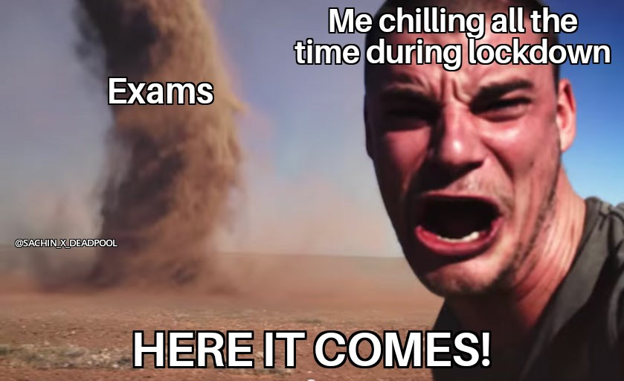
How does it work?
Platform for both teachers and students
Students are assigned to teachers in subjects: 1st grade math, Algebra
Teacher creates a class and generates a class ID that is tied to their class
Students given the assigned class key
A pre-test is taken by the student
For all questions answered incorrectly, links to additional resources will populate
Teachers can see test scores for their students along with class averages

