Slide 1


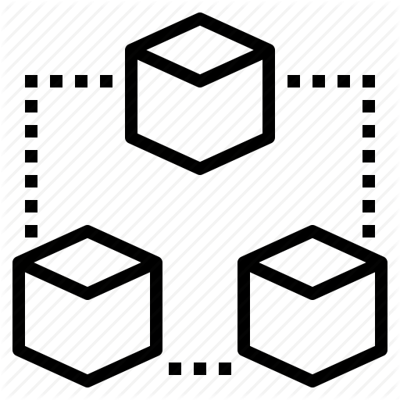


Context Diagram
NODE
Decentralized File System
File System Interface
MSP
BLOCKCHAIN
ORCHESTRATOR
Block Chain Interface
Database

Slide 2







Architecture Diagram
Ethereum Node
Decentralized File System
REST API
IPFS Interface
REST API
Orchestrator Service
Ethereum Blockchain
REST API
EVM Interface
JSON-RPC
DAO

