Slide 1



—Electrically Tunable Selective Light Absorber using Epsilon-Near-Zero InSb and High-k Dielectrics —
RIC ID: RICf6219bdb
Soham Chatterjee¹, Rajib Lochan Ghadei², Rishi Maiti³
^{1,2,3} Department of Physics
Indian Institute of Technology Guwahati, Guwahati-781039, India
Presented at:
2025 Research & Industrial Conclave (RIC 2025)
Indian Institute of Technology Guwahati, Assam, India, 10 -12 October 2025
Indian Institute of Technology Guwahati Research & Industrial Conclave 2025

Slide 2





Motivation & Background
Problem? Static optical components limit adaptability in modern photonic systems.
Solution? Electrically tunable elements enable real time control of optical properties.
How? Epsilon-Near-Zero (ENZ) materials allow strong modulation when Re(ε) → 0.
White light
Light of selective wavelength absorbed
Optical Color Filter
Switch currently off
White light
Light of different wavelength selectively absorbed
Optical Color Filter
Switch on
2

Slide 3
Objective
Design and simulate an electrically tunable selective light absorber based on n-InSb.
Compare high-k dielectrics (TiO₂, HfO₂, ZrO₂) to find optimal tunability and best absorption characteristics.
Show that on altering cavity thickness, resonant wavelength shifts from Visible to near IR range.
Demonstrate bias-dependent ENZ shift and spectrally selective absorption.
3

Slide 4
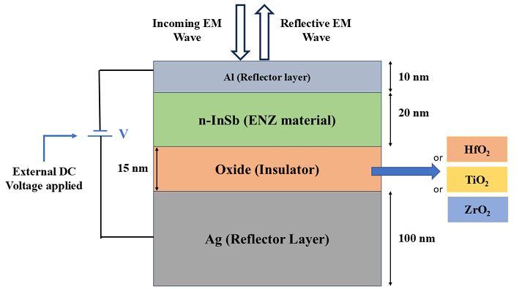
Device Architecture
Why n-InSb as ENZ?
high electron mobility
narrow bandgap
CMOS compatible
ideal for visible/IR modulation.
Active layer (ENZ+insulator) thickness and the choice of insulator determines the resonant wavelength
Electrical gating: 0 V and 15 V
Fig 1. Schematic
4

Slide 5
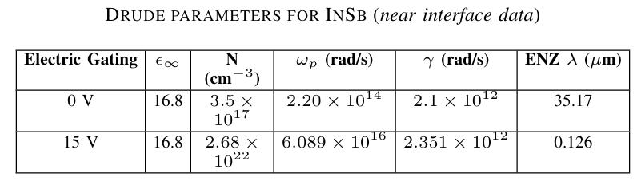
Simulation and Computational Details
Ansys Charge;
Electrostatic Simulations
Drude Model;
Compute R.I of ENZ material
Transfer Matrix Method;
Compute Reflectance Spectra
Optical data for materials were obtained from Palik
Electrical properties from Ansys Charge Materials library
Constant Dopant value of 3.5×10¹⁷ cm⁻³ was applied to InSb layer
5

Slide 6

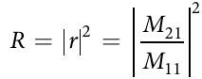
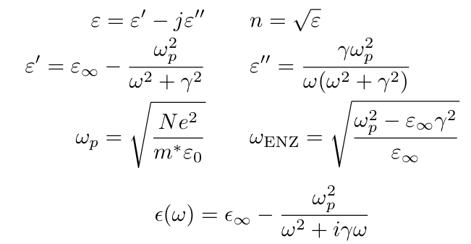
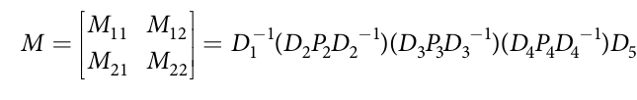
Theory
Electrostatic Calculations:
Transfer Matrix Method :
Drude Dispersion Model:
Where Mij are elements of the Overall Transfer Matrix
6

Slide 7
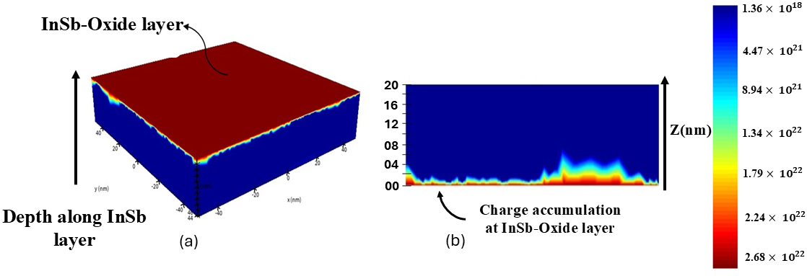

Electrostatic Simulation Results
ON 15V BIASING
15 V bias increases electron density: 3.5×10¹⁷ → 2.68×10²² cm⁻³
Strong carrier accumulation near the semiconductor–insulator interface
Carrier Concentration profile across InSb on 15V biasing
7

Slide 8
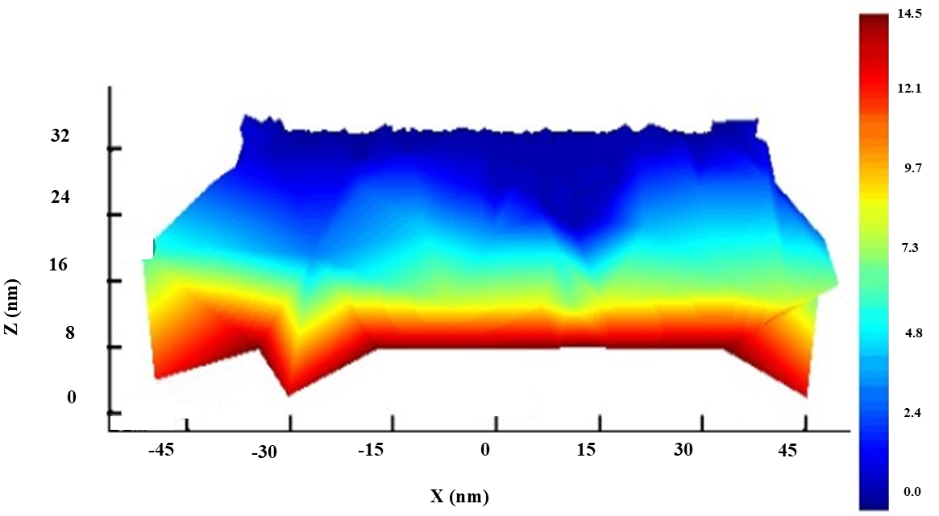

Electrostatic Simulation Results
InSb-Metal interface
ON 15V BIASING
A fraction of the total external voltage suffers a drop across the semiconductor layer.
Electrical Potential Distribution (V) for Active layer (ENZ+insulator) on 15V biasing
8

Slide 9
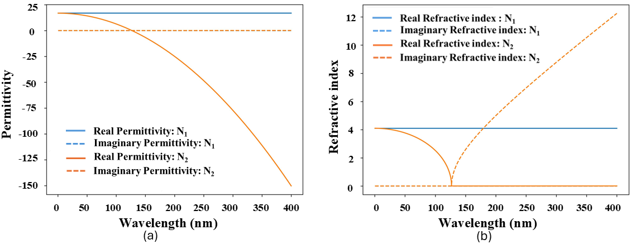
Drude Modelling Results for InSb
where N1 = 3.5 × 10^17 cm−3 and N2 = 2.68 ×10^22 cm−3.
With application of voltage bias, there is a shift of ENZ wavelength from 35.17 microns to 126 nm.
(a) Permittivity plot (b) Refractive Index plot for n-InSb
9

Slide 10
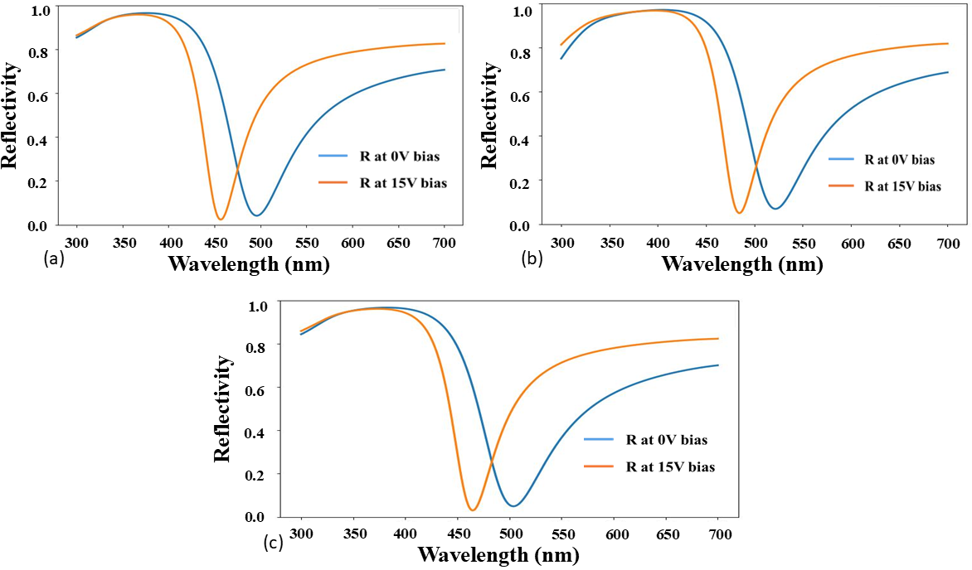
Optical Results — Visible Range
TiO₂
HfO₂
ZrO₂
10

Slide 11
Result Comparison among Dielectrics
Insulator used in the device | Resonant Wavelength On 0V biasing | Resonant Wavelength On 15V biasing | Spectral Shift (Blue Shift) | Reflectance dip at 0V biasing | Reflectance Dip at 15V biasing
HfO₂ | 520 nm | 480 nm | 40 nm | ~95.3% | ~97.6%
TiO₂ | 495 nm | 460 nm | 35 nm | ~95% | ~97%
ZrO₂ | 505 nm | 470 nm | 35 nm | ~95% | ~97%
11

Slide 12
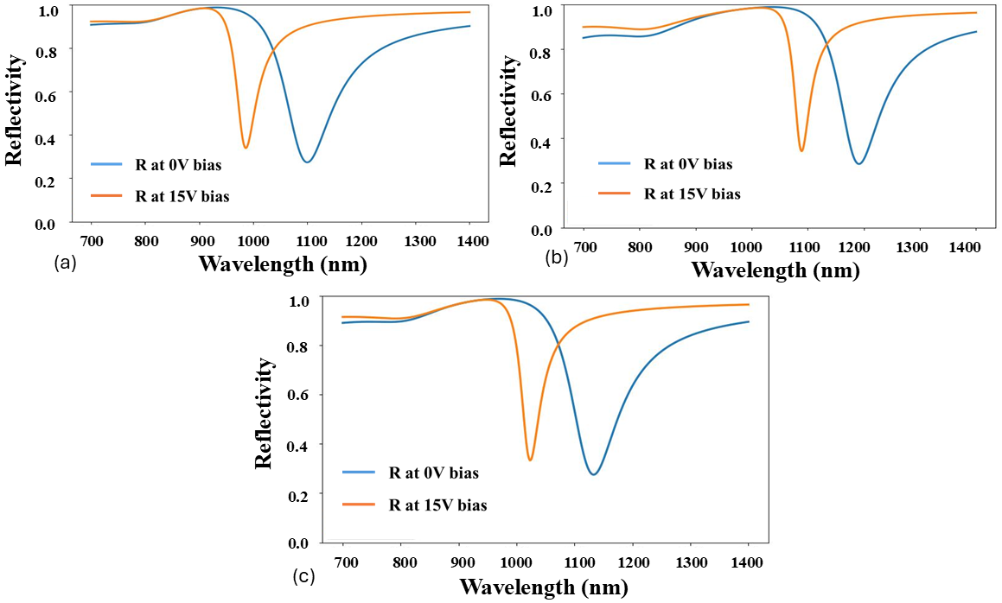
Optical Results — Near IR Range (Thicker Cavity)
HfO₂
TiO₂
Cavity thickness engineered such that semiconductor: 50 nm, insulator: 100 nm
ZrO₂
12

Slide 13
Result Comparison among Dielectrics (Thicker Cavity)
Insulator used in the device | Resonant Wavelength On 0V biasing | Resonant Wavelength On 15V biasing | Spectral Shift (Blue Shift)
HfO₂ | 1.10 microns | 895 nm | 115 nm
TiO₂ | 1.19 microns | 1.09 microns | 100 nm
ZrO₂ | 1.13 microns | 1.025 microns | 105 nm
Reflectance dip falls to 73.7% approximately.
13

Slide 14
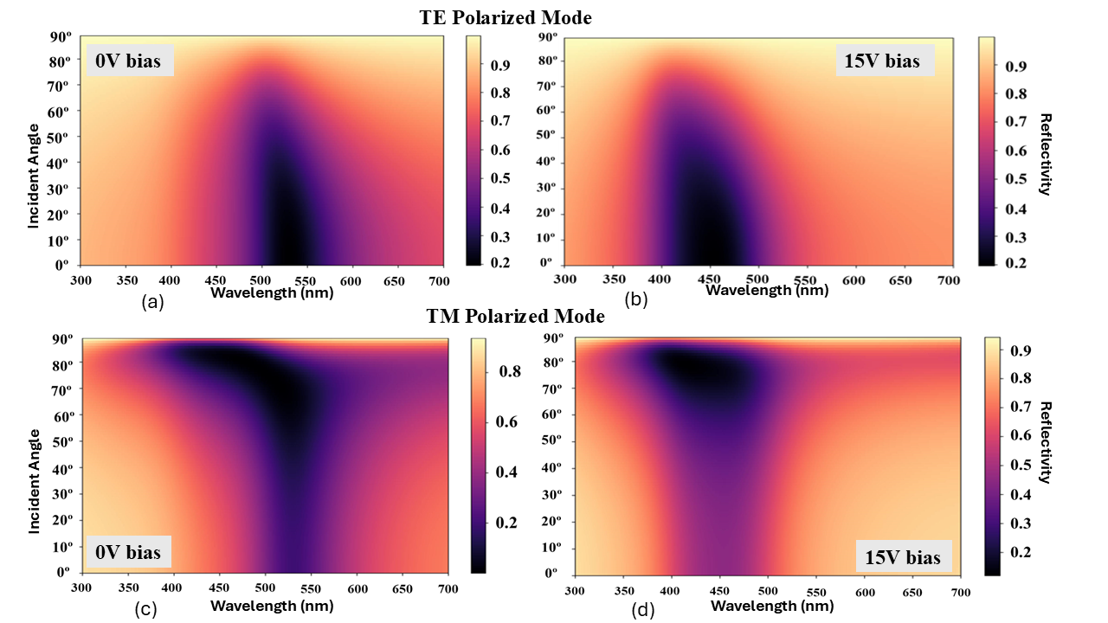
Optical Results — Incident Angle Colormap
TE and TM polarized colormaps for Device with ZrO₂ as insulator
14

Slide 15
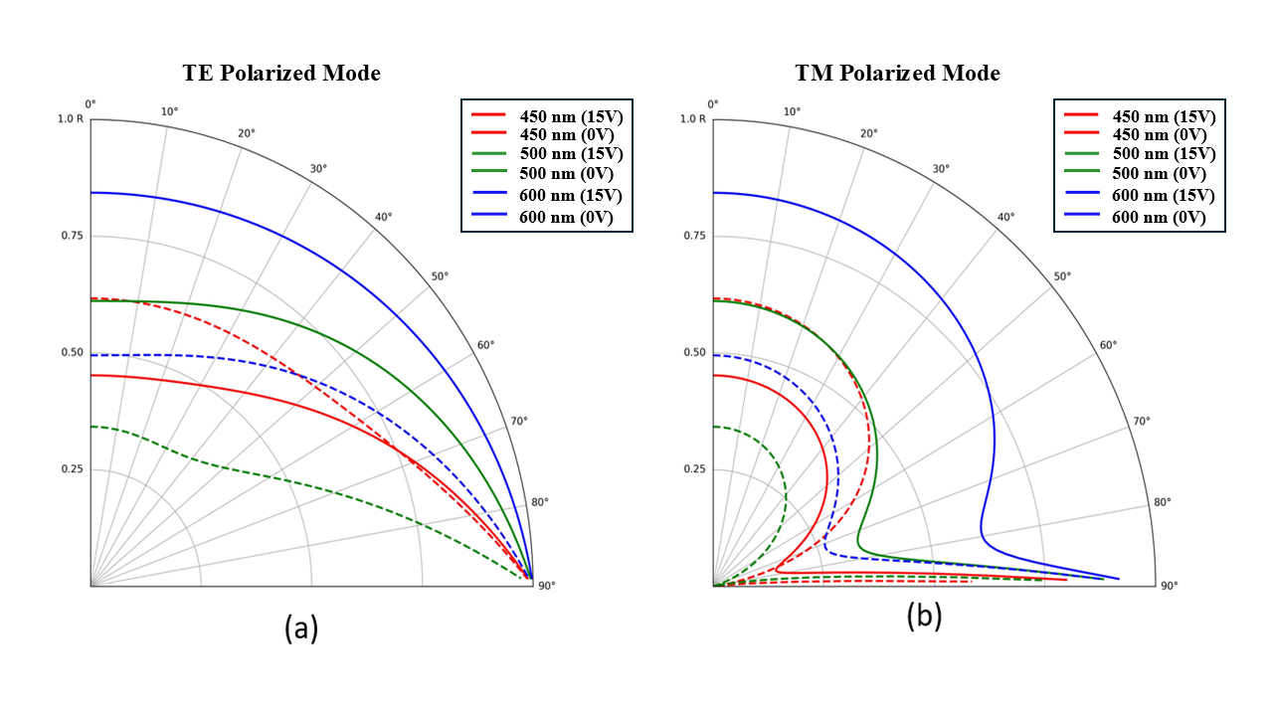
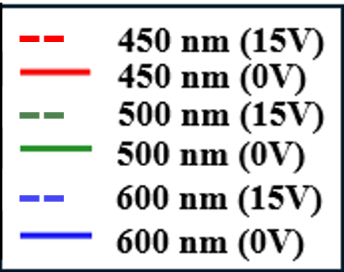
Optical Results – Polar Plot
--
TE and TM polarization analyzed using TMM.
TE mode: nearly angle-independent reflectance.
TM mode: shows pseudo-Brewster angle with sharp reflectance minimum.
--
--
Reflectance Polar Plots for TE and TM polarized modes with ZrO₂ chosen as insulator for the Device
15

Slide 16
Conclusion
Electrically tunable ENZ-InSb light absorber successfully demonstrated.
Best case achieved tunability:
40 nm (visible)
115 nm (near-IR)
The optimum tunability and absorption peak was obtained when Hafnium Oxide was chosen as the dielectric for our device architecture
Compact and CMOS-compatible design.
16

Slide 17
THANK YOU
Speaker and First Author: Soham Chatterjee
Affiliation: B.Tech Engineering Physics, IIT Guwahati (2023-2027) Email: chsoham04@gmail.com
I WOULD BE HAPPY TO TAKE ANY QUESTIONS….
17

