Slide 1
SPECTRAL LIGHT ABSORPTION IN FABRY PEROT NANOCAVITY USING MEEP

Slide 2
ABSTRACT :
Controlling the spectral absorption of light is a key objective in the development of advanced optoelectronic devices. Fabry–Perot nanocavities, constructed from thin layers of semiconductor and metal, offer a promising route to selectively enhance light absorption at specific wavelengths. By adjusting the nanocavity thickness and employing nanostructure patterning, the absorption properties can be finely tuned. These structures benefit from straightforward thin-film fabrication processes, making them cost-effective and suitable for large-scale applications without the need for complex nanopatterning. Notably, the integration of a Fabry–Perot nanocavity can yield substantial modulation of optical properties, enabling a transition from highly absorptive to highly reflective states, which is particularly attractive for applications in telecommunications and optical switching technologies. This project utilizes the Meep simulation platform to investigate and optimize the spectral absorption characteristics of Fabry–Perot nanocavities, aiming to provide insights into their design for efficient light management in optoelectronic systems.

Slide 3
INTRODUCTION AND METHODOLOGY
Thin-film structures made from alternating dielectric and metal layers can form Fabry-Perot nanocavities that enhance light absorption at specific wavelengths through optical interference. By adjusting the thickness of the semiconductor layer, the absorption peak can be tuned across ultraviolet, visible, and mid-infrared ranges. Epsilon-near-zero (ENZ) materials, such as n-type doped indium antimonide and indium tin oxide, are widely used for their tunable optical properties. These materials enable narrow and broad band absorption in nanocavity devices and are promising for applications like color filters, high-resolution displays, photodetectors, and tunable coatings, though achieving perfect tunable absorption remains challenging
In this Project, I have simulated a fabry perot cavity (structural definition described in upcoming slide) with a Gaussian Light Source at 300K using the open source Electromagnetic simulation platform MEEP. The incident light has a wavelength range of 0.4 microns to 1 microns and output plot has been obtained for Absorption and Reflectance behavior of the structure against the light source. The output plot has been obtained only for Visible region (0.55 microns to 0.75 microns) since that’s the region in which we get spectral peak absorption as per our particular structure thickness. Various models used to describe the optical properties of materials used is defined in upcoming slides.
The absorption wavelength depends on the thickness of active layer (n Insb + TiO2). The thick bottom layer of Silver ensures negligible transmission. (ie A=1-R)

Slide 4
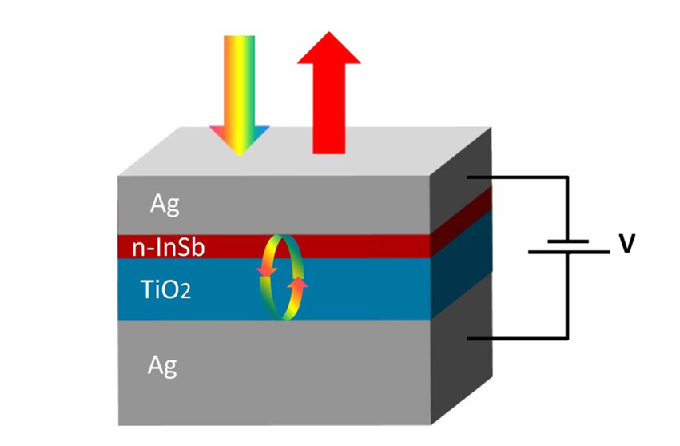
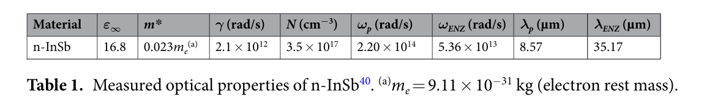
STRUCTURE IN USE:
We are using a Fabry Perot Nanocavity with the following structure definition: Silver (top layer- 35nm) / n doped Indium Antimonide (20 nm)/ dielectric TiO2 (40 nm)/ Silver (bottom layer- 100 nm)
MEEP has a predefined material package for Silver and the same has been used for the simulation. For the dielectric layer of TiO2, refractive index data had been selected from Palik Handbook of Optical Constants and the selected data had been applied a Lorentzian fitting after necessary interpolation. For n doped InSb , Drude Model has been followed with following parameters:
#Reference paper : Electrically tunable perfect light absorbers as color filters and modulators

Slide 5
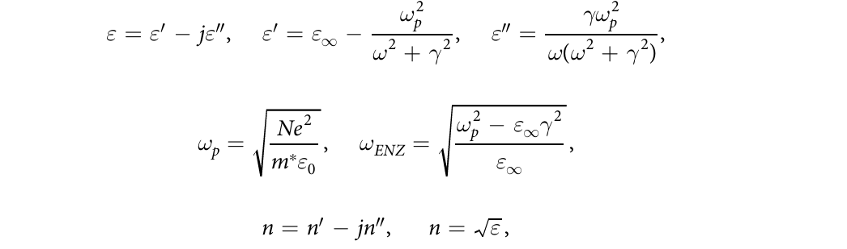
DRUDE MODEL
For the present study, the optimum ENZ material should have a real permittivity near zero in the visible or infrared region. The wavelength can be adjusted by changing the carrier density of the material via controlling the deposition conditions and doping level.
where ε′ is the real part and ε″ is the imaginary part of the complex permittivity ε. ε∞ is the permittivity at high frequencies, ω = 2πc/λ, γ is the scattering constant, ωp is the plasma frequency, and ωENZ is the ENZ frequency when ε′ = 0. In equation (2), N is the carrier density, e is the electron charge, m* is electron effective mass, and ε0 is the permittivity of vacuum. In equation (3), n is the complex refractive index of the ENZ material with a real part of n′ and an imaginary part of n″. Some metals, doped semiconductors, and metamaterials can be ENZ materials as well, with dielectric constants adequately described by the Drude model. Doped semiconductors have metal-like behavior in the infrared region similar to those of metals in the UV-visible range. For metals, ε∞ = 1 and γ ≪ ωp, and therefore the ENZ wavelength ω ENZ, where the real part of the permittivity vanishes, coincides with the plasma frequency ωp according to the Drude model. For doped semiconductors however, the plasma frequency ωp and the ENZ frequency ω ENZ are different. In this study, n-InSb (tellurium doped indium antimonide) is chosen as the ENZ mate rial, with an achievable electron carrier density of 3.5 × 10^17 cm−3 and a resulting ENZ wavelength of 35.17 µm.

Slide 6
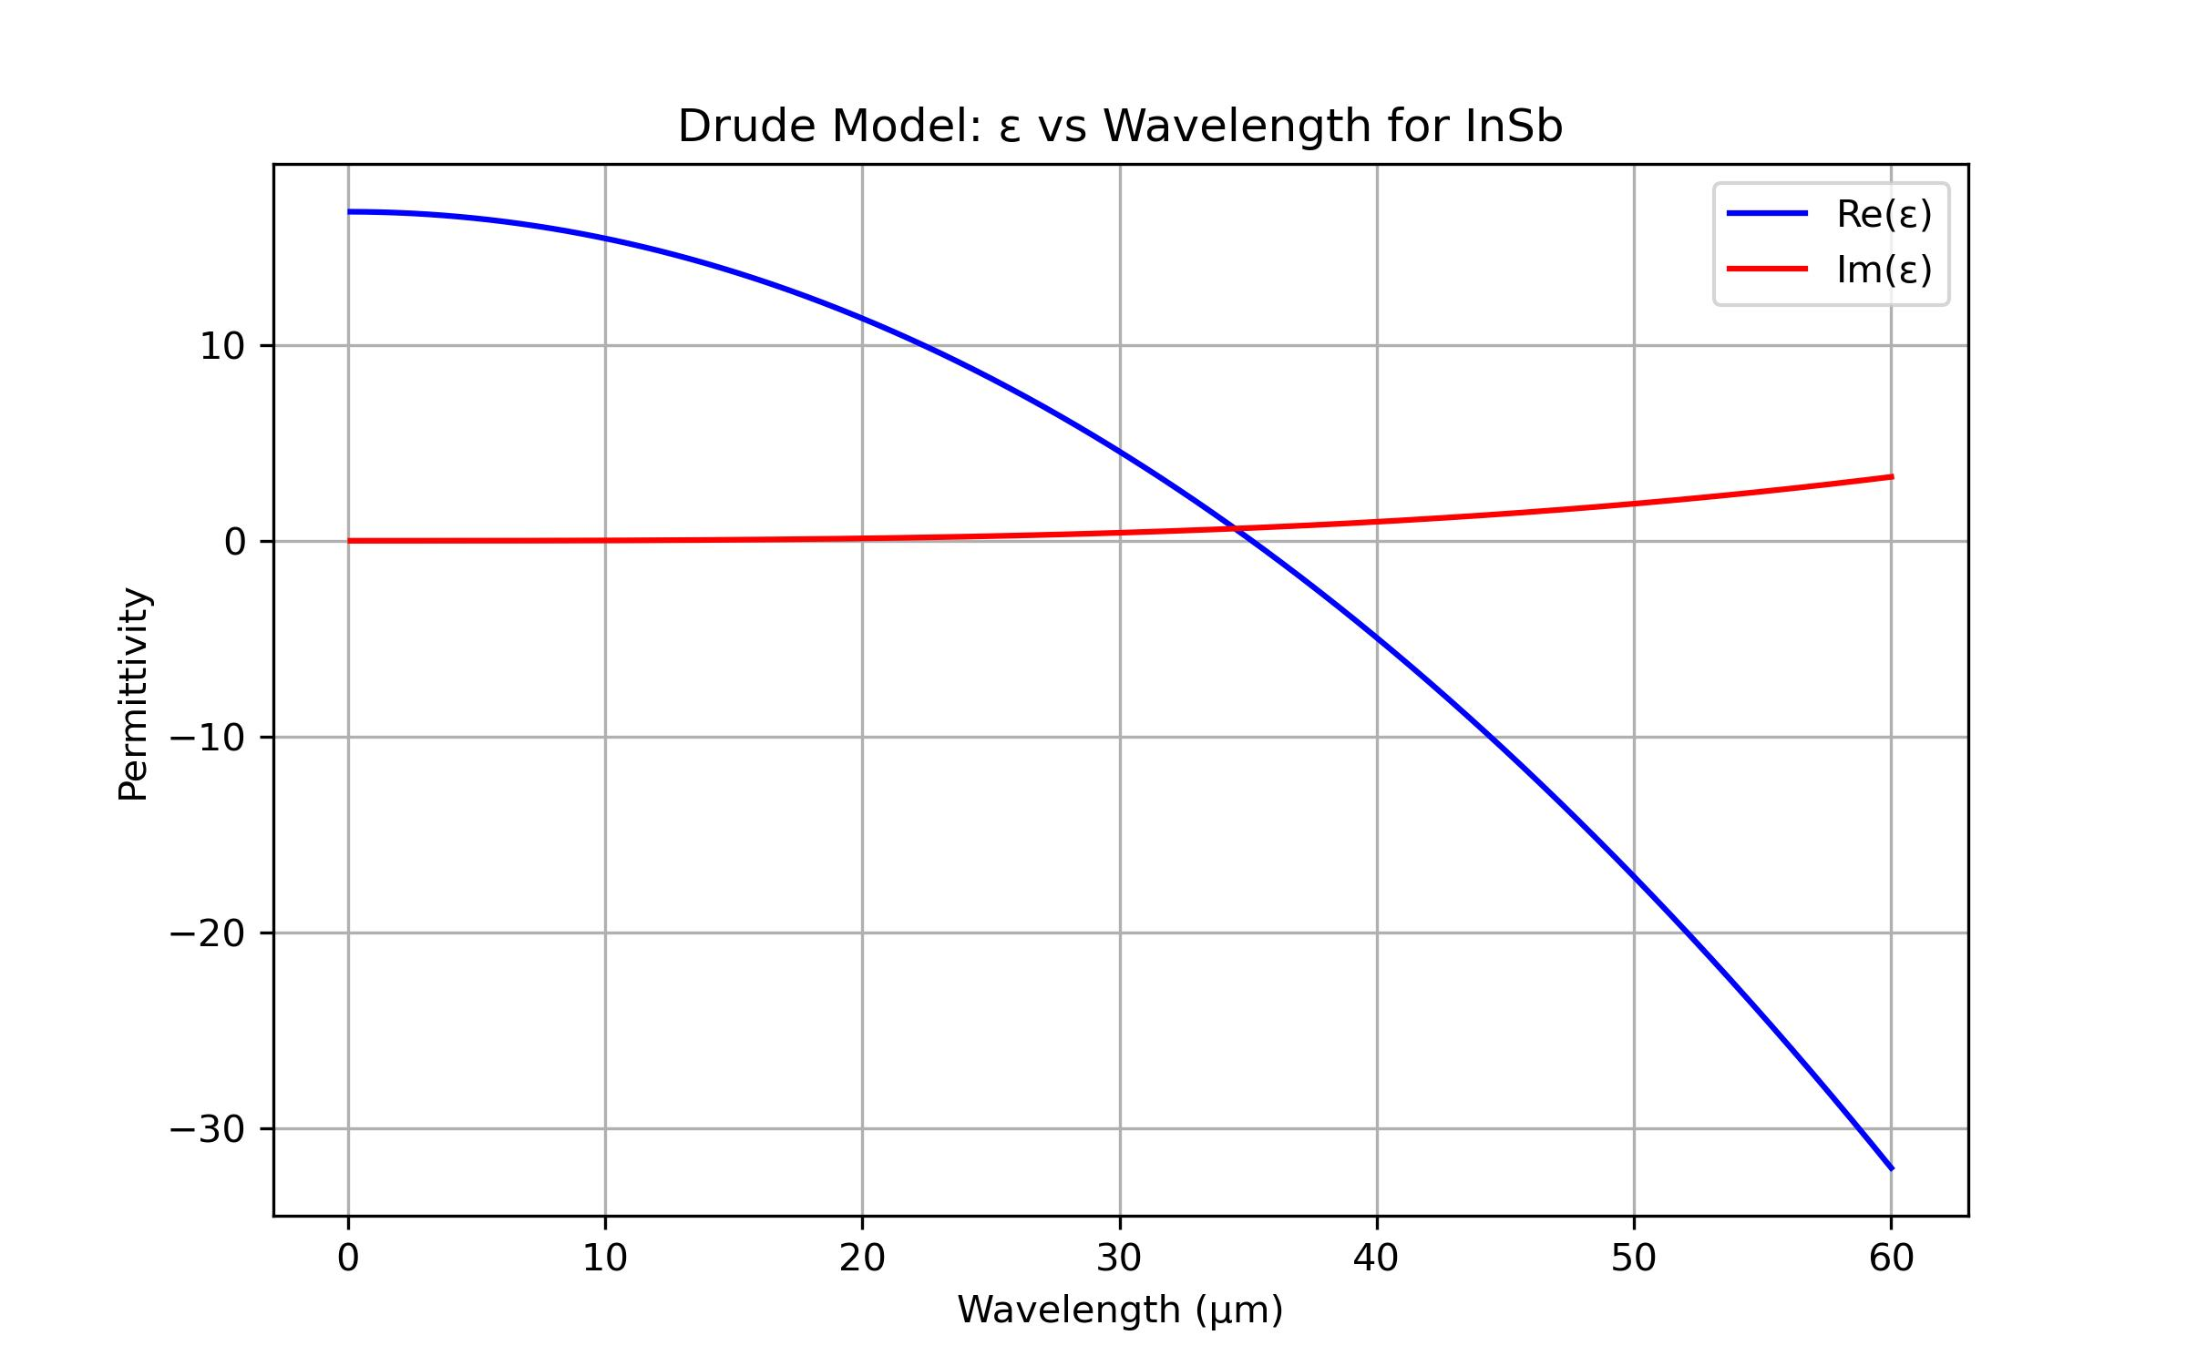
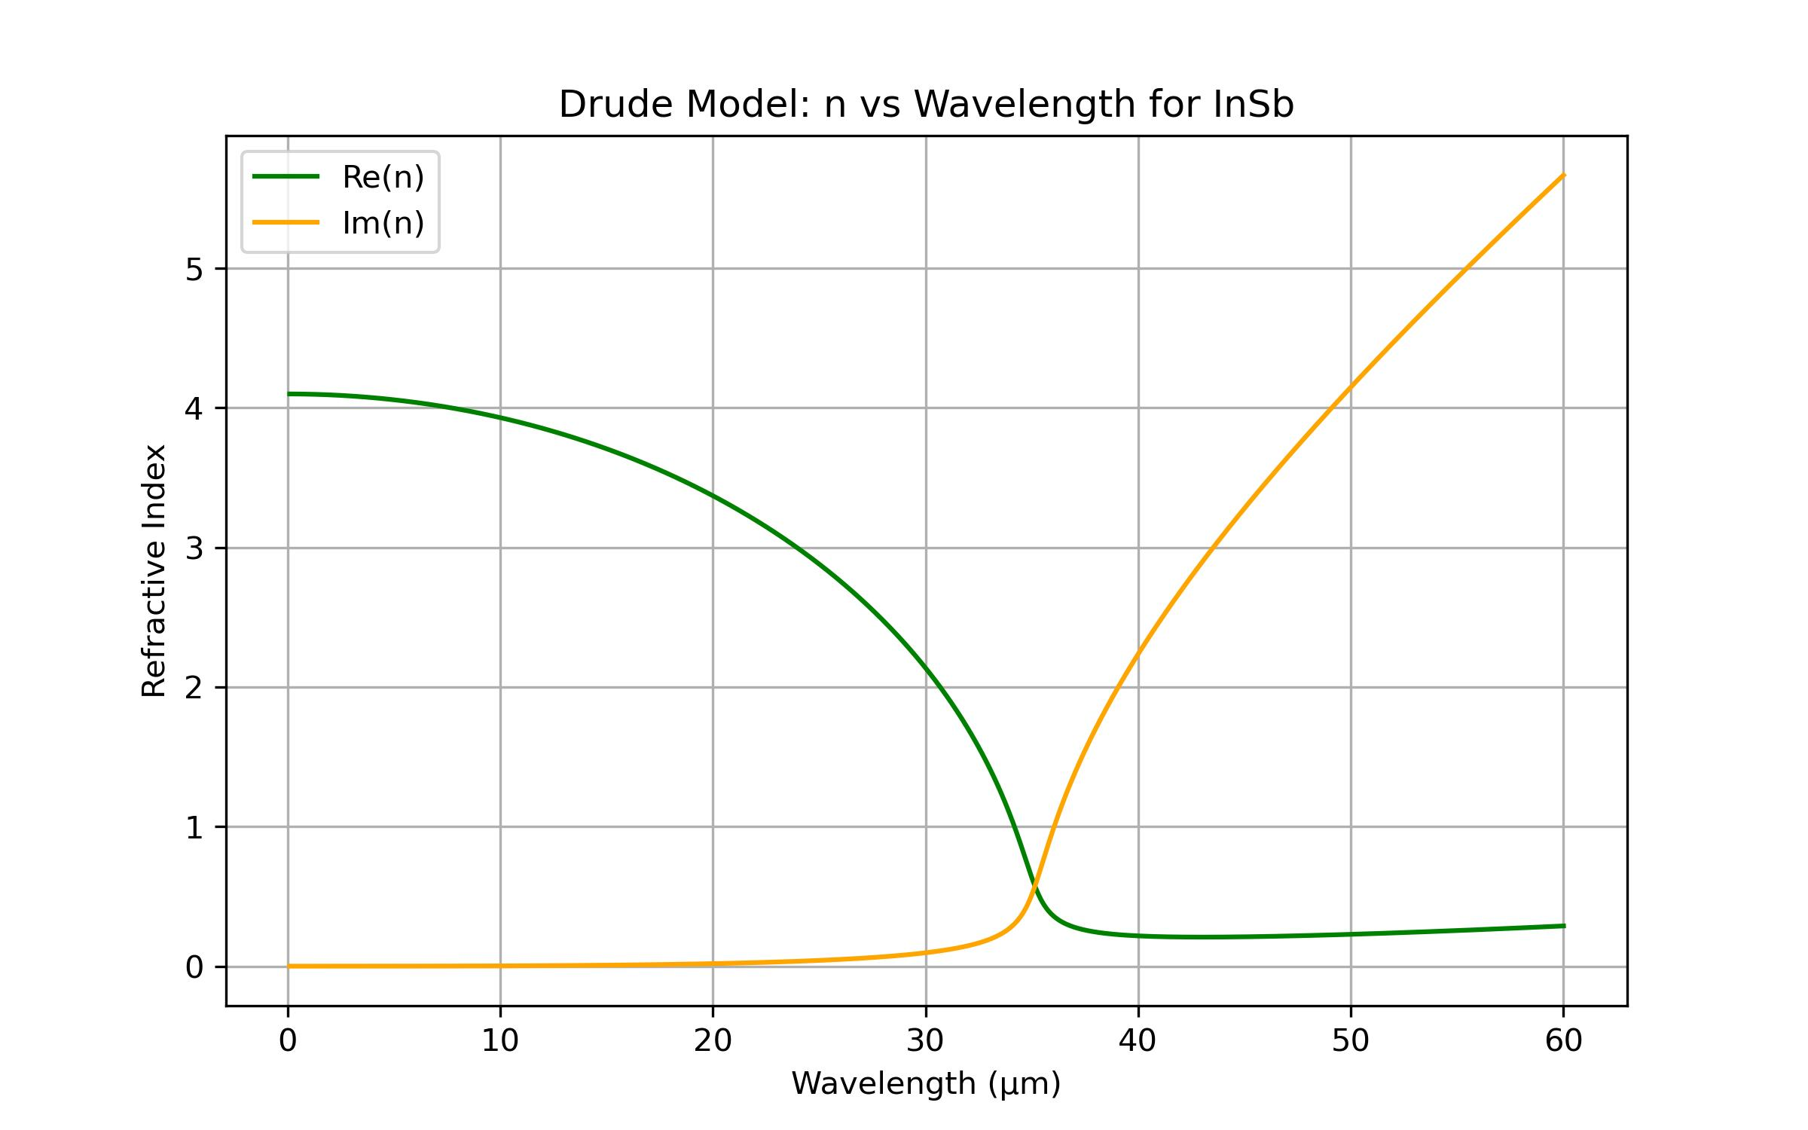
PERMITTIVITY AND REFRACTIVE INDEX OF n INSB
A Python script had been run to plot the resultant permittivity and refractive index of n InSb using the given Drude parameters. Here are the results:

Slide 7
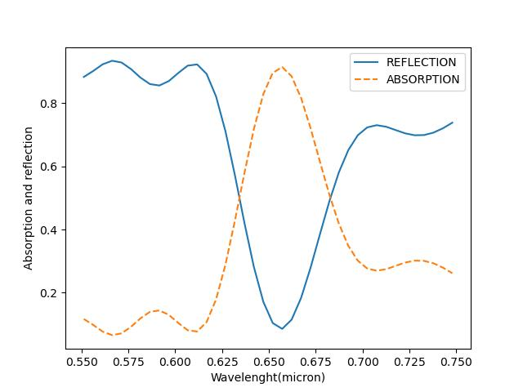
RESULTS AND CONCLUSION:
The adjoining plot clearly shows the absorption peak is obtained only for a particular wavelength, here 660 nanometres with an absorption efficiency of about 91 percentage. The predicted 91% sharp change in reflectance, transforming the device from perfectly absorbing to highly reflective, should make this technology attractive to the telecommunication (switching) industry

