Slide 1

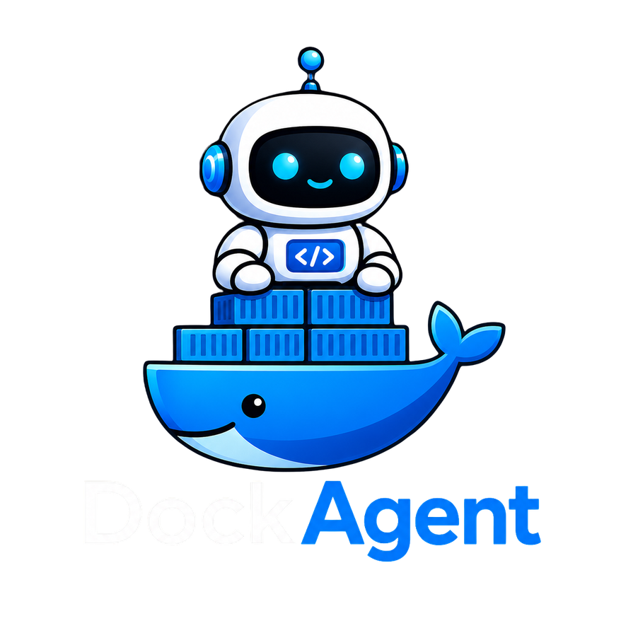
DockAgent
An LLM-Driven System for Automated Dockerfile Generation, Testing and Flakiness Repair
PRESENTED BY
A. M Samdani Mozumder | Roll: 1412
SUPERVISED BY
Mridha Md. Nafis Fuad | Lecturer
COURSE
SE 801 (SPL-3)
Notes:
1

Slide 2



Motivation
2 / 8
¹
²
26%
9.81%
100%
of GitHub Dockerfiles fail to build
of Dockerfiles exhibit build flakiness
manual effort — no automation end-to-end
Writing Dockerfiles is hard
Requires knowledge of base images, package managers, build tools, entry points unique for every project.
Builds break unexpectedly
Dependencies change, packages disappear, base images update without touching the Dockerfile itself.
No standard way to verify
A Dockerfile that builds can still produce the wrong environment, wrong version, missing binary, bad CMD.
¹ Shipwright: A Human-in-the-Loop System for Dockerfile Repair. ICSE 2021. ² Dockerfile Flakiness: Characterization and Repair. ICSE 2025 (FLAKIDOCK).
Notes:
2

Slide 3
Problem Statement
3 / 8
Setting up Docker environments is difficult, time consuming, and fragile. Developers must manually write Dockerfiles, verify the container environment is correct, and deal with builds that silently break over time all without automated tooling.
Problem 1
Problem 2
Problem 3
No Dockerfile Exists
No Correctness Guarantee
Builds Break Over Time
Developer must read the project, understand its stack, and write Docker setup from scratch. Error-prone and repetitive.
A build that succeeds does not mean the environment is right. Wrong versions, missing files, and bad configs go undetected.
Dockerfile flakiness - caused by dependency changes, expired keys, removed packages - breaks previously working setups.
Problem Statement
Notes:
3

Slide 4
Proposed Solution
4 / 8
DockAgent
A VS Code extension that automates the full Docker lifecycle from repository to a correct, tested, and stable container environment.
01
Dockerfile Generation
03
Flakiness Detection & Repair
LLM generates a Dockerfile from repository context, then iteratively patches it based on build errors until the build succeeds. Also optimises final image size.
Runs repeated builds to detect flaky behaviour, retrieves similar past repairs using RAG, and uses an LLM feedback loop to patch the Dockerfile.
02
Test Generation
04
Chat-based Assistant
Analyses Docker image layers to identify files and binaries, selects high value test targets using scoring rules, and generates CST tests to verify correctness.
VS Code sidebar panel (like Copilot Chat) that explains errors in plain language and answers questions about the Docker setup.
Unified Feedback Loop - test failures & flakiness signals feed back into Dockerfile generation
Notes:
4

Slide 5
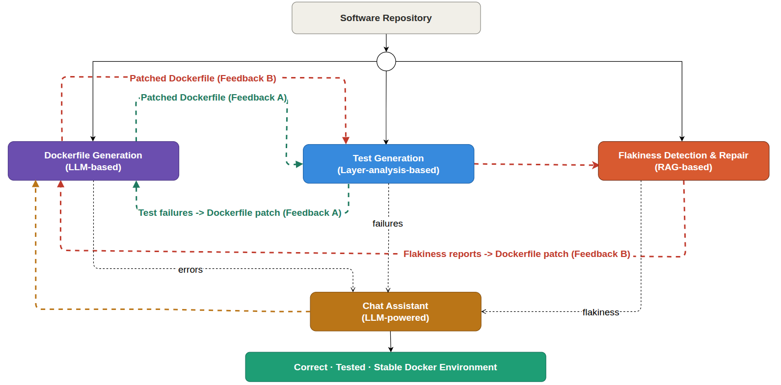
High Level Architecture
5 / 8
4 / 8
Notes:
5

Slide 6
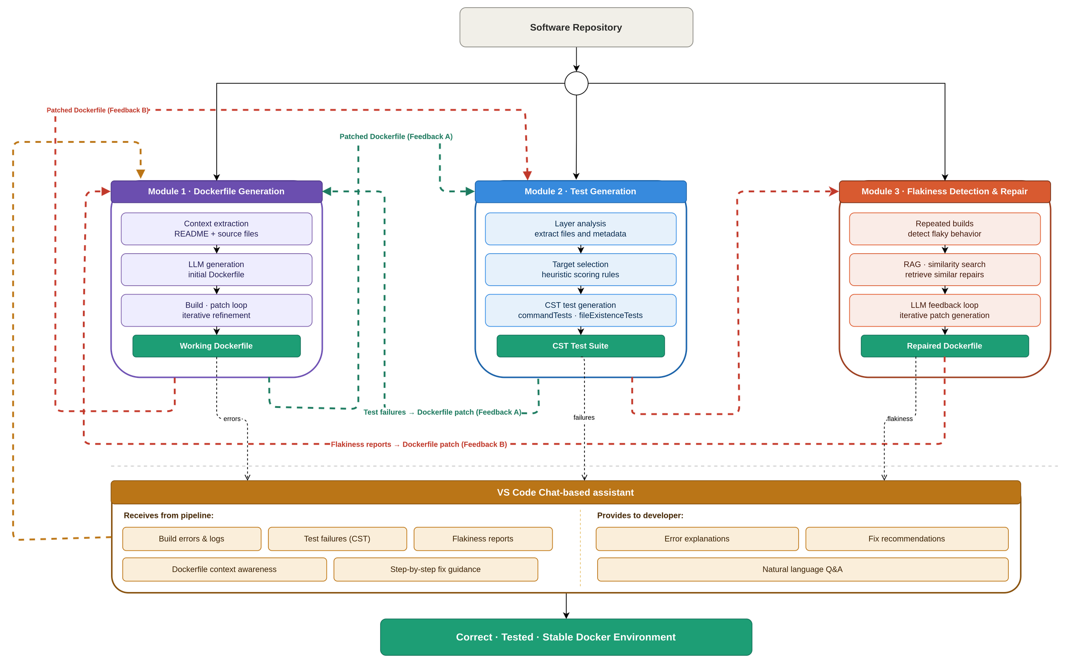
High Level Architecture
5 / 8
4 / 8
Notes:
5

Slide 7
Technologies & Tools
6 / 8
LANGUAGES
CONTAINERIZATION
TypeScript · Python
Docker
AI / LLM
RAG & VECTOR STORE
OpenAI GPT-4 / Local model
RAG & ChromaDB
BACKEND
TESTING
FastAPI
Container Structure Tests (CST)
IDE INTEGRATION
VERSION CONTROL
VS Code Extension API · Webview API
Git · GitHub
Notes:
6

Slide 8
References
7 / 8
[1]
Toward Automated Test Generation for Dockerfiles Based on Analysis of Docker Image Layers
EASE 2025
Yuki Goto, Shinsuke Matsumoto, Shinji Kusumoto
Evaluation and Assessment in Software Engineering (EASE '25), June 17–20, 2025, Istanbul, Turkey. ACM.
[2]
Dockerfile Flakiness: Characterization and Repair
ICSE 2025
Taha Shabani, Noor Nashid, Parsa Alian, Ali Mesbah
IEEE/ACM International Conference on Software Engineering (ICSE), 2025. FLAKIDOCK.
Notes:
7

Slide 9
Thank You
Notes:
8

