Slide 1

Organizational Behavior
Nineteenth Edition
Chapter 1
What Is Organizational Behavior?
Copyright © 2023, 2019, 2017 Pearson Education, Inc. All Rights Reserved
Notes:
If this PowerPoint presentation contains mathematical equations, you may need to check that your computer has the following installed:
1) MathType Plugin
2) Math Player (free versions available)
3) NVDA Reader (free versions available)
Welcome to this Organizational Behavior course that uses the 19th edition of the textbook, Organizational Behavior by Robbins and Judge. This is considered among the most widely used OB textbooks in the world. Robbins and Judge are recognized as definitive aggregators of OB concepts, applications, and practices. The course and this book will provide you with a resource that will benefit you throughout your degree program and your professional life.

Slide 2
Learning Objectives
1.1 Define organizational behavior (O B).
1.2 Show the value of systematic study to O B.
1.3 Identify the major behavioral science disciplines that contribute to O B.
1.4 Demonstrate why few absolutes apply to O B.
1.5 Identify managers’ challenges and opportunities in applying O B concepts.
1.6 Compare the three levels of analysis in this text’s O B model.
1.7 Describe the key employability skills gained from studying O B that are applicable to other majors or future careers.
Notes:
The first chapter entitled “What Is Organizational Behavior?” begins by defining seven learning objectives for the chapter. These lay a foundational understanding for the origins of OB and its applications in management and organizational existence. You should focus on this chapter to ground yourself, and as a starting place for the more complex and significant concepts throughout the book. We will elaborate on each of these objectives to ensure that you acquire a base knowledge of the core OB competencies.

Slide 3
Demonstrate the Importance of O B Skills in the Workplace
O B skills are important because…
“Good places to work” have better financial performance.
Better interpersonal skills result in lower turnover of quality employees and higher quality applications for recruitment.
There is a strong association between the quality of workplace relationships and job satisfaction, stress, and turnover.
It fosters social responsibility awareness.
Notes:
Managers need a cadre of skills to create a productive workplace, including technical and quantitative skills. However, leadership and communication skills are critical to organizational success. When managers have solid interpersonal skills, there are positive work outcomes for the organization. These outcomes include lower turnover of strong employees, improved recruitment pools for filling employment positions, and a better bottom line.

Slide 4
Describe the Manager’s Functions, Roles, and Skills (1 of 4)
Manager: someone who gets things done through other people in organizations.
Organization: a consciously coordinated social unit composed of two or more people that functions on a relatively continuous basis to achieve a common goal or set of goals.
Planning, organizing, leading, and controlling.
Notes:
A manager is someone in the organization who gets things done through the efforts of other people, while a worker is someone who contributes to the accomplishment of goals. It is important to keep in mind that an organization is defined as a social entity comprised of two or more people and can be found at any level within the organization.
The work of managers revolves around four functions: planning, organizing, leading, and controlling. When thinking about these functions, one realization comes forward: that they all involve the interpersonal skills of communication for their effective implementation.

Slide 5
Describe the Manager’s Functions, Roles, and Skills (2 of 4)
Exhibit 1.1 Mintzberg’s Managerial Roles
Role | Description
Interpersonal | Blank
Figurehead | Symbolic head; required to perform a number of routine duties of a legal or social nature
Leader | Responsible for the motivation and direction of employees
Liaison | Maintains a network of outside contacts who provide favors and information
Informational | Blank
Monitor | Receives a wide variety of information; serves as nerve center of internal and external information of the organization
Disseminator | Transmits information received from outsiders or from other employees to members of the organization
Spokesperson | Transmits information to outsiders on organization’s plans, policies, actions, and results; serves as expert on organization’s industry
Notes:
Henry Mintzberg looked at management differently when he defined the 10 roles of managers. Notice though that they again involve implementation through the interpersonal skills of communication.
In fact, if you look at the three categories of roles suggested by Mintzberg—interpersonal, informational, and decisional—you will note the distribution of communication and interpersonal skills such as tact, diplomacy, and the like, focusing on both internal and external audiences in the role’s activities. For this reason, developing the interpersonal skills introduced in this course is essential to the professional development of young professionals and is essential to managerial success.

Slide 6
Describe the Manager’s Functions, Roles, and Skills (3 of 4)
Exhibit 1.1 Mintzberg’s Managerial Roles
Role | Description
Decisional | Blank
Entrepreneur | Searches organization and its environment for opportunities and initiates projects to bring about change
Disturbance handler | Responsible for corrective action when organization faces important, unexpected disturbances
Resource allocator | Makes or approves significant organizational decisions
Negotiator | Responsible for representing the organization at major negotiations
Source: H. Mintzberg, The Nature of Managerial Work, 1st ed., © 1973, pp. 92–93. Reprinted and electronically reproduced by permission of Pearson Education, Inc., New York, N Y.
Notes:
Henry Mintzberg looked at management differently when he defined the 10 roles of managers. Notice though that they again involve implementation through the interpersonal skills of communication.
In fact, if you look at the three categories of roles suggested by Mintzberg—interpersonal, informational, and decisional—you will note the distribution of communication and interpersonal skills such as tact, diplomacy, and the like, focusing on both internal and external audiences in the role’s activities. For this reason, developing the interpersonal skills introduced in this course is essential to the professional development of young professionals and is essential to managerial success.

Slide 7
Describe the Manager’s Functions, Roles, and Skills (4 of 4)
Management Skills
Technical Skills – the ability to apply specialized knowledge or expertise. All jobs require some specialized expertise, and many people develop their technical skills on the job.
People Skills – the ability to work with, understand, and motivate other people.
Conceptual Skills – the mental ability to analyze and diagnose complex situations.
Notes:
What skills do managers need to effectively achieve their goals? Researchers have identified several skills that set successful managers apart from their less effective counterparts. These include technical skills, human skills, and conceptual skills.

Slide 8
Effective Versus Successful Managerial Activities (1 of 2)
Luthans and his associates found that all managers engage in four managerial activities:
Traditional management
Communication
Human resource management
Networking
Notes:
Luthans and his research associates found that all managers engage in four managerial activities.
Traditional management is decision making, planning, and controlling. The average manager spent 32 percent of his or her time performing this activity.
Communication involves exchanging routine information and processing paperwork. The average manager spent 29 percent of his or her time performing this activity.
Human resource management includes motivating, disciplining, managing conflict, staffing, and training. The average manager spent 20 percent of his or her time performing this activity.
Networking is socializing, politicking, and interacting with outsiders. The average manager spent 19 percent of his or her time performing this activity.

Slide 9
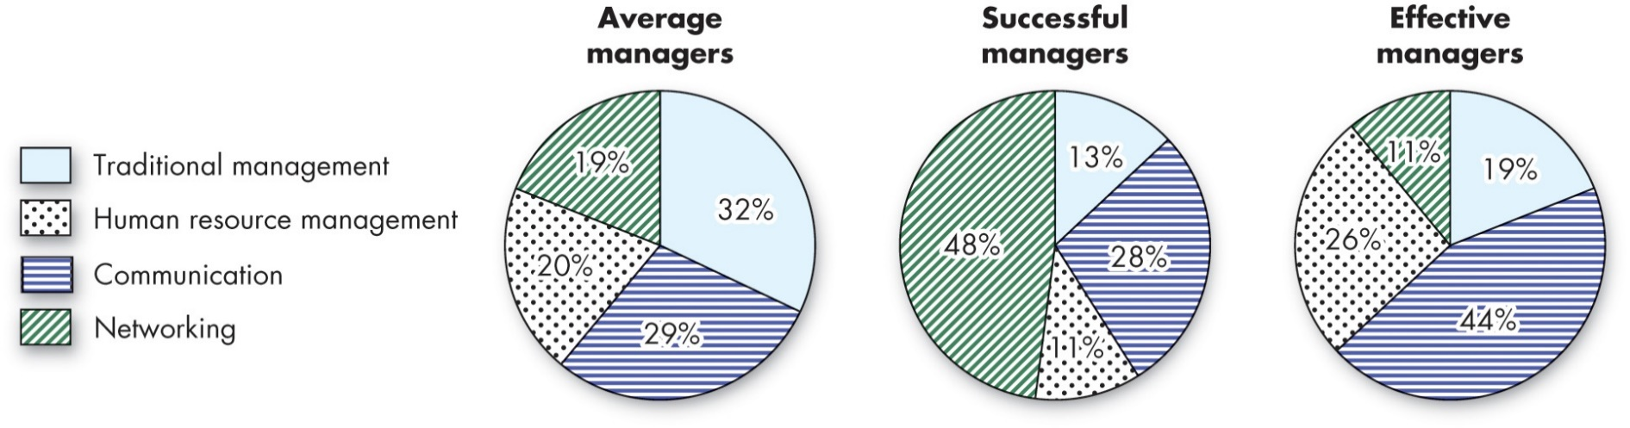
Effective Versus Successful Managerial Activities (2 of 2)
Exhibit 1.2 Allocation of Activities by Time
Source: Based on F. Luthans, R. M. Hodgetts, and S. A. Rosenkrantz, Real Managers (Cambridge, M A: Ballinger, 1988).
Notes:
Managers who were high performing in these activities were found to be fast-tracked through organizational promotion.
Long Description:
Data from the pie charts in the format activities: percentage is as follows.
Results of average managers. Traditional management: 32 percent. Communication: 29 percent. Human resource management: 20 percent. Networking: 19 percent.
Results of successful managers. Networking: 48 percent. Communication: 28 percent. Traditional management: 13 percent. Human resource management: 11 percent.
Results of effective managers. Communication: 44 percent. Human resource management: 26 percent. Traditional management: 19 percent. Networking: 11 percent.

Slide 10
Define Organizational Behavior
Organizational behavior (O B) is a field of study that investigates the impact that individuals, groups, and structure have on behavior within organizations for the purpose of applying such knowledge toward improving an organization’s effectiveness.
Notes:
Organizational behavior (OB) is a field of study that investigates the impact that individuals, groups, and structure have on behavior within organizations for the purpose of applying such knowledge toward improving an organization’s effectiveness. More specifically, OB explores motivation, leader behavior and power, interpersonal communication, group structure and processes, attitude development and perception, change processes, conflict and negotiation, and work design.

Slide 11
Complementing Intuition with Systematic Study
Systematic Study of Behavior
Behavior generally is predictable if we know how the person perceived the situation and what is important to the person.
Evidence-Based Management (E B M)
Complements systematic study.
Argues for managers to make decisions based on evidence.
Intuition
Systematic study and E B M add to intuition, or those “gut feelings” about “why I do what I do” and “what makes others tick.”
If we make all decisions with intuition or gut instinct, we’re likely working with incomplete information.
Notes:
Many people say that the ideas and concepts of OB are commonsense. However, the systematic study of OB has come closer to finding ways to predict the behavior of individuals and groups through an understanding of the situation and composition of the people. Evidence-based management (EBM) complements systematic study by basing managerial decisions on the best available scientific evidence.
“Intuition” is a decision-making approach advocated by numerous managers and pundits. However, if we make all decisions with intuition or gut instinct, we are likely working with incomplete information. EBM and the systematic study of behavior enhance the understanding of these internal contributors to organizational behavior.

Slide 12
Big Data
Background:
The use of Big Data for managerial practices is a relatively new area, but one that holds convincing promise.
Current Usage:
The reasons for data analytics include predicting any event, detecting how much risk is incurred at any time, and preventing catastrophes.
New Trends:
The use of Big Data for understanding, helping, and managing people is relatively new but holds promise.
Limitations:
Use evidence as much as possible to inform your intuition and experience.
Notes:
The recent availability of “big data” shows promise for the field of OB, potentially providing evidence that can be used to support intuition and experience.

Slide 13
Identify the Major Behavioral Science Disciplines That Contribute to O B (1 of 4)
Organizational behavior is an applied behavioral science that is built upon contributions from a number of behavioral disciplines:
Psychology
Social psychology
Sociology
Anthropology
Notes:
OB is a behavioral social science that merges concepts from a number of different social sciences to apply specifically to the organizational setting at both the individual (or micro) and group (or macro) levels. The most significant social sciences are psychology, social psychology, sociology, and anthropology. Look at each for a moment.

Slide 14
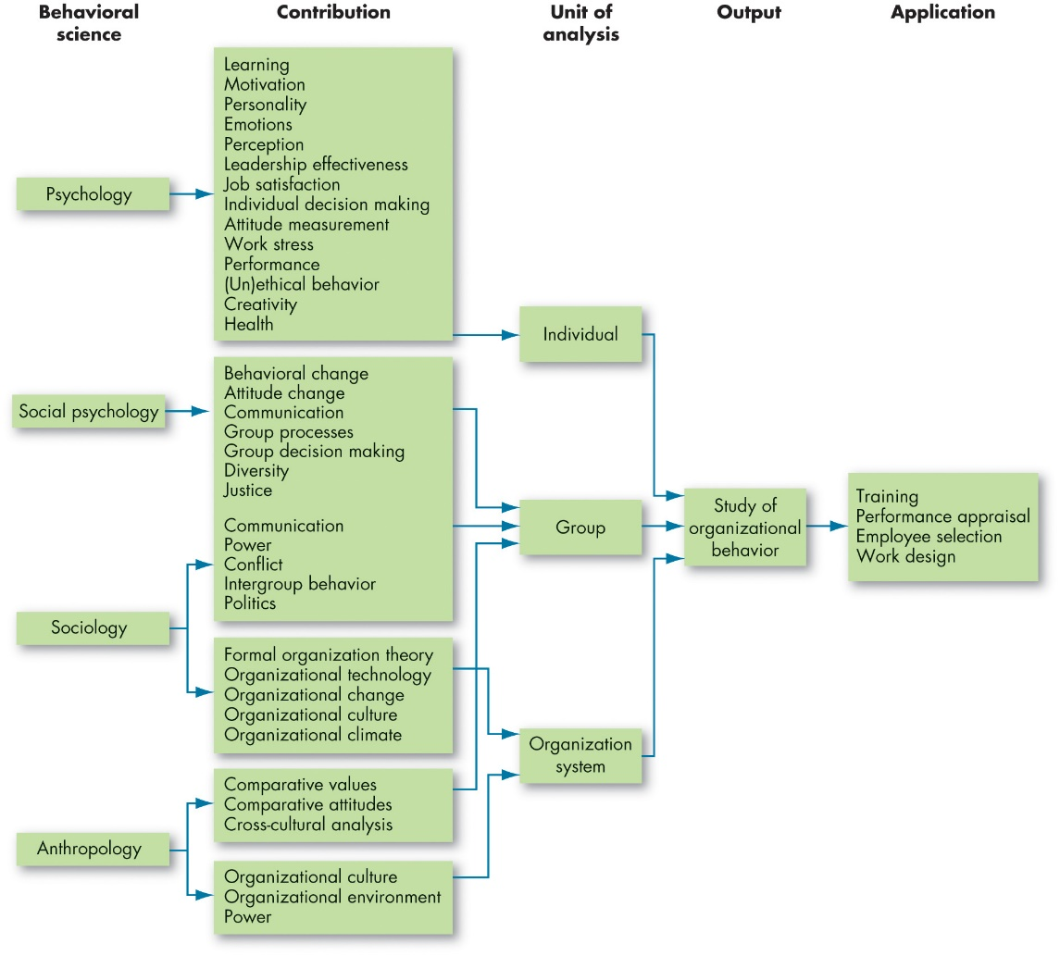
Identify the Major Behavioral Science Disciplines That Contribute to O B (2 of 4)
Exhibit 1.3 Toward an O B Discipline
Notes:
This exhibit shows the contributions made by other disciplines to the development of organizational behavior. Notice the predominant areas of psychology, social psychology, sociology, and anthropology. Each of the disciplines has contributed specific concepts and theories to the study of OB and its increasing applications.
Long Description:
The predominant areas of behavioral science are psychology, social psychology, sociology, and anthropology.
Psychology contributes to learning, motivation, personality, emotions, perceptions, leadership effectiveness, job satisfaction, individual decision making, attitude measurement, work stress, performance, (un)ethical behavior, creativity and health. This then flows to the individual unit of analysis.
Social psychology contributes to behavioral change, attitude change, communication, group processes, group decision making, diversity, justice, communication, power, conflict, intergroup behavior and politics. This leads to group analysis.
Sociology contributes communication, power, conflict, intergroup behavior and politics which leads to group analysis and formal organization theory, organizational technology, organizational change, organizational culture and organizational climate which leads to organizational system analysis.
Anthropology contributes to comparative values, comparative attitudes and cross-cultural analysis that leads to the group analysis and organizational culture, organizational environment and power that leads to organization system analysis.
The individual, group and organizational system analyses leads to the output of studying the organizational behavior which in turn leads to the following applications: training, performance appraisal, employee selection, and work design.

Slide 15
Identify the Major Behavioral Science Disciplines That Contribute to O B (3 of 4)
Psychology
seeks to measure, explain, and sometimes change the behavior of humans and other animals.
Social psychology
blends the concepts of psychology and sociology.
Notes:
Psychology focuses on the individual level by seeking to measure, explain, and sometimes change behaviors in individuals. This area of study offers insights into such areas as learning, training, decision-making, and employee selection.
Social psychology moves beyond individual analysis to look at group behavior and how individuals can influence one another. It blends together sociology and psychology and looks primarily at change, communication, and group interactions.

Slide 16
Identify the Major Behavioral Science Disciplines That Contribute to O B (4 of 4)
Sociology
studies people in relation to their social environment or culture.
Anthropology
is the study of societies to learn about human beings and their activities.
Notes:
Sociology looks at the relationship between people and their environment. Sociologists’ main contribution to OB has been a better understanding of group behavior, particularly in formal and complex organizations. Another key area that sociologists contribute to in OB is organizational culture, a key factor in OB studies.
Anthropologists study societies to learn about human beings and their activities. They help us understand the differences between different groups in terms of their values, attitudes, and behaviors.

Slide 17
Demonstrate Why Few Absolutes Apply to O B
There are few, if any, simple and universal principles that explain organizational behavior.
Contingency variables situational factors are variables that moderate the relationship between the independent and dependent variables.
Notes:
There are few absolutes in organizational behavior. When making decisions, you must always take into account the situational factors that can change the relationship between two variables. Every situation has the potential to have unseen factors or even known factors that can change rapidly. Opening your minds to detecting these changes and unseen factors, and to being ready with optional responses, is essential to effective management.

Slide 18
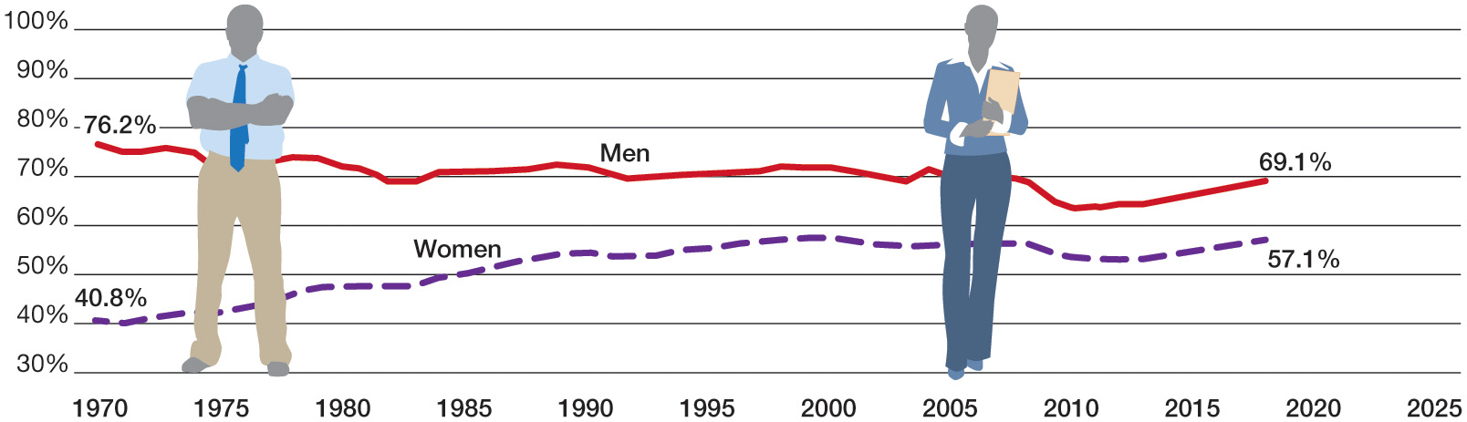
Identify the Challenges and Opportunities of O B Concepts (1 of 10)
OB POLL Percentage of Men and Women Working
Sources: Based on U.S. Bureau of Labor Statistics, “Women in the Labor Force: A
Datebook,” 2019,
https://www.bls.gov/opub/reports/womensdatabook/2019/home.htm
Notes:
As students of OB, we can investigate what factors lead employees to make various choices and how their experiences affect their perceptions of their workplaces. In turn, this can help us predict organizational outcomes. As shown in the OB Poll for example, the days when women stayed home because it was expected are just a memory in some cultures, while in others, women still face significant barriers to entry into the workplace.
Long Description:
The horizontal axis is marked with years and ranges from 1970 to 2025 in increments of 5. The vertical axis is labeled with the percentage of working men and women and ranges from 30 percent to 100 percent in increments of 10 percent. The approximate data from the graph is as follows. The line for men starts from 76.2 percent in 1970 and has a decreasing and fluctuating trend till 69.1 percent in 2018. The lowest peak is at 62.5 percent in 2010. The line for women starts at 40.8 percent in 1970, grows with fluctuations and increases gradually till 57.1 percent in 2018.

Slide 19
Identify the Challenges and Opportunities of O B Concepts (2 of 10)
Managing workforce diversity
Workforce diversity – organizations are becoming more heterogeneous in terms of gender identity, age, race, ethnicity, sexual orientation, and other characteristics
Workforce inclusion – creating and maintaining workplaces that support and leverage their members’ diversity.
Notes:
We are seeing more and more heterogeneity in the workplace. Managers today need to embrace diversity and find ways to manage it effectively. The changing demographics have shifted management philosophy in a way that recognizes and utilizes differences to create productivity, profitability, and welcoming workplace cultures.

Slide 20
Identify the Challenges and Opportunities of O B Concepts (3 of 10)
Responding to globalization
Increased expatriate assignments.
Expatriate – person who works outside their native country.
Working with people from different cultures.
Notes:
Globalization means that organizations now exist in an environment with no national borders. As a result, the manager’s job has changed. Managers today need to have a broader perspective when making decisions.
As foreign assignments increase, you will need to be able to manage a workforce that is different than what you may be used to, and which may bring different needs, aspirations, and attitudes to the workplace.
You will also have individuals who come from different cultures coming to work in your own country. You will need to find ways to accommodate their needs and help them assimilate to your workplace culture.
As more jobs move to countries with low-cost labor, managers will need to balance the needs of their organizations with the needs of the countries in which they operate.
In the new global village, managers need to understand the implications of differing cultural and legal practices on their operations. Violating local regulations and practices could have serious consequences for the organization.

Slide 21
Identify the Challenges and Opportunities of O B Concepts (4 of 10)
Using technology and social media at work
Policies on accessing social media at work.
When, where, and for what purpose.
Impact of social media on employee well-being.
“Always-on” culture of the virtual workplace.
Making virtual workers a part of the team.
Achieving work-life balance.
Notes:
Social media is a difficult issue for today’s manager, presenting both a challenge and an opportunity for OB.
Advances in technology have facilitated a virtual workplace, but in doing so, new challenges are created. For example, virtual workers may feel that they are not part of the team.
Achieving a work–life balance is harder in an “always-on” culture.

Slide 22
Identify the Challenges and Opportunities of O B Concepts (5 of 10)
Improving ethical behavior
Ethical dilemmas and ethical choices are situations in which an individual is required to define right and wrong conduct.
Good ethical behavior is not so easily defined.
Managers need to create an ethically healthy climate.
Ethics training
Notes:
Increased scrutiny by society and governmental entities has increased business concerns with ethical behavior. Lapses in ethical behavior have resulted in everything ranging from public sanctions against businesses to legal penalties against a firm and its managers.
Ethical dilemmas require managers to make decisions involving right and wrong conduct. Managers and leaders must clearly define what constitutes appropriate, ethical behavior by the organization and its people, and they must lead by example.

Slide 23
Identify the Challenges and Opportunities of O B Concepts (6 of 10)
Practicing corporate social responsibility (C S R)
Environmental sustainability initiatives
Nonprofit work
Volunteering
Charitable giving
Sustainability training and development
Triple bottom line: people, planet, revenue
Notes:
Committing to corporate social responsibility (CSR) has become increasingly important in the working world.
CSR is good for the planet and for people. In fact, CSR positively affects worker attitudes, turnover intentions, and performance. It can encourage workers to identify more strongly with their organizations and experience a sense of meaningfulness. CSR also positively impacts the bottom line.
Keep in mind though, that not all efforts are equally meaningful for employees, even though participation is often expected or even prescribed. Pressuring people to engage in CSR when it’s not a good fit for them can backfire.

Slide 24
Identify the Challenges and Opportunities of O B Concepts (7 of 10)
Creating a positive work environment
Positive organizational scholarship is concerned with how organizations develop human strength, foster vitality and resilience, and unlock potential.
This field of study focuses on employees’ strengths versus their limitations, as employees share situations in which they performed at their personal best.
Notes:
Creating a positive work environment has been found to be a basis for employee satisfaction, increased productivity, and longevity of skilled personnel.
Positive organizational scholarship studies what is “good” about organizations.

Slide 25
Identify the Challenges and Opportunities of O B Concepts (8 of 10)
Responding to the Gig Economy
Independent and autonomous work
“a company of one”
Notes:
About one-fifth of American workers are part of the Gig Economy. For many workers, this translates into financial instability, job insecurity, and career path uncertainty. At the same time, the autonomy inherent in the Gig Economy gives many workers flexibility in their location of work and their schedule.

Slide 26
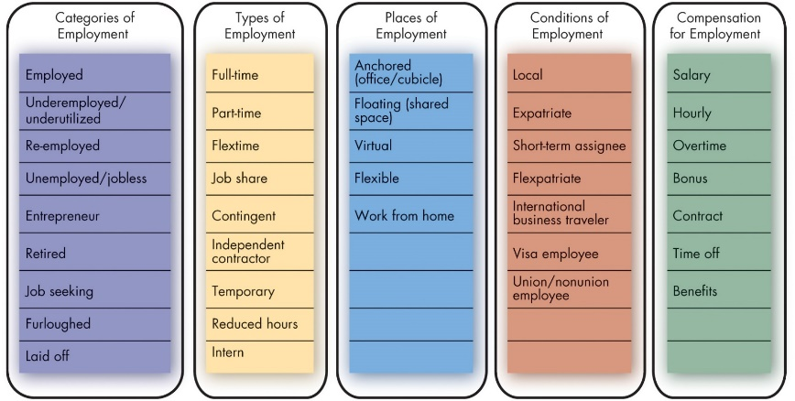
Identify the Challenges and Opportunities of O B Concepts (9 of 10)
Exhibit 1.4 Employment Characteristics in the Gig Economy
Sources: Based on J. R. Anderson, E. Binney, N. M. Davis, G. Kraft, S. Miller, T. Minton-Eversole,... and A. Wright, “Action Items: 42 Trends Affecting Benefits, Compensation, Training, Staffing and Technology,” HR Magazine (January 2013): 33; M. Dewhurst, B. Hancock, and D. Ellsworth, “Redesigning Knowledge Work,” Harvard Business Review (January–February 2013): 58–64; E. Frauenheim, “Creating a New Contingent Culture,” Workforce Management (August 2012): 34–39; N. Koeppen, “State Job Aid Takes Pressure off Germany,” The Wall Street Journal, February 1, 2013, A8; and M. A. Shaffer, M. L. Kraimer, Y.-P. Chen, and M. C. Bolino, “Choices, Challenges, and Career Consequences of Global Work Experiences: A Review and Future Agenda,” Journal of Management (July 2012): 1282–27.
Notes:
About one-fifth of American workers are part of the Gig Economy. For many workers, this translates into financial instability, job insecurity, and career path uncertainty. At the same time, the autonomy inherent in the Gig Economy gives many workers flexibility in their location of work and their schedule.
Long Description:
Categories of employment lists the following: employed, underemployed or underutilized, re-employed, unemployed or jobless, entrepreneur, retired, job seeking, furloughed, and laid off.
Types of employment lists the following: full-time, part-time, flextime, job share, contingent, independent contractor, temporary, reduced hours and intern.
Places of employment lists the following: anchored in office or cubicle, floating in shared space, virtual, flexible and work from home.
Conditions of employment list the following: Local, expatriate, short-term assignee, flexpatriate, international business traveler, visa employee, and union or nonunion employee.
Compensation for employment lists salary, hourly, overtime, bonus, contract, time off, and benefits.

Slide 27
Identify the Challenges and Opportunities of O B Concepts (10 of 10)
Managing crises
The differences between good and bad management can be the differences between profit and loss or survival or failure.
How can we use our knowledge of workplace behavior to inform decision making during crises?
Notes:
Managing during crises is just as hard, if not harder, than managing during good times. In good times, managers focus on how to reward, satisfy, and retain employees. In bad times, the focus shifts to issues like stress, decision making, and coping.

Slide 28
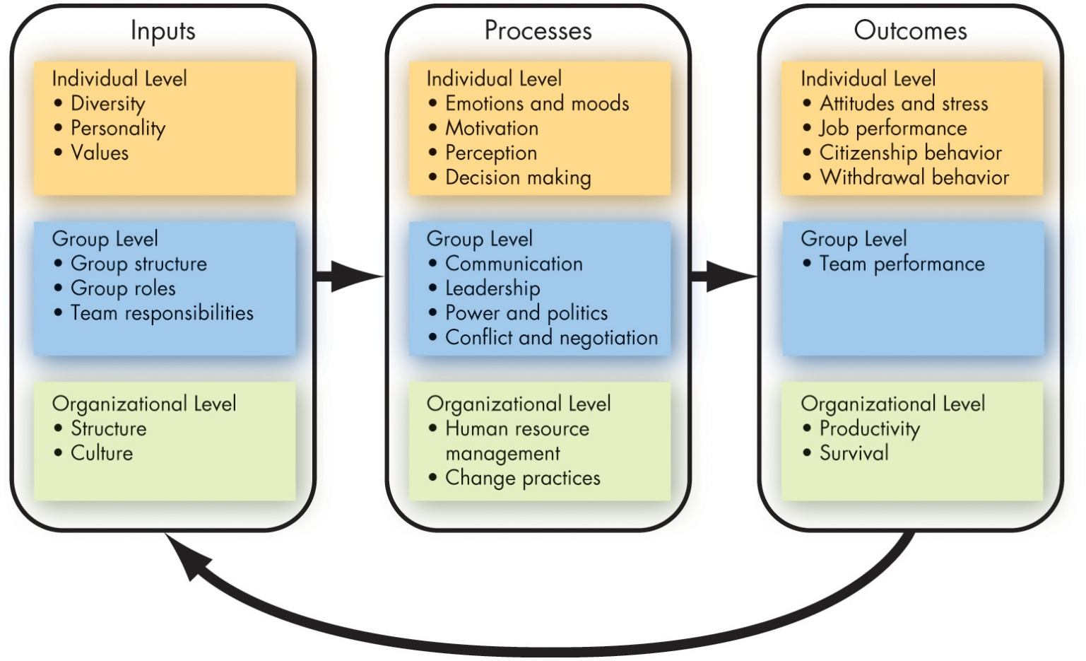
Three Levels of Analysis in This Book’s O B Model (1 of 4)
Exhibit 1.5 A Basic O B Model
Notes:
This book proposes three types of variables—inputs, processes, and outcomes—at three levels of analysis: individual, group, and organizational.
The basic OB model here proceeds from left to right, with inputs leading to processes and processes leading to outcomes. Notice that the model also shows that outcomes can influence inputs in the future.
Long Description:
The basic OB model proceeds from left to right, with inputs leading to processes and processes leading to outcomes. The outcomes can influence inputs in the future.
Data from the inputs is as follows. Individual level lists diversity, personality and values. Group level lists group structure, group roles and team responsibilities. Organizational level lists the structure and culture.
Data from the processes is as follows. Individual level lists emotions and moods, motivation, perception ad decision making. Group level lists communication, leadership, power and politics, and conflict and negotiation. Organizational level lists human resource management and change practices.
Data from the outcomes is as follows. Individual level lists attitudes and stress, job performance, citizenship behavior and withdrawal behavior. Group level includes team performance. Organizational level lists productivity and survival.

Slide 29
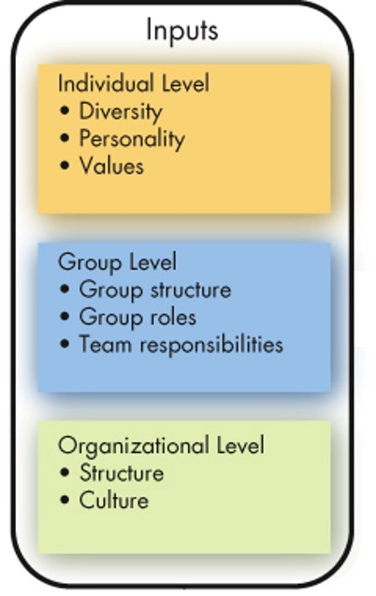
Three Levels of Analysis in This Book’s O B Model (2 of 4)
Inputs
Variables like personality, group structure, and organizational culture that lead to processes.
Group structure, roles, and team responsibilities are typically assigned immediately before or after a group is formed.
Organizational structure and culture change over time.
Notes:
Inputs are factors that exist in advance of the employment relationships. For example, individual diversity characteristics, personality, and values are shaped by a combination of an individual’s genetic inheritance and childhood environment.
Group structure, roles, and team responsibilities are typically assigned immediately before or after a group is formed.
Long Description:
The levels of analysis is as follows. Individual level lists diversity, personality and values. Group level lists group structure, group roles and team responsibilities. Organizational level lists the structure and culture.

Slide 30
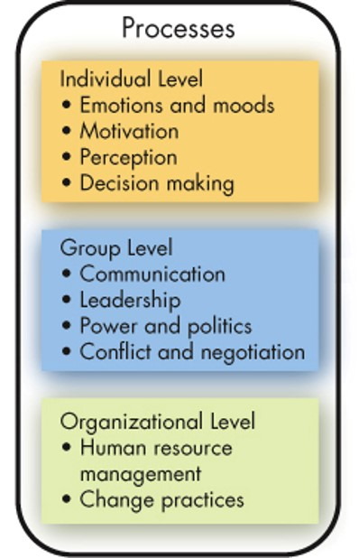
Three Levels of Analysis in This Book’s O B Model (3 of 4)
Processes
If inputs are like the nouns in organizational behavior, processes are like verbs.
Defined as actions that individuals, groups, and organizations engage in as a result of inputs, and that lead to certain outcomes.
Notes:
Processes are actions that individuals, groups, and organizations engage in as a result of inputs, and that lead to certain outcomes.
At the individual level, processes include emotions and moods, motivation, perception, and decision making.
At the group level, they include communication, leadership, power and politics, and conflict and negotiation.
Finally, at the organizational level, processes include human resource management and change practices.
Long Description:
The levels of analysis is as follows. Individual level lists emotions and moods, motivation, perception ad decision making. Group level lists communication, leadership, power and politics, and conflict and negotiation. Organizational level lists human resource management and change practices.

Slide 31
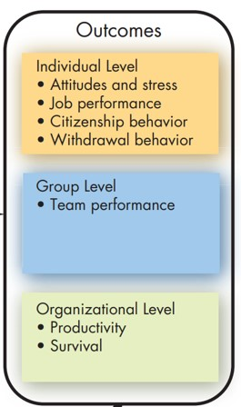
Three Levels of Analysis in This Book’s O B Model (4 of 4)
Outcomes
Key variables that you want to explain or predict, and that are affected by some other variables.
Notes:
Scholars have emphasized individual-level outcomes such as attitudes and stress, job performance, citizenship behavior, and withdrawal behavior.
At the group level, team performance is the focus.
Finally, at the organizational level, we look at overall profitability and survival.
Because these outcomes will be covered in all of the chapters, we will briefly discuss each of them on the following slides, so you can understand what the “goal” of OB will be.
Long Description:
The levels of analysis is as follows. Individual level lists attitudes and stress, job performance, citizenship behavior and withdrawal behavior. Group level includes team performance. Organizational level lists productivity and survival.

Slide 32
Outcome Variables (1 of 5)
Attitudes and stress
Employee attitudes are the evaluations employees make, ranging from positive to negative, about objects, people, or events.
Stress is a psychological process that occurs in response to environmental pressures.
Notes:
The belief that satisfied employees are more productive than dissatisfied employees has been a basic tenet among managers for years, though only now research has begun to support it. Some people might think that influencing employee attitudes and stress is purely soft stuff, and not the business of serious managers, but as we will show, attitudes often have behavioral consequences that relate directly to organizational effectiveness.

Slide 33
Outcome Variables (2 of 5)
Job performance
The total value of your contributions to an organization through your behaviors reflects your level of job performance.
Task performance
The combination of effectiveness and efficiency at doing your core job tasks is a reflection of your level of task performance.
Notes:
Task performance is the most important human output contributing to organizational effectiveness, so in every chapter we devote considerable time to discussing how task performance is affected by specific topics.

Slide 34
Outcome Variables (3 of 5)
Organizational citizenship behavior (O C B)
The discretionary behavior that is not part of an employee’s formal job requirements, and that contributes to the psychological and social environment of the workplace, is called organizational citizenship behavior.
Notes:
In today’s dynamic workplace, where tasks are increasingly performed by teams and flexibility is critical, employees who engage in good citizenship behaviors help others on their team by volunteering for extra work, avoiding unnecessary conflicts, respecting the spirit as well as the letter of rules and regulations, and gracefully tolerating occasional work-related impositions and nuisances.

Slide 35
Outcome Variables (4 of 5)
Withdrawal behavior
Withdrawal behavior is the set of actions that employees take to separate themselves from the organization.
Team performance
Team performance is the quantity and quality of a team’s work output.
Notes:
Employee withdrawal can have a very negative effect on an organization. The cost of employee turnover alone has been estimated to run into the thousands of dollars, even for entry-level positions. Absenteeism also costs organizations significant amounts of money and time every year. For instance, a recent survey found the average direct cost to U.S. employers of unscheduled absences is 8.7 percent of payroll.
Like a sports team’s performance, group functioning is more than the sum of individual performances. A team can perform effectively in different ways.

Slide 36
Outcome Variables (5 of 5)
Productivity
An organization is productive if it achieves its goals by transforming inputs into outputs at the lowest cost. This requires both effectiveness and efficiency.
Survival
The final outcome is organizational survival, which is simply evidence that the organization is able to exist and grow over the long term.
Notes:
Popular measures of organizational efficiency include return on investment, profit per dollar of sales, and output per hour of labor. Service organizations must include customer needs and requirements in assessing their effectiveness. These measures of productivity are affected by the behaviors of managers, employees, and supervisors. Increased productivity leads to the ultimate goal of most organizations, which is the survival of the firm.

Slide 37
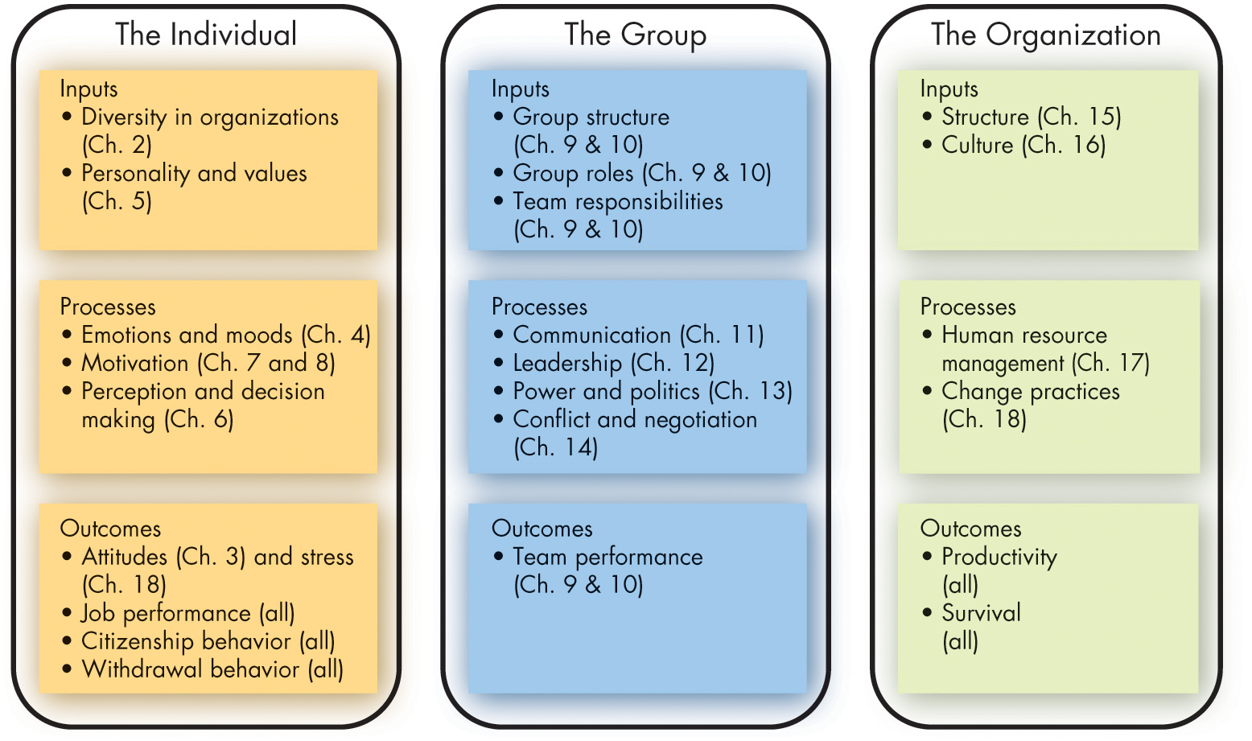
The Plan of the Text
Exhibit 1.6 The Plan of the Text
Notes:
As you can see in this exhibit, we will deal with inputs, processes, and outcomes at all three levels of analysis, but we group the chapters as shown here to correspond with the typical ways that research has been done in these areas.
Long Description:
The chapters listed are as follows.
Individual analysis lists: Inputs which includes diversity in organizations in chapter 2 and personality and values in chapter 5. Processes includes emotions and moods in chapter 4, motivation in chapter 7 and 8, and perception and decision in chapter 6. Outcomes include attitudes in chapter 3 and stress in chapter 18, job performance, citizenship behavior, and withdrawal behavior in all the chapters.
The group level analysis lists: Inputs which includes the group structure in chapter 9 and 10, group roles in chapter 9 and 10, team responsibilities in chapter 9 and 10. Processes includes communication in chapter 11, leadership in chapter 12, power and negotiation I chapter 14. Outcomes includes team performance in chapter 9 and 10.
The organizational level analysis lists: Inputs which includes structure in chapter 15 and culture in chapter 16. Processes includes human resource management in chapter 17, and change practices in chapter 18. Outcome includes productivity and survival in all the chapters.

Slide 38
Employability Skills
Critical thinking and creativity
Communication
Collaboration
Self-management
Social responsibility
Leadership
Career management
Notes:
The skills you’ll learn throughout this text will make you an attractive job candidate or will be useful if you decide to start your own business.

Slide 39
Implications for Managers (1 of 2)
Resist the inclination to rely on generalizations; some provide valid insights into human behavior, but many are erroneous.
A nuanced understanding of the situation is often needed to reach the best solutions. Try to understand the people involved and the context. From there, try and figure out what works, what does not work, and any contingencies that qualify these practices.
Strive for evidence-based solutions to problems and evaluate your hunches and intuition critically.
Notes:
This first chapter has provided a firm foundation that will be the basis for the study and application of concepts and practices that make the young professional more successful in productivity, job satisfaction, and career development. The systematic study of OB can improve predictability of behavior and, while it is not perfect, it provides excellent roadmaps to guide managers and leaders. These studies help to ensure that contingencies are in place to better understand people’s behaviors and how to influence them for the success of the employee and the organization.

Slide 40
Implications for Managers (2 of 2)
Work on your people skills to better interact with peers, work on teams more effectively, and both lead and manage your followers to do great things.
Improve your technical skills and conceptual skills through training and staying current with O B trends like big data and fast data.
O B can improve your employees’ work quality and productivity by showing you how to empower your employees, design and implement change programs, improve customer service, and help your employees balance work–life conflicts.
Notes:
It is important for managers to develop their interpersonal “people skills” to be effective. Understanding OB makes their organizations work more effectively by improving productivity, reducing absenteeism, turnover, and deviant workplace behavior, and increasing organizational citizenship behavior and job satisfaction.

Slide 41
Discussion Questions
How has the C O V I D-19 pandemic changed the role of the manager? What does your response suggest about the skills managers will need to navigate the changed workplace?
Corporate social responsibility (C S R) focuses on the triple bottom line of people, planet, and revenue. Is it ethical for managers to insist employees engage in C S R initiatives? Is it ethical for employees to object to doing so?
Do you expect to be a part of the Gig Economy? What do you see as the benefits and drawbacks of being a gig worker? Do the benefits offset the drawbacks?

Slide 42

Copyright
This work is protected by United States copyright laws and is provided solely for the use of instructors in teaching their courses and assessing student learning. Dissemination or sale of any part of this work (including on the World Wide Web) will destroy the integrity of the work and is not permitted. The work and materials from it should never be made available to students except by instructors using the accompanying text in their classes. All recipients of this work are expected to abide by these restrictions and to honor the intended pedagogical purposes and the needs of other instructors who rely on these materials.

