Slide 1

Organizational Behavior
Nineteenth Edition
Chapter 3
Job Attitudes
Copyright © 2023, 2019, 2017 Pearson Education, Inc. All Rights Reserved
Notes:
If this PowerPoint presentation contains mathematical equations, you may need to check that your computer has the following installed:
1) MathType Plugin
2) Math Player (free versions available)
3) NVDA Reader (free versions available)
Welcome to this Organizational Behavior course that uses the 19th edition of the textbook, Organizational Behavior by Robbins and Judge. This is considered among the most widely used OB textbooks in the world. Robbins and Judge are recognized as definitive aggregators of OB concepts, applications, and practices. The course and this book will provide you with a resource that will benefit you throughout your degree program and your professional life.

Slide 2
Learning Objectives
3.1 Contrast the three components of an attitude.
3.2 Summarize the relationship between attitudes and behavior.
3.3 Compare the major job attitudes.
3.4 Identify the two approaches for measuring job satisfaction.
3.5 Summarize the main causes of job satisfaction.
3.6 Identify four outcomes of job satisfaction.
3.7 Identify four employee responses to job dissatisfaction.
Notes:
After studying this chapter, you should be able to:
Contrast the three components of an attitude.
Summarize the relationship between attitudes and behavior.
Compare the major job attitudes.
Identify the two approaches for measuring job satisfaction.
Summarize the main causes of job satisfaction.
Identify four outcomes of job satisfaction.
Identify four employee responses to job dissatisfaction.

Slide 3
Contrast the Three Components of an Attitude (1 of 2)
Attitudes are judgments or evaluative statements—either favorable or unfavorable—about objects, people, or events.
They reflect how we feel about something.
Notes:
Attitudes are evaluative statements or judgments concerning objects, people, or events. They reflect how we feel about something. In other words, saying “I like my job,” reflects your attitude toward work.

Slide 4
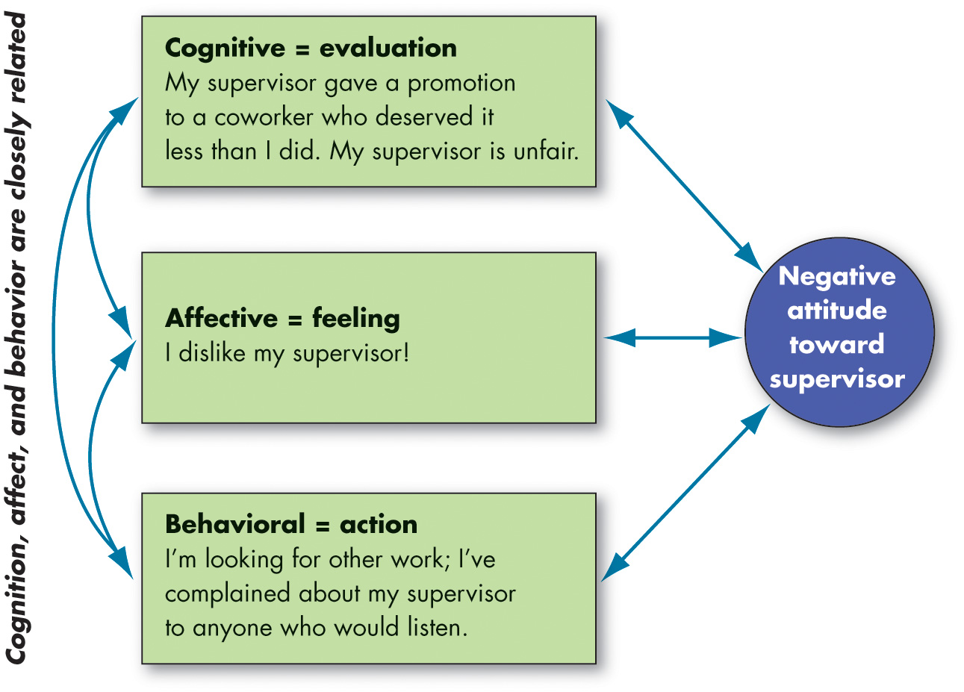
Contrast the Three Components of an Attitude (2 of 2)
Exhibit 3.1 The Components of an Attitude
Notes:
Attitudes are made up of three components. The cognitive component is the belief in the way things are. The affective component is the more critical part of the attitude, as it calls upon emotions or feelings. The behavioral component describes the intention to behave in a certain way toward someone or something.
These three components work together to aid in our understanding of the complexity of an attitude.
Long Description:
Cognitive component equals evaluation. Notes read: My superior gave a promotion to a coworker who deserved it less than I did. My superior is unfair.
Affective component equals feeling. Notes read: I dislike my supervisor.
Behavioral component equals action. Notes read: I’m looking for other work; I’ve complained about my superior to anyone who would listen.
All the above components affect and gets affected by the negative attitude towards the supervisor.

Slide 5
Summarize the Relationship Between Attitudes and Behavior (1 of 2)
The attitudes that people hold determine what they do.
Cognitive dissonance is any incompatibility an individual might perceive between two or more attitudes or between behavior and attitudes.
Research has generally concluded that people seek consistency among their attitudes and between their attitudes and their behavior.
Notes:
Research, in general, supports the idea that attitudes predict future behavior. When attitudes and behaviors don’t line up, individuals will experience cognitive dissonance. This incongruity is uncomfortable, and individuals will seek to reduce the dissonance to find consistency.
People are willing to live with some discomfort, but the degree to which this is true depends on the importance of the elements, how much influence the individual has on the situation, and the rewards available.

Slide 6
Summarize the Relationship Between Attitudes and Behavior (2 of 2)
Moderating Variables:
Attitude’s importance
Correspondence to behavior
Accessibility
Presence of social pressures
Whether a person has direct experience with the attitude
The attitude-behavior relationship is likely to be much stronger if an attitude refers to something with which we have direct personal experience.
Notes:
Some variables moderate the relationship between attitude and behavior. These variables include the importance of the attitude to the person, the correspondence of the attitude to the behavior, the accessibility of the attitude, the presence of social pressures on behavior, and the direct experience a person has with the attitude. These mitigating variables will affect whether or not and to what degree a certain attitude will predict behavior.
Finally, the attitude–behavior relationship is likely to be much stronger if an attitude refers to something with which we have direct personal experience.

Slide 7
Compare the Major Job Attitudes (1 of 7)
Organizational Identification
The extent to which employees define themselves by the same characteristics that define their organization.
Gig workers can identify with their contracting organizations.
Notes:
A review of hundreds of job attitude-behavior studies found that organizational identification strongly predicted job attitude formation.
Organizational identification has become a hot topic in the Gig Economy. Contract and freelance workers engage in short-term agreements with multiple organizations and people who come and go over time. It might seem like these gig workers would probably develop little identification toward these organizations. However, recent research suggests that this might not be the case.

Slide 8
Compare the Major Job Attitudes (2 of 7)
Job Satisfaction
A positive feeling about the job resulting from an evaluation of its characteristics.
Job Involvement
Degree to which a person identifies with a job, actively participates in it, and considers performance important to self-worth.
Psychological Empowerment
Belief in the degree of influence over one’s job, competence, job meaningfulness, and autonomy.
Notes:
In addition to organizational identification, most of the research in OB has been concerned with three major job attitudes: job satisfaction, job involvement, and organizational commitment. In addition, perceived organizational support and employee engagement are important.
Job satisfaction is the positive feeling about the job resulting from an evaluation of its characteristics.
Job involvement looks at the degree of psychological identification with the job. Related to this is psychological empowerment, which is defined as employees’ beliefs in the degree to which they influence their work environment, their competencies, the meaningfulness of their job, and their perceived autonomy.

Slide 9
Compare the Major Job Attitudes (3 of 7)
Organizational Commitment
Identifying with a particular organization and its goals and wishing to maintain membership in the organization.
Employees who are committed will be less likely to engage in work withdrawal even if they are dissatisfied, because they have a sense of organizational loyalty.
Notes:
Another important job attitude is organizational commitment, which is defined as the act of identifying with a particular organization and its goals, and wishing to remain a member of the organization.

Slide 10
Compare the Major Job Attitudes (4 of 7)
Perceived Organizational Support (P O S)
Degree to which employees believe the organization values their contribution and cares about their well-being.
Higher when rewards are fair, employees are involved in decision-making, and supervisors are seen as supportive.
P O S is important in countries where power distance is lower.
Notes:
Perceived organizational support (or POS) is the degree to which employees believe the organization values their contribution and cares about their well-being. The perception of fairness is a key factor in determining the willingness of employees to work hard for the organization. In addition, employees have a higher POS when they perceive that they have some input in decision-making processes.
POS is important in countries where power distance, the degree to which people in a country accept that power in institutions and organizations is distributed unequally, is lower.

Slide 11
Compare the Major Job Attitudes (5 of 7)
Employee Engagement
The individual’s involvement with, satisfaction with, and enthusiasm for the work.
Engaged employees are passionate about their work and company.
Notes:
Employee engagement goes beyond just job satisfaction. It also includes involvement and enthusiasm for the job. Highly engaged employees have a passion for their work and feel a deep connection to their company. Disengaged employees have essentially checked out—putting time but not energy or attention into their work.
Engagement becomes a real concern for most organizations because disengaged employees cost organizations money—one study suggests that organizations can lose up to $550 billion annually in lost productivity.

Slide 12
Compare the Major Job Attitudes (6 of 7)
Job Attitudes in the Gig Economy
Influenced by factors such as the stability of the work, characteristics of the assignment, and the gig workers themselves.
Notes:
One meta-analysis of hundreds of thousands of workers suggests that gig workers’ job satisfaction is only slightly less than permanent workers.
However, the type of gig worker matters: Temporary agency workers do experience substantial decrements in job satisfaction compared with other workers (including other gig workers). Similarly, temporary agency workers are also less committed to their organizations, their occupation, and their form of employment than permanent and self-employed individuals.
Justice and ethics also play a role. Gig workers’ perceptions of the organizations’ fairness, that the organizations are fulfilling their obligations to them, and that the organizations do not see them as lesser in status are critical in developing gig-worker commitment, encouraging OCB, and discouraging gig-worker turnover.

Slide 13
Compare the Major Job Attitudes (7 of 7)
Are these job attitudes really all that distinct?
No, these attitudes are highly related; and while there is some distinction, there is also a lot of overlap that may cause confusion.
Notes:
There is a high degree of overlap between the different job attitudes. For example, if a worker has higher job satisfaction, he or she tends to be more engaged and shows a stronger commitment to the organization. Researchers are trying to find ways to measure the different attitudes in order to get at their distinctiveness.

Slide 14
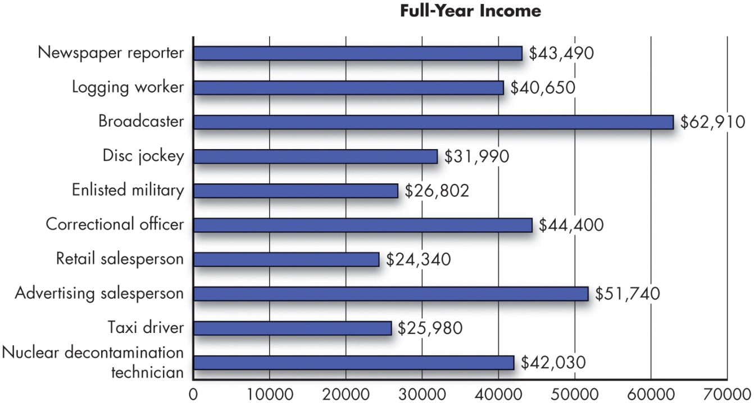
Define Job Satisfaction (1 of 5)
Exhibit 3.2 Worst Jobs of 2019 for Job Satisfaction*
*Based on physical demands, work environment, income, stress, and hiring outlook.
Source: Based on CareerCast.com (2019),
http://www.careercast.com/jobs-rated/worst-jobs-2019
Notes:
When it comes to job satisfaction, some jobs are less attractive, as shown in Exhibit 3.2.
Long Description:
The horizontal axis is labeled full-year income and ranges from 0 to 70000 in increments of 10000. The vertical axis is marked with different job roles. The data from the graph in the format job roles: income is as follows. Nuclear decontamination technician: 42030 dollars. Taxi driver: 25980 dollars. Advertising salesperson: 51740 dollars. Retail salesperson: 24340 dollars. Correctional officer: 44400 dollars. Enlisted military: 26802 dollars. Disc jockey: 31990 dollars. Broadcaster: 62910 dollars. Logging worker: 40650 dollars. Newspaper reporter: 43490 dollars.

Slide 15
Define Job Satisfaction (2 of 5)
Job Satisfaction
A positive feeling about a job resulting from an evaluation of its characteristics.
Two approaches for measuring job satisfaction are popular:
The single global rating.
The summation of job facets.
Notes:
As we have discussed, job satisfaction is defined as a positive feeling about a job resulting from an evaluation of its characteristics. There are multiple ways to measure job satisfaction, but two approaches are popular.
The single global rating approach is a response to one question, such as, “All things considered, how satisfied are you with your job?” Respondents circle a number between 1 and 5 on a scale from “highly satisfied” to “highly dissatisfied.”
The second approach, the summation of job facets, is more sophisticated. It identifies key elements in a job, such as the nature of the work, supervision, present pay, promotion opportunities, and relations with coworkers.

Slide 16
Define Job Satisfaction (3 of 5)
How satisfied are people in their jobs?
Employees in the United States and most developed countries are generally satisfied with their jobs.
Economic conditions influence job satisfaction rates.
Satisfaction levels differ depending on the facet involved.
There are racial and cultural differences in job satisfaction.
Notes:
The majority of U.S. workers are satisfied with their jobs. However, economic conditions influence satisfaction levels.
The exhibits on the following two slides illustrate additional details regarding differences among job satisfaction, including the effect of particular facets and cultural context.

Slide 17
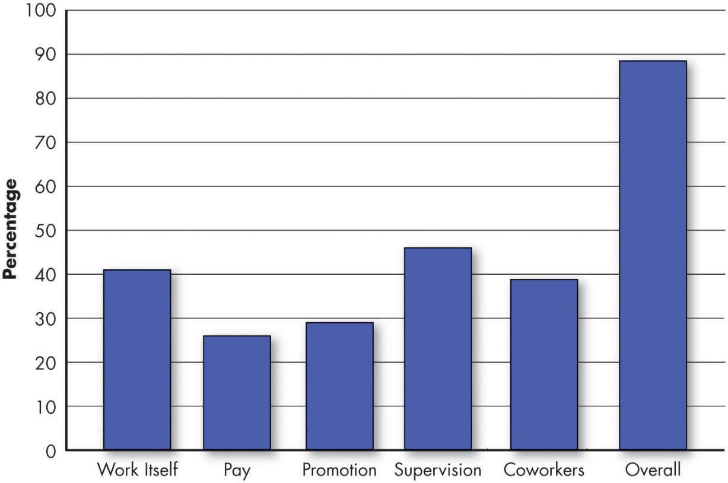
Define Job Satisfaction (4 of 5)
Exhibit 3.3 Average Job Satisfaction Levels by Facet
Source: Society for Human Resource Management, 2017 Employee Job Satisfaction and Engagement: The Doors of Opportunity Are Open, April 24, 2017,
https://www.shrm.org/hr-today/trends-and-forecasting/research-and-surveys/pages/ 2017-job-satisfaction-andengagement-doors-of-opportunity-are-open.aspx
Notes:
As shown here in Exhibit 3.3, people have typically been more satisfied with their jobs overall, with the work itself, and with their supervisors and coworkers, than they have been with their pay and promotion opportunities.
Long Description:
The horizontal axis is marked with different facets. The vertical axis is labeled with the percentage of job satisfaction and ranges from 0 to 100 in increments of 10. The approximate data from the graph in the format job facets: job satisfaction percentage is as follows. Work itself: 41 percent. Pay: 26.5 percent. Promotion: 29.5 percent. Supervision: 46 percent: coworkers: 39.5 percent. Overall: 89 percent.

Slide 18
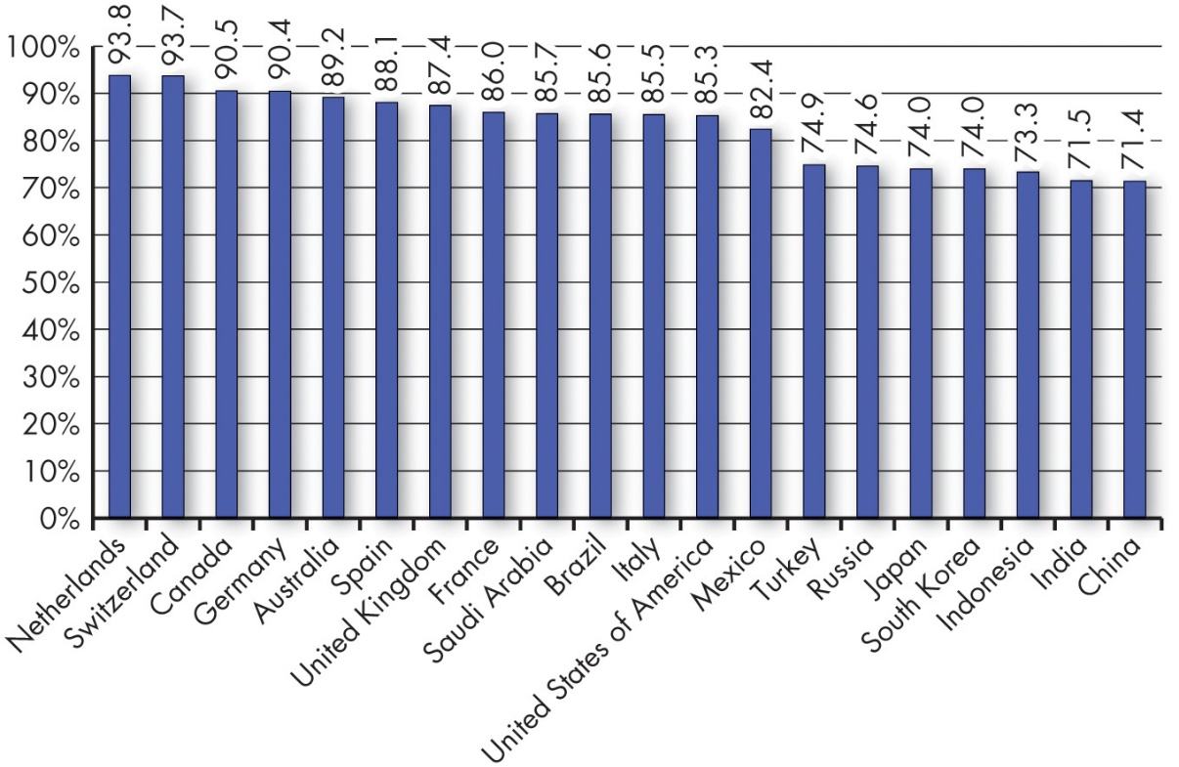
Define Job Satisfaction (5 of 5)
Exhibit 3.4 Average Levels of Employee Job Satisfaction by Country
Source: J.-E. De Neve and G. Ward, “Happiness at Work,” in J. Helliwell, R. Layard, and J. Sachs (eds.), World Happiness Report (World Happiness Report APPENDIX, 2017).
Notes:
Exhibit 3.4 provides results of a global study of job satisfaction levels of workers in 20 countries. Netherlands and Switzerland report the highest levels of job satisfaction.
Long Description:
The horizontal axis is marked with different countries. The vertical axis is labeled with the percentage of job satisfaction and ranges from 0 to 100 in increments of 10. Data from the graph in the format Country: job satisfaction percentage is as follows. Netherlands: 93.8. Switzerland: 93.7. Canada: 90.5. Germany: 90.4. Australia: 89.2. Spain: 88.1. United Kingdom: 87.4. France: 86.0. Saudi Arabia: 85.7. Brazil: 85.6. Italy: 85.5. United States of America: 85.3. Mexico: 82.4. Turkey: 74.9. Russia: 74.6. Japan: 74.0. South Korea: 74.0. Indonesia: 73.3. India: 71.5. China: 71.4.

Slide 19
Summarize the Main Causes of Job Satisfaction (1 of 2)
What causes job satisfaction?
Job Conditions
The intrinsic nature of the work itself, social interactions, and supervision are important predictors of satisfaction and employee well-being.
Personality and Individual Differences
People who have positive core self-evaluations, who believe in their inner worth and basic competence, are more satisfied with their jobs than those with negative core self-evaluations.
Pay
Notes:
Interesting jobs that provide training, variety, independence, and control satisfy most employees. There is also a strong correspondence between how well people enjoy the social context of their workplace and how satisfied they are overall. Interdependence, feedback, social support, and interaction with coworkers outside the workplace are strongly related to job satisfaction even after accounting for characteristics of the work itself.
Personality and individual differences also play a role in job satisfaction. Research has shown that people who have positive core self-evaluations, who believe in their inner worth and basic competence, are more satisfied with their jobs than those with negative core self-evaluations.
Pay also has an influence on job satisfaction but not as much as one might think. We’ll look at it in the next slide.

Slide 20
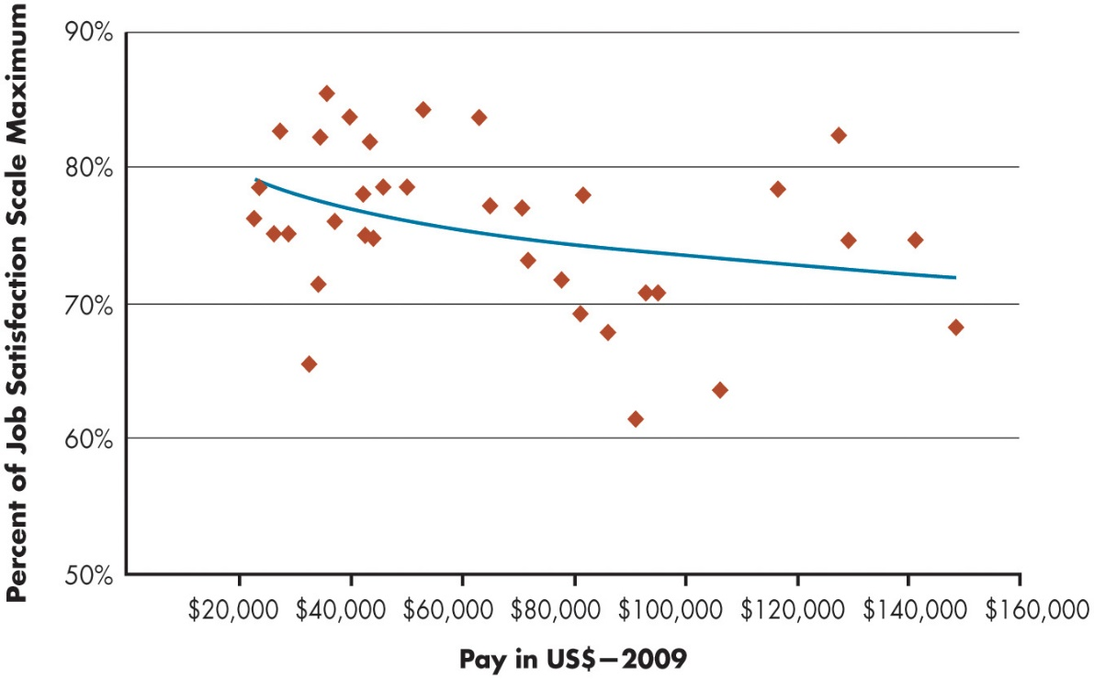
Summarize the Main Causes of Job Satisfaction (2 of 2)
Exhibit 3.5 Relationship Between Average Pay in Job and Job Satisfaction of Employees in That Job
Source: Based on T. A. Judge, R. F. Piccolo, N. P. Podsakoff, J. C. Shaw, and B. L. Rich, “The Relationship Between Pay and Job Satisfaction: A Meta-Analysis of the Literature,” Journal of Vocational Behavior 77, no. 2 (2010): 157–67.
Notes:
Exhibit 3.5 shows the relationship between the average pay for a job and the average level of job satisfaction. As you can see, there is not much of a relationship. Money does motivate people, as we will discover in Chapter 8, but what motivates us is not necessarily the same as what makes us happy.
Long Description:
The horizontal axis is labeled with pay in U S dollars in 2009 and ranges from 20000 dollars to 160000 dollars in increments of 20000 dollars. The vertical axis is labeled with percent of job satisfaction scale maximum and ranges from 50 percent to 90 percent in increment of 10 percent. All data are approximate. A trend line starts from 79 percent with 20000 dollars and slopes downward to 72 percent with 148000 dollars. The plots are distributed within 85 percent and 61 percent around the trend line and is more between 20000 dollars to 50000 dollars, moderate between 60000 dollars and 110000 dollars, and less between 110000 dollars and 150000 dollars.

Slide 21
Outcomes of Job Satisfaction
Job Performance
Happy workers are more likely to be productive workers.
O C B
People who are more satisfied with their jobs are more likely to engage in O C B.
Customer Satisfaction
Satisfied employees increase customer satisfaction and loyalty.
Life Satisfaction
Research shows that job satisfaction is positively correlated with life satisfaction.
Notes:
Now, let’s look at specific outcomes of job satisfaction related to job performance, OCB, customer satisfaction, and life satisfaction.
Job Performance: Happy workers are more likely to be productive workers—the evidence suggests that productivity is likely to lead to satisfaction.
Organizational Citizenship Behavior (OCB): It seems logical to assume job satisfaction should be a major determinant of an employee’s organizational citizenship behavior (OCB). Research shows that when people are more satisfied with their jobs, they are more likely to engage in OCBs.
Customer Satisfaction: Evidence indicates that satisfied employees increase customer satisfaction and loyalty.
Life Satisfaction: Research indicates that job satisfaction is positively correlated with life satisfaction, and your attitudes and experiences in life spill over into your job approaches and experiences. Furthermore, life satisfaction decreases when people become unemployed.

Slide 22
Four Employee Responses to Dissatisfaction (1 of 2)
Exhibit 3.6 Responses to Dissatisfaction.
Blank | Constructive | Destructive
Active | VOICE | EXIT
Passive | LOYALTY | NEGLECT
Notes:
What happens when employees dislike their jobs? The exit–voice–loyalty–neglect framework shown in Exhibit 3.6 is helpful for understanding the consequences of dissatisfaction.
The exhibit illustrates employees’ four responses to job dissatisfaction, which differ along two dimensions: constructive/destructive and active/passive.
The responses are as follows:
Exit: The exit response directs behavior toward leaving the organization, including looking for a new position or resigning.
Voice: The voice response includes actively and constructively attempting to improve conditions, including suggesting improvements, discussing problems with superiors, and undertaking union activity.
Loyalty: The loyalty response means passively but optimistically waiting for conditions to improve, including speaking up for the organization in the face of external criticism and trusting the organization and its management to “do the right thing.”
Neglect: The neglect response passively allows conditions to worsen and includes chronic absenteeism or lateness, reduced effort, and increased error rate.

Slide 23
Four Employee Responses to Dissatisfaction (2 of 2)
Counterproductive Work Behavior (C W B)
Counterproductive work behavior: actions that actively damage the organization, including stealing, behaving aggressively toward coworkers, or being late or absent.
Absenteeism: the more satisfied you are, the less likely you are to miss work.
Turnover: a pattern of lowered job satisfaction is the best predictor of intent to leave.
Managers Often “Don’t Get It”
Notes:
In addition, we can look at job dissatisfaction by exploring counterproductive work behavior. Substance abuse, stealing at work, undue socializing, gossiping, absenteeism, and tardiness are examples of behaviors that are destructive to organizations.
They are indicators of a broader syndrome called counterproductive work behavior (CWB), also termed deviant behavior in the workplace, or simply employee withdrawal. CWB doesn’t just happen—the behaviors often follow negative and sometimes longstanding attitudes. Generally, job dissatisfaction predicts CWB. People who are not satisfied with their work become frustrated, which lowers their performance and makes them more likely to commit CWB. Other research suggests that, in addition to vocational misfit (being in the wrong line of work), lack of fit with the organization (working in the wrong kind of organizational culture) also predicts CWBs.
As a manager, you can take steps to mitigate CWB. You can poll employee attitudes, for instance, and identify areas for workplace improvement. If there is no vocational fit, the employee will not be fulfilled, so you can screen for that. Tailoring tasks so a person’s abilities and values can be exercised should increase job satisfaction and reduce CWB. Furthermore, creating strong teams, integrating supervisors with them, providing formalized team policies, and introducing team-based incentives may help lower the CWB “contagion” that lowers the standards of the group.
Absenteeism: We find a consistent negative relationship between satisfaction and absenteeism. The more satisfied you are, the less likely you are to miss work.
Turnover: Satisfaction is also negatively related to turnover, but the correlation is stronger than what we found for absenteeism.
Workplace Deviance: Job dissatisfaction predicts unionization, stealing, undue socializing, and tardiness. If employees don’t like their work environment, they will respond somehow.
Managers Often “Don’t Get It”
It should come as no surprise that job satisfaction can affect the bottom line. Regular surveys can reduce gaps between what managers think employees feel and what they really feel.

Slide 24
Implications for Managers (1 of 2)
Of the major job attitudes—job satisfaction, job involvement, organizational commitment, perceived organizational support (P O S), and employee engagement—remember that an employee’s job satisfaction level is the best single predictor of behavior.
Pay attention to your employees’ job satisfaction levels as determinants of their performance, turnover, absenteeism, and withdrawal behaviors.
Notes:
Creating a satisfied workforce is not a guarantee of successful performance, but managers should make it a priority as much as possible. In particular, managers should:
Of the major job attitudes—job satisfaction, job involvement, organizational commitment, perceived organizational support (POS), and employee engagement—remember that an employee’s job satisfaction level is the best single predictor of behavior.
Pay attention to employees’ job satisfaction levels as determinants of their performance, turnover, absenteeism, and withdrawal behaviors.

Slide 25
Implications for Managers (2 of 2)
Measure employee job attitudes objectively and at regular intervals to determine how employees are reacting to their work.
To raise employee satisfaction, evaluate the fit between the employee’s work interests and the intrinsic parts of the job; then create work that is challenging and interesting to the individual.
Consider the fact that high pay alone is unlikely to create a satisfying work environment.
Notes:
Measure employee job attitudes objectively and at regular intervals to determine how employees are reacting to their work.
Evaluate the fit between the employee’s work interests and the intrinsic parts of the job; then create work that is challenging and interesting to the individual.
Consider the fact that high pay alone is unlikely to create a satisfying work environment.

Slide 26
Discussion Questions
How is the growth of the Gig Economy changing the way we think about organizational identification and job attitudes? Do you think companies need to do more to support and engage with gig workers?
The COVID-19 pandemic forced many people to switch to a remote workplace. How did this change affect job satisfaction? What do you think will happen as employees return to in-person work environments?
Some companies are allowing employees to continue to work remotely if they choose to do so. Why do you think companies are making this decision? What does it tell you about creating a satisfying work environment?

Slide 27

Copyright
This work is protected by United States copyright laws and is provided solely for the use of instructors in teaching their courses and assessing student learning. Dissemination or sale of any part of this work (including on the World Wide Web) will destroy the integrity of the work and is not permitted. The work and materials from it should never be made available to students except by instructors using the accompanying text in their classes. All recipients of this work are expected to abide by these restrictions and to honor the intended pedagogical purposes and the needs of other instructors who rely on these materials.

