Slide 1
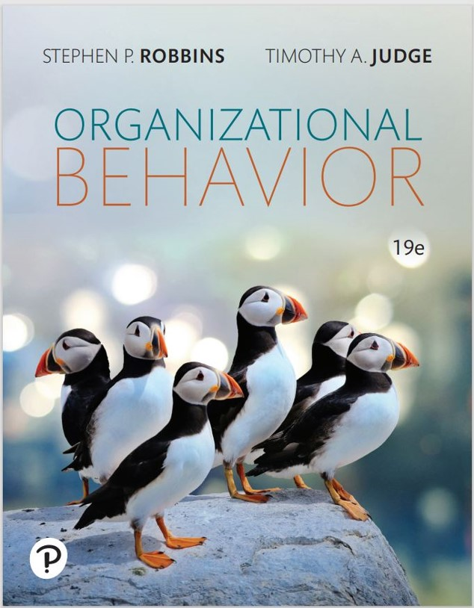
Organizational Behavior
Nineteenth Edition
Chapter 4
Emotions and Moods
Copyright © 2023, 2019, 2017 Pearson Education, Inc. All Rights Reserved
Notes:
If this PowerPoint presentation contains mathematical equations, you may need to check that your computer has the following installed:
1) MathType Plugin
2) Math Player (free versions available)
3) NVDA Reader (free versions available)
Welcome to this Organizational Behavior course that uses the 19th edition of the textbook, Organizational Behavior by Robbins and Judge. This is considered among the most widely used OB textbooks in the world. Robbins and Judge are recognized as definitive aggregators of OB concepts, applications, and practices. The course and this book will provide you with a resource that will benefit you throughout your degree program and your professional life.

Slide 2
Learning Objectives
4.1 Differentiate between emotions and moods.
4.2 Identify the sources of emotions and moods.
4.3 Show the impact emotional labor has on employees.
4.4 Describe affective events theory.
4.5 Describe emotional intelligence.
4.6 Identify strategies for emotion regulation.
4.7 Apply concepts about emotions and moods to specific O B issues.
Notes:
After studying this chapter, you should be able to:
Differentiate between emotions and moods.
Identify the sources of emotions and moods.
Show the impact emotional labor has on employees.
Describe affective events theory.
Describe emotional intelligence.
Identify strategies for emotion regulation.
Apply concepts about emotions and moods to specific OB issues.
We will discuss each of these objectives in some detail.

Slide 3
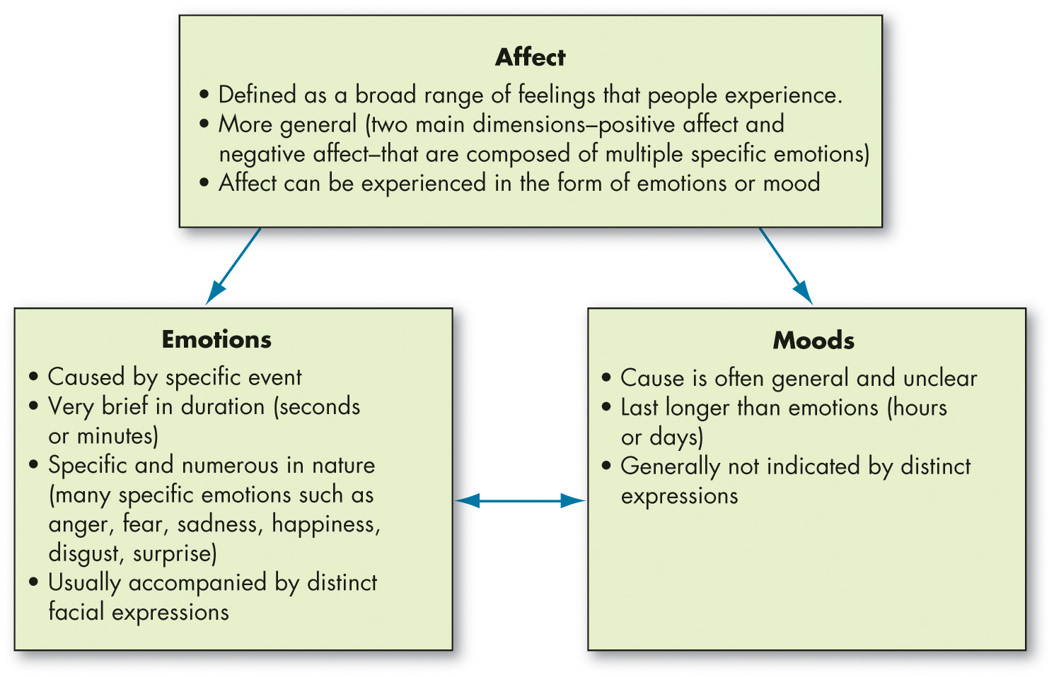
Differentiate Between Emotions and Moods (1 of 6)
Exhibit 4.1 Affect, Emotions, and Moods
Notes:
Three terms that are closely intertwined: affect, emotions, and moods.
Affect is a generic term that covers a broad range of feelings people experience. This includes both emotions and moods. Emotions are intense feelings that are directed at someone or something. Moods are the feelings that tend to be less intense than emotions and that lack a contextual stimulus.
Long Description:
Notes read: Affect is defined as a broad range of feelings that people experience. More general where the two main dimension-positive affect and negative affect that are composed of multiple specific emotions. Affect can be experienced in the form of emotions or mood.
Emotions are caused by specific event. Very brief in duration which lasts for seconds or minutes. Specific and numerous in nature and many specific emotions such as anger, fear, sadness, happiness, disgust and surprise. Usually accompanies by distinct facial expressions.
Moods: Cause is often general and unclear, last longer that emotions which lasts for hours or days and are generally not indicated by distinct expressions.

Slide 4
Differentiate Between Emotions and Moods (2 of 6)
Six essentially universal emotions
Anger
Fear
Sadness
Happiness
Disgust
Surprise
Notes:
Though not all psychologists agree, there do seem to be six basic emotions that emerge in studies: anger, fear, sadness, happiness, disgust, and surprise. All other emotions fall under these six categories.

Slide 5
Differentiate Between Emotions and Moods (3 of 6)
Moral Emotions
Moral emotions: emotions that have moral implications because of our instant judgement of the situation that evokes them.
Our responses to moral emotions differ from our responses to other emotions.
Moral emotions are developed during childhood.
Because morality is a construct that differs between cultures, so do moral emotions.
Notes:
Researchers have been studying what are called moral emotions; that is, emotions that have moral implications because of our instant judgment of the situation that evokes them. Interestingly, research indicates that our responses to moral emotions differ from our responses to other emotions.
Moral emotions are developed during childhood as children learn moral norms and standards, so they depend upon the situation and norms more so than other emotions.
Because morality is a construct that differs between cultures, so do moral emotions. Therefore, we need to be aware of the moral aspects of situations that trigger our emotions and make certain we understand the context before we act, especially in the workplace.

Slide 6
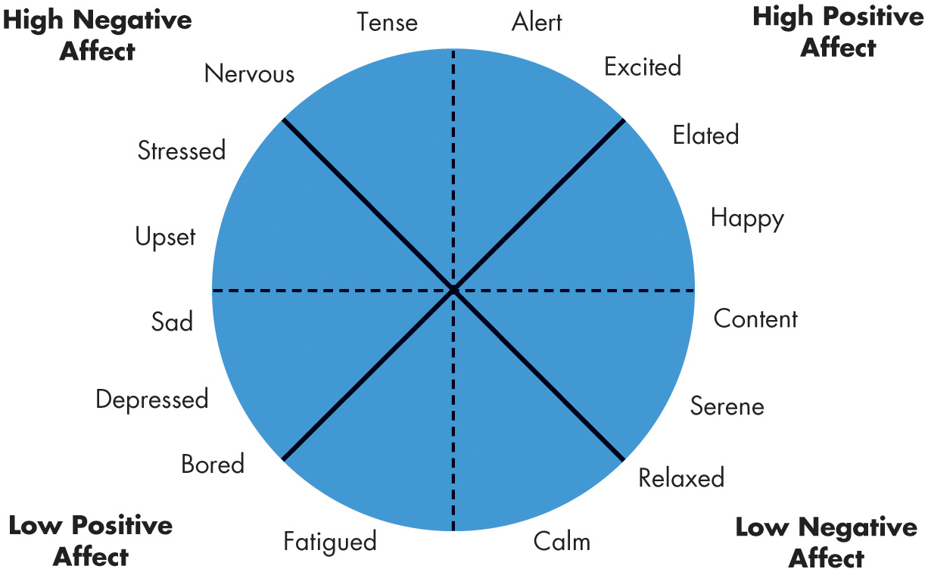
Differentiate Between Emotions and Moods (4 of 6)
Exhibit 4.2 The Affective Circumplex
Notes:
Our basic moods carry positive and negative affects. They cannot be neutral. Emotions are grouped into general mood states as shown in Exhibit 4.2. These states impact how employees perceive reality; thereby, the moods can impact the work of employees.
Long Description:
It has a circle divided in eight parts by a pair of dotted lines that runs horizontal and vertical and a pair of straight lines that run diagonal. Data in the clockwise direction is as follows. Alert, excited, elated, and happy are labeled high positive affect. Content, serene, relaxed, and calm are labeled low negative affect. Fatigued, bored, depressed, and sad are labeled low positive affect. Upset, stressed, nervous and tense are labeled high negative affect.

Slide 7
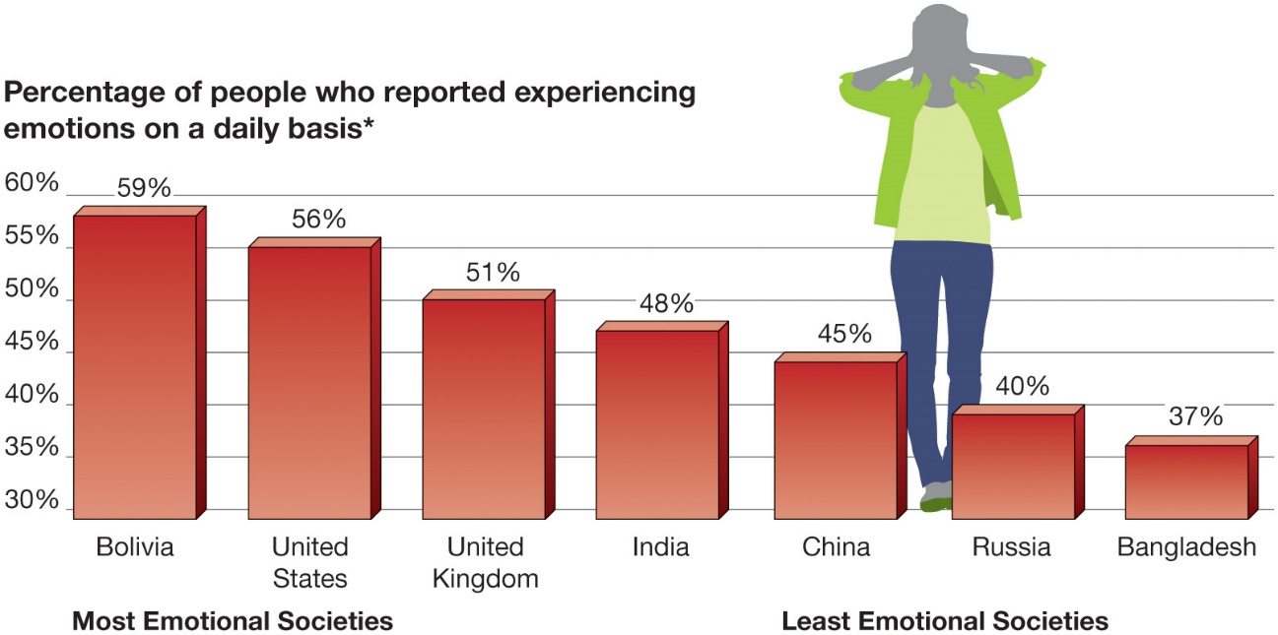
Differentiate Between Emotions and Moods (5 of 6)
OB POLL Emotional States
*Respondents in 148 countries worldwide during 2014 were asked whether they experienced five positive (well-rested, treated with respect, enjoyment, smiling and laughing, learning or doing something interesting) and five negative emotions (anger, stress, sadness, physical pain, worry) daily.
Source: Based on J. Clifton, “Latin Americans Lead World in Emotions,” Gallup (August 27, 2015),
http://www.gallup.com/poll/184631/latin-americanslead-world-emotions.aspx
Notes:
As if it weren’t complex enough to consider the many distinct emotions and moods a person might identify, the reality is that we all experience moods and emotions differently.
For most people, positive moods are somewhat more common than negative moods. Indeed, research finds a positivity offset, meaning that at zero input (when nothing in particular is going on), most individuals experience a mildly positive mood.
Does the degree to which people experience positive and negative emotions vary across cultures? Yes (see the OB Poll).
People in most cultures appear to experience certain positive and negative emotions, and people interpret them in much the same way worldwide.
However, an individual’s experience of emotions appears to be culturally shaped.
Long Description:
The horizontal axis is labeled with different states and ranges from most emotional societies to least emotional societies. The vertical axis is labeled percentage of people who reported experiencing emotions on a daily basis and the notes read respondents in 148 countries worldwide during 2014 were asked whether they experienced five positive which includes well-rested, treated with respect, enjoyment, smiling and laughing, learning or doing something interesting, and five negative emotions like anger, stress, sadness, physical pain, worry, daily. The data from the graph in the format country: percentage is as follows. Bolivia: 59 percent. United States: 56 percent. United Kingdom: 51 percent. India: 48 percent. China: 45 percent. Russia: 40 percent. Bangladesh: 37 percent. An image of a women standing with her ears closed is placed between the bars China and Russia.

Slide 8
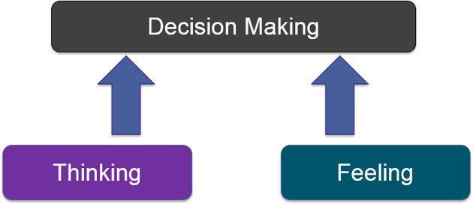
Differentiate Between Emotions and Moods (6 of 6)
Notes:
Do emotions make us irrational? There are some who think that emotions are linked to irrationality and that expressing emotions in public may be damaging to your career or status. However, research has shown that emotions are necessary for rational thinking. They help us make better decisions and help us understand the world around us. If we are going to make decisions, we need to incorporate both thinking and feeling.

Slide 9
Identify the Sources of Emotions and Moods (1 of 3)
Personality
Moods and emotions have a trait component.
Affect intensity: how strongly people experience their emotions.
Time of Day
There is a common pattern for all of us.
Happier in the midpoint of the daily awake period.
Day of the Week
Happier toward the end of the week.
Notes:
There are many things that impact our moods and emotions. Personality is a key component and will definitely impact the intensity of the emotions we feel. The day and time of the week is a common pattern for all of us as well.
Exhibit 4.3 in your text shows the results of recent research related to time of day. Positive emotions have their greatest effect in mid-morning and then remain stable before rising again until midnight.
In Exhibit 4.4, we can see how the day of the week affects emotions. As the week progresses, positive effects of emotions increases while negative effects decrease. So positive emotions are considerably higher toward the end of the week than they are at the beginning. This tends to be true among many cultures.

Slide 10
Identify the Sources of Emotions and Moods (2 of 3)
Weather
Illusory correlation—no effect.
Stress
Even low levels of constant stress can worsen moods.
Social Interactions
Negative interactions at work not only can affect your emotions at work, they can “spill over” into family life.
Notes:
Weather is thought to have an impact on our emotions, but there is no proven effect.
Stress is an important factor and even at low levels it can cause our mood to change. It is important to maintain a low level of stress to help control psychological and physical health.
The social interactions we have with other people can affect our emotions and moods.

Slide 11
Identify the Sources of Emotions and Moods (3 of 3)
Sleep
Poor sleep quality increases negative affect.
Exercise
Does improve mood, especially for depressed people.
Gender Identity
Stereotypical perceptions of women as ‘emotional’ and men as ‘angry’ persist in the workplace.
Notes:
Some additional sources of emotion and moods include such factors as sleep and exercise. It is important to get enough and high-quality levels of sleep.
Physical activity can also aid in keeping our moods upbeat, particularly for people who are depressed.
Stereotypical perceptions of women as “emotional” and men as “angry” persist in the workplace despite little evidence that they are true.

Slide 12
Show the Impact Emotional Labor Has on Employees (1 of 2)
Emotional labor: an employee’s expression of organizationally desired emotions during interpersonal transactions at work.
Types of Emotions
Felt: the individual’s actual emotions.
Displayed: required or appropriate emotions.
Surface acting: hiding feelings and foregoing emotional expressions in response to display rules.
Deep acting: trying to modify true inner feelings based on display rules.
Notes:
In many jobs, there is an implied agreement on the types of emotions that should be expressed. For example, waitresses are supposed to be friendly and cheerful, whether they are currently feeling that emotion or not.
An employee’s actual emotions are their felt emotions. The emotions that are required or deemed appropriate by the employer are called displayed emotions. Displaying fake emotions requires suppressing real ones and acting.
Surface acting occurs when an employee displays the appropriate emotions even when he or she don’t feel those emotions. Deep acting occurs when the employee actually changes his or her internal feelings to match display rules; this level of acting can be very stressful.

Slide 13
Show the Impact Emotional Labor Has on Employees (2 of 2)
Emotional dissonance: Inconsistencies between the emotions people feel and the emotions they project.
Long-term emotional dissonance is a predictor for job burnout, declines in job performance, and lower job satisfaction.
Notes:
When employees must project one emotion while feeling another, this disparity is called emotional dissonance.
Bottled-up feelings of frustration, anger, and resentment can lead to emotional exhaustion.
Long-term emotional dissonance is a predictor for job burnout, declines in job performance, and lower job satisfaction.
Emotionally intelligent employees as well as those who have a high capacity for self-control, who get a daily good night’s sleep on a daily basis, and who have strong relationships with their customers or clients tend to be buffered to some degree from the negative side effects of emotional dissonance.

Slide 14
Describe Affective Events Theory
Affective events theory (A E T): employees react emotionally to things that happen to them at work and this influences job performance and satisfaction.
Emotions provide valuable insights into how workplace events influence employee performance and satisfaction.
Employees and managers shouldn’t ignore emotions or the events that cause them, even when they appear minor, because they accumulate.
Notes:
Affective Events Theory, or AET, demonstrates that employees react emotionally to things that happen to them at work, which can influence their job performance and job satisfaction. The intensity of these responses will be based on emotion and mood.
In sum, AET offers two important messages. First, emotions provide valuable insights into how workplace events influence employee performance and satisfaction. Second, employees and managers shouldn’t ignore emotions or the events that cause them, even when they appear minor, because they accumulate.

Slide 15
Describe Emotional Intelligence (1 of 2)
Emotional Intelligence:
A person’s ability to:
Perceive emotions in the self and others.
Understand the meaning of these emotions.
Regulate one’s emotions accordingly in a cascading model.
Notes:
Emotional Intelligence is a person’s ability to be self-aware, which is to recognize his or her own experienced emotions and to understand them. More significantly is the ability to observe and detect emotion in others, and to regulate the emotions in a cascading relationship. People who know their emotions and can read emotional cues are likely to be most effective.

Slide 16
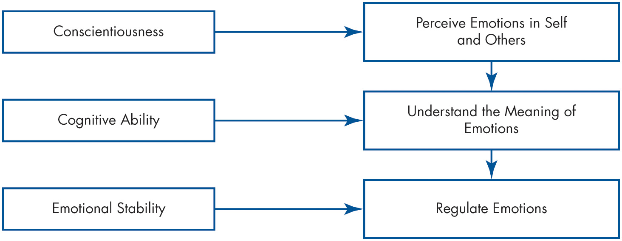
Describe Emotional Intelligence (2 of 2)
Exhibit 4.5 A Cascading Model of Emotional Intelligence
Source: Based on D. L. Joseph and D. A. Newman, “Emotional Intelligence: An Integrative Meta-Analysis and Cascading Model,” Journal of Applied Psychology 95, no. 1 (2010): 54–78.
Notes:
Exhibit 4.5 illustrates the Cascading Model of Emotional Intelligence. Here we see the suggested relationship between Conscientiousness, Cognitive Ability, and Emotional Stability, and the outcomes of detecting one’s own and others’ emotions, understanding what they mean, and regulating the emotions successfully.
Long Description:
The flowchart shows the breakdown of emotional intelligence into three distinct abilities. Conscientiousness leads to perceive emotions in self and others. This along with cognitive leads to understanding the meaning of emotions. This along with emotional stability leads to regulate emotions.

Slide 17
Identify Strategies for Emotion Regulation (1 of 3)
Emotion regulation involves identifying and modifying the emotions you feel.
Emotion Regulation Influences and Outcomes
Diversity in work groups may help us to regulate our emotions more consciously and effectively.
Notes:
The process of identifying and modifying emotions you feel is called emotion regulation.
As you might suspect, not everyone is equally good at regulating emotions.
Individuals who are higher in the personality trait of neuroticism have more trouble doing so and often find their moods are beyond their ability to control.
The workplace environment has an effect on an individual’s tendency to employ emotion regulation.
In general, diversity in work groups increases the likelihood that you will regulate your emotions. Racial diversity also has an effect: if diversity is low, the minority will engage in emotion regulation, perhaps to “fit in” with the majority race as much as possible; if diversity is high and many different races are represented, the majority race will employ emotion regulation, perhaps to integrate themselves with the whole group.
These findings suggest a beneficial outcome of diversity—it may cause us to regulate our emotions more consciously and effectively.
It’s important to note that there is a downside to trying to change the way you feel. The effort involved can be exhausting.
From another perspective, research suggests that avoiding negative emotional experiences is less likely to lead to positive moods than does seeking out positive emotional experiences.

Slide 18
Identify Strategies for Emotion Regulation (2 of 3)
Emotion Regulation Techniques
Surface acting
Deep acting
Emotional suppression
Cognitive reappraisal
Social sharing
While emotion regulation techniques can help us cope with difficult workplace situations, research indicates that the effect varies.
Notes:
Researchers of emotion regulation often study the strategies people employ to change their emotions.
One technique of emotion regulation is emotional suppression, or suppressing initial emotional responses to situations. This response seems to facilitate practical thinking in the short term. However, it appears to be helpful only when a strongly negative event would illicit a distressed emotional reaction during a crisis. Thus, unless we’re truly in a crisis, acknowledging rather than suppressing our emotional responses to situations, and re-evaluating events after they occur, yields the best outcomes.
Cognitive reappraisal, or reframing our outlook on an emotional situation, is one way to effectively regulate emotions. This result suggests that cognitive reappraisal may allow people to change their emotional responses, even when the subject matter is highly emotionally charged.
Another technique with potential for emotion regulation is social sharing, or venting. Research shows that the open expression of emotions can help individuals to regulate their emotions, as opposed to keeping emotions “bottled up.” Social sharing can reduce anger reactions when people can talk about the facts of a bad situation, their feelings about the situation, or any positive aspects of the situation.
While emotion regulation techniques can help us cope with difficult workplace situations, research indicates that the effect varies.

Slide 19
Identify Strategies for Emotion Regulation (3 of 3)
Ethics of Emotion Regulation
Some people might argue or perceive that controlling your emotions is unethical because it requires a degree of acting.
Other people might argue that all emotions should be controlled so you can take a dispassionate perspective.
Notes:
On one end of the continuum, some people might argue or perceive that controlling your emotions is unethical because it requires a degree of acting.
On the other end, people might argue that all emotions should be controlled so you can take a dispassionate perspective.
Both arguments—and all arguments in between—have ethical pros and cons that you will have to decide for yourself.

Slide 20
Apply Concepts About Emotions and Moods to Specific O B Issues (1 of 4)
Selection
E I should be a hiring factor, especially for social jobs.
Decision Making
Positive emotions can lead to better decisions.
Creativity
Positive mood increases flexibility, openness, and creativity.
Notes:
Understanding emotions and moods can help us explain and predict selection, decision making, creativity, motivation, leadership, interpersonal conflict, negotiation, customer service, job attitudes, and deviant workplace behaviors. When it comes to selection, EI should be a hiring factor to ensure employee fit. Positive emotions can lead to better decisions and often more creative ones as well.

Slide 21
Apply Concepts About Emotions and Moods to Specific O B Issues (2 of 4)
Motivation
Positive mood affects expectations of success.
Feedback amplifies this effect.
Leadership
Emotions are important to acceptance of messages from organizational leaders.
Negotiation
Emotions can affect negotiations.
Notes:
Positive mood affects expectations of success by all people, which contributes to their motivation for performance. Leadership is affected by mood and emotion, as people in a positive emotional state are found to be more receptive of messages from leaders. Emotions, those both held and displayed, are effective contributors to negotiation, as the potential impact of displayed emotion on negotiation is large. The best negotiators are probably those who remain emotionally detached.

Slide 22
Apply Concepts About Emotions and Moods to Specific O B Issues (3 of 4)
Customer Service
Emotions influence customer service.
Influences repeat business and customer satisfaction.
Emotional contagion: “catching” emotions.
Work-Life Conflict
A good day at work tends to be followed by a good mood at home and vice versa.
This usually dissipates overnight.
Notes:
Emotions affect customer service in a number of ways, ranging from the attitude of the employee, to the effectiveness of communication with customers, to overall feelings about the outcome. Research has found that people who are on an emotional high at the end of a day take the positive feelings home with them, and vice versa. This good mood, however, tends to dissipate overnight.

Slide 23
Apply Concepts About Emotions and Moods to Specific OB Issues (4 of 4)
Unethical Workplace Behaviors
Negative emotions lead to deviant behaviors.
Actions that violate norms and threaten the organization.
Safety and Injury at Work
Don’t do dangerous work when in a bad mood.
Notes:
Negative emotions can lead to deviant behaviors. These are actions that violate norms and threaten the organization.
Once aggression starts, it’s likely that other people will become angry and aggressive, so the stage is set for a serious escalation of negative behavior.
Managers, therefore, need to stay connected with their employees to gauge emotions and emotional intensity levels.
In addition, research has found that workers asked to do dangerous work while in negative emotional states are more likely to have accidents. Selecting positive team members can have a contagion effect, as positive moods transmit from team member to team member.

Slide 24
Implications for Managers (1 of 3)
Recognize that emotions are a natural part of the workplace and good management does not mean creating an emotion-free environment.
Emotional experience is volatile and unpredictable. Just as we often have trouble predicting what happens in work life, so, too, do we have trouble predicting our emotional responses to what happens. But we can attempt to regulate how we react to the events and respond to others’ emotions.
Notes:
Recognize that emotions are a natural part of the workplace and good management does not mean creating an emotion-free environment.
Emotional experience is volatile and unpredictable. Just as we often have trouble predicting what happens in work life, so, too, do we have trouble predicting our emotional responses to what happens. But we can attempt to regulate how we react to the events and respond to others’ emotions.

Slide 25
Implications for Managers (2 of 3)
As a manager, consider how employees may react when announcing a new policy or taking action that affects them. You may be the catalyst for an affective event that has emotional consequences. Because of this, you should try to anticipate how you could effectively respond to their reactions.
Surface acting and emotional suppression are generally ineffective strategies for managing ones’ emotions. Deep acting, natural emotional expression, and cognitive reappraisal may be more effective strategies.
Notes:
As a manager, consider how employees may react when announcing a new policy or taking action that affects them. You may be the catalyst for an affective event that has emotional consequences. Because of this, you should try to anticipate how you could effectively respond to their reactions.
Surface acting and emotional suppression are generally ineffective strategies for managing ones’ emotions. Deep acting, natural emotional expression, and cognitive reappraisal may be more effective strategies.

Slide 26
Implications for Managers (3 of 3)
Work to develop an understanding of the role of emotions and moods to significantly improve your ability to explain and regulate your own and others’ behavior.
To foster effective decision making, creativity, and motivation, model positive emotions and moods as much as is authentically possible.
In the service sector, encourage authentic, appropriate positive displays of emotion, which are “contagious” to customers and improve service interactions and negotiations.
Notes:
Finally,
Work to develop an understanding of the role of emotions and moods to significantly improve your ability to explain and regulate your own and others’ behavior.
To foster effective decision making, creativity, and motivation, model positive emotions and moods as much as is authentically possible.
In the service sector, encourage authentic, appropriate positive displays of emotion, which are “contagious” to customers and improve service interactions and negotiations.

Slide 27
Discussion Questions
Emotions related to political divisions have intensified over the past few years. How can managers help employees manage their emotions and build awareness of others’ emotions when political divisions spill over into the workplace?
What are the benefits of mindfulness? Have you tried to be more mindful? Why might mindfulness at work be more important today than ever before?
How does the time of day or the day of the week influence your emotions and moods? How can you use that knowledge to improve your overall well-being?

Slide 28

Copyright
This work is protected by United States copyright laws and is provided solely for the use of instructors in teaching their courses and assessing student learning. Dissemination or sale of any part of this work (including on the World Wide Web) will destroy the integrity of the work and is not permitted. The work and materials from it should never be made available to students except by instructors using the accompanying text in their classes. All recipients of this work are expected to abide by these restrictions and to honor the intended pedagogical purposes and the needs of other instructors who rely on these materials.

