Slide 1
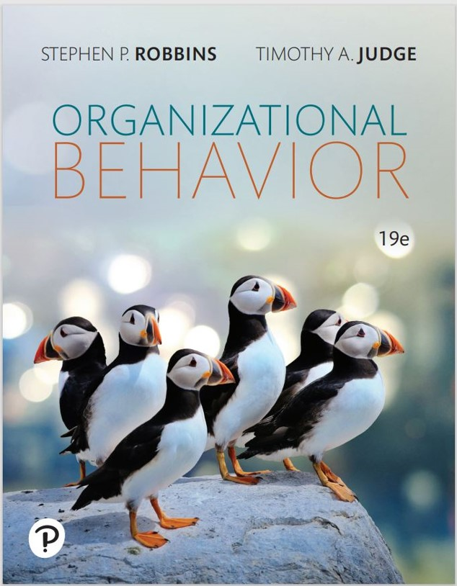
Organizational Behavior
Nineteenth Edition
Chapter 5
Personality and Individual Differences
Copyright © 2023, 2019, 2017 Pearson Education, Inc. All Rights Reserved
Notes:
If this PowerPoint presentation contains mathematical equations, you may need to check that your computer has the following installed:
1) MathType Plugin
2) Math Player (free versions available)
3) NVDA Reader (free versions available)
Welcome to this Organizational Behavior course that uses the 19th edition of the textbook, Organizational Behavior by Robbins and Judge. This is considered among the most widely used OB textbooks in the world. Robbins and Judge are recognized as definitive aggregators of OB concepts, applications, and practices. The course and this book will provide you with a resource that will benefit you throughout your degree program and your professional life.

Slide 2
Learning Objectives (1 of 2)
5.1 Describe the differences between person–job fit and person–organization fit.
5.2 Describe personality, the way it is measured, and the factors that shape it.
5.3 Describe the strengths and weaknesses of the Myers-Briggs Type Indicator (M B T I) personality framework, the Big Five model, and the Dark Triad.
5.4 Discuss how the concepts of core self-evaluation (C S E), self-monitoring, and proactive personality contribute to the understanding of personality.
Notes:
After studying this chapter, you should be able to:
Describe the differences between person–job fit and person–organization fit.
Describe personality, the way it is measured, and the factors that shape it.
Describe the strengths and weaknesses of the Myers-Briggs Type Indicator (MBTI) personality framework, the Big Five model, and the Dark Triad.
Discuss how the concepts of core self-evaluation (CSE), self-monitoring, and proactive personality contribute to the understanding of personality.

Slide 3
Learning Objectives (2 of 2)
5.5 Describe how the situation affects whether personality predicts behavior.
5.6 Demonstrate the relevance of intellectual and physical abilities to O B.
5.7 Contrast terminal and instrumental values.
Notes:
Additional objectives for this chapter.
Describe how the situation affects whether personality predicts behavior.
Demonstrate the relevance of intellectual and physical abilities to OB.
Contrast terminal and instrumental values.

Slide 4
Describe the Differences Between Person– Job Fit and Person–Organization Fit (1 of 4)
Personality–job fit theory identifies six personality types and proposes that the fit between personality type and occupational environment determines satisfaction and turnover.
Notes:
We begin by exploring John Holland’s personality-job fit theory matching job requirements with personality characteristics. Holland presented six personality types and proposed that satisfaction and the propensity to leave a position depend on how well individuals match their personalities to a job. Holland presented the six personality types shown on the next slide and proposed that satisfaction and the propensity to leave a position depend on how well individuals match their personalities to a job.

Slide 5
Describe the Differences Between Person– Job Fit and Person–Organization Fit (2 of 4)
Exhibit 5.1 Holland’s Typology of Personality and Congruent Occupations
Type | Personality Characteristics | Congruent Occupations
Realistic: Prefers physical activities that require skill, strength, and coordination | Shy, genuine, persistent, stable, conforming, practical | Mechanic, drill press operator, assembly-line worker, farmer
Investigative: Prefers activities that involve thinking, organizing, and understanding | Analytical, original, curious, independent | Biologist, economist, mathematician, news reporter
Artistic: Prefers ambiguous and unsystematic activities that allow creative expression | Imaginative, disorderly, idealistic, emotional, impractical | Painter, musician, writer, interior decorator
Social: Prefers activities that involve helping and developing others | Sociable, friendly, cooperative, understanding | Social worker, teacher, counselor, clinical psychologist
Enterprising: Prefers verbal activities in which there are opportunities to influence others and attain power | Self-confident, ambitious, energetic domineering | Lawyer, real estate agent, public relations specialist, small business manager
Conventional: Prefers rule-regulated, orderly, and unambiguous activities | Conforming, efficient, practical, unimaginative, inflexible | Accountant, corporate manager, bank teller, file clerk
Notes:
Exhibit 5.1 describes the six types, their personality characteristics, and examples of the congruent occupations for each. Notably, this theory tends to be supported, with person–job fit strongly predicting job satisfaction, organizational commitment, and intentions to quit.

Slide 6
Describe the Differences Between Person– Job Fit and Person–Organization Fit (3 of 4)
Personality–organization fit theory suggests that people are attracted to and selected by organizations that match their values and leave when there is no compatibility.
Notes:
We have noted that researchers have looked at matching people to organizations and jobs. If an organization has a dynamic and changing environment and needs employees able to change tasks readily and move easily between teams, it is more important that employees’ personalities and individual differences fit with the overall organization’s culture than with the characteristics of any specific job.
Person–organization fit essentially means that people are attracted to and are selected by organizations that match their values (discussed later in this chapter) and they leave organizations that are not compatible with them.

Slide 7
Describe the Differences Between Person– Job Fit and Person–Organization Fit (4 of 4)
Other dimensions of fit
Person–group fit
Person–supervisor fit
Notes:
Person–group fit is important in team settings, where the dynamics of team interactions significantly affect work outcomes.
Person–supervisor fit has become an important area of research because poor fit in this dimension can lead to lower job satisfaction and reduced performance.

Slide 8
Describe Personality, the Way It Is Measured, and the Factors That Shape It (1 of 3)
Defining Personality
Personality is the sum of ways in which an individual reacts to and interacts with the world around them.
Personality traits – enduring characteristics that describe an individual’s behavior.
Notes:
Personality is a dynamic concept, meaning it is changing all the time. It describes the total of growth and development of a person’s whole psychological system. The text definition is that personality is the sum of ways in which an individual reacts to and interacts with others.

Slide 9
Describe Personality, the Way It Is Measured, and the Factors That Shape It (2 of 3)
Measuring Personality
Managers need to know how to measure personality.
Personality tests are useful in hiring decisions and help managers forecast who is best for a job.
The most common means of measuring personality is through self-report surveys.
Notes:
One of the greatest challenges in the study of personality is its measurement. Managers need to know how to measure personality because accurately measuring personality gives managers an advantage in the recruitment and hiring processes. Typically, personality is measured using self-report surveys.
Research indicates that our culture influences the way we rate ourselves. People in individualistic countries trend toward self-enhancement, while people in collectivist countries such as Taiwan, China, and South Korea trend toward self-diminishment.
Observer-ratings surveys provide an independent assessment of personality. Here, a coworker or another observer does the rating.
Though the results of self-reports and observer-ratings surveys are strongly correlated, research suggests observer-ratings surveys predict job success more than self-ratings alone.
However, each can tell us something unique about an individual’s behavior, so a combination of self-reports and observer reports predicts performance better than any one type of information.

Slide 10
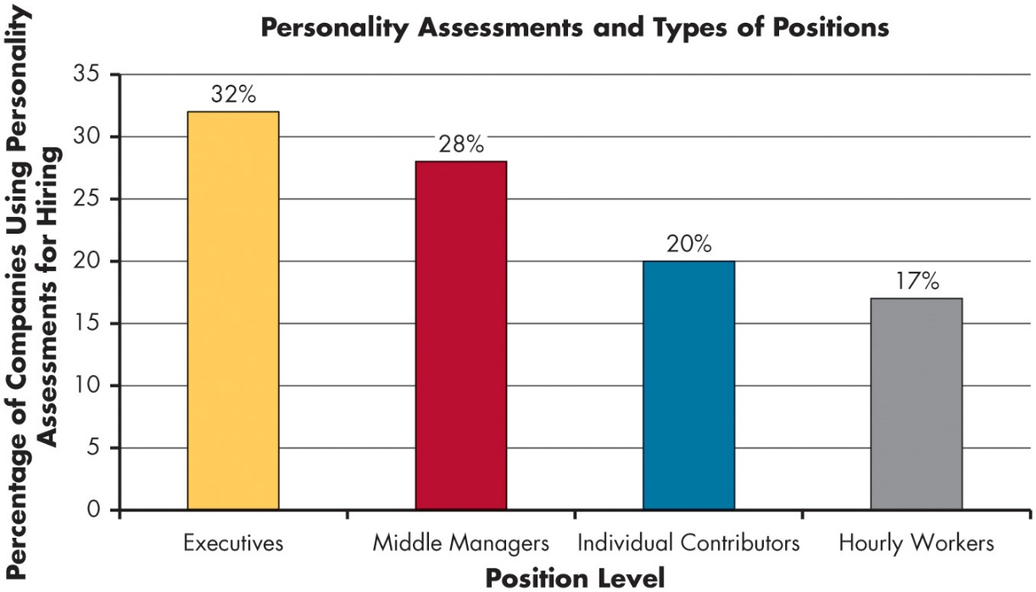
Describe Personality, the Way It Is Measured, and the Factors That Shape It (3 of 3)
OB POLL Are Personality Assessments Only Used for High-Level Positions?
Source: Based on K. Rockwood, “How Accurate Are Personality Assessments,” Society for Human Resource Management, November 21, 2019,
https://www.shrm.org/hr-today/news/hr-magazine/winter2019/pages/how-accurate-are-personality-assessments.aspx
Notes:
More and more organizations are beginning to use personality tests to hire both full-time and hourly employees.
Long Description:
The horizontal axis represents position level showing different levels. The vertical axis represents percentage of companies using personality assessments for hiring ranging from 0 to 35 in increments of 5. The approximate data from the graph is as follows: executives, 32 percent; middle managers, 28 percent; individual contributors, 20 percent; and hourly workers, 17 percent.

Slide 11
Strengths and Weakness of the M B T I, Big Five Model, and Dark Triad (1 of 6)
The most widely used personality framework is the Myers-Briggs Type Indicator (M B T I).
Individuals are classified as:
Extroverted or Introverted (E or I)
Sensing or Intuitive (S or N)
Thinking or Feeling (T or F)
Perceiving or Judging (P or J)
I N T Js are visionaries.
E S T Js are organizers.
E N T Ps are conceptualizers.
Notes:
The most widely used personality framework is the Myers-Briggs Type Indicator (MBTI). Individuals are classified as Extroverted or Introverted (E or I), Sensing or Intuitive (S or N), Thinking or Feeling (T or F), and Perceiving or Judging (P or J). These classifications are then combined into 16 personality types.
INTJs are visionaries. They usually have original minds and great drive. They are characterized as skeptical, critical, independent, determined, and often stubborn.
ESTJs are organizers. They are realistic, logical, analytical, decisive, and have a natural head for business or mechanics.
ENTPs are conceptualizers. They are innovative, individualistic, versatile, and attracted to entrepreneurial ideas. They tend to be resourceful in solving challenging problems but may neglect routine assignments.
MBTI is widely used. It is taken by over 2.5 million people each year and 89 of the Fortune 100 companies use it.

Slide 12
Strengths and Weakness of the M B T I, Big Five Model, and Dark Triad (2 of 6)
The Big Five Model
Conscientiousness
Emotional stability
Extroversion
Openness to experience
Agreeableness
Notes:
An impressive body of research supports that five basic dimensions underlie all other personality dimensions. The five basic dimensions are conscientiousness, emotional stability, extroversion, openness to experience, and extroversion, agreeableness. Let’s look at each of these for a minute.
Conscientiousness is a measure of reliability. A highly conscientious person is responsible, organized, dependable, and persistent. Those who score low on this dimension are easily distracted, disorganized, and unreliable.
Emotional stability describes a person’s ability to withstand stress. People with positive emotional stability tend to be calm, self-confident, and secure. Those with high negative scores tend to be nervous, anxious, depressed, and insecure.
Extroverts tend to be gregarious, assertive, and sociable. Introverts tend to be reserved, timid, and quiet.
Openness to experience suggests the range of interests and fascination with novelty. Extroversion is a comfort level with relationships. Extremely open people are creative, curious, and artistically sensitive. Those at the other end of the openness category are conventional and find comfort in the familiar.
And lastly, agreeableness is an individual’s propensity to defer to others. People who are high on agreeableness are cooperative, warm, and trusting. Low agreeableness is indicated by people who are cold, disagreeable, and antagonistic.

Slide 13
Strengths and Weakness of the M B T I, Big Five Model, and Dark Triad (3 of 6)
Exhibit 5.2 Traits That Matter Most to Business Success at Buyout Companies
Most Important | Less Important
Persistence | Strong oral communication
Attention to detail | Teamwork
Efficiency | Flexibility/adaptability
Analytical skills | Enthusiasm
Setting high standards | Listening skills
Source: Based on S. N. Kaplan, M. M. Klebanov, and M. Sorensen, “Which C E O Characteristics and Abilities Matter?” The Journal of Finance 67, no. 3 (2012): 973–1007.
Notes:
Exhibit 5.2 shows the results of research on personality scores of CEO candidates. The study found that conscientiousness—in the form of persistence, attention to detail, and setting of high standards—was more important than other traits. These results attest to the importance of conscientiousness to organizational success. Although conscientiousness is the best predictor of job performance, other traits are also important.

Slide 14
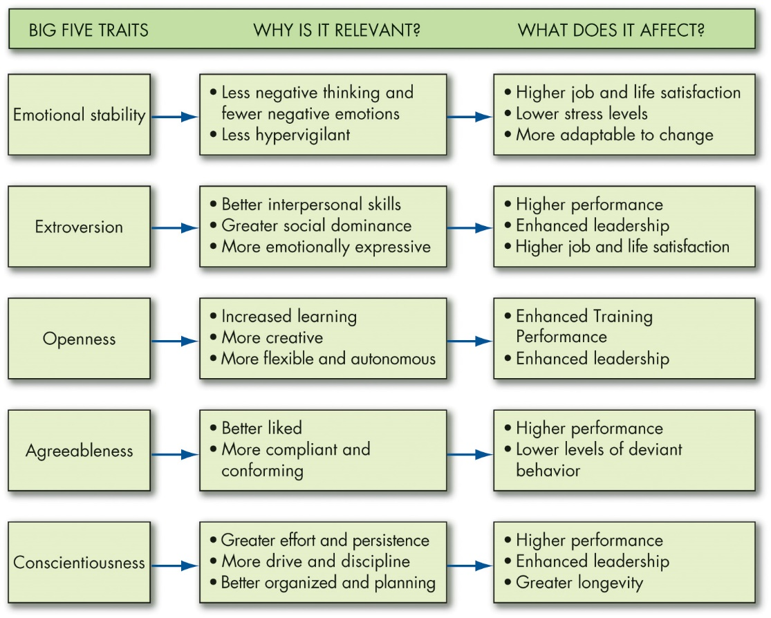
Strengths and Weakness of the M B T I, Big Five Model, and Dark Triad (4 of 6)
Exhibit 5.3 Model of How Big Five Traits Influence OB Criteria
Notes:
All five traits also have other implications for work and for life. Let’s look at these one at a time. Exhibit 5.3 summarizes the points.
Of the Big Five traits, emotional stability is most strongly related to life satisfaction, job satisfaction, and reduced intentions to quit and burnout.
People with high emotional stability can adapt to unexpected or changing demands in the workplace.
Extroversion is a relatively strong predictor of leadership emergence and behaviors in groups. Extroverts also tend to have generally high job satisfaction and reduced burnout. Some negatives are that extroverts can appear to be self-aggrandizing, egoistic, or too dominating and that their social behavior can be disadvantageous for jobs that do not require frequent social interaction.
Individuals who score high on openness to experience are more likely to be effective leaders and are more comfortable with ambiguity. They cope better with organizational change and are more adaptable in changing contexts.
Agreeable individuals are better liked than disagreeable people, which explains why they should perform well in interpersonally oriented jobs such as customer service.
They experience less work–family conflict and are less likely to turnover. People who are agreeable are more satisfied in their jobs and contribute to organizational performance by engaging in citizenship behavior. They are also less likely to engage in organizational deviance.
One downside is that agreeableness is associated with lower levels of career success.
The five personality factors identified in the Big Five model appear in almost all cross-cultural studies.
These studies have included a wide variety of diverse cultures such as China, Israel, Germany, Japan, Spain, Nigeria, Norway, Pakistan, and the United States. Generally, the findings corroborate what has been found in U.S. research: of the Big Five traits, conscientiousness is the best predictor of job performance.
Long Description:
The flowchart has three columns: big five traits, why it is relevant, and what it affects and flow from left to right.
The emotional stability trait relates to less negative thinking and fewer negative emotions, and less hypervigilant. It affects higher job and life satisfaction, lower stress levels, and is more adaptable to change.
The extraversion trait relates to better interpersonal skills, greater social dominance, and more emotional expressive. It affects higher performance, enhanced leadership and higher job and life satisfaction.
Openness traits relates to increased learning, more creative, and is more flexible and autonomous. It affects enhanced training performance and enhanced leadership.
Agreeableness relates to better liked, and more complaint and conforming. It affects higher performance, lower levels of deviant behavior.
Conscientiousness relates to greater effort and persistence, more drive and discipline, and better organized and planning. It affects higher performance, enhanced leadership and greater longevity.

Slide 15
Strengths and Weakness of the M B T I, Big Five Model, and Dark Triad (5 of 6)
The Dark Triad
Machiavellianism: the degree to which an individual is pragmatic, maintains emotional distance, and believes that ends can justify means.
Narcissism: the tendency to be arrogant, have a grandiose sense of self-importance, require excessive admiration, and have a sense of entitlement.
Psychopathy: the tendency for a lack of concern for others and a lack of guilt or remorse when their actions cause harm.
Notes:
The Dark Triad is a group of negative personality traits including Machiavellianism, narcissism, and psychopathy—all three of which have relevance for organizational behavior.
Machiavellianism is the degree to which an individual is pragmatic, maintains emotional distance, and believes that ends can justify means. Narcissism refers to the tendency to be arrogant, have a grandiose sense of self-importance, require excessive admiration, and have a sense of entitlement. And psychopathy is the tendency for a lack of concern for others and a lack of guilt or remorse when their actions cause harm.

Slide 16
Strengths and Weakness of the M B T I, Big Five Model, and Dark Triad (6 of 6)
Other Frameworks
DiSC Framework
Personality characteristics can be represented on a circle with more similar traits in closer proximity, whereas more dissimilar traits are positioned farther apart.
H E X A C O model
Incorporates an additional trait, honesty-humility, into the Big Five framework.
Notes:
Similar to the MBTI, in the DiSC framework, people cluster into personality “types” based on their primary characteristic: dominating (D), influencing (i), steadiness (S), and conscientiousness (C), although the framework recognizes that “people are not their types.” More research and evidence are needed on the DiSC.
The HEXACO model is composed of a new trait, honesty-humility (H), and emotionality (E; i.e., emotional stability), extroversion (X), agreeableness (A), conscientiousness (C), and openness to experience (O).

Slide 17
C S E, Self-Monitoring, and Proactive Personality
Other Personality Traits Relevant to O B
Core Self-Evaluation: bottom line conclusions individuals have about their capabilities, competence, and worth as a person.
Self-Monitoring: measures an individual’s ability to adjust his or her behavior to external, situational factors.
Proactive Personality: people who identify opportunities, show initiative, take action, and persevere until meaningful change occurs.
Notes:
Some other personality traits relevant to OB include core self-evaluation, self-monitoring, and proactive personality.
People who have a positive core self-evaluation see themselves as effective, capable, and in control. People who have a negative core self-evaluation tend to dislike themselves.
Self-monitoring refers to an individual’s ability to adjust his or her behavior to external, situational factors. Individuals high in self-monitoring show considerable adaptability. They are highly sensitive to external cues, can behave differently in different situations, and are capable of presenting striking contradictions between their public persona and their private selves.
An individual with a proactive personality actively takes the initiative to improve his or her current circumstances. These individuals identify opportunities, show initiative, take action, and persevere.

Slide 18
The Situation, Personality, and Behavior (1 of 3)
Situation strength theory indicates that the way personality translates into behavior depends on the strength of the situation.
The degree to which norms, cues, or standards dictate appropriate behavior.
Clarity
Consistency
Constraints
Consequences
Notes:
Research shows that the effect of a particular trait on organizational behavior depends on the situation. Two theoretical frameworks that can help explain this are the situation strength theory and trait activation theory.
Situation strength in an organization can be analyzed in terms of:
Clarity, or the degree to which cues about work duties and responsibilities are available and clear.
Consistency, or the extent to which cues regarding work duties and responsibilities are compatible with one another.
Constraints, or the extent to which individuals’ freedom to decide or act is limited by forces outside their control.
Consequences, or the degree to which decisions or actions have important implications for the organization or its members, clients, suppliers, and so on.

Slide 19
The Situation, Personality, and Behavior (2 of 3)
Trait activation theory (T A T) predicts that some situations, events, or interventions “activate” a trait more than others.
Notes:
Trait activation theory (TAT) helps us foresee which jobs suit certain personalities. For example, a commission-based compensation plan would likely activate extroversion because extroverted people are more reward-sensitive, than, say, open people. Conversely, in jobs that encourage creativity, differences in openness may better predict desired behavior than differences in extroversion.
Together, situation strength and trait activation theories show that the classic debate over nature versus nurture might best be framed as nature and nurture. Not only does each affect behavior, but they interact with one another. Put another way, personality and the situation both affect work behavior, but when the situation is right, the power of personality to predict behavior is even higher.

Slide 20
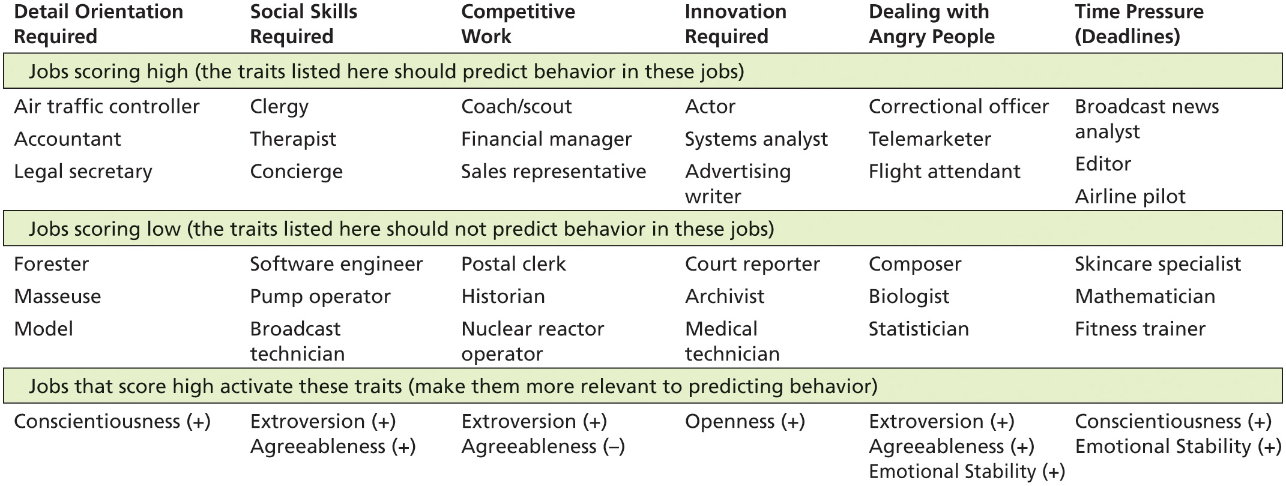
The Situation, Personality, and Behavior (3 of 3)
Exhibit 5.4 Trait Activation Theory: Jobs in Which Certain Big Five Traits Are More Relevant
Note: A plus (+) sign means that individuals who score high on this trait should do better in this job. A minus (−) sign means that individuals who score low on this trait should do better in this job.
Notes:
Trait activation theory predicts that some situations, events, or interventions “activate” a trait more than others. Exhibit 5.4, shown here, provides specific examples of this theory.
Long Description:
The table has 6 columns: detail orientation required, social skills required, competitive work, innovation required, dealing with angry people and time pressure. Data from the table in the format traits: jobs is given below.
Data for jobs scoring high, the traits listed here should predict behavior in these jobs is as follows.
Detail orientation required: air traffic controller, accountant, and legal secretary; Social skills required: clergy, therapist, and concierge; Competitive work: coach or scout; financial manager, and sales representative; Innovation required: actor, systems analyst, and advertising writer; Dealing with angry people: correctional officer, telemarketer, and flight attendant; Time pressure: broadcast news analyst, editor, and airline pilot.
Data for jobs scoring low, the traits listed here should not predict behavior in these jobs is as follows.
Detail orientation required: forester, masseuse, and model; Social skills required: software engineer, pump operator, and broadcast technician; Competitive work: postal clerk, historian, and nuclear reactor operator; Innovation required: court reporter, archivist and medical technician; Dealing with angry people: composer, biologist, and statistician; Time pressure: skincare specialist, mathematician, and fitness trainer.
Data for jobs that score high activate these traits make them more relevant to predicting behavior is as follows.
Detail orientation required: conscientiousness is positive; Social skills required: positive extroversion and agreeableness; Competitive work: extroversion is positive and agreeableness is negative; Innovation required: positive openness; Dealing with angry people: positive extroversion, agreeableness, and emotional stability; Time pressure: positive conscientiousness and emotional stability.

Slide 21
Relevance of Intellectual and Physical Abilities to O B (1 of 5)
Ability is an individual’s current capacity to perform the various tasks in a job.
Intellectual abilities
Physical abilities
Notes:
What does ability mean? As we use the term, ability is an individual’s current capacity to perform the various tasks in a job. Overall abilities are essentially made up of two sets of factors: intellectual and physical.

Slide 22
Relevance of Intellectual and Physical Abilities to O B (2 of 5)
Intellectual abilities
Abilities needed to perform mental activities
General mental ability (G M A)
Wonderlic Ability Test
Notes:
Intellectual abilities are abilities needed to perform mental activities—thinking, reasoning, and problem solving.
Jobs differ in the demands they place on intellectual abilities. Research consistently indicates a correspondence between ability and job performance, especially for complex jobs and tasks.

Slide 23
Relevance of Intellectual and Physical Abilities to O B (3 of 5)
Exhibit 5.5 Dimensions of Intellectual Ability
Dimension | Description | Job Example
Number aptitude | Ability to do speedy and accurate arithmetic | Accountant: Computing the sales tax on a set of items
Verbal comprehension | Ability to understand what is read or heard and the relationship of words to each other | Plant manager: Following corporate policies on hiring
Perceptual speed | Ability to identify visual similarities and differences quickly and accurately | Fire investigator: Identifying clues to support a charge of arson
Inductive reasoning | Ability to identify a logical sequence in a problem and then solve the problem | Market researcher: Forecasting demand for a product in the next time period
Deductive reasoning | Ability to use logic and assess the implications of an argument | Supervisor: Choosing between two different suggestions offered by employees
Spatial visualization | Ability to imagine how an object would look if its position in space were changed | Interior decorator: Redecorating an office
Memory | Ability to retain and recall past experiences | Salesperson: Remembering the names of customers
Notes:
The seven most frequently cited dimensions making up intellectual ability are number aptitude, verbal comprehension, perceptual speed, inductive reasoning, deductive reasoning, spatial visualization, and memory.
Exhibit 5.5 describes these dimensions. These dimensions are positively correlated, so if you score high on verbal comprehension, for example, you are also more likely to score high on spatial visualization. The correlations are high enough that researchers also recognize that intelligence takes on an overall, global form as general mental ability (GMA).

Slide 24
Relevance of Intellectual and Physical Abilities to O B (4 of 5)
Physical abilities
The capacity to do tasks that demand stamina, dexterity, strength, and similar characteristics
Notes:
Though the changing nature of work suggests that intellectual abilities are increasingly important for many jobs, physical abilities have been and will remain valuable. Research on hundreds of jobs has identified the nine basic abilities, shown in the next slide, needed in the performance of physical tasks.

Slide 25
Relevance of Intellectual and Physical Abilities to O B (5 of 5)
Exhibit 5.6 Nine Basic Physical Abilities
Strength Factors | Blank
1. Dynamic strength | Ability to exert muscular force repeatedly or continuously over time
2. Trunk strength | Ability to exert muscular strength using the trunk (particularly abdominal) muscles
3. Static strength | Ability to exert force against external objects
4. Explosive strength | Ability to expend a maximum of energy in one or a series of explosive acts
Flexibility Factors | Blank
5. Extent flexibility | Ability to move the trunk and back muscles as far as possible
6. Dynamic flexibility | Ability to make rapid, repeated flexing movements
Other Factors | Blank
7. Body coordination | Ability to coordinate the simultaneous actions of different parts of the body
8. Balance | Ability to maintain equilibrium despite forces pulling off balance
9. Stamina | Ability to continue maximum effort requiring prolonged effort over time
Notes:
Exhibit 5.6 describes the nine basic abilities needed to perform physical tasks.

Slide 26
Contrast Terminal and Instrumental Values (1 of 4)
Values—basic convictions about what is right, good, or desirable.
Value system—ranks values in terms of intensity
The Importance and Organization of Values
Values:
Lay the foundation for understanding of attitudes and motivation
Influence attitudes and behaviors
Notes:
Values represent basic convictions that a person has about what is right, good, or desirable. Values have both content and intensity attributes, and have the tendency to be stable and enduring. An individual’s set of values ranked in terms of intensity is considered the person’s value system. Values lay the foundation for our understanding of attitudes and motivation and generally influence attitudes and behaviors.

Slide 27
Contrast Terminal and Instrumental Values (2 of 4)
Terminal versus Instrumental Values
Terminal values: desirable end-states of existence.
Instrumental values: preferred modes of behavior or means of achieving terminal values.
Notes:
A specific mode of conduct or end-state of existence is personally or socially preferable to an opposite or converse mode of conduct or end-state of existence. Terminal values refer to desirable end-states of existence. These are the goals that a person would like to achieve during his or her lifetime. Instrumental values refer to preferable modes of behavior, that is, the means of achieving the terminal values.

Slide 28
Contrast Terminal and Instrumental Values (3 of 4)
Generational Values
Lack solid research to support actual generational differences
Research does support perceived generational differences
Can lead to ageist or discriminatory climates
Notes:
Though it is fascinating to think about generational values, remember that these classifications lack solid research support. Reviews suggest that many of the generalizations are either overblown or incorrect.
Although there is little validity to generational differences, nevertheless, these differences are still perpetuated as stereotypes that are often applied in the workplace, which can result in ageist or discriminatory climates if left unchecked.

Slide 29
Contrast Terminal and Instrumental Values (4 of 4)
Exhibit 5.7 Dominant Generational Work Values in Today's Workforce
Generational Cohort | Born | Entered the Workforce | Dominant Work Values
Baby Boomers | 1946–1964 | 1961–1979 | Optimism, Competition, Hard Work, Teamwork, Loyalty, Duty
Generation Xers | 1965–1980 | 1980–1995 | Flexibility, Informality, Skepticism, Independence, Diversity, Work-Life Balance, Self-Enhancement
Millennials | 1981–2000 | 1996–2015 | Competition, Open-mindedness, Achievement, Responsibility, Uniqueness, Quality Relationships
Generation Zers | 2001–2020 | 2015 to present | Multiculturalism, Diversity, Entrepreneurship, Progressiveness, Ambidexterity, Personalization, Individuality, Creativity, and Innovation
Source: Based on Purdue Global, Generational Differences in the Workplace, accessed February 18, 2021,
https://www.purdueglobal.edu/education-partnerships/generational-workforce-differences-infographic/
Notes:
Exhibit 5.7 segments employees by the era during which they entered the workforce.

Slide 30
Implications for Managers (1 of 4)
Evaluate jobs, workgroups, and your organization to determine the optimal value, interest, and personality fit with employees.
Consider screening job candidates for the personality traits that are most relevant to your organization’s values (e.g., conscientiousness, extroversion) and the requirements most important for success in the job.
Notes:
Evaluate jobs, workgroups, and your organization to determine the optimal value, interest, and personality fit with employees.
Consider screening job candidates for the personality traits that are most relevant to your organization’s values (e.g., conscientiousness, extroversion) and the requirements most important for success in the job.

Slide 31
Implications for Managers (2 of 4)
Although many personality frameworks exist, there are striking differences in evidence and empirical support across measures. Based on these findings, managers should critically evaluate personality frameworks and the instruments used to measure them before making substantive decisions based on their results. We recommend the Big Five as this is the most widely supported personality framework to date.
Notes:
Although many personality frameworks exist, there are striking differences in evidence and empirical support across measures. Based on these findings, managers should critically evaluate personality frameworks and the instruments used to measure them before making substantive decisions based on their results. We recommend the Big Five as this is the most widely supported personality framework to date.

Slide 32
Implications for Managers (3 of 4)
Although some personality traits are more suitable for predicting job performance while on the job, other personality traits can predict how well employees do in training and onboarding. Employees with certain traits may do better with additional support and guidance to prevent early turnover and contribute to their career development.
Consider situational factors when evaluating observable personality traits. Policies, practices, and even events can make situations strong or weak or elicit the display of (un)desired personality traits. Attempt to modify the situation to encourage or dissuade certain behaviors but recognize that this can sometimes have unintended effects.
Notes:
Although some personality traits are more suitable for predicting job performance while on the job, other personality traits can predict how well employees do in training and onboarding. Employees with certain traits may do better with additional support and guidance to prevent early turnover and contribute to their career development.
Consider situational factors when evaluating observable personality traits. Policies, practices, and even events can make situations strong or weak or elicit the display of (un)desired personality traits. Attempt to modify the situation to encourage or dissuade certain behaviors but recognize that this can sometimes have unintended effects.

Slide 33
Implications for Managers (4 of 4)
Although abilities are often the best predictors of job performance outside of proving that one can directly do the job, they tend to be wrought with disparate impact concerns. Exercise caution in assessing applicants and candidates for ability unless intellectual or physical abilities are necessary and required for the job.
Resist the temptation to group coworkers and employees into generational categories—the evidence suggests that these differences are not very compelling. Furthermore, these generational categories can lead to harmful stereotyping and potentially to disparate impact or treatment toward employees from protected age classes.
Notes:
Although abilities are often the best predictors of job performance outside of proving that one can directly do the job, they tend to be wrought with disparate impact concerns. Exercise caution in assessing applicants and candidates for ability unless intellectual or physical abilities are necessary and required for the job.
Resist the temptation to group coworkers and employees into generational categories—the evidence suggests that these differences are not very compelling. Furthermore, these generational categories can lead to harmful stereotyping and potentially to disparate impact or treatment toward employees from protected age classes.

Slide 34
Discussion Questions
Choose three different types of jobs that are open at your university. Then, using John Holland’s typology, describe what type of personality characteristics best fit the job and why.
Think about jobs, internships, or leadership roles that you’ve had. What abilities and traits do you possess that made you well suited to your position?
Many Baby Boomers are retiring just as people from Generation Z begin their careers. Discuss what this shift means to values within the workplace. As Generation X rises to senior management levels, how will their values change the status quo?

Slide 35

Copyright
This work is protected by United States copyright laws and is provided solely for the use of instructors in teaching their courses and assessing student learning. Dissemination or sale of any part of this work (including on the World Wide Web) will destroy the integrity of the work and is not permitted. The work and materials from it should never be made available to students except by instructors using the accompanying text in their classes. All recipients of this work are expected to abide by these restrictions and to honor the intended pedagogical purposes and the needs of other instructors who rely on these materials.

