Slide 1
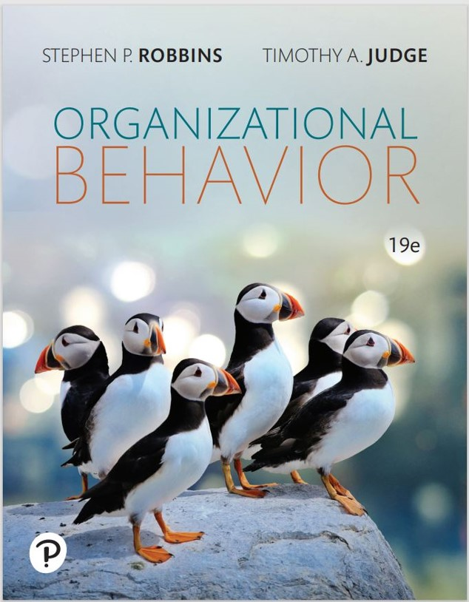
Organizational Behavior
Nineteenth Edition
Chapter 6
Perception and Individual Decision Making
Copyright © 2023, 2019, 2017 Pearson Education, Inc. All Rights Reserved
Notes:
If this PowerPoint presentation contains mathematical equations, you may need to check that your computer has the following installed:
1) MathType Plugin
2) Math Player (free versions available)
3) NVDA Reader (free versions available)
Welcome to this Organizational Behavior course that uses the 19th edition of the textbook, Organizational Behavior by Robbins and Judge. This is considered among the most widely used OB textbooks in the world. Robbins and Judge are recognized as definitive aggregators of OB concepts, applications, and practices. The course and this book will provide you with a resource that will benefit you throughout your degree program and your professional life.

Slide 2
Learning Objectives
6.1 Explain the factors that influence perception.
6.2 Describe attribution theory.
6.3 Explain the link between perception and decision making.
6.4 Contrast the rational model of decision making with bounded rationality and intuition.
6.5 Explain how individual differences and organizational constraints affect decision making.
6.6 Contrast the three ethical decision criteria.
6.7 Describe the three-stage model of creativity.
Notes:
After studying this chapter, you should be able to:
Explain the factors that influence perception.
Describe attribution theory.
Explain the link between perception and decision making.
Contrast the rational model of decision making with bounded rationality and intuition.
Explain how individual differences and organizational constraints affect decision making.
Contrast the three ethical decision criteria.
Describe the three-stage model of creativity.

Slide 3
Explain the Factors That Influence Perception (1 of 2)
Perception is a process by which individuals organize and interpret their sensory impressions to give meaning to their environment.
It is important to the study of O B because people’s behaviors are based on their perception of what reality is, not on reality itself.
Notes:
Perception is a process by which individuals organize and interpret their sensory impressions to give meaning to their environment. It is important to the study of OB because people’s behaviors are based on their perception of what reality is, not on reality itself.

Slide 4
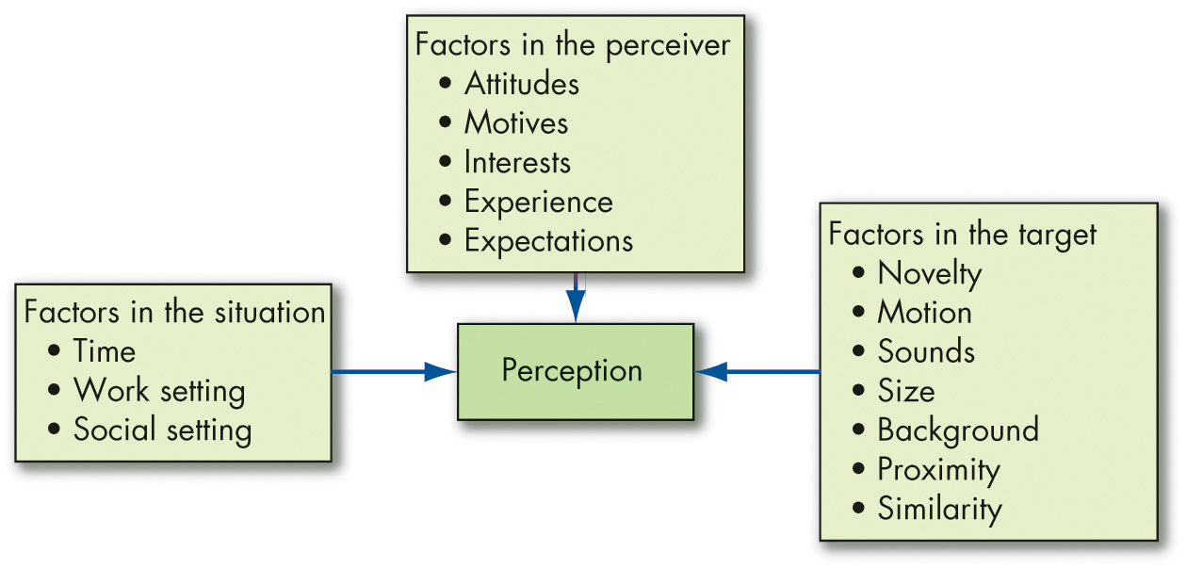
Explain the Factors That Influence Perception (2 of 2)
Exhibit 6.1 Factors That Influence Perception
Notes:
Many factors shape and sometimes distort perception. These factors can reside in the perceiver, the object or target being perceived, or the situation in which the perception is made (see Exhibit 6.1).
Long Description:
Factors in the perceiver include attitudes, motives, interests, experience, and expectations.
Factors in the target include novelty, motion, sounds, size, background, proximity, and similarity.
Factors in the situation include time, work setting, and social setting.

Slide 5
Explain Attribution Theory (1 of 11)
Attribution theory suggests that when we observe an individual’s behavior, we attempt to determine whether it was internally or externally caused.
Determination depends on three factors:
Distinctiveness
Consensus
Consistency
Notes:
Attribution theory suggests that when we observe an individual’s behavior, we attempt to determine whether it was internally or externally caused. That determination depends largely on three factors: distinctiveness, consensus, and consistency. We’ll talk more about each of these in a minute.

Slide 6
Explain Attribution Theory (2 of 11)
Clarification of the differences between internal and external causation
Internally caused—those that are believed to be under the personal control of the individual.
Externally caused—resulting from outside causes.
Notes:
First, let’s clarify the differences between internal and external causation. Internally caused behaviors are those who are believed to be under the personal control of the individual. Externally caused behavior is seen as resulting from outside causes; that is, the person is seen as having been forced into the behavior by the situation.

Slide 7
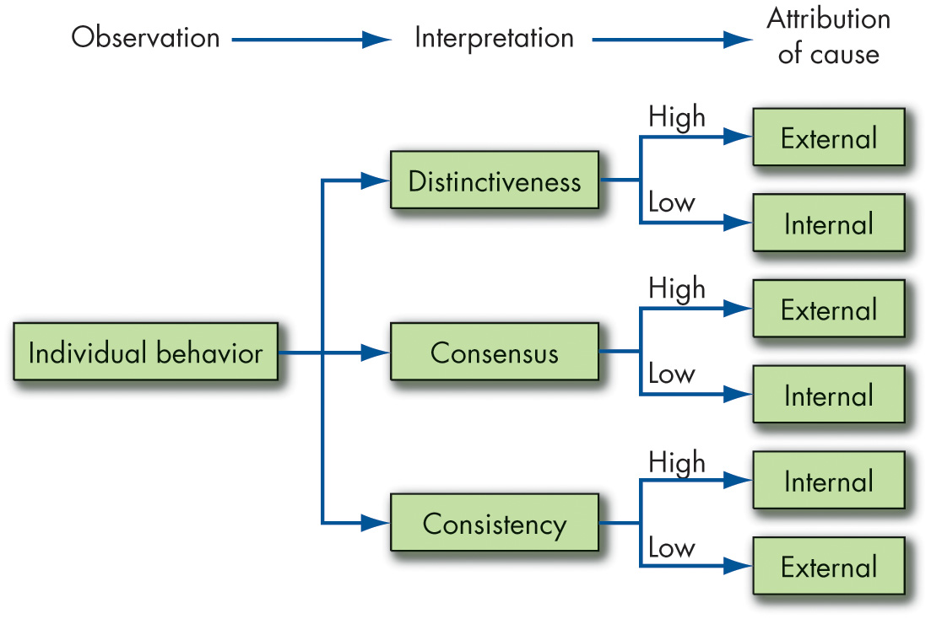
Explain Attribution Theory (3 of 11)
Exhibit 6.2 Attribution Theory
Notes:
Now, let’s look at each of the three determining factors shown here in Exhibit 6.2, more closely. Distinctiveness refers to whether an individual displays different behaviors in different situations. Consensus occurs if everyone who is faced with a similar situation responds in the same way. Finally, is there consistency in a person’s actions?
Long Description:
The data from the flowchart from left to right is as follows. The individual behavior interprets distinctiveness, consensus, and consistency. Each interpretation divides into external attribution, when interpretation is high, and internal attribution when interpretation is low.

Slide 8
Explain Attribution Theory (4 of 11)
Fundamental attribution error
We have a tendency to underestimate the influence of external factors and overestimate the influence of internal or personal factors.
Self-serving bias
Individuals attribute their own successes to internal factors.
Notes:
Errors or biases can distort attributions. Fundamental attribution error occurs when we underestimate the influence of external factors and overestimate the influence of internal or personal factors. Self-serving bias occurs when individuals attribute their own successes to internal factors, such as ability or effort, while putting the blame for failure on external factors, such as luck.

Slide 9
Explain Attribution Theory (5 of 11)
Common Shortcuts in Judging Others
Selective perception
Any characteristic that makes a person, object, or event stand out will increase the probability that it will be perceived.
Since we can’t observe everything going on around us, we engage in selective perception.
Notes:
We use a number of shortcuts when we judge others, but it’s important to recognize that while these shortcuts can be helpful, they can also result in significant distortions.
Let’s begin with selective perception. Any characteristic that makes a person, object, or event stand out will increase the probability that it will be perceived. Since we can’t observe everything going on around us, we engage in selective perception.

Slide 10
Explain Attribution Theory (6 of 11)
Halo effect
The halo effect occurs when we draw a positive general impression based on a single characteristic.
Horns effect
The tendency to draw a negative general impression about an individual based on a single characteristic.
Contrast effects
We do not evaluate a person in isolation.
Our reaction to one person is influenced by other persons we have recently encountered.
Notes:
When we draw a positive impression about an individual based on a single characteristic, such as intelligence, sociability, or appearance, a halo effect is operating. In contrast, the horns effect is the tendency to draw a negative general impression about an individual based on a single characteristic.
Another shortcut involves contrast effects. We do not evaluate a person in isolation. Our reaction to one person is influenced by other individuals we have recently encountered. For example, an interview situation in which one sees a pool of job applicants can distort perception. Distortions of any given candidate’s evaluation can occur as a result of his or her place in the interview schedule.

Slide 11
Explain Attribution Theory (7 of 11)
Stereotyping
Judging someone based on one’s perception of the group to which that person belongs.
We have to monitor ourselves to make sure we’re not unfairly applying a stereotype in our evaluations and decisions.
Notes:
Stereotyping involves judging someone based on our perception of the group to which that person belongs. Generalization is not without advantages—it is a means of simplifying a complex world, and it permits us to maintain consistency. The problem, of course, is when we inaccurately stereotype. We have to monitor ourselves to make sure we’re not unfairly applying a stereotype in our evaluations and decisions.

Slide 12
Explain Attribution Theory (8 of 11)
Applications of Shortcuts in Organizations
Employment Interview
Evidence indicates that interviewers make perceptual judgments that are often inaccurate.
Interviewers generally draw early impressions that become very quickly entrenched.
Studies indicate that most interviewers’ decisions change very little after the first four or five minutes of the interview.
Notes:
Let’s look at some specific applications of shortcuts in organizations starting with the employment interview. Evidence indicates that interviewers make perceptual judgments that are often inaccurate. Moreover, early impressions can become quickly entrenched. In fact, research shows that most interviewers’ decisions change very little after the first few minutes of an interview.

Slide 13
Explain Attribution Theory (9 of 11)
Performance Expectations
Evidence demonstrates that people will attempt to validate their perceptions of reality, even when those perceptions are faulty.
Self-fulfilling prophecy, or the Pygmalion effect, characterizes the fact that people’s expectations determine their behavior.
Expectations become reality.
Notes:
A second application of shortcuts involves performance expectations. Evidence demonstrates that people will attempt to validate their perceptions of reality, even when those perceptions are faulty. Self-fulfilling prophecy, or the Pygmalion effect, characterizes the fact that people’s expectations determine their behavior. Expectations become reality.

Slide 14
Explain Attribution Theory (10 of 11)
Performance Evaluation
An employee’s performance appraisal is very much dependent upon the perceptual process.
Many jobs are evaluated in subjective terms.
Subjective measures are problematic because of the errors we have discussed.
Notes:
A third application of shortcuts involves performance evaluation. An employee’s performance appraisal is very much dependent upon the perceptual process. Although the appraisal can be objective, many jobs are evaluated in subjective terms. Subjective measures can be problematic because of selective perception, contrast effects, halo effects, and so on.

Slide 15
Explain Attribution Theory (11 of 11)
Social Media
About four in ten organizations use social media or online searches to screen applicants for jobs.
Research supports the social media decision-making bias link.
Potential Remedies
AI-assisted performance assessments
Other decision-support systems
Notes:
Social media and the Internet have made it easier than ever to obtain information about other people. This imperfect window into others’ lives opens the possibility of employees and managers making shortcut evaluations of others, such as applicants and candidates—sometimes without even meeting them in person. However, using social media for hiring can result in biased decision making.
For example, in a series of studies using Facebook profiles, researchers found that when the applicant’s political affiliation displayed on their social media matched the hiring manager’s, the manager was more likely to perceive the applicant as similar, likeable, a potentially strong performer, and more hirable than one with a different political affiliation.
Technology has been proving useful in combatting these biases—for example, AI-assisted performance assessments and other decision-support systems can help reduce these common shortcuts in judging others.

Slide 16
Explain the Link Between Perception and Decision Making
Individuals make decisions—choosing from two or more alternatives.
Decision making occurs as a reaction to a problem.
There is a discrepancy between some current state of affairs and some desired state, requiring consideration of alternative courses of action.
One person’s problem is another’s satisfactory state of affairs.
Notes:
Individuals in organizations constantly make decisions. They make choices from among two or more options many times during the day, and at different levels of importance or intensity.
Usually, decision making occurs as a reaction to a problem: there is a discrepancy between some current state of affairs and some desired state, requiring consideration of alternative courses of action. One person’s problem is another’s satisfactory state of affairs.
Every decision requires interpretation and evaluation of information. Data are typically received from multiple sources. The perceptions of the decision maker will decide which data are relevant to the decision and which are not. Alternatives will be developed, and the strengths and weaknesses of each need to be evaluated.

Slide 17
Rational Model of Decision Making Versus Bounded Rationality and Intuition (1 of 11)
Exhibit 6.3 Steps in the Rational Decision-Making Model
Define the problem.
Identify the decision criteria.
Allocate weights to the criteria.
Develop the alternatives.
Evaluate the alternatives.
Select the best alternative.
Notes:
We often think the best decision maker is rational and makes consistent, value-maximizing choices within specified constraints. This Rational Decision-Making process follows six steps, as shown here in Exhibit 6.3.
Step 1: Define the problem.
Step 2: Identify the decision criteria.
Step 3: Allocate weights to the criteria.
Step 4: Develop the alternatives.
Step 5: Evaluate the alternatives.
Step 6: Select the best alternative.

Slide 18
Rational Model of Decision Making Versus Bounded Rationality and Intuition (2 of 11)
Assumptions of the Rational Model
The decision maker…
Has complete information.
Is able to identify all the relevant options in an unbiased manner.
Chooses the option with the highest utility.
Most decisions in the real world don’t follow the rational model.
Notes:
The rational decision-making model assumes the decision maker has complete information, is able to identify all the relevant options in an unbiased manner, and chooses the option with the highest utility.
Most decisions in the real world don’t follow the rational model. People are usually content to find an acceptable or reasonable solution to a problem rather than an optimal one. Choices tend to be limited to the neighborhood of the problem symptom and the current alternative. As one expert in decision making put it, “Most significant decisions are made by judgment, rather than by a defined prescriptive model.” People are remarkably unaware of making suboptimal decisions.

Slide 19
Rational Model of Decision Making Versus Bounded Rationality and Intuition (3 of 11)
Bounded Rationality
Most people respond to a complex problem by reducing it to a level at which it can be readily understood.
People satisfice—they seek solutions that are satisfactory and sufficient.
Individuals operate within the confines of bounded rationality.
They construct simplified models that extract the essential features.
Notes:
When faced with a complex problem, most people respond by reducing the problem to a level at which it can be readily understood. This is because the limited information-processing capability of human beings makes it impossible to assimilate and understand all the information necessary to optimize. Instead, people satisfice; that is, they seek solutions that are satisfactory and sufficient. Individuals operate within the confines of bounded rationality and construct simplified models that extract the essential features.

Slide 20
Rational Model of Decision Making Versus Bounded Rationality and Intuition (4 of 11)
Intractable problem—a problem that may change entirely or become irrelevant before we finish the process of organizing our thoughts, gathering information, analyzing the information, and making judgments or decisions.
Notes:
Many problems do not have an optimal solution because they are too complicated to fit the rational decision-making model. Furthermore, if we were to use the rational approach, we may run into a situation where the problem is intractable.
To use the rational model in the real world, you need to gather a great deal of information about all the options, compute applicable weights, and then calculate values across a huge number of criteria. All these processes can cost time, energy, and money. If there are many unknown weights and preferences, the fully rational model may not be any more accurate than a best guess. Sometimes a fast-and-frugal process of solving problems is the best option.

Slide 21
Rational Model of Decision Making Versus Bounded Rationality and Intuition (5 of 11)
Intuition
Intuitive decision making occurs outside conscious thought; it relies on holistic associations, or links between disparate pieces of information, is fast, and is affectively charged, meaning it usually engages the emotions.
While intuition is not rational, it is not inherently bad or necessarily wrong, nor does it always contradict rational analysis.
Notes:
Another important decision-making technique is intuition. Perhaps the least rational way of making decisions, intuitive decision making is an unconscious process created from distilled experience. It occurs outside conscious thought, relies on holistic associations, or links between disparate pieces of information, is fast, and is affectively charged, meaning it usually engages the emotions. While intuition isn’t rational, it isn’t necessarily wrong. Nor does it always contradict rational analysis; rather, the two can complement each other. Within the confines of bounded rationality, in situations requiring quick decisions (e.g., crises) or highly risky or certain contexts, we may need to rely on experts’ intuitions to identify quick solutions or take desirable risks.

Slide 22
Rational Model of Decision Making Versus Bounded Rationality and Intuition (6 of 11)
Exhibit 6.4 Reducing Biases and Errors
Focus on Goals. Without goals, you cannot be rational, you do not know what information you need, you do not know which information is relevant and which is irrelevant, you will find it difficult to choose between alternatives, and you are far more likely to experience regret over the choices you make. Clear goals make decision making easier and help you eliminate options that are inconsistent with your interests.
Look for Information That Disconfirms Your Beliefs. One of the most effective means for counteracting overconfidence and the confirmation and hindsight biases is to actively look for information that contradicts your beliefs and assumptions. When we overtly consider various ways we could be wrong, we challenge our tendencies to think we are smarter than we actually are.
Notes:
Decision makers allow systematic biases and errors to creep into their judgments. People tend to rely on experience, impulses, gut feelings, and rules of thumb, which can all lead to distortions. Exhibit 6.4 suggests some techniques to avoid decision biases or errors beginning with focusing on goals.

Slide 23
Rational Model of Decision Making Versus Bounded Rationality and Intuition (7 of 11)
Exhibit 6.4 Reducing Biases and Errors
Do Not Try to Create Meaning out of Random Events. The educated mind has been trained to look for cause-and-effect relationships. When something happens, we ask why. And when we cannot find reasons, we often invent them. You have to accept that there are events in life that are outside your control. Ask yourself if patterns can be meaningfully explained or whether they are merely coincidence. Do not attempt to create meaning out of coincidence.
Increase Your Options. No matter how many options you have identified, your final choice can be no better than the best of the option set you have selected. This argues for increasing your decision alternatives and for using creativity in developing a wide range of diverse choices. The more alternatives you can generate, and the more diverse those alternatives, the greater your chance of finding an outstanding one.
Source: Based on S. P. Robbins, Decide & Conquer: Making Winning Decisions and Taking Control of Your Life (Upper Saddle River, NJ: Financial Times/Prentice Hall, 2004), 164–68.
Notes:
Decision makers allow systematic biases and errors to creep into their judgments. People tend to rely on experience, impulses, gut feelings, and rules of thumb, which can all lead to distortions. Exhibit 6.4 suggests some techniques to avoid decision biases or errors beginning with focusing on goals.

Slide 24
Rational Model of Decision Making Versus Bounded Rationality and Intuition (8 of 11)
Common Biases and Errors in Decision Making
Overconfidence Bias: individuals whose intellectual and interpersonal abilities are weakest are most likely to overestimate their performance and ability.
Anchoring Bias: fixating on initial information as a starting point and failing to adequately adjust for subsequent information.
Notes:
Decision makers engage in bounded rationality, but they also allow systematic biases and errors to creep into their judgments.
The first is overconfidence bias. Individuals whose intellectual and interpersonal abilities are weakest are most likely to overestimate their performance and ability. The tendency to be too confident about their ideas might keep some from planning how to avoid problems that arise. Investor overconfidence operates in a variety of ways. People think they know more than they do, and it costs them. Investors, especially novices, overestimate not just their own skill in processing information, but also the quality of the information with which they’re working.
A second bias is anchoring bias. This involves fixating on initial information as a starting point and failing to adequately adjust for subsequent information. Anchors are widely used by people in advertising, management, politics, real estate, and law, where persuasion skills are important. Any time a negotiation takes place, so does anchoring.

Slide 25
Rational Model of Decision Making Versus Bounded Rationality and Intuition (9 of 11)
Confirmation Bias: type of selective perception.
Seek out information that reaffirms past choices, and discount information that contradicts past judgments.
Availability Bias: tendency for people to base judgments on information that is readily available.
Notes:
A third bias is confirmation bias. It is a type of selective perception. Here we seek out information that reaffirms past choices, and discount information that contradicts past judgments.
Fourth is availability bias, or the tendency for people to base judgments on information that is readily available.

Slide 26
Rational Model of Decision Making Versus Bounded Rationality and Intuition (10 of 11)
Escalation of Commitment: staying with a decision even when there is clear evidence that it’s wrong.
Likely to occur when individuals view themselves as responsible for the outcome.
Randomness Error: our tendency to believe we can predict the outcome of random events.
Decision making becomes impaired when we try to create meaning out of random events.
Notes:
Escalation of commitment is a bias that occurs when we stay with a decision even when there is clear evidence that it’s wrong. This type of bias is most likely to occur when individuals view themselves as responsible for the outcome.
Another bias is randomness error, which is rooted in our tendency to believe we can predict the outcome of random events. Decision making becomes impaired when we try to create meaning out of random events.

Slide 27
Rational Model of Decision Making Versus Bounded Rationality and Intuition (11 of 11)
Risk Aversion: the tendency to prefer a sure thing instead of a risky outcome.
Ambitious people with power that can be taken away appear to be especially risk averse.
People will more likely engage in risk-seeking behavior for negative outcomes, and risk-averse behavior for positive outcomes, when under stress.
Hindsight Bias: the tendency to believe falsely that one has accurately predicted the outcome of an event, after that outcome is actually known.
Notes:
Another bias, risk aversion, is the tendency to prefer a sure thing instead of a risky outcome. Overall, the framing of a decision has an effect on whether or not people will engage in risk aversive behavior—when decisions are framed positively, such as a potential gain of $50, people will be more risk averse (conversely, when the decision is framed in a negative manner, such as a loss of $50, people will engage in riskier behaviors). Generally speaking, people will more likely engage in risk-seeking behavior for negative outcomes, and risk-averse behavior for positive outcomes, when under stress.
Finally, hindsight bias is the tendency to believe falsely that one has accurately predicted the outcome of an event, after that outcome is actually known. Hindsight bias reduces our ability to learn from the past.

Slide 28
Individual Differences, Organizational Constraints, and Decision Making (1 of 2)
Individual Differences
Personality
Intuition
Self-esteem
Narcissism
Gender
Mental Ability
Cultural Differences
Notes:
Individual differences and organizational constraints also affect decision making.
Personality influences our decisions. First, employees differ in the extent to which they trust their intuitions, and this can lead them to make a riskier decision or even to be harsher when condemning unethical behavior. Second, people with high self-esteem are strongly motivated to maintain it, so they use the self-serving biases to preserve it. They may be more prone to blame others for their failures while taking credit for successes. Third, narcissists naturally tend to be prone to overconfidence or overclaiming and to self-serving biases
Additional individual characteristics include gender.
Next is intellectual ability. We know people with higher levels of mental ability are able to process information more quickly, solve problems more accurately, and learn faster, so you might expect them also to be less susceptible to common decision errors.
Cultural differences also come into play. The rational model makes no acknowledgment of cultural differences, nor does the bulk of OB research literature on decision making. However, it is important to recognize that the cultural background of a decision maker can significantly influence the selection of problems, the depth of analysis, the importance placed on logic and rationality, and whether organizational decisions should be made autocratically by an individual manager or collectively in groups. Cultures differ in their time orientation, the importance of rationality, their belief in the ability of people to solve problems, and their preference for collective decision making. While rationality is valued in North America, that’s not true elsewhere in the world.
Some cultures emphasize solving problems, while others focus on accepting situations as they are. The United States falls in the first category, while Thailand and Indonesia are examples of the second. Because problem-solving managers believe they can and should change situations to their benefit, U.S. managers might identify a problem long before their Thai or Indonesian counterparts would choose to recognize it. Decision making by Japanese managers is much more group-oriented than in the United States. The Japanese value conformity and cooperation. Before Japanese CEOs make an important decision, they collect a large amount of information, which they use in consensus-forming group decisions. In short, there are probably important cultural differences in decision making, but unfortunately there is not yet much research to identify them.

Slide 29
Individual Differences, Organizational Constraints, and Decision Making (2 of 2)
Organizational Constraints
Performance Evaluation Systems
Reward Systems
Formal Regulations
Time Constraints
Historical Precedents
Decision-Making in Times of Crisis
Notes:
Organizational constraints that impinge on decision making begin with performance evaluation. Managers are strongly influenced in their decision making by the criteria by which they are evaluated. The organization’s reward system influences decision makers by suggesting to them what choices are preferable in terms of personal payoff.
Other constraints are the formal rules, policies, procedures, and other formalized regulations created by organizations to standardize the behavior of their members. System-imposed time constraints are another influence wherein organizations impose deadlines on decisions.
Finally, historical precedents can serve to impede decision making. Decisions have a context. Individual decisions are more accurately characterized as points in a stream of decisions. Decisions made in the past are ghosts, which continually haunt current choices. For example, it is common knowledge that the largest determining factor of the size of any given year’s budget is last year’s budget.

Slide 30
Contrast the Three Ethical Decision Criteria (1 of 3)
Utilitarianism: decisions are made solely on the basis of their outcomes or consequences.
Focus on rights: calls on individuals to make decisions consistent with fundamental liberties and privileges as set forth in documents such as the Bill of Rights.
Protects whistleblowers.
Impose and enforce rules fairly and impartially to ensure justice or an equitable distribution of benefits and costs.
Notes:
Ethical considerations should be an important criterion in organizational decision making. The first is utilitarianism, which occurs when decisions are made solely on the basis of their outcomes or consequences. The focus on rights calls on individuals to make decisions consistent with fundamental liberties and privileges as set forth in documents such as the Bill of Rights; this particular criterion protects whistleblowers in organizations. The third criterion involves imposing and enforcing rules fairly and impartially to ensure justice or an equitable distribution of benefits and costs.
The ethical decision-making process itself is complex, and the traditional perspective of viewing these criteria as completely separate is giving way to one that views them as interrelated and contingent upon whether decisions are made about the self or judging others’ behavior. This is where CSR comes in to effect a positive change.

Slide 31
Contrast the Three Ethical Decision Criteria (2 of 3)
Behavioral ethics: an area of study that analyzes how people behave when confronted with ethical dilemmas.
Individuals do not always follow ethical standards promulgated by their organizations, and we sometimes violate our own standards.
Why good people can still do bad things.
Consider cultural differences.
Notes:
Increasingly, researchers are turning to behavioral ethics—an area of study that analyzes how people behave when confronted with ethical dilemmas. Their research tells us that while ethical standards exist collectively (e.g., in society and organizations) and individually (e.g., personal ethics), individuals do not always follow ethical standards promulgated by their organizations and we sometimes violate our own standards.
Behavioral ethics research stresses the importance of culture in ethical decision-making. What is ethical in one culture may be unethical in another.
Without sensitivity to cultural differences in defining ethical conduct, organizations may encourage unethical conduct without even knowing it.

Slide 32
Contrast the Three Ethical Decision Criteria (3 of 3)
Lying
Lying and dishonest behavior are very common.
It undermines all efforts toward sound decision making.
Managers—and organizations—simply cannot make good decisions when facts are misrepresented and people give false motives for their behaviors.
Lying is a big ethical problem as well.
Notes:
Lying and dishonest behavior are very common, and it undermines all efforts toward sound decision making. Lying is deadly to decision making, whether we sense the lies or not. Managers—and organizations—simply cannot make good decisions when facts are misrepresented and people give false motives for their behaviors.
Lying is a big ethical problem as well.

Slide 33
Describe the Three-Stage Model of Creativity (1 of 2)
Creativity is the ability to produce novel and useful ideas.
These are ideas that are different from what has been done before, but that are also appropriate to the problem.
Notes:
Creativity is the ability to produce novel and useful ideas.

Slide 34
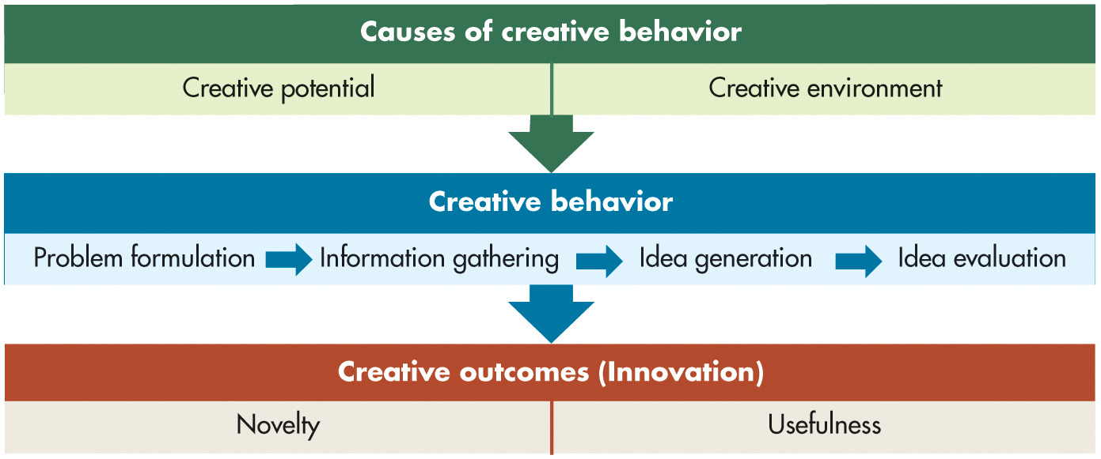
Describe the Three-Stage Model of Creativity (2 of 2)
Exhibit 6.5 Three-Stage Model of Creativity in Organizations
Notes:
Creative behavior occurs in four steps, each of which leads to the next:
Problem formulation: the stage of creative behavior in which we identify a problem or opportunity that requires a solution yet unknown.
Information gathering: the stage of creative behavior when possible solutions to a problem incubate in an individual’s mind.
Idea generation: the process of creative behavior in which we develop possible solutions to a problem from relevant information and knowledge.
Idea evaluation: the process of creative behavior in which we evaluate potential solutions to identify the best one.
Lastly, we can define creative outcomes as ideas or solutions judged to be novel and useful by relevant stakeholders. Novelty itself does not generate a creative outcome if it isn’t useful; thus, “off-the-wall” solutions are creative only if they help solve the problem. Softs skills help translate ideas into results. Another important factor is organizational climate. A study of health care teams found that team creativity translated into innovation only when the climate actively supported innovation.
Long Description;
The first stage, causes of creative behavior consists of creative potential and creative environment.
The second stage, creative behavior occurs in four steps, each of which leads to the next: Problem formulation, Information gathering, Idea generation, and Idea evaluation.
The third stage, and creative outcomes consists of novelty and usefulness.

Slide 35
Implications for Managers (1 of 4)
Behavior follows perception. To influence behavior at work, assess how people perceive their work, understand how the environment affects their perceptions, and examine how you perceive other people. Often behaviors we find puzzling can be explained by understanding the initiating perceptions.
When judging others’ (e.g., clients, coworkers) behavior, be wary of jumping to conclusions about why they behave the way they do (or why certain things happen to them). Recognize that your perception of what causes their behavior, such as internal or external forces, can cause you to come to flawed conclusions about them.
Notes:
Behavior follows perception. To influence behavior at work, assess how people perceive their work, understand how the environment affects their perceptions, and examine how you perceive other people. Often behaviors we find puzzling can be explained by understanding the initiating perceptions.
When judging others’ (e.g., clients, coworkers) behavior, be wary of jumping to conclusions about why they behave the way they do (or why certain things happen to them). Recognize that your perception of what causes their behavior, such as internal or external forces, can cause you to come to flawed conclusions about them.

Slide 36
Implications for Managers (2 of 4)
Make better decisions in recruitment, selection, and performance appraisal by recognizing perceptual errors, heuristics, and biases in decision making. Learning about these problems does not always prevent us from making mistakes, but it does help. You can also leverage technology as an aid to reduce perceptual errors.
Adjust your decision-making approach by recognizing constraints on your decision making and understanding whether some other factor might be affecting your perception at the moment. For instance, your personality traits and other individual differences, as well as the organizational context, may be influencing how you see the problem.
Notes:
Make better decisions in recruitment, selection, and performance appraisal by recognizing perceptual errors, heuristics, and biases in decision making. Learning about these problems does not always prevent us from making mistakes, but it does help. You can also leverage technology as an aid to reduce perceptual errors.
Adjust your decision-making approach by recognizing constraints on your decision making and understanding whether some other factor might be affecting your perception at the moment. For instance, your personality traits and other individual differences, as well as the organizational context, may be influencing how you see the problem.

Slide 37
Implications for Managers (3 of 4)
Be flexible in your approach to solving problems. Know the situations in which rational analysis is preferable and which situations may require quick, intuitive decisions. Understand that forces beyond our control bound our rationality. It is our responsibility to navigate the problem space to select the right strategy given the problem.
Use a common language of consequences, responsibilities, duties, and rights when considering ethical dilemmas you may face. Ask yourself questions about whether your behavior would result in the greatest good for the greatest number of people or infringes upon others’ rights or if you have a responsibility or duty to behave in a certain way.
Notes:
Be flexible in your approach to solving problems. Know the situations in which rational analysis is preferable and which situations may require quick, intuitive decisions. Understand that forces beyond our control bound our rationality. It is our responsibility to navigate the problem space to select the right strategy given the problem.
Use a common language of consequences, responsibilities, duties, and rights when considering ethical dilemmas you may face. Ask yourself questions about whether your behavior would result in the greatest good for the greatest number of people or infringes upon others’ rights or if you have a responsibility or duty to behave in a certain way.

Slide 38
Implications for Managers (4 of 4)
Try to enhance your creative process and foster an environment where creativity is encouraged. To solve a problem creatively, formulate the problem, gather information on it, generate ideas on how to solve the problem, and evaluate those ideas. Try to remove work and organizational barriers that might impede creativity, and nurture an atmosphere that rewards creativity and innovation. Consider employees’ and coworkers’ creative potential when delegating creative tasks.
Notes:
Try to enhance your creative process and foster an environment where creativity is encouraged. To solve a problem creatively, formulate the problem, gather information on it, generate ideas on how to solve the problem, and evaluate those ideas. Try to remove work and organizational barriers that might impede creativity, and nurture an atmosphere that rewards creativity and innovation. Consider employees’ and coworkers’ creative potential when delegating creative tasks.

Slide 39
Discussion Questions
Reflect of the challenges of decision making during times of crisis, and specifically decisions your university made on how to manage the C O V I D-19 crisis in the spring of 2020, the fall of 2020, and in the fall of 2021. How did decision-making change over time? What does your response tell you about decision making in a crisis?
In addition to product features, many consumers are now making C S R initiatives a part of the buying decision. How is public pressure forcing companies to behave more responsibly? Would you make a company’s record on C S R a factor in a buying or employment decision?

Slide 40

Copyright
This work is protected by United States copyright laws and is provided solely for the use of instructors in teaching their courses and assessing student learning. Dissemination or sale of any part of this work (including on the World Wide Web) will destroy the integrity of the work and is not permitted. The work and materials from it should never be made available to students except by instructors using the accompanying text in their classes. All recipients of this work are expected to abide by these restrictions and to honor the intended pedagogical purposes and the needs of other instructors who rely on these materials.

