Slide 1


Organizational Behavior
Nineteenth Edition
Chapter 7
Motivation Concepts
Copyright © 2023, 2019, 2017 Pearson Education, Inc. All Rights Reserved
Notes:
If this PowerPoint presentation contains mathematical equations, you may need to check that your computer has the following installed:
1) MathType Plugin
2) Math Player (free versions available)
3) NVDA Reader (free versions available)
Welcome to this Organizational Behavior course that uses the 19th edition of the textbook, Organizational Behavior by Robbins and Judge. This is considered among the most widely used OB textbooks in the world. Robbins and Judge are recognized as definitive aggregators of OB concepts, applications, and practices. The course and this book will provide you with a resource that will benefit you throughout your degree program and your professional life.

Slide 2
Learning Objectives (1 of 2)
7.1 Describe the three key elements of motivation.
7.2 Compare the early theories of motivation.
7.3 Contrast the content-based theories of motivation, including self-determination theory, regulatory-focus theory, and job engagement theory.
7.4 Understand the differences between the context-based theories of motivation: reinforcement theory and social learning theory.
Notes:
After studying this chapter, you should be able to:
Describe the three key elements of motivation.
Compare the early theories of motivation.
Contrast the content-based theories of motivation, including self-determination theory, regulatory-focus theory, and job engagement theory.
Understand the differences between the context-based theories of motivation: reinforcement theory and social learning theory.

Slide 3
Learning Objectives (2 of 2)
7.5 Compare the process-based theories of motivation: expectancy theory, goal-setting theory, and self-efficacy theory.
7.6 Describe the forms of organizational justice, including distributive justice, procedural justice, informational justice, and interactional justice.
7.7 Describe how the contemporary theories of motivation complement one another.
Notes:
In addition, after studying this chapter, you should be able to:
Compare the process-based theories of motivation: expectancy theory, goal-setting theory, and self-efficacy theory.
Describe the forms of organizational justice, including distributive justice, procedural justice, informational justice, and interactional justice.
Describe how the contemporary theories of motivation complement one another.

Slide 4
Describe the Three Key Elements of Motivation (1 of 2)
Motivation is the processes that account for an individual’s intensity, direction, and persistence of effort toward attaining a goal.
The level of motivation varies both between individuals and within individuals at different times.
Notes:
Motivation is the processes that account for an individual’s intensity, direction, and persistence of effort toward attaining a goal. We will narrow the focus to organizational goals in order to reflect our singular interest in work-related behavior. Keep in mind that the level of motivation varies both between individuals and within individuals at different times.

Slide 5
Describe the Three Key Elements of Motivation (2 of 2)
The three key elements of motivation are:
Intensity: concerned with how hard a person tries.
Direction: the orientation that benefits the organization.
Persistence: a measure of how long a person can maintain their effort.
Notes:
The three key elements of our definition of motivation are intensity, direction, and persistence. Intensity is concerned with how hard a person tries to do anything. This is the element most of us focus on when we talk about motivation. Direction is the orientation that benefits the organization; it can be positive or negative. Persistence is a measure of how long a person can maintain their effort. Motivated individuals stay with a task long enough to achieve their goal.

Slide 6
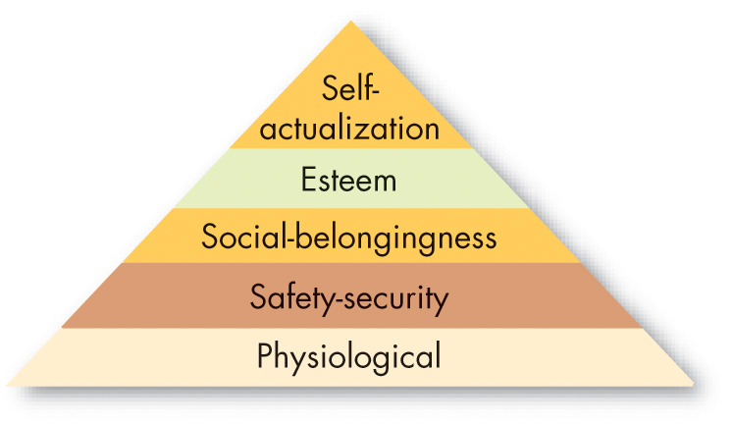
Compare the Early Theories of Motivation (1 of 7)
Exhibit 7.1 Maslow’s Hierarchy of Needs
Source: Based on H. Skelsey, “Maslow’s Hierarchy of Needs—the Sixth Level,” Psychologist (2014): 982–83.
Notes:
Abraham Maslow’s hierarchy of needs is the most well-known theory of motivation. Maslow hypothesized that within every human being there exists a hierarchy of five needs, beginning with physiological needs that include hunger, thirst, shelter, sex, and other bodily needs. The second level is safety needs that include security and protection from physical and emotional harm. The next level is social belongingness that include affection, belongingness, acceptance, and friendship. Reaching a higher level, we find esteem needs that include internal esteem factors such as self-respect, autonomy, and achievement, and external esteem factors such as status, recognition, and attention. At the top of the hierarchy is self-actualization needs; this is the drive to become what one is capable of becoming, and includes growth, achieving one’s potential, and self-fulfillment.
Maslow separated the five needs into higher and lower orders. As a need becomes substantially satisfied, the next need becomes dominant. No need is ever fully gratified; a substantially satisfied need no longer motivates.
Recently, a sixth need has been proposed for a highest level—intrinsic values—which is said to have originated from Maslow, but it has yet to gain widespread acceptance.

Slide 7
Compare the Early Theories of Motivation (2 of 7)
Maslow’s need theory has received wide recognition, particularly among practicing managers.
It is intuitively logical and easy to understand and some research has validated it.
However, most research does not, and it hasn’t been frequently researched since the 1960s.
Notes:
Maslow’s need theory has received wide recognition, particularly among practicing managers. It is intuitively logical and easy to understand, and some research has validated it. However, most research does not, and it hasn’t been frequently researched since the 1960s.

Slide 8
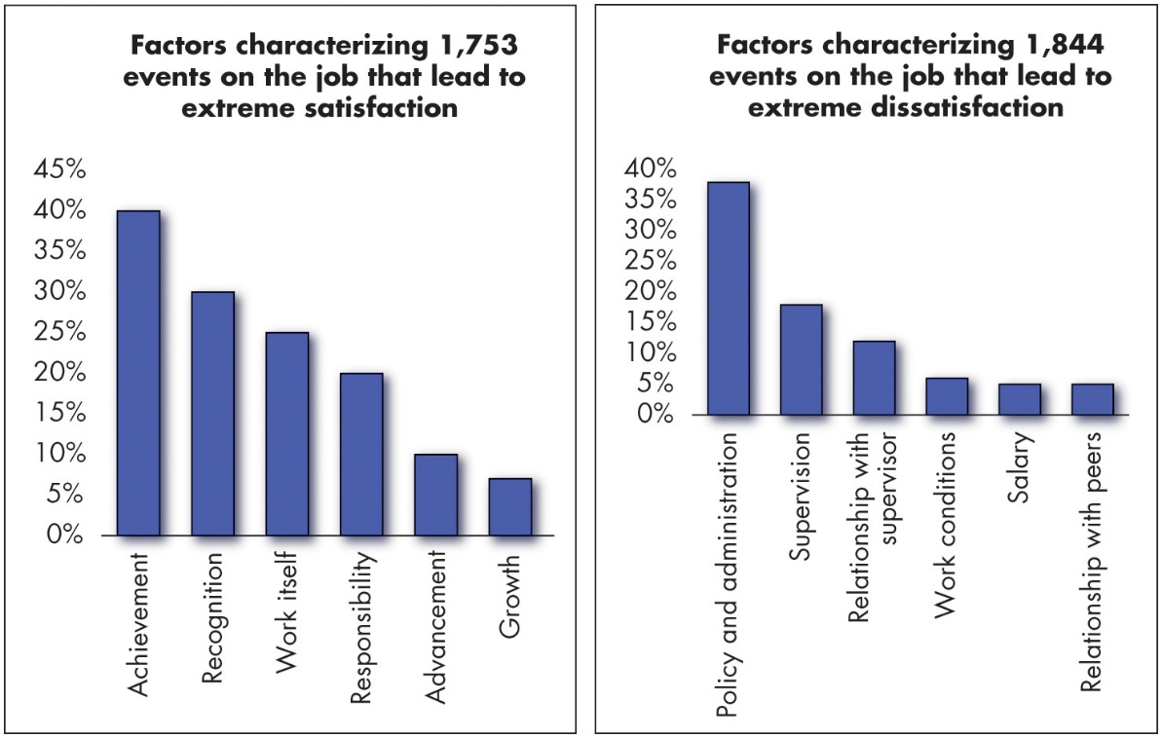
Compare the Early Theories of Motivation (3 of 7)
Exhibit 7.2 Comparison of Satisfiers and Dissatisfiers
Source: Based on Harvard Business Review, “Comparison of Satisfiers and Dissatisfiers,” An exhibit from One More Time: How Do You Motivate Employees? by Frederick Herzberg, January 2003. Copyright © 2003 by the Harvard Business School Publishing Corporation. All rights reserved.
Notes:
Proposed by psychologist Frederick Herzberg when he investigated the question, “What do people want from their jobs?” the two-factor theory is sometimes also called motivation-hygiene theory. Herzberg asked people to describe situations in which they felt exceptionally good or bad about their jobs. These responses were then tabulated and categorized.
From the categorized responses, as shown here in Exhibit 7-2, Herzberg concluded that intrinsic factors, such as advancement, recognition, responsibility, and achievement seem to be related to job satisfaction. Dissatisfied respondents tended to cite extrinsic factors, such as supervision, pay, company policies, and working conditions.
Moreover, the opposite of satisfaction is not dissatisfaction. Removing dissatisfying characteristics from a job does not necessarily make the job satisfying. Job satisfaction factors are separate and distinct from job dissatisfaction factors.
Long Description:
Graph 1: tiled factors characterizing 1753 events on the job that lead to extreme satisfaction. The horizontal axis is marked with different factors. The vertical axis is marked with percentage and ranges from 0 percent to 45 percent in increments of 5. The approximate data from the graph in the format factor: percentage is as follows. Achievement: 40 percent. Recognition: 30 percent. Work itself: 25 percent. Responsibility: 20 percent. Advancement: 10 percent. Growth: 7 percent.
Graph 2: tiled factors characterizing 1844 events on the job that lead to extreme dissatisfaction. The horizontal axis is marked with different factors. The vertical axis is marked with percentage and ranges from 0 percent to 40 percent in increments of 5. The approximate data from the graph in the format factor: percentage is as follows. Policy and administration: 37.5 percent. Supervision: 17.5 percent. Relationship with supervisor: 12 percent. Work conditions: 5 percent. Salary: 4 percent. Relationship with peers: 4 percent

Slide 9
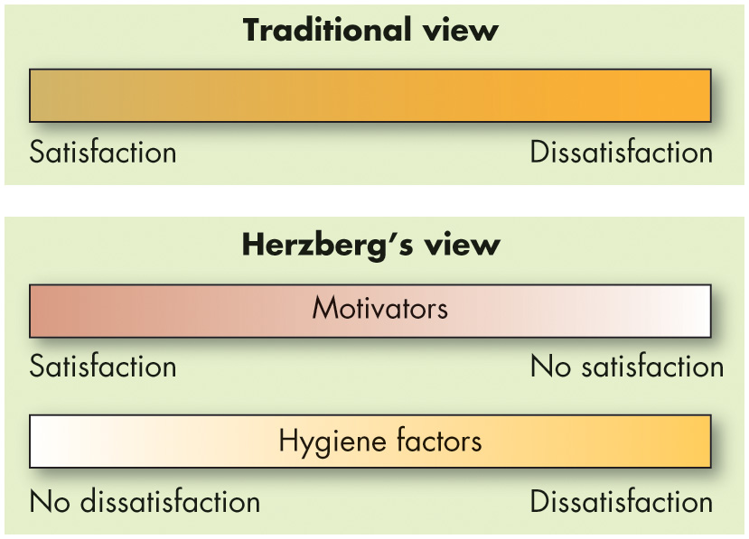
Compare the Early Theories of Motivation (4 of 7)
Exhibit 7.3 Contrasting View of Satisfaction and Dissatisfaction
Notes:
Managers who eliminate job dissatisfaction factors may not necessarily bring about motivation. Exhibit 7.3 reveals that when hygiene factors are adequate, people will not be dissatisfied. Neither will they be satisfied. To motivate people, managers must emphasize intrinsically rewarding factors that are associated with the work itself or to outcomes directly derived from it.
Long Description:
The traditional view ranges from satisfaction to dissatisfaction.
The Herzberg’s view for motivators range from satisfaction to no satisfaction.
The Herzberg’s view for hygiene factors ranges from no dissatisfaction to dissatisfaction.

Slide 10
Compare the Early Theories of Motivation (5 of 7)
Criticisms of Herzberg’s theory:
Limited because it relies on self-reports.
Reliability of methodology is questioned.
Regardless, the theory has been quite influential.
Notes:
Recent reviews of Herzberg’s research have resulted in many criticisms of the theory. The procedure that Herzberg used is limited by its methodology, therefore, the reliability of Herzberg’s methodology is questioned.
Regardless of criticisms, Herzberg’s theory has been widely read, and few managers are unfamiliar with his recommendations.

Slide 11
Compare the Early Theories of Motivation (6 of 7)
McClelland’s Theory of Needs
The theory focuses on three needs:
Need for achievement (nAch): drive to excel, to achieve in relation to a set of standards, to strive to succeed.
Need for power (nPow): need to make others behave in a way that they would not have behaved otherwise.
Need for affiliation (nAfl): desire for friendly and close interpersonal relationships.
Notes:
Another traditional theory is McClelland’s Theory of Needs. This theory focuses on three needs: achievement, power, and affiliation. Let’s look at each one in more detail.
The first of this theory’s variables is achievement need, abbreviated as nAch, which is the drive to excel, to achieve in relation to a set of standards, and to strive to succeed. High achievers perform best when they perceive their probability of success as 50/50. They like to set goals that require stretching themselves a little.
Need for power, the second variable, is the need to make others behave in a way that they would not have behaved otherwise. The need for power, abbreviated as nPow, is the desire to have impact, to be influential, and to control others. Individuals high in nPow enjoy being “in charge.” They strive for influence over others. They prefer to be placed into competitive and status-oriented situations. They also tend to be more concerned with prestige and gaining influence over others than with effective performance.
Finally, the need for affiliation, abbreviated as nAfl, is the desire for friendly and close personal relationships. This need has received the least attention from researchers. In general, individuals with high affiliation strive for friendship and prefer cooperative situations over competitive ones. They typically desire relationships involving a high degree of mutual understanding.

Slide 12
Compare the Early Theories of Motivation (7 of 7)
Research shows some relationships between nAch and job performance.
Employees high on nAch:
Exhibit more positive moods and greater interest in the task at hand.
Perform very well in high-stakes conditions on the job.
Research also supports nPow and nAff concepts.
Notes:
Research supports McClelland’s theory, specifically, relationships between nAch and job performance. When employees have a high level of nAch, they tend to exhibit more positive moods and be more interested in the task at hand. Employees high on nAch tend to perform very well in high-stakes conditions on the job, like work walkthroughs or sales encounters.
There is also research support for the nPow and nAff concepts as well. .

Slide 13
Contemporary Theories of Motivation: Content-Based (1 of 5)
Self-determination theory (S D T): employees’ well-being and performance are influenced by the nature of their motivation for certain job activities.
Motivation can be either autonomous or controlled.
Cognitive evaluation theory: when people are paid for work, it feels less like something they want to do and more like something they have to do.
Notes:
We begin our discussion of contemporary theories of motivation by explaining the idea of content-based theories. Content-based theories are primarily concerned with fundamental motives and individual differences in motivation states common to all people. This category includes self-determination theory, regulatory-focus theory, and job engagement theory.
Let’s start with self-determination theory, which proposes that people prefer to feel they have control over their actions, so anything that makes a previously enjoyed task feel more like an obligation than a freely chosen activity will undermine motivation.
Much research on self-determination theory in OB has focused on cognitive evaluation theory, which hypothesizes that extrinsic rewards will reduce intrinsic interest in a task. For example, when people are paid for work, it feels less like something they want to do and more like something they have to do.

Slide 14
Contemporary Theories of Motivation: Content-Based (2 of 5)
Self-concordance theory: considers how strongly people’s reasons for pursuing goals are consistent with their interests and core values.
S D T also suggests that there are several basic psychological needs that affect work motivation.
Need for autonomy
Need for competence
Notes:
Another aspect of self-determination theory is self-concordance, which considers how strongly peoples’ reasons for pursuing goals are consistent with their interests and core values. If individuals pursue goals because of an intrinsic interest, they are more likely to attain their goals and are happy even if they do not.
SDT also suggests that there are several basic psychological needs that affect work motivation. When they are satisfied, we tend to be more motivated; when they are frustrated, we tend to be less motivated. Need for relatedness is very similar to nAff, discussed in the prior section. However, need for autonomy and need for competence are two newer needs that correspond with the need to feel in control and autonomous at work and the need to feel like we are good at what we do and proud of it. Of all the three needs, however, the need for autonomy is the most important for attitudinal and affective outcomes.

Slide 15
Contemporary Theories of Motivation: Content-Based (3 of 5)
What does all of this mean?
For individuals:
Choose your job for reasons other than extrinsic rewards.
For organizations:
Provide intrinsic as well as extrinsic incentives.
Notes:
What does all of this mean? For individuals, it means to choose your job for reasons other than extrinsic rewards. For organizations, it means managers should make the work interesting, provide recognition, link organizational and employee goals, and support employee growth and development. Employees who feel what they do is within their control and a result of free choice are likely to be more motivated by their work and committed to their employers.

Slide 16
Contemporary Theories of Motivation: Content-Based (4 of 5)
Regulatory focus theory: people differ in the way they regulate their thoughts and behaviors during goal pursuit.
People fall into two categories:
Promotion focus
Prevention focus
Notes:
People differ in the way they regulate their thoughts and behaviors during goal pursuit, typically falling into one of two categories, or regulatory foci, though they could belong to both.
Those with a promotion focus strive for advancement and accomplishment and approach conditions that move them closer toward desired goals. Those with a prevention focus strive to fulfill duties and obligations and avoid conditions that pull them away from desired goals.
Keep in mind that people do not necessarily stick with one strategy permanently.

Slide 17
Contemporary Theories of Motivation: Content-Based (5 of 5)
Job engagement
The investment of an employee’s physical, cognitive, and emotional energies into job performance.
Job engagement predicts higher levels of task performance and citizenship behavior
Notes:
Job engagement refers to the investment of an employee’s physical, cognitive, and emotional energies into job performance.
What makes people more likely to be engaged in their jobs? One review of over 40,000 employees suggests that apart from a proactive personality, conscientiousness, and extraversion, one key trait predicts job engagement: employees’ tendencies to experience positive moods and emotions .

Slide 18
Contemporary Theories of Motivation: Context-Based (1 of 2)
Reinforcement theory: behavior is a function of its consequences.
Reinforcement conditions behavior.
Behavior is environmentally caused.
Operant conditioning theory: people learn to behave to get something they want or to avoid something they don’t want.
B.F. Skinner’s behaviorism.
Notes:
Let’s move on to context-based theories of motivation, beginning with reinforcement theory. Reinforcement theory is behaviorist, meaning that it portrays behavior as caused by the context or environment. So, behavior is controlled by reinforcers—the consequences that, when they immediately follow responses, increase the probability that the behavior will be repeated.
Reinforcement theorists see behavior as environmentally caused, ignoring the inner state of the individual and concentrating solely on what happens when he or she takes some action. Because it does not concern itself with what initiates behavior, it is not, strictly speaking, a theory of motivation. But it does provide a powerful means of analyzing what controls behavior, and this is why we typically consider it in discussions of motivation.
Operant conditioning theory argues that people learn to behave to get something they want or to avoid something they don’t want. Operant behavior is influenced by the reinforcement or lack of reinforcement brought about by its consequences. Reinforcement strengthens a behavior and increases the likelihood it will be repeated. B. F. Skinner’s theory of behaviorism argues that behavior follows stimuli in a relatively unthinking manner. He demonstrated that people will most likely engage in desired behaviors if they are positively reinforced for doing so, that rewards are most effective if they immediately follow the desired response, and that behavior that is not rewarded or is punished is less likely to be repeated.

Slide 19
Contemporary Theories of Motivation: Context-Based (2 of 2)
Social-learning theory: we can learn through both observation and direct experience.
Assumes behavior is a function of consequences.
Notes:
Social-learning theory argues that we can learn through both observation and direct experience. Social learning theory, like reinforcement theory, assumes behavior is a function of consequences—but it also clarifies the effects of observation and perception in motivation. People respond to the way they perceive and define consequences, not to the objective consequences themselves.

Slide 20
Contemporary Theories of Motivation: Process-Based (1 of 10)
Expectancy theory: a tendency to act in a certain way depends on an expectation that the act will be followed by a given outcome and on the attractiveness of that outcome to the individual.
Three relationships:
Effort–performance relationship
Performance–reward relationship
Rewards–personal goals relationship
Notes:
Let’s continue to process-based theories of motivation beginning with expectancy theory, one of the most widely accepted explanations of motivation.
Expectancy theory argues that the strength of one’s tendency to act in a certain way depends on the strength of the expectation that the act will be followed by a given outcome and on the attractiveness of that outcome to the individual. It says that an employee will be motivated to exert a high level of effort when he or she believes that effort will lead to a good performance appraisal, that a good appraisal will lead to organizational rewards, and that the rewards will satisfy his or her personal goals.

Slide 21
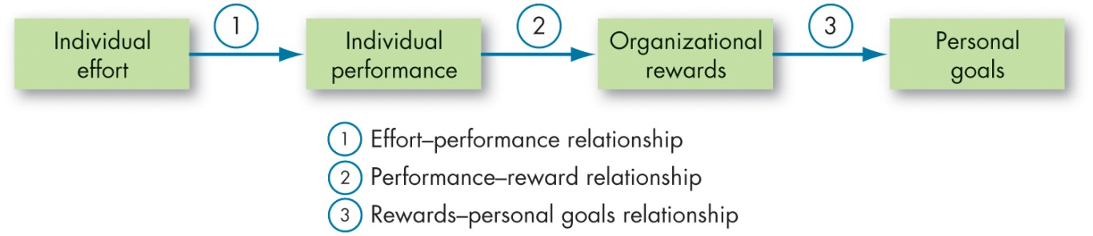

Contemporary Theories of Motivation: Process-Based (2 of 10)
Exhibit 7.4 Expectancy Theory
Notes:
Exhibit 7.4 shows the three key relationships:
Expectancy: the effort–performance relationship, which is the probability perceived by the individual that exerting a given amount of effort will lead to performance;
Instrumentality: the performance–reward relationship, which is the degree to which the individual believes that performing at a particular level will lead to the attainment of a desired outcome;
Valence: the rewards–personal goals relationship, which is the degree to which organizational rewards satisfy an individual’s personal goals or needs and the attractiveness of those potential rewards for the individual.
Long Description:
Individual effort to individual performance requires effort-performance relationship. Individual performance to organizational rewards requires performance-reward relationship. Organizational rewards to personal goals requires rewards-personal goals relationship.

Slide 22
Contemporary Theories of Motivation: Process-Based (3 of 10)
Goal-setting theory: intentions to work toward a goal are considered a major source of work motivation.
Goals:
direct attention.
mobilize effort.
encourage persistence.
facilitate the development of strategy.
Notes:
Edwin Locke’s goal-setting theory proposed that intentions to work toward a goal are a major source of work motivation. According to the theory and decades of evidence supporting it, goals do four things: (1) they direct attention, (2) they mobilize effort, (3) they encourage persistence, and (4) they facilitate the development of strategy.

Slide 23
Contemporary Theories of Motivation: Process-Based (4 of 10)
Goal origins
Self-set goals can lead to greater employee enthusiasm, whereas supervisor-set goals may lead to heightened anxiety and perceptions of uncertainty and threat.
Goal characteristics
Specific goals increase performance.
Difficult goals, when accepted, result in higher performance than do easy goals.
Notes:
If employees can participate in the setting of their own goals, will they try harder? The evidence is mixed, although across studies it appears that they will not perform any better.
Evidence does strongly suggest that specific goals increase performance and that difficult goals, when accepted, result in higher performance than do easy goals.

Slide 24
Contemporary Theories of Motivation: Process-Based (5 of 10)
Other factors influencing the goals-performance relationship:
Goal commitment
Task characteristics
Feedback
Goal orientation
Goal conflict
Notes:
Other factors influencing the goals-performance relationship: include goal commitment, task characteristics, feedback, goal orientation, and goal conflict.
Goal commitment is most likely to occur when employees expect that their efforts will pay off in goal attainment, when accomplishing the goal is attractive to them, and when they actively participate in goal setting.
Goals seem to affect performance more strongly when tasks are simple rather than complex.
Feedback, in general, leads to higher performance.
Goal orientation suggests that people systematically differ in the extent they are motivated to prove themselves through good performance and avoiding poor performance.
Goal conflict has a nefarious effect on employee stress and anxiety and can even linger and affect your performance on tasks that are completely unrelated.

Slide 25
Contemporary Theories of Motivation: Process-Based (6 of 10)
Implementing goal setting
Management by objectives (M B O): a program that encompasses specific goals, participatively set, for an explicit time period, with feedback on goal progress.`
Notes:
How do managers set goals in their organizations? That is often left up to the individual manager. A more systematic way to utilize goal setting is with management by objectives (MBO), an initiative most popular in the 1970s but still used today. MBO emphasizes participatively set goals that are tangible, verifiable, and measurable.

Slide 26
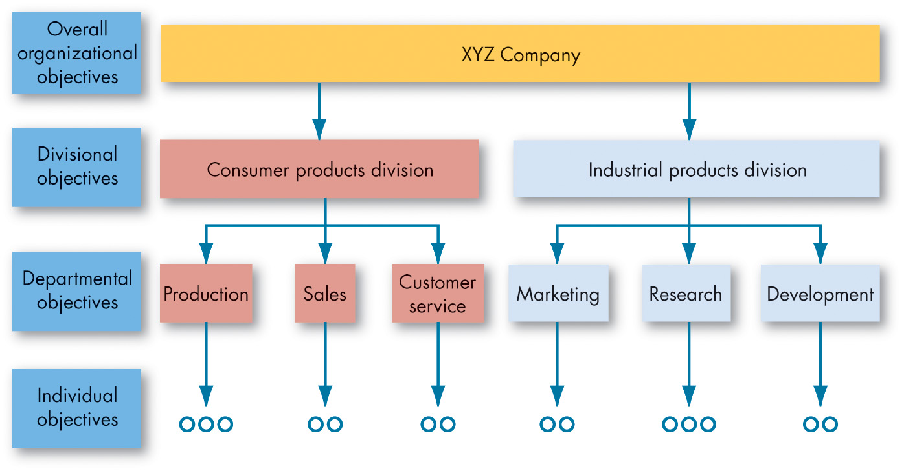
Contemporary Theories of Motivation: Process-Based (7 of 10)
Exhibit 7.5 Cascading of Objectives
Notes:
How do you put goal-setting operations into practice? Management by Objectives (MBO) allows employees to participatively set goals that are tangible, verifiable, and measurable.
As shown in Exhibit 7.5, an organization’s overall objectives are translated into specific objectives for each succeeding level. Four ingredients common to MBO programs are: goal specificity, participation in decision making, explicit time period, and performance feedback. MBO programs are common in many business, healthcare, educational, government, and nonprofit organizations.
Long Description:
The flow is as follows. The overall organizational objectives of an X Y Z company flows down to the divisional objectives as consumer products division and industrial products division. The consumer products division flows down to three departmental objectives as production, sales, and customer service. The industrial products division flows down to three departmental objectives as marketing, research, and development. The production and research departmental objectives flow down to three individual objectives and all the other departmental objectives flow down to two individual objectives.

Slide 27
Contemporary Theories of Motivation: Process-Based (8 of 10)
Self-efficacy theory is an individual’s belief that he or she is capable of performing a task.
Increasing self-efficacy
Enactive mastery
Vicarious modeling
Verbal persuasion
Arousal
Notes:
Self-efficacy theory defines four characteristics: enactive mastery, or gaining relevant experience with the task or job; vicarious modeling, or becoming more confident because you see someone else doing the task; verbal persuasion, occurring when a person is more confident because someone convinces him that he has the skills; and arousal, which leads to an energized state, driving a person to complete the task.

Slide 28
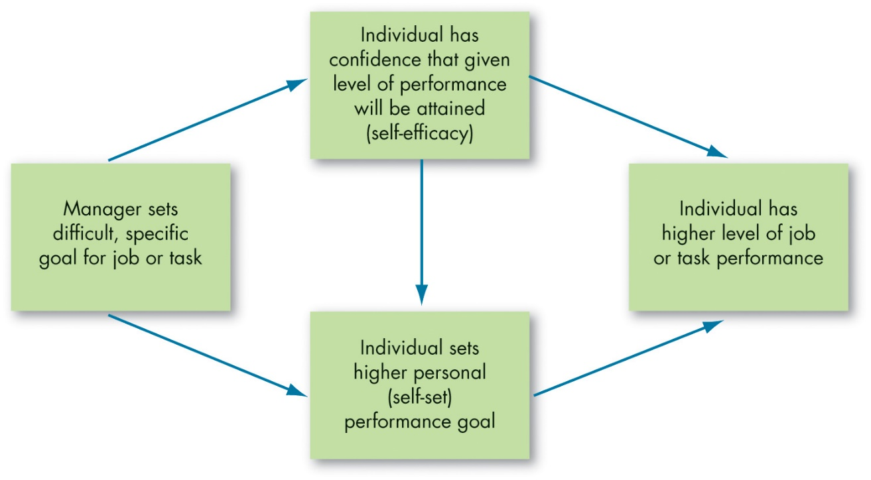
Contemporary Theories of Motivation: Process-Based (9 of 10)
Exhibit 7.6 Joint Effects of Goals and Self-Efficacy on Performance
Source: Based on E. A. Locke and G. P. Latham, “Building a Practically Useful Theory of Goal Setting and Task Motivation: A 35-Year Odyssey,” American Psychologist (September 2002): 705–17.
Notes:
As Exhibit 7.6 shows, supportive managers who set difficult goals for their employees may lead them to have a higher level of self-efficacy and set higher goals for their own performance.
Long Description:
The flow is as follows. Manager sets difficult, specific goal for job or task leads to individual has confidence that given level of performance will be attained which is self-efficacy, and individual sets higher personal self-set performance goal. This self-efficacy and self-set goals lead to individual having higher level of job or task performance. Self-efficacy also leads to self-set goals.

Slide 29
Contemporary Theories of Motivation: Process-Based (10 of 10)
The best way for a manager to use verbal persuasion is through the Pygmalion effect.
A form of self-fulfilling prophecy—believing in something can make it true.
Notes:
The best way for a manager to use verbal persuasion is through the Pygmalion effect. A form of self-fulfilling prophecy—believing in something can make it true.

Slide 30
Forms of Organizational Justice (1 of 5)
Exhibit 7.7 Equity Theory
Ratio Comparisons* | Perception
 | Inequity due to being underrewarded
 | Equity
 | Inequity due to being overrewarded
*Where
represents the employee and
represents relevant others
Notes:
What role does equity play in motivation? Equity theory argues that individuals make comparisons of their job inputs and outcomes relative to those of others and then respond to any inequities. If we perceive our ratio to be equal to that of the relevant others with whom we compare ourselves, a state of equity is said to exist. We perceive our situation as fair. When we see the ratio as unequal, we experience equity tension. This is shown in Exhibit 7.7.

Slide 31
Forms of Organizational Justice (2 of 5)
When employees perceive an inequity, they can be predicted to make one of six choices:
Change inputs.
Change outcomes.
Distort perceptions of self.
Distort perceptions of others.
Choose a different referent.
Leave the field.
Notes:
When employees perceive an inequity, they can be predicted to make one of six choices: they can change inputs, change outcomes, distort perceptions of self, distort perceptions of others, choose a different referent, or they can leave the field.

Slide 32
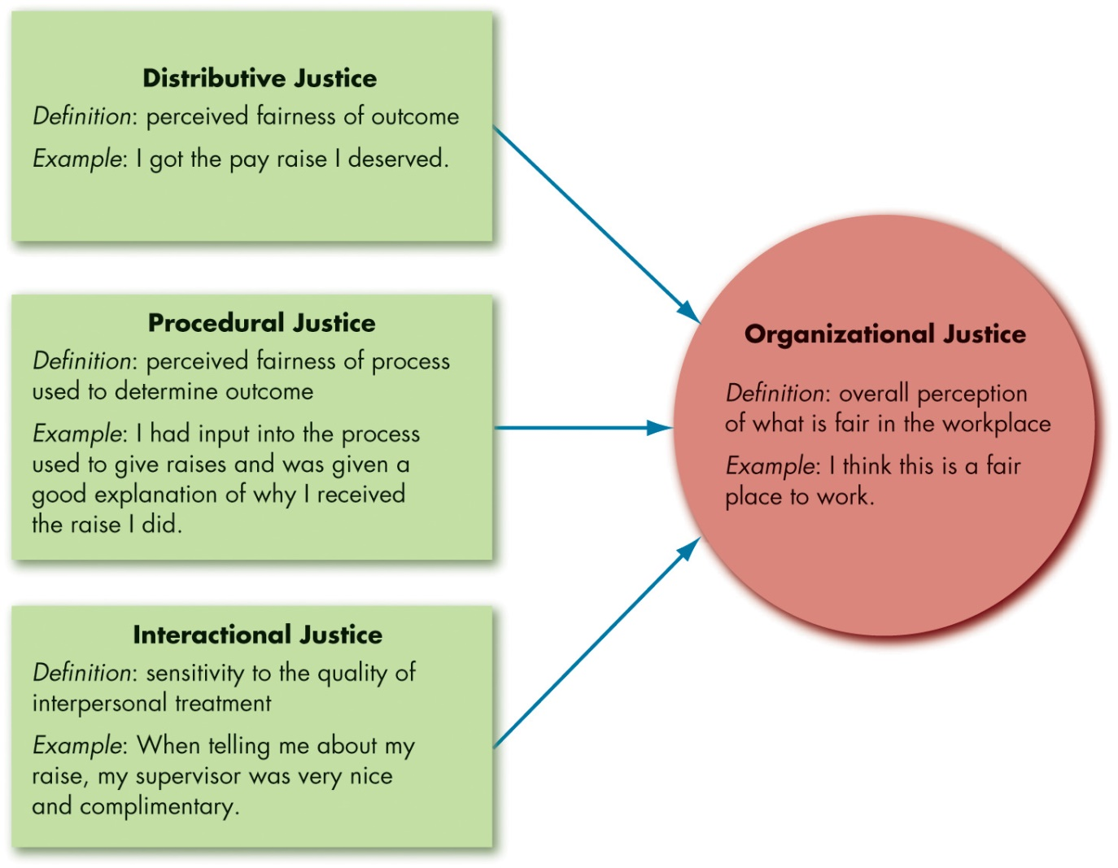
Forms of Organizational Justice (3 of 5)
Exhibit 7.8 Model of Organizational Justice
Notes:
Although equity theory’s propositions have not all held up, the hypothesis served as an important precursor to the study of organizational justice, or more simply, fairness, in the workplace. Organizational justice is concerned with how employees feel they are treated by authorities and decision makers at work. For the most part, employees make their evaluations along four dimensions, as shown in Exhibit 7.8.
Distributive justice is concerned with the fairness of the outcomes, such as pay and recognition that employees receive. Although employees care a lot about what outcomes are distributed (distributive justice), they also care a lot about how outcomes are distributed. While distributive justice looks at what outcomes are allocated, procedural justice examines how outcomes are allocated. Having direct influence over how decisions or made, or at the very least being able to present your opinion to decision makers, creates a sense of control and makes us feel empowered. Employees also perceive that procedures are fairer when decision makers follow several “rules.” It turns out that procedural and distributive justice combine to influence people’s perceptions of fairness. If outcomes are favorable and individuals get what they want, they care less about the process, so procedural justice doesn’t matter as much when distributions are perceived to be fair.
Research has shown that employees care about two other types of fairness that have to do with the way they are treated during interactions with others.
The first type is informational justice, which reflects whether managers provide employees with explanations for key decisions and keep them informed of important organizational matters. The second type of justice relevant to interactions between managers and employees is interpersonal justice, which reflects whether employees are treated with dignity and respect.
Long Description:
Distributive justice defines the perceived fairness of outcome. An example is: I got the pay raise I deserved.
Procedural justice defines the perceived fairness of process used to determine outcome. An example is: I had input into the process used to give raises and was given a good explanation of why I received the raise I did.
Interactional justice defines the sensitivity to the quality of interpersonal treatment. An example is: when telling me about my raise, my supervisor was very nice and complimentary.
Organizational justice defines the overall perception of what is fair in the workplace. An example is: I think this is a fair place to work.

Slide 33
Forms of Organizational Justice (4 of 5)
Justice Outcomes
All the types of justice discussed have been linked to higher levels of task performance and citizenship.
Third-party, or observer, reactions to injustice can be substantial.
Notes:
After all this talk about types of justice, how much does justice really matter to employees? A great deal, as it turns out. When employees feel fairly treated, they respond in many positive ways. All the types of justice discussed in this section have been linked to higher levels of task performance and citizenship behaviors such as helping coworker’s, as well as lower levels of counterproductive behaviors such as shirking job duties.
Why does justice have these positive effects? Fair treatment enhances commitment to the organization and makes employees feel it cares about their well-being. In addition, employees who feel fairly treated trust their supervisors more, which reduces uncertainty and fear of being exploited by the organization. Finally, fair treatment elicits positive emotions, which in turn prompts behaviors like citizenship.
Your coworker’s reactions to injustice can be just as important as your own. Research is beginning to suggest that third party, or observer, reactions to injustice can have a substantial effect.

Slide 34
Forms of Organizational Justice (5 of 5)
Promoting Justice
Adopting strong justice guidelines in an attempt to mandate certain managerial behavior isn’t likely to be universally effective.
Culture and Justice
Inputs and outcomes are valued differently in various cultures.
Notes:
How can an organization affect the justice perceptions and rule adherence of its managers? This depends upon the motivation of each manager. Some managers are likely to calculate justice by their degree of adherence to the justice rules of the organization. These managers will try to gain greater subordinate compliance with behavioral expectations, create an identity of being fair to their employees, or establish norms of fairness. Other managers may be motivated in justice decisions by their emotions. When they have a high positive affect and/or a low negative affect, these managers are most likely to act fairly.
It might be tempting for organizations to adopt strong justice guidelines in attempts to mandate managerial behavior, but this isn’t likely to be universally effective. In cases where managers have more rules and less discretion, those who calculate justice are more likely to act fairly, but managers whose justice behavior follows from their affect may act more fairly when they have greater discretion.
Across nations, the same basic principles of procedural justice are respected in that workers around the world prefer rewards based on performance and skills over rewards based on seniority. However, inputs and outcomes are valued differently in various cultures.

Slide 35
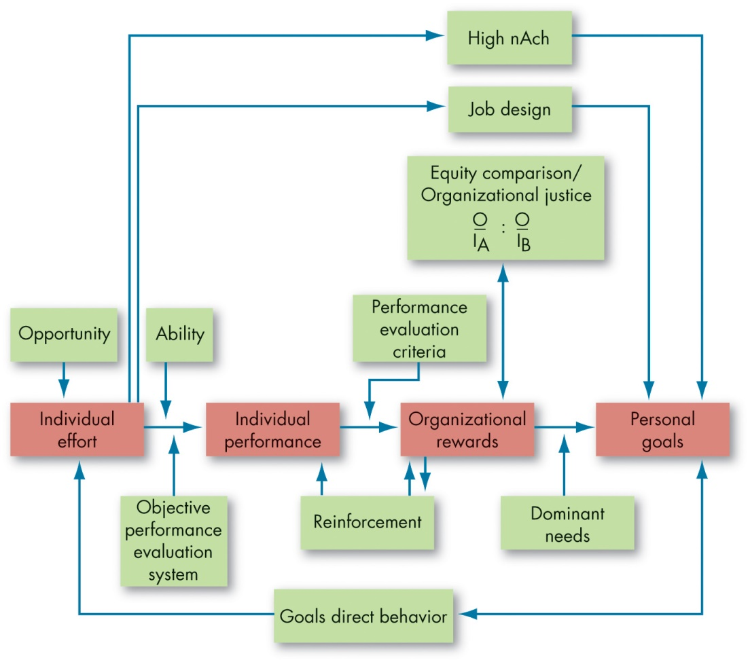
Integrating Contemporary Theories of Motivation
Exhibit 7.9 Integrating Contemporary Theories of Motivation
Notes:
Exhibit 7.9 integrates much of what we know about motivation. Its basic foundation is the expectancy model. Expectancy theory predicts that an employee will exert a high level of effort if he or she perceives that there is a strong relationship between effort and performance, performance and rewards, and rewards and satisfaction of personal goals. Each of these relationships, in turn, is influenced by certain factors. For effort to lead to good performance, the individual must have the requisite ability to perform, and the performance appraisal system must be perceived as being fair and objective. The final link in expectancy theory is the rewards–goals relationship.
The model also considers the achievement, need, reinforcement, and equity/organizational justice theories. High achievers are internally driven as long as the jobs they are doing provide them with personal responsibility, feedback, and moderate risks. Reinforcement theory recognizes that the organization’s rewards reinforce the individual’s performance. Individuals will compare the rewards they receive (outcomes) from the inputs they make with the outcome–input ratio of relevant others, and inequities may influence the effort expended.
Long Description:
The Expectancy theory predicts that an employee will exert a high level of effort if he or she perceives that there is a strong relationship between effort and performance, performance and rewards, and rewards and satisfaction of personal goals. Individual effort requires opportunity. For effort to lead to good performance, the individual must have the requisite ability to perform, and the performance appraisal system must be perceived as being fair and objective. The individual performance to organizational rewards influence performance evaluation criteria and reinforcement. Dominant needs affect the organizational rewards to personal goals relationship. The individual effort needs high nAch and job design to reach the personal goals. The organizational rewards affects and gets affected by the equity comparison or organizational justice represented by the ratio of upper O over upper I sub upper A is to upper O over upper I sub upper B. Personal goals affects and gets affected by the goals direct behavior which influences the individual efforts.

Slide 36
Implications for Managers (1 of 5)
Classic theories paint an incomplete picture of motivation. Consider contemporary theories when assessing motivation in your organization.
People will be motivated if they feel like their actions are feely chosen and in alignment with their interests and values. Try to foster this autonomy instead of treating motivation as completely “controllable” through pressure, direction, or reward.
Notes:
What are the implications for managers?
Classic theories paint an incomplete picture of motivation. Consider contemporary theories when assessing motivation in your organization.
People will be motivated if they feel like their actions are feely chosen and in alignment with their interests and values. Try to foster this autonomy instead of treating motivation as completely “controllable” through pressure, direction, or reward.

Slide 37
Implications for Managers (2 of 5)
Despite the power of autonomy, rewards and reinforcement can still be a powerful force in promoting desired behaviors in organizations—but do not underestimate the psychological aspects of motivation. Rewards alone cannot fix organizational problems.
Depending on which behaviors are desirable given the task, try to adopt or lead others toward a promotion focus (e.g., for innovation goals) or prevention focus (e.g., for safety goals).
Notes:
In addition:
Despite the power of autonomy, rewards and reinforcement can still be a powerful force in promoting desired behaviors in organizations—but do not underestimate the psychological aspects of motivation. Rewards alone cannot fix organizational problems.
Despite the power of autonomy, rewards and reinforcement can still be a powerful force in promoting desired behaviors in organizations—but do not underestimate the psychological aspects of motivation. Rewards alone cannot fix organizational problems.

Slide 38
Implications for Managers (3 of 5)
Job engagement is still a management “buzzword,” and there is confusion regarding what job engagement actually represents. However, it can help put motivation into practice. Apply other contemporary motivation theories to understand how employees and managers can become (and stay) engaged in the workplace.
Lead by example: Model and encourage others to model the types of behaviors you would like to see performed by employees.
Notes:
Furthermore:
Job engagement is still a management “buzzword,” and there is confusion regarding what job engagement actually represents. However, it can help put motivation into practice. Apply other contemporary motivation theories to understand how employees and managers can become (and stay) engaged in the workplace.
Lead by example: Model and encourage others to model the types of behaviors you would like to see performed by employees.

Slide 39
Implications for Managers (4 of 5)
Thinking of motivation in terms of expectancy, instrumentality, and valence can help you break down many common motivation problems in organizations into their parts. Ask yourself whether effort leads to performance, whether performance leads to the desired outcome, and whether those involved actually care about it.
Harness the power of goal setting: Set specific, difficult goals. Consider the factors that may affect goal setting. Determine whether a management by objectives program would be suitable for your organization.
Notes:
In addition:
Thinking of motivation in terms of expectancy, instrumentality, and valence can help you break down many common motivation problems in organizations into their parts. Ask yourself whether effort leads to performance, whether performance leads to the desired outcome, and whether those involved actually care about it.
Harness the power of goal setting: Set specific, difficult goals. Consider the factors that may affect goal setting. Determine whether a management by objectives program would be suitable for your organization.

Slide 40
Implications for Managers (5 of 5)
Self-efficacy can affect motivation and behavior throughout the motivation process and is sometimes helpful and sometimes even harmful. Consider how self-efficacy changes throughout the goal-setting process and adapt accordingly.
When making decisions regarding resources in your organization, make sure to consider how the resources are being distributed (and who is affected), the fairness of the decision, and whether your actions demonstrate that you respect those involved.
Notes:
Finally:
Self-efficacy can affect motivation and behavior throughout the motivation process and is sometimes helpful and sometimes even harmful. Consider how self-efficacy changes throughout the goal-setting process and adapt accordingly.
When making decisions regarding resources in your organization, make sure to consider how the resources are being distributed (and who is affected), the fairness of the decision, and whether your actions demonstrate that you respect those involved.

Slide 41
Discussion Questions
How do you think the COVID-19 pandemic has changed the factors that lead to satisfaction in the workplace? Using McClelland’s Theory of Needs, consider whether employees will be motivated by the same factors post-pandemic as pre-pandemic. Does your response change if you consider white-collar workplaces versus blue-collar? Explain.
Using self-concordance theory, think about your own career plans. What do you think will be your motivating factors?
What does job engagement mean to you?

Slide 42

Copyright
This work is protected by United States copyright laws and is provided solely for the use of instructors in teaching their courses and assessing student learning. Dissemination or sale of any part of this work (including on the World Wide Web) will destroy the integrity of the work and is not permitted. The work and materials from it should never be made available to students except by instructors using the accompanying text in their classes. All recipients of this work are expected to abide by these restrictions and to honor the intended pedagogical purposes and the needs of other instructors who rely on these materials.

