Slide 1


Organizational Behavior
Nineteenth Edition
Chapter 10
Understanding Work Teams
Copyright © 2023, 2019, 2017 Pearson Education, Inc. All Rights Reserved
Notes:
If this PowerPoint presentation contains mathematical equations, you may need to check that your computer has the following installed:
1) MathType Plugin
2) Math Player (free versions available)
3) NVDA Reader (free versions available)
Welcome to this Organizational Behavior course that uses the 19th edition of the textbook, Organizational Behavior by Robbins and Judge. This is considered among the most widely used OB textbooks in the world. Robbins and Judge are recognized as definitive aggregators of OB concepts, applications, and practices. The course and this book will provide you with a resource that will benefit you throughout your degree program and your professional life.

Slide 2
Learning Objectives
10.1 Contrast groups and teams.
10.2 Contrast the five types of team arrangements.
10.3 Identify the characteristics of effective teams.
10.4 Explain how organizations can create effective teams.
10.5 Decide when to use individuals instead of teams.
Notes:
After studying this chapter, you should be able to:
Contrast groups and teams.
Contrast the five types of team arrangements.
Identify the characteristics of effective teams.
Explain how organizations can create effective teams.
Decide when to use individuals instead of teams.

Slide 3
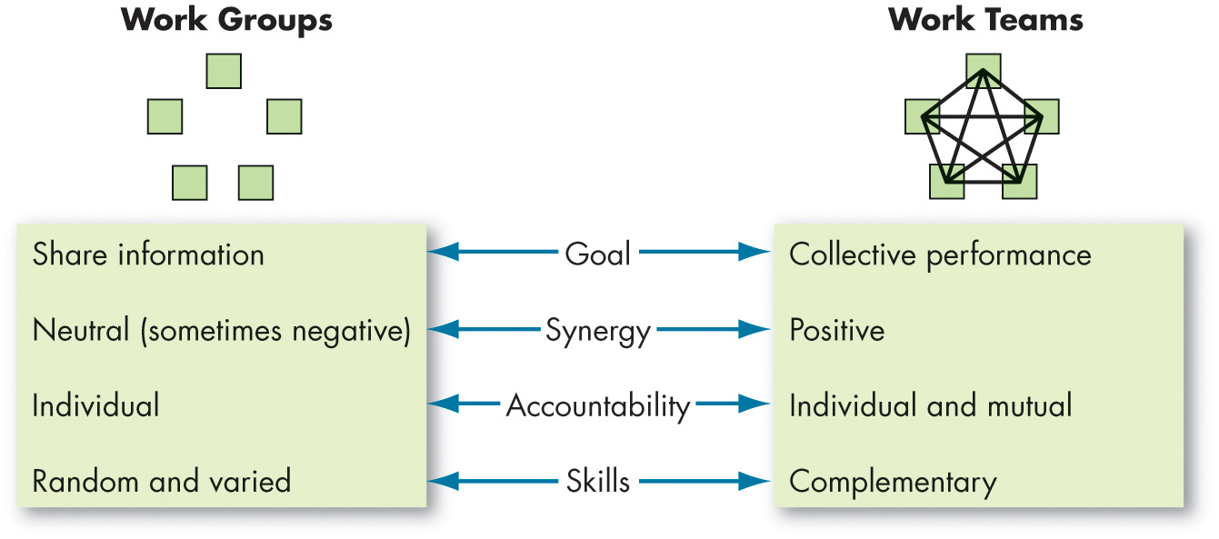
Contrast Groups and Teams
Exhibit 10.1 Comparing Work Groups and Work Teams
Notes:
Groups and teams are not the same thing. Exhibit 10.1 shows that a work group interacts primarily to share information and make decisions to help members perform within his or her area of responsibility. In contrast, a work team generates positive synergy through coordinated effort. Individual efforts result in a level of performance that is greater than the sum of those individual inputs.
Long Description:
Work group consists of five groups and each group is placed in each corner of a pentagon shape.
Work teams consists of five groups and each group is placed in each corner of a pentagon shape and each team is connected with the other four teams through lines.
The goal influences sharing information of the work groups and collective performance of the work teams.
Synergy is neutral and sometimes negative in work groups and positive in work teams.
Accountability is on an individual basis in work groups and on an individual and mutual basis in work teams.
Skills are random and varied in work groups and complementary in work teams.

Slide 4
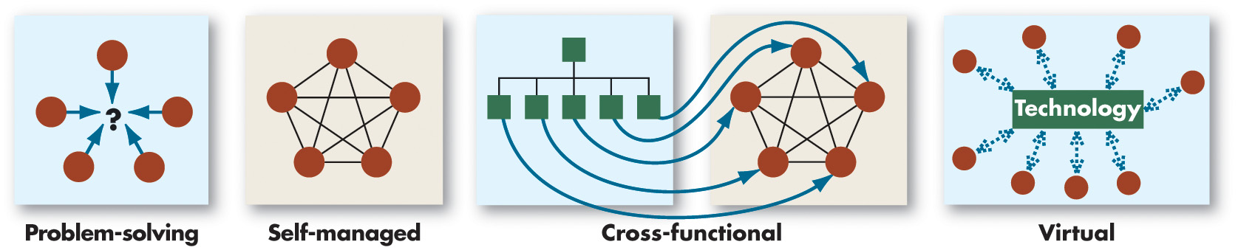
Contrast the Five Types of Teams
Exhibit 10.2 Four Types of Teams
Notes:
Exhibit 10.2 identifies four common types of teams. In addition, we’ll also describe multiteam systems.
First are problem-solving teams. This type of team has been in use for many years. Originally seen most often in manufacturing plants, these were permanent teams that generally met at a regular time, sometimes weekly or daily, to address quality standards and any problems with the products made. Problem-solving teams rarely have the authority to implement their suggested actions.
Long Description;
Problem-solving team. Five different groups denoted by five dots come towards the center of the query.
Self-managed team. It consists of five groups and each group is placed in each corner of a pentagon shape. Each team is connected with the other four teams through lines.
Cross-functional team consists of two work areas. The first work area consists of five team member under a head. The second work area consists of five groups and each group is placed in each corner of a pentagon shape and each team is connected with the other four teams through lines. Each employee from the first work area work together with each employee of the second work area to accomplish a task.
Virtual team uses computer technology to tie together physically dispersed members in order to achieve a common goal.

Slide 5
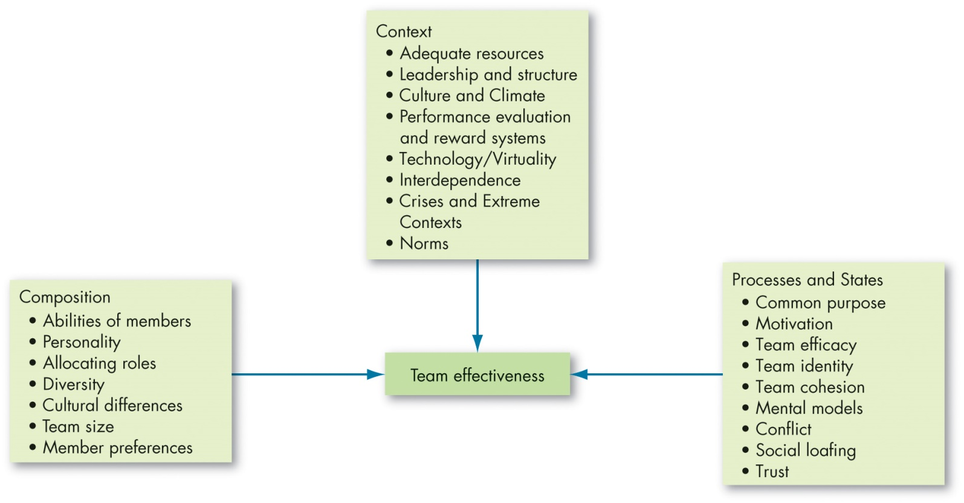
Identify the Characteristics of Effective Teams (1 of 7)
Exhibit 10.3 Team Effectiveness Model
Notes:
Exhibit 10.3 summarizes what we know about what makes teams effective.
We can organize the key components of effective teams into three general categories:
First are the resources and other contextual influences that make teams effective.
The second relates to the team’s composition.
Finally, process and state variables are events within the team that influence effectiveness. We will explore each of these components next.
Keep in mind two points.
First, as we have discussed, teams differ in form and structure. The model attempts to generalize across all varieties of teams but avoids rigidly applying its predictions to all teams. Use it as a guide.
Second, consider what team effectiveness means in this model. Typically, team effectiveness includes objective measures of the team’s productivity, managers’ ratings of the team’s performance, and aggregate measures of member satisfaction.
Long Description:
The components of context is as follows. Adequate resources, leadership and structure, culture and climate, performance evaluation and reward systems, technology or virtuality, interdependence, crises and extreme contexts, and norms.
The components of composition is as follows. Abilities of members, personality, allocating roles, diversity, cultural differences, team size, and member preferences.
The components of processes and states is as follows. Common purpose, motivation, team efficacy, team identity, team cohesion, mental models, conflicts, social loafing, and trust.

Slide 6
Identify the Characteristics of Effective Teams (2 of 7)
Team Context: What factors determine whether teams are successful?
Adequate resources
Leadership and structure
Culture and climate
Performance evaluation and reward system
Crises and extreme contexts
Leadership
Team scaffolds
Positive affectivity
Informed decision making
Notes:
What factors determine whether teams are successful? There are four contextual factors that are most significant to team performance.
First, adequate resources are needed. All work teams rely on resources outside the group to sustain it. A scarcity of resources directly reduces the ability of the team to perform its job effectively.
Second, leadership and structure must be present. Teams can’t function if they can’t agree on who is to do what and ensure all members share the workload. Leadership is especially important in multiteam systems, in which different teams coordinate their efforts to produce a desired outcome.
Third, culture and climate matter. A shared sense of vision, a sense of being able to share and collaborate in a nonthreatening environment, a concern for performance quality, encouragement of creative and innovative solutions, and practicing regular, frequent interaction are the most important factors for team climate.
Next, a performance evaluation and reward system must be in place. Individual performance evaluations and incentives may not be consistent with the development of high-performance teams. In addition to evaluating and rewarding employees for their individual contributions, management should modify the traditional, individually oriented evaluation and reward system to reflect team performance and focus on hybrid systems that recognize individual members for their exceptional contributions and reward the entire group for positive outcomes.
Finally, crises and extreme contexts are a crucible in which the merits of teams can be put to the test. Several factors play a role in influencing team success during crises. Leaders are extremely important. Structure also plays an important role. At the individual level, positive affectivity is important to buffer the negative impact of the crisis. Lastly, informed decision making is critical.

Slide 7
Identify the Characteristics of Effective Teams (3 of 7)
Team Composition: How should teams be staffed?
Abilities of members
Personality
Allocating roles
Diversity
Demography
Cultural differences
Size of teams
Member preferences
Notes:
Factors to consider when staffing a team are the abilities of members, personalities, allocating roles, diversity, team size, and member preferences. Let’s look at each of these, beginning with abilities of members.
Part of a team’s performance depends on the knowledge, skills, and abilities of its individual members. Research suggests that a number of groups of abilities are helpful to be an effective team member, namely conflict resolution, collaborative problem solving, communication, goal setting, and planning abilities/skills.
Second is personality of members. Many of the dimensions identified in the Big Five personality model have shown to be relevant to team effectiveness. Teams that rate higher on mean levels of conscientiousness and openness to experience tend to perform better, and the minimum level of team member agreeableness also matters. Teams did worse when they had one or more highly disagreeable members.
Third is allocating roles. Teams have different needs, and people should be selected for a team to ensure that there is diversity and that all various roles are filled. Managers need to understand the individual strengths that each person can bring to a team, select members with their strengths in mind, and allocate work assignments accordingly. Put your most able, experienced, and conscientious workers in the most central roles in a team.
Fourth is the diversity of members. If the diverse team sticks it out and stays together over time, they can reach desirable performance levels. Moreover, they are less likely to fall victim to conformity, are more likely to share more information with one another, make fewer errors, and may be more creative than non-diverse teams.
Fifth is cultural differences. We have discussed research on team diversity in race or gender. But what about diversity created by national differences? Like the earlier research, evidence here indicates these elements of diversity interfere with team processes, at least in the short term. Cultural diversity does seem to be an asset for tasks that call for a variety of viewpoints. But culturally heterogeneous teams have more difficulty learning to work with each other and solving problems. The good news is that these difficulties seem to dissipate with time. Although newly formed culturally diverse teams underperform newly formed culturally homogeneous teams, the differences disappear after about three months.
When it comes to the size of teams, most experts agree that keeping teams small is a key to improving group effectiveness. When teams have excess members, cohesiveness and mutual accountability decline, social loafing increases, and more people communicate less.
Finally, we come to the issue of member preferences. Not every employee is a team player. Given the option, many employees will select themselves out of team participation. High performing teams are likely to be composed of people who prefer working as part of a group.

Slide 8
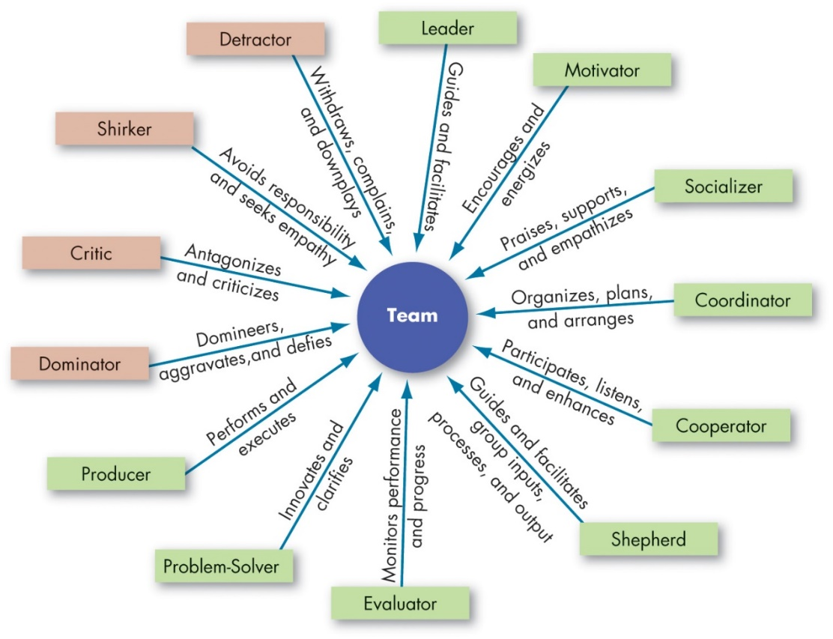
Identify the Characteristics of Effective Teams (4 of 7)
Exhibit 10.4 Key Roles of Teams
Sources: Based on T. Driskell, J. E. Driskell, C. Shawn Burke, and E. Salas, “Team Roles: A Review and Integration,” Small Group Research 48, no. 4 (2017): 482–511.
Notes:
Nine roles of potential teams members are shown in Exhibit 10.4 above.
Long Description:
Team is placed at the center and an arrow from each of the below team member point toward the team.
The nine roles of potential teams members are:
A leader who guides and facilitates.
A motivator who encourages and energizes.
A socializer who praises, supports, and empathizes.
A coordinator who organizes, plans, and arranges.
A cooperator who participates, listens, and enhances.
A shepherd who guides and facilitates group inputs, processes, and output.
An evaluator who monitors performance and progress.
A problem-solver who innovates and clarifies.
A producer who performs and executes.
The other roles are as follows.
A dominator who domineers, aggravates, and defies.
A critic who antagonizes and criticizes.
A shirker who avoids responsibilities and seeks empathy.
A detractor who withdraws, complains, and downplays.

Slide 9
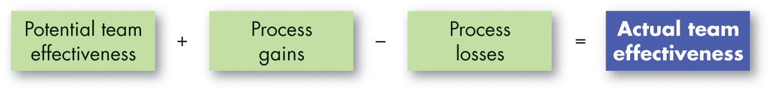
Identify the Characteristics of Effective Teams (5 of 7)
Exhibit 10.5 Effects of Team Processes
Notes:
The final category related to team effectiveness includes processes, for example, procedures, activities, and behaviors, and team states including collective emotional, attitudinal, or motivational states such as member commitment to a common plan and purpose, motivation, team efficacy, team identity, team cohesion, mental models, conflict, social loafing, and trust.
These characteristics tend to be excellent predictors of team performance and team member attitudes. They are especially important in larger teams and in teams that are highly interdependent.
Exhibit 10.5 illustrates how group processes can have an impact on a group’s actual effectiveness.

Slide 10
Identify the Characteristics of Effective Teams (6 of 7)
Team Processes
Common Plan and Purpose
Reflexivity
Mental Models
Transactive memory systems
Team Conflict
Relationship
Task
Ethical
Social Loafing
Notes:
The team process starts with a common plan and purpose. Effective teams begin by analyzing the team’s mission, developing goals to achieve that mission, and creating strategies for achieving the goals. Teams that establish a clear sense of what needs to be done and how consistently perform better. Effective teams show reflexivity, meaning they reflect on and adjust their master plan when necessary.
The members of an effective team share accurate mental models. In other words, they share an understanding of the key elements within their task environment. Teams should also develop transactive memory systems, which represent the ways in which team members collect, integrate, generate, and distribute knowledge to develop a shared understanding of their environment.
Conflict on a team isn’t necessarily bad. Relationship conflicts—those based on interpersonal incompatibilities, tension, and animosity toward others—are almost always dysfunctional. When teams are performing nonroutine activities, disagreements about task content (called task conflicts) stimulate discussion, promote critical assessment of problems and options, and can lead to better team decisions. Finally, a newer form of ethical conflict describes the ways in which team members disagree about ethical issues.
Finally, social loafing occurs when individuals hide inside a group. Effective teams undermine this tendency by making members individually and jointly accountable for the team’s purpose, goals, and approach. Members should be clear on what they are individually and jointly responsible for.

Slide 11
Identify the Characteristics of Effective Teams (7 of 7)
Team States
Motivation
Team Efficacy
Team Identity
Team Cohesion
Team Trust
Notes:
Emergent states are also critical to team effectiveness. These collective attitudinal, emotional, and motivational states are important because they guide how team members approach teamwork. The context, structure, and processes within a team can all be in place, but without positive emergent states, team members may be less motivated to work together.
Motivational factors beyond goals matter for team effectiveness. For instance, beyond goal setting, the actual experience of striving toward a goal involves wins, setbacks, and conservation of energy. Teams that are geared toward achievement tend to perform better over time.
Effective teams have confidence in themselves and believe they can succeed—this is team efficacy. Management can increase team efficacy by helping the team to achieve small successes and skill training. Small successes build team confidence. The greater the abilities of team members, the greater the likelihood that the team will develop confidence and the capability to deliver that confidence.
By recognizing individuals’ specific skills and abilities, as well as creating a climate of respect and inclusion, leaders and members can foster positive team identity and improved team outcomes. The term team cohesion means members are emotionally attached to one another and motivated toward the team because of their attachment.
Finally, trust in teams entails a mutual, positive state of positive expectations between team members. When you trust a team member, you believe in their reliability and dependability and are genuinely concerned for their welfare. Team trust evolves over time as members share with one another, put effort into the team, and monitor one another’s performance. Team trust has been shown to have a sizeable effect on team performance, especially in virtual teams.

Slide 12
Explain How Organizations Can Create Team Players
Creating Team Players
Selecting: hire team players
Cluster hiring
Training: create team players
Rewarding: incentives to be a good team player`
Notes:
How can organizations create effective teams?
First, managers should be sure to hire applicants who have the highest potential to perform well in a team and strategically place them in teams where they are most likely to work well with the other team members. Some managers today are engaging in cluster hiring, or the selection of an already-existing team to work in a new role.
Second, create team players. Training specialists conduct exercises that allow employees to experience the satisfaction teamwork can provide. Keep in mind that developing an effective team doesn’t happen overnight—it takes time.
Finally, provide rewards as incentives to be a good team player. An organization’s reward system must be reworked to encourage cooperative efforts rather than competitive ones. Promotions, pay raises, and other forms of recognition should be given to individuals who work effectively as team members by training new colleagues, sharing information, helping resolve team conflicts, and mastering needed new skills. Finally, don’t forget the intrinsic rewards, such as camaraderie, that employees can receive from teamwork. The opportunity for personal development of self and teammates can be a very satisfying and rewarding experience.

Slide 13
Decide When to Use Individuals Instead of Teams
Ask:
Can the work be done better by one person?
Does the work create a common goal or purpose?
Are the members of the group interdependent?
Notes:
Teams are not always the answer to organizational productivity.
How do you know whether the work of your group would be better done in teams? You can apply three tests to see whether a team fits your situation:
Can the work be done better by more than one person? A good indicator is the complexity of the work and the need for different perspectives. Simple tasks that don’t require diverse input are probably better left to individuals.
Does the work create a common purpose or set of goals for the people in the group that is more than the aggregate of individual goals? Many service departments of new-vehicle dealers have introduced teams that link customer-service people, mechanics, parts specialists, and sales representatives. Such teams can better manage collective responsibility for ensuring customer needs are properly met.
Are the members of the group interdependent? Using teams makes sense when there is interdependence between tasks—the success of the whole depends on the success of each one, and the success of each one depends on the success of the others. Soccer, for instance, is an obvious team sport. Success requires a great deal of coordination between interdependent players. Conversely, except possibly for relays, swim teams are not really teams; rather, they are groups of individuals performing individually, whose total performance is the aggregate summation of their individual performances.

Slide 14
Implications for Managers (1 of 6)
Always start with the work to be accomplished. Begin with the mission, goals, and nature of the work to be completed and determine whether the work is best accomplished by individuals, groups, or teams.
If a team is essential for fulfilling a particular mission or set of goals, select a team type or structure best suited toward meeting that goal.
Sometimes, multiple teams are needed, and managers should consider how they will interact and coordinate.
Notes:
Always start with the work to be accomplished. Begin with the mission, goals, and nature of the work to be completed and determine whether the work is best accomplished by individuals, groups, or teams.
If a team is essential for fulfilling a particular mission or set of goals, select a team type or structure best suited toward meeting that goal.
Sometimes, multiple teams are needed, and managers should consider how they will interact and coordinate.

Slide 15
Implications for Managers (2 of 6)
Managers need to establish contexts in which effective teams can flourish. By providing adequate resources to teams to fulfill their objectives, developing strong leadership and structure (essential in crises), monitoring and rewarding team performance, and establishing policies and practices that ensure mutual trust among team members, managers can nurture the conditions for team success.
Notes:
Managers need to establish contexts in which effective teams can flourish. By providing adequate resources to teams to fulfill their objectives, developing strong leadership and structure (essential in crises), monitoring and rewarding team performance, and establishing policies and practices that ensure mutual trust among team members, managers can nurture the conditions for team success.

Slide 16
Implications for Managers (3 of 6)
Building a team is incredibly complex, and it is difficult to predict how they will fare over time. Managers can do their part by keeping team size relatively small (between five and nine members is ideal) and taking the personality, preferences, and abilities of team members into account when building the team. Also, managers should match these individual differences to the work to be done, allocating roles to members who are best suited to these individual differences.
Notes:
Furthermore:
Building a team is incredibly complex, and it is difficult to predict how they will fare over time. Managers can do their part by keeping team size relatively small (between five and nine members is ideal) and taking the personality, preferences, and abilities of team members into account when building the team. Also, managers should match these individual differences to the work to be done, allocating roles to members who are best suited to these individual differences.

Slide 17
Implications for Managers (4 of 6)
Although team diversity can initially hurt team performance, sometimes teams experience “growing pains” as members learn to interact with one another. As a manager, do your best to support the team during these times, especially if the team will be interacting with one another long-term. These early investments may pay off in a cohesive, synergistic team that can leverage diverse strengths and experiences to meet organizational demands.
Notes:
Remember:
Although team diversity can initially hurt team performance, sometimes teams experience “growing pains” as members learn to interact with one another. As a manager, do your best to support the team during these times, especially if the team will be interacting with one another long-term. These early investments may pay off in a cohesive, synergistic team that can leverage diverse strengths and experiences to meet organizational demands.

Slide 18
Implications for Managers (5 of 6 )
Team leaders play a vital role in creating processes that guide the team toward effective performance. Ensure team leaders establish a common plan and purpose, set aside time to reflect on and adjust this purpose when necessary, make sure team members are “on the same page” in the team (e.g., shared mental models), and appropriately resolve conflict and issues of social loafing when needed. These leaders should also foster a sense of motivation, efficacy, identity, cohesion, and trust in their teams.
Notes:
Keep in mind that:
Team leaders play a vital role in creating processes that guide the team toward effective performance. Ensure team leaders establish a common plan and purpose, set aside time to reflect on and adjust this purpose when necessary, make sure team members are “on the same page” in the team (e.g., shared mental models), and appropriately resolve conflict and issues of social loafing when needed. These leaders should also foster a sense of motivation, efficacy, identity, cohesion, and trust in their teams.

Slide 19
Implications for Managers (6 of 6)
Select individuals who have the interpersonal skills to be effective team players, provide training to develop teamwork skills, and reward individuals for cooperative efforts.
Do not assume that teams are always needed. When tasks do not benefit from interdependency, individuals may be the better choice.
Notes:
Finally:
Select individuals who have the interpersonal skills to be effective team players, provide training to develop teamwork skills, and reward individuals for cooperative efforts.
Do not assume that teams are always needed. When tasks do not benefit from interdependency, individuals may be the better choice.

Slide 20
Discussion Questions
How have the different types of teams been affected by the move to remote work? Can all team types function in a work-from-home environment? Which types are more likely to thrive in the “new” workplace?
As the COVID-19 pandemic rapidly spread across the world, managers were forced to quickly make decisions without always having the time to fully consider the implications of those decisions. What are the benefits of teams in rapidly changing environments like this? Do you see any drawbacks?

Slide 21

Copyright
This work is protected by United States copyright laws and is provided solely for the use of instructors in teaching their courses and assessing student learning. Dissemination or sale of any part of this work (including on the World Wide Web) will destroy the integrity of the work and is not permitted. The work and materials from it should never be made available to students except by instructors using the accompanying text in their classes. All recipients of this work are expected to abide by these restrictions and to honor the intended pedagogical purposes and the needs of other instructors who rely on these materials.

