Slide 1

Organizational Behavior
Nineteenth Edition
Chapter 11
Communication
Copyright © 2023, 2019, 2017 Pearson Education, Inc. All Rights Reserved
Notes:
If this PowerPoint presentation contains mathematical equations, you may need to check that your computer has the following installed:
1) MathType Plugin
2) Math Player (free versions available)
3) NVDA Reader (free versions available)
Welcome to this Organizational Behavior course that uses the 19th edition of the textbook, Organizational Behavior by Robbins and Judge. This is considered among the most widely used OB textbooks in the world. Robbins and Judge are recognized as definitive aggregators of OB concepts, applications, and practices. The course and this book will provide you with a resource that will benefit you throughout your degree program and your professional life.

Slide 2
Learning Objectives
11.1 Describe the types of interpersonal communication.
11.2 Evaluate how to choose communication methods and handle barriers to effective communication.
11.3 Discuss the various forms of virtual communication used in modern organizations.
11.4 Analyze the issues surrounding smartphones, social media, and cybersecurity confronting modern organizations.
11.5 Recognize how to engage in effective cross-cultural communication in organizations.
Notes:
After studying this chapter, you should be able to:
Describe the types of interpersonal communication.
Evaluate how to choose communication methods and handle barriers to effective communication.
Discuss the various forms of virtual communication used in modern organizations.
Analyze the issues surrounding smartphones, social media, and cybersecurity confronting modern organizations.
Recognize how to engage in effective cross-cultural communication in organizations.

Slide 3
Describe the Types of Interpersonal Communication (1 of 6)
Oral Communication
Synchronicity
Synchronous communication
Asynchronous communication
Conversations, Discussions, and Listening
Active listening
Reflective listening
Meetings
Speeches
Notes:
When most of us think of communication, we most likely immediate jump to oral communication. When we think of oral communication, we often assume synchronicity, with both the sender and receiver present, aware, and focused on the communication exchange.
The advantages of this synchronous communication are speed, feedback, and exchange. However, given the advent of technological advances in communication (which we discuss throughout this chapter), it may surprise you to learn that oral communication can also be asynchronous communication, with verbal messages sent and received outside a physically or psychologically present communication exchange.
Regardless of whether we are psychologically and physically present when communicating with others, we should acknowledge that we are usually bad listeners. We are often prone to “listener burnout,” in which we tune the other person out, think about what we are going to say next, or rush to offer advice.
Active listening—in which we actively engage in sensing and processing others’ communication messages (both subtle and overt) and then responding in ways that show we are actively engaged in the conversation—helps us become more present in our oral communication.
In addition to active listening, reflective listening—acknowledging, restating, or reformulating others’ messages to provide nonjudgmental affirmation and encourage them to further elaborate or share—can also help us become better listeners.
Meetings are often thought of as formal discussions or conversations that include two or more people and take place in almost any venue. How can OB contribute to the conversation of how organizations can make meetings more effective? Some suggestions are to only meet when it is truly needed; gather input from attendees prior to meeting; provide an agenda to attendees; delegate roles to attendees; limit distractions; and start and end meetings on time.
Finally, executives, managers, and team leaders alike recognize the importance of speeches in influencing the motivation, perspectives, and understanding of others.

Slide 4
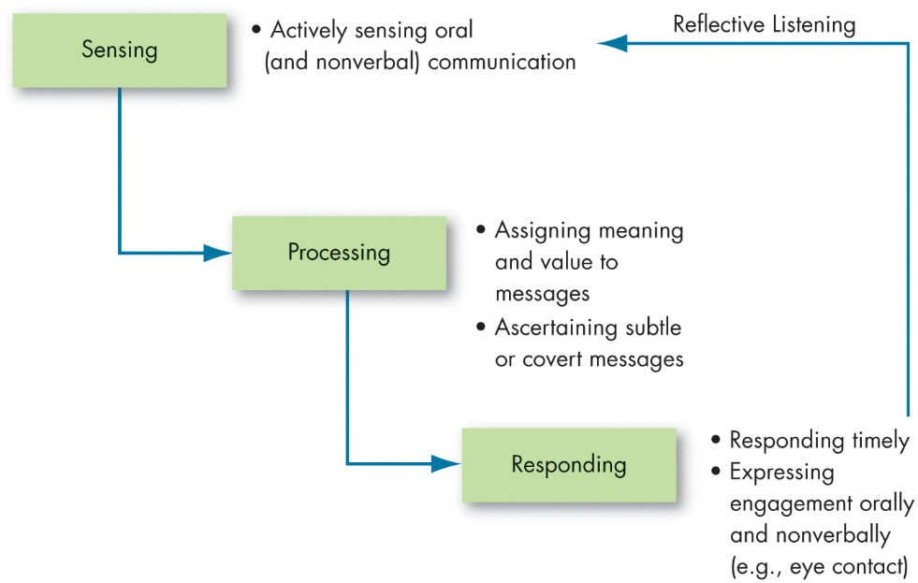
Describe the Types of Interpersonal Communication (2 of 6)
Exhibit 11.1 Active and Reflective Listening in Oral Communication
Sources: G. D. Bodie, “The Active-Empathic Listening Scale (A E L S): Conceptualization and Evidence of Validity Within the Interpersonal Domain,” Communication Quarterly 59, no. 3 (2011): 277–95; E. Rautalinko and H.-O. Lisper, “Effects of Training Reflective Listening in a Corporate Setting,” Journal of Business and Psychology 18, no. 3 (2004): 281–99; E. Teng, L. Zhang, and M. Lou, “I Am Talking but Are You Listening? The Effects of Challenge and Hindrance Stressors on Effective Communication,” Human Performance 33, no. 4 (2020): 241–57.
Notes:
Exhibit 11.1 shows how active and reflective listening can be employed during the process. By using both, managers and employees may become better listeners.
Long Description:
It involves three steps which flow one after the other: sensing, processing, and responding. Responding returns to sensing through reflective listening.
Sensing involves actively sensing oral and nonverbal communication.
Processing involves assigning meaning and value to messages, and ascertaining subtle or covert messages.
Responding involves a timely response, expressing engagement orally and nonverbally, for example, eye contact.

Slide 5
Describe the Types of Interpersonal Communication (3 of 6)
Written Communication
E-mail
Instant Messaging and Text Messaging
Natural Language Processing
Notes:
Written communication includes letters, e-mail, instant messaging, blogs newsletters, and any other method that conveys written words or symbols. Some of these create a digital or physical long-term record, while the advantage of others is quick, fleeting information exchange.

Slide 6
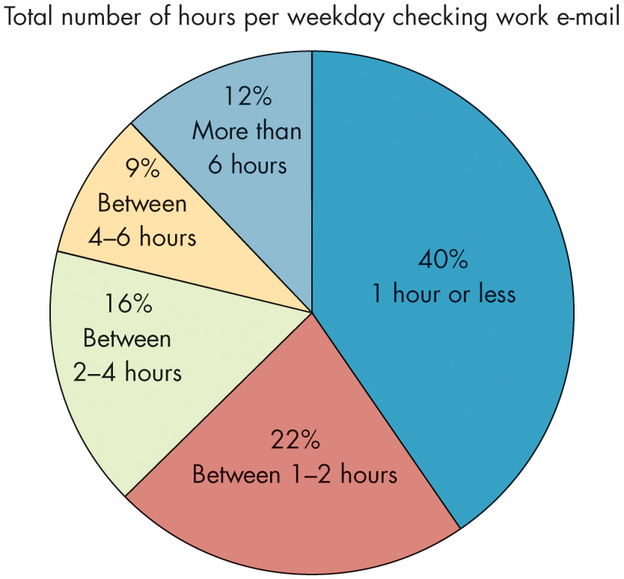
Describe the Types of Interpersonal Communication (4 of 6)
Exhibit 11.2 Time Spent Checking E-mail at Work
Source: Based on Adobe, Consumer Email Survey (San Jose, CA: 2018).
Notes:
In 2020, there were more than 3.9 billion active e-mail users worldwide—more than half of the world’s population—operating 5.6 billion separate accounts.
Exhibit 11.2 shows that employees spend an average of three hours every day checking e-mail.
Researchers and practitioners have a number of suggestions to manage your inbox effectively if you are struggling from e-mail overload:
• Turn off notifications.
• Check your e-mail at regular intervals (exact times during the day—for instance, every three hours).
• Immediately move your e-mail out of your inbox after reading.
• Use the search functionality and e-mail filters to find e-mails.
• Use shortcuts to archive e-mails in a small number of categorized folders.
• Single out important e-mails individually; process and treat less important e-mails in groups or batches.
• Use “reply all” thoughtfully and only when all people need to receive your response (to avoid clogging their inboxes).
• Do not treat e-mail like an in-person dialogue.
• Avoid the temptation to skim or skip e-mails.
• Think before you send.
Long Description:
The details from the chart in the format hours per weekday: percentage is as follows. 1 hour or less: 40 percent. Between 1 to 2 hours: 22 percent. Between 2 to 4 hours: 16 percent. More than 6 hours: 12 percent. Between 4 to 6 hours: 9 percent.

Slide 7
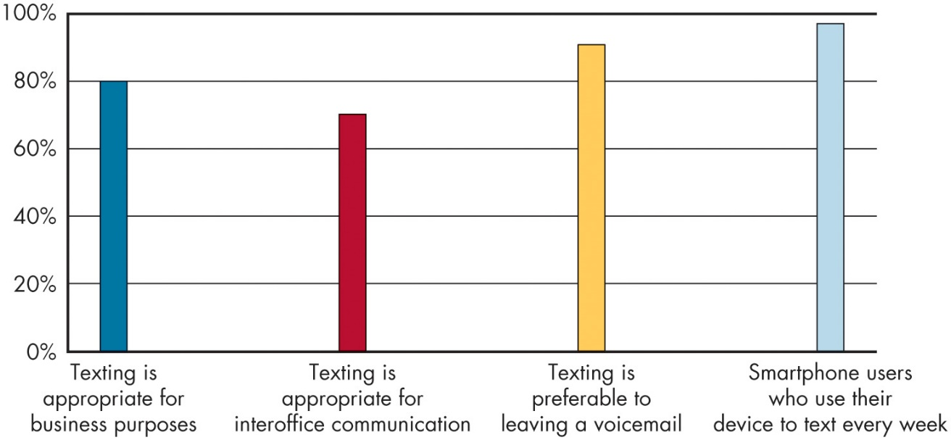
Describe the Types of Interpersonal Communication (5 of 6)
OB POLL Is it appropriate and common to use texting for work purposes?
Source: Based on A.E. Curwen, “Text and E-mails vs. Oral Communication at Work: Which Is Best?,” Society for Human Resource Management , April 21, 2017,
https://www.shrm.org/resourcesandtools/hr-topics/employee-relations/pages/ written-versus-oral-communication-.aspx
Notes:
Text messaging is, in some ways, a more reliable form of communication than IM as it is tied to people’s wireless and phone services. An instant message, on the other hand, involves sending a message through a third-party chat app or system such as, Messenger, Teams, or Slack. IMs can also be sent through social media networks, where they are also sometimes referred to as direct messages (DMs).
Unlike e-mail, instant and text messaging have a strong immediacy norm, meaning that recipients are expected to respond to incoming messages quickly and in a brief, conversational manner. Finally, data mining and artificial intelligence (AI) approaches to analyzing (and learning from) this data have benefited greatly from written business communication repositories. Through natural language processing, researchers can train algorithms to incorporate the actual words people use in e-mail, instant messages, social media, and other written communication media (including hashtags) to measure emotions, moods, personality traits, stress, and data mining and artificial intelligence (AI) approaches to analyzing (and learning from) this data have benefited greatly from written business communication repositories. Through natural language processing, researchers can train algorithms to incorporate the actual words people use in e-mail, instant messages, social media, and other written communication media (including hashtags) to measure emotions, moods, personality traits, stress, and her characteristics of employees.
Long Description:
The horizontal axis is marked with texting for work purposes. The vertical axis is labeled with percentage and ranges from 0 to 100 in increments of 20 percent. The approximate data from the graph in the format work purposes texting: percentage is as follows. Texting is appropriate for business purposes: 80 percent. Texting is appropriate for interoffice communication: 70 percent. Texting is preferable to leaving a voicemail: 90 percent. Smartphone users who use their device to text every week: 98 percent.

Slide 8
Describe the Types of Interpersonal Communication (6 of 6)
Nonverbal Communication
Body Language and Movement
Contact and Senses
Sounds and vocal intonations
Smell and odor
Contact and touch
Physical Space and the Use of Time
Notes:
Nonverbal communication can be unconscious and automatic—when events happen, we react and express our emotions, and the bystanders perceiving our emotions then make appraisals based on the emotional expressions.
Body language can convey status, level of engagement, and emotional state, and adds to and often clarifies verbal communication. In fact, studies indicate that people read much more about another’s attitude and emotions from their nonverbal cues than their words!
Although we normally think of body language and movement when we think of nonverbal communication, our other senses play a major role as well.
First, sounds and vocal intonations, sometimes called paralanguage, could also be considered a sensory form of nonverbal communication that serve as their own form of communication beyond verbal messages.
Second, smell and odor are powerful, symbolic forms of nonverbal communication in the workplace that can elicit a number of emotions.
A final sensory form of nonverbal communication is contact and touch. Touch can help provide support during times of loss and need, communicate warmth and welcoming, and even lead to improved team performance through increases in cooperative intent.
Finally, although relatively new to OB, time and physical space also matter for nonverbal behavior. For instance, how close we stand to other people sends subtle communication signals; that we like and accept them.

Slide 9
Choosing Communication Methods and Handling Barriers (1 of 5)
Exhibit 11.3 Guide to Choosing Communication Methods
In-person or virtual meetings are appropriate when . . . | Blank
 | You need to set structure, assumptions, or expectations for the entire team on a certain issue. You need to evaluate as a group obstacles or hurdles that may come up in an upcoming task. You need to discuss an issue that will involve others’ emotions or convey feelings that could be misinterpreted. You need to discuss conflict, performance goals and milestones, or behavioral issues. You need to collaborate in a way that will require a back-and-forth exchange of information. You need to gauge the receptivity to an idea, persuade others about the utility of the idea, and work toward making the idea better.
Notes:
The choice of whether to schedule a meeting or a phone chat or send an e-mail or a text is a complicated one. After determining what the norms and guidelines are in your organization, it might be helpful to match the message to the method. Exhibit 11.3 presents a guide for choosing a communication method in this way.

Slide 10
Choosing Communication Methods and Handling Barriers (2 of 5)
Phone calls are appropriate when . . . | Blank
 | You need something done or answered in the next thirty minutes (during working hours, unless it is absolutely critical). Your question or idea requires a lot of verbal explanation. Your message needs to be carefully conveyed, but certain obstacles present you from managing impressions effectively in person (e.g., under emotional labor).

Slide 11
Choosing Communication Methods and Handling Barriers (3 of 5)
Texts or instant messages are appropriate when . . . | Blank
 | You need to share a thought on a task that has already been started. You have a quick, noncritical question multiple people are capable of answering. You have brief, additional information (e.g., “by the ways” or “for your information”) you need to notify your team about. You are sharing information (e.g., a document or link) that multiple people need to collaborate or work on in real time. You are asking whether another person is available for an in-person or phone meeting.

Slide 12
Choosing Communication Methods and Handling Barriers (4 of 5)
E-mails are appropriate for when . . . | Blank
 | You need to relay a message to multiple people on your team. You need to confirm expectations or get on the same page after a meeting. You are sharing confidential information or formal documentation. You are giving your official approval or endorsement on a plan or decision. You are outlining procedures, strategies, or steps others need to follow.
Source: Based on C. D. Ellis, “Stop. Does That Message Really Need to Be an Email?”
Harvard Business Review, March 30, 2021,
https://hbr.org/2021/03/stop-does-that-
message-really-need-to-be-an-email;
see also A. Brodsky, “Virtual Surface Acting in
Workplace Interactions: Choosing the Best Technology to Fit the Task,” Journal of Applied Psychology 106, no. 5 (2021): 714–33.

Slide 13
Choosing Communication Methods and Handling Barriers (5 of 5)
Handling Barriers to Effective Communication
Information overload: a condition in which information inflow exceeds an individual’s processing capacity.
Communication apprehension: undue tension and anxiety about communication.
Communicating in times of crisis
Effective messaging
Work together rather independently
Use technology to communicate
Notes:
Several barriers can slow or distort effective communication. Three of the most important barriers to effective communication are information overload, communication apprehension, and crisis situations.
When the information we must work with exceeds our processing capacity, the result is information overload. What happens when individuals have more information than they can sort and use? They tend to select, ignore, pass over, or forget it. Or they may put off further processing until the overload situation ends. In any case, lost information and less effective communication result, making it more important to deal with overload proactively.
Surprisingly, research over the past several decades suggests that most people actually like being overloaded with information on a daily basis. Why do people feel this way? This comfort with information overload is primarily attributable to the rise in smart gadgets and devices that people use to manage large amounts of information. They feel that these devices enable them to keep up with demands, determine what information to trust more quickly, and have control over their lives. Providing technological support and equal access to devices can help forge units better equipped to manage large amounts of information.
One barrier to effective communication, communication apprehension, results when people experience undue tension or anxiety surrounding their communication with others. Communication apprehension has a number of implications to effective communication in organizational contexts.
For example, it can affect the emergence of leadership in virtual teams. Learning to regulate and cope with anxiety about communication may be one potential solution.
The final barrier to effective communication can be found in the underlying context: Communication becomes more challenging during times of crisis.
Effective communication during times of crisis involves breaking down crisis response into several stages: (1) communicating in anticipation of or preparation for crises, (2) managing responses to the crises while they are occurring, and (3) communicating with stakeholders after the crisis and catalyzing shared learning.

Slide 14
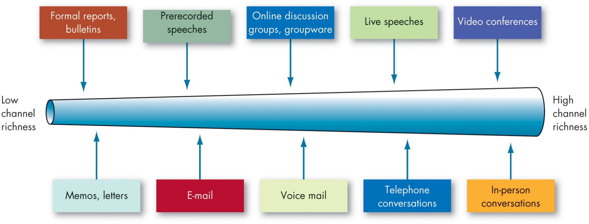
Forms of Virtual Communication (1 of 5)
Exhibit 11.4 Information Richness and Communication Channels
Source: Reproduced from R. L. Daft and R. A. Noe, Organizational Behavior (Fort Worth, TX: Harcourt, 2001), 311.
Notes:
Some communication channels are rich in that they can (1) handle multiple cues simultaneously, (2) facilitate rapid feedback, and (3) be very personal. Others are lean in that they score low on these factors. As Exhibit 11.4 illustrates, in-person conversation scores highest in channel richness because it transmits the most information per communication episode—multiple information cues, immediate feedback, and the personal touch of being present. Impersonal written media such as formal reports and bulletins rate lowest in richness.
Long Description:
The channel ranges from low richness on the left to high richness on the right. The data starting from low channel richness to the high channel richness is as follows. Formal reports and bulletins, memos and letters, prerecorded speeches, e-mail, online discussion groups and groupware, voice mail, live speeches, telephone conversations, video conferences, and in-person conversations.

Slide 15
Forms of Virtual Communication (2 of 5)
Leveraging Videoconferencing
Be mindful of your nonverbal behavior, just as you would in person.
Set the stage.
Be aware of the other people on the call.
Leverage (but be sure to test) technology.
Manage videoconferencing fatigue.
Play with innovative videoconferencing applications.
Notes:
The COVID-19 pandemic has led to an unprecedented number of people downloading videoconferencing software and applications. In March 2020, there were a record 62 million downloads of platforms like Google Hangouts Meet, Zoom, and Microsoft Teams.

Slide 16
Forms of Virtual Communication (3 of 5)
Blogging, Vlogging, and Podcasting
Blog
Engagement
Searchable content
Vlogging
Useful when step-by-step instructions are presented.
Podcasts
In-depth discussion and storytelling
Notes:
Although many people monetize blogs, vlogs, and podcasts as solo entrepreneurs, organizations are also hopping onto this trend and starting their own with the hope of connecting and engaging with their audiences. In all three cases, increased access to what was once prohibitively expensive audiovisual equipment has enabled them to spread like wildfire.
A blog (short for “web log”) is a website by a single person, team, or company that is used to share primarily written content with others and engage them.
Blogging has given way to vlogging, which serves essentially the same functions as a blog, but through a different medium: video. Vlogs are especially useful to connect with customers and clients if your products are used in projects, require step-by-step instruction, or sometimes require proficiency to use properly.
Finally, podcasts resemble mini-radio shows, with people sharing primarily audio content to serve the same function as a written blog, but with more emphasis on in-depth discussion and storytelling.

Slide 17
Forms of Virtual Communication (4 of 5)
E-collaboration and E-learning
Create and share content
Accomplish work tasks
Manage projects, goals, and timelines
Organize as teams
Communicate with one another
Notes:
As a final category of communication medium, we turn toward e-collaboration and e-learning. These media essentially build upon corporate social media approaches, but rather than being solely devoted to social networking, these media are literal platforms through which employees do their work or train to do their work.

Slide 18
Forms of Virtual Communication (5 of 5)
Emojis, Usernames, Selfies, etc.
Communicating in pictures rather than words
In a work setting, following the norms of the people you are interacting with.
Don’t overdo it.
Notes:
The rise of virtual communication has transformed the ways in which we communicate with one another. From emojis to memes to expressing ourselves with usernames and selfies, a new “language” for communicating has developed within the span of decades.

Slide 19
Smartphones, Social Media, and Cybersecurity (1 of 4)
3.5 billion people—about 45% of the world’s population—use social media.
Worldwide, 2.5 billion people own smartphones.
Effects
Blurred boundaries between work and home life.
Perceptions of others as being more abstract than if they were sitting across from us in an office.
Notes:
About 3.5 billion people use social media, or around 45 percent of the world’s population, 68 percent of U.S. adults use Facebook to connect with others, and the average adult spends three hours on social media, primarily using mobile devices like smartphones. Combined with our earlier estimate on e-mail, this equates to six hours daily checking e-mail and social media. Worldwide, over 2.5 billion people own smartphones, with about 81 percent of Americans owning smartphones.

Slide 20
Smartphones, Social Media, and Cybersecurity (2 of 4)
Smartphones (and Other Smart Devices)
Smartphones and Stress, Health, and Well-Being
Technoference
Other Smart Devices
Smart-homes
Digital assistants
Wearable digital devices
Sensors
Notes:
Much of the research in OB on smartphones has focused on their impact on stress, health, and well-being.
Smartphones have enabled people to connect with colleagues and perform relational work from just about anywhere. However, with this increased connectedness come increased threats to employee health and well-being. This situation has resulted in a paradox of sorts—although people report that the increased connection gives them a deeper sense of autonomy, that they can control when and where they work, they end up using it everywhere and all of the time, which actually strips them of autonomy.
Beyond smartphones, a new frontier in OB research revolves around smart-homes and digital assistants), which are voice-activated AI that are integrated with other devices in one’s environment. These devices can theoretically be employed in the work and home contexts to manage and accomplish one’s work.

Slide 21
Smartphones, Social Media, and Cybersecurity (3 of 4)
Social Media
What is social media anyway?
More of a context than a technology
You are what you post.
Personality via social media
The personal and relational outcomes of social media.
Shallowing hypothesis
The organizational outcomes of social media.
Organizational reputation
Notes:
Nowhere has online communication been more transformed than in the rise of social media. For decades, businesses have been coming to grips with the reality of social media—not merely to cope with it but rather to leverage it as a part of their strategy. Furthermore, many organizations have developed their own in-house social-networking applications, known as enterprise social software, and most have their own presence on popular social media sites like Facebook, Twitter, and Instagram.

Slide 22
Smartphones, Social Media, and Cybersecurity (4 of 4)
Cybersecurity
Understand the threats in order to mitigate them.
Build a culture that values cybersecurity.
Adapt to everchanging cybersecurity threats.
Management may monitor employee online activity and communications, while employees may safeguard their own privacy by sharing less and being vigilant about the personal information they do share.
Notes:
Security is a huge concern for nearly all organizations with private or proprietary information about clients, customers, and employees. Organizations worry about the security of the electronic information they seek to protect, such as hospital patient data, the physical information they still keep in file cabinets, and the security of the information they entrust their employees with knowing.
In general, cybersecurity threats can come from a variety of sources, all with various motivations: organized attackers, employees, professional hackers or criminals, and even amateurs. As employees are the only group in this list companies have direct contact with, management may monitor employee online activity and communications, which can seem invasive to employees.
Employees are also concerned with their privacy—as a number of organizations get caught up in massive data breaches in which their personal information is stolen.

Slide 23
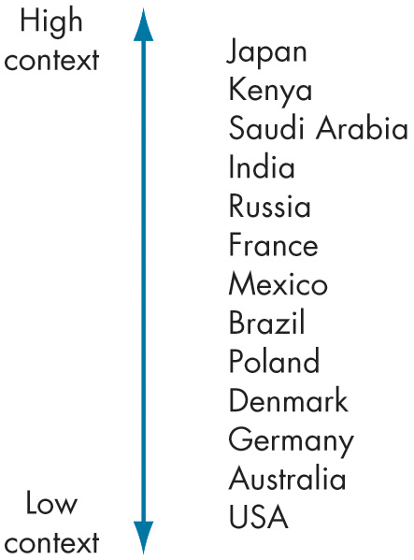
Engaging in Effective Cross-Cultural Communication (1 of 5)
Exhibit 11.5 High- Versus Low-Context Cultures
Source: Based on E. Meyer, The Culture Map: Breaking Through the Invisible Boundaries of Global Business (New York, N Y: Perseus, 2014).
Notes:
Effective communication is difficult under the best of conditions. Effective cross-cultural communication is no different and experiences its own unique challenges stemming from the values, traditions, and beliefs that differ across people.
Cultures differ in the degree to which context influences the meaning individuals take from communication.
In high-context cultures people rely heavily on nonverbal and subtle cues in communicating with others, and a person’s official status, place in society, and reputation carry considerable weight. What is not said may be more significant than what is said. In contrast, people from low-context cultures rely essentially on spoken and written words to convey meaning; body language and formal titles are secondary. Exhibit 11.5 shows where different countries range on cultural context.
Long Description:
The data from low context to high context is as follows. U. S. A., Australia, Germany, Denmark, Poland, Brazil, Mexico, France, Russia, India, Saudi Arabia, Kenya, and Japan,

Slide 24
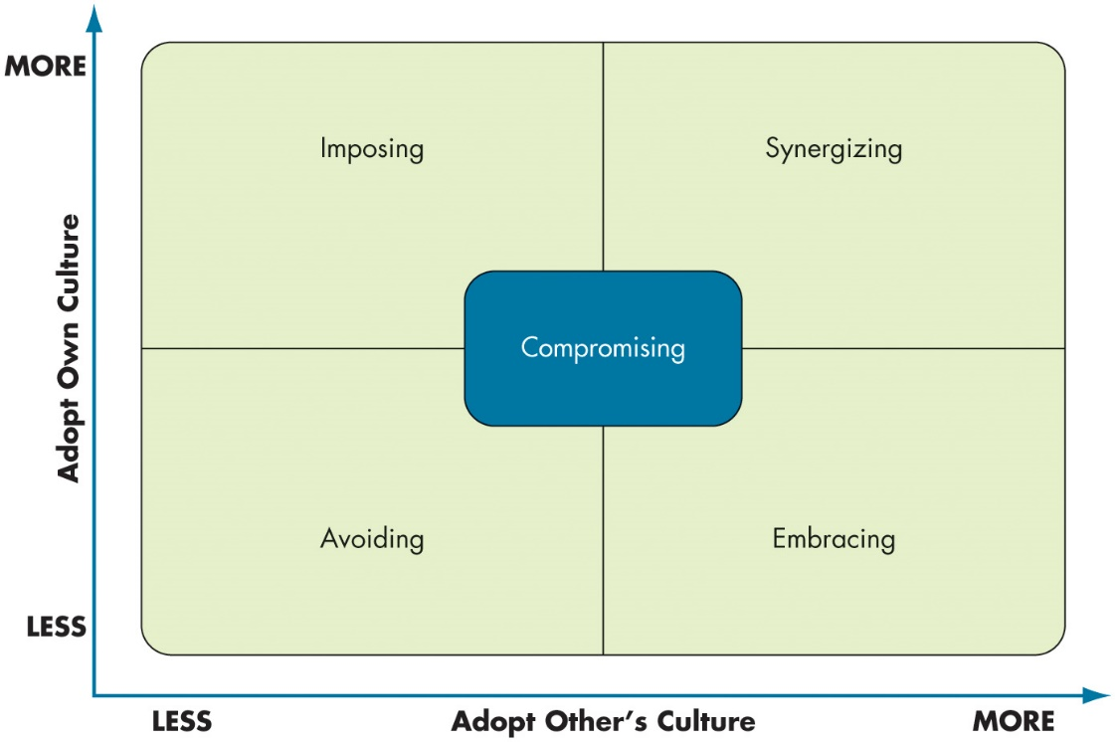
Engaging in Effective Cross-Cultural Communication (2 of 5)
Exhibit 11.6 Cross-Cultural Interaction Approaches
Source: Based on N. J. Adler and Z. Aycan, “Cross-Cultural Interaction: What We Know and What We Need to Know,” Annual Review of Organizational Psychology and Organizational Behavior 5 (2018): 307–33.
Notes:
There are complex dynamics surrounding cross-cultural interactions that involve not only the context and situation but also (1) an understanding of one’s own cultural approach and (2) an understanding of the interaction partner’s cultural approach.
As shown in Exhibit 11.6, there is a trade-off between five approaches that all vary as a function of one’s own and others’ cultural approaches. Try not to think of the interaction in terms of how both interaction partners can come to an agreement on the cultural approach given the situation.
• Avoiding (Low-Own/Low-Other): Putting aside cultural preferences, values, practices, or customs, often for tactical or strategic reasons.
• Imposing (High-Own/Low-Other): Asserting one’s own cultural preferences, values, practices, and customs without acknowledging others’ cultural approaches.
• Embracing (Low-Own/High-Other): Putting aside one’s own cultural preferences, values, practices, and customs in order to acknowledge or embrace others’ cultural approaches.
• Synergizing (High-Own/High-Other): Celebrating both interaction partners’ cultural preferences, values, practices, and customs, often in an improvisational or flexible way.
• Compromising (Mid-Own/Mid-Other): Treating the cultural interaction as a give-and-take; recognizing when cultural preferences, values, practices, and customs conflict and embracing some and putting aside others in order to reduce conflict.
Long Description:
The data from the matrix is as below.
Avoiding takes place when both adopting others’ and own culture is less, and is represented at the bottom left of the matrix.
Embracing takes place when adopting other’s culture is more and adopting own culture is less, and is represented at the bottom right of the matrix.
Imposing takes place when adopting other’s culture is less and adopting own culture is more, and is represented at the top left of the matrix.
Synergizing takes place when adopting both the culture is more and is represented at the top right of the matrix.
Compromising is at the mid of both the cultures and is equally placed.

Slide 25
Engaging in Effective Cross-Cultural Communication (3 of 5)
Aspects of Cultural Communication
Cross-cultural differences:
Words mean different things to different people
Connotations—words imply different things in different languages
Tone differences
Tolerance for conflict and methods for resolving conflicts
Types of information communicated to others
Use of metaphor and analogy
Standards for aggression
Notes:
In cross-cultural communication, there are several aspects of others’ cultures that can lead to differences in perspectives, perceptions, and attributions.
Words mean different things to different people, particularly people from
different cultures.
Word connotations matter in cross-cultural communication because the same
word can imply different things in different languages.
Tone differences can lead to emotional misconceptions during cross-cultural
interactions.
Cultures may differ in tolerance for conflict and methods for resolving conflicts.
Cultures may differ in the types of information they communicate to others.
Lastly, a study of Spanish-speaking Latinx people found a clear preference for
communicating with metaphor and analogy, which they found more convincing in arguments, and they liked people who used metaphor and analogy better than those who abstained from that type of language.
In addition, while all cultures identify certain words and behaviors as overly aggressive, there are certain types of behaviors that are more likely to be identified as negative depending on the culture.

Slide 26
Engaging in Effective Cross-Cultural Communication (4 of 5)
A Guide to Cross-Cultural Communication
Intercultural communication should be based on sensitivity and pursuit of common goals.
Form an ad hoc “third culture”
Notes:
According to Fred Casmir, a leading expert in intercultural communication research, we often do not communicate well with people outside our culture because we tend to generalize from only their cultural origin.
Because there are far too many cultures for anyone to understand completely and individuals interpret their own cultures differently, intercultural communication should be based on sensitivity and pursuit of common goals. Casmir found the ideal condition is an ad hoc “third culture” that a group can form when its members seek to incorporate aspects of each member’s cultural communication preferences. The norms that this subculture establishes through appreciating individual differences create a common ground for effective communication.

Slide 27
Engaging in Effective Cross-Cultural Communication (5 of 5)
Prior to Interaction
Know yourself.
Foster a climate of mutual respect, fairness, and democracy.
During the Interaction
Consider the other person’s viewpoint.
Learn from misunderstandings.
After the Interaction
Proactively maintain the identity and culture of the group.
Learn from all intercultural interactions.
Notes:
When communicating with people from a different culture, what can you do to reduce misinterpretations? Casmir and other experts offer the following suggestions:
Prior to Interaction
Know yourself.
Foster a climate of mutual respect, fairness, and democracy.
During the Interaction
Consider the other person’s viewpoint.
Learn from misunderstandings.
After the Interaction
Proactively maintain the identity and culture of the group.
Learn from all intercultural interactions.

Slide 28
Implications for Managers (1 of 4)
Consider issues of (a)synchronicity when deciding how to communicate any messages. Does the message require everyone to be psychologically and physically present?
Practice active and reflective listening to communicate more effectively and build stronger, trusting work relationships.
Be aware of your message, language, and nonverbal communication—they can make or break an effective speech.
Follow best practices and norms when communicating electronically to reduce stress and overload as well as to save time for you and your coworkers.
Notes:
Consider issues of (a)synchronicity when deciding how to communicate any messages. Does the message require everyone to be psychologically and physically present?
Practice active and reflective listening to communicate more effectively and build stronger, trusting work relationships.
Be aware of your message, language, and nonverbal communication—they can make or break an effective speech.
Follow best practices and norms when communicating electronically to reduce stress and overload as well as to save time for you and your coworkers.

Slide 29
Implications for Managers (2 of 4)
Although we often do not have control over some of our more automatic, subtle nonverbal communication, we should be aware of how it influences the messages we are trying to convey.
Reduce information overload by leveraging technology, develop personal and team awareness of information demands, and reduce the ambiguity and complexity of messages.
If you are experiencing communication apprehension, develop emotion regulation techniques that enable you to cope with the increased apprehension.
Notes:
In addition:
Although we often do not have control over some of our more automatic, subtle nonverbal communication, we should be aware of how it influences the messages we are trying to convey.
Reduce information overload by leveraging technology, develop personal and team awareness of information demands, and reduce the ambiguity and complexity of messages.
If you are experiencing communication apprehension, develop emotion regulation techniques that enable you to cope with the increased apprehension.

Slide 30
Implications for Managers (3 of 4)
In crises, work together and use technology to make sense of the situation and to develop solutions to the problems the crisis produces.
Mindfully use smartphones and social media to meet your personal and professional objectives. However, always be aware of the effect they may be having on you. Take action when you recognize that their use is depleting or interfering with your well-being or health.
Notes:
Further,
In crises, work together and use technology to make sense of the situation and to develop solutions to the problems the crisis produces.
Mindfully use smartphones and social media to meet your personal and professional objectives. However, always be aware of the effect they may be having on you. Take action when you recognize that their use is depleting or interfering with your well-being or health.

Slide 31
Implications for Managers (4 of 4)
Try not to see cross-cultural communication as you managing someone else’s culture. Instead, view cross-cultural communication as something collaborative and reconciled through interaction, mutual understanding, and mutual learning.
Notes:
Finally,
Try not to see cross-cultural communication as you managing someone else’s culture. Instead, view cross-cultural communication as something collaborative and reconciled through interaction, mutual understanding, and mutual learning.

Slide 32
Discussion Questions
If you’re like many people, you probably suffered from Zoom fatigue when college classes moved online in the spring of 2020. How did you manage your Zoom fatigue? How will the skills you developed help you in the workplace?
When do you think it’s appropriate to use emojis and memes in a workplace setting? Have you ever deleted or added an emoji or meme prior to sending an email to your boss or professor? Why?
How can you improve your ability to be effective in cross-cultural communication?

Slide 33

Copyright
This work is protected by United States copyright laws and is provided solely for the use of instructors in teaching their courses and assessing student learning. Dissemination or sale of any part of this work (including on the World Wide Web) will destroy the integrity of the work and is not permitted. The work and materials from it should never be made available to students except by instructors using the accompanying text in their classes. All recipients of this work are expected to abide by these restrictions and to honor the intended pedagogical purposes and the needs of other instructors who rely on these materials.

