Slide 1


Organizational Behavior
Nineteenth Edition
Chapter 12
Leadership
Copyright © 2023, 2019, 2017 Pearson Education, Inc. All Rights Reserved
Notes:
If this PowerPoint presentation contains mathematical equations, you may need to check that your computer has the following installed:
1) MathType Plugin
2) Math Player (free versions available)
3) NVDA Reader (free versions available)
Welcome to this Organizational Behavior course that uses the 19th edition of the textbook, Organizational Behavior by Robbins and Judge. This is considered among the most widely used OB textbooks in the world. Robbins and Judge are recognized as definitive aggregators of OB concepts, applications, and practices. The course and this book will provide you with a resource that will benefit you throughout your degree program and your professional life.

Slide 2
Learning Objectives (1 of 2)
12.1 Summarize the conclusions of trait theories of leadership.
12.2 Identify the central tenets and main limitations of behavioral theories.
12.3 Contrast contingency theories of leadership.
12.4 Describe the positive leadership styles and relationships.
Notes:
After studying this chapter, you should be able to:
Summarize the conclusions of trait theories of leadership.
Identify the central tenets and main limitations of behavioral theories.
Contrast contingency theories of leadership.
Describe the positive leadership styles and relationships.

Slide 3
Learning Objectives (2 of 2)
12.5 Discuss the roles of leaders in creating ethical organizations.
12.6 Describe how leaders can have a positive impact on their organizations through building trust.
12.7 Identify the challenges and opportunities to our understanding of leadership.
Notes:
Additional objectives for this chapter.
Discuss the roles of leaders in creating ethical organizations.
Describe how leaders can have a positive impact on their organizations through building trust.
Identify the challenges and opportunities to our understanding of leadership.

Slide 4
Summarize the Conclusions of Trait Theories of Leadership (1 of 6)
Leadership is the ability to influence a group toward the achievement of a vision or set of goals.
Not all leaders are managers, nor are all managers leaders.
Nonsanctioned leadership is often as important or more important than formal influence.
Notes:
Leadership is the ability to influence a group toward the achievement of a vision or set of goals. The source of this influence may be formal, such as that provided by managerial rank in an organization. But not all leaders are managers, nor, for that matter, are all managers leaders. Just because an organization provides its managers with certain formal rights is no assurance they will lead effectively.
Nonsanctioned leadership—the ability to influence that arises outside the formal structure of the organization—is often as important or more important than formal influence. In other words, leaders can emerge from within a group as well as by formal appointment.

Slide 5
Summarize the Conclusions of Trait Theories of Leadership (2 of 6)
Trait theories of leadership focus on personal qualities and characteristics.
The search for personality, social, physical, or intellectual attributes that differentiate leaders from nonleaders goes back to the earliest stages of leadership research.
Notes:
Trait theories of leadership focus on personal qualities and characteristics. The search for personality, social, physical, or intellectual attributes that differentiate leaders from nonleaders goes back to the earliest stages of leadership research.

Slide 6
Summarize the Conclusions of Trait Theories of Leadership (3 of 6)
Personality Traits and Leadership
Good leaders:
Are able to assert themselves (extroverted).
Are disciplined and able to keep commitments they make (conscientious).
Are creative and flexible.
Notes:
What makes a person a leader?
In general, individuals who like being around people and who can assert themselves, who are disciplined and able to keep commitments they make, and who are creative and flexible have an apparent advantage when it comes to leadership.

Slide 7
Summarize the Conclusions of Trait Theories of Leadership (4 of 6)
Big Five Traits
Extraversion to be the strongest predictor of motivation to lead and leader emergence.
Unlike agreeableness and emotional stability, conscientiousness and openness to experience also showed strong relationships to leadership, though not quite as strong as extraversion.
Proactive Personality Traits
Dark Triad Traits
Notes:
In examining the Big Five personality traits, researchers have consistently found extroversion to be important for several leadership outcomes. Despite being the strongest predictor of motivation to lead and leader emergence, extroversion also predicts several leadership behaviors or styles.
Unlike agreeableness and emotional stability, conscientiousness and openness to experience also showed strong relationships to leadership, though not quite as strong as extraversion.
Leaders’ proactive personality also has an important influence on leadership outcomes. In particular, it appears to matter during specific times during a team, department, or organization’s life cycle.
What about the Dark Triad personality traits? Research indicates they are not all bad for leadership: Normative scores on the Dark Triad personality traits were optimal, suggesting that having too much of the Dark Triad traits can result in ineffective leadership.

Slide 8
Summarize the Conclusions of Trait Theories of Leadership (5 of 6)
Emotional Intelligence and Leadership
Another trait that may indicate effective leadership is emotional intelligence (E I).
A core component of E I is empathy.
People high in E I are more likely to emerge as leaders, even after taking cognitive ability and personality into account.
Notes:
Another trait that may indicate effective leadership is emotional intelligence (EI). A core component of EI is empathy. A leader who effectively displays and manages emotions will find it easier to influence the feelings of followers, by both expressing genuine sympathy and enthusiasm for good performance and by using irritation for those who fail to perform.
Recent research has demonstrated that people high in EI are more likely to emerge as leaders, even after taking cognitive ability and personality into account.

Slide 9
Summarize the Conclusions of Trait Theories of Leadership (6 of 6)
Two conclusions:
Traits can predict leadership.
Traits do a better job predicting the emergence of leaders than they do at distinguishing between effective and ineffective leaders.
Notes:
Based on the latest findings, we offer two conclusions. We can say that traits can predict leadership. Second, traits do a better job predicting the emergence of leaders and the appearance of leadership than they do at distinguishing between effective and ineffective leaders. The fact that an individual exhibits the traits and that others consider him or her a leader does not necessarily mean that he or she will be an effective one.
Trait theories help us predict leadership, but they don’t fully help us explain leadership.

Slide 10
Central Tenets and Main Limitations of Behavioral Theories (1 of 2)
Behavioral theories of leadership imply we can train people to be leaders.
The Ohio State studies found two behaviors that accounted for most leadership behavior:
Initiating structure
Consideration
Notes:
While trait research provides a basis for selecting the right people for leadership, behavioral theories of leadership imply that we can train people to be leaders.
The most comprehensive theories resulted from the Ohio State Studies which sought to identify independent dimensions of leader behavior. Beginning with more than a thousand dimensions, the studies narrowed the list to two that substantially accounted for most of the leadership behavior described by employees: initiating structure and consideration.
Initiating structure is the extent to which a leader defines and structures his or her role and those of subordinates to facilitate goal attainment. It includes behavior that attempts to organize work, work relationships, and goals. A leader high in initiating structure is someone who “assigns group members to particular tasks,” “expects workers to maintain definite standards of performance,” and “emphasizes the meeting of deadlines.”
Consideration is the extent to which a leader has job relationships that are characterized by mutual trust, respect for employees’ ideas, and regard for their feelings. A leader high in consideration helps employees with personal problems, is friendly and approachable, treats all employees as equals, and expresses appreciation and support.

Slide 11
Central Tenets and Main Limitations of Behavioral Theories (2 of 2)
Summary of Trait Theories and Behavioral Theories
Research indicates there is validity for both the trait and behavioral theories.
Parts of each theory can help explain facets of leadership emergence and effectiveness.
Traits and behaviors do not guarantee success though.
Context matters too.
Notes:
In summary, research indicates there is validity for both the trait and behavioral theories. Parts of each theory can help explain facets of leadership emergence and effectiveness. However, identifying the exact relationships is not a simple task.
The first difficulty is in correctly identifying whether a trait or a behavior predicts a certain outcome.
The second is in exploring which combinations of traits and behaviors yield certain outcomes.
The third challenge is to determine the causality of traits to behaviors so that predictions toward desirable leadership outcomes can be made.
This final challenge is complicated by the varieties of contexts and situations leaders may find themselves in. Some leaders may have the right traits or display the right behaviors—but still fail. Context matters, too.

Slide 12
Contrast Contingency Theories of Leadership (1 of 7)
The Fiedler contingency model: effective group performance depends upon the proper match between the leader’s style of interacting with subordinates and the degree to which the situation gives control to the leader.
Task-oriented
Relationship-oriented
Notes:
The first comprehensive contingency model for leadership was developed by Fred Fiedler, who proposed that effective group performance depends on the proper match between the leader’s style of interacting with subordinates and the degree to which the situation gives control to the leader.
The first step in the Fiedler contingency model is identifying leadership style. Fiedler believed that a key factor in leadership success is the individual’s basic leadership style. According to this model, the individual’s leadership style is assumed to be stable or permanent and refers to the degree to which leaders approach leadership from a task-oriented or relationship-oriented perspective.

Slide 13
Contrast Contingency Theories of Leadership (2 of 7)
Defining the Situation
Contingency dimensions:
Leader–member relations
Task structure
Position power
Notes:
After assessing leadership style, it is necessary to match the leader with the situation. Fiedler has identified three contingency or situational dimensions:
Leader–member relations—the degree of confidence, trust, and respect members have in their leader.
Task structure—the degree to which the job assignments are procedural.
Position power—the degree of influence a leader has over power variables such as hiring, firing, discipline, promotions, and salary increases.
The next step is to evaluate the situation in terms of these three contingency variables. Leader–member relations are either good or poor. Task structure is either high or low. Position power is either strong or weak. Fiedler states the better the leader–member relations, the more highly structured the job, and the stronger the position power, the more control the leader has.

Slide 14
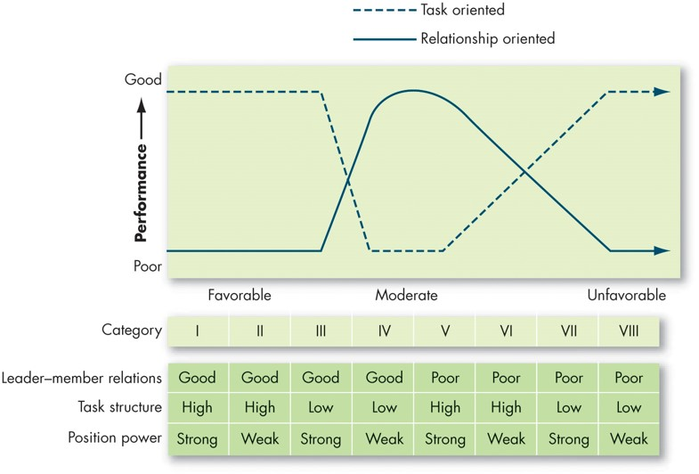
Contrast Contingency Theories of Leadership (3 of 7)
Exhibit 12.1 Predictions from the Fiedler Model
Notes:
As shown in Exhibit 12.1, Fiedler concluded that task-oriented leaders tend to perform better in situations that were very favorable to them as well as in situations that were very unfavorable. Fiedler would predict that when faced with a category I, II, III. VII, or VIII situation, task-oriented leaders perform better. Relationship-oriented leaders, however, perform better in moderately favorable situations—categories IV through VI. Fiedler has condensed these eight situations to three.
Long Description:
The horizontal axis is marked with situations and ranges from favorable, moderate, and then to unfavorable situations. The vertical axis is labeled with the performance and ranges from poor to good performance levels. The approximate data from the graph is as follows. The line for task oriented leaders starts from good performance under favorable conditions, decreases to poor under moderate conditions and then increases to good performance under unfavorable conditions. Inversely, the line for relationship oriented leaders starts from poor performance under favorable conditions, increases to good performance in moderate situations, and then again decreases to poor performance under unfavorable conditions. Both the line continue in the same manner.
The table below reads as follows. The performance of leader-member relations, task structure and position are noted in different categories from 1 to 8. Data in the format approaches: categories 1 to 8 is as follows. Leader-member relations: good, good, good, good, poor, poor, poor, poor. Task structure: high, high, low, low, high, high, low, low. Position power: strong, weak, strong, weak, strong, weak, strong, weak.

Slide 15
Contrast Contingency Theories of Leadership (4 of 7)
Situational leadership theory (S L T) is a contingency theory that focuses on the followers.
Successful leadership is achieved by selecting the right leadership style, which is contingent on the level of the followers’ readiness to accomplish a specific task.
Notes:
Although LPC theory is the most researched contingency theory, three others deserve mention.
First, situational leadership theory (SLT) is a contingency theory that focuses on the followers. It proposes that successful leadership is achieved by selecting the right leadership style, which is contingent on the level of the followers’ readiness. The term readiness refers to the extent to which people have the ability and willingness to accomplish a specific task.

Slide 16
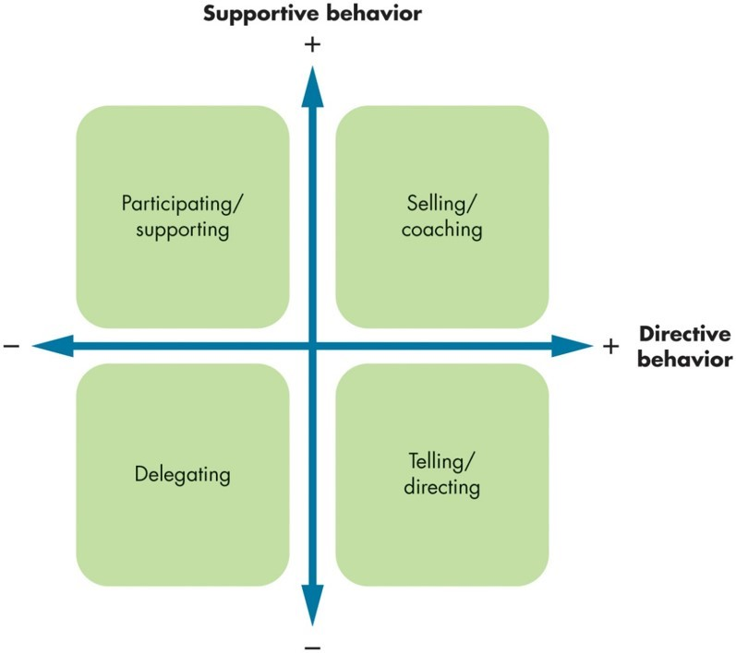
Contrast Contingency Theories of Leadership (5 of 7)
Exhibit 12.2 Manager Leadership Styles by Behavior in Situational Leadership Theory
Source: Based on K. H. Blanchard, D. Zigarmi, and R. B. Nelson, “Situational Leadership After 25 Years: A Retrospective,” The Journal of Leadership Studies, 1, no. 1 (1993): 21–36; and G. Tortorella and F. Fogliatto, “Implementation of Lean Manufacturing and Situational Leadership Styles: An Empirical Study,” Leadership & Organization Development Journal 38, no. 7 (2017): 946–68.
Notes:
As shown in Exhibit 12.2, a leader should choose one of four behaviors depending on follower readiness. If followers are unable and unwilling to do a task, the leader needs to give clear and specific directions. If they are unable but willing, the leader needs to display high task orientation to compensate for followers’ lack of ability and high relationship orientation to get them to “buy into” the leader’s desires. Conversely, if followers are able but unwilling, the leader needs to use a supportive and participative style. If they are both able and willing, the leader doesn’t need to do much.
SLT has intuitive appeal. Yet, research efforts to test and support the theory have generally been disappointing.
Long Description:
The graph shows the four quadrants and the horizontal axis is labeled with directive behavior and the vertical axis is labeled with supportive behavior. Selling or coaching is plotted in the first quadrant. Telling or directing is plotted in the second quadrant. Delegating is plotted in the third quadrant. Participating or supporting is plotted in the fourth quadrant.

Slide 17
Contrast Contingency Theories of Leadership (6 of 7)
Follower Contingency Theories
The leader–participation model relates leadership behavior and participation in decision making.
Leader behavior must adjust to reflect the task structure.
Shared leadership theory: leadership is capable of being enacted by a collective.
Followership: the capability of followers to put into practice a leader’s vision or set of goals.
Notes:
The final contingency theories we’ll discuss concern the role that followers play.
The leader–participation model which argues that the way the leader makes decisions is as important as what she or he decides. It says leader behavior must adjust to reflect the task structure.
As suggested by the leader–participation model, sometimes the situation calls for followers to play an active role in the decision making that affects the team, work group, or unit. Shared leadership theory takes this idea a step further to suggest that leadership can become an emergent state in which leadership roles are distributed across followers, and all are capable of influencing one another.
Like the contingency theories we have discussed so far, followership theory places a heavy emphasis on followers in affecting the success of leadership. In many ways, followership “flips the leadership script” to focus on the follower’s capability to put into practice a leader’s vision or set of goals. Therefore, the success of a leader depends heavily on the quality and makeup of the followers they are attempting to influence toward a common goal or visions. Moreover, the leader’s emotion and behavior can be affected or influenced by followers.

Slide 18
Contrast Contingency Theories of Leadership (7 of 7)
Leading in Times of Crisis
“Cometh the hour, cometh the man.”
Think crisis, think female effect
Charismatic leadership
Visionary
Crisis-responsive
Notes:
A popular English proverb states, “Cometh the hour, cometh the man.” Despite its sexist phrasing, this proverb suggests that during times of crisis, leaders will emerge to bring order and understanding to the chaos.
Of all the leadership styles during times of crisis, charismatic leadership has been studied the most frequently. During times of crisis, charismatic leadership can be visionary or crisis-responsive.

Slide 19
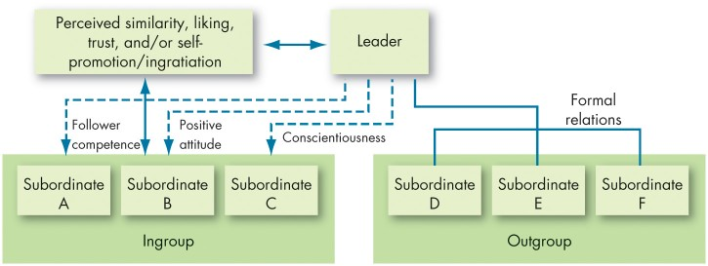
Positive Leadership Styles and Relationships
Exhibit 12.3 Leader-Member Exchange Theory
Notes:
The leader-member exchange (LMX) theory argues that leaders establish a special relationship with a small group of their followers (see Exhibit 12.3). These individuals make up the in-group—they are trusted, get a disproportionate amount of the leader’s attention, and are more likely to receive special privileges. The theory proposes that early in the history of the interaction between a leader and a given follower, the leader implicitly categorizes the follower as an “in” or an “out” and that relationship is relatively stable over time. The leader does the choosing on the basis of the follower’s characteristics.
Research to test LMX theory has been generally supportive, with substantive evidence that leaders do differentiate among followers. These disparities are far from random; and followers with in-group status will have higher performance ratings, engage in more helping or “citizenship” behaviors at work, engage in less deviant or “counterproductive” behaviors at work, and report greater satisfaction with their superior.
Long Description:
The leader exhibits relationship with two categories of followers: ingroup and outgroup. The ingroup has subordinate A, subordinate B, and subordinate C. the leader exerts a follower competence with the subordinate A, positive attitude with the subordinate B and conscientiousness with subordinate C.
Outgroup has subordinate D, subordinate E, and subordinate F and the leader had formal relationship with these subordinates.
The leader has a reversible relationship with the people having perceived similarity, liking, trust, and or self-promotion or ingratiation who in turn have a reversible relationship with the ingroup subordinates.

Slide 20
Contemporary Theories of Leadership (1 of 11)
Exhibit 12.4 Key Characteristics of Charismatic Leaders
Vision and articulation. Has a vision—expressed as an idealized goal—that proposes a future better than the status quo; able to clarify the importance of the vision in terms that are understandable to others.
Personal risk. Willing to take on high personal risk, incur high costs, and engage in self-sacrifice to achieve the vision.
Sensitivity to follower needs. Perceptive of others’ abilities and responsive to their needs and feelings.
Unconventional behavior. Engages in behaviors that are perceived as novel and counter to norms.
Source: Based on J. A. Conger and R. N. Kanungo, Charismatic Leadership in Organizations (Thousand Oaks, CA: Sage, 1998), 94.
Notes:
Charismatic leadership theory states that followers make attributes of heroic or extraordinary leadership abilities when they observe certain behaviors, as seen in Exhibit 12.4. General characteristics are: they have vision; they are willing to take personal risk; they are sensitive to followers’ needs; and they exhibit extraordinary behaviors.

Slide 21
Contemporary Theories of Leadership (2 of 11)
How Charismatic Leaders Influence Followers
Articulating an appealing vision.
Developing a vision statement.
Establishing a new set of values.
Conveying courage and conviction about the vision.
Notes:
How does a charismatic leader influence followers? By articulating an appealing vision, developing an accompanying vision statement, conveying a new set of values, and demonstrating courage and conviction about the vision. Followers “catch” the emotions their leader is conveying.

Slide 22
Contemporary Theories of Leadership (3 of 11)
Does Effective Charismatic Leadership Depend on the Situation?
People are especially receptive when they sense a crisis or when they are under stress.
Notes:
Does effective charismatic leadership depend on the situation? Charisma appears to be most appropriate when the follower’s task has an ideological component or when the environment involves a high degree of stress and uncertainty. People are especially receptive when they sense a crisis or when they are under stress.
This may explain why, when charismatic leaders surface, it’s more likely to be in politics, religion, wartime; or when a business firm is in its infancy or facing a life-threatening crisis.

Slide 23
Contemporary Theories of Leadership (4 of 11)
The Dark Side of Charismatic Leadership
Many leaders don’t necessarily act in the best interest of their companies.
Many have allowed their personal goals to override the goals of the organization.
Individuals who are narcissistic are also higher in some behaviors associated with charismatic leadership.
Notes:
Some charismatic leaders don’t necessarily act in the best interest of their companies, allowing their personal goals to override the goals of the organization.
Research has shown that individuals who are narcissistic are also higher in some behaviors associated with charismatic leadership. It’s not that charismatic leadership isn’t effective; overall, it is. But a charismatic leader isn’t always the answer. Success depends, to some extent, on the situation and on the leader’s vision.

Slide 24
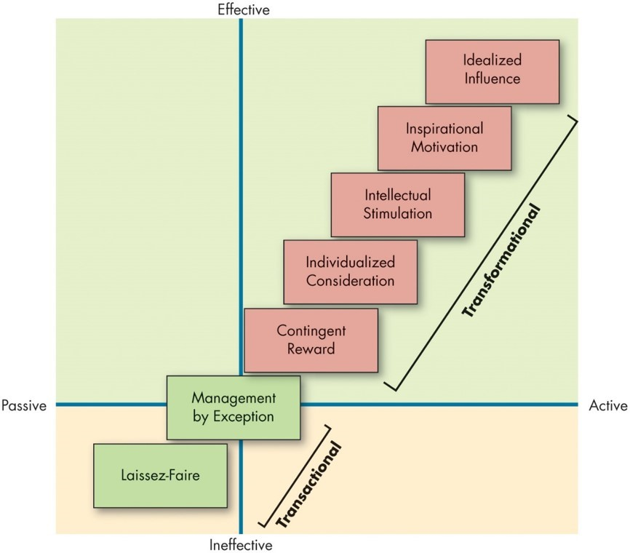
Contemporary Theories of Leadership (5 of 11)
Exhibit 12.5 Full Range Leadership Model
Source: Adapted from B. M. Bass and B. J. Avolio, Improving Organizational Effectiveness Through Transformational Leadership (Thousand Oaks, CA: Sage, 1994).
Notes:
Exhibit 12.5 shows the full range of the leadership model indicating that there are a number of approaches or styles on leadership that vary on a continuum from passive and ineffective to active and effective.
Long Description:
The horizontal axis ranges from passive to active leadership. The vertical axis ranges from the ineffective to effective leadership.
The data from the graph form the bottom left to the top right is as follows. Laissez-Faire falls in the third quadrant and management by exception falls on the origin and is equally placed in all the four quadrants. These two components form the transactional phase. The components of transformational phase that falls in the first quadrant, from the bottom left to top right is: contingent reward, individualized consideration, intellectual stimulation, inspirational motivation and idealized influence.

Slide 25
Contemporary Theories of Leadership (6 of 11)
Exhibit 12.6 Characteristics of Full Range Leadership Styles
Laissez-Faire Leader
Laissez-Faire: Abdicates responsibilities, avoids making decisions.
Transactional Leader
Contingent Reward: Contracts exchange of rewards for effort, promises rewards for good performance, recognizes accomplishments.
Management by Exception (active): Watches and searches for deviations from rules and standards, takes corrective action.
Management by Exception (passive): Intervenes only if standards are not met.
Notes:
Exhibit 12.6 shows the characteristics of each of the full range leadership model’s leadership styles.

Slide 26
Contemporary Theories of Leadership (7 of 11)
Transformational Leader
Idealized Influence: Provides vision and sense of mission, instills pride, gains respect and trust.
Inspirational Motivation: Communicates high expectations, uses symbols to focus efforts, expresses important purposes in simple ways.
Intellectual Stimulation: Promotes intelligence, rationality, and careful problem solving.
Individualized Consideration: Gives personal attention, treats each employee individually, coaches, advises.
Source: B. M. Bass, “From Transactional to Transformational Leadership: Learning to Share the Vision,” Organizational Dynamics 18, no. 3 (1990): 19–31.

Slide 27
Contemporary Theories of Leadership (8 of 11)
Integrating and Evaluating Positive Leadership Styles
Transformational Versus Charismatic Leadership
Charismatic leadership places more emphasis on the way leaders communicate—are they passionate and dynamic?
Transformational leadership focuses more on what they are communicating—is it a compelling vision?
Both focus on the leader’s ability to inspire followers.
Notes:
First, one clear conclusion can be drawn regarding laissez-faire leadership: You probably should not use it. Laissez-faire leadership, or doing nothing—often when something should be done—mostly results in destructive outcomes like social loafing, harmed interpersonal relationships, and the perpetuation of toxic group or work environments.
However, a comparison between charismatic, transactional, and transformational styles is somewhat trickier. Although all of these styles can be useful in their own right, transformational leadership tends to consistently result in optimal leadership outcomes. Therefore, in this section, we primarily focus on how charismatic and transactional leadership stack up to transformational leadership.
Charismatic leadership places somewhat more emphasis on the way leaders communicate (are they passionate and dynamic?), while transformational leadership focuses more on what they are communicating (is it a compelling vision?).
Still, the theories are more alike than different. At their heart, both focus on the leader’s ability to inspire followers, and sometimes they do so in the same way. Because of this, some researchers believe the concepts are somewhat interchangeable.

Slide 28
Contemporary Theories of Leadership (9 of 11)
Integrating and Evaluating Positive Leadership Styles
Transformational Versus Transactional Leadership
Transformational leadership builds on transactional leadership and produces levels of follower effort and performance beyond what transactional leadership alone can do.
Notes:
Transactional and transformational leadership complement each other; they are not opposing approaches to getting things done. Transformational leadership builds on transactional leadership and produces levels of follower effort and performance beyond what transactional leadership alone can do.
Many researchers have commented on how the contingent reward aspect of transactional leadership appears to be just as effective as many of the transformational approaches to leadership, although the management by exception approach does lag behind in effectiveness.

Slide 29
Contemporary Theories of Leadership (10 of 11)
Integrating and Evaluating Positive Leadership Styles
Five Reasons Why Transformational Leadership Is Effective
Affective or attitudinal mechanism
Motivational mechanism
Identification mechanism
Social exchange mechanism
Justice enhancement mechanism
Notes:
Researchers have found that transformational leadership is, in general, effective for five reasons:
Affective or attitudinal mechanism: Transformational approaches promote positive employee moods, emotions, job satisfaction, organizational commitment, and feelings of well-being.
Motivational mechanism: Transformational approaches motivate employees—they become more confident and engaged and are more willing to put in the time and effort.
Identification mechanism: Transformational approaches lead employees to personally identify with the leader and the leader’s values and identity as well as the team or organization.
Social exchange mechanism: Transformational approaches improves the quality of exchange and relationship between leaders and followers (i.e., LMX; see earlier in this chapter). Followers are also more likely to perceive that they are supported by the leader, team, and/or organization.
Justice enhancement mechanism: Transformational approaches improve employee fairness perceptions, motivating followers to contribute more and to trust the leader, team, and organization more.

Slide 30
Contemporary Theories of Leadership (11 of 11)
Integrating and Evaluating Positive Leadership Styles
Are There Downsides to Transformational Leadership?
In general, organizations perform better when they have transformational leaders.
Notes:
In general, organizations perform better when they have transformational leaders. However, transformational leadership is not without its critics, some of whom boldly claim that transformational leadership behaviors can be construed as manipulative and unduly granting power to inspirational people.

Slide 31
Role of Leaders in Creating Ethical Organizations (1 of 4)
Authentic Leadership
Authentic leaders:
Know who they are.
Know what they believe in and value.
Act on those values and beliefs openly and candidly.
The result: people come to have faith in them.
Notes:
What is authentic leadership? Authentic leaders know who they are. They know what they believe in and value. And they act on those values and beliefs openly and candidly. The result: people come to have faith in them.

Slide 32
Role of Leaders in Creating Ethical Organizations (2 of 4)
(Un)Ethical Leadership
How leaders serve as ethical role models to followers and thus demonstrate normatively appropriate (or inappropriate) behavior by using their power in (un)ethical ways and by treating others fairly (or unfairly).
Notes:
(Un)ethical leadership tends to affect employees in a number of ways.
First, (un)ethical leadership has a direct influence on how employees think about moral issues and establishes an organizational culture with clear values and principles for what is (un)ethical behavior.
Second, ethical leadership sets the example for how employees should treat one another (therefore, reducing CWBs).
Third, ethical leadership tends to improve follower job attitudes and perceptions of leaders—indeed, ethical leadership tends to increase followers’ trust in their leaders, which in turn can lead to these positive outcomes.

Slide 33
Role of Leaders in Creating Ethical Organizations (3 of 4)
Servant Leadership
Servant leaders go beyond their self-interest and instead focus on opportunities to help followers grow and develop.
Characteristic behaviors include listening, empathizing, persuading, accepting stewardship, and actively developing followers’ potential.
Notes:
Scholars have recently considered ethical leadership from a new angle by examining servant leadership. Because servant leadership focuses on serving the needs of others, research has focused on its outcomes for the well-being of followers.
Characteristic behaviors include listening, empathizing, persuading, accepting stewardship, and actively developing followers’ potential.
Similar to authentic leadership, there appears to be an advantage for women who are servant leaders because the leadership style stereotypically matches the gender role prototype.

Slide 34
Role of Leaders in Creating Ethical Organizations (4 of 4)
Abusive Supervision
Refers to the perception that a supervisor is hostile in their verbal and nonverbal behavior.
Negatively affects health, leads to increased depression, emotional exhaustion, and job tension perceptions.
Leads to decreases in organizational commitment, job satisfaction, and perceived organizational support along with increased work–family conflict.
Can adversely affect employee performance and other employee behaviors.
Notes:
It can happen to anyone—we’re all capable of being abusive as managers.
Although not a form of leadership in all cases, abusive supervision refers to the perception that a supervisor is hostile in their verbal and nonverbal behavior.
Research suggests that there are a variety of dire consequences for abusive supervision. First and foremost, abusive supervision negatively affects health: it leads to increased depression, emotional exhaustion, and job tension perceptions. Second, it also leads to decreases in organizational commitment, job satisfaction, and perceived organizational support along with increased work-family conflict. Finally, it can adversely affect employee performance and other employee behaviors: victims of abusive supervision are more prone to engage in CWBs and other deviant behaviors (especially retaliatory ones directed toward their supervisors) and less prone to engage in OCBs.

Slide 35
Positive Leadership (1 of 3)
Trust and Leadership
Trust: a psychological state that exists when you agree to make yourself vulnerable to another because you have positive expectations about how things are going to turn out.
A primary attribute associated with leadership.
When trust is broken, it can have serious adverse effects on a group’s performance.
Notes:
Trust is a psychological state that exists when you agree to make yourself vulnerable to another because you have positive expectations about how things are going to turn out. Trust is a primary attribute associated with leadership. When trust is broken, it can have serious adverse effects on a group’s performance. People are unlikely to look up to or follow someone they perceive as dishonest or likely to take advantage of them. Thus, as you might expect, transformational leaders do generate higher levels of trust from their followers, which in turn is related to higher levels of team confidence and, ultimately, higher levels of team performance.

Slide 36
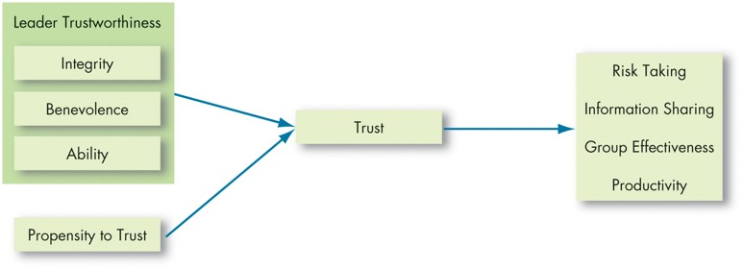
Positive Leadership (2 of 3)
Exhibit 12.7 The Nature of Trust
Notes:
Trust isn’t just about the leader; the characteristics of the followers will also influence the development of trust. What key characteristics lead us to believe a leader is trustworthy? Exhibit 12.7 shows three characteristics: integrity, benevolence, and ability.
Integrity refers to honesty and truthfulness. It seems the most critical of the three in assessing another’s trustworthiness. Benevolence means the trusted person has your interests at heart, even if yours aren’t necessarily in line with theirs. Ability encompasses an individual’s technical and interpersonal knowledge and skills.
The Outcomes of Trust:
Trust encourages taking risks.
Whenever employees decide to deviate from the usual way of doing things, or to take their supervisors’ word on a new direction, they are taking a risk.
Trust facilitates information sharing.
One big reason employees fail to express concerns at work is that they don’t feel psychologically safe revealing their views.
Trusting groups are more effective.
When a leader sets a trusting tone in a group, members are more willing to help each other and exert extra effort, which further increases trust.
Trust enhances productivity.
The bottom-line interest of companies also appears positively influenced by trust. Employees who trust their supervisors tend to receive higher performance ratings.

Slide 37
Positive Leadership (3 of 3)
Trust Propensity
How likely an employee is to trust a leader.
Trust and Culture
Does trust look the same in every culture?
The Role of Time
We come to trust people by observing their behavior over a period of time.
Regaining Trust
Trust can be restored when we observe a consistent pattern of trustworthy behavior by the transgressor.
Notes:
Trust propensity refers to how likely a particular employee is to trust a leader. Some people are simply more likely to believe others can be trusted. Trust may be built on very different perceptions from culture to culture.
Time is the final ingredient in the recipe for trust. Trust doesn’t happen immediately: we come to trust people based on observing their behavior over a period of time. Trust can also be won in the ability domain simply by demonstrating competence.
Leaders who break the psychological contract with workers, demonstrating they aren’t trustworthy, will find that employees are less satisfied and less committed, have higher intentions to turnover, engage in less citizenship behavior, and have lower task performance.

Slide 38
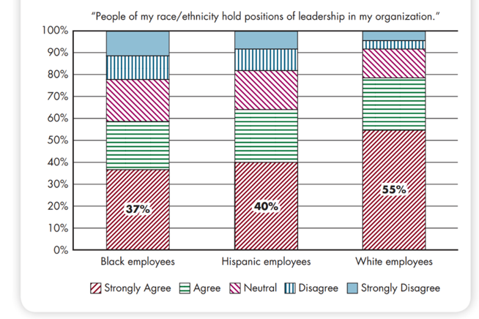
Challenges to Our Understanding of Leadership (1 of 5)
O B POLL Leadership Representation in Organizations
Source: Based on M. Brenan and W. Dupree, “Representation Shapes Black Employees’
Work Experience,” Gallup, January 15, 2021,
https://news.gallup.com/poll/328457/
representation-shapes-black-employees-work-experience.aspx;
C. Lloyd, “The Culture
Costs of No Black Leaders,” Gallup, February 11, 2021,
https://news.gallup.com/opinion/
gallup/329588/culture-costs-no-black-leaders.aspx
Notes:
The attribution theory of leadership says leadership is merely an attribution people make about other individuals. Thus, we attribute to leaders’ intelligence, outgoing personality, strong verbal skills, aggressiveness, understanding, and industriousness. At the organizational level, we tend to see leaders, rightly or wrongly, as responsible for extremely negative or extremely positive performance.
We also make demographic assumptions about leaders. Research shows that many individuals hold stereotypes of men as having more leader characteristics than women, although, as you might expect, this tendency to equate leadership with masculinity has decreased over time. Other data suggest women’s perceived success as transformational leaders may be based on situations. These differences in race and ethnicity-based leadership attributions may be one mechanism behind leadership under-emergence for women and employees from ethnically diverse backgrounds, as can be seen in the OB Poll. Attribution theory suggests that what is important is projecting the appearance of being a leader rather than focusing on actual accomplishments.
Long Description:
The approximate data from the graph in the format understanding levels: percentage is as follows.
Black employees. Strongly agree: 37 percent; agree: 22 percent; neutral: 19 percent; disagree: 10 percent; strongly disagree: 12 percent. Hispanic employees. Strongly agree: 40 percent; agree: 24 percent; neutral: 18 percent; disagree: 9 percent; strongly disagree: 9 percent.
White employees: Strongly agree: 55 percent; agree: 23 percent; neutral: 13 percent; disagree: 4 percent; strongly disagree: 6 percent.

Slide 39
Challenges to Our Understanding of Leadership (2 of 5)
Exhibit 12.8 Neutralizers of and Substitutes for Leadership
Defining Characteristics | Relationship-Oriented Leadership | Task-Oriented Leadership
Individual Experience/training Professionalism Indifference to rewards | No effect on Substitutes for Neutralizes | Substitutes for Substitutes for Neutralizes
Job Highly structured task Provides its own feedback Intrinsically satisfying | No effect on No effect on Substitutes for | Substitutes for Substitutes for No effect on
Organization Explicit formalized goals Rigid rules and procedures Cohesive work groups | No effect on No effect on Substitutes for | Substitutes for Substitutes for Substitutes for
Source: Based on K. B. Lowe and W. L. Gardner, “Ten Years of the Leadership Quarterly: Contributions and Challenges for the Future,” Leadership Quarterly 11, n o. 4 (2000): 459–514.
Notes:
As shown here in Exhibit 12.8, experience and training are among the substitutes that can replace the need for a leader’s support or ability to create structure. Organizational characteristics such as explicit formalized goals, rigid rules and procedures, and cohesive work groups can also replace formal leadership, while indifference to organizational rewards can neutralize its effects. Neutralizers make it impossible for leader behavior to make any difference to follower outcomes. Sometimes the difference between substitutes and neutralizers is fuzzy.

Slide 40
Challenges to Our Understanding of Leadership (3 of 5)
Leadership Opportunities
Identifying and Selecting Leaders
Identifying effective leaders:
Review specific requirements for the position.
Consider personality tests to identify leadership traits.
Situation-specific experience is relevant.
Plan for a change in leadership.
Notes:
The process that organizations go through to fill management positions is essentially an exercise in trying to identify individuals who will be effective leaders. You might begin by reviewing the specific requirements for the position such as knowledge, skills, and abilities that are needed to do the job effectively. Personality tests can identify traits associated with leadership—extraversion, conscientiousness, and openness to experience.
In addition, it’s important to plan for a change in leadership.

Slide 41
Challenges to Our Understanding of Leadership (4 of 5)
Training and Developing Leaders
What are our current staffing needs?
What is our current leadership talent pool like?
Notes:
Billions are spent on leadership training and development every year. Here are some things management can do to get the maximum effect from their leadership-training budgets:
First, the key is to conducting a good needs analysis. Organizations need to ask themselves, “What are our current staffing needs?” and “What is our current leadership talent pool like?”
From there, they have a better idea of what their leadership training needs are. Furthermore, organizations need to explicitly identify what they are looking to develop in leaders.
After the design and delivery of training (from either an outside vendor or internally developed program), organizations should determine whether the training transferred to the new environment. Did the trained leader actually put into practice what they learned? If not, did they have an opportunity to demonstrate the new skill, or were they motivated to demonstrate it? Leaders should make it a habit to regularly review their leadership after key organizational events as part of their development.
After identifying and “grooming” leaders and determining whether they have developed the requisite skills, these accomplishments can be considered in determining which leaders should be promoted, retained in their current positions, or (in the case of poor performance) demoted or transferred laterally.

Slide 42
Challenges to Our Understanding of Leadership (5 of 5)
Exhibit 12.9 Career and Psychological Functions of the Mentoring Relationship
Career Functions | Psychosocial Functions
Lobbying to get the protégé challenging and visible assignments Coaching the protégé to help develop their skills and achieve work objectives Providing exposure to influential individuals within the organization Protecting the protégé from possible risks to their reputation Sponsoring the protégé by nominating them for potential advances or promotions Acting as a sounding board for ideas the protégé might be hesitant to share with a direct supervisor | Counseling the protégé to bolster their self-confidence Sharing personal experiences with the protégé Providing friendship and acceptance Acting as a role model
Notes:
Leaders often take responsibility for developing future leaders. A mentor is a senior employee who sponsors and supports a less-experienced employee, a protégé. Mentoring relationships serve career and psychosocial functions (see Exhibit 12.9). Successful mentors build a personal relationship with protégés that is characterized by mutual trust, instill accountability and build confidence and adaptability in protégés, and seek to improve protégés’ competence and career progression (e.g., through networking).

Slide 43
Implications for Managers (1 of 7)
Although extroverted people are more likely to be hired or promoted into leadership positions, extroversion does not necessarily predict more effective leadership. Instead, try to focus on how the person leads and their leadership skills.
As a leader, the worst thing that you can probably do is to do nothing. Although there may be times when inaction is necessary, it may spell disaster if it is your default style.
Notes:
Although extroverted people are more likely to be hired or promoted into leadership positions, extroversion does not necessarily predict more effective leadership. Instead, try to focus on how the person leads and their leadership skills.
As a leader, the worst thing that you can probably do is to do nothing. Although there may be times when inaction is necessary, it may spell disaster if it is your default style.

Slide 44
Implications for Managers (2 of 7)
When it comes to leadership, there may very well be no one-size-fits-all approach. When deciding how to act as a leader, consider the situation and context first (e.g., the culture, the climate, the follower base) and decide which approach may be most appropriate. Moreover, consider the outcomes and side effects of the approaches you choose and work pre-emptively to address them.
Out of all the behavior leaders engage in, two are the most important: initiating structure and consideration. Depending upon the situation, leadership problems require some degree of both to be solved.
Notes:
In addition,
When it comes to leadership, there may very well be no one-size-fits-all approach. When deciding how to act as a leader, consider the situation and context first (e.g., the culture, the climate, the follower base) and decide which approach may be most appropriate. Moreover, consider the outcomes and side effects of the approaches you choose and work pre-emptively to address them.
Out of all the behavior leaders engage in, two are the most important: initiating structure and consideration. Depending upon the situation, leadership problems require some degree of both to be solved.

Slide 45
Implications for Managers (3 of 7)
Leadership should be built on a solid foundation of managerial and transactional leadership, which sets the structure for the goals to be accomplished to realize the vision.
Charismatic and transformational leadership can be practical tools for inspiring and motivating followers to do great things and build high-quality relationships with followers. However, they can also be used for unethical purposes, which should be avoided.
Understand the ethical context and issues surrounding the leadership problems you are charged with addressing. Strive to act authentically, ethically, and in a way that serves your followers.
Notes:
Further,
Leadership should be built on a solid foundation of managerial and transactional leadership, which sets the structure for the goals to be accomplished to realize the vision.
Charismatic and transformational leadership can be practical tools for inspiring and motivating followers to do great things and build high-quality relationships with followers. However, they can also be used for unethical purposes, which should be avoided.
Understand the ethical context and issues surrounding the leadership problems you are charged with addressing. Strive to act authentically, ethically, and in a way that serves your followers.

Slide 46
Implications for Managers (4 of 7)
Understand the negative consequences of destructive and abusive leadership. Regulate your emotions and your actions to avoid this type of behavior. If you do act abusively, own up to your misbehavior and work with the victim constructively to move forward and ensure that it does not happen again.
When establishing relationships with followers, try not to “play favorites.” Although it may not be possible to develop high-quality exchange relationships with all your followers, try to treat everyone fairly and supportively, and base any recognition and resources given out on performance and skill, not friendship or how much you like them.
Notes:
In addition,
Understand the negative consequences of destructive and abusive leadership. Regulate your emotions and your actions to avoid this type of behavior. If you do act abusively, own up to your misbehavior and work with the victim constructively to move forward and ensure that it does not happen again.
When establishing relationships with followers, try not to “play favorites.” Although it may not be possible to develop high-quality exchange relationships with all your followers, try to treat everyone fairly and supportively, and base any recognition and resources given out on performance and skill, not friendship or how much you like them.

Slide 47
Implications for Managers (5 of 7)
Trust is a critical component of the leader–follower relationship. Not only is it important to feel trusted by your followers (and to know that they trust you), but it is also vital for your followers to know that you trust them. Work toward building trust over time, and when trust is broken, quickly own up to it. Also, know that trust is challenging to rebuild after an ethical violation (e.g., deception) and may never fully recover.
Notes:
Further,
Trust is a critical component of the leader–follower relationship. Not only is it important to feel trusted by your followers (and to know that they trust you), but it is also vital for your followers to know that you trust them. Work toward building trust over time, and when trust is broken, quickly own up to it. Also, know that trust is challenging to rebuild after an ethical violation (e.g., deception) and may never fully recover.

Slide 48
Implications for Managers (6 of 7)
Certain aspects of the organization (e.g., its culture, climate, structure) can sometimes neutralize the effects of leadership. Moreover, other aspects of the organization may “fill in” or “substitute” for the absence of leadership. Try to recognize if this is happening and get a sense of the effect that it is having. There could be a missed opportunity to improve processes by enhancing leadership.
Notes:
In addition,
Certain aspects of the organization (e.g., its culture, climate, structure) can sometimes neutralize the effects of leadership. Moreover, other aspects of the organization may “fill in” or “substitute” for the absence of leadership. Try to recognize if this is happening and get a sense of the effect that it is having. There could be a missed opportunity to improve processes by enhancing leadership.

Slide 49
Implications for Managers (7 of 7)
Many contend that leadership is all about perception. People can behave in ways that make them “appear” like leaders. Otherwise, influential people may be passed up for a leadership position or promotion because they do not “come off” as leaders. Try to be mindful of your own leadership biases and use objective criteria as much as possible when making decisions, especially those involving identifying leaders.
Consider evidence-based leadership selection, training and development, and mentoring programs to leverage the power of leadership in your organization.
Notes:
Finally,
Many contend that leadership is all about perception. People can behave in ways that make them “appear” like leaders. Otherwise, influential people may be passed up for a leadership position or promotion because they do not “come off” as leaders. Try to be mindful of your own leadership biases and use objective criteria as much as possible when making decisions, especially those involving identifying leaders.
Consider evidence-based leadership selection, training and development, and mentoring programs to leverage the power of leadership in your organization.

Slide 50
Discussion Questions
Compare and contrast the leadership styles of two well-known individuals, for example the President of the United States and Elon Musk, head of Tesla. How are the leadership styles of the two individuals different? Which leadership traits are most important to the individuals’ success? Explain.
Which leadership traits are most important for an individual in the police force? Now compare your response to the traits that are important for the individual leading the organizing committee for the upcoming Olympic games. Where are there similarities and where are there differences? What does your response tell you about leadership in the workplace?

Slide 51

Copyright
This work is protected by United States copyright laws and is provided solely for the use of instructors in teaching their courses and assessing student learning. Dissemination or sale of any part of this work (including on the World Wide Web) will destroy the integrity of the work and is not permitted. The work and materials from it should never be made available to students except by instructors using the accompanying text in their classes. All recipients of this work are expected to abide by these restrictions and to honor the intended pedagogical purposes and the needs of other instructors who rely on these materials.

